Slide 1
PDPP
Designing my own Success!
Ville Kivimäki
12 September 2019

Slide 2
PERSONAL LIFE
STUDIES
WORK
Life management skills
Motivation
Learning skills
Building mastery
Competencies
Future plans
Development planning
Meaningful learning
Values

Slide 3
PDPP PROCESS
1. What is my PDPP about?
2. Submit version 0.3
3. Feedback round
4. Submit version 0.7
6. Submit version 1.0
X. Retrospective
5. Feedback round

Slide 4
1. WHAT IS MY PDPP?
What does Personal Development Project Plan mean to you?
What kind of goal you want to reach by making a PDPP?
You can answer in Finnish, English or Swedish. Answer with text. You can also attach a link.
Time usage: 30 min

Slide 5
Example:
PDPP means to me a way to define and achieve goals in my masters studies. I also want to utilize pdpp when making my learning portfolio.
Ultimately I want to have a job in production design field so I want PDPP to help me in that path.
There are sub goals for that:
I want to be product designer or involved in product development
I want to know production and design
I want to have job/contacts
And I want PDPP to help me to achieve these sub goals.

Slide 6
2. SUBMISSION OF 0.3 VERSION
Student can name software/method to be used
Table of index of the scope you want to cover with your PDPP
hobbies, studies, sleeping, eating, friends, exchange studies...
How are these aligned?
Use time here: 4,5 hours
Notes:
This is the first PDPP version that you need to submit. In ideal situation you have already worked your PDPP iteratively and had your 0.1 and 0.2 versions, of course. Certainly this first submission can also be your 0.4 or 0.5. That is not the point. The point is that in this submission version your PDPP should meet the following criteria: You can name what software, cloud based software, phone app, post it notes, painting or whatever, you plan to use as a platform/platforms for your PDPP
Table of index of the scope you want to cover with your PDPP (hobbies, studies, sleeping, eating, friends, exchange studies...)
What tool you plan to design to help you reach your goals? (i.e. app for keeping track on how many hours you sleep or excel spreadsheet to visualize study progression)
You can submit this in any format: Word, Powerpoint, web link, video
Use time here: 4,5 hours
Cumulative time usage so far: 5 hours

Slide 7
3. FEEDBACK ROUND
First, receive feedback on your 0.3 version by:
Attending a workshop on Thursdays 12am-6pm and talk with teachers
Or having a Skype with teacher
Or by waiting to receive feedback on you 0.3 version submission
Notes:
First, receive feedback on your 0.3 version:Attend workshop on Thursdays (Otakaari 4, 3rd floor) 12am-6pm and talk with teachers
or
Have a Skype with teacher: ville.kivimaki@aalto.fi or saara.meriluoto@aalto.fi
or
Wait to receive feedback on you 0.3 version submission
Second, reflect what you plan to do next, based on the feedback. Write it down here. After this submission. Start doing.
Use time here: 1 hour
Time usage so far: 6 hours

Slide 8
4. SUBMISSION OF 0.7 VERSION
Structure of your PDPP defined
At least one already working functionality
Other parts of PDPP has already started to take shape
(i.e. excel file in desktop and vision board service located and you something else than a blank page there)
Notes:
In this version you should have:
Structure of your PDPP defined (i.e. I have a vision board online, excel for study stuff and priority list in OneNote App)
At least one already working functionality (i.e. keeping priority task list in Google Keep)
Other parts of PDPP already started to take shape (i.e. excel file in desktop and vision board service located and you something else than a blank page there)
Use time here: 10 hours
Time usage so far: 16 hours

Slide 9
5. FEEDBACK ROUND
Second, reflect what you plan to do next, based on the feedback.
Write it down here.
After this submission – START DOING.
Notes:
First, receive feedback on your 0.7 version:
Attend workshop on Thursdays (Otakaari 4, 3rd floor) 12am-6pm and talk with teachers
or
Have a Skype with teacher: ville.kivimaki@aalto.fi or saara.meriluoto@aalto.fi
or
Wait to receive feedback on you 0.7 version submission
Second, reflect what you plan to do next, based on the feedback. Write it down here. After this submission. Start doing.
Use time in this step: 1 hour
Time usage so far: 17 hours

Slide 10
6. SUBMISSION OF 1.0 VERSION
This is the final version and should meet at least following criteria:
You have a plan for the future (time span is up to you, but typically it is 5-10 years)
You have been able to find milestones that are closer (half year, one year ahead)
You have designed or adopted a tool that will help you on your journey
You can show that you have already started using that tool.
Notes:
This is the final version.
Your final version should meet at least following criteria:
You have a plan for the future (time span is up to you, but typically it is 5-10 years)
You have been able to find milestones that are closer (half year, one year ahead)
You have designed or adopted a tool that will help you on your journey
You can show that you have already started using that tool.
Make your file submission below and answer to the following questions:
What is PDPP? (your own definition)
What have you learned during the course?
Did you manage to find tools that will probably help you to reach your goals?
We will contact you about 6 months after submitting 1.0 version. What would you like us to ask you then?
Use time here: 10 hours
Time usage so far: around 27 hours

Slide 11
6. SUBMISSION OF 1.0 VERSION
Make your file submission and answer to the following questions:
What is PDPP? (your own definition)
What have you learned during the course?
Did you manage to find tools that will probably help you to reach your goals?
We will contact you about 6 months after submitting 1.0 version. What would you like us to ask you then?
Notes:
Use time here: 10 hours
Time usage so far: around 27 hours

Slide 12
X. RETROSPECTIVE
Contacting student 6 months after submitting PDPP 1.0 version
Idea is to ask the question student has formulated when submitting 1.0 version
E.g. Did I finish my first marathon? Did I finish it in my target time?

Slide 13
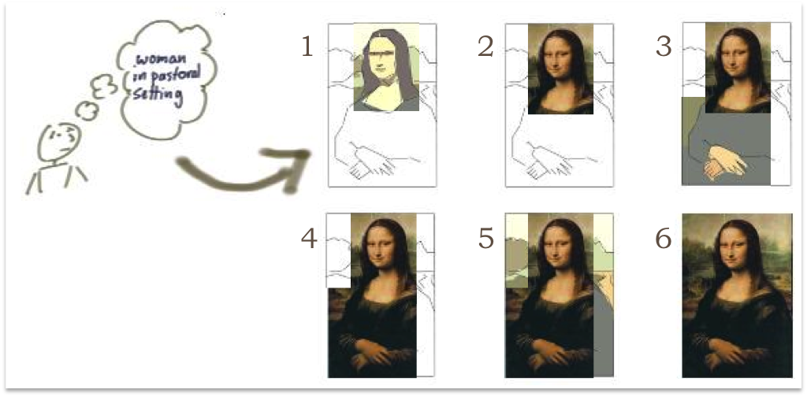
Iterative and incremental
Thomas, S. (2012, 16 November). Revisiting the Iterative Incremental Mona Lisa. Blog commenting on Patton, J. (2008, 1 January). Don’t know what I want, but I know how to get it. Agile Product Design.

Slide 14
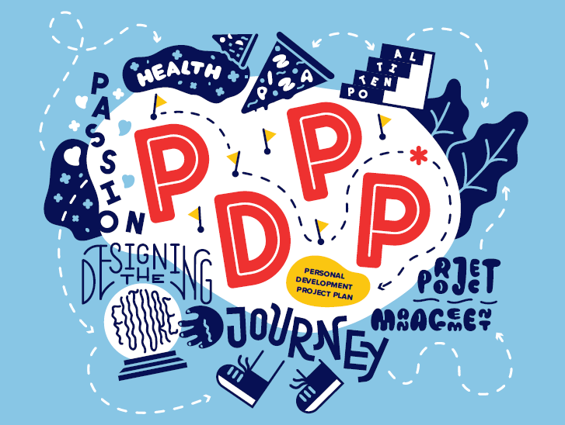
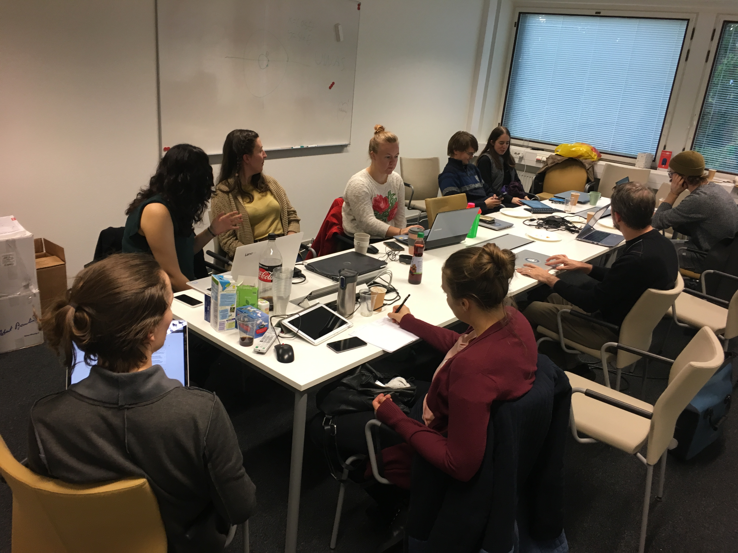
PDPP workshops every Thursday

Slide 15
EXAMPLES

Slide 16
PDPP StuDENT 1 (Modified to anonymous and translated to english by Saara Meriluoto)
Version 1.0

Slide 17
In year 2026… after 10 years…
I have completed my Master’s degree
I have gained work experience from my study field.
I have found interesting and challenging work.
I might have my own company…
I live in Northern Finland.
Or maybe I live abroad?
Life is in balance.
Everyday life is inspiring!

Slide 18
Worklife? Life’s work?
Work for someone else Or
Own your own company
Interesting and challenging
You can be creative
Free-natured and not always in same place
International
You can get concrete results
Reasonably good salary
My passion
Free-natured, gets you in many places
Diverse workduties
You get money based on how well your company succeeds.
You can be proud of your own company

Slide 19
Alternative career paths
Kaupunkisuunnittelun ja kaavoituksen konsultti tai virkamies (City Planning and Zoning Consultant or Officer)
Employer would be a city or a planning company
Maanrakennuksen insinööri (Civil Engineering Engineer)
Employer would be a big company form infrastucture:
For example: Destia, Lemminkäinen
Kaivosalan suunnittelija (Mining designer)
Employer would be a company related to mining or I could be a consultant
For example Otanmäki or Talvivaara,
A work abroad related to mining. Somewhere arctic!
General executive tasks in engineering company
Self-employed
Innovation of your own
Joint worker in culture or entertainment field
Oman elämänsä taiteilija (An artist of my own life)

Slide 20
GOAL
Targets
Complete BSc-degree in three years
Complete MSc-degree maximum of six years
Good skills in my own field (expertise)
To be ready for worklife
Wide netswork for working life
To get to work where I want to work and to be able to do what I want to
The target is a company of my own
Ways and means
Good performance in studies
Pass the courses
Study hard, time management skills
Increase my own know-how
Study hard in courses and on my own time too
reading, doing research, following news
Work experience from my study field
Summer jobs and interns
Creating networks
Partícipate in different events
Activity in student life → say yes!

Slide 21
Studies
BASIC STUDIES 70 credits
MAJOR 50+10 credits
Built environment -courses
MINOR 25 credits
Aaltonaut
or
Energy and environmental technology
ELECTIVE STUDIES 25 CREDITS
Industrial Management 15-20 credits
Citycourse 5 op
+ studies in language: english, swedish + germany
Excel-workbook!
Plan of the courses (PSP)
Aalto University
School of Engineering
Built environment
Bachelor’s + Master’s degree
Spatial planning (and transportation engineering)

Slide 22
MINOR AND ORIENTATION IN STUDIES
Aaltonaut –minor
Energy and environmental technology as a minor
Product development and projects
To develop general project and teamwork competencies
Learn about self-employment
Develop international nets and learn english
Completely different compared to my major (Built environment)
Leads me towards self-employment or different kind of project work
I will apply to this minor during November and start the studies in January
Energy production, water construction, geology, measurement technology
Offers an emhasize to my major (Built environment) from environmental technology
Leads me towards construction and mining
I WILL KEEP THIS MINOR AS AN OPTION

Slide 23
ME
Where i am good at:
Where i am not good at:
Planning and organizing
Leading people
Solve problems
Creativity
Writing
Dramatic art
Sports
Math
Computer science
Machines and equipments
Creating nets
Time management

Slide 24
Development goals
To set clear targets
Make clear plans and follow them
Improve time managemt skills
Good scheduling
Follow the schedule
Math and computer science
Give extra effort to courses related to these subjects
Unprompted studying
Create networks
Actively participate different events
Friends
Do more sports
Go to gym regularly or do body weight training
3 times weekly
To be more often more creative
Creative hobbies
Theatre, improvization, music, writing

Slide 25
Tools to achieve targets
WEEKLY PLANNING (EXCEL)
Daily schedule and the most important duty of the day
Plan and check on Thursdays and Sundays
WORK 5 & FREE 5 -slots
On the same time you can only have:
5 duties related to work/studies!
5 free-time activities!
WEEKLY DIARY
Goals of the week
Events of the week
Thoughts of the week
Monthly budget
Obligatory expenses
Food expenses
Enetrtainement
Extra expenses
Weekly schedule-excel!
Task-list on your phone
+ WORK5 & FREE5
+ Riskanalysis!

Slide 26
MY STUDENT LIFE GOLDEN RULES (ALIAS TARGETS)
My home is for free-time!
I only study at the university or somewhere else.
Own day for each course
I work daily max 10h.
5 days to work, 2 days for entertainment, 1 day for rest.

Slide 27
Risk analysis of the studies
Student X (translated and modified by Saara Meriluoto)

Slide 28
RISK | PROBABILITY | SERIOUSNESS | EFFECT | SIGNALS | HOW TO PREVENT | HOW TO FIX | BRUTE FORCE
I don’t pass the course | SMALL I naturally want to pass the courses | MEDIUM I have time to redo 1-2 courses a year | - I have to redo the course -It prevents me from following my studyplan and graduating on time -Next periods would feel more difficult | - I can’t do the assignments and retun those on time. -I have not learned what is expected to pass the exam. | - Do the assignments on time - Make sure I have learned what we have studied during the course. | - Give more effort to individual work - Schedule enough time to study for this course | - Save the weekend for studying to pass the course (no other activities)
Motivation is not big enough for studying | GREAT I have previous experience from low motivation | MEDIUM | -Makes studying harder -Participation in activities will suffer | -I don’t give effort to individual studying -I will not return the assignments on time or I return them regularly on last minute. | -I have to write up things I am interested in and make me excited -Practical projects | -I should do more things that I find interesting -Participate in practical projects -Talk with my friends and psychology | -Contact study counsellor
Burnout | MEDIUM I have almost had burnout before, I know that I sometimes do too much | GREAT | -Decrease motivation and coping -Studies suffer | - No spare time during the evenings -stress -difficulties to concentrate -skip assignments -feeling tired | -Keep the workload smaller than I think I could manage -Have 3 hours of rest and free-time every day → not working/studying during the evenings -Enough sleep (8h) | -Reduce workload and the amount of courses on purpose -Cancel all plans from the weekend -Talk to psychologist | -Completely rest for 1-2 weeks -Follow-up by a doctor or psychologist

Slide 29
RISK | PROBABILITY | SERIOUSNESS | EFFECT | SIGNALS | HOW TO PREVENT | HOW TO FIX | BRUTE FORCE
Depression | MEDIUM Earlier experience | GREAT Paralyzes | -Very low motivation and energy levels -Makes studying a lot harder -Everyday life becomes problematic -Difficult to get over | -Extended low motivation -”I don’t care” -attitude -Returning assignments late or skipping them totally -Skive off from studies and events -Problems with sleeping | -spare time during the evenings -Practical projects -Complete something -Do well in studies -Have a regular contact with friends -Creative hobby | -Reduce work load -Give extra effort to some assignments -More spare time -Creative hobby -Talk with psychologist | -Visit a doctor -Sick leave
Mild illness | MEDIUM Flu every now and then | SMALL I can still study almost normally | -Reduced feeling of coping in studies and everyday life -Feeling tired -Can’t exercise -Can’t participate all the events I would need to go or I would like to go | -Cold in the head -My closest friends/famil y members/roommates have a flu | -Wash hands regularly -Have enoug clothes on | -Schdule time: Rest+sleep+food -Reduce workload -Reduce events | -Have sick leave for 2-4 days
Serious illness | SMALL Health has been good this far. No chronical diseases. | EXTREME Prevent normal life and ability to study | -Drop out from studies -Makes everyday life more difficult -Life-threatening -Expensive | -Prologned illness -Feeling tired longer than a week -Body does not function normally | - Follow the health -Visit a doctor | -Physical examination and diagnosis + treatment | -Longer sick leave
Problems with money | MEDIUM As a student I don’t earn that much money but the expenses can easily be too big. | GREAT | -Causes stress -Makes everyday life harder -Not eating properly → feeling tired -Prevent participating events -Possible Indebtedness and even dropping out of studies and moving somewhere else | Expenses>Incomes -Take the debt -Payday loans -”I don’t care”-thoughts regarding spending money | -Strict budget and staying in the budget! -Savings and putting money aside regularly | -Reduce expences -Economize -Canceling events -More work shifts -Selling stuff | -Selling my car -Give someone rights to take care of my bank account and savings

