Slide 1
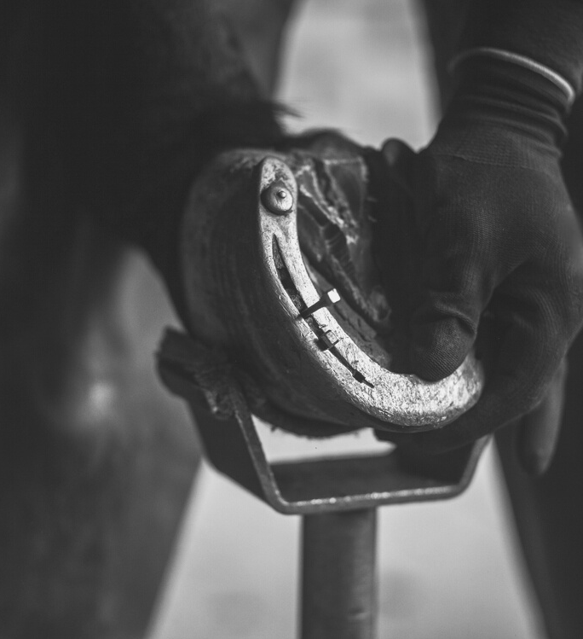
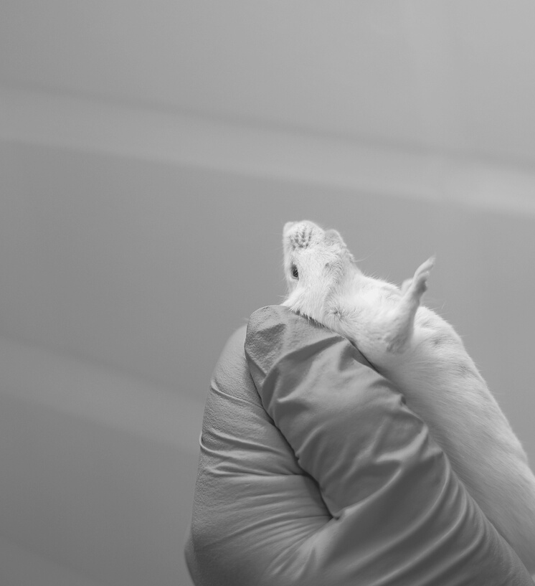
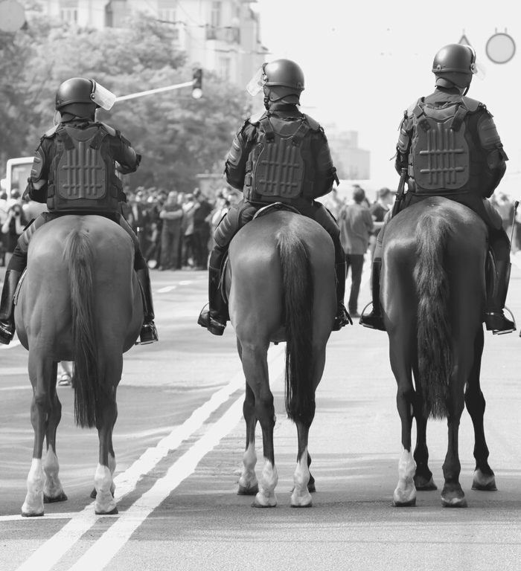
Animal Organization Studies – advancing a radically novel field.
In our current world of climate disasters, biodiversity loss and pandemics, how human-led organizations and human businesses organize (non-human) animals is a key societal concern. Yet very little concerns have been raised with regards to the ‘single species’-focus of work, organizing, organizations and inequalities within Management and Organization Studies (MOS).
RADICALLY NOVEL RESEARCH QUESTIONS ARE NEEDED.
What is ‘more-than-human’ or multispecies organizing? What does human-animal work entail in practice? What methodological advancements are needed within MOS to be better able to explore human-animal work? How is ‘work’ configured when animal and human co-produce outcomes of use for the human? How is the (un)ethical organization of work affected when animals are recognized to be co-workers, entangled in human work practices?

Slide 2
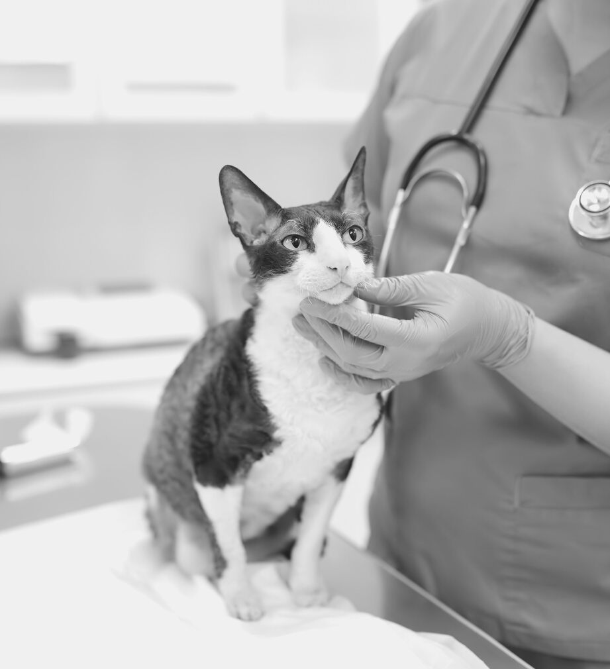
Animal organization studies – advancing a radically novel field
I'm looking for master thesis students interested in carrying out a qualitative study to investigate different forms of human-animal work, or work/organizing that is carried out together with/for/on animals (e.g., mounted police work, police dog work, veterinary work, human-animal work in tourism, sports and leisure, office dogs, assistant dogs at work, pain dogs, therapy dogs, food animal organizing, laboratory animals, and the like).
The student would get to advance a scholarly underdeveloped and exciting novel field, get excellent supervision, and also get a chance to do research that contributes to creating better businesses and better societies for humans and animals the like. If interested, please be in contact!
Astrid Huopalainen, Assistant Professor in Leadership for Creativity
astrid.huopalainen@aalto.fi
+358 503042693
RADICALLY NOVEL RESEARCH QUESTIONS ARE NEEDED.
3. HÅLL YTOR RENA OCH ÖPPNA.
Presentationer är kommunikationsverktyg som kan användas för föreläsningar.

Slide 3
Gender- and diversity-related inequalities in Higher Education (HE) and the creative industries
Today, equality between women, men and other genders enjoys widespread support. Still, gender(ed) inequalities and discrimination persist in Finnish organizations, also to a significant degree in universities and in the creative industries. This problem remains challenging to understand, diagnose and ‘fix’. I’m looking for students keen to investigate the (re)production of gender and diversity-related inequalities in the context of Finnish Higher Education insitutions or in the creative industries, with a focus on e.g., music, performing arts, dance organizations, and theatre. The studies would be qualitative and include collecting and analyzing interviews with professionals in these contexts (female professors, professional artists, leaders of artistic organizations, dancers, actors etc.) and possibly also ethnographic data. The student would get excellent supervision and do research that contributes to creating more equal and inclusive organizations and societies. If interested, please be in contact!
Astrid Huopalainen
astrid.huopalainen@aalto.fi
+358503042693
RADICALLY NOVEL RESEARCH QUESTIONS ARE NEEDED.
3. HÅLL YTOR RENA OCH ÖPPNA.
Presentationer är kommunikationsverktyg som kan användas för föreläsningar.

Slide 4
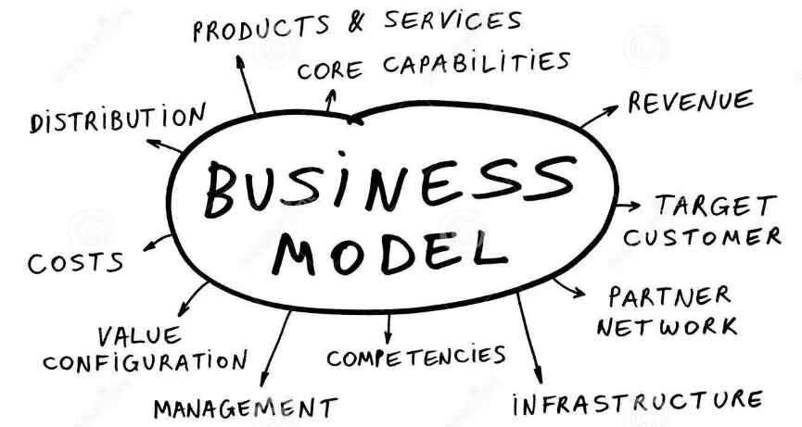
Business model innovation
Most executives believe that competing through business models is critical for success.
Due to the growing emphasis on business model innovation, many fields have been going through a shake up, as firms have come up with business models that challenge the traditional ways of conducting business exchange.
Alongside with this trend, many manufacturing firms have repositioned themselves from sales of products to the sales of capabilities or the outcome. Among these are famous examples of Rolls Royce with is bold “power by the hour” concept, the tire provider Michelin with its “tire as a service” promise and many others that have with business model innovation targeted to change the way in which value is proposed, captured and delivered (Massa, Tucci, and Afuah, 2017).
Business models related to services have been also found to be supporting market driven and often times volatile product business. E.g. when companies have moved from pure production to product service systems or total solutions.
We are looking for a master thesis students who are interested to carry out a study to investigate how business model choices impact of financial sustainability, especially in manufacturing.
If interested, please be in contact!
Taija Turunen
taija.turunen@aalto.fi
+358503440132

Slide 5
Puettu Äitiys (Enclothed Motherhood)
Projektissa tutkimme, minkälaista identiteettityötä äidit tekevät siirtyessään päivittäin vanhemman roolista työrooliin. Tarkastelemme erityisesti sitä, mikä on vaatetuksen ja ehostuksen rooli ammatillisen minän rakentajana.
Tutkimuksemme kohderyhmä on kahden vuoden aikana vanhempainvapaalta töihin palanneet äidit. Pyrkimyksemme on ymmärtää vanhemmuuden työn yhdistämiseen liittyviä haasteita ja ratkaisukeinoja.
Tutkimus on haastattelututkimus. Haastattelut toteutetaan haastateltavalle sopivalla tavalla (kasvotusten/online) ja hänelle sopivassa paikassa. Haastatteluja on kerätty jo n. 20kpl ja etsimme jatkuvasti lisää haastateltavia. Keräämme myös aihepiiriin liittyvää kuvamateriaalia visuaalista analyysiä varten.
Etsimme gradutyöntekijöitä, jotka ovat kiinnostuneita aihepiiristä. Tarjoamme analysoitavaksi jo olemassa olevaa dataa ja mahdollisuutta kerätä lisäaineistoa osana projektia.
Mikäli haluat osallistua, otathan yhteyttä!
Taija Turunen
taija.turunen@aalto.fi
+358503440132

Slide 6
I don’t have a particular project in mind in which I could use the help of a student, but I do have some topics I’d find particularly interesting. The student would get better-than-average supervision, given that I’m an expert in these areas/topics.
Corporate wrongdoing. Anything related to it: How instances of corporate wrongdoing are portrayed in the media, social evaluations of wrongdoing, legal processes regarding wrongdoing, how corporations react to (allegations of) wrongdoing, how employees relate to wrongdoing etc.
Sustainability and business. I’m especially interested in biodiversity considerations and corporate efforts in or responses to systems-level initiatives like science-based targets or new, upcoming EU-level regulations.
Sub-topic: EU’s nature restoration plans, and how in the COP15 on biodiversity it was agreed 30% of Earth’s land and water should be restored and protected by 2030. What are corporate responses to this (could be a specific company or sector), and ESPECIALLY discourse/narrative analysis of how nature restoration has been discussed in Finland (media) over the last few years.
Anything related to history and memory. E.g. organizations leveraging their history in attempting to reach their aims, organizations grappling with difficult pasts (e.g. alleged wrongdoing) etc.
Bureaucratic processes. I’m especially interested in how various types of policies are rolled out over different levels (e.g. from government all the way grassroot-level, or from top management across the organization.
Jukka Rintamäki
jukka.rintamaki@aalto.fi

