Slide 1
Session 3 Consumer Theory
31 January 2024

Slide 2
A theoretical apparatus to analyze choices by individuals facing constraints
Individuals buy goods and services but also…
They rent/sell/lend their labor services (most common) or other resources they own (like land or €€€) to get income
Deciding how much to work can be framed as a consumption choice: how much leisure to consume vs how much income to acquire
This apparatus also works for non-monetary decisions: eg how to use time
The theory assumes that individuals are rational and self-interested*
Meaning they seek maximum satisfaction given their constraints
They are assumed to have consistent, stable preferences
Consumer theory was the first shot fired in the “Marginal Revolution” (1870s)
*more on this later

Slide 3
Let’s start with the constraint side of things
At this stage, we assume an individual Aada has a fixed budget or income to spend on the things she likes. Call her income I. She spends it all.
We sensibly limit our diagrams to two dimensions, so we’ll strip away all but two goods from her decision process: good X and good Y.
She also faces market prices she can’t control (she’s a price taker). Those prices are Px and Py.
Aada’s budget constraint: Px X + PyY = I
It has the same form and look of the PPF

Slide 4
The budget constraint
Good Y
PxX + PyY = I
X intercept (all income spent on good X, Y = 0): X = I/Px
Y intercept (all income to Y):
Y = I/Py
Slope: Y = (I – PxX)/Py
Y = (-Px/Py)X + I/Py
slope
the slope, - Px/Py, is the relative price of good X. The negative sign indicates tradeoff. Getting more X means less of Y.
I/Py
Good X
I/Px

Slide 5
Easier with numbers Aada’s entertainment budget (I) is €120/month Films cost €10 and crime novels cost €20
Crime novels
PxX + PyY = I
X intercept (all income spent on good X, Y = 0): X = I/Px
Y intercept (all income to Y):
Y = I/Py
Slope: Y = (I – PxX)/Py
Y = (- Px/Py)X + I/Py
slope
the slope, - Px/Py, is -10/20 = -1/2
That tells us a film costs her ½ of a crime novel. A relative price or opportunity cost
I/Py =
120/20 = 6
Films
I/Px = 120/10 =12

Slide 6
Altering her budget constraint What if a price changes?
Crime novels
A change in one price rotates the BC.
Example: novels now cost €24
The new Y intercept is 120/24 = 5
the new slope, - Px/Py’, is -10/24 = -.42
The relative price of films has fallen.
I/Py =
120/20 = 6
5
Remember, the slope is the
relative price of the HORIZ axis good (X or Films).
Films
I/Px = 120/10 =12

Slide 7
Altering her budget constraint What if income changes?
Crime novels
A change in income shifts the BC parallel.
Example: her budget rises to €140.
Relative prices stay the same
I’/Py =
140/20 = 7
6
Films
12
I’/Px = 140/10 =14

Slide 8
Next step: model Aada’s preferences
Neoclassical theory makes no judgments about the individual’s preferences. There are no good or bad preferences.
Economists sometimes use the term “utility” to mean pleasure, satisfaction, or happiness
Starting early 20th C, economists avoided trying to measure utility, seeing that as impossible. In particular, they rejected the idea of comparing pleasure across different individuals*
As a result, this model relies on ordinal utility—one bundle of goods is better or worse than another to Aada, but we don’t have info about the absolute level of pleasure attained (cardinal utility)
* Behavioral economics has opened that door back up

Slide 9
Indifference curves A graphical tool to represent preferences without measuring pleasure
Crime novels
Building Aada’s I.C.
Start with any bundle (combo) of films and novels (point A)
Then find a second bundle that keeps her equally happy…with either more films and fewer novels, or the opposite (point B has fewer films and more novels)
B
A
Films

Slide 10
Indifference curves A graphical tool to represent preferences without measuring pleasure
Crime novels
The indifference curve shows the complete set of bundles that provide equal utility to bundle A
Aada is “indifferent” among all the bundles (points) along the curve
A
Films

Slide 11
Indifference curves A graphical tool to represent preferences without measuring pleasure
Crime novels
Negative slope: tradeoff. If you take away films, you have to give her more novels to keep her equally happy
The shape--the changing slope--means a changing psychological tradeoff for her
B Slope here is about -3
Slope here is about -1/4
A
Films

Slide 12
Psychological tradeoff???
At A, Aada consumes a lot of films and few crime novels
Crime novels are very pleasurable, since she has so few
She would give up 4 films this month, get 1 more novel, and be equally happy as she is at point A
At B, it’s the opposite case. She has a lot of novels and sees few films
If you gave her 1 more film, she’d be willing to accept 3 fewer novels
The tradeoff along her indifference curve is called The Marginal Rate of Substitution and it is the |slope of the I.C.|

Slide 13
An aside on the usual shape of an I.C.
There’s nothing in micro theory that says they must have that bowed shape
It’s just thought to be likely for most goods
The shape means that as a person consumes more of something, each unit brings her less pleasure (“declining marginal utility”)
That shape implies that people prefer bundles with some of both goods, rather than very extreme bundles with lots of one and few of the other
In principle, we could survey people to learn the shape of their indifference curves

Slide 14
An Indifference Map Maps ALL of Aada’s preferences (well, not all but a lot of them)
Crime novels
Each I.C. corresponds to a different level of utility. Any bundle on III is better than all bundles on I or II
Utility increases to the NE
I.C. do not shift!
They can’t cross and would only slope up if one good were a “bad”.
More utility this way
III
II
I
Films

Slide 15
A gallery of misguided indifference curves
They cross They curl around and These WOULD cross
slope up at the ends if you extended them

Slide 16
Now, we solve a maximization problem (find max utility) by bringing together BC & ICs
novels
Q: Where is the BEST indifference curve Aada can reach???
Hard limit:
She can’t go above her budget constraint!!
films

Slide 17
Q: Where is the BEST indifference curve Aada can reach???
novels
A: The one that just barely touches the budget constraint… is tangent to it.
Hard limit:
She can’t go above her budget constraint!!
films

Slide 18
Consumer equilibrium: maximum utility
novels
Slopes are equal at the tangency
Aada’s marginal rate of substitution of novels for films = marginal cost of films =1/2 novel
Qn
Qf
films

Slide 19
What’s significant about the tangency?
Maximization/minimization problems in economics (max utility, max profits, minimum cost) are solved when two marginal values are set equal as in our indifference curve/budget constraint tangency
The BC slope tells us what Aada gets “in the market” if she gives up a film: she gets €10, or ½ novel
When her psychological tradeoff is ALSO exactly ½, she can’t do any better by shifting around her spending. A film is worth ½ novel to her, and that’s just what she could get if she didn’t buy that movie ticket
When the slopes are DIFFERENT, she can gain utility by shifting her spending

Slide 20
Pause now for some unrelated activities

Slide 21
Let’s look at point C where the slopes are different. The budget constraint is flatter than the indifference curve.
Moving down the IC from C, you can see that Aada is equally happy if she gives up 2 novels and gets 1 film. (Same IC)
But market prices are such that if she gives up 2 novels, she’ll have €40! With that, she can go to 4 films! And be WAY happier.
novels
C
films

Slide 22
Let’s look at point C where the slopes are different. The budget constraint is flatter than the indifference curve
The orange reallocation of her money, cutting back on novels by 2, and getting 4 films at D, gets her to a higher indifference curve
She should keep shifting € toward films until the tradeoffs/slopes are =.
novels
C
D
films

Slide 23
Let’s look at point C where the slopes are different. The budget constraint is flatter than the indifference curve
She should keep shifting € toward films until the tradeoffs/slopes are =.
That’s at point E
novels
C
D
E
films

Slide 24
Now that we have set up the structure, how do shocks play out?
novels
What if Aada’s income rises?
films

Slide 25
Now that we have set up the structure, how do shocks play out?
What if Aada’s income rises?
Her new equilibrium will be on
a higher indifference curve, probably consuming more films and more novels.
What’s her marginal rate of substitution now?
novels
Qn’
Qn
Qf Qf’
films

Slide 26
Another shock: a change in price
Quantity
A fall in the price of any good rotates the budget constraint, changing its slope
of novels
D
New budget constraint
We can see on the diagram that Aada ends up buying more novels and going to fewer films
New optimum
B
I₂
I₁
A
0
Quantity
of films

Slide 27
But it could have worked out differently, if she’d had slightly different preferences (a slightly different shape to her indifference curves)
It would be completely reasonable for Aada to buy more crime novels and ALSO go to more films—although she wouldn’t end up with as many crime novels as in the last slide’s equilibrium
We’re going to look at what is driving those two outcomes:
more novels + fewer films
more novels + more films

Slide 28
Income and Substitution Effects
A price change has two effects on consumption.
The substitution effect is the change in consumption that results from a price change: the consumer tends to buy more of the cheaper good
The income effect is the change in real income CAUSED BY A CHANGE IN PRICE. If it’s a fall in a price, the consumer can buy more of both goods (but may choose not to)

Slide 29
Income and Substitution Effects. Difficult diagram!
Quantity
Substitution Effect
Here we imagine what it would look like if the consumer faces a price change but is restricted to stay on her original indifference curve I₁.
Illustrated by movement from point A to point B. Slope changes but IC doesn’t.
of novels
In real life, we only observe point A and C.
Point B is akin to a thought experiment.
New budget constraint
C
New optimum
Income Effect
The price decline has given her more real income, so we show that with a parallel shift up to the red budget constraint. The consumer will move to a higher indifference curve, B to C.
Income
effect
B
Initial optimum
Substitution
Initial
effect
budget
constraint
A
I₂
I₁
0
Quantity
Substitution effect A to B
of films
Income effect B to C

Slide 30
Showing the income and substitution effects When the price of novels falls (both goods normal)
Good | Substitution effect | Income effect | Total effect
Crime novels | Novels are relatively cheaper, so Aada buys more. | Aada is richer in real terms (more purchasing power) So she buys more crime novels | Sub & Income effect are in the same direction. She buys more novels for sure!
Films | Films are relatively more expensive, so she buys fewer of them | Aada is richer, so she tends to also consume more films | Sub & Income effect are opposite, so she could go to more films OR fewer films
Try drawing the same diagram but have her going to MORE films in the end

Slide 31
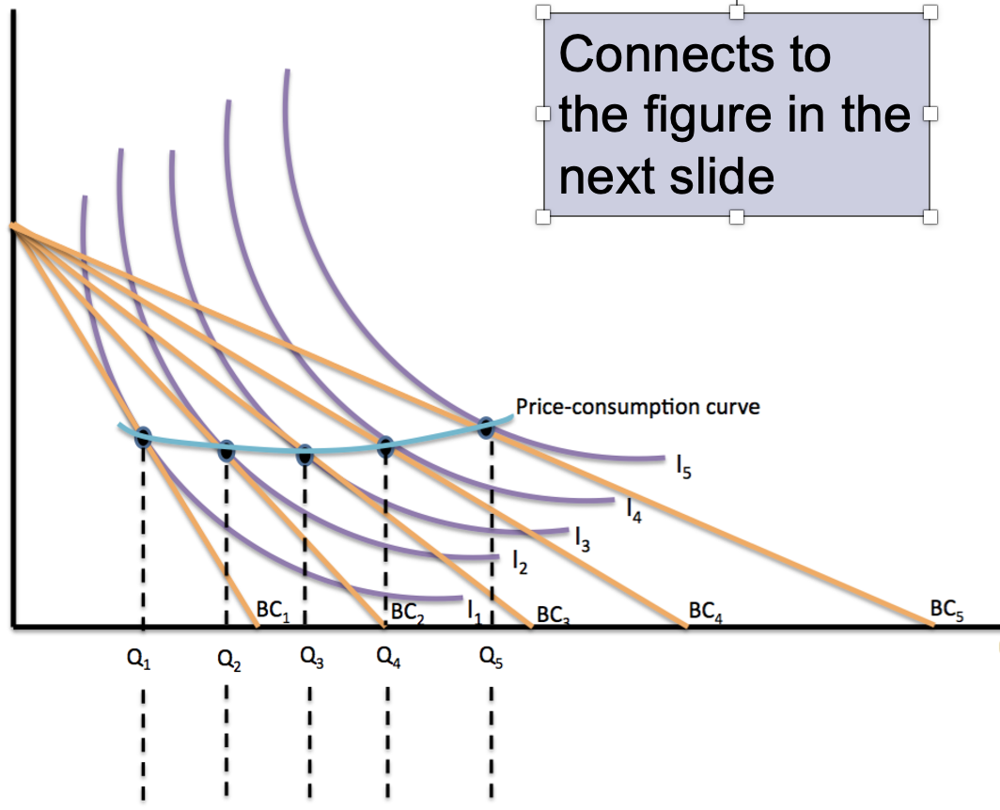
Finally, we can use the BC/IC set-up to construct a demand curve. This time, we’re changing the price of films
crime novels
Budget constraint rotates out as the price of films drops
Aada buys more movie tickets each time the price falls
(Sub effect and income effect both contribute!)
Films

Slide 32
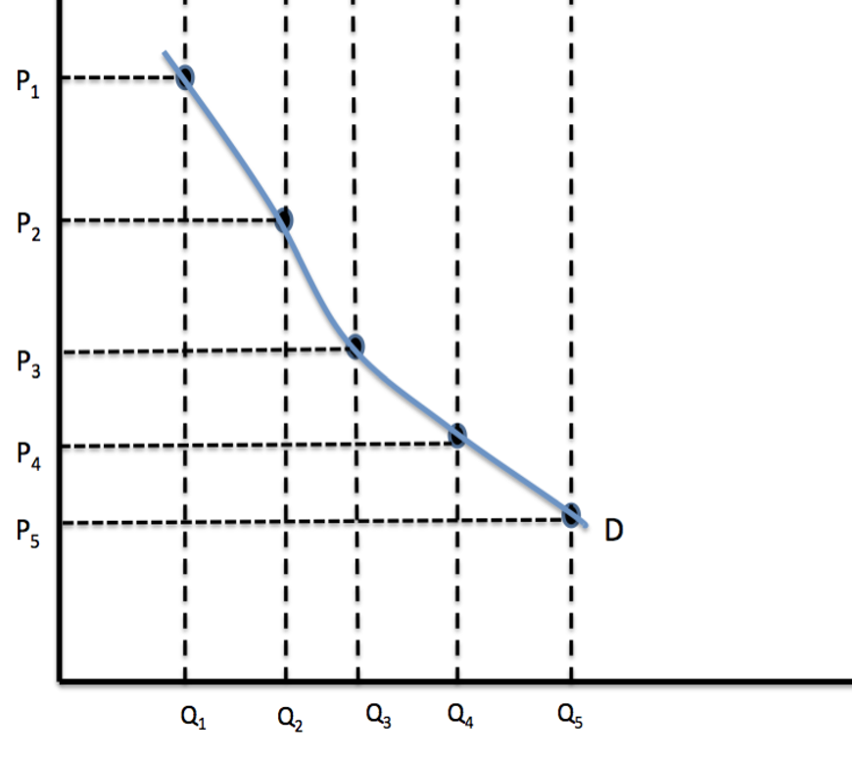
Aada’s demand curve for films, derived from her indifference map
Price of films
(Sub effect and income effect both contribute!)
Quantity of films

Slide 33
To reiterate, in these pictures both novels and films are normal goods
Reminder: normal goods have positive income elasticity of demand. When income (or real income) rises, consumption increases
An inferior good has negative income elasticity. When income rises, consumption falls.
If we included an inferior good in the picture (either films or novels), the income effect would be NEGATIVE for that good.
The substitution effect would not change

Slide 34
This time, films are an inferior good
Quantity
Substitution Effect
A price change first causes the consumer to move from one point on an indifference curve to another on the same curve.
Illustrated by movement from point A to point B.
of novels
Look at the change in films from B to C.
Real income ↑ but Q of films falls from B to C
Income & sub effects BOTH
reduce film consumption
C
Income Effect
The consumer moves to another indifference curve.
Illustrated by movement from point B to point C.
B
Initial optimum
I₂
A
I₁
0
Qf_{C} Qf_{b} Qf_{a}
inc eff. sub eff
Quantity
of films

Slide 35
When goods are inferior, some odd things can happen
A Giffen good is a good that is so inferior…
when its price goes up, the consumer buys more of it
Why? The price increase made her so much poorer that she cut way back on the normal good, and had to buy more of the inferior good just to stay alive
I will spare you the diagram

Slide 36
Another pause before we go on…

Slide 37
Behavioral economics
This field challenges some important assumptions in neoclassical choice theory such as
Rational, self-interested actors
Known, stable, internally consistent preferences
It’s quite friendly with psychology
Relies on experiments (in labs or ‘natural experiments’)
It’s popular (and somewhat controversial) and has stimulated a lot of policy ideas

Slide 38
Key concept: Thaler & Kahneman’s theory of mind
System 1
“Humans”
Automatic process
Uncontrolled
Effortless
Associative
Fast
Unconscious
Skilled
Instinctive
System 2
“Econs” or “Homo economicus”
Reflective process
Controlled
Effortful
Deductive
Slow
Self-aware
Rule-following
Cognitive

Slide 39
Kahneman:
“The rational agent of economic theory would be described, in the language of the present treatment, as endowed with a single cognitive system that has the logical ability of a flawless System 2 and the low computing costs of System 1.” *
Kahneman and Thaler argue that in fact people often rely on System 1 to make decisions. As a result, they might misinterpret information, make logical mistakes, and choose consumption that doesn’t make them happy. System 2 is fairly weak and easily overloaded.
*From “Maps of Bounded Rationality” in The American Economic Review, 93:5, December 2003

Slide 40
Biased or faulty use of information It throws doubt on the assumption of rationality
Framing and anchoring: They are powerful influencers.
Our survey: treatment framed as 400 deaths (bad) or 200 people saved (ok).
Anchor: the number you were asked to write at the top. Affects your guess?
Memory: people mostly remember the peak and the end, not the whole experience
Misprediction: people think material things will make them happy, but often it’s intrinsically-oriented experiences
Overconfidence in decision-making
Status quo bias

Slide 41
Unstable preferences These contradict the assumption of intrinsic, stable preferences
Framing can shift preferences.
See drug treatment question. 400 deaths vs. 200 lives saved.
Visceral emotions: ‘hot’ and ‘cold’ states lead to different choices
Intra-personal conflict: prefer one thing, choose another.
Saving money; eating; drinking; exercising, etc
”Present bias” is one aspect: intertemporal inconsistency
Herd behavior: we follow what others do.
On our survey, the question about the tallest peak. If you’re not sure, tendency to follow the crowd.
Concern for rank: your position compared to others matters.
On our survey, the question about which house is better

Slide 42
Widely-shared preferences These are neglected by core theory but have been repeatedly shown in experimental settings
Loss aversion: the pain of loss matters more than the pleasure of a gain
On our survey, the drug treatment leading to deaths (loss, rejected) or to people saved (accepted though same)
Contributes to “status quo bias”
It makes policy difficult
Willingness to sacrifice money for fairness/altruism/justice
On our survey, sending money to the partner; receiver sending money back. Altruism and trust.
Caring about process, not just outcomes

Slide 43
Why does all this matter?
For the real world: If people are making choices that misuse info or consistently make “wrong” choices (from their point of view), how efficient is our economy?
For economic theory: If theory overstates rationality, self-interest and $ incentives, economists won’t be successful in predicting behavior (which reduces the value of economics)

Slide 44
This problem is on PS 2 (multi-part)
Topi likes to swim and golf. His sports budget is €180/month. A visit to the pool costs €10, and a round of golf costs €15.
Draw his budget constraint, exact intercepts, golf on horiz. axis.
He swims 6 times a month. Find golf rounds; draw in indifference curve
Sale on swims: price at the pool falls to €7.50. Draw new budget constraint
He still swims 6 times. How many rounds of golf does he play? Draw I.C.
There’s more in the PS.

