Slide 1
Political Corporate Responsibility
32E28000 Legal Environment of Business
PhD, Jukka Mäkinen,
Senior University Lecturer
Aalto University School of Business

Slide 2
Today’s Agenda
Part 1: Introducing the idea of business firms as a political actor in global economy (The new political CSR discussion).
Part 2: A framework to contextualize the new political CSR.
Part 3: The political interpretations of the major CSR discussions.

Slide 3
Part 1 : New Political CSR “We suggest that, under the conditions of globalization, the strict division of labor between private business and nation-state governance does not hold any more” (Scherer & Palazzo)

Slide 4
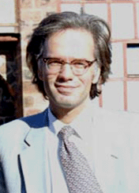
New Political CSR
Globalization blurs the traditional boundaries between the political and economic spheres of society leading to the politicization of the business firms.

Slide 5
Corporate Citizenship
Private firms take over the traditional governmental tasks of social regulation and operate as new providers of citizenship rights and public goods.

Slide 6
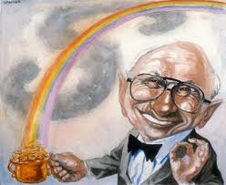
New CSR Paradigm
The traditional picture of firms as apolitical actors focusing on economic roles in society does not hold anymore. The new political CSR goes beyond and replaces the mainstream instrumental CSR.

Slide 7
Implications
Laws are replaced with voluntary guidelines; the self-regulation of businesses via CSR techniques.
Normative prescriptions as commodities; produced, distributed and consumed in the markets for morals.
Commercial enterprises perform civic and political tasks.
CSR becomes a major political issue
Different spheres of society in transition
http://www.youtube.com/watch?v=yI7_pwxcC6M&feature=relmfu

Slide 8
Topics for Consideration
How seriously does the new political CSR challenge the traditional economic understanding of business firm?
What are the political implications of the possible paradigm shift?

Slide 9
Part 2: A framework to contextualize the new political CSR. Notion of Division of Moral Labor -Libertarianism -Classical liberalism -Liberal Equality -Welfare-state Capitalism Property-owning Democracy -Market Socialism

Slide 10
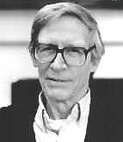
Notion of Division of Moral Labor
Refers to the ways in which responsibilities for the political, social and economic dimensions of society are divided among different political and socio-economic institutions and various actors operating within the structures

Slide 11
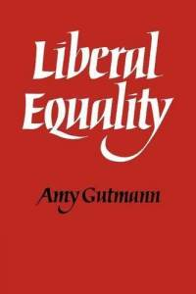
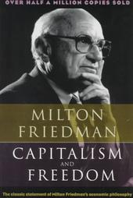
Political Doctrines
 | Market socialism | Property-owning democracy | Welfare-state capitalism | Liberal equality | Classical liberalism | Libertarianism
Division of labor | Real equality demands the public ownership of productive assets and democratic economy. Limited role for markets; addressing allocative efficiency | The democratic control of social life requires the robust public structures of society stopping the concentration of socio-economic power over time and its transformation into political power | The overall welfare of society demands the relatively robust public structures of society taking care of the redistribution of socio-economic power in a society | Free market economy set within the framework of social structures aiming towards equal opportunities | Extensive private sector and markets having a major role in a society Limited state needed for the economic efficiency | Society as the network of private agreements Minimal state or private firms as protectors of private property rights and freedoms of contracts

Slide 12
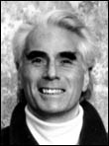
Libertarian Laissez-faire
The relation of citizens to the state is like their relation with any private corporation with which they have made an agreement.
Terms of citizenship depend on the bargaining powers of contractors.
Only minimal state or private firms needed to protect the private property rights and freedom of contracts.
Society as the network of private agreements.
Entirely blurred boundaries between business and politics.

Slide 13
Classical Liberalism
“First the scope of government must be limited. Its major function must be to protect our freedom both from the enemies outside our gates and from our fellow-citizens: to preserve law and order, to enforce private contracts, to foster competitive markets. Beyond this major function, government may enable us at times to accomplish jointly what we would find it more difficult or expensive to accomplish severally. However, any such use of government is fraught with danger. We should not and cannot avoid using government in this way. But there should be a clear and large balance of advantages before we do. By relying primarily on voluntary co-operation and private enterprise, in both economic and other activities, we can insure that the private sector is a check on the powers of the governmental sector and an effective protection of freedom of speech, of religion, and of thought.” (Milton Friedman 1961)

Slide 14
Liberal Equality
Worried about the cumulative effects of free market transactions over time on peoples’ equal changes.
Sets markets within the framework of social structures.
The task of these structures is to preserve equality of opportunity.
The life prospects of those with the same abilities and aspirations should not be affected by their social starting positions.

Slide 15
Welfare-state Capitalism
Markets left alone, produce socio-economic inequalities that do not maximize overall welfare in a society
Aims at increasing the overall level of welfare in a society via redistributive socio-economic programs
Allows significant public sector interventions to the market allocations.
Egalitarian social sector and ex post progressive tax structures and transfer programs to scale up welfare levels in a society.

Slide 16
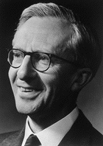
Property-owning Democracy
The democratic control of social life and economy as a major political goal.
Focus on the institutional means of preserving widespread property ownership in a society and stopping the concentration of economic power over time.
Inequalities of wealth/power offer corporations too much room to use the political system to further their private interests.
Robust egalitarian inheritance and gift taxes needed
Government policies to promote equal opportunity
The public financing of political parties and promotion of
free public discussion.

Slide 17
Market Socialism
Combines the socialist conception of distributive equity and efficiency of markets.
Markets used to allocate the factors of production but not to distribute incomes and wealth.
Means of production are publicly owned and leased to competing firms owned by workers.
Distribution of goods by the democratic processes.
The democratic control of firms.

Slide 18
Part 3: The political interpretations of the major CSR discussions (1950-2011). -Classic CSR -Economic CSR - New Political CSR

Slide 19
A Framework for Political Interpretation
Political doctrines Phases of CSR | Market socialism | Property-owning democracy | Welfare-state capitalism | Liberal equality | Classical liberalism | Libertarianism
Classical | Classical CSR discussion from the 1950s and 1970s
Economic | Dominant contemporary CSR discussion
New political | Challenger of the dominant CSR discussion

Slide 20
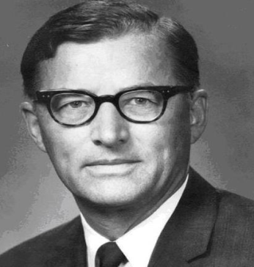
Classic CSR
Howard Bowen (1953): Social Responsibilities of the Businessman
Keynesian economist and Business School Dean.
Focus more on overall social welfare than firms’ profits
Evaluating the responsibilities of the businesses in different political systems.
Adopting pluralist position politically
Foundation for the later research on CSR

Slide 21
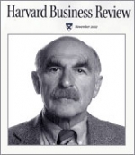
Classic CSR
Theodore Levitt (1958): The Dangers of Social Responsibility
American economist and Professor at Harvard Business School, Editor of the Harvard Business Review
Idea is to present a strong rejection of the idea of CSR based on the welfare-state capitalist premises.
Strict division of moral labor: Task of managers is economic and governments should take care of general welfare.
Need for the strong and extensive democratic state.

Slide 22
Classic CSR
K. D. Walters (1977): CSR and Political Ideology
- Arguing for and against CSR from conservative and liberal perspectives.
L. E. Preston & J. E. Post (1975): Private Management and Public Policy
- Examination of the division of responsibilities between public policy and firms.

Slide 23
Political Pluralism of Classic CSR
Political systems CSR periods | Market socialism | Property -owning democracy | Welfare-state capitalism | Liberal equality | Classical liberalism | Libertarian laissez-faire
Classic CSR |  |  | Narrow CSR: Levitt Wider CSR: Bowen Evaluation of CSR within different political systems: Bowen, Walters Examination of the division of responsibilities between public policy and firms: Preston & Post

Slide 24
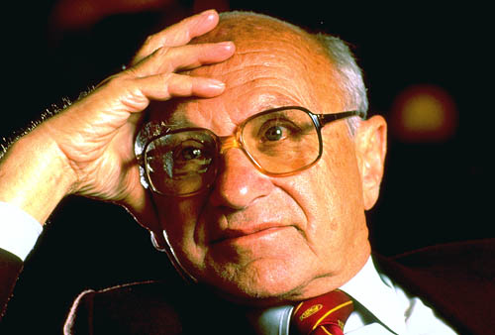
Economic CSR
Milton Friedman
Limited public structures and narrow CSR in the same package.
“Business of business is business”.
The role of the state is to enforce law and order, define ownership rights…
“Such a government would have clearly limited functions and would refrain from a host of activities that are now undertaken by federal and state governments in the USA and other Western countries” (Friedman 1962)

Slide 25
Economic CSR
Michael C. Jensen
Political Goal: State of affairs where society uses its resources most efficiently
Government and state power should be separated from the particular interests and private advantages.
The state has limited functions of protection of people and enforcing voluntary contracts and minimizing externalities.
The role of corporations is to extend the narrow focus of shareholder value maximization and concentrate on the maximization of the long-run total value of firms.

Slide 26
Economic CSR
Mainstream CSR
A firm can do well by doing good
Focus on the ”business case of CSR”
Normally not much political discussion on the roles of businesses in a society
Central aim is to develop a wider conception of CSR than Friedman’s narrow view, without losing his (classical liberal) voluntarism and economic efficiency emphasis.

Slide 27
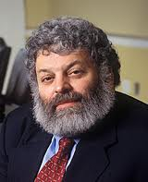
Economic CSR
R. Edward Freeman
The proper political context of the wider stakeholder responsibilities is libertarian political doctrine
It involves deep skepticism toward the state and its abilities to take care of the social background of businesses.
The libertarian political setting emphasizes the role of managers and firms as bearers of social responsibilities.
Libertarianism distributes moral labor strongly to private firms and suits well with the political aim of extending the influence of managers over their political and social environment.

Slide 28
Right wing instrumental CSR
Political systems CSR periods | Market socialism | Property -owning democracy | Welfare-state capitalism | Liberal equality | Classical liberalism | Libertarian laissez-faire
Instrumental CSR |  |  |  |  | Narrow CSR: Friedman
 |  |  |  |  | Middle ground CSR: Jensen
 |  |  |  |  | Wide CSR: Mainstream instrumental CSR research | Wide CSR: Freeman et al.

Slide 29
New Political CSR
Globalization blurs the traditional boundaries between the political and economic spheres of society leading to the politicization of the business firms (Scherer & Palazzo).
Private firms take over the traditional governmental tasks of social regulation and operate as new providers of citizenship rights and public goods (Crane, Matten & Moon).
The traditional picture of firms as apolitical actors focusing on economic roles in society does not hold anymore (Scherer & Palazzo).
The politicization of firms in global economy goes beyond the reach of mainstream economic CSR (Scherer & Palazzo).

Slide 30
Corporations as Governments
Instead of governments, corporations become the main providers of the social rights, political rights and civil rights of citizens (= extended corporate citizenship ECC).
For new political CSR, the process of ECC is relevant in the global economy where states lose their power to corporations.
ECC challenges the traditional economic CSR and its classical liberal conception of division of moral labor in a society with strict separation between business and politics.

Slide 31
New political CSR adapted from Guido Palazzo
Government
Government
Parliament
Parliament
Political Parties
Political Parties
Civil Society
Public
corporations
Private
corporations

Slide 32
Significance of new political CSR
ECC may (or may not) challenge the classical liberal conception of proper business-society relations.
However, ECC is fully in line with the libertarian conception of business-society relations.
Thus, new political CSR does not fundamentally challenge or go beyond the instrumental CSR paradigm. (Mäkinen & Kourula, 2012)

Slide 33
New political CSR
Political systems CSR periods | Market socialism | Property -owning democracy | Welfare-state capitalism | Liberal equality | Classical liberalism | Libertarian laissez-faire
New political CSR | Gap: The alternative conceptions of background justice are needed in new political CSR to challenge instrumental CSR and aim towards the deliberative democratic conception of CSR |  |  |  | Benchmark for Scherer & Palazzo: New political CSR attempts to go beyond this view | Political CSR without background justice: Extended corporate citizenship

Slide 34
Political Map
Political systems CSR periods | Market socialism | Property -owning democracy | Welfare-state capitalism | Liberal equality | Classical liberalism | Libertarian laissez-faire
Classic CSR |  |  | Narrow CSR: Levitt Wider CSR: Bowen Evaluation of CSR within different political systems: Bowen, Walters Examination of the division of responsibilities between public policy and firms: Preston & Post
Instrumental CSR |  |  |  |  | Narrow CSR: Friedman
 |  |  |  |  | Middle ground CSR: Jensen
 |  |  |  |  | Wide CSR: Mainstream instrumental CSR research |  | Wide CSR: Freeman et al.
New political CSR | Gap: The alternative conceptions of background justice are needed in new political CSR to challenge instrumental CSR and aim towards the deliberative democratic conception of CSR |  |  |  | Benchmark for Scherer & Palazzo: New political CSR attempts to go beyond this view |  | Political CSR without background justice: Extended corporate citizenship

Slide 35
Session Message
Discussion over CSR is always political.
The dominant framing of new political CSR faces real political challenges in its attempt to go beyond mainstream economic CSR discussion.
There is risk that new political CSR promotes one particular political (libertarian) conception of society.
To answer the challenges of political pluralism there is a need to take a fresh look at the history of CSR studies and to the contemporary political theory.
Without the background justice CSR is easily done solely for the neo-liberals.

Slide 36
Additional Readings
Mäkinen, J. & Kourula, A. (2012) Pluralism in Political Corporate Responsibility, Business Ethics Quarterly 22:4, pp 646-678.
Crouch, C. (2011) The Strange Non-Death of Neoliberalism. Polity Press.
Reich, R. B. (2007) Supercapitalism.Vintage Books.
Marens, R. (2008) Getting Past the ”Government Sucks” Story: How Government Really Matters. Journal of Management Inquiry 17/84.
Heath, J., Moriarty, J., & Norman, W. (2010) Business Ethics and (or as) Political Philosophy. Business Ethics Quarterly, 20/3.
Scherer, A. & Palazzo, G. Handbook of Research on Global Corporate Citizenship. Edward Elgar
Fougère, M., Gyöngyi, K., Mäkinen, J., Siltaoja, M., & Sobczak, A. (eds.) EJBO Electronic Journal of Business Ethics and Organization Studies, Vol. 16, No. 2 (2011)

