Slide 1
ELEC-C1310 Automaatio- ja systeemitekniikan laboratoriotyöt Laboratory Course in Automation and Systems Technology
Spring 2022

Slide 2
Background
ELEC-C1310
Automaatio- ja systeemitekniikan laboratoriotyöt
Laboratory Course in Automation and Systems Technology
A core course of Automation B.Sc. Major
5 ECTs
Responsible lecturer: Prof. Quan Zhou
Course manager: Shahriar Haeri
Other teachers/assistants responsible for individual labs (lab teacher):
Arash Azangoo
Jifei Deng
Ilka Seilonen
Hoang Nguyen Khac
Issouf Ouattara
Francesco Verdoja
Shahriar Haeri

Slide 3
Course Organization
Content
6 labs
1-3 lab teachers for each lab
Rules
Teaching group size: 4 students / group
Grading: Pass/Fail
Language:
Labs: Finnish or English
Introduction and course information: English
Schedule for each lab:
Scheduled time is fixed, please respect the schedule and do your best to come
No exception case for students without compelling reasons
Only one extra timeslot reserved in each lab for exceptional cases

Slide 4
Course Organization
Special arrangements due to Covid-19
Lab teachers will arrange labs offline
Prehearing session will be online or offline depending lab teacher’s opinion
Replacement assignment for students unable to attend due to Covid-related reasons
Follow lab arrangement details from lab folders and announcements in Mycourses
We are following university teaching guidlines, and the course arrangements might change depending on Covid-19 situation

Slide 5
Procedure
Students form groups in MyCourses using the group choice functionality
Group choice open until Friday, January 21
Lab teacher prepares a scheduler in MyCourses
Announcement in the “News” –section when the lab is open for booking
Each student group selects a suitable timeslot for each lab
Prehearing and lab time agreed with the lab teacher via MyCourses scheduler
Lab teacher specifies the location
Lab teacher uploads the pre-assignment to MyCourses
Student group completes the pre-assignment of each lab and submits it as instructed by lab teacher

Slide 6
Procedure…
Student group attends the prehearing of each lab
~15 min,
Condition to proceed to the real lab,
The whole group needs to redo the prehearing if fails; 3 times failure – fail the course;
If a student in a group is not coming, it is considered the student is dropped from the group,
the student can join other group if there is compelling reasons
Student group attends the lab session according to the schedule
~90-120 min
If a student in a group is not coming, it is considered the student is dropped from the group,
The student can join other group if there is compelling reasons, otherwise fail the course
Student group submits a lab report when required
Instructions and deadlines are provided by lab teacher
Submitted to the relevant assignment corresponding folder in MyCourses

Slide 7
Time table
Lab | Period | Responsible teacher/s
Process Plant Automation Systems | 24.1 - 11.2.2022 (week 4-6) | Azangoo Mohammad mohammad.azangoo@aalto.fi Jifei Deng jifei.deng@aalto.fi Ilkka Seilonen ilkka.seilonen@aalto.fi
Control Engineering Lab 1 & 2 o Optimal Control of an Inverted Pendulum o PID Control of a DC Motor | 14.2 – 11.3.2022 (week 7-10) | Nguyen Khac Hoang hoang.kh.nguyen@aalto.fi
Sensor Fusion with Kalman Filter | 14.3 – 1.4.2022 (week 11-13 ) | Issouf Ouattara issouf.ouattara@aalto.fi
Fixing Bugs in Industrial Robot | 4.4 – 22.4.2022 (week 14-16) | Francesco Verdoja francesco.verdoja@aalto.fi
Microforce Measurement | 25.4 – 13.5.2022 (week 17-19) | Shahriar Haeri Shahriar.haeri@aalto.fi

Slide 8
Skills | Control lab | Process lab | Micro lab | Robot lab | Automation lab
Understanding the physics and models of systems | X |  |  |  | X
Understanding the control concept | X
implement, use and program automation systems, |  | X
implement, use and program microcontrollers, PLC, etc |  | X |  |  | X
implement, use and program sensors, |  |  | X
implement, use and program automation networks, |  | X
implement, use and program robots |  |  |  | X
Perform data measurements |  |  | X |  | X
Interpret measurement results |  |  | X |  | X
Basic software engineering and IT technology |  | X |  | X

Slide 9
General skill | Control lab | Process lab | Micro lab | Robot lab | Automation lab
Group work | X | X | X | X | X
Applying theoretical concepts/knowledge in practice | X | X | X | X | X
Practicing scientific method | X |  | X | X
Solving engineering problems | X | X |  | X
Design engineering solutions | X | X |  | X
Critical thinking |  |  | X | X
Perform data analysis |  |  | X | X | X
Presentation skills (oral and writing). | X | X | X | X | X

Slide 10
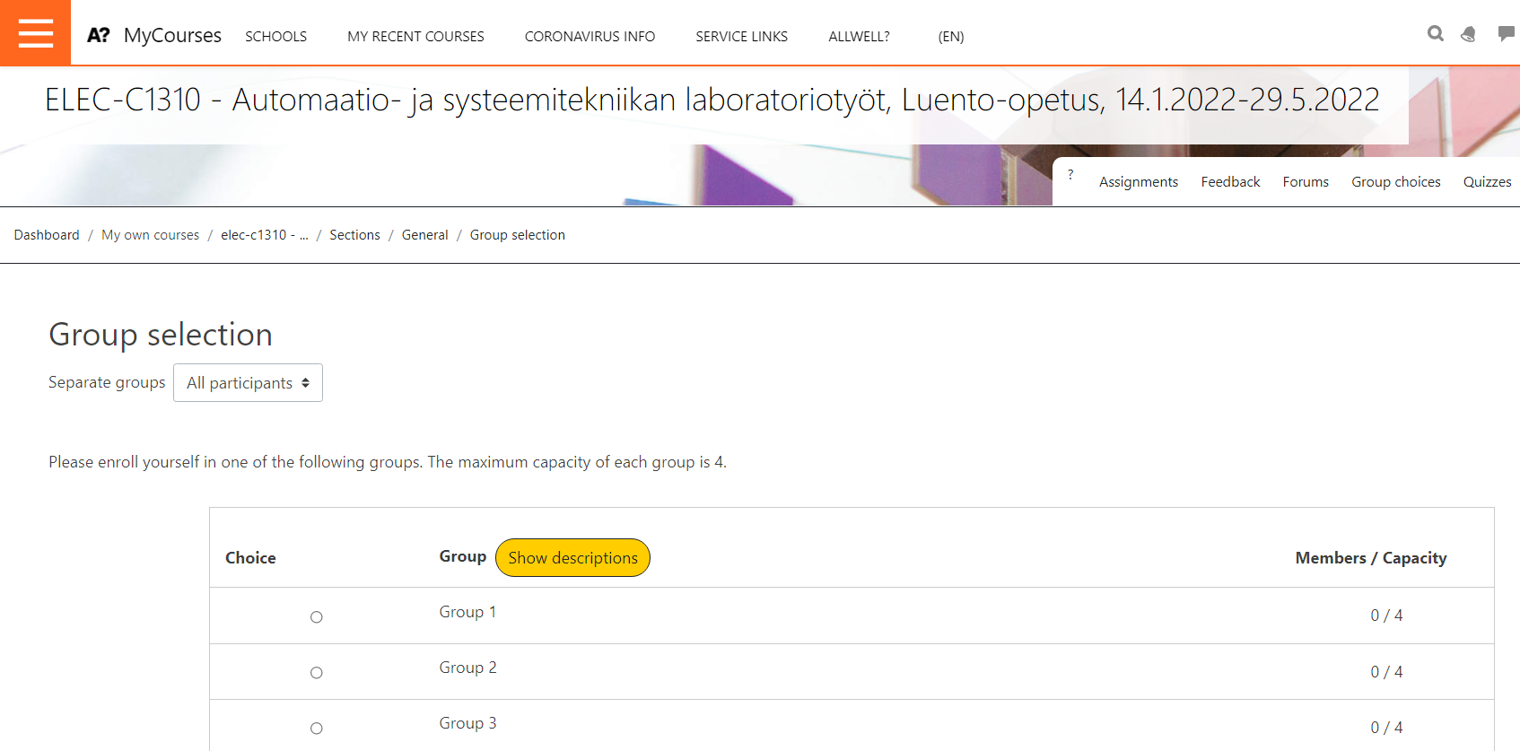
MyCourses course page
Group selection

Slide 11
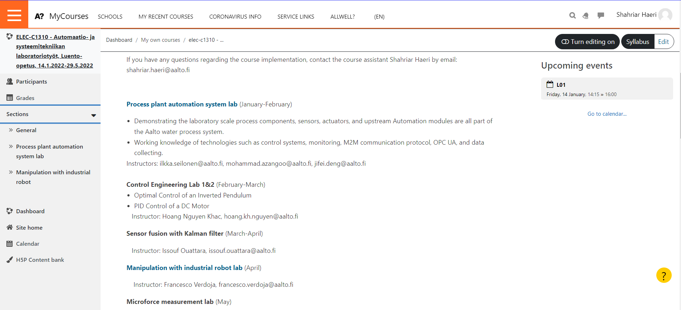
MyCourses course page
First lab

Slide 12
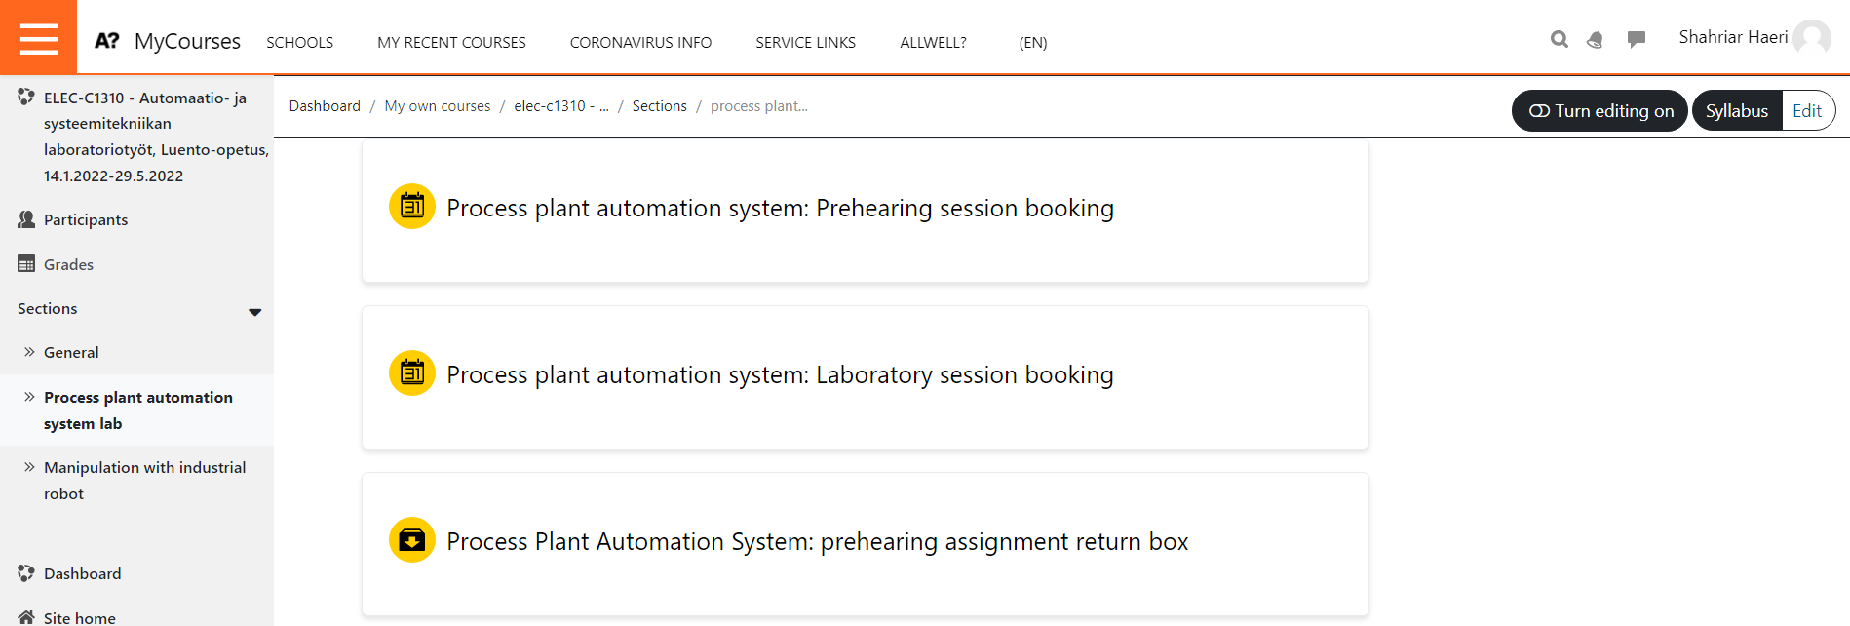
MyCourses course page
First lab session bookings

Slide 13
Questions?

