Slide 1
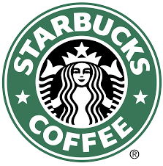
Starbucks in India

Slide 2
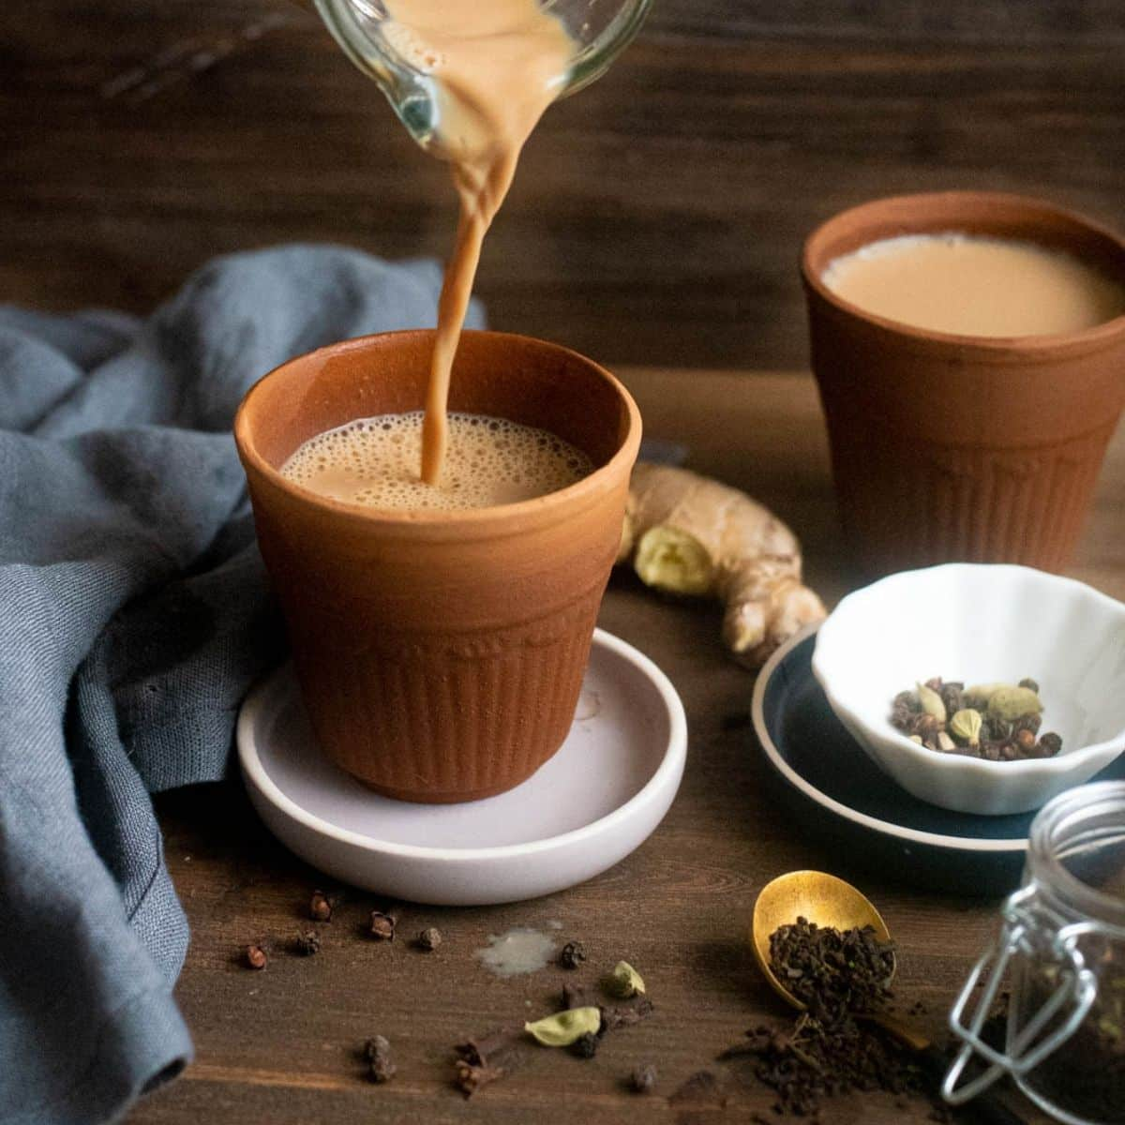
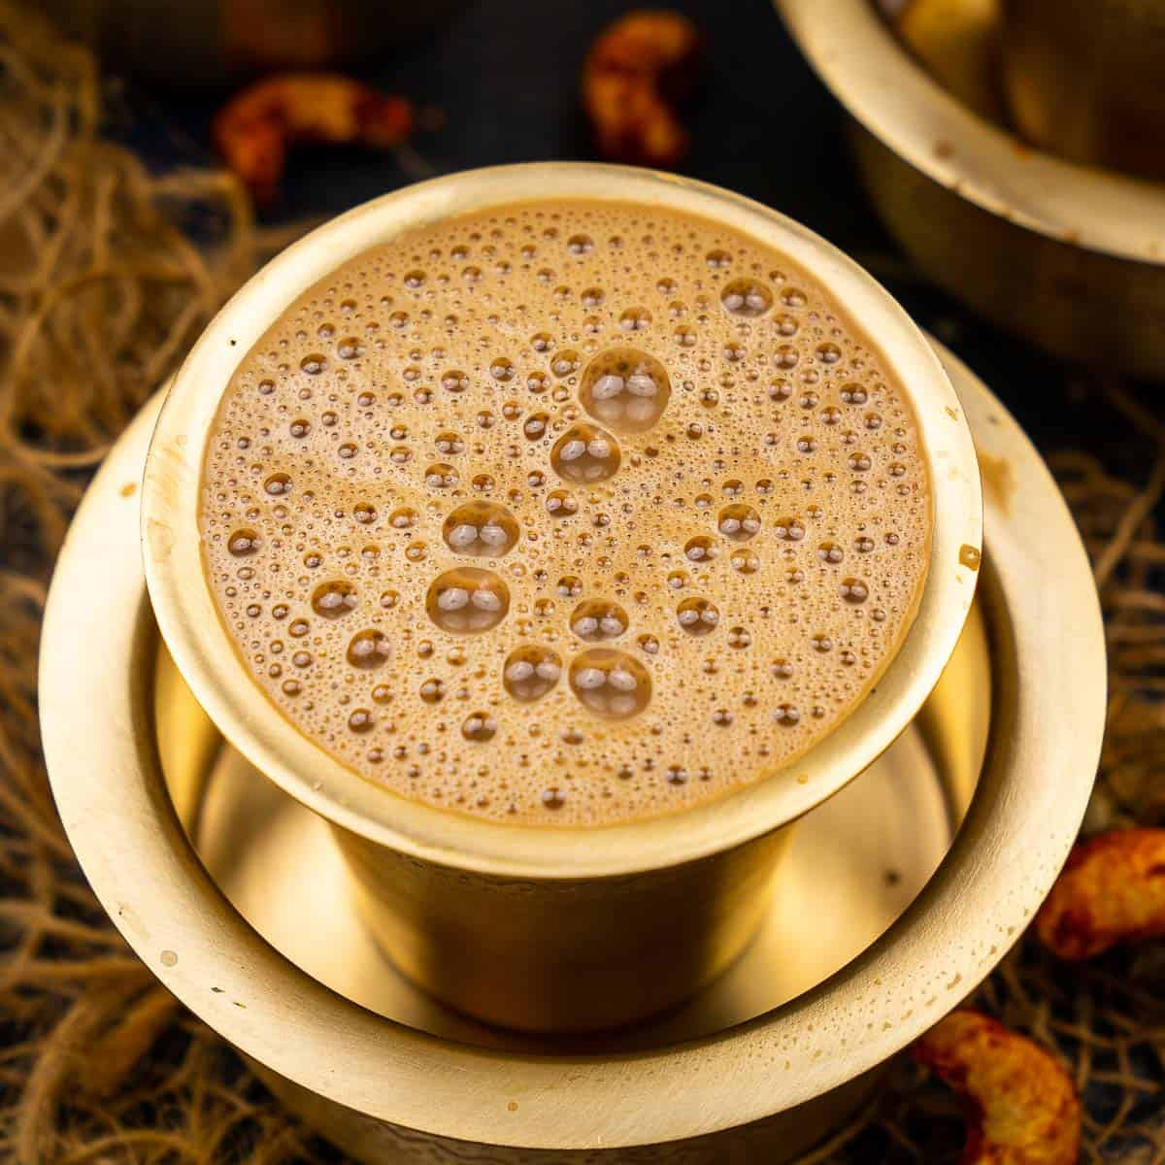
What do most people drink in the morning?
Chai (Tea)
Filter Coffee
Notes:
In India most people drink Chai or Filter Coffee, or just Instant coffee which is more convenient. These are the local drinks that are readily available in everyone’s homes

Slide 3
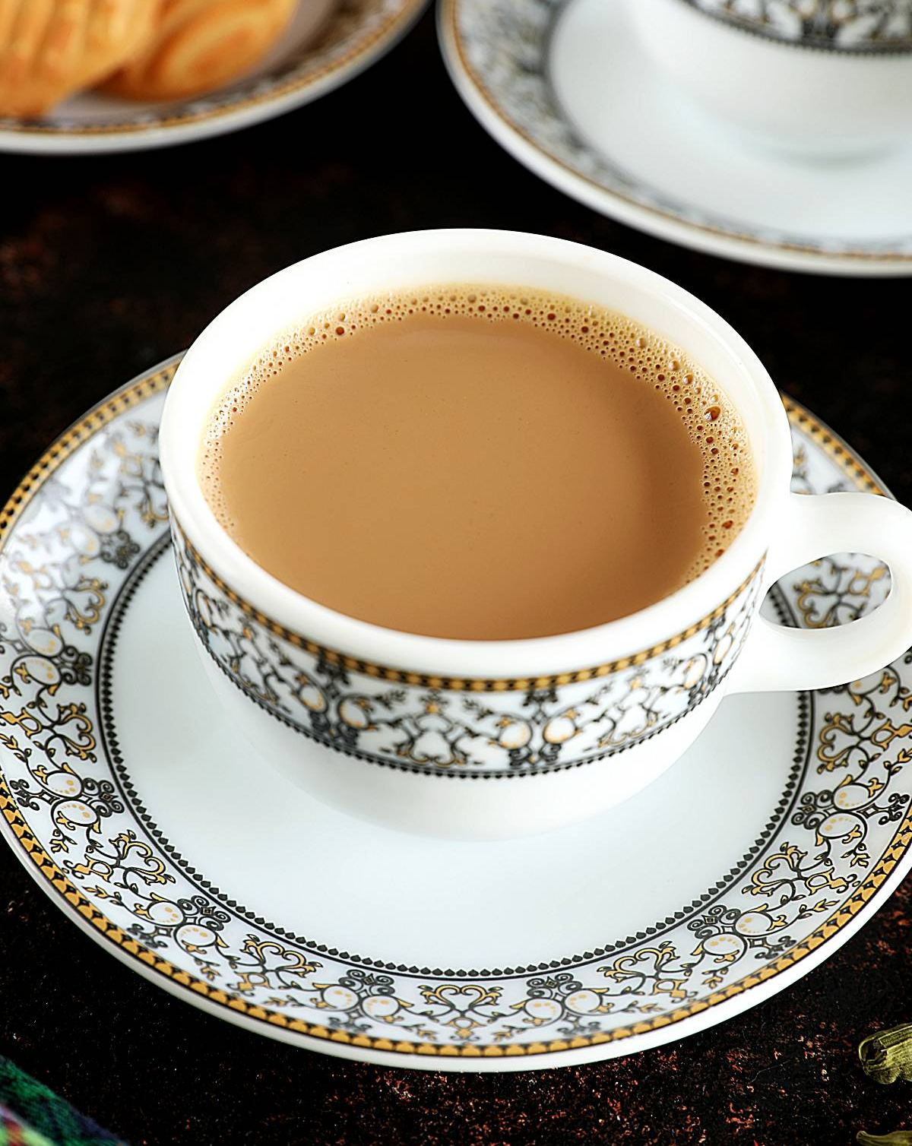
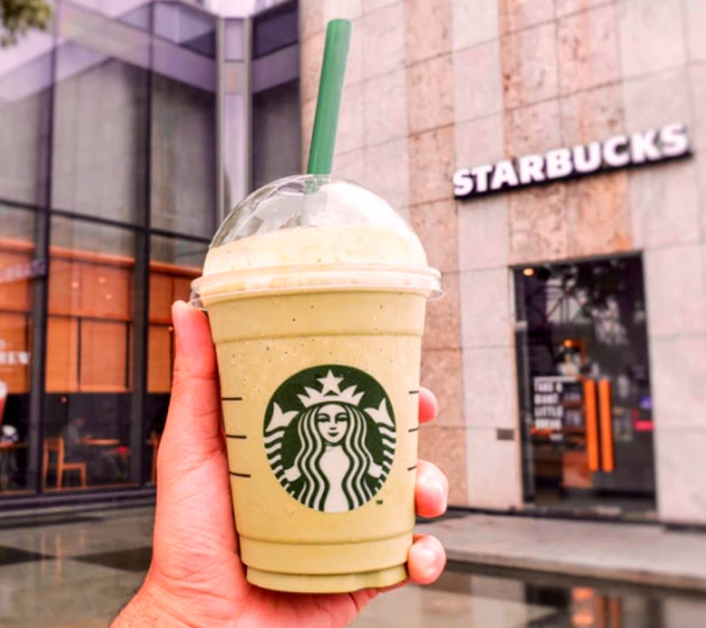
Chai – 30 Rupees
Starbucks Coffee – 250 Rupees
Notes:
This is not a fair comparison, because Chai is an everyday drink, and Starbucks is occasional, it’s for the experience. Starbucks is expensive compared to local alternatives.

Slide 4
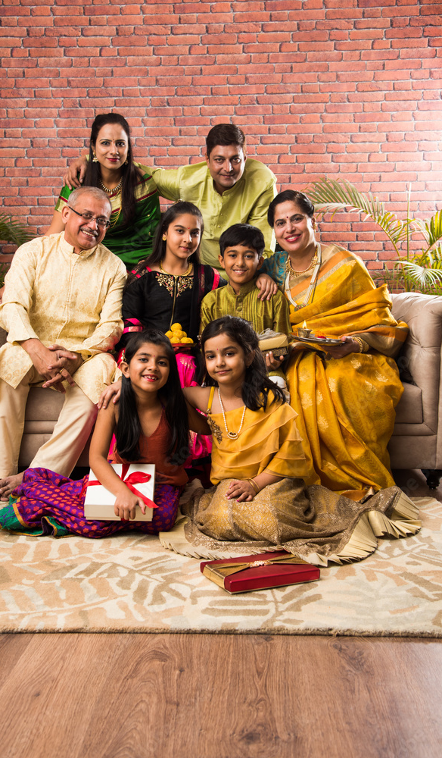
Notes:
This is an Indian Family, and they buy coffee from a grocery store. Usual choices are instant coffee, and tea which is quite cheap. And it’s very rare for a family like this to go to Starbucks.

Slide 5
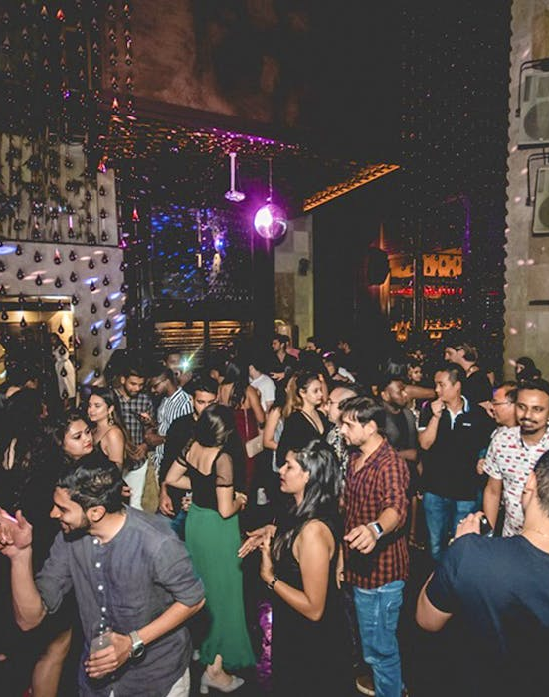
But where do these Indians buy Coffee?
Notes:
The younger generation, who around the age group 20-40, so Millennial's, and grew in big metropolitan cities in India like Delhi, Bangalore, Mumbai, Chennai, etc

Slide 6
They are heavily influenced by worldwide trends.
And they have more money to spend
Notes:
They are more aware of what good coffee is and they wouldn’t mind spending money on it.

Slide 7
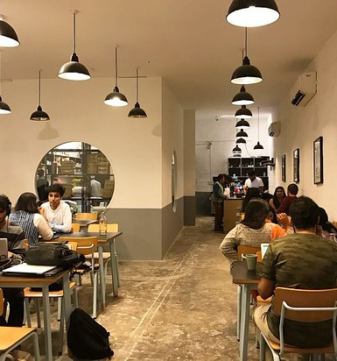
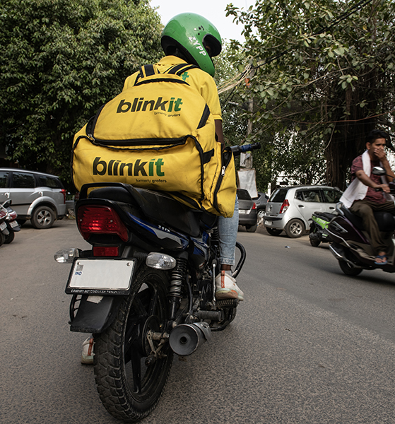
Notes:
A lot of the young people go to the Cafes to hangout or to work. But not regularly. And certainly not every day. Most of the young people make coffee at home. Since they are aware of what good coffee is, but it’s not possible to go to a café every day, they would buy good coffee, and then make it at home. Some buy coffee from grocery stores. But a lot of them, just order it online.

Slide 8
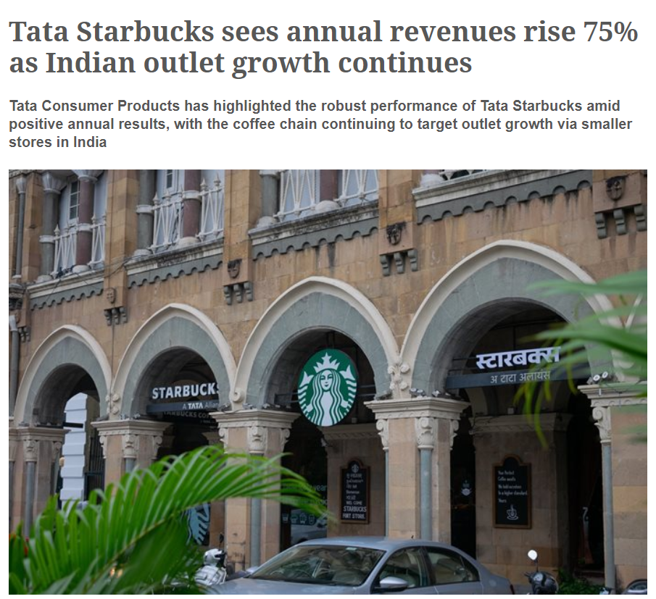
Notes:
Coming back to Cafes. India has a rapidly growing Specialty coffee market. Starbucks has seen high growth after Covid.

Slide 9
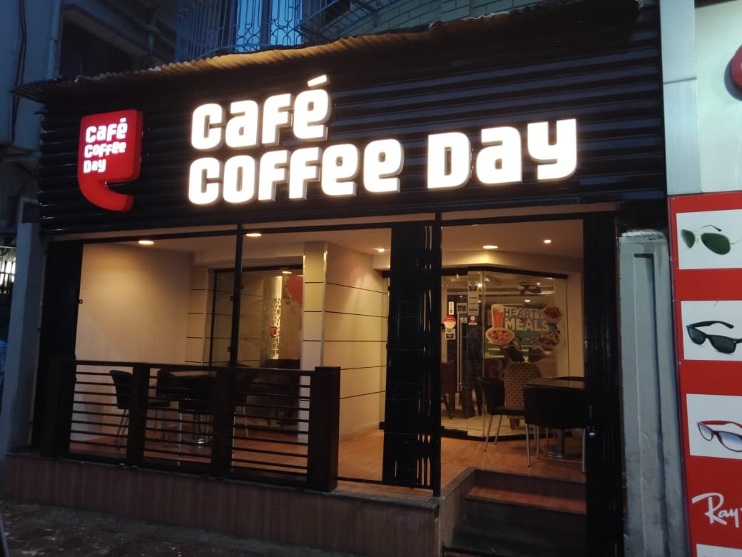
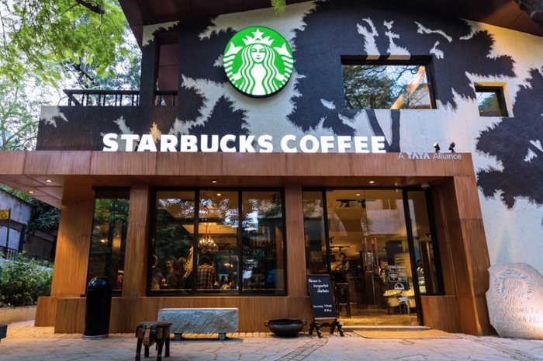
Café Coffee Day - Started in 1996
Starbucks Coffee- Started in 2012 in India
1384 stores
337 stores
Notes:
Café Coffee day is the biggest café brand in India. And Starbucks has a relatively small market share.

Slide 10
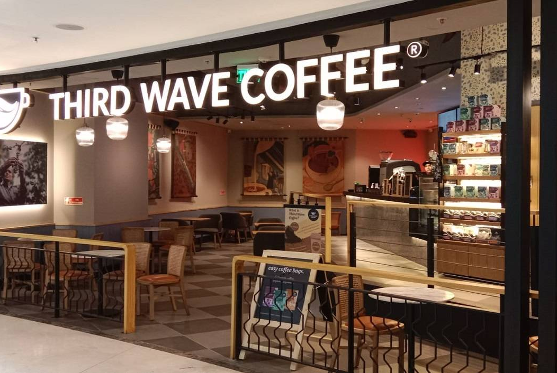
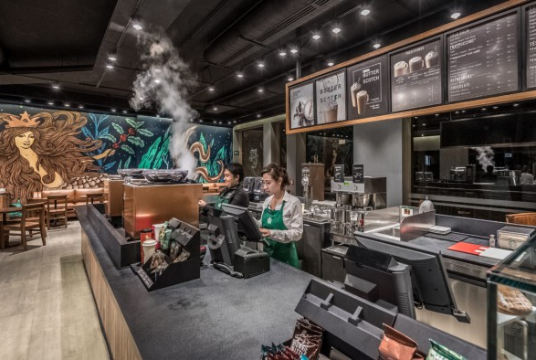
Third Wave Coffee- Started in 2016
Blue Tokai- Started in 2013
300+ stores by the end of 2023
80+ stores
Notes:
These coffee startups are direct competitors to Starbucks, and there are many more. Indian consumers are value-conscious, and these homegrown brands provide great value in terms of quality and pricing of the product.

Slide 11
Notes:
India has an unprecedented increase in the number of coffee lovers. Increase in disposable income, global exposure, digital and media, urbanization, lifestyle changes, are responsible for India Coffee market growth.

Slide 12
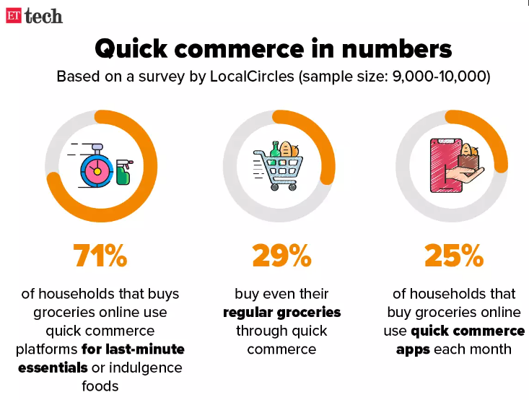
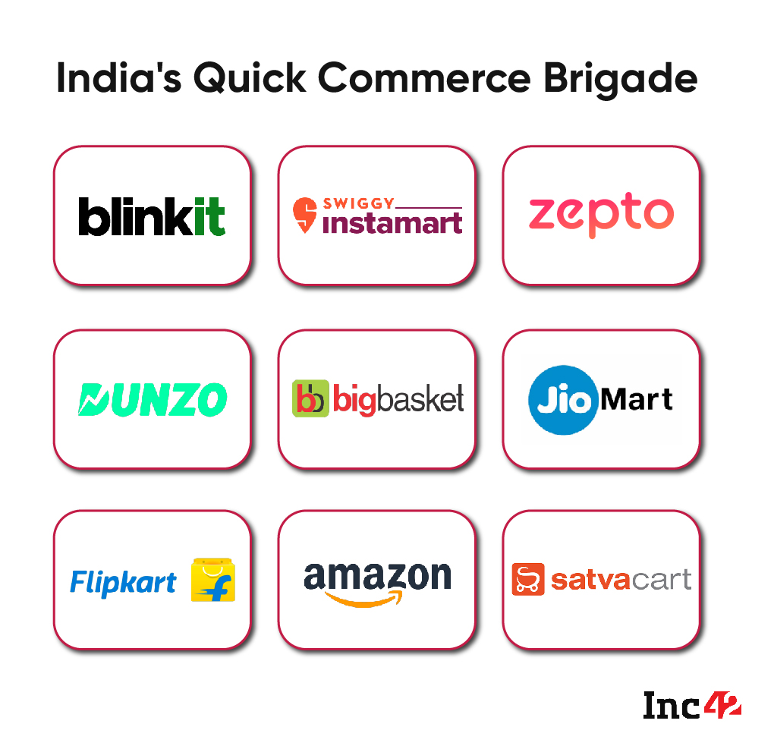
Source: https://economictimes.indiatimes.com/tech/technology/flipkart-launches-45-minute-grocery-delivery-to-scale-up-operations-next-month/articleshow/89643564.cms
Notes:
Usually, young people order groceries from quick commerce apps. Quick commerce is rapidly growing in India, an there are many business competing in this space.

Slide 13
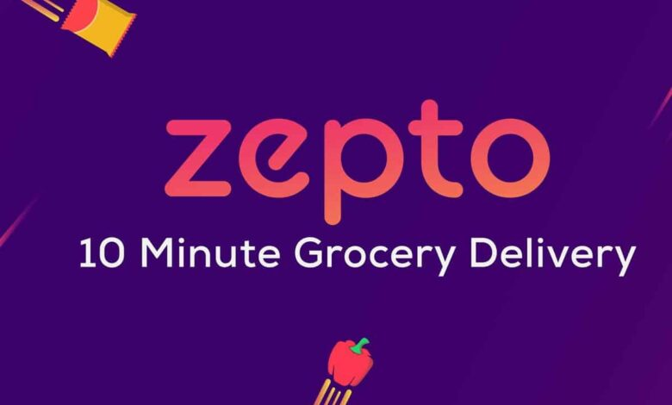
Notes:
When I was back in India, this is where I used to get my groceries from.

Slide 14
What can Starbucks do?

Slide 15
Make good coffee more accessible by bringing convenience to people who are looking for quality

Slide 16
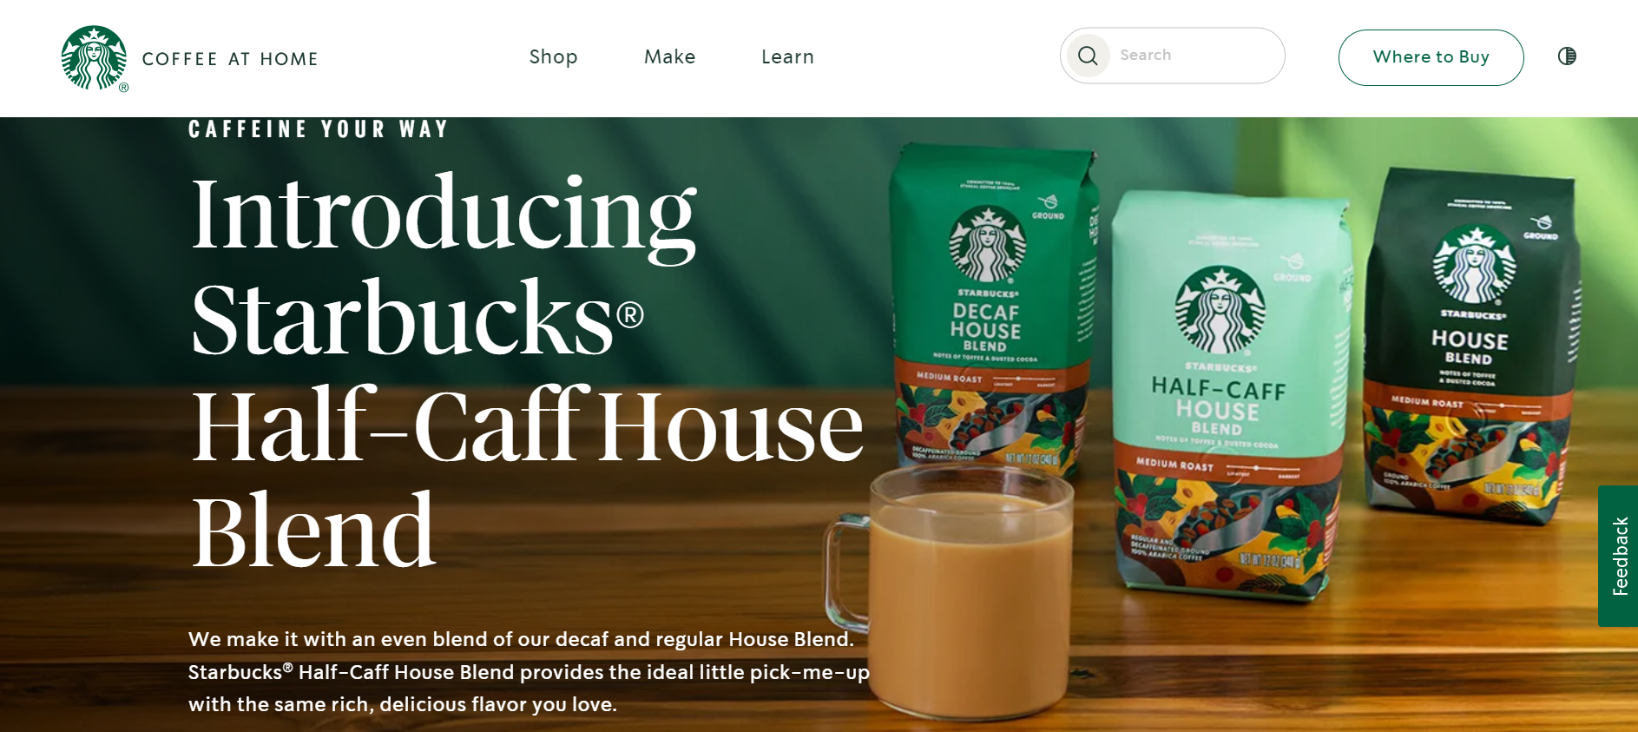
Notes:
This is from the Starbucks website. They already have a product range for coffee at home. But they are not sold in the platforms where most people buy coffee from. It is available on Amazon India, where it’s expensive, but not on the quick commerce apps.

Slide 17
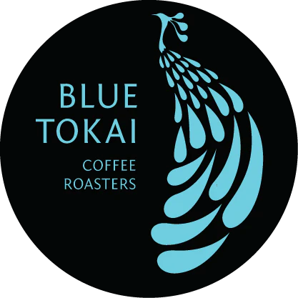
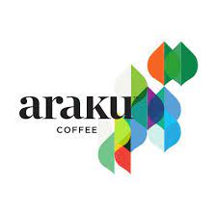
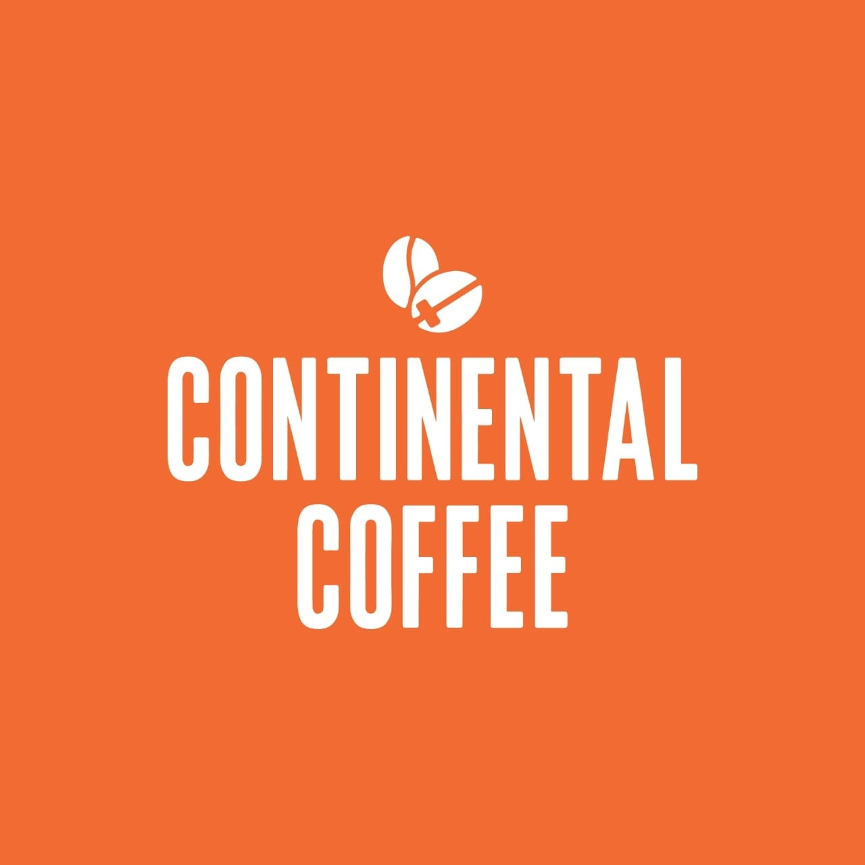
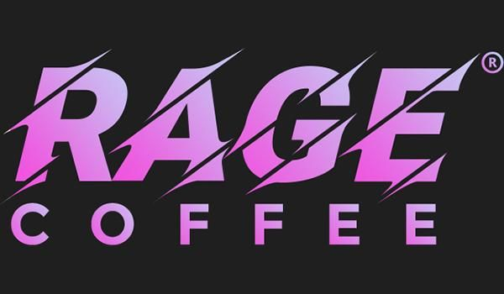
Notes:
There are a lot of Homegrown coffee brands competing in the online space as well. Some offer great quality, and some offer better pricing.

Slide 18
Competitive Advantage
Everybody knows the brand
Everybody thinks it’s good
Notes:
Starbucks has the competitive advantage because of it’s instant brand recognition mostly because of American pop culture. With competitive pricing in the online coffee market, Starbucks can easily have a large online business.

Slide 19
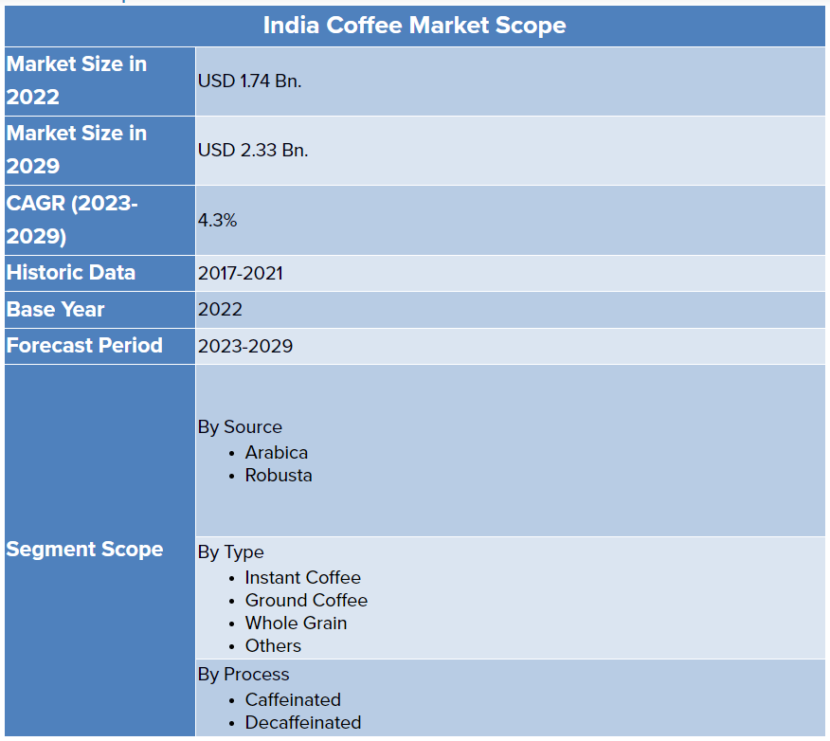
Source: https://www.stellarmr.com/report/India-Coffee-Market/65
Notes:
Indian Coffee market is set to grow to 2.33Bn USD by 2029, and CAGR (2023-2029) of 4.3%, and a lot of the business is shifting online.

Slide 20
Thanks.

