Slide 1
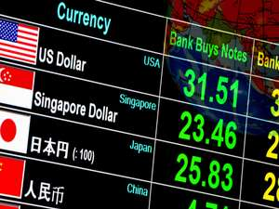
Inflation and exchange rates in Emerging Markets
Svetlana Ledyaeva
Aalto University School of Business

Slide 2
Inflation and investment decisions
The rate of inflation is important as it represents the rate at which the real value of an investment is eroded.
Investors should try to buy investment products with returns that are equal to or greater than inflation. For example, if a company`s stock returned 4% and inflation was 5%, then the real return on investment would be - 1% (4%-5%).
Inflation uncertainty/volatility ➔ uncertainty about the real net revenues ➔ investment decision

Slide 3
Inflation for investment in stocks versus bonds
Stocks – more likely no real significant impact on the return:
a company's revenue and earnings should increase at approximately the same pace as inflation, so the prices of stocks should rise along with the general prices of consumer and producer goods.
Bonds – significant impact of inflation as Bond yeild is fixed over certain period of time.
Foreign Direct Investment – high and volatile inflation – negative effects.

Slide 4
Inflation risk and investment decisions in emerging markets
A mix of strong economic growth and insufficient monetary restraint can result in high inflation, a problem that has periodically cropped up in emerging markets.
Runaway inflation can devalue currencies, hurt corporate profit margins, and abruptly slow economic growth.

Slide 5
Inflation in emerging markets
After the crises that hit various emerging markets in the 1990s (Mexico in 1994, Asia in 1997 and 1998) central banks began to adopt policies that aimed to make inflation targeting part of their standard, ongoing monetary policy.
These, combined with increased independence for the major emerging market central banks and broadly lower levels of domestic currency volatility have meant that emerging market inflation has generally trended downwards over the past 10-15 years with fewer spikes of hyper-inflation.

Slide 8
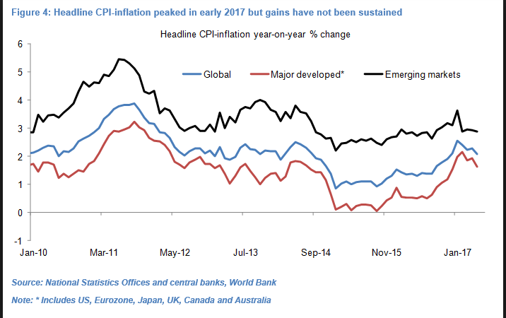

Slide 9
Inflation volatility in emerging markets

Slide 10
Inflation volatility in emerging markets: conclusions
The average volatility in headline prices across emerging markets has fallen gradually over the past two decades, and now sits at a record low of 1.5 percent.
Factors contributed to it:
Inflation targeting has become the primary policy objective.
Globalization of trade and increased labor mobility via increased product competition and lower labor costs.
Lower potential growth rates in emerging markets.
Market-friendly governments are less inclined to regulate prices for services and goods -- which tends to trigger abrupt price hikes -- have also contributed to the drop.

Slide 11
Video: Get Your Portfolio Ready for Future Inflation

Slide 12
Inflation-protected investment in emerging markets
A standard bond:
Nominal – the fixed initial investment amount;
Coupon – the regular payments of interest which must be made;
Maturity – the fixed period of time until the debt must be repaid.
Inflation linked bonds:
has the same features as standard but nominal of the bond is no longer fixed; it is
linked to inflation ➔ the coupon is applied to a proportional larger or smaller nominal.
Emerging market inflation linked debt – around 20% of it in the World in 2013.

Slide 13
Exchange risk and investment decisions in emerging markets
When investing in any international market, investors face the risk that exchange rates will move in an unfavorable direction.
For instance, if the foreign currency in which an investment is denominated declines in value relative to the dollar, it could reduce gains or magnify losses for U.S. investors in dollar terms.

Slide 14
What is exchange rate: Reminder
Nominal Exchange Rate (NER): The price of a nation’s currency in terms of another currency
Real Exchange Rate (RER): Compares the relative price of two countries’ consumption baskets.
RER = (NER x Price of the foreign basket) / (Price of the domestic basket)
Exchange Rate Depreciation/Appreciation (ERD/ERA) is a decrease/increase in the level (value, price) of a currency in a floating exchange rate system due to market forces

Slide 15
Why exchange rate for investment decision?
“Exchange rate risk management is an integral part in every firm’s decisions about foreign currency exposure” (Allayannis, Ihrig, and Weston, AER P&P 2001)
Reducing a firm’s vulnerabilities from major exchange rate movements is important.
In this vein, the ability to measure and manage exchange rate risk exposure is critical and does affect asset value and profit margins.
“Exchange rate exposure, as one of the main issues in international finance, has been extensively studied in the last two decades. It is defined as the degree to which the value of a firm is affected by changes in exchange rate”(Adler and Dumas, 1984).

Slide 16
Exchange rate and invetsment decisions (Nucci and Pozzolo 2001, EER)
ERD/ERA:
a firm is dependent on imported inputs ➔ the increase/decrease in variable costs ➔ the reduction/enlargement in the marginal value of capital ➔ the reduction/increase in its level of investment.
a firm with a larger share of revenues from the export markets ➔ the increase/decrease in price competitiveness ➔ the increase/decrease in the expected value of its capital ➔ the increase/decrease in its level of investment
ER depreciation – bad for importer and good for exporter
ER appreciation – good for importer, bad for exporter.

Slide 17
Exchange rate and invetsment decisions
Depreciation of local currency – good for exporting firms with low share of imported inputs. ➔ increase in investments
Appreciation of local currency – good for non-exporting firms with high share of imported inputs. ➔ increase in investments

Slide 18
Exchange rates and Foreign Direct Investment (Goldberg)
”Relative wage” channel: ERD ➔ it reduces country’s wages and production costs relative to those of its foreign counterparts. ➔ “Locational advantage" or attractiveness as a location for receiving productive capacity investments. ➔ improves the overall rate of return to foreigners contemplating an overseas investment project in this country.
“Relative wealth” channel: ERD ➔ raises the relative wealth of source country agents and can raise multinational acquisitions of certain destination market assets. ➔To the extent that source country agents hold more of their wealth in own currency-denominated form, a depreciation of the destination currency increases the relative wealth position of source country investors, lowering their relative cost of capital. ➔This allows the investors to bid more aggressively for assets abroad.

Slide 19
A “firm-specific asset” argument (Blonigen, American Economic Review 1997)
If foreign (Japanese) and domestic (US) firms have equal opportunity to purchase firm-specific assets in the domestic (US) market, but different opportunities to generate returns on these assets in foreign markets.
➔
Currency movements may affect relative valuations of different assets. While domestic (US) and foreign (Japanese) firms pay in the same currency, the firm-specific assets may generate returns in different currencies.
➔
If a representative foreign (Japanese) firm and domestic (US) firm bid for a domestic (US) target firm with firm-specific assets, real exchange rate depreciations of the domestic (US) currency can plausibly increase foreign (Japanese) acquisitions of these target (US) firms.
➔
This channel predicts that domestic (US) currency depreciation will lead to enhanced FDI into this (US) economy.
Example: Data on Japanese acquisitions in the United States support the hypothesis that real dollar depreciations make Japanese acquisitions more likely in U.S. industries with firm-specific assets.

Slide 20
Volatility of exchange rate and FDI activity: ”Production flexibility” argument
Producers need to commit investment capital to domestic and foreign capacity before they know the exact production costs and exact amounts of goods to be ordered from them in the future.
When exchange rates and demand conditions are realized, the producer commits to actual levels of employment and the location of production.
In the production flexibility arguments, the important presumption is that producers can adjust their use of a variable factor following the realization of a stochastic input into profits.
Without this variable factor, i.e. under a productive structure with fixed instead of variable factors, the potentially desirable effects on profits of price variability are diminished.
By the production flexibility arguments, more volatility is associated with more FDI ex ante, and more potential for excess capacity and production shifting ex post, after exchange rates are observed.

Slide 21
Volatility of exchange rate and FDI activity: “Risk aversion” argument
Investors require compensation because exchange rate movements introduce additional risk into the returns on investment.
Higher exchange-rate variability lowers the certainty equivalent expected exchange-rate level.
Certainty equivalent levels are used in the expected profit functions of firms that make investment decisions today in order to realize profits in future periods.
If exchange rates are highly volatile, the expected values of investment projects are reduced, and FDI is reduced accordingly.

Slide 22
”Production flexibility” vs. ”Risk aversion” arguments
Risk aversion arguments are more convincing than the production flexibility arguments posed in relation to the effects of short-term exchange rate variability.
For variability assessed over longer time horizons, the production flexibility motive provides a more compelling rationale for linking foreign direct investment flows to the variability of exchange rates.

Slide 23
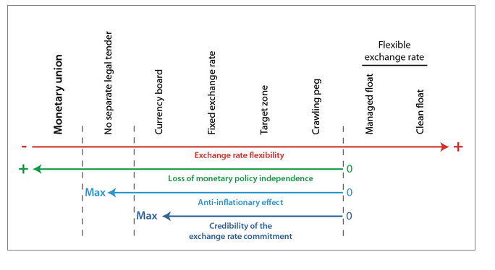
Exchange rate regimes

Slide 24
De facto regimes differ from de jure
Most of those listed as floating in fact intervene in the foreign exchange market frequently.
As Calvo and Reinhart (2000) and Reinhart (2000) observe: “Countries that say they allow their exchange rate to float mostly do not.” Only the United States (US) floats so purely that intervention is relatively rare.
Worryingly, the attempts at de facto classification differ widely, not just from the de jure classification, but from each other as well.

Slide 25
Advantages of fixed exchange rates
The nominal anchor for monetary policy.
Higher exchange rate variability would create uncertainty; this risk would in turn discourage international trade and investment.
Fixing the exchange rate in terms of a large neighbor would eliminate exchange rate risk, and so encourage international trade and investment.
Going one step farther, and actually adopting the neighbor's currency as one's own, would eliminate transactions costs as well and thus promote trade and investment still more.
Prevent competitive depreciation or competitive appreciation.
Preclude speculative bubbles. Some exchange rate fluctuations appear utterly unrelated to economic fundamentals. This observation then allows at least the possibility that, if the exchange rate fluctuations were eliminated, there might in fact not be an outburst of fundamental uncertainty somewhere else.

Slide 26
Advantages of floating exchange rates
It allows the country to pursue an independent monetary policy.
It allows automatic adjustment to trade shocks. The currency responds to adverse developments in the country’s export markets or other shifts in the terms of trade by depreciating, thus achieving the necessary real depreciation even in the presence of sticky prices or wages.
Government retains two important advantages of an independent central bank: seigniorage and lender-of-last resort ability.

Slide 27
Which factors are likely to dominate, the advantages of fixed exchange rates or the advantages of floating?
There is no one right answer for all countries.
The answer must depend, in large part, on the characteristics of the country in question.
If the country is subject to many external disturbances, such as fluctuations in foreigners' eagerness to buy domestic goods and domestic assets (perhaps arising from business cycle fluctuations among the country's neighbors), then it is more likely to want to float its currency. In this way, it can insulate itself from the foreign disturbances, to some degree.
On the other hand, if the country is subject to many internal disturbances, then it is more likely to want to peg its currency.
The answer also depends: whether the source of shocks is monetary or real; the degree of capital and other factor mobility; the relative size of countries.

Slide 28
Exchange rate regime choice: Theory
Standard theory of exchange rate regime choice bases its analysis on the nature of shocks:
Nominal shocks prevail – fixed regime.
A monetary shock will tend to depreciate a floating ER, thus transmitting a nominal shock ino a real one. In this context, a fixed ERR would provide a mechanism which accomodates a shift in money supply or demand with less output volatility.
Real shocks prevail – floated regime.
In this case, when the economy needs to respond to a change in relative equilibrium prices (i.e. tradable prices vs. non-tradable prices), a shift in the nominal ER could avoid any detrimental/unfavourable effects in output and employment (De Grauwe, 1997).

Slide 29
Exchange rate regimes in emerging markets

Slide 30
Discussion of the previous graph
The number of economies using hard-currency pegs has actually gone up a bit over time.
Free floating, which peaked right before the global recession, has lately gone out of fashion.
The big shifts, as it turns out, are in the hybrid exchange-rate regimes. In particular, there has been a broad move away from crawling pegs and toward managed floats.
Source: http://www.economist.com/blogs/freeexchange/2014/04/emerging-markets-0

Slide 31
Choice of Exchange Rate Regime in Emerging Markets
Whether countries are free to choose any regime they want, or whether they are instead forced to adopt a particular regime or to choose among a limited number of options?
Determinants in emerging markets:
International financial market integration,
Macroeconomic performance,
Financial sector development,
Political economy considerations.

Slide 32
11 empirical regularities of exchange rates in Emerging Markets (Edwards 2011)
The analysis is undertaken from the perspective of both the Latin American and East Asian nations.
Some of the topics addressed include:
the relationship between exchange rate regimes and growth,
the costs of currency crises,
the merits of “dollarization,”
the relation between exchange rates and macroeconomic stability,
monetary independence under alternative exchange rate arrangements,
the effects of global “currency wars” on exchange rates in commodity exporters.

Slide 33
1st regularity: ER crises are very costly
A “crisis” occurs when there is either a large depreciation of the nominal exchange rate (a depreciation that exceeds 20%, in a two months period)
and/or
A “sudden stop” or a “current account reversal,” where a country’s current account deficit is reduced significantly in a short period of time (foreign capital outflow).
___________________________________________________________________
Numerous empirical evidence:
Currency crises are extremely costly in terms of growth slowdown, increased unemployment, and higher inflation.

Slide 34
2nd regularity: Countries with More Flexible Exchange Rates Have Tended to Grow Faster in the Long Run than Countries with Rigid Currency Pegs
Levy-Yeyati and Sturzenegger (2003) estimated a traditional cross country growth model to analyze whether the exchange rate regime affects long term growth. Their results indicate that emerging countries with more rigid exchange rates have experienced slower growth and higher output volatility than countries with more flexible exchange rate regimes.
They also found that the exchange rate regime has no effect on output growth or output volatility in industrial countries.
Other authors that have reached similar conclusions include Edwards and Levy-Yeyati (2005) and Reinhart and Rogoff (2004).

Slide 35
3rd regularity: Dollarized Countries do not Outperform Countries with a Currency of their Own
A number of economists argued that there were no compelling reasons for (some) emerging countries having national currencies.
According to this view a number of emerging nations would benefit from adopting an advanced nation’s currency as legal tender. This proposal has come to be known by the general name of “dollarization”.
There is wide agreement among economists that countries that give up their currency, and delegate monetary policy to an advanced country’s (conservative) central bank, will tend to have lower inflation than countries that pursue an active domestic monetary policy.

Slide 36
Economic effects of dollarization: Supporters
According to its supporters, dollarization will positively affect growth through two channels:
First, dollarization will tend to result in lower interest rates, higher investment and faster growth (Dornbusch, 2001).
And, second, by eliminating currency risk, a common currency will encourage international trade; this, in turn, will result in faster growth (Rose (2000), and Rose and Van Wincoop (2001)).

Slide 37
Economic effects of dollarization: Opponents
Edwards and Magendzo (2003, 2006):
With other things given, dollarized countries have had a slightly lower rate of growth than countries with a domestic currency; this difference, although small, is statistically significant.
(b) GDP volatility has been significantly higher in dollarized economies,
than in with-currency countries.

Slide 38
4th regularity: Countries with Flexible Exchange Rates are able to Accommodate External Shocks Better than Countries with Rigid Rates
This, in turn, will allow countries with floating rates to avoid costly and protracted/long-standing adjustment processes.

Slide 39
5th regularity: Under Capital Mobility and Fixed Exchange Rates, there is no room for (fully) Independent Monetary Policy (The Impossibility of the Holy Trinity)
This principle has received the name of the “Impossibility of the Holy Trinity,” (Three in one; One in three; Blessed trinity) and in its simplest incarnation may be stated as follows: it is not possible to simultaneously have:
free capital mobility, a pegged exchange rate,
and an independent monetary policy.
Some authors, however, have argued that this is a false dilemma, since there is no reason for emerging economies to have free capital mobility:
problem of capital flight ➔ need for capital control.

Slide 40
6th regularity: Exchange Rate Adjustment Based on Inflation Rate Differentials Result in a Loss of Anchor and in Macroeconomic Instability
This type of exchange rate system is known as “crawling peg”:
In 1960s-1980s, it was thought that by adjusting the nominal exchange rate by the difference of domestic and international inflation, it was possible to avoid disequilibria – and, in particular overvaluation –, and achieve stability.
There is abundant empirical evidence, however, suggesting that this exchange rate rule tends to generate significant inflationary inertia.

Slide 41
7th regularity: Exchange Rate-Based Stabilization Programs are Dangerous, and have often generated severe Currency Overvaluation
Pegging the nominal exchange rate as a way of introducing price discipline.
The rationale behind this approach to stabilization is simple: if exchange rate indexation contributed to inflationary inertia (this is Regularity 6), pegging the nominal exchange rate will help eliminate it.
Chile and Mexico are two examples of this policy. This process generated overvalued real exchange rates and a decline in international competitiveness. In both cases the final outcome was a major and costly currency crisis.

Slide 42
8th regularity: Real Exchange Rate Misalignment can be Very Costly; Central Bank Intervention may be justified from time to time, even under a flexible rates regime.
The emerging countries’ currency crises of the 1990s and early 2000s underscored the need of avoiding overvalued real exchange rates -- that is, real exchange rates that are incompatible with maintaining sustainable external accounts.
Generally speaking, the RER is said to be “misaligned” if its actual value exhibits a (sustained) departure from its long run equilibrium.
The extent of misalignment tends to be significantly smaller under flexible regimes than under pegged systems.

Slide 43
9th regularity: There is an asymmetry between overvaluation and undervaluation
There is a clear asymmetry between situations of currency undervaluation and currency overvaluation. The latter, simply cannot be sustained, and a country that faces persistent overvaluation will have to impose increasingly tighter protectionist measures and will, eventually, experience a currency collapse (Edwards, 1989).

Slide 44
10th regularity: Even under Flexible Exchange Rates the extent for Independent Monetary Policy is Limited
Mundell-Fleming model: countries with fixed regimes cannot undertake independent monetary policy.
On the other hand, and according to this view, countries with flexible exchange rates are able to conduct independent monetary policy. More recently, however, some authors, including Frankel et al (2004) and Edwards (2010), have argued that countries with flexible exchange rate do not have true monetary autonomy.

Slide 45
11th regularity: There has been an important Structural Break in the relationship between the USD Real Effective Exchange Rate and the Real Effective Exchange Rate of the Emerging Commodity Exporters
In the aftermath of the 2007-2009 global financial crisis policymakers throughout Latin America (and other commodity exporting countries, for that matter) have become concerned about the (real) strengthening of their currencies.
Real exchange rate (RER) appreciations throughout the region have reduced competitiveness, hurt export, and generated political pressure from tradable goods’ producers.

Slide 47
Exchange rate in advanced emerging markets, local currency to USD

Slide 48
Exchange rate in secondary emerging markets, local currency to USD

Slide 49
Exchange rate in frontier emerging markets, local currency to USD

Slide 50
Exchange rate in frontier emerging markets, local currency to USD

Slide 51
Exchange rate in advanced markets, local currency to USD

