Slide 1
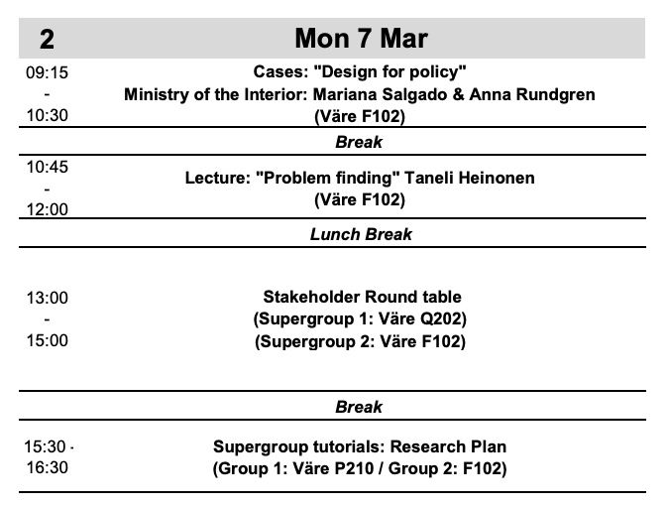
Notes:
To show where we are at today: 1. I will be briefly talking about finding and loving problems in Design for Government
2. Lunch break and start to prepare for the roundtable with our client side
3. Afternoon, after the roundtable you will make your first preliminary research plan – which will be shared with a fellow team and you will get comments from them and comment on another teams plan.
I will try to prepare you for this by giving some viewpoints

Slide 2
How to find problems worth solving?
Notes:
THE MAIN LEARNING I WANT YOU TO TAKE OUT IF THIS IS THAT WE ARE NOT GOING TO JUMP INTO IDEATION MODE AND SOLVE OUR BRIEFS.
THE WAY I WANT YOU TO THINK ABOUT THE BRIEF IS MORE LIKE A JUNGLE OF POTENTIAL PROBLEMS TO BE DISCOVERED AND THEN LATER ON DEFINED AS DESIGN CHALLENGES
TAKE A STEP BACK AND STUDY THE FIELD WITH AN OPEN MIND – we will study the world, we will make interpretations, and we will take a creative leap so there are no right or wrong answers

Slide 3
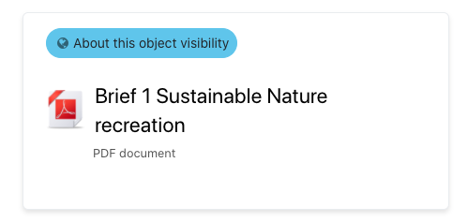
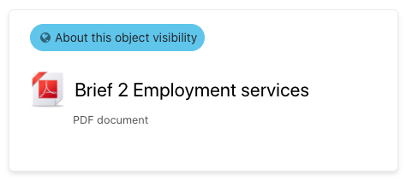
Notes:
In the briefs we have a general outline of the institutional context Ministry x or Kela or Metsähallitus doing this in order to a) improve sustainability in the recreational use of national parks b) to support collaboration in the reform in order to create succesful workplaces c) to provide best possible joint services in collaboration, for a specific target customer group
AS A STARTING POINT, WE HAVE:
INSTITUTIONS + GOALS

Slide 4
Goals + institutions
What other viewpoints can we have?
Notes:
IN ORDER TO FIND FRUITFUL PROBLEMS THAT WE CAN FRAME IN A WAY THAT ALLOWS US TO BUILD SOMETHING VALUABLE

Slide 5
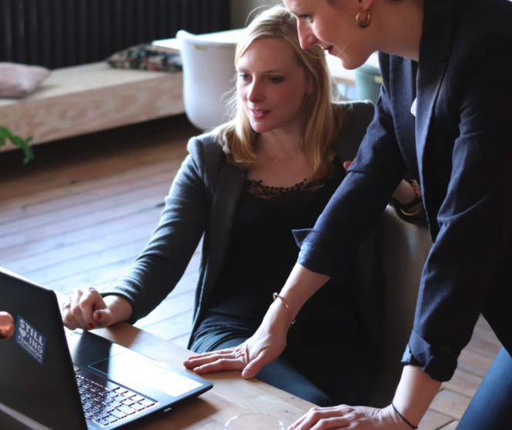
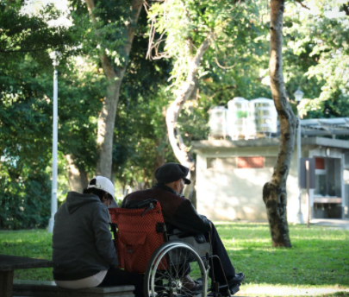
PEOPLE
Notes:
PEOPLE: people seeking for work, people working in employment services, people traveling, people working as researchers, administrators, nature guides etc.
We have people in different institutional roles and people in their daily lives.
WHO ARE THE PEOPLE? What matters to them, what is their life or work like, what do they fear, what do they hope, what is common for them, what is different for them.

Slide 6
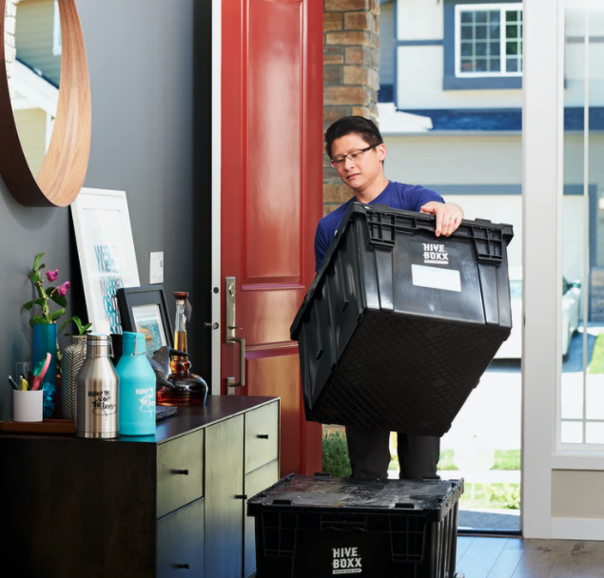
PRACTICE
Notes:
Camping, jobseeking, learning about nature, cooking in nature etc…
Re-occurring activities

Slide 7
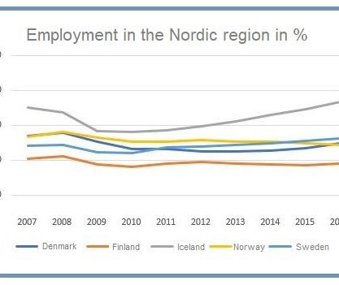
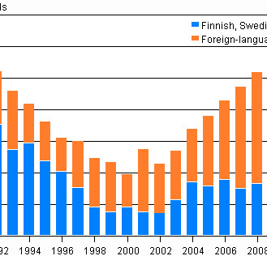
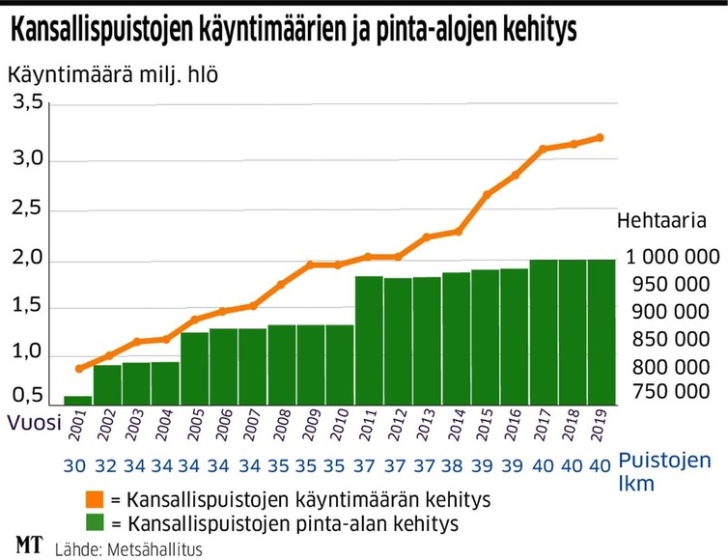
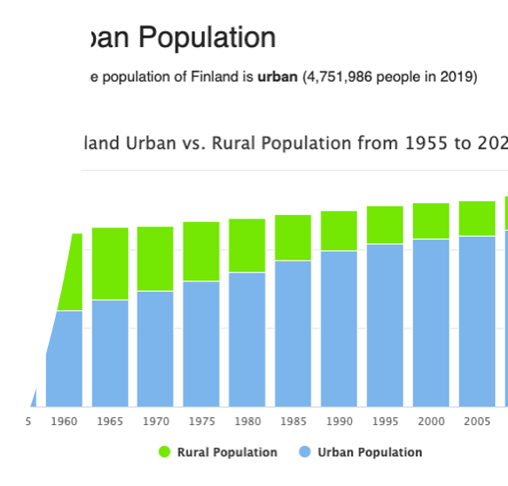
STRUCTURE
Notes:
Examples of large structural trends that are potentially relevant to our briefs: change in the employment rates compared to other Nordic countries. How that affects people working on this system? What other changes it connects to?
Changes in the population growth – population growth has been mainly driven by foreign-language speakers. How does that affect the development of Finnish public services? Including employment services.
Changes in the usage and size of national parks – how does this affect their development and what matters to the growing population of visitors?
Wider macro level population change: Shifts of population densities and the mass movement to urban areas over the past decades. These affect mobility, work, housing, how we live on daily basis, how we experience nature etc.

Slide 8
PEOPLE
Who are the people we need to understand?
What is it like being them?
How is this policy/service/problem/solution part of their life?
PRACTICE
What are the relevant practices people engage in?
How are these practices experienced?
What is the role of policy/service/product in these practices?
STRUCTURE
What are the relevant social and cultural structures in our context?
How are they changing?
How are the changes affecting people and practices?
Notes:
THESE LENSES OVERLAP – THEY ARE ASPECTS TO THE WORLD RATHER THAN SEPARATE PARTS OF THE WORLD.

Slide 9
How to Study These?

Slide 10
Notes:
Innovation is about making bets on human behavior! Sometimes it’s linear and relatvely easy to predict, often NOT

Slide 11
Traditional academic research vs. applied research in DfG
Academic
Applied
Value
Absolute value in the accumulation of knowledge itself
Long processes
Chosen methodological frameworks as discourses to participate in
Using chosen theories to make sense of the research topic and to connect to a theoretical discussion
Functional value in order to achieve something
Limited projects and resources
Choosing and mixing methods according to the task at hand
Using a mix of concepts and theories as ideas that serve as tools to make sense of data
Time
Use of methods
Use of theories
Notes:
Comparison of academic research, or basic research. It is good to understand that we are working here on a very applied field…
- It means that we are working in varied teams with people from different backgrounds – academic work happens alone or in teams which have similar background and interests.
- It means that we are aiming for something.. Innovations, or to learn something useful or fruitful that supports our creative work – academic social science could have just an absolute value as increasing knowledge or re-constrcuting society in a critical way – as we are actually constructing or proposing something proactive here.

Slide 12
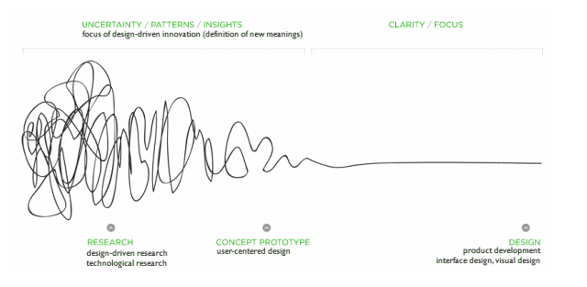
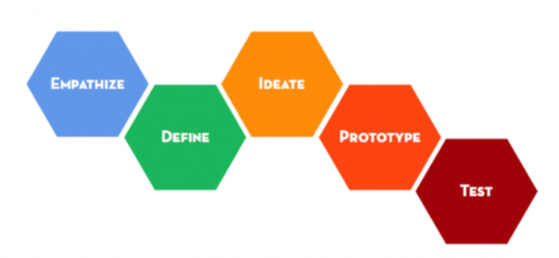
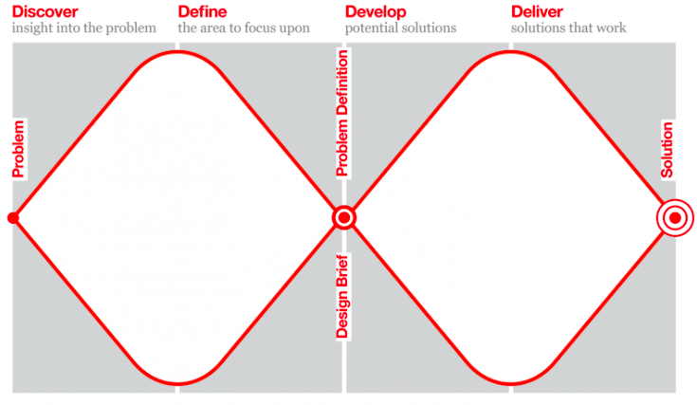
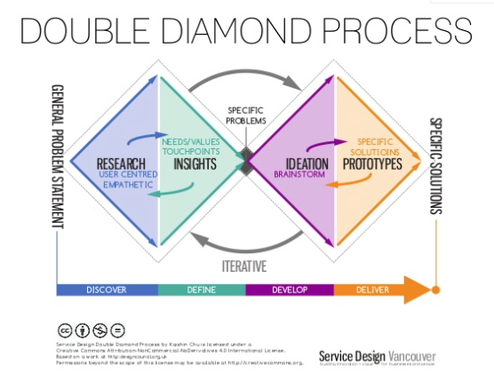
Problem-finding in design processes
Notes:
These kind of models describe design thinking or service design processes – we start with a more general problem and aim to find a more specific one – BY discovering, studying, going back and forth. Emphatizing, looking things from the perspective of consumers, citizens, small business owners, civil servants.
the deep understanding is the distintictive key ingredient that is supposed to separate service design and design thinking from some kind of traditional development projects and processes.
This being said, it’s important to recognize that the field in both design and this kind of applied research is pretty novel, say in comparison to philosophy or natural sciences.

Slide 13
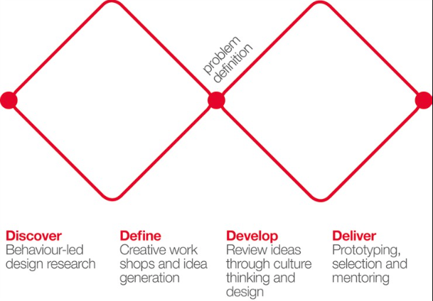
Aim of the research is to help define right (fruitful) problems
Double diamond model of Design Council UK
Notes:
There might not be a single right problem, but different opportunities for solvable problems that will support the larger aim of the client side.

Slide 14
Aim of the research is to help define right (fruitful) problems
Double diamond model of Design Council UK
Notes:
It’s messier, and it’s ok. We are in search of fruitful framings worth working with in the solution phase.

Slide 15
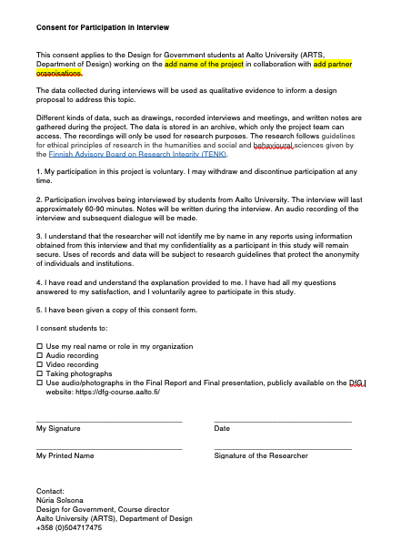
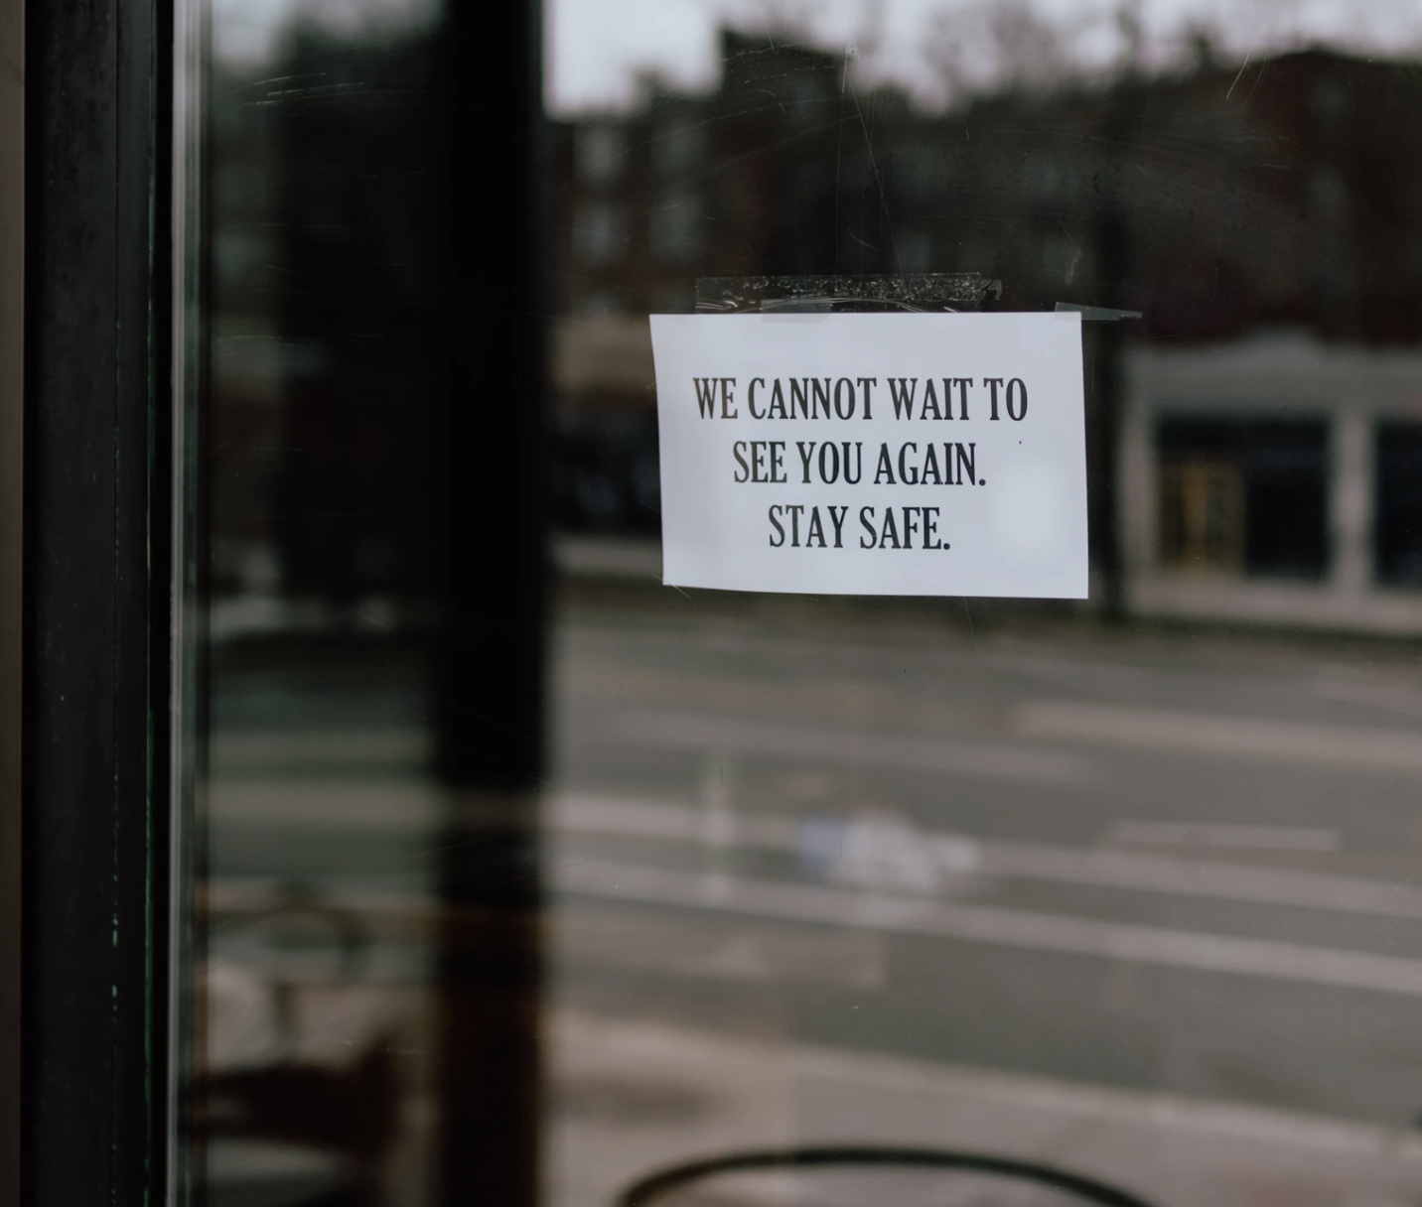
Aim for access and informed consent
Notes:
Written informed consent by using the consent form – who we are and what we are doing with the data – we are keeping respondents anonymous, which is a common practice.
IF face-to-face have two forms, so they sign the other one for you, and keep the other one IF REMOTE:
SHARE THE CONSENT FORM ON AN EMAIL, AND ASK PEOPLE TO JUST STATE THEY AGREE, AND THEN SAVE THOSE AGREEMENTS AS PDF. IF THIS IS NOT POSSIBLE, PRESENT THIS AND ASK FOR A VERBAL AGREEMENT in the beginning of the interview
For some places and some people, the access might be difficult or impossible, so we need to be smart and we need to share resources between teams in the supergroup. Share data, share connections, make sure you are aligned in this sense. Interpretations and interests will differe between teams, but access should be as shared as possible.

Slide 16
What about methods?

Slide 17
Disclaimer on method-naming:
It is about differentiation and legitimation
In practice research methods are tools for an end – choose a tool based on your aim
Notes:
Marketing of your approach, making it academically legit OR interesting in an applied context, interesting for your clients and other stakeholders (Design for Government is in itself a label, a name that we attach things to)
Research methods are tools – especially when we talk about applied research – methods are as good as the analysis they help us build AND the analysis is as good as the design or decision it helps us build

Slide 18
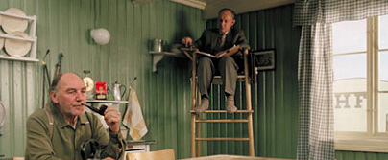
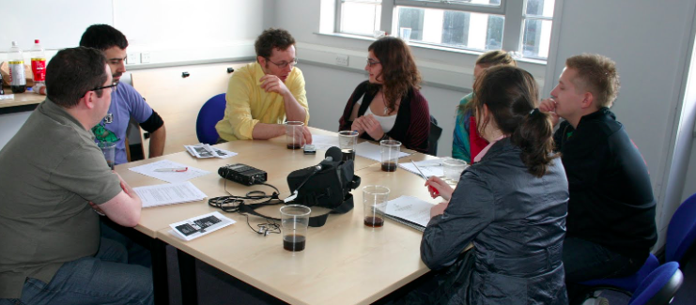
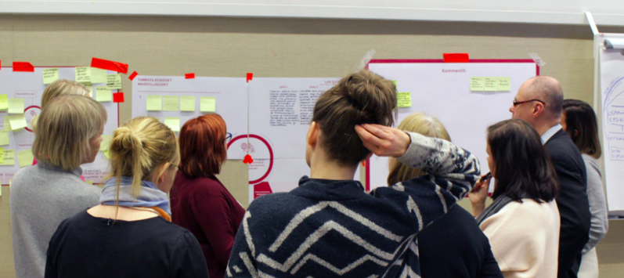
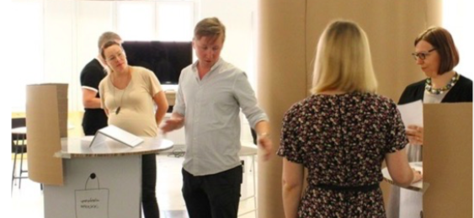
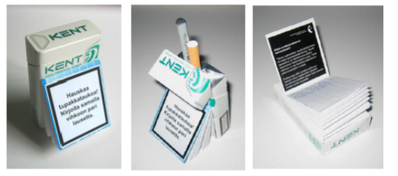
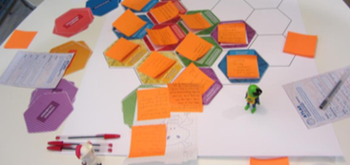
Watch
Observations
Desktop research
See what is being done in practice
Immerse yourself in the context
Listen
Interviews
Group discussions
Dig deeper by asking
Learn the story
Understand their thought process
Work
Co-creation workshops
Prototyping workshops
Get viewpoints
Engage in creating together
Test how something works
Play
Design probes
Design games
Step out of institutional roles
View things from different perspectives
Use imagination
Notes:
Sometimes methods are difficult to separate, BUT in general it’s good to consider and frame what we do in order to learn from our field and research questions: Are we watching something
Listening
Working in order to learn something
Playing in order to learn something

Slide 19
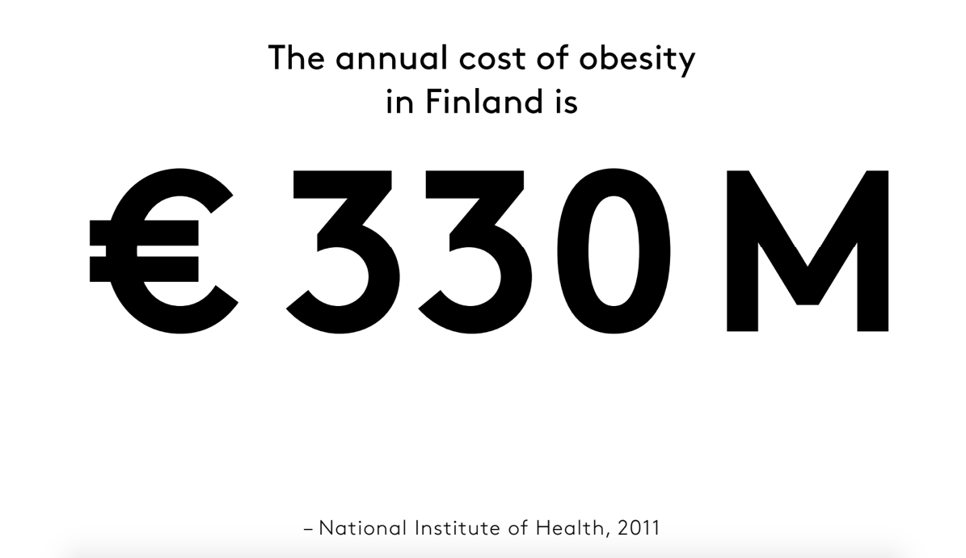
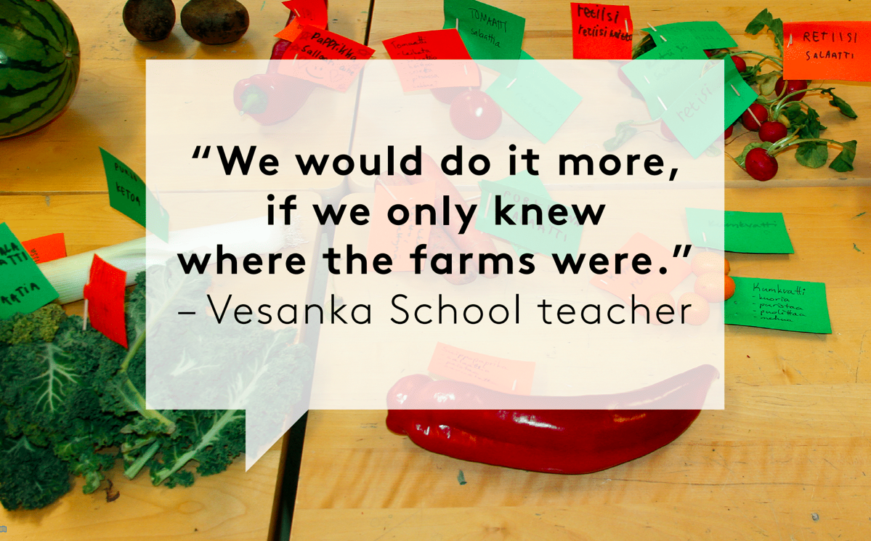
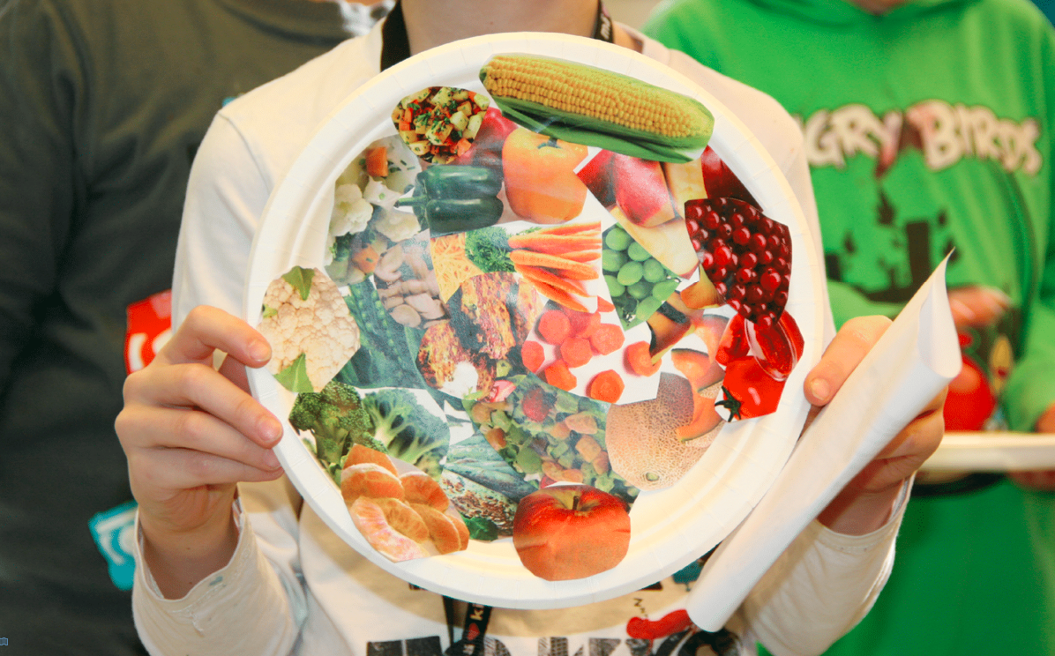
Examples of methods from past DfG courses
Desktop for statistics
Interviews
Co-creation workshops
DfG 2015. School Fruits and Vegetables team. Anna-Kaisa Varjus, Jaakko Kalervo Kalsi, Maija Jantunen, Maria Jaatinen, Paula Karlsson
Notes:
How to use money from EU fund for school fruits and vegetables – interviews with teachers - workshops in schools AND connecting these to big numbers, co-creating a plan for educational program about food.

Slide 20
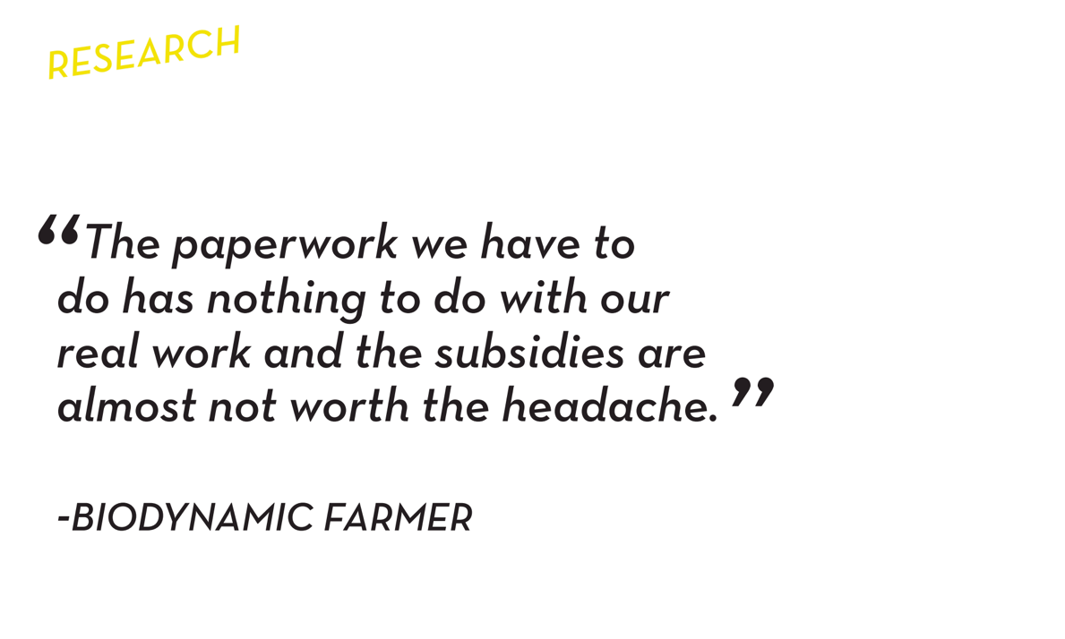
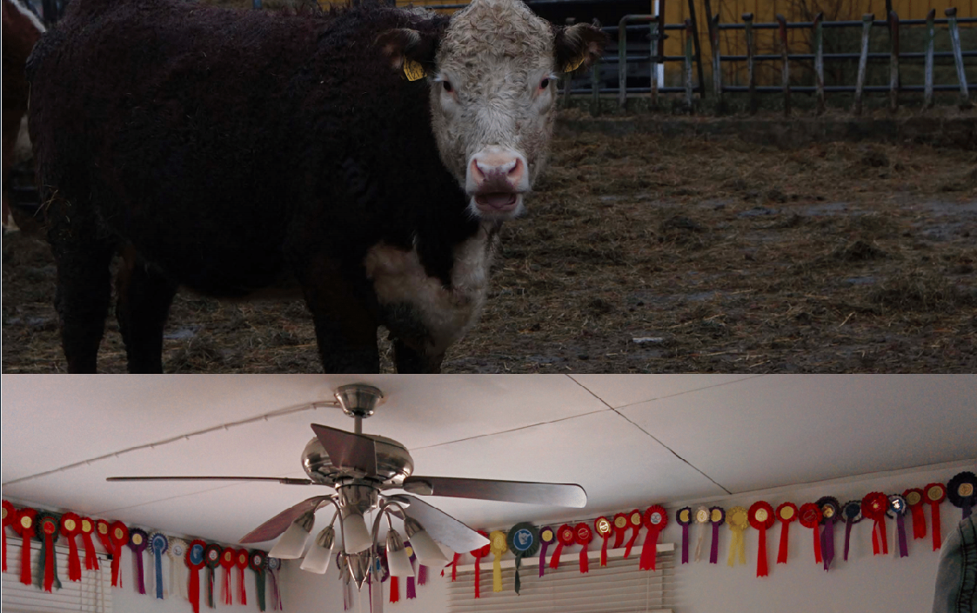
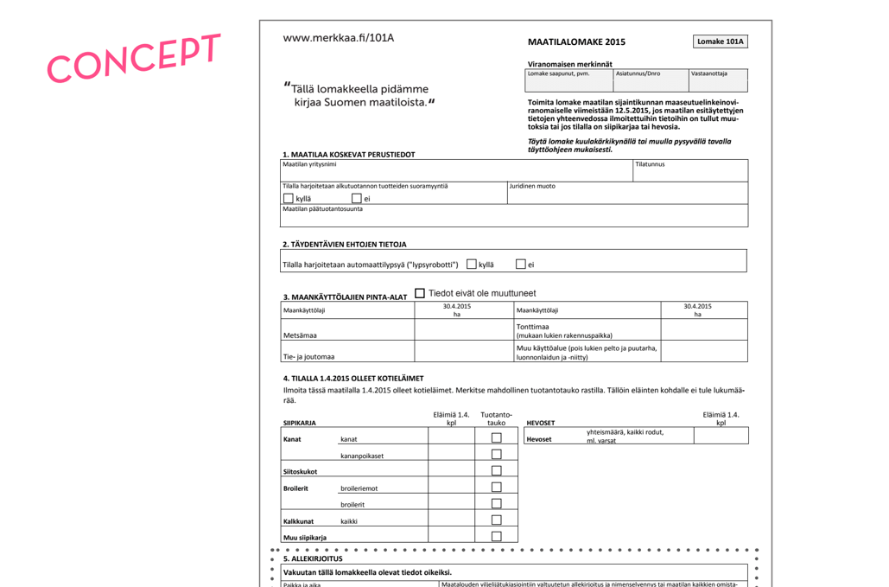
Examples of methods from past DfG courses
Participant observation
Interviews of extreme users
Prototyping
DfG 2015. Primary Producers team. Bice Lee Herold, Eevi Pauliina Saarikoski, Panu Matias Autio, Richard Eric Birger Hylerstedt
Notes:
Primary producers notification systems
Going into the farms to obsrve, see and understand
Inetrviewing the users who ared difficult to serve well
Testing different value propositions to some people who would benefit from the solution

Slide 21
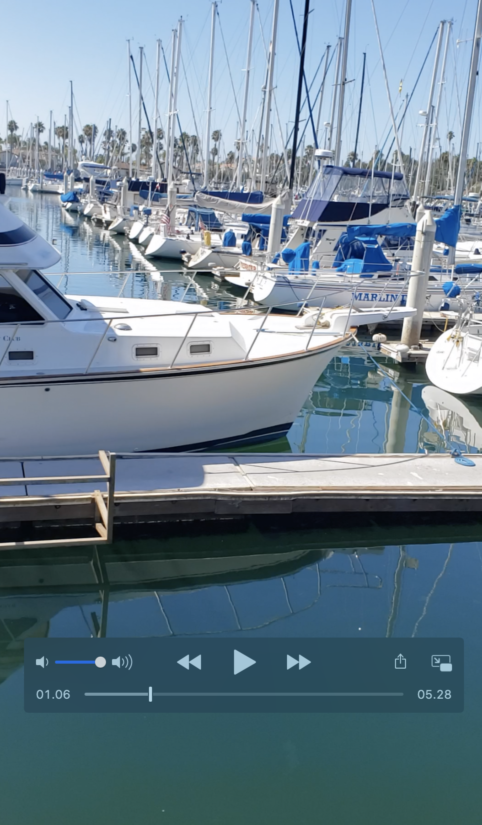
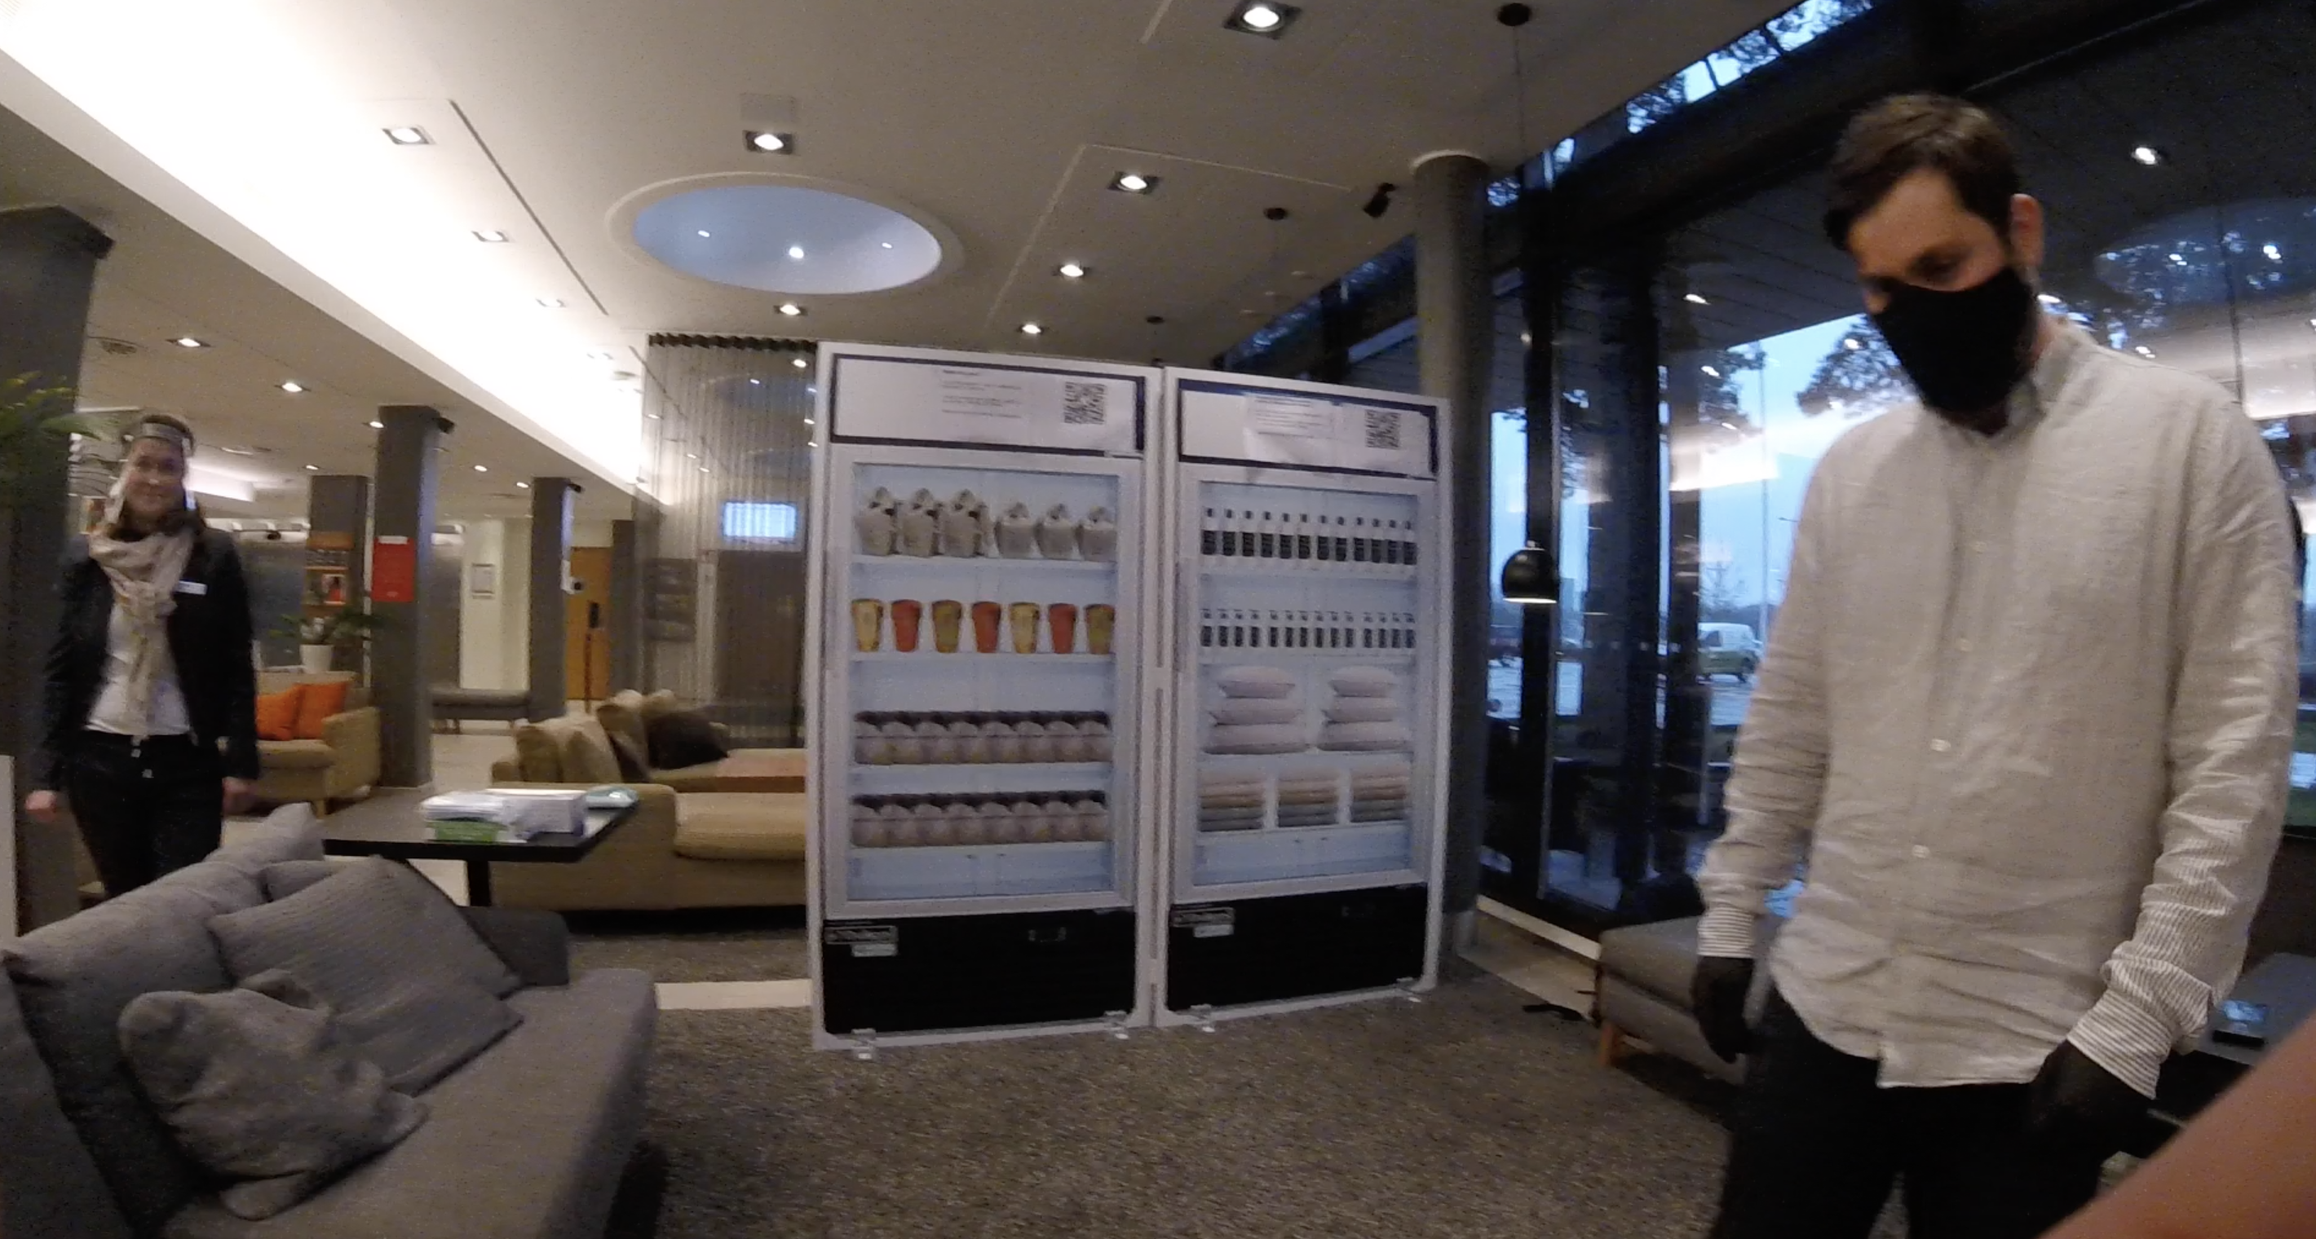
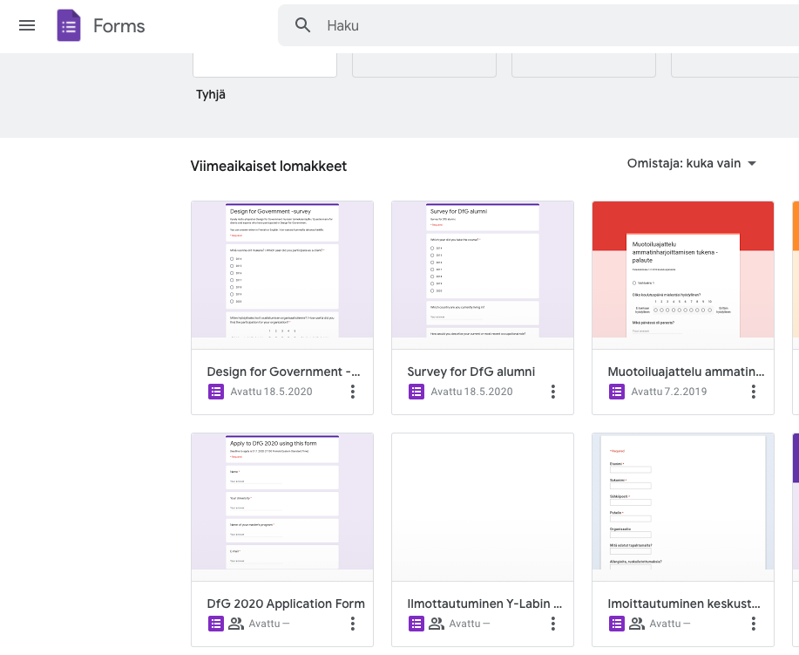
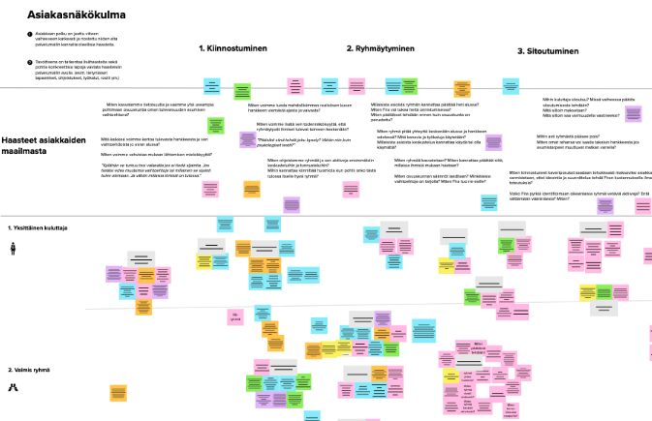
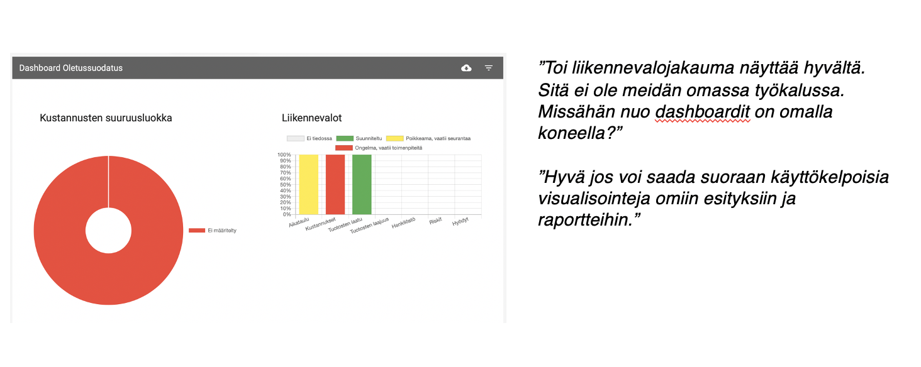
Examples of methods in the pandemic
Notes:
Video exercises on boating – asking them to tell about their experiences, showing their boat, marina etc. -> then we would later have an interview online or by phone – I would also be able to ask about things they have shown to us on their videos. Other one is from GoPro which I have just set on our informant, we have prototype here and more prototypes in another space, she is walking with the gopro and explaing what she sees and thinks about it – again after this, we have a short interview
Mural, which is a similar tool to Miro, we have used for simple workshops with clients – you need to be aware that it takes a while for them to learn how to use these tools. We have also used them for sharing simple visualizations when we have a discussion in Teams or phone on the side. I have also done this by having the interview in Teams and a colleague listening in through Google Meet.
Forms are usually a way to collect quant data, but you can also do qualitative questionnaires
Screen sharing and trying out existing software solutions – a project for the government on digital project management systems

Slide 22
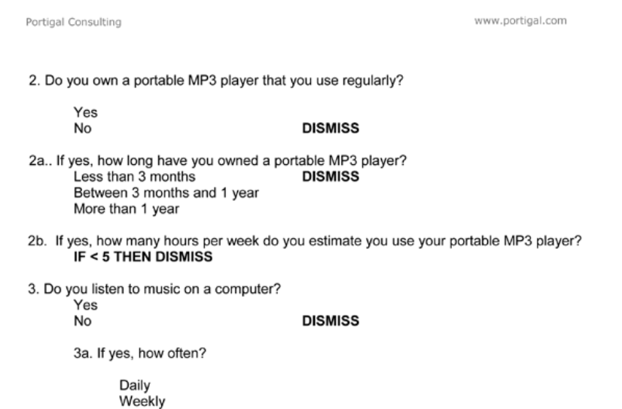
Interviews
How to set up an interview?
Recruitment – find the right people
Brief – explain what and how of the interview
What will we discuss, in some cases also what not
How long will it take
What will it be like
What if you need to take a break
What kind of information are we after
Why we want to talk to you
What kind of a project is this part of
How their words and their name will be referred to, what is the level of anonymity
Make sure you have consent on your research and documentation
Steve Portigal, 2013
Notes:
RECRUITMENT + EXPLAIN AND DEFINE BOUNDARIES
Kuva rekry screeneristä – kerro, että vie aikaa usein, vaatii pohdintaa etc.
Brief – kerro, mitä odotat, mistä keskustellaan, mistä ei, millainen tilanne on luvassa, put people at ease
Think of the criteria of people you want to interview – they could all have similar background or then you might want to compare for example users and non-users of a specific service.
Translate the criteria into a screener – a document used for recruiting. Try to be specific by thinking what active means for example.
Use recruitment stage to analyze believes of the customers and treat the process as valuable data. If you can’t find certain kind of people that’s a finding (in itself).
Plan according to the scope of the project and consider the access to respondents
Example from gardens in stockholm – segments did not match the reality – finding number one.
If you make really strict and detailed screener – be prepared to spend more resources on finding the people (incentives, professional recruiters etc.) Friends of friends vs. agency

Slide 23
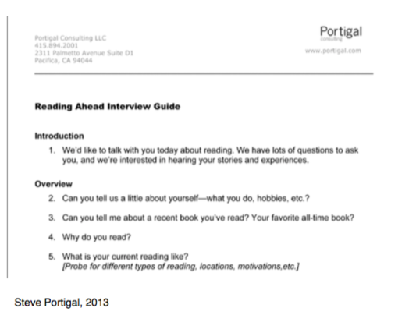
Interviews
Using an interview guide vs. defined script
Following a strictly defined set of questions vs. themes you wish to cover.
Translate your research questions into something that can be asked in a discussion. Typically, you start from more open-ended question and consider possible follow-ups.
Plan well and use the guide as a tool that supports you but doesn’t restrict you. You don’t have to go word-by-word.
Think about your timing – how much for different themes and sections.
If you are doing exercises, such as card sorting or map drawing, have everything you need prepared beforehand.
Notes:
When you ask ”how” –questions you usually get decriptions, stories that will increase your understanding and often highlight something interesting.

Slide 24
Interviews
5 x Why?
Often used for root-cause analysis in organizational settings, but you can also apply it in an interview setting.
Helps you discover how actions, believes and thoughts ladder. Consider also 5 x “in order to”
Notes:
In design thinking we always encourage the WHY question – it enforces a bit of reflection and argumentation
I also strongly encourage you to ask HOW questions – they force people to explain and elaborate

Slide 25
Interviews
Other tips on getting the most out of an interview:
Think about where you will have the interview and how you will document it. Real contexts usually provide rich discussions. When remote, make use of cameras.
Leave your worldview behind the door. Embrace and learn from theirs.
Listen to, by asking questions and body language – don’t be afraid of silence.
Focus on the respondent, don’t start sharing too much of your own experiences.
Feel free to ask stupid and simple questions – you are there to learn about their experience and views.
Try to ask open questions that provide stories instead of closed “yes” or “no” answers.
Don’t lead the respondent e.g. “Why do you think it is important for high school students to learn about bio-diversity?”
Think about the order in which you’re asking your questions, make it easy in the beginning and allow them to relax.
Plan your interview, but be prepared to discover emerging themes and new ways to frame the problem you are working on.
Notes:
Exact questions to get concrete stories
Take a position of a learner (sometimes if your doing an expert interview it makes sense to explain what and how you understand something you will discuss, WITH citizens on the other hand it can be good to hide your level of knowledge
Especially in this country: don’t be afraid of silence, give people some room to think
Having a plan gives you also freedom to deviate from the plan if necessary
Especially if you record audio (which is often a good idea) consider the place (also consider who are hearing and what will you promise of confidentiality and anonymity)

Slide 26
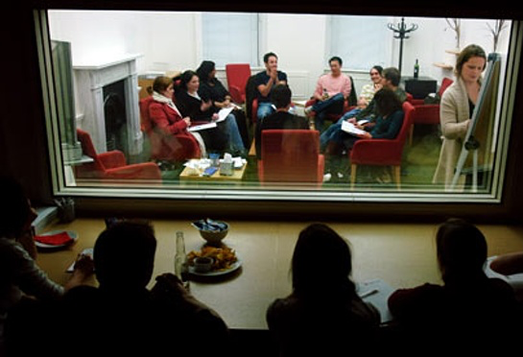
Interviews
Different types of interviews: focus groups or group discussions – study the discussion on a specific topic
Often used for concept and product testing in different phases of the development process.
Well-planned discussion moderated by a researcher whose goal is to tease out useful answers and engage all participants into the discussion.
Typically 6-8 people in a group for 1-2 hours.
Allows you to study how ideas, topics or concepts are received in a group. What kind of conflicts and consensus they evoke.
Example from: guardian.com Taking time out to listen: the benefits of focus groups.
Notes:
When you have a group of people, study how they have different ways of making sense of the same thing. What is the discourse in regards to conflicts and consensus?
DISCOURSE & DIFFERENT PERSPECTIVES

Slide 27
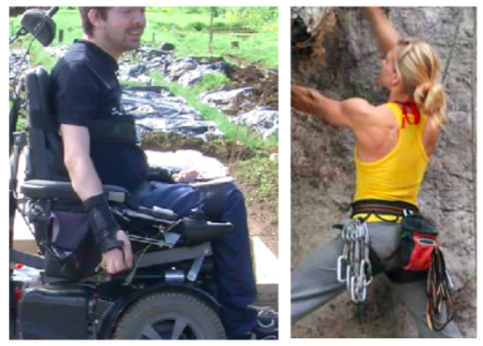
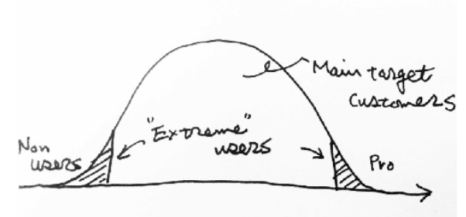
Interviews
Different types of interviews: extreme users
Consider different extreme types of users that really stretch some qualities of a service or product
“If it works for the extreme user it works for everyone”
Very skilled and experienced vs. inexperienced users
Notes:
Do you have either first movers or really inexperienced users to consider from these perspectives? Savvy hikers in natural parks, or first timers in the Finnish nature, or first time job-seekers, or ones approaching their retirement age

Slide 28
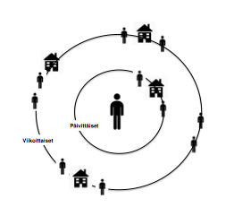
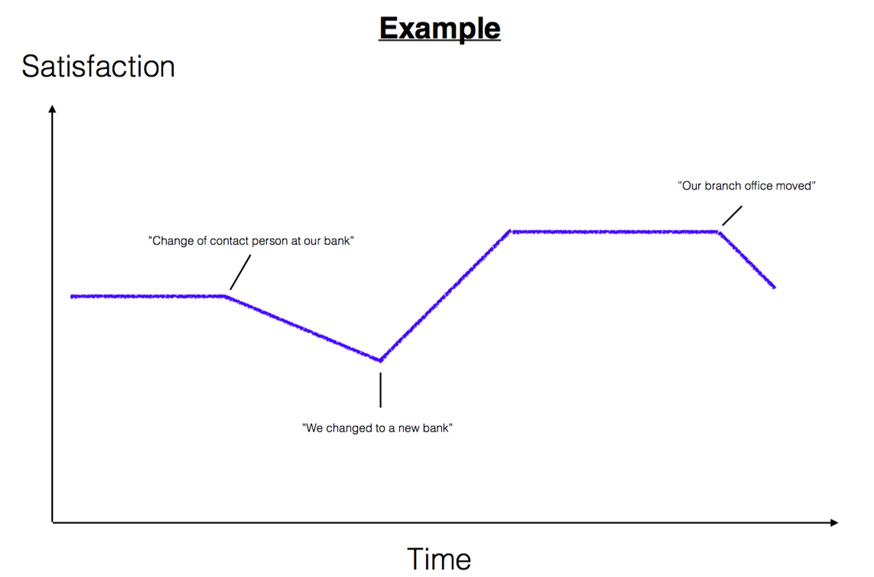
Interviews
Different types of interviews: drawing exercises
Visualizing while discussing helps stick to concrete experiences, and tell stories around them.
Drawing as an activity allows the respondent to take a step back from their own life and reflect.
Drawing timelines and sociograms provides comparable visual data.
Notes:
Timelines
Sociograms
How about the perception of how a reform will unfold from somebody’s perspective – or how their experience of nature has been chaging over the course of their lifetime?
Drawing or drawn for them..

Slide 29
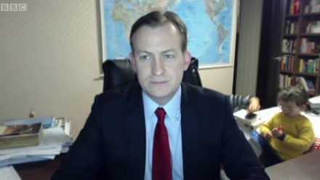
Interviews
Different types of interviews: synchronous vs. a synchronous
Asynchronous discussions can be a way to give people time to reflect their answers.
You can develop the discussion and take time to clarify your thoughts in the written form.
Might be easier for some people with hectic schedules.
It may be challenging to keep people engaged in asynchronous discussion for longer time periods.
Notes:
Are you doing and recording live in one hour, or is it better to write down questions or use voice messages and conduct the interview over a long period of time, allowing people to take hours or days to respond to each question.
Example: Oil heating project with their facebook interview

Slide 30
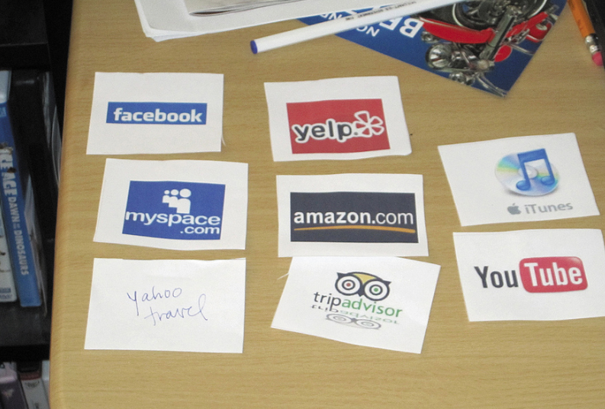
Interviews
Different types of interviews: card sorting exercises
Visual aids that evoke discussion through the exercise of arranging cards or coming up with thoughts and stories based on them.
You can use visual cues of ideas, sort brands an images related to them, use pictures of places, times of the day etc.
Helps you see how people organize and relate things to each other and what kind of preferences they have.
Portigal 2013.

Slide 31
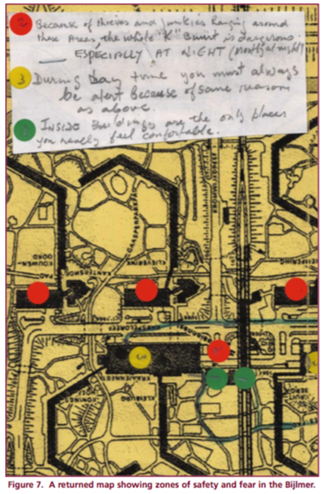
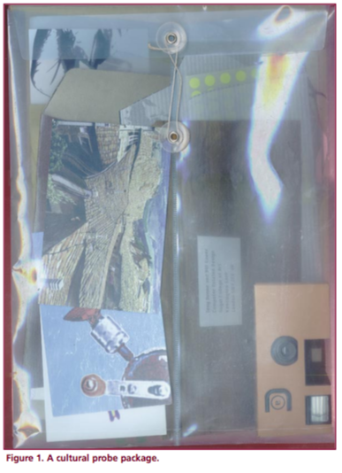
Cultural Probes
Probes and diary studies help you gather qualitative self-reported data over time
Packages with tasks and artifacts given to research participants. They record and deliver the tasks to researchers.
Typically, disposable cameras, diaries, stories, maps etc.
Allows the gathering of data over time.
Requires good briefing.
Recruitment is crucial to get right kind of people who are able to self-report with your support.
Analyzing the probes and conducting a follow-up interview with the respondents.
Originally introduced by Gaver, Dunne & Precenti on a design research project of elderly people in 3 different EU countries.
Notes:
Last summer I did a study for families travelling in trains.

Slide 32
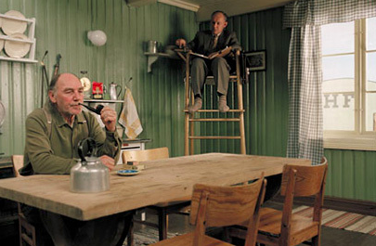
Observation
Observation without interfering vs. participant observation
Fly on the wall
Participant observation
Observe and record
Beware of the illusion of objectivity
Active learner who engages with the field
Reflection on biases, but no value judgments
Notes:
Participant observation – taking part in the world you study as an active open learner – using the fact that you are human being capable of interacting with the other human beings BUT at the same time aiming not to make ethnocentric value judgements (of course you can never be completely unbiased, but need to reflect your biases)
Jussi Perälä’s ethnography on drug dealers in Helsinki

Slide 33
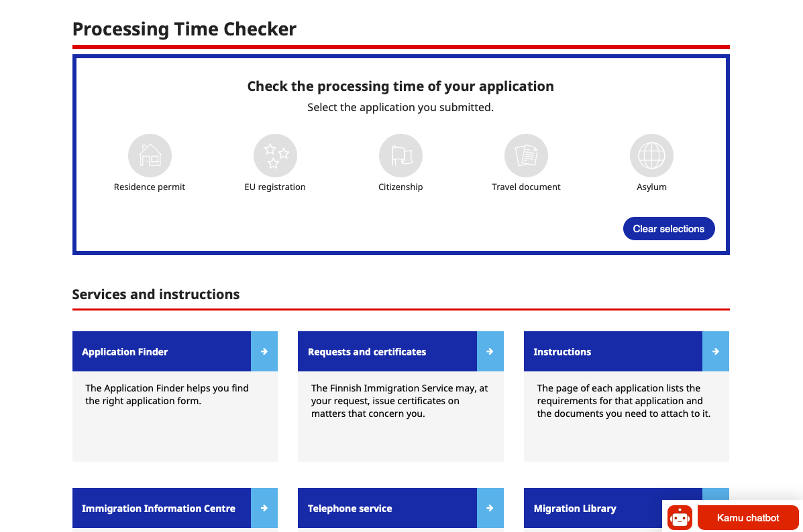
Mystery Shopping
Try out a service from the perspective of a specific role
You can do this yourself or ask someone to try out and record their experience.
Can be used to search for moment-of-truths, potential problems in how the service is perceived etc.
Consider connecting this to other methods as part interviews or group discussions for example.
Notes:
VRT. PLANNING A TRIP ON A RECORDED ONLINE VIDEO
+ DISCUSS DOUBLE CULTURAL ANALYSIS

Slide 34
How to plan?

Slide 35
Research Plan
Add group number and team members names
DfG 2022

Slide 36
Research goals
Goals of your project
What are your commissioner’s goals? Why does your commissioner need these goals met?
List the stakeholder groups and topics you want to learn from them. Who do you need to learn from? Who will be important for framing the problem space?
Research questions: Frame the learning goals, focus and scope of your research into 1-2 research questions.
…
…
Notes:
Think about the goals + core research questions you wish to study + who you would like to have access to

Slide 37
Research methods
Desktop research:
Information, documents and reports you will study
Organizations and websites to study
Roles within team (also consider supergroup team members)
Timeframe when shall this activity start and end.
Fieldwork research:
Research methods you want to use and other technique or tools you may need to support this
Logistics and other planning considerations
Roles within team (also consider supergroup team members)
Timeframe when shall this activity start and end.
Notes:
What desktop materials + what research methods + who does what divide and conquer, share data

Slide 38
Research documentation
Documentation:
How will you capture and document your research? (consider audio, video, formats for notes, photos etc.)
How will you share the data within your team and supergroup?
Analysis:
How and when will you analyze the data? (you will be given tools and time to do this in the class, but reserve face-to-face time besides class, also be prepared to revise your analysis after comments from mid-review)
Notes:
Document and share

Slide 39
Recruitment plan
Research question For each stakeholder group or organisation address your research questions as stated on the previous slide | Who do you want to learn from? Add the stakeholder group, organisation or specific role (one per raw) | Research method(s) Be specific on the research methods and add other research considerations (e.g. on-site visists at the x National park, individual or group interview…) | Recruitment Do you have the contact? How do you plan to recruit them? | When does it need to take place?

Slide 40
Supporting exercises to consider

Slide 41
Consider a purpose statement for your research
The purpose of this study is to [explore/describe/discover/understand/develop] the [phenomenon] in/at [research site/field].
For example:
The purpose of this study is to explore opportunities for secondary schools to address climate anxiety in their curriculum and counseling.
Provides guidance for research and setting of research questions
Helps in taking the research to a more concrete empirical level
Notes:
Not the same as the original problem leading to the study
+ for the statement consider: This is relevant because… (for our project)
This is considered relevant in providing a sense of agency for young citizens.

Slide 42
Pre-Research Method
Write your assumptions and hypotheses down and put them in a bucket
“How do we know that we are not biased in our analysis?”
->
“What kind of thoughts, roles and relations affect our biases?”
Notes:
Process as a way of curious doubt: Believe in conclusive facts vs. doubt in “near truths”
Assumption and hypotheses buckets. We can never get completely rid of assumptions and stereotypes, BUT we can try to acknowledge them and make them visible to ourselves.
WHAT DO WE CONSIDER AS KNOWN KNOWNS and WHY?
Take time to do this individually and collect your assumptions and physically put them on a table and then on the basket or folder them away for now.

Slide 43
Pre-Research Method
Discuss what is known and what is not
Known unknowns
(identified factors to study or measure)
Unknown unknowns
(things we don’t know will be recognized as important)
Known knowns
(the world as understood and measured)
Unknown knowns
(things we recognize, but don’t know how or why behind them)
Notes:
We know that x is an important question/thing/measure BUT we don’t know what the answer is (K+U)
Data we know and understand – question and answer (K+K) – existing research findings you can use.
We know the answer, but don’t really know the question or the dyamic behind a fact (U+K) (Example of the number of oil-heated homes and need to transition to other means, but no real knowledge we transitiona has not happened in these households?)
Exploration, we don’t know what we don’t know (some of these will turn out to be important) – Look for these

Slide 44
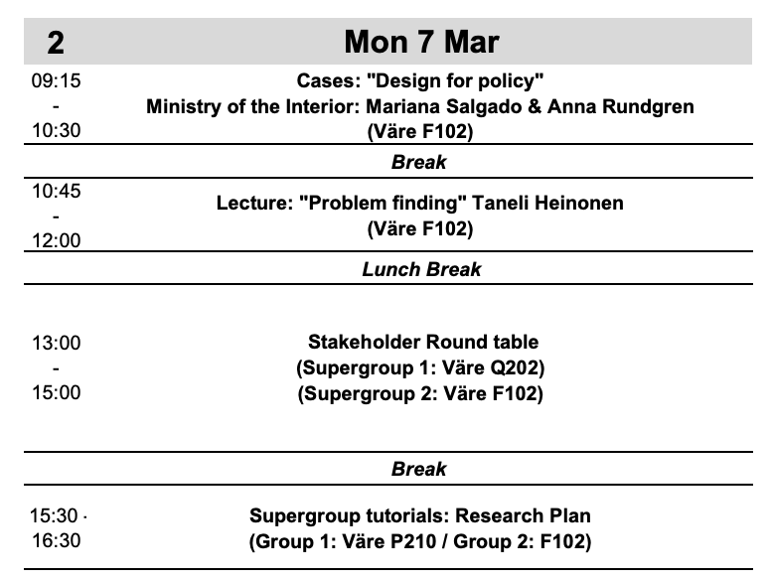
Have lunch
After the roundtable: supergroup tutorial – from roundtable to research
Start working on the first version of your research plan
Feedback for preliminary research plans (11.3.)
Blog 1 (18.3.)

