Slide 1
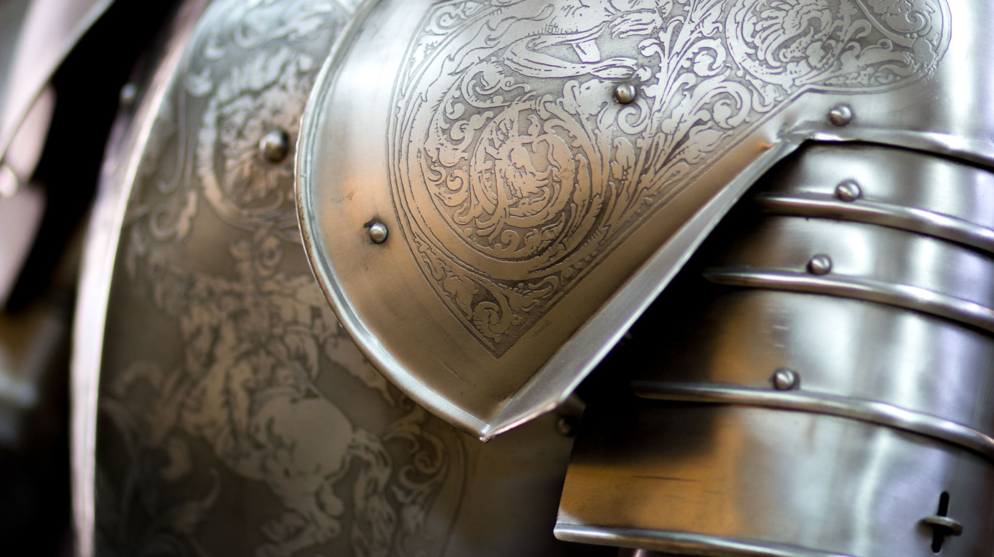
Holy Roman Empire and REGENCY early 18th century
Lecture 6 / Period Costume & Style
9.3.2022

Slide 2
Charles V - Holy Roman Empire
to throne in 1519 in Habsburg at age 19
Charles V, 1533 Titian, Museo del Prado, Madrid, Spain
1506 inherits Spain from Grandparents Ferdinand & Isabella
Inherits New World, Austria & Northern Italy from grandfather Maximilian of Austria

Slide 3
Isabella of Portugal, wife of Charles V
Titian, c.1535

Slide 4
Spanish Throne
Elisabeth of Valois marries Philip II of Spain
She is given as a token of peace to end 60 years of war between Spain & France
Black velvet Spanish coat with pendent sleeves caught by broaches over the sleeves of the gown. High neck supports the ruff.
Gown sleeves are decorated with horizontal bands of ribbon.
Expensive gold clasps decorated with red coral from the Indies decorate the front.
Notes:
1579 she is given as a token of peace to end 60 years of war between Spain & France.

Slide 5
Spain
Philip II of Spain (1527-1598)
With the emblem of the golden fleece around his neck and a sugarloaf hat.
The white ruff and cuffs
More modest beard starts as ruffs grow higher
Painting by Alonso Sanchez Coello.

Slide 6
Daughters of Philip II
Daughters of Philip II aged about 6 and 8 years of age, around 1567
Both wear children’s version of the Spanish Coat with pendant sleeves.
Notes:
Philip was disappointed to have girls as he needed a son to secure the throne.

Slide 7
Sons of Philip II
The Oldest son became Philip III
It was a huge disappointment to all as he didn’t have no leadership skills
Here he is at age four with his brother c. 1582
Notes:
Isabella of Valois failed to provide Philip a heir
- She died in 1568
- Philip married his niece Anna,
daughter of the Emperor Maximillian
She gave him two sons

Slide 8
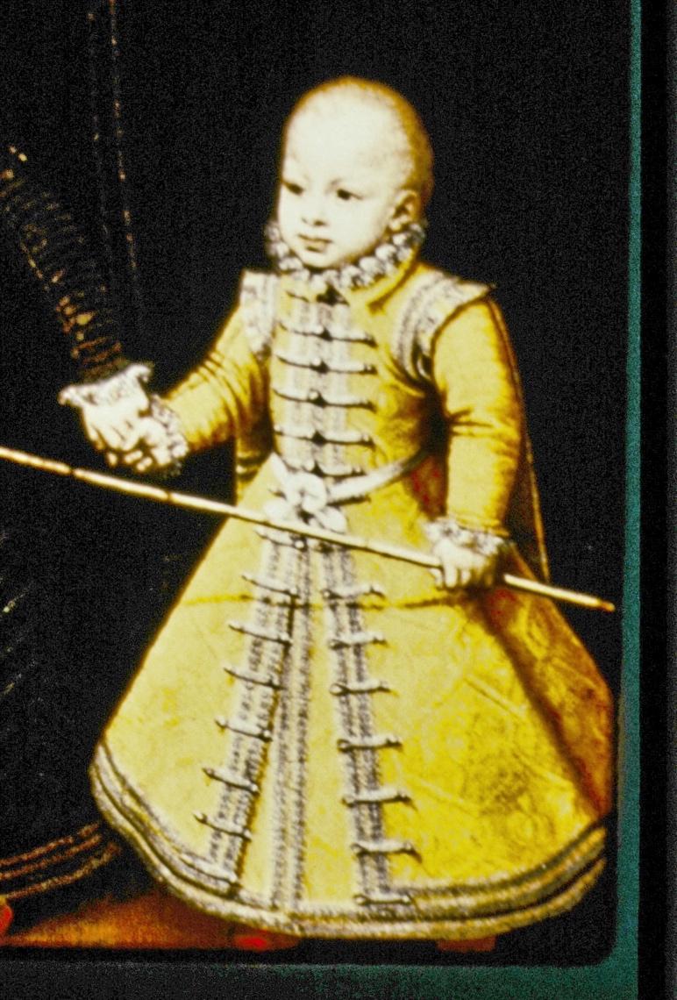
This painting by a court painter Alonso Sanchez Coello
Boys are dressed in the Spanish coats, typical of women’s dress in the time period.
Young boys are always dressed in women’s clothing until the age of 6.

Slide 9
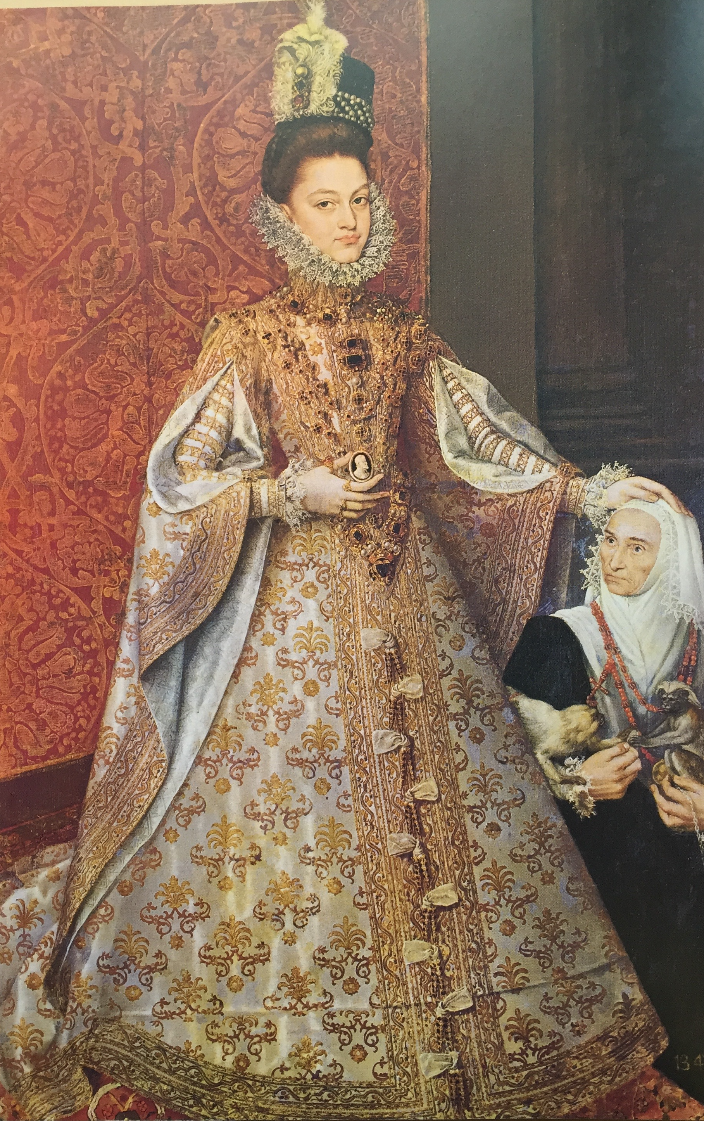
1556 empire divided
Philip II -Spain, Lowlands& New World
brother Ferdinand -Austria& Holy Roman
Infanta Isabella Clara Eugenia
1584, Madrid

Slide 10
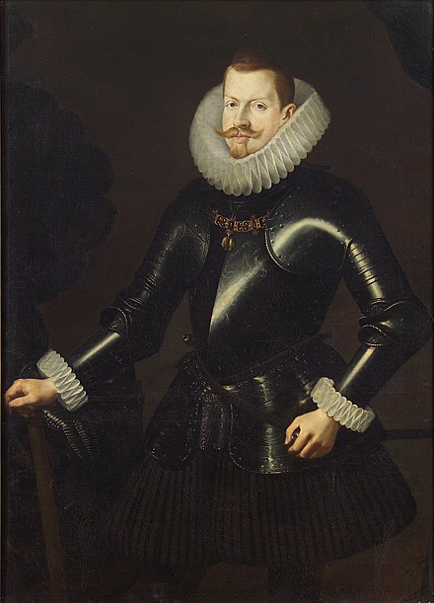
Philip III of Spain
Ruled 1598 – 1621
Unfavoured the Moorish craftsmen
→ textiles with patterns became rare
Gold and silver from the new world
Economy decreased

Slide 11
Charles II of Spain at age 15
He only lived to the age of 36 and was the last Hapsburg King.
Too much intermarriage among the Hapsburgs. He is the son of Philip IV and Philip’s niece.
He wears a fashionable cravat like Louis XIV and red bow made of ribbons

Slide 12
Inés de Zúniga, countess of Monterey 1660- 1670
Following the spanish court style

Slide 13
France – early 18th century

Slide 14
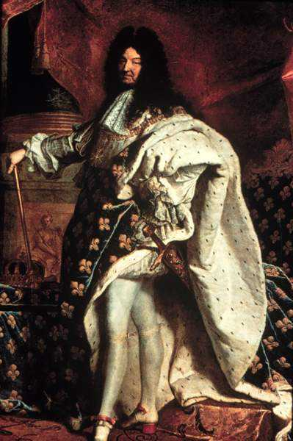
Louis XIV 1695
Full bottomed wig
Rabat at neck
Breeches still worn for Court formal occasions like coronations, etc.
High heeled shoes with red heels peculiar to the court of Louis XIV. Red bows and buckle.
Coronation Robes (even though he’s been King for many years) and it is blue velvet with the gold Plantagenet “fleurs de lys” and lined in ermine.

Slide 15
After the death of Louis XIV, the new king is his granson Louis XV
His mistress Madame Pompadour

Slide 16
Jean-Antoine Watteau The “Watteau Back” on “Le Sacque”

Slide 17
1720 Gersaint’s Shop in Paris Jean Antoine Watteau - Note the pigtail wraps on man’s wig - Dark coat over a gown, the laces up the front.

Slide 19
1720 Day Dress Boston Museum of Fine Arts

Slide 20
Sack back dresses from 1750 and 1760
It started as informal loose garment in 1720’s and developed into a court dress

Slide 21
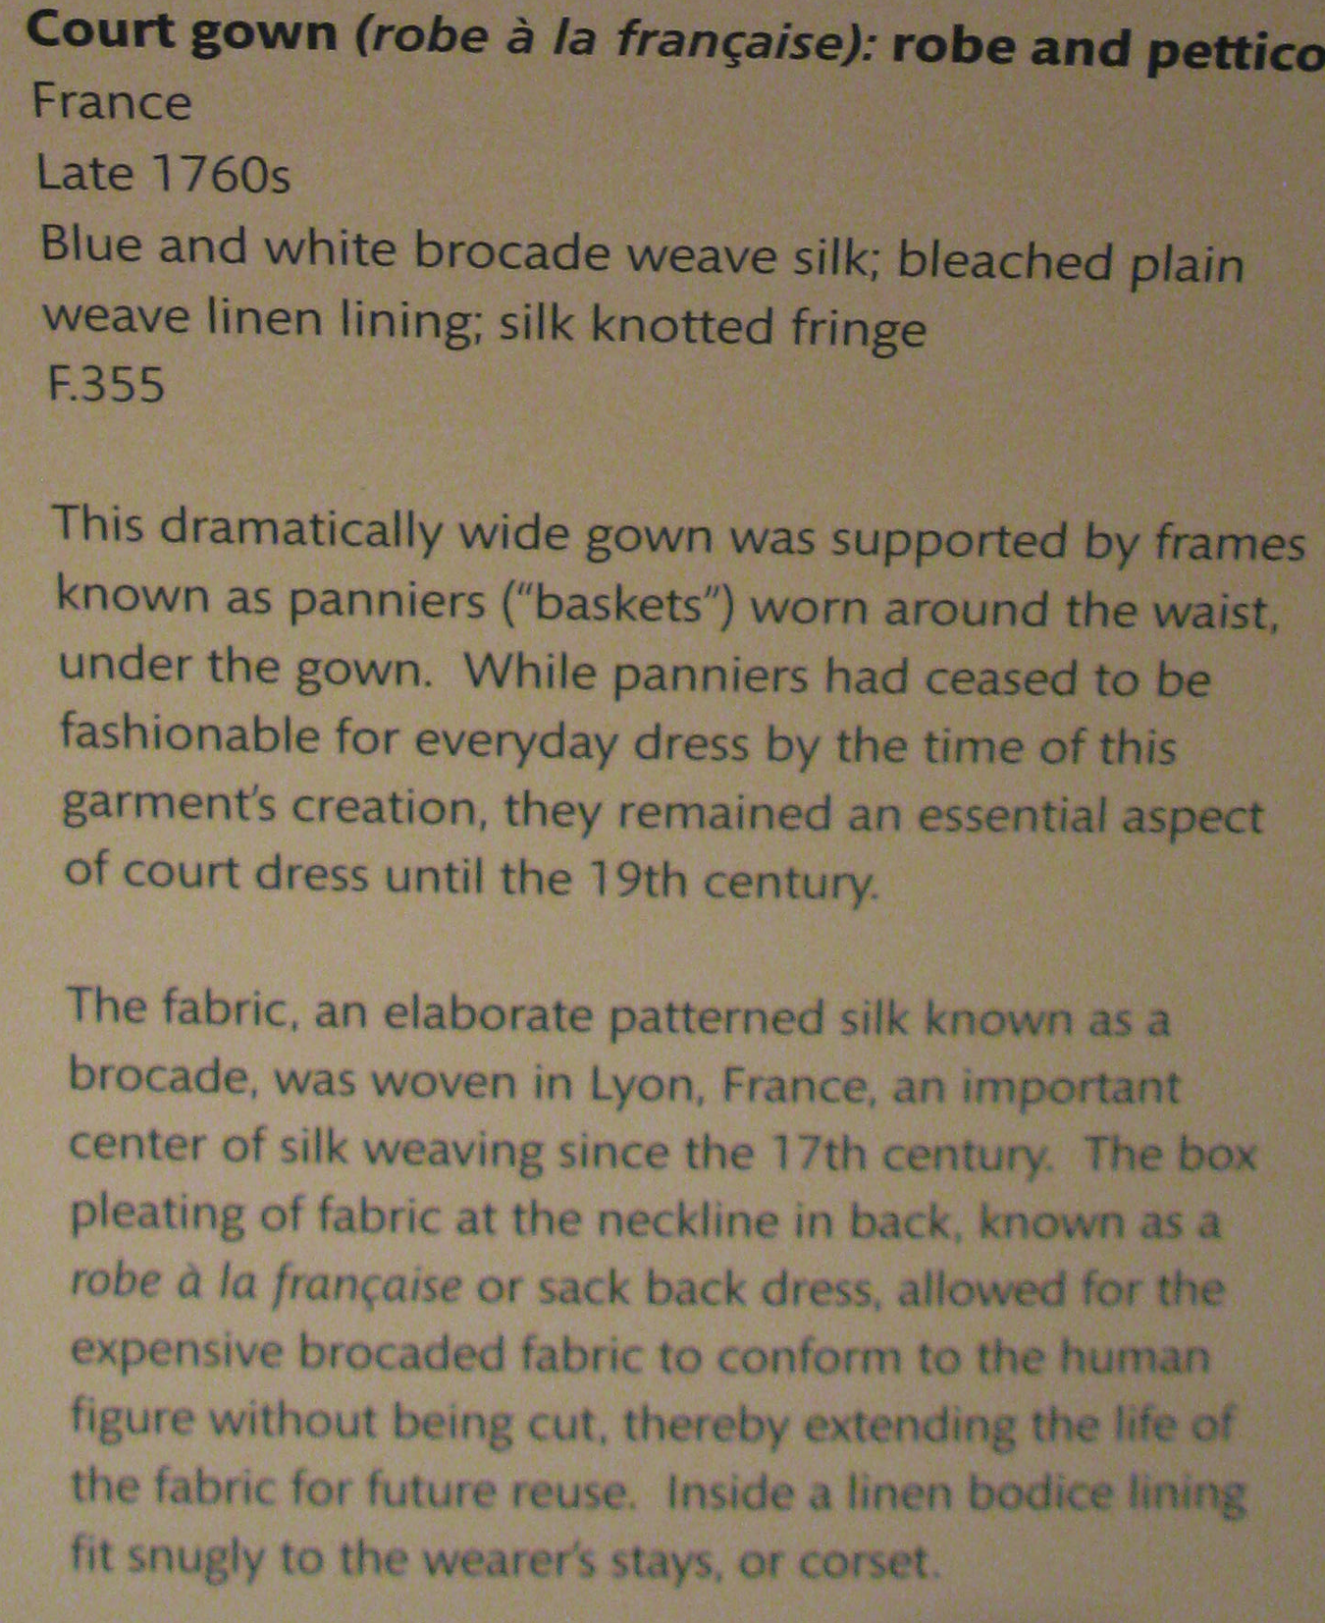

Slide 22
1745 Court Dress Court dress of Italian brocaded silk with wide panniers. The Museum of Costume Assembly Rooms, Bath

Slide 23
Sofia Magdalena, ceremonial robe 1776 Sweden

Slide 24
1745 Madame Pompadour by Francois Boucher Gown with matching petticoat Ruffles become popular in the Rococo period Pastel colors are in fashion Louis XV’s mistress, everyone followed her styles

Slide 25
1742 Mary Edwards by William Hogarth English, gown with matching petticoat. Bodice fastens in front with bows. Necklines lower, sleeves up to elbow.

Slide 26
Men’s coat, justaucorps, 1720
Waistcoat 1730 Germany

Slide 27
1730- 40 Justaucorps , wool, embroidered with silver thread Notice tight fitting breeches

Slide 28
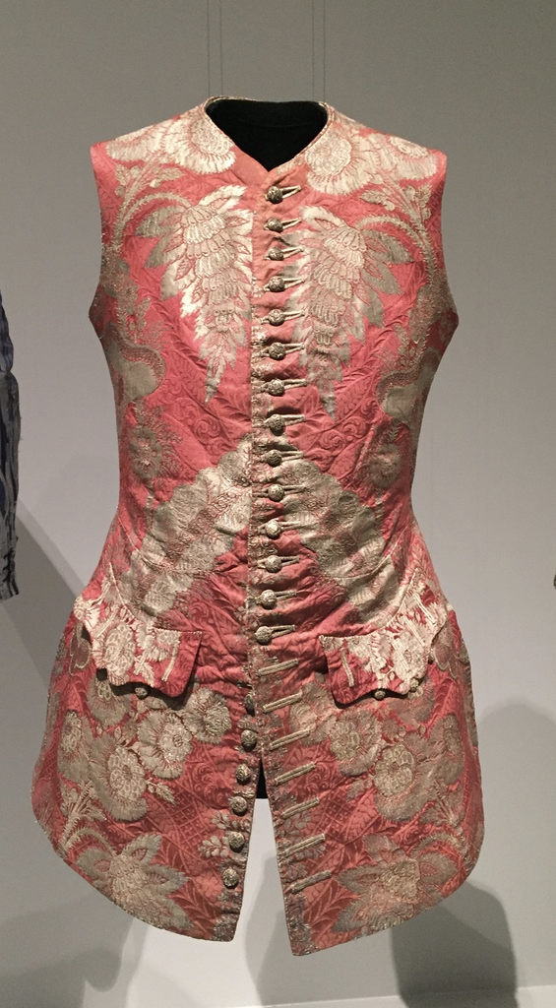
Waistcoats, 1730 & 1740
Gold and silver embroidered textiles were sold according to the weight of gold and silver each piece contained

Slide 29
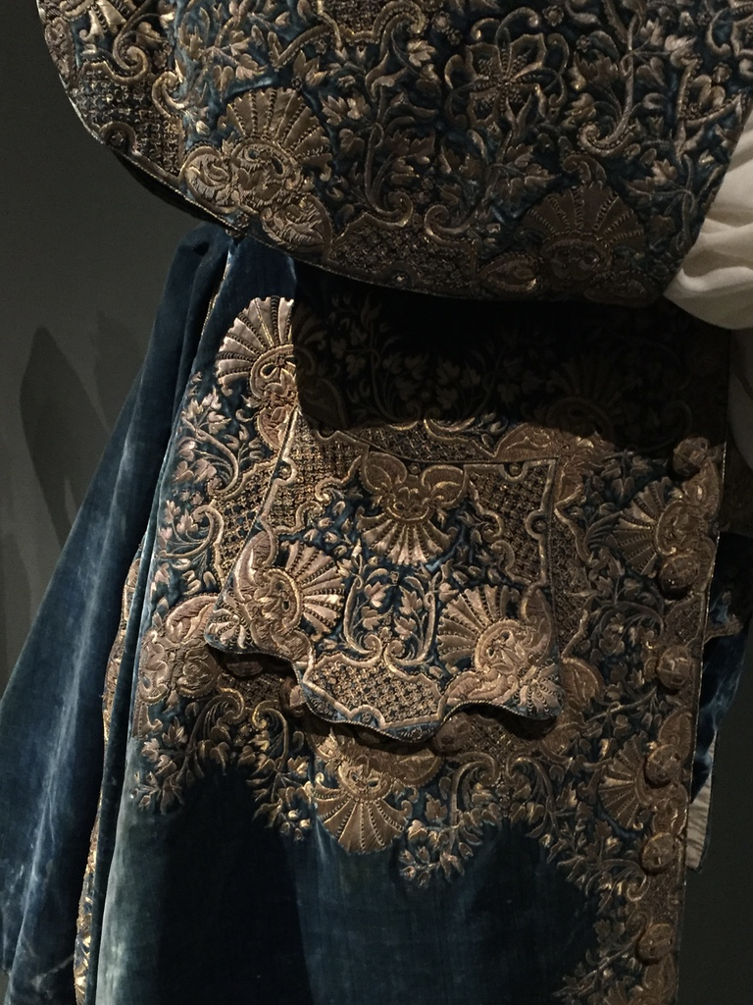
Court Suit, 1720-30 Changes appeared in men’s daily dress, but formal court dress remained heavy in weight and volume, elaborate surfaces

Slide 30
Fabric manufacture
The Flying Shuttle, a device that automatically carried yarn across the fabric was invented in 1733
This dramatically changed the development of weaving techniques and the speed of making fabric

Slide 31
Fabric manufacture
East India Company was established in early 17th century
Brought fabrics, especially cotton and silk from India to Europe
Chintz fabric popular with oriental print designs
Calico is a fine quality cotton fabric from Calcutta, India

