Slide 1
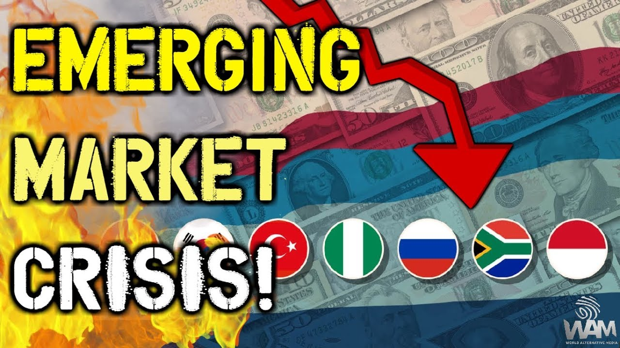
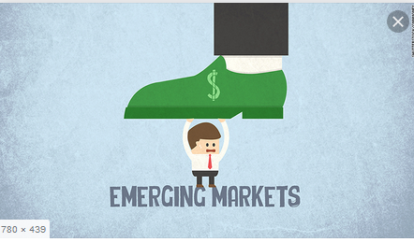
Crises in Emerging Markets
Svetlana Ledyaeva
Aalto University School of Business

Slide 2
Crisis – how it happends in general?
High capital inflow into the country ➔
Economic growth, local currency appreciation, current account deficit (import is financed not by export but by capital inflow)
Something happends (external shock) and capital stops flowing into the country! ➔
Economic downturn, sharp currency devaluation, country`s default on its debt, …

Slide 3
Car crash analogy of the crisis
From lecture of J Frankel (Harvard)

Slide 4
Car crash analogy of the crisis 1
From lecture of J Frankel (Harvard)

Slide 5
Car crash analogy of the crisis 2
From lecture of J Frankel (Harvard)

Slide 6
Car crash analogy of the crisis 3
From lecture of J Frankel (Harvard)

Slide 7
Car crash analogy of the crisis 4
From lecture of J Frankel (Harvard)

Slide 8
Three waves of crises in emerging markets
From lecture of J Frankel (Harvard)

Slide 9
First cycle: 1975-1981-1989
1970s – two large oil price shocks
Created current account surpluses among oil-exporting countries ➔
Invested via large US money-center banks and US government (US treasury bills) to emerging markets➔
Created current account deficits among oil-consuming countries, in particular, emerging ➔
High international debt of emerging markets
Early 80s: World recession, developed world aim: lowering inflation ➔ tightening of monetary policy in US (Volcker tightening) ➔higher interest rates on loans in US ➔ capital flows from US to emerging markets➔emerging markets default

Slide 10
Second cycle: 1990-1996-2002
Plaza accord of 1985 ➔ major superpowers agreed to weaken US dollar ➔
Low interest rate in developed countries ➔
Investors look for opportunities of high return somewhere else ➔
1990s – influx of capital into emerging countries: hot money, portfolio investment dominated ➔
Economic bubble, external shocks (devaluation of Chinese and Japanese currencies; appreciation of US currency; US economy recovered from recession; rising US interest rates to head off inflation)➔
Capital outflow from emerging markets to US.

Slide 11
Third cycle: 2003-2008-2015/16
High oil prices ➔ petrodollar money
Oil exporters opted to make most of their investments directly into diverse global markets, and the recycling process was less dependent on intermediary channels such as international banks and the IMF.
Global financial crisis quickly shifted to emerging markets in 2008-2009.
US monetary policy: Taper talk in 2013 ➔ increase of interest rates in US.
Oil prices started to collapse in 2014, driven by a growing supply glut.
Stop of capital coming to emerging markets. ➔ Crises in emerging markets

Slide 12
2016
From lecture of J Frankel (Harvard)

Slide 13
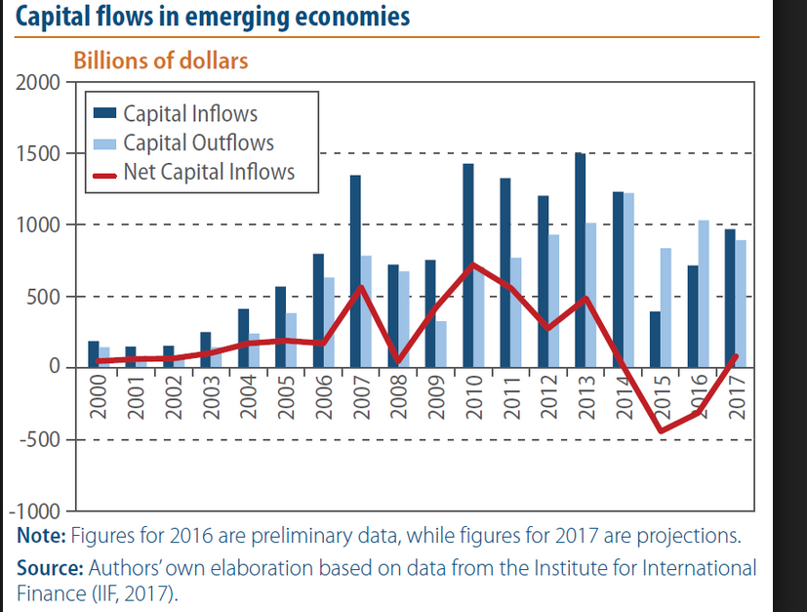
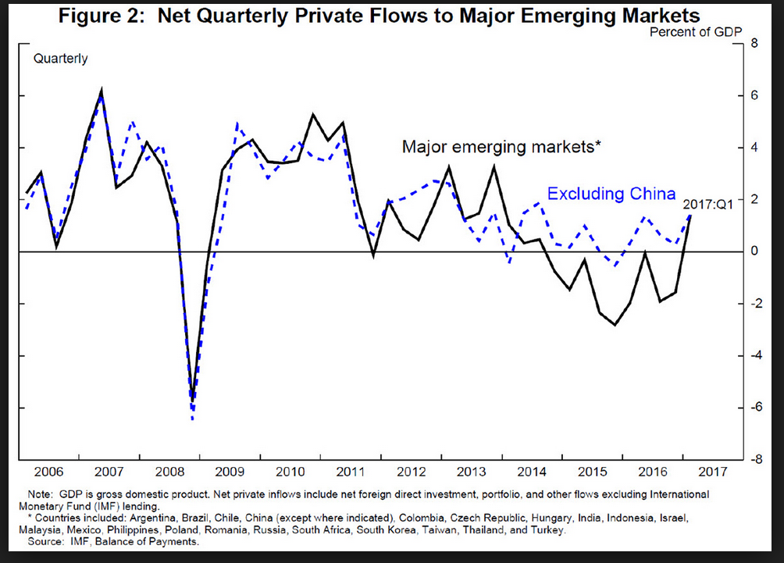

Slide 14
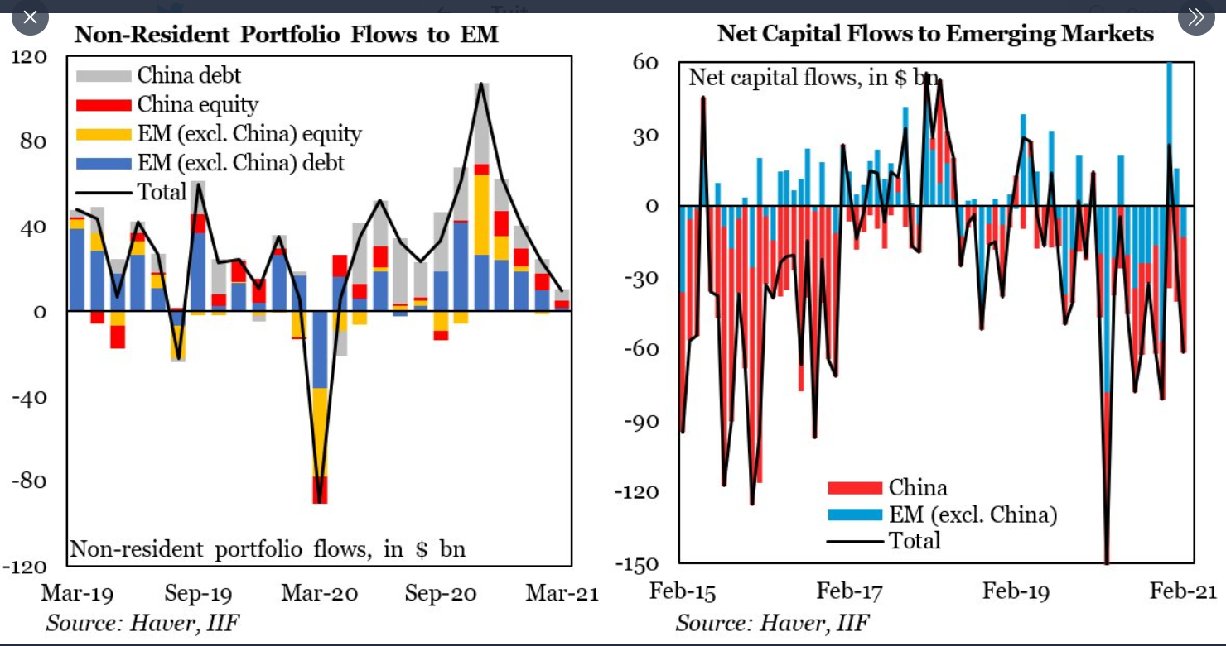

Slide 15
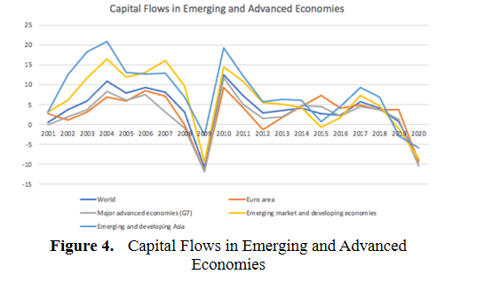

Slide 16
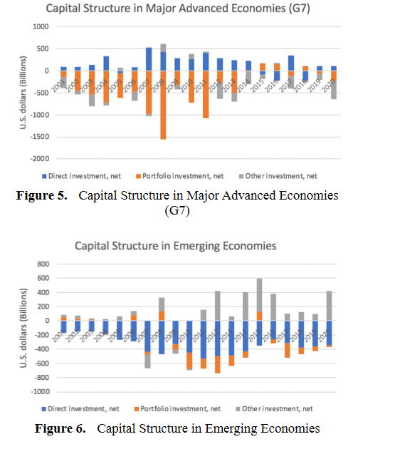

Slide 17
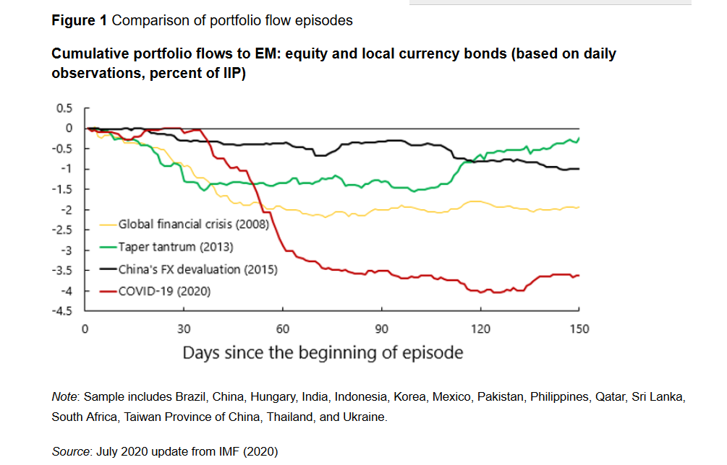
Capital flows in emerging markets: Present (VoxEU 2020)

Slide 18
Main factors of crises in emerging markets
Oil price volatility
US monetary policy – tightening of monetary policy (taper talk; tapering)
High risks in the world economy in general, global crisis
(COVID pandemic is a good example!)
Contagion effects

Slide 19
The role of US monetary policy in crises in emerging markets
US FED tightening; Taper talk
The word ”tapering” in financial terms is increasingly being used to refer to the reduction of the Federal Reserve's quantitative easing, or a cutback in bond buying program.
Less money available in US economy ➔ Higher interest rates in US ➔ Investments come back from emerging markets to US.

Slide 20
From lecture of J Frankel (Harvard)

Slide 21
Professor Andrew Karolyi (Cornell University) on taper tantrum of May-June 2013
When interests rates in advanced markets are low, investors put money into EMs, where interest rates are high.
May-June 2013: Federal reserve chief Ben Bernanke laid out his most specific plan yet for when the central bank will start easing up on its controversial stimulus program which is pumping 85 billion USD a month into the economy.
In many EMs equity inflows has dropped but not in all.

Slide 22
From lecture of J Frankel (Harvard)

Slide 23
Tapering talk: The impact of expectations of reduced Federal Reserve security purchases on emerging markets Barry Eichengreen, Poonam Gupta 19 December 2013, VoxEU
The largest negative impact of tapering ➔ countries that allowed exchange rates to run up most dramatically in the earlier period when large amounts of capital were flowing into emerging markets.
The largest negative impact was in countries that allowed the current account deficit to widen most dramatically in the earlier period when it was easily financed.

Slide 24
From lecture of J Frankel (Harvard)

Slide 25
Notes to previous slide
VIX is a key measure of market expectations of near-term volatility conveyed by S&P 500 stock index option prices.
Since 1993, the VIX Index has been considered to be the world's premier barometer of investor sentiment and market volatility.
The higher the value of VIX, the higher the risk.

Slide 26
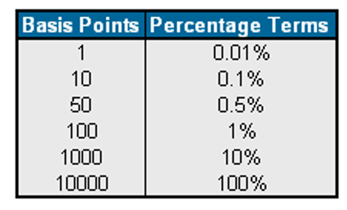
Sovereign spread is related to country risk, which is the difference between the interest rate on a US Treasury issue and a similar issue of another government.
From lecture of J Frankel (Harvard)

Slide 27
From lecture of J Frankel (Harvard)

Slide 28
From lecture of J Frankel (Harvard)

Slide 29
Crises` consequencies
Local currency devaluation
Inflation
Economic downturn

Slide 30
From lecture of J Frankel (Harvard)

Slide 31
Trade balance –
Net Export
From lecture of J Frankel (Harvard)

Slide 32
From lecture of J Frankel (Harvard)

Slide 33
Balance sheet effect ➔ currency mismatch
The extent to which economy`s liabilities determined in foreign currency and assets – in domestic currency.
Asset-liability missmatch
For example, a bank that chose to borrow entirely in US dollars and lend in Russian rubles would have a significant currency mismatch: if the value of the ruble were to fall dramatically, the bank would lose money.

Slide 34
Russian bank example
Russian bank takes a loan of 1000 USD from US Bank in the year 1 when 1USD = 30 Rubles.
The Russian bank transfers USD loan into Russian rubles ➔ 30 000 rubles.
The Russian bank lends 30 000 rubles to business with an interest rate 10% for one year.
In the year 2 the bank gets the loan and interest back ➔ 30 000+30 000*0.1=33 000 rubles.
In the year 2 there has been a significant devaluation of Russian ruble: 1USD = 50 rubles.
Hence, Russian bank cannot return the whole loan to US bank. It can return only 660 USD without profit to itself.
The Russian bank defaults!

Slide 35
From lecture of J Frankel (Harvard)

Slide 36
From lecture of J Frankel (Harvard)

Slide 37
From lecture of J Frankel (Harvard)

Slide 38
From lecture of J Frankel (Harvard)

Slide 39
From lecture of J Frankel (Harvard)

Slide 40
From lecture of J Frankel (Harvard)

Slide 41
From lecture of J Frankel (Harvard)

Slide 42
From lecture of J Frankel (Harvard)

Slide 43
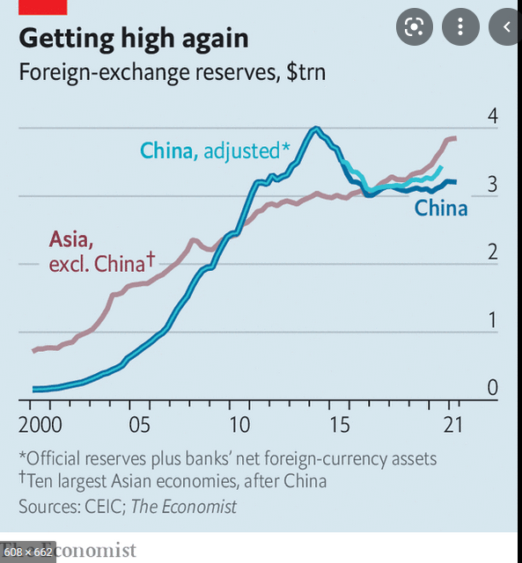

Slide 44
From lecture of J Frankel (Harvard)

Slide 45
From lecture of J Frankel (Harvard)

Slide 47
From lecture of J Frankel (Harvard)

Slide 48
From lecture of J Frankel (Harvard)

Slide 49
From lecture of J Frankel (Harvard)

Slide 50
From lecture of J Frankel (Harvard)

Slide 51
Negative number – ER appreciation
From lecture of J Frankel (Harvard)

Slide 52
From lecture of J Frankel (Harvard)

Slide 53
From lecture of J Frankel (Harvard)

Slide 54
Expert opinion: Nenad Pacek, President, Global Success Advisors GmbH; Co-Founder, CEEMEA Business Group
Crisis in Asia in 1997 - all Asian markets crashed except China.
It can happened again! But now things are different.
In that times Asia had only 500 billion USD foreign currency reserves; now they have 5 trillion USD (10 fold increase). ➔
They do not want to ask money from IMF, they want to be masters of their dignity ➔
They want to have a buffer.
They also cut foreign debt – 17% of GDP (Asia, aggregate) – good for businesses.

