Slide 1
Principles of Empirical Analysis Lecture 9: Difference-in-differences part 2 Regression Discontinuity Design
Spring 2024
Miri Stryjan

Slide 2
Observational alternatives to experiments
Selection on observables: treatment and control groups differ from each other only w.r.t. observable characteristics, there is no problematic selection into treatment
Lecture 7 discussed such a situation
Selection on unobservables: treatment and control groups differ from each other in unobservable characteristics
Treatment and controls are observed before and after treatment – difference-in-differences (DID). Today we continue discussion from Lecture 8.
Selection mechanism is known – regression discontinuity designs (RDD)
Exogenous variable induces variation in treatment – instrumental variables (IV)

Slide 3
Outline
DID continued: Last lecture, we discussed the basic idea of difference-in-difference designs: DID with two groups and two time periods
Today: More general case with many time periods
Application: Currie and Walker paper on congestion and infant health
Some words on limitations of DID with several time periods and staggered treatment effects.
Other examples
Introduction to Regression discontinuity design (RDD)

Slide 4
DID recap
Idea:
Even if treated and control groups differ in baseline characteristics, we can use observations on treatment and control groups before and after the treatment to estimate a causal effect.
Assumptions:
The potential outcomes (not observed) would have developed in a parallel manner for both groups in the absence of treatment.
This assumption includes the “Common shocks” assumption: There can be no differential changes over time for the treated and control groups.
Testing for design validity:
Visualization and testing: are trends in outcomes parallel before treatment? Discuss: Is there anything else that could have happened to one group but not the other? (know your institutional setting!)

Slide 5
Staggered or differential treatment timing

Slide 6
Staggered or differential treatment timing
In our examples thus far, we had two time periods and two groups, and the treatment timing was the same for all treated units
Most DID applications, however, exploit variation across groups of units that receive treatment at different times
In some applications, all units are eventually treated while in others there is a control group that never gets treated

Slide 7
Staggered timing - example
y
No one treated
Green treated
Green and red treated
Time

Slide 8
Staggered timing - example
Comparison of early treated group to the control group and the late treated group
y
No one treated
Green treated
Green and red treated
Time

Slide 9
Staggered timing - example
Comparison of late treated group to the control group and the early treated group
y
No one treated
Green treated
Green and red treated
Time

Slide 10
Examples of “treatments” w. staggered implementation
Effect of more education on later labor market outcomes: country-wide reform of the education system that is gradually implemented – late implementation areas can serve as controls for early implementation areas.
Effect of access to abortion on womens’ and children’s socio-economic outcomes: gradual legistation of abortion across US states – late legalization state serve as controls to those where legalization happened earlier.
Effect of the “green revolution” in agriculture in the 1960’s-70’s: (introduction of new improved seeds for food crops) on crop yields – different crops had an improved version at different times. Compare [yield difference] for early improved crops to [difference for] those improved later.

Slide 11
https://www.aeaweb.org/articles?id=10.1257/app.3.1.65

Slide 12
Research question
How does a reduction in air pollution affect the health of infants? The “bigger” question is how does pollution affect health.
Why is this interesting?
There is increasing evidence of the long-term effects of poor health at birth on future outcomes
There is also evidence that exposure to polluted air affects health negatively
The study of newborns overcomes several difficulties in making the connection between pollution and health because the link between cause and effect is immediate

Slide 13
Selection bias
T = being more vs less exposed to pollution Y = premature birth and low birth weight
Since air pollution is not randomly assigned, studies comparing health outcomes for populations exposed to differing pollution levels may not adequately control for confounding determinants of health
Families with higher incomes or preferences for cleaner air are likely to sort into locations with better air quality, and failure to account for this sorting overestimates of the effects of pollution
Alternatively, pollution levels are higher in urban areas where there are often more educated individuals with better access to health care, which can cause underestimates of the true effects of pollution on health

Slide 14
Natural/Policy experiment
Studies the effect of E-Zpass in New Jersey and Pennsylvania, which led to to sharp reductions in local traffic congestion, on the health of infants born to mothers living near toll plazas.
T = living near a Toll plaza (used as a proxy* for reduced air pollution) Y = premature birth and low birth weight
E-ZPass is an interesting policy experiment because, while pollution control was an important reason that policy makers implemented the pass, the main reasons that consumers signed up for E-ZPass was to reduce travel time.
*proxy = an (imperfect) measure of

Slide 15
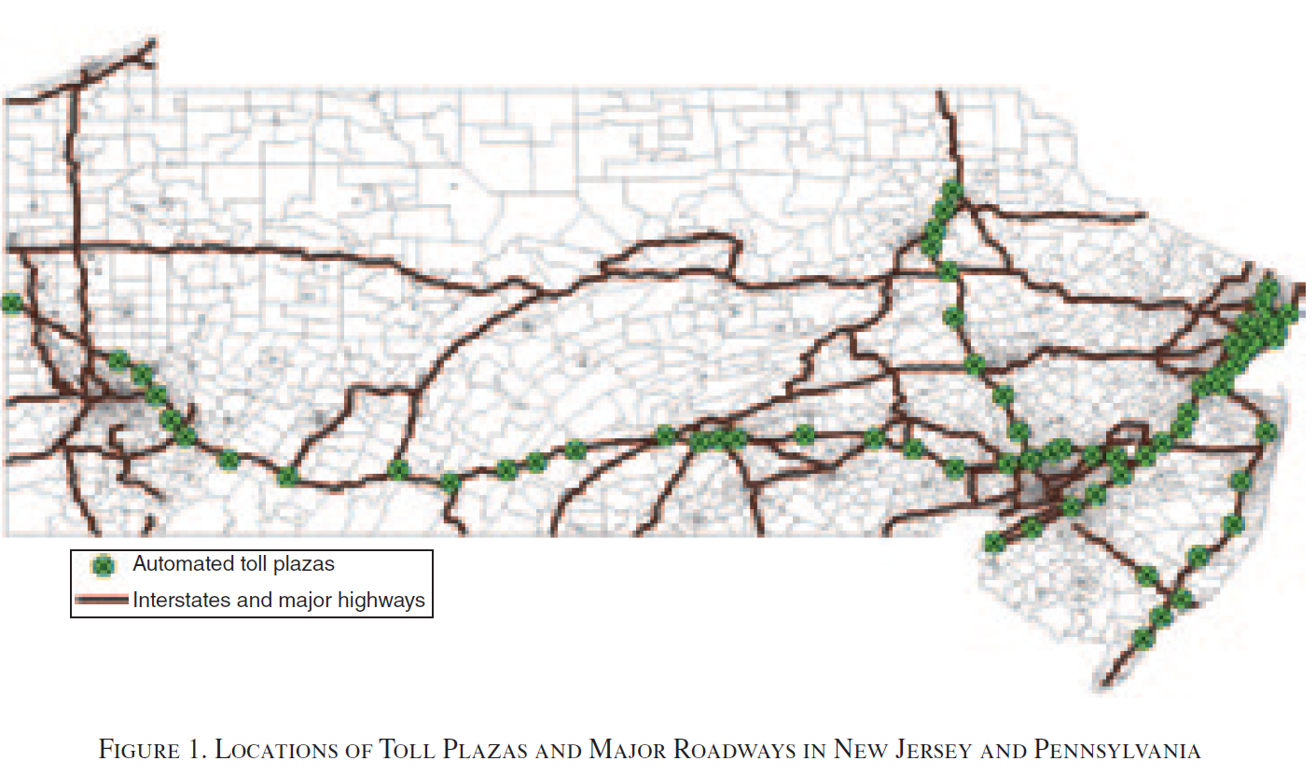
Empirical strategy

Slide 16
Empirical strategy
“we compare mothers within 2 km of a toll plaza to mothers who are between 2 km and 10 km from a toll plaza, but still within 3 km, of a major highway before and after the adoption of E-ZPass in New Jersey and Pennsylvania.”
Assumption:
“Our difference in differences research design relies on the assumption that the characteristics of mothers near a toll plaza change over time in a way that is comparable to those of other mothers who live further away from a plaza, but still close to a major highway.”

Slide 17
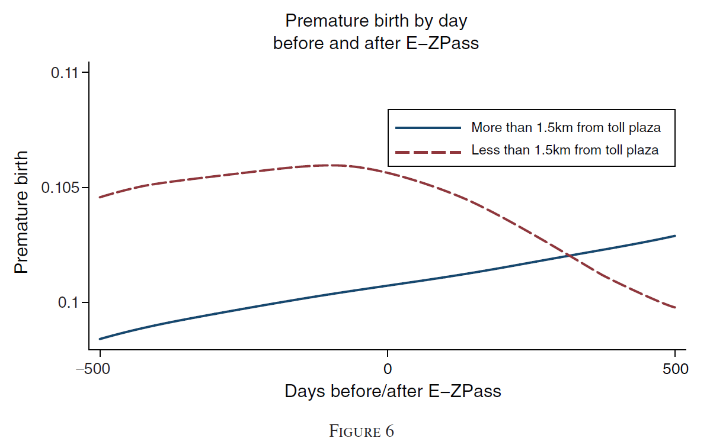
Main results

Slide 18
Main results
Counterfactual trend in the treatment groups

Slide 19
Main results
Counterfactual trend in the treatment groups
Difference-in-differences
Difference before treatment
Difference after treatment

Slide 20
Conclusions – Currie & Reed (2011)
The E-ZPass reduced the incidence of prematurity and low birth weight in the vicinity of toll plazas by 6.7–9.1 percent and 8.5–11.3 percent, respectively
These are large but not implausible effects given the correlations between proximity to traffic and birth outcomes found in previous studies
Take away: policies intended to curb traffic congestion can have significant health benefits for local populations (in addition to the more often cited benefits in terms of reducing travel costs)

Slide 21
Regression for multi-period DID*
Question last time: Why is regression better than just comparing means?
For a simple 2X2 example as we saw in Lecture 8 (Card and Kreuger, 1994) the difference is not that big.
Regression provides both an estimate and standard error, and calculates the p-value (but it is of course possible to get similar information also with means and standard deviations for a known distribution).
Regression is easier to generalize to more demanding setups, such as with DID analysis with many periods and multiple comparisons.

Slide 22
DID with differential treatment times
Most DID applications exploit variation across groups of units that receive treatment at different times
In some applications, all units are eventually treated, e.g. a rollout of a national policy
In others there is a control group that never gets treated
Rollout is a great way to make sure we learn something about the effects of the policy
In principle this is all fine
But there are complicated issues concerning staggered designs and the literature is moving forward on this

Slide 23
Problems with staggered T: Recall example
Comparison of late treated group to the control group and the early treated group
Comparison of early treated group to the control group and the late treated group
y
No one treated
Green treated
Green and red treated
Time

Slide 24
Problems with staggered treatment
In the example on previous page, the Green group is both part of the control group and part of the treated group.
More generally, in DID with staggered treatment, the analysis consists of multiple 2X2 comparisons around the time windows when a unit is treated.
If treatment effects are heterogenous, i.e. differ over time, analyzing staggered treatments with “regular” DID methods (Two way fixed effects) can give biased results, and lead to both Type I and Type II errors (i.e. we do not know in what direction the bias goes!)
There is currently an active discussion and new method versions have been developed that can address these challenges.

Slide 25
Other Applications

Slide 26
Harjunen (2018): West Metro extension and house prices

Slide 27
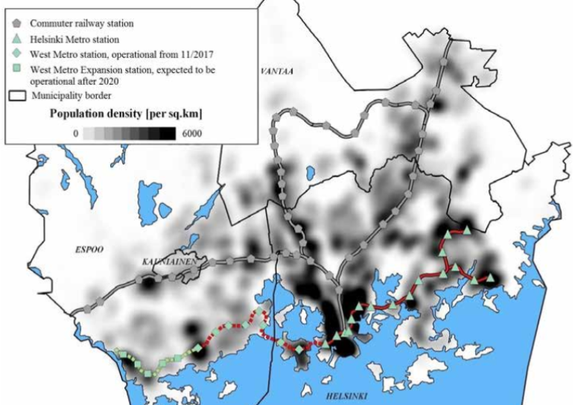
West Metro extension in the HMA
https://www.hel.fi/hel2/tietokeskus/julkaisut/pdf/18_01_25_tyopapereita_02_Harjunen.pdf

Slide 28
Harjunen 2018 measures “anticipation effects”
“The estimated completion date and projected construction costs of the West Metro were adjusted during the construction period. Before the tunnel works of the first stage of the West Metro began in 2009, the aim was that the metro would start operating in fall 2014 and the budget was 714 million euros (index corrected budget for 2016 was 849 million euros). However, this estimate of the opening was year later postponed to 2015 and later on to 2016. Finally, the opening date was announced to be 15th of august 2016”
The date of treatment is in 2009 when the concrete plans of the metro were initiated, and expectations were that the metro stations would indeed open.

Slide 29
DID design
New station
Control
Treatment
e.g. 800m

Slide 30
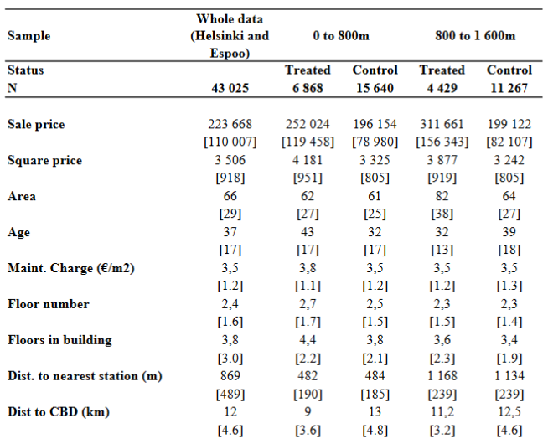
Data

Slide 31
Results

Slide 32
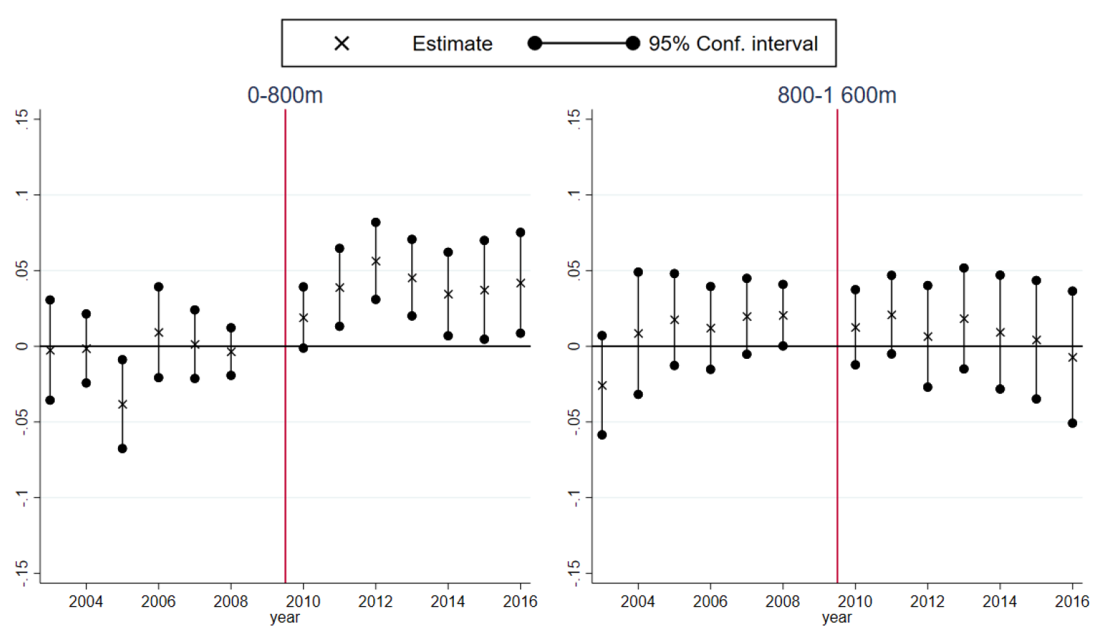
Results

Slide 33
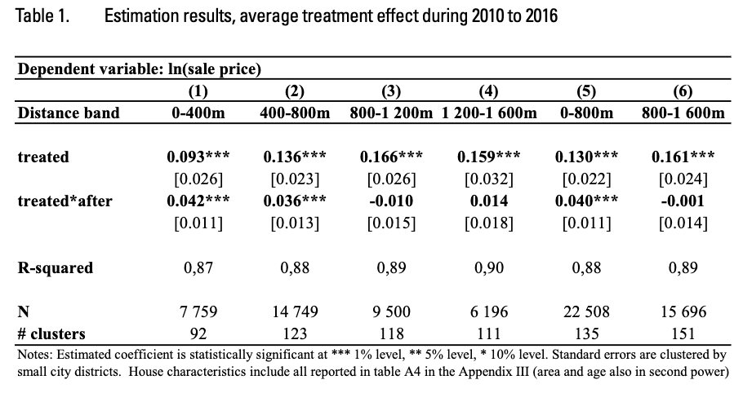
Results

Slide 34
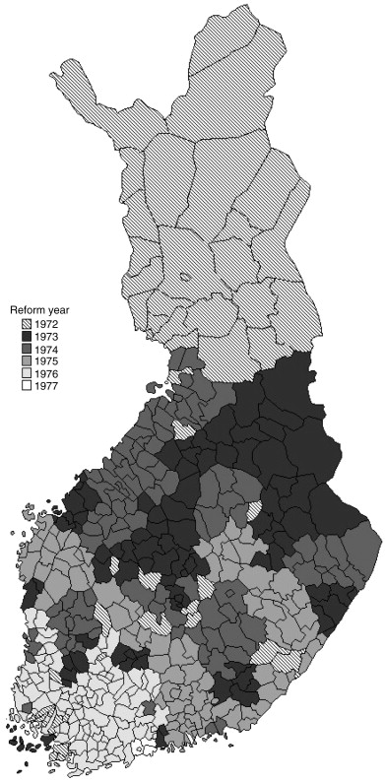
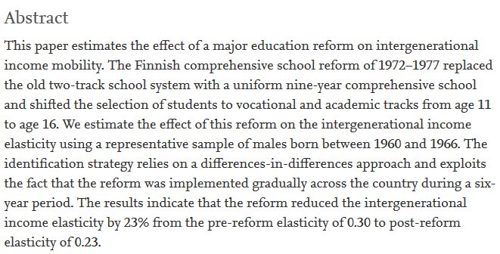
Rollout implementation of a policy – Pekkarinen et al. (2009)
https://www.sciencedirect.com/science/article/pii/S0047272709000619

Slide 35
DID recap
Idea:
Even if treated and control groups differ in baseline characteristics, we can use observations on treatment and control groups before and after the treatment to estimate a causal effect.
Assumptions:
The potential outcomes (not observed) would have developed in a parallel manner for both groups in the absence of treatment.
This assumption includes the “Common shocks” assumption: There can be no differential changes over time for the treated and control groups.
Testing for design validity:
Visualization and testing: are trends in outcomes parallel before treatment? Discuss: Is there anything else that could have happened to one group but not the other? (know your institutional setting!)

Slide 36
Regression discontinuity design (RDD)

Slide 37
Observational alternatives to experiments
Selection on observables: treatment and control groups differ from each other only w.r.t. observable characteristics
Lecture 8
Selection on unobservables: treatment and control groups differ from each other in unobservable characteristics
Treatment and controls are observed before and after treatment – difference-in-differences (DID) Lecture 8-9
Selection mechanism is known – regression discontinuity designs (RDD)
Exogenous variable induces variation in treatment – instrumental variables (IV)

Slide 38
Outline
Basic idea of regression discontinuity designs
Setup and assumptions
Fuzzy and sharp RDD
Testing RDD assumptions
Manipulation, covariate balance, fake cutoff placebos and other placebos

Slide 39
RDD
Introduced by Thistlethwaithe and Cambell (1960)
Studied the impact of merit awards on future academic outcomes, where merit award was given if test score exceeds a cutoff
Idea: students can (of course) affect their test scores by studying, but they cannot manipulate their scores to be just above the cutoff because the cutoff is unknown to them ex ante
Reappeared and formalized in economics in late 90s and has proven to be a powerful causal tool in empirical economics and other disciplines
Political science, education, epidemiology, criminology etc.
Strong internal validity, but very data intensive
Need to have a lot of observations near the cutoff

Slide 40
Estimating causality and RDD
As usual, we start with some causal relationship in mind.
We would like to estimate the effect of some treatment, T on some outcome, Y.
But we suspect that there is selection into treatment: treatment status T is correlated with unobservables that may also affect Y.
RDD can be used to isolate the causal effect of treatment in certain situations where Individuals (or units) become treated after crossing some arbitrary cutoff.

Slide 41
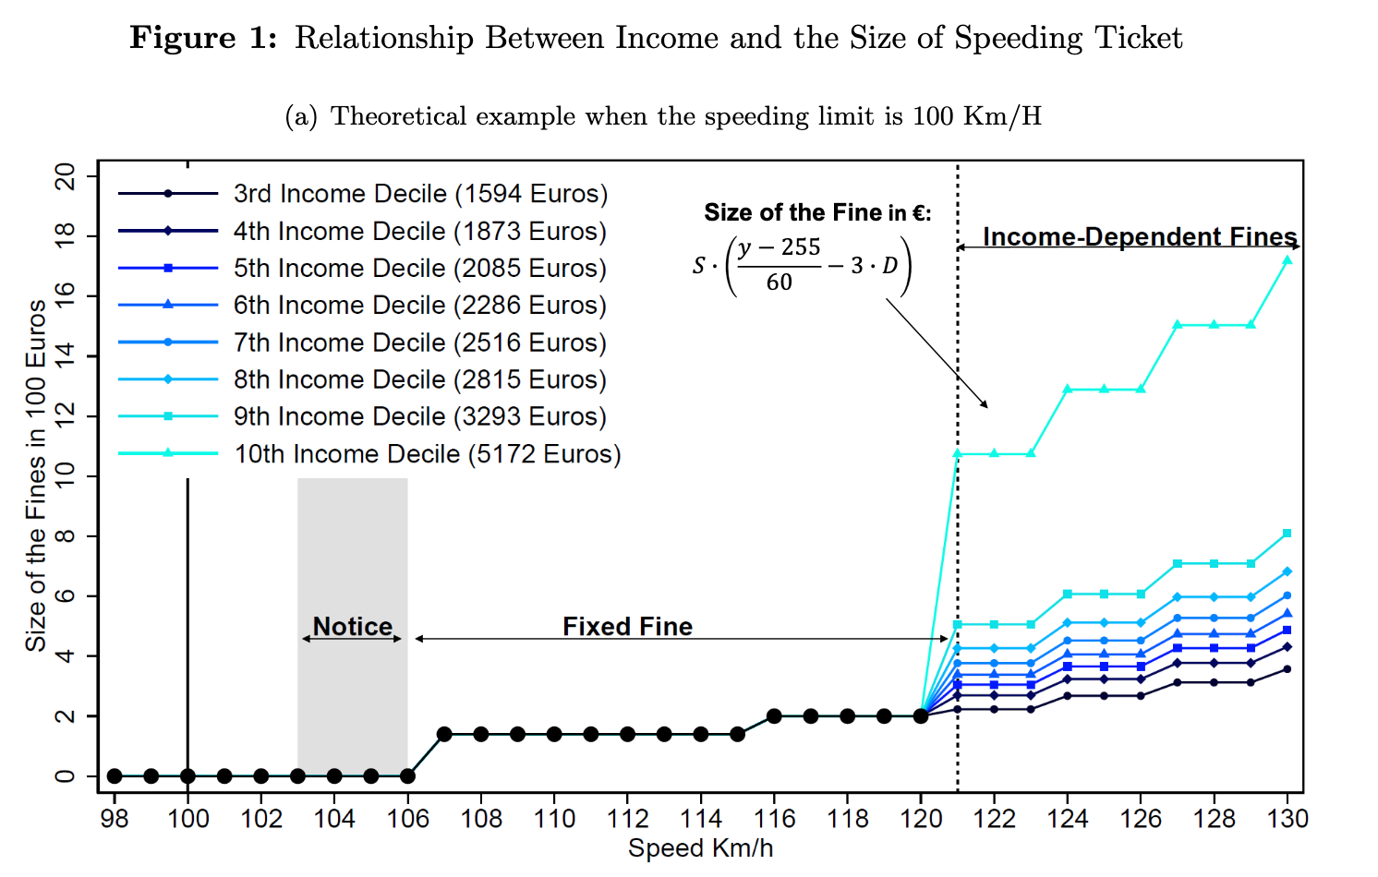
Speeding tickets in Finland (Martti Kaila, 2023)
“In Finland, speeding tickets become income-dependent if the driver’s speed exceeds the
speeding limit by more than 20 km/h, leading to a substantial jump in the size of the fine.

Slide 42
RDD – the setup
RDD has three fundamental components: running variable, cut-off, and treatment
Individuals become treated after crossing some cutoff in the running (or forcing or score) variable
Sharp RDD: treatment received with probability zero below the cut-off (or threshold) and probability one above cut-off
Fuzzy RDD: The probability of receiving the treatment increases discontinuously at the threshold (imperfect compliance)
Assumption: the potential outcomes evolve smoothly across the cutoff. In other words:
If there is no precise manipulation of the running variable, observations just below the threshold are very similar to those just above the threshold and therefore constitute a valid control group.

Slide 43
Examples of running variables and cutoffs that can be used for RDD
Test scores: entry to high school/university depends on some test score/GPA
Age: after some age (e.g. 18, 21), you become eligible to do something (vote, buy alcohol in US)
Geography: access to services based on residential location and catchment areas; coordinates or distance to some boundary/border determines treatment
Elections: candidate’s vote share (running variable) determines election status (treatment)
Speed: in Finland, after exceeding speed limit by more than 20 km, you get a different type of fine.

Slide 44
Sharp RDD
For the following graphs, let’s think of the example of test scores: admission to a course or school depends on some test score/GPA
Running variable: test score
Cutoff: a threshold score required for passing the exam, e.g. 50/100.
Treatment: attending that course/school

Slide 45
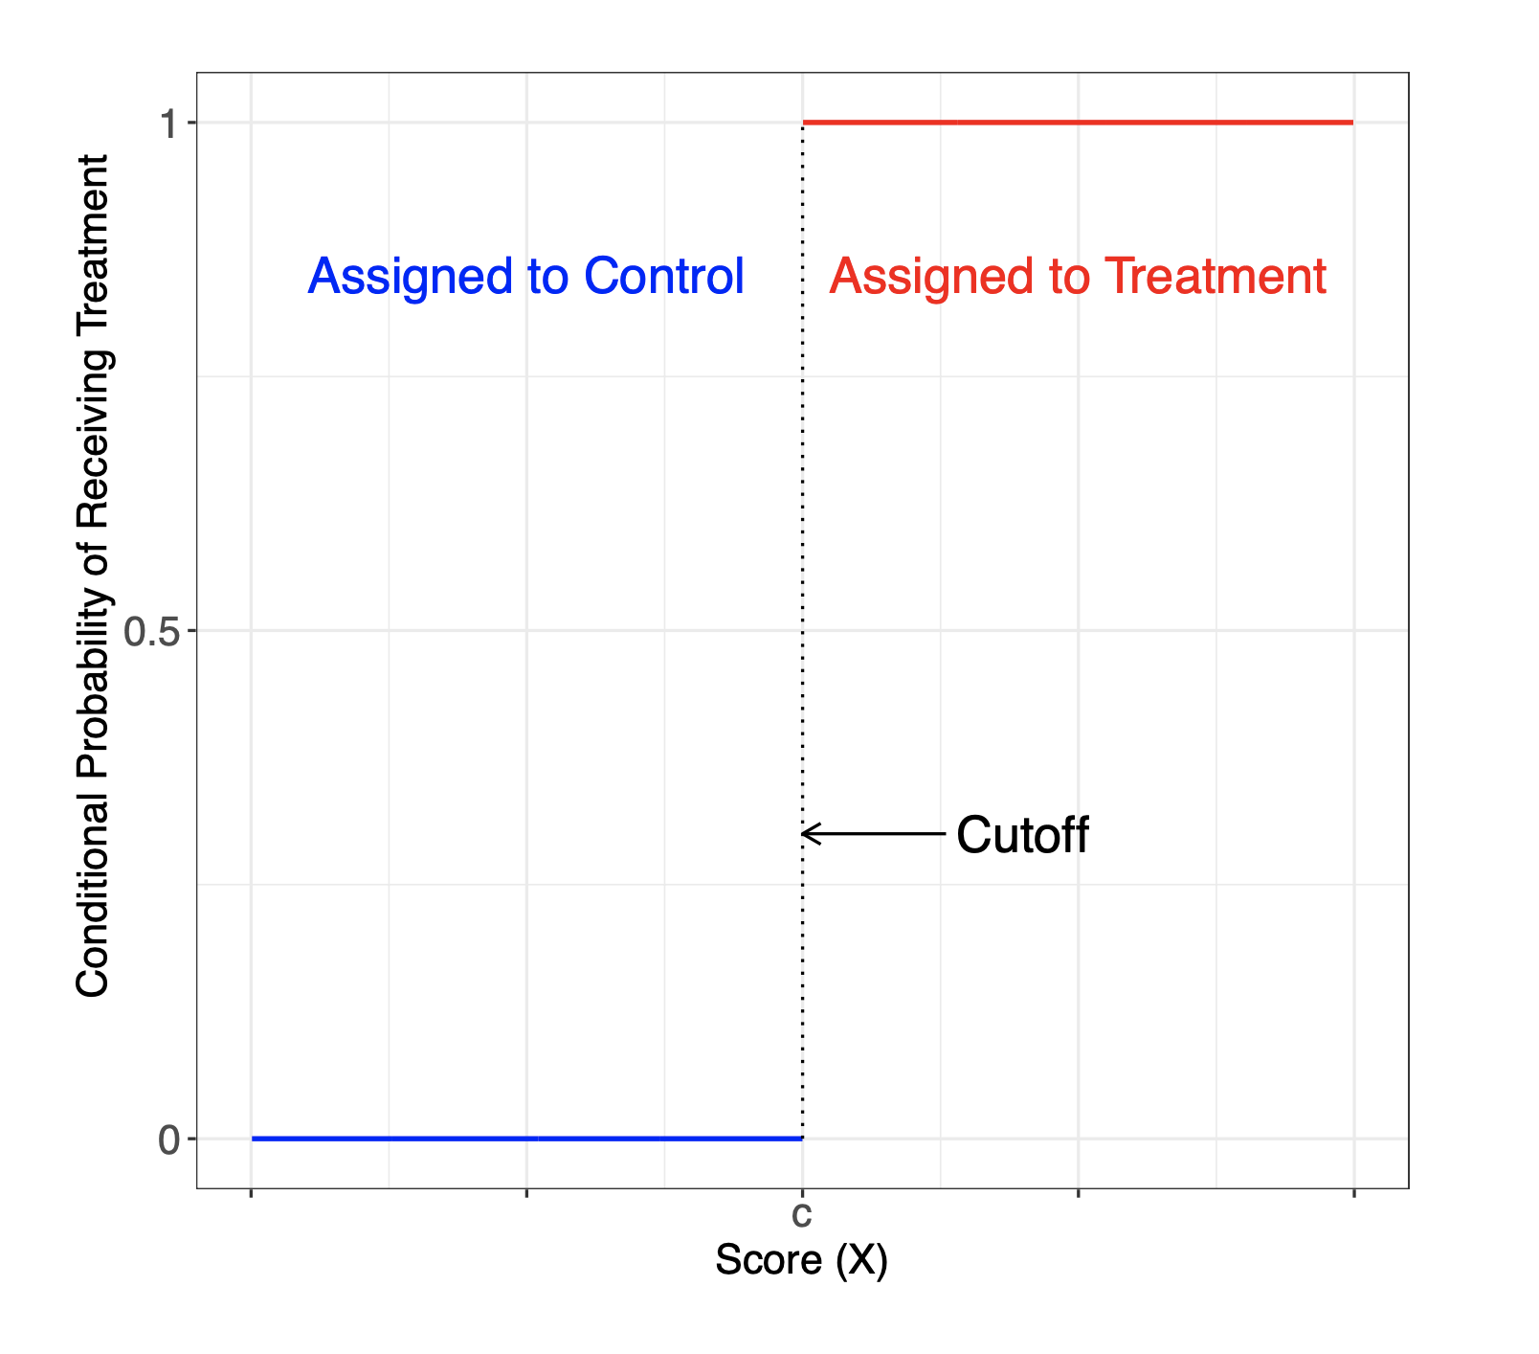
Sharp RDD
Source: Cattaneo et al. (2019): A Practical Introduction to Regression Discontinuity Designs: Foundations.

Slide 46
The problem of causal inference in RDD
”The fundamental problem of causal inference [in RDD] occurs because we only observe the outcome under control, Yi(0), for those units whose score is below the cut-off, and we only observe the outcome under treatment, Yi(1), for those units whose score is above the cut-off”
Source: Cattaneo et al. (2019): A Practical Introduction to Regression Discontinuity Designs: Foundations.
In the example of test scores that determine entry to education: we never observe two people with the same score, but where one was accepted and one was rejected. --> There is no common support in scores between the accepted and rejected group.
The potential outcomes (based on pre treatment characteristics such as ability and motivation) are likely to be different between those who score high and those who score low.

Slide 47
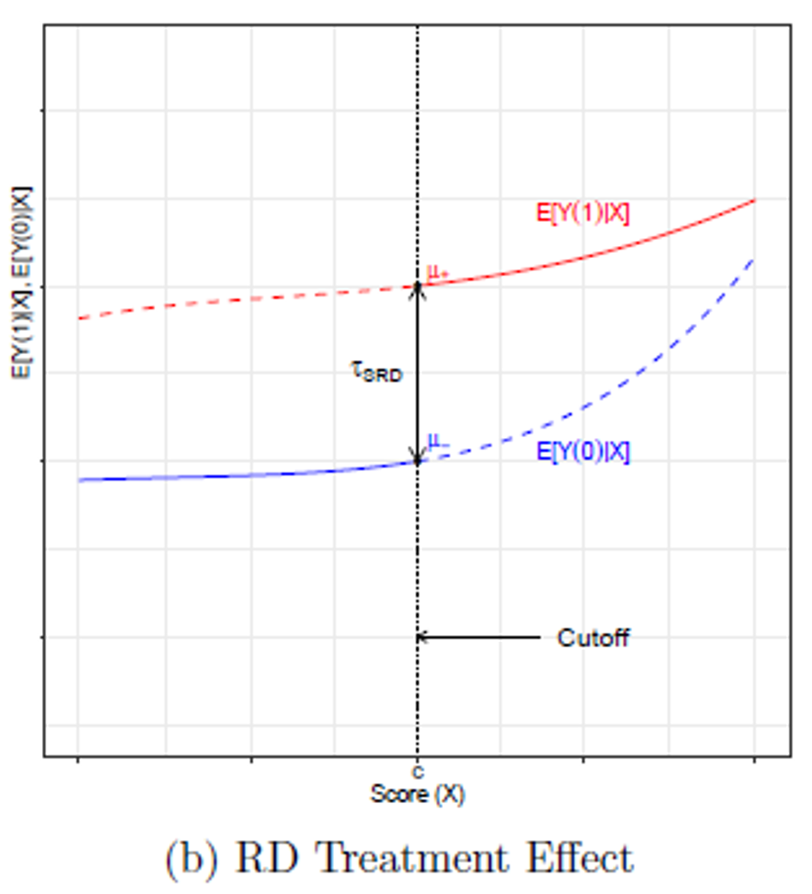
Potential outcomes for those with high scores
Average potential outcomes when treated E[Y(1)|X] (Observed)
Not observed
Average potential outcomes when not treated E[Y(0)|X] Observred
Not observed
Source: Cattaneo et al. (2019): A Practical Introduction to Regression Discontinuity Designs: Foundations.

Slide 48
Local causal effect
If units CANNOT perfectly “sort” around the cutoff, the discontinuous change in the probability of treatment can still be used to learn about the local causal effect of the treatment
Units with scores barely below the cutoff can be used as a control group for units with scores barely above it
Local causal effect
Source: Cattaneo et al. (2019): A Practical Introduction to Regression Discontinuity Designs: Foundations.

Slide 49
Notes to figures on p 12-13 Source: Cattaneo et al. (2019): A Practical Introduction to Regression Discontinuity Designs: Foundations.
The Sharp RD design exhibits an extreme case of lack of common support, as units in the control and treatment groups cannot have the same value of the running variable (X_{i}). This feature makes RD designs different from other non- experimental settings.
→ RD analysis fundamentally relies on extrapolation towards the cutoff point in order to compare control and treatment units.

As shown in the Figures, the average treatment effect at a given value of the score, E[Y_{i}(1)|X_{i} =x]−E[Y_{i}(0)|X_{i} =x], is the vertical distance between the two regression curves at that value. This distance cannot be directly estimated because we never observe both curves for the same value of x.

Slide 50
Key point and assumption of RDD
Units that receive very similar score values on opposite sides of the cut-off are comparable to each other in all relevant aspects, except for their treatment status.
There are different ways of thinking of what this “comparability” means formally
in a small neighborhood around the cut-off we obtain conditions that mimic a randomized experiment, meaning that units on each side of the cut-off are as good as randomly assigned to either receive treatment or not (local randomization framework)
There is a continuity of average potential outcomes near the cut-off (continuity-based framework). This is a conceptually more difficult to think about since potential outcomes cannot be observed.

