Slide 1
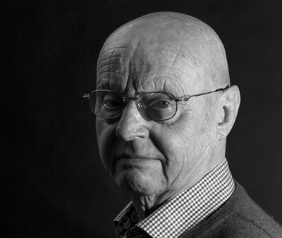
The cultural Dimensions
A host of observations based on Geert Hofstede’s research work

Slide 2
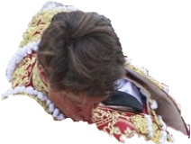
Bullfighting
You want to convince your Spanish uncle that bullfighting is a piece of
What values and attitudes are fostered in each claim?
Bullfighting requires too many subsidies and it’s not that popular anymore.
You must understand the bulls have rights too, and this show is cruel and ridiculous.
I’m not sure why the bull attacks. What is your opinion? Maybe it feels threatened… At least I think I’d feel like that.
I respect tradition, but I think human beings can tame nature without resorting to violence.
Which would work best/worst? Why?
776.000 people attended a bullfight in Spain in 2022, a figure in constant decline. The number of bullfights has increased though by 8,5% since 2019, when there were 3,1 million attendants.

Slide 3
The Cultural Dimensions
Power Distance
Individualism
Masculinity
Uncertainty Avoidance
Long-Term Orientation
Indulgence
Country comparison:
https://www.hofstede-insights.com/fi/product/compare-countries/

Slide 4
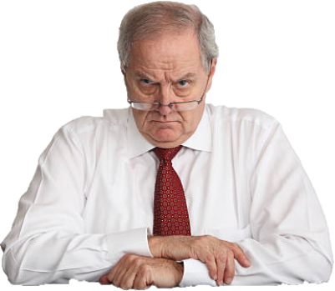
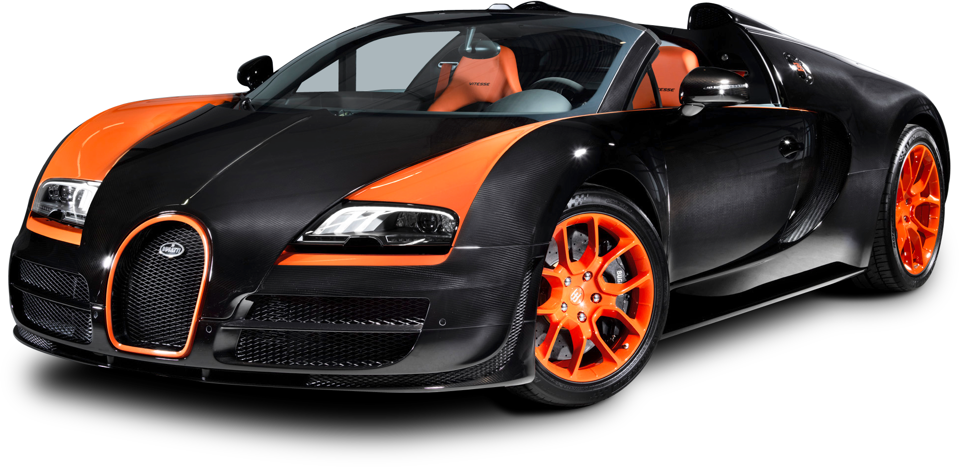
Jealous of his Neighbor’s car
How would he react if he was…
Finnish?
Columbian?
A U.S. citizen?
Options
He’d work more.
He’d key the car!
Other?
Why?

Slide 5
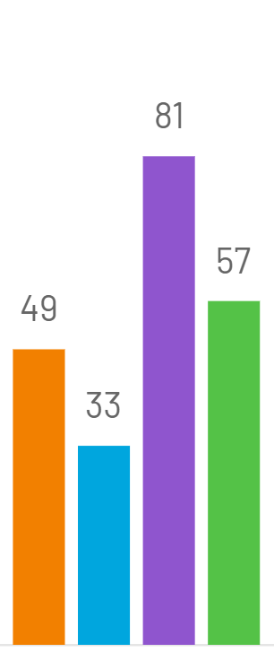
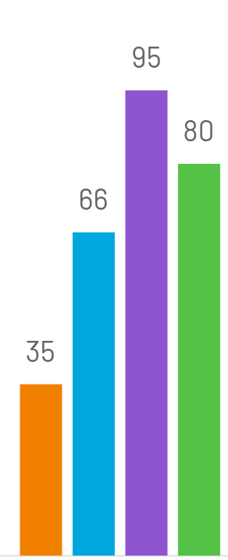
Verticality
Power Distance
Who could the driver blame for this accident? (Say all that come mind.)
Do you find it easy to ask for help? How easy is it for you to say “no” if you don’t want to help?
Do people get a very different treatment in your country depending on how they dress?
Is it important for politicians to dress well if they want to succeed in your country?
Argentina
Finland
Mexico
Spain
Costa Rica
El Salvador
Guatemala
Honduras

Slide 6
Public and Private Spheres
Could you walk through this forest (not Owned by you) if you were in…
Finland?
Britain?
Chile?
How much do people litter in…
Spain?
Hong Kong?
Iceland?
Why?

Slide 7
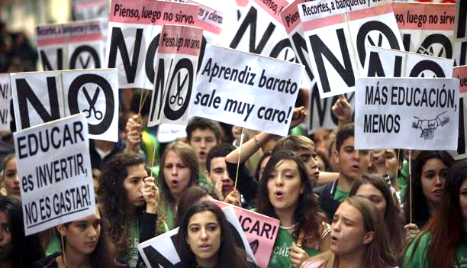
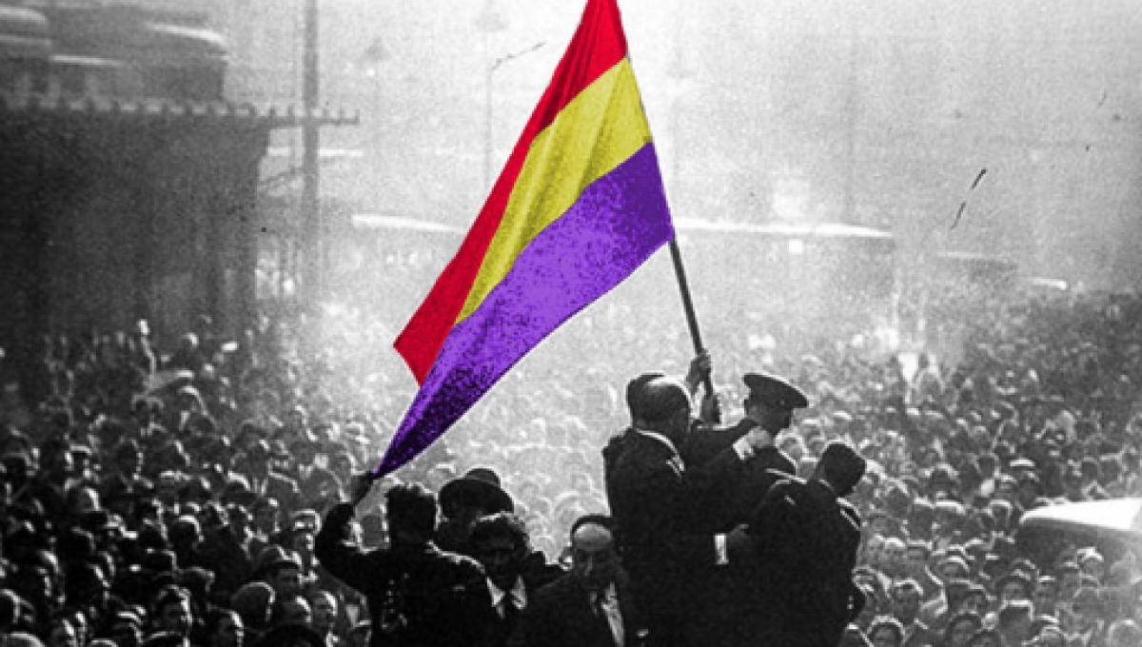
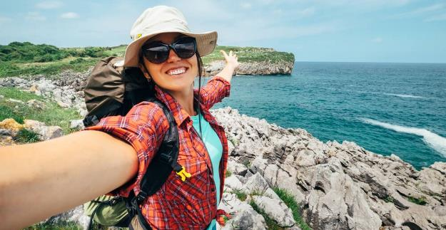
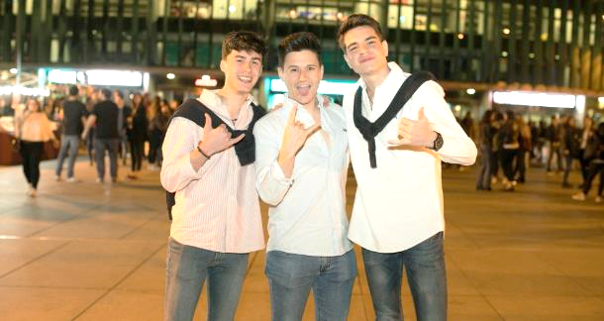
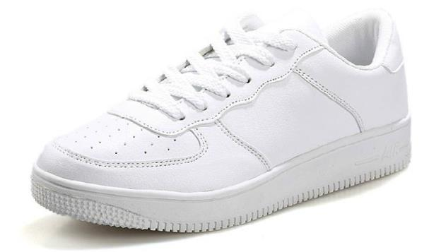
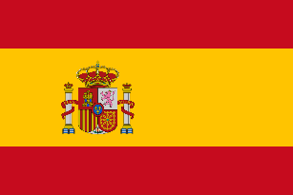
Fun with Flags
1
2
Which of the flags below would you probably find in the following places (numbers 1-4)?
Why?
3
3

Slide 8
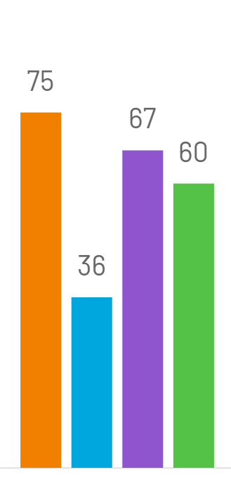
The Individual vs. Society
Individualism
Do you agree? Why?
People don’t look after the library books because such books don’t belong to anybody.
Using the public transport without paying the fare is very unjust to everybody.
As Donald Trump said in 2016, not paying taxes made him smart.
Finland
Guatemala
Spain
USA

Slide 9
Corruption
Think of some examples of the corrupt practices below.
In your opinion, in which of the countries below are these corrupt practices more probable? Why?
Corrupt practices
Fraud in public procurement
Favoritism
Small bribes
Countries
El Salvador
Spain
Finland
China

Slide 10
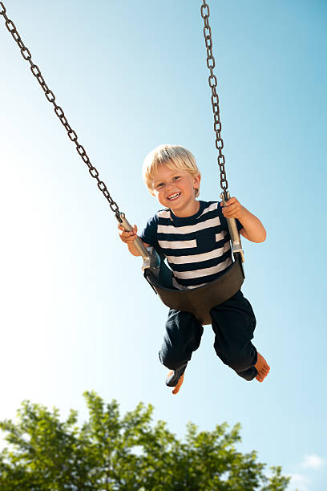
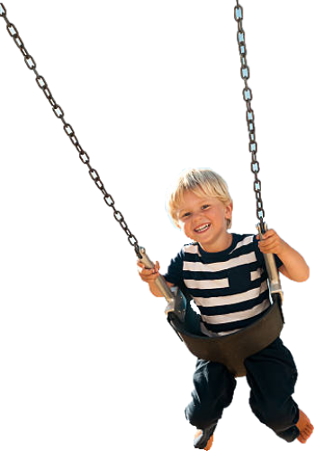
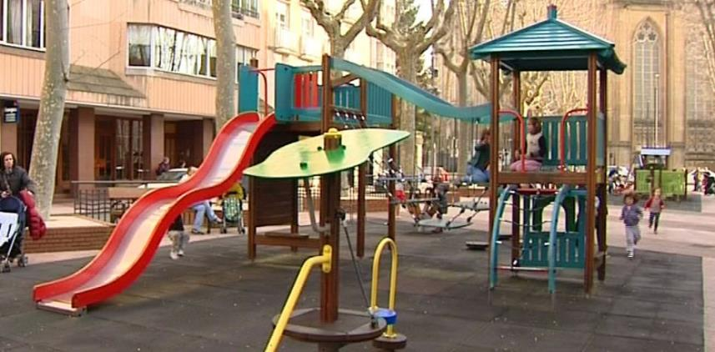
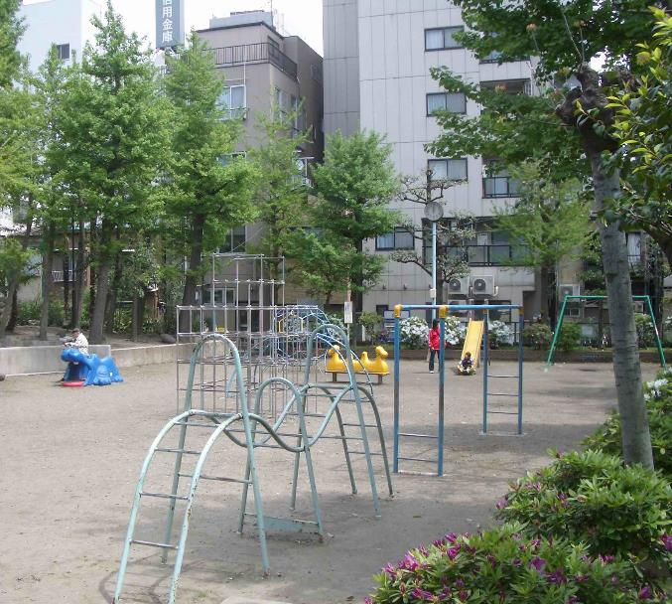
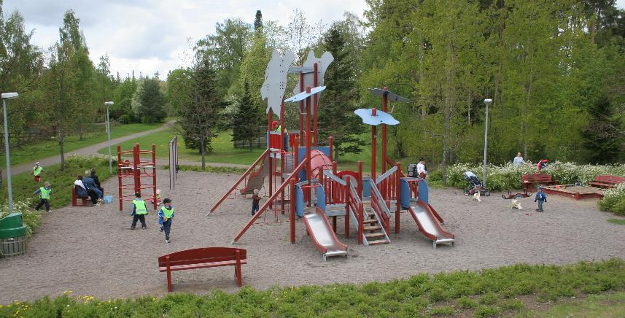
Ground rules
Where are we? Why?
Finland
Japan
Spain

Slide 11
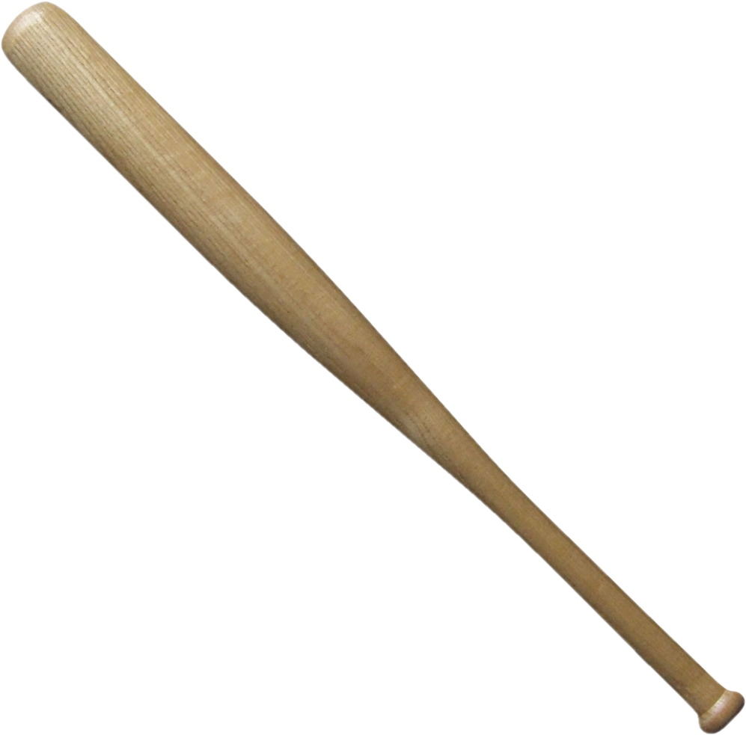
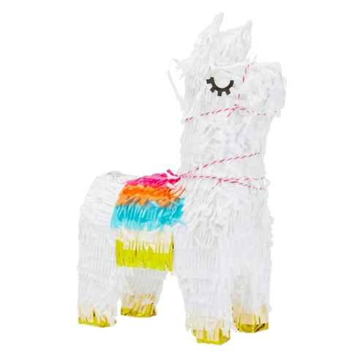
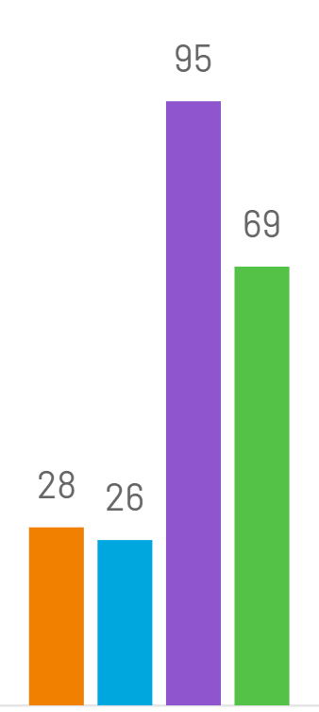
Piñata
How is the candy divided…
In Finland?
In Mexico?
Why?
95
Masculinity
Chile
Finland
Japan
Mexico

Slide 12
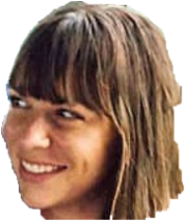
Social relationships
You are in package trip and want to strike a conversation with the people sitting in front of you. Arrange the following topics from better to worse according to your preferences:
What’s your name?
Do you have any children?
Where are you from?
What do you do for a living?
Sunny day, isn’t it?
I love your shirt.
Did you watch yesterday’s match?

Slide 13
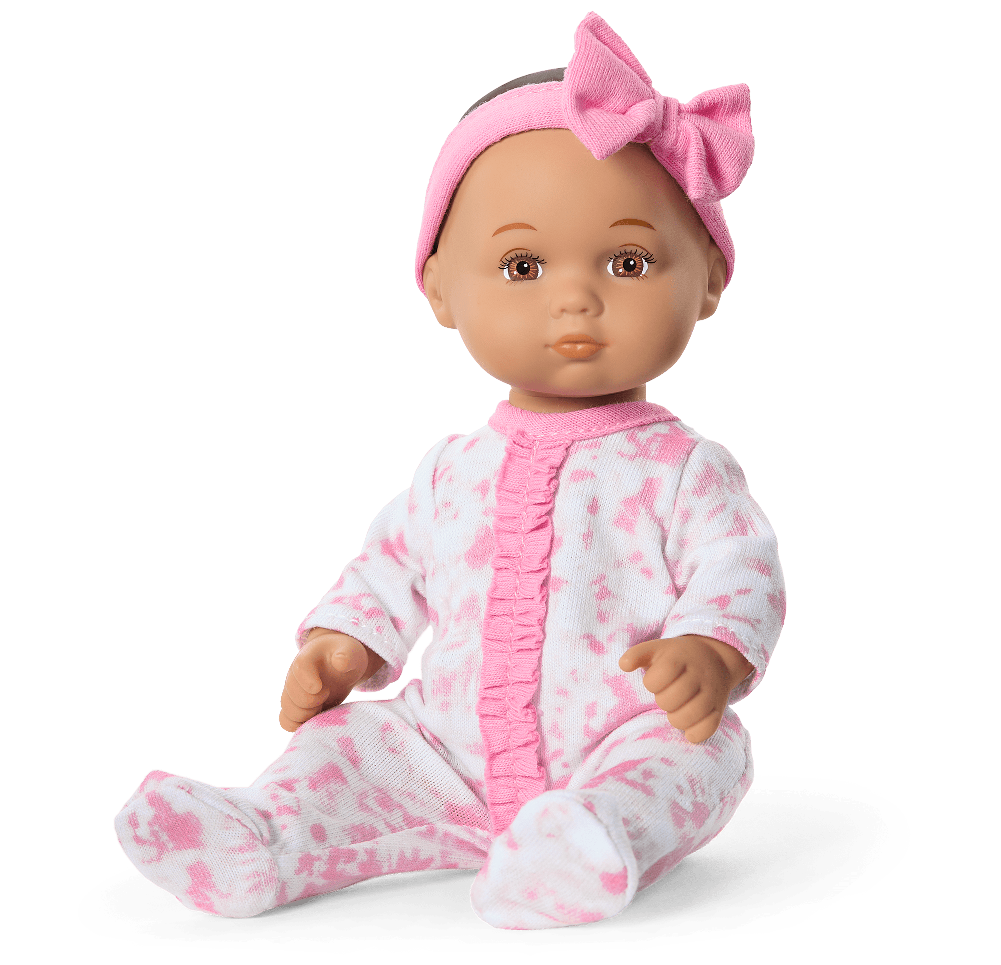
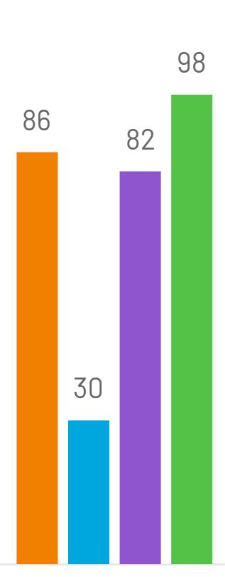
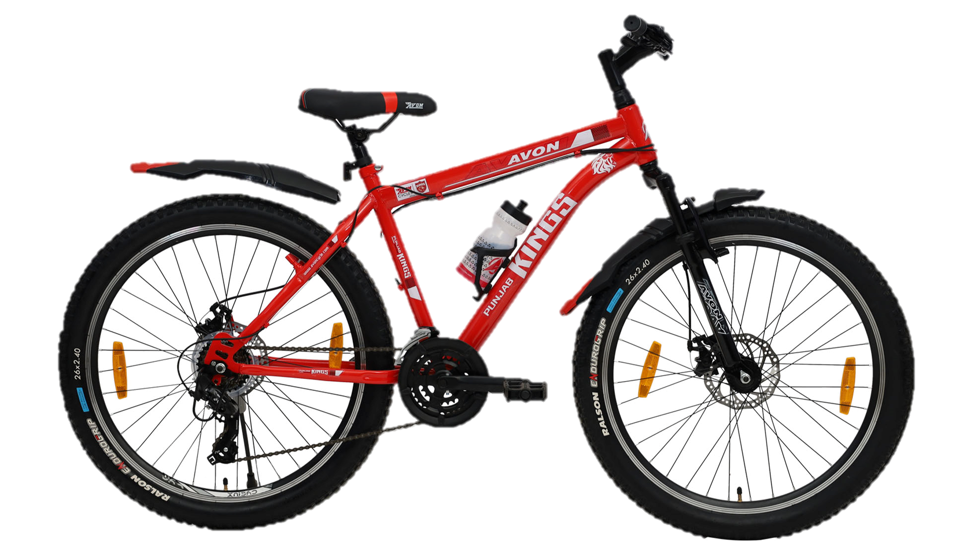
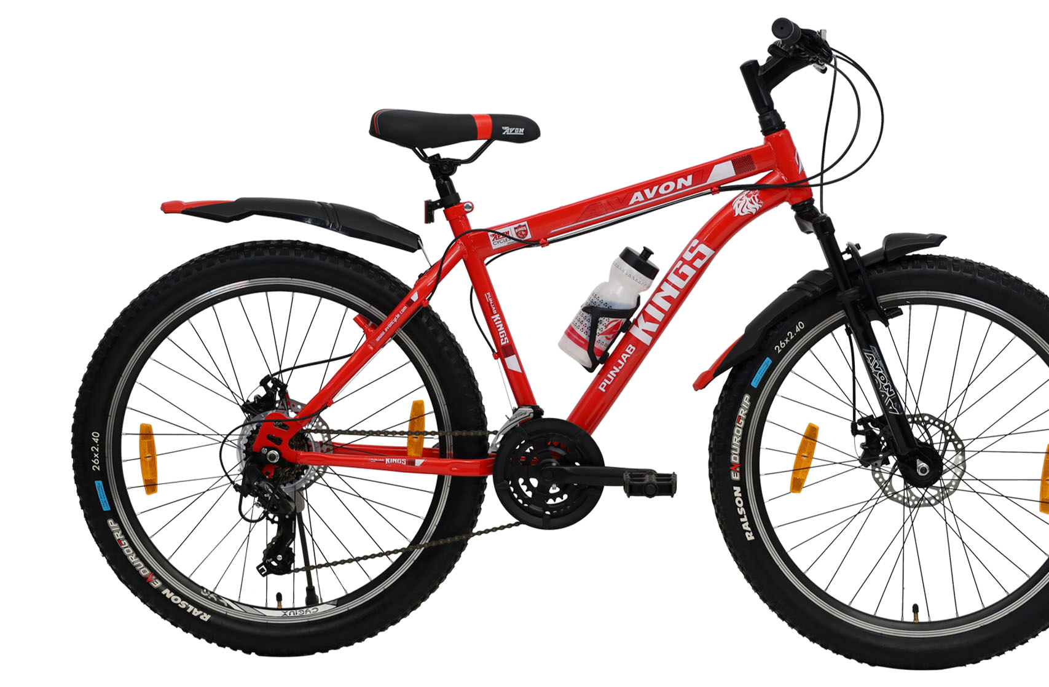
The gears
What are the typical inspiration sources for babies’ names in your culture? Nature? The ancestors?
Is it typical in your culture to give old names a little twist so you can come up with a new original name for a baby?
How open are the people in your culture to a new cultural trend? For instance, do many people start practicing any new sport that happens to become fashionable?
Uncertainty avoidance
Finland
Peru
Spain
USA
Argentina
China
Mexico
Uruguay
Eres de piñón fijo.
You are a fixed gear rider.

Slide 14
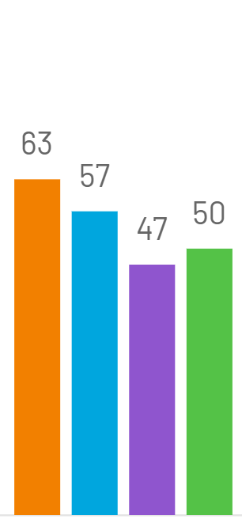
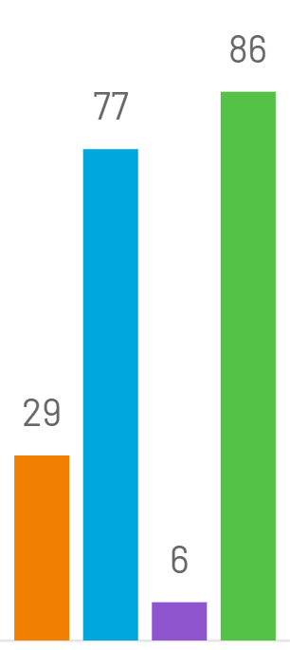
Formal interaction
You get an invitation to an important birthday, but you don’t feel like going. What do you do? Why?
You go anyway.
You openly refuse to go.
You think of an excuse.
How many guests are usually invited to weddings in your culture? Who pays for the wedding?
How are the religious authorities elected in different religions / Churches?
Who do the Catholics ask for help when praying?... Think again.
Long-Term Orientation
Finland
Germany
Spain
USA
Argentina
China
Mexico
S. Korea

Slide 15
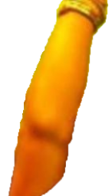
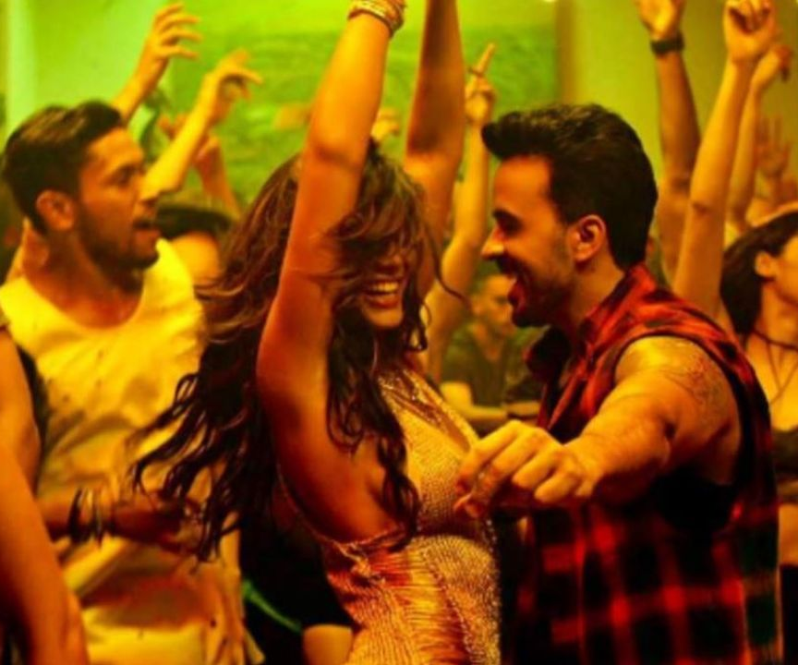
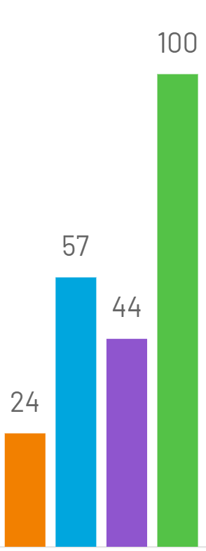
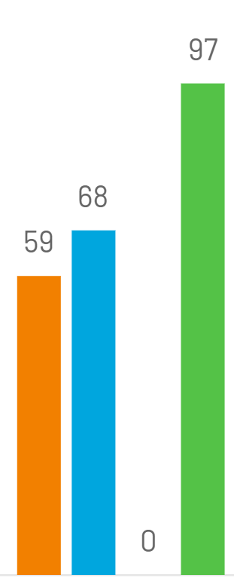
Impulsiveness
How does people in your culture react when someone…
smiles a lot?
tells jokes?
talks loudly?
gossips?
dances publicly when music is played?
wolfs his/her food down?
drinks some beer or wine during a break at work?
swears?
is clumsy or a coward?
Indulgence
China
Finland
Spain
Venezuela
Brazil
Chile
Egypt
Mexico
What are the worst faults someone can have?

