Slide 1
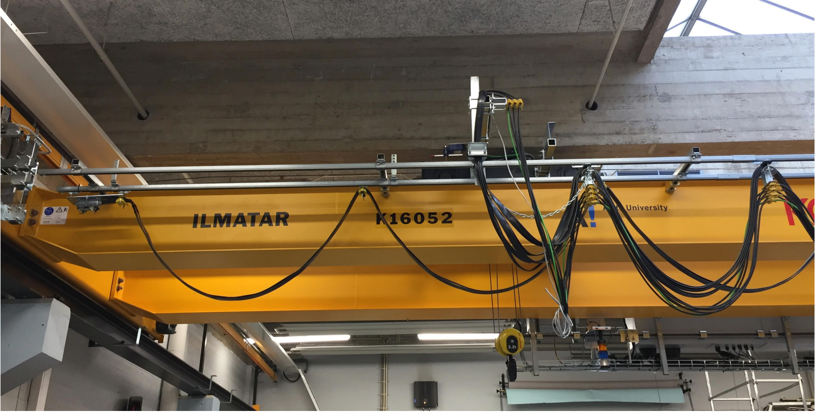
Project work MMD
25.01.2021
Riku Ala-Laurinaho
Anna Nikander: User experience Challenges in Designing Industrial Internet of Things Applications. 2020. B.Sc. Thesis. Aalto

Slide 2
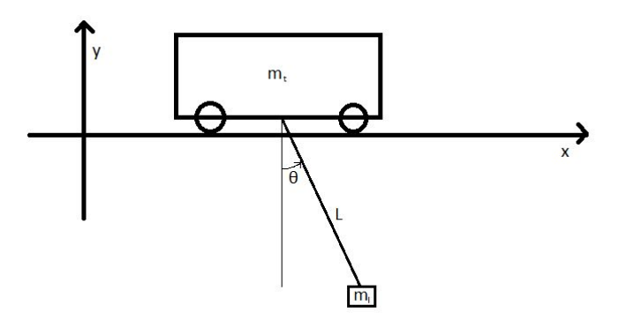
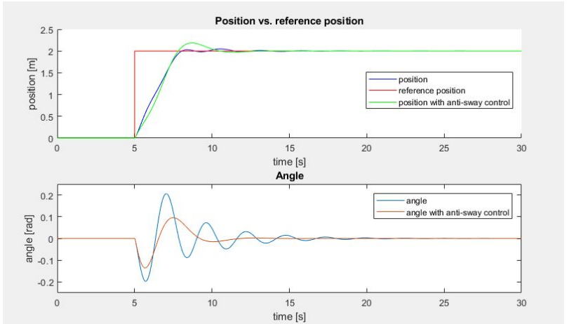
Idea: Build an anti-sway control for an overhead crane
Derive equations for pendulum
CAD modelling and component selection
Build a model using Simulink or Amesim
Design and implement an antisway control mechanism (for ex, PID or LQR)

Slide 3
Step 1: Background study/startup submission (5p)
Startup submission is intended to get you started and familiarize you with the topic, DL Sun 7th February 11:55 pm
Find two academic articles on topic (2p)
Worth to spend time on, you can for example get help for deriving equations for the pendulum
Sketch pendulum and consider how the angle is measured (1p)
Describe how you will solve the remaining tasks (2p)
For example, will you use miniature scale, which CAD software you will use

Slide 4
Step 2: Numeric modelling (5p)
a) Make force equations for horizontal and vertical forces in your system according to the Newton’s Second law of motion. (1 p)
b) Form the nonlinear equations of motion that are needed for creating the simulation model of the system. (2 p)
c) Form the linear equations of motion that are needed for creating the simulation model of the system. (1.5 p) 3 rules!
d) What does linearization mean and why is it often necessary in control systems? (0.5 p)
This might be a little bit tricky. However, there are a lot of material about (inverted-) pendulum in Internet .
Tip: Lagrangian kinectics and Lagrangian equations. L = T − V, T = kinetic energy, V = potential enegy

Slide 5
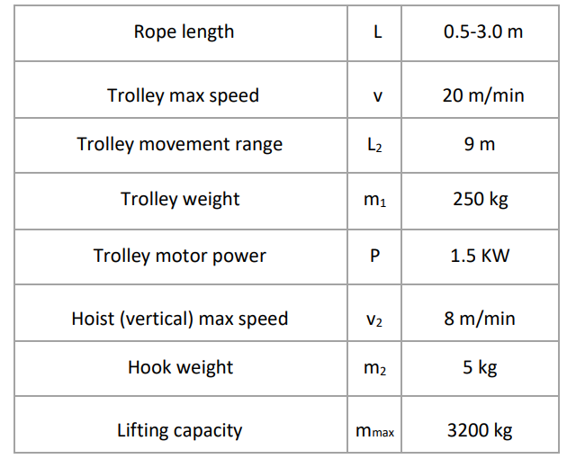
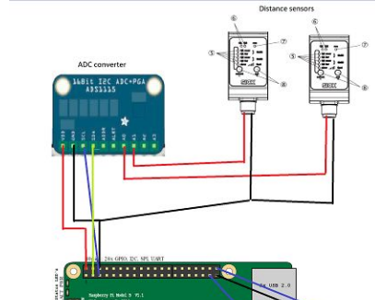
Step 3: Component selection (6p)
For component selection you need to decide the size of the crane
Ilmatar specification can be found from (connect to Aalto VPN to get access) https://doi.org/10.1109/WF-IoT.2018.8355217 or project work document
You need to select:
Actuator moving the trolley (1.5p)
Sensor measuring the rope angle (1.5p)
Electric components: controller and power supply (2p)
Draw a sketch of electric circuit (1p)

Slide 6
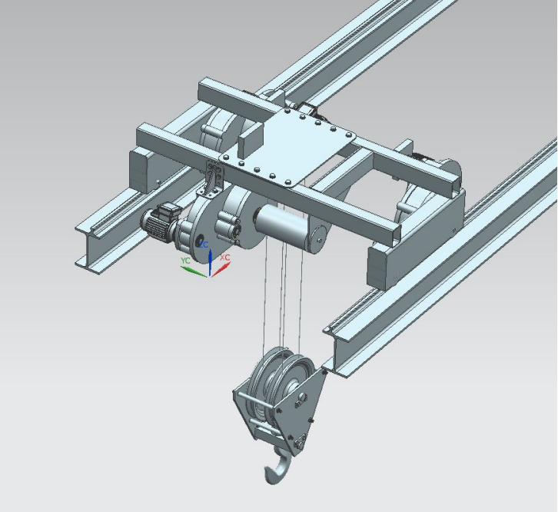
Step 4: CAD modelling (5p)
You can use any CAD software
Please, include a few photos, so that it is clear and easy to see if the component is modelled or not
0.5 points modelled, 1 point modelled in detail
1. Hook, trolley and rail frame modelled (1p)
2. Actuator and sensor modelled (1p)
3. Bearings and couplings/gears/belts modelled (1p)
4. Electronics modelled (e.g. controller and power supply, wires NOT needed) (1p)

Slide 7
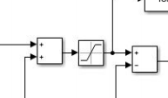
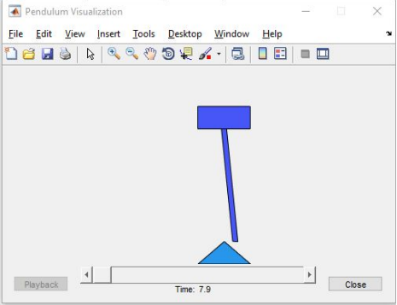
Step 5: Simulation and control (8p)
Make a Simulink model based on equations (2p)
Make visualization, does not have to be fancy (example video with penddemo) (2p)
Introduce sway control (4p)
Control performance (2p)
Control method (2p)
PID with manual tuning 0.5p, PID with more advanced tuning 1p
LQR 2p

Slide 8
Step 6: Feeback (1p)
Did everyone participate to the project equally?
How many hours in total did you spend (per person) for the project?
How difficult was the project?
Do you think that the topic of the project was interesting and useful?

Slide 9
Presentation Tue 16th February 9-12
Each group gives max 5 minutes, can be less, you can aim to 3 minute-presentation
Only few slides (3-5)
Concentrate on one aspect you found interesting. For example: deriving equations, CAD modelling, building simulation model, control algorithm…

Slide 10
Some practicalities
DL Sun 28th February, note: presentation already 16th.
If questions, send me email riku.ala-laurinaho@aalto.fi
The project work is laborious, so, please, reserve enough time. Starting at the final week is not possible
We strongly recommend 3 persons per group to share workload
Workload approx. 20-40 hours per person

