Slide 1
S-group personal data management
Presentation
2.4.2019
Kai Kuikkaniemi

Slide 2
About S-group

Slide 3
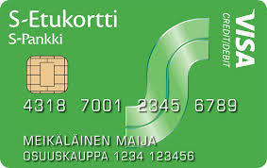
S-group in a Nutshell
Big Finnish Co-operative Consortium
20 local co-operatives joined together + some international businesses
Grocery is the Core Business
Market leader in Finland
Over 40 000 Employees total
Depending how you count it, the S-group one of the biggest private employer in Finland
Popular loyalty card system
2.4 Million+ customer owners

Slide 4
S-group is a business ecosystem Our businesses and partners are market leaders or on top in their businesses areas
Loyalty Partners
20 local co-operatives
Supermarket
Department stores
Gas Stations
Hotels and restaurants
Hardware
Bank
Local businesses
10+ restaurant chain brands

Slide 5
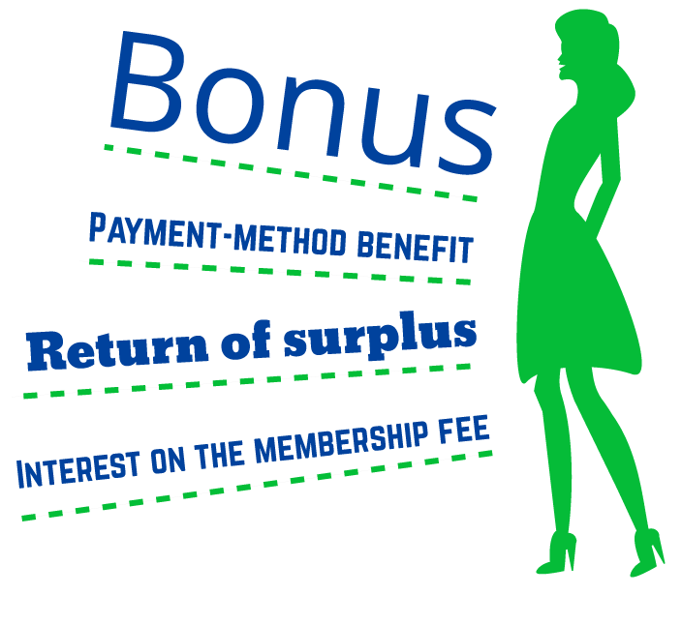
Co-op membership
S Group is owned by its more than two million co-op members.
Members enjoy a broad range of services in all of Finland. The more you use the services, the bigger the benefits.
The number one benefit is the Bonus reward. In 2017, the Bonus rewards paid to co-op members totalled EUR 334 million.
Other monetary benefits of co-op membership are the payment-method benefit, surplus return and interest on the membership fee.
2.35 Million Co-op members in 5.5 Million population
Registered household members approx. 4 million
Co-op members are identified

Slide 6
S Group’s key figures in 2017
Retail sales (excl. taxes) | €11 billion
Operating result | EUR 344 million
Investments | EUR 492 million
Outlets | 1.631
Employees | 39.382
Co-op members | 2.35 million
Bonus and other monetary benefits in total | EUR 382 million 130+EUR / member

Slide 7
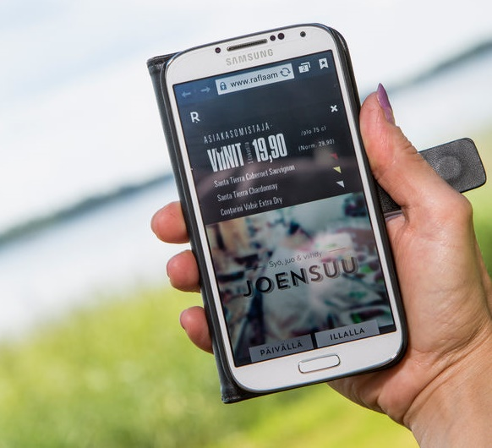
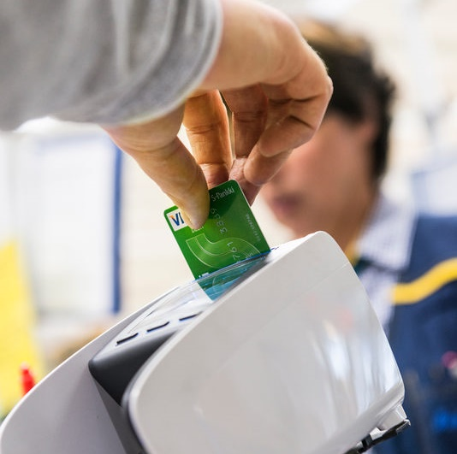
What kind of use cases drive personal data management and identity and access management?
Personalized physical and digital services
better customer experience
better service
Targeted digital marketing and customer journey management
Efficient self-service of Co-op membership and loyalty and retail in general
Kuvat: Harri Mäenpää, Nina Kaverinen, Lauri Mannermaa

Slide 8
What is personal data platform
Mobile clients
Web clients
Customer
Service
Social media
& Messaging
External data
Personal data and identity platform
Platform identity, authorization, core data, access management, sessions
Client registration
CRM
Marketing automation
Event data management
Core sytems
(POS)
Analytics
Data
science

Slide 9
Customer data should be divided according to core structures
Customer data
Identity and
Basic info
Purchase data
Event data
Profile and preference data
Customer ID
Name
Contact address
All shopping transactions
Receipt details
Web site visits
Service logs
I am vegetarian
Governacne models should not be generic only, but focus on specific data charasteristics

Slide 10
POS data anatomy
IAM/IDM
Profile data
POS Data (payment, core transaction details, ID)
Purchase data
DAM
Digital Asset
Management
Or
Product Content
Master
Context data
Data about shops
PIM
Product
Information
Management
External
Product
Attributes

Slide 11
Bonus is money
Data is
MyData

Slide 12
Examples what we do

Slide 13
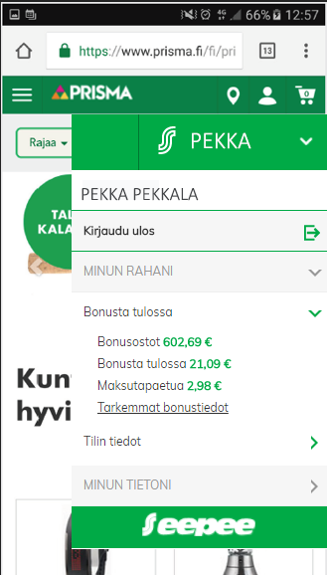
Example for app to web transition
the user is logged in
Application, and intends to move to a web shop
User is informed about the transition. The user can also move in as anonymous user
User is logged in web store
User has access to personal data
S-mobiili application + S-identification
Prisma web store
Prisma web store
S-mobiili application

Slide 14
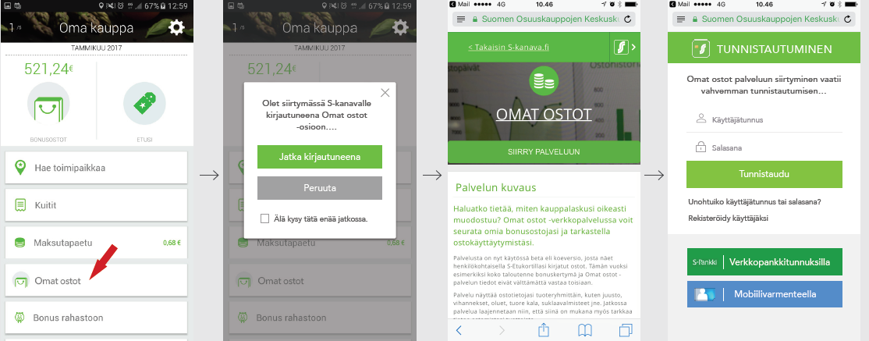
An example of upgrading level of assurance during service use
the user is persistently logged in to our loyalty mobile application, and intends to view more purchase details
User is informed about the transition. The user can also move in as anonymous user by logging out in this point
User is logged in web service and wants to access to a service which contains sensitive purchase data (all details)
User is forced to upgrade the level of assurance with strong authentication (national standard)

Slide 15
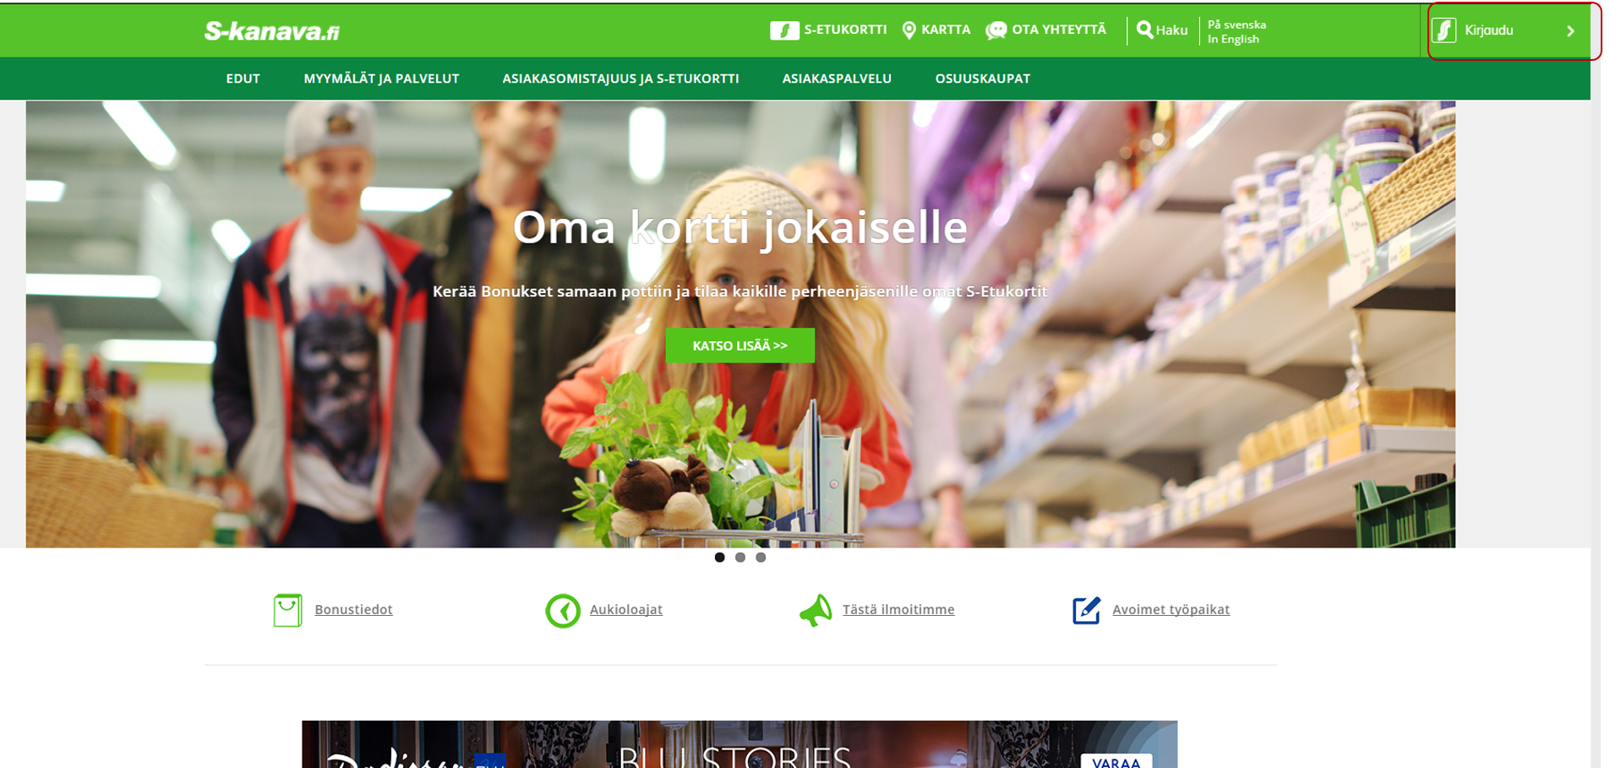
examples from the s-group's web pages

Slide 17
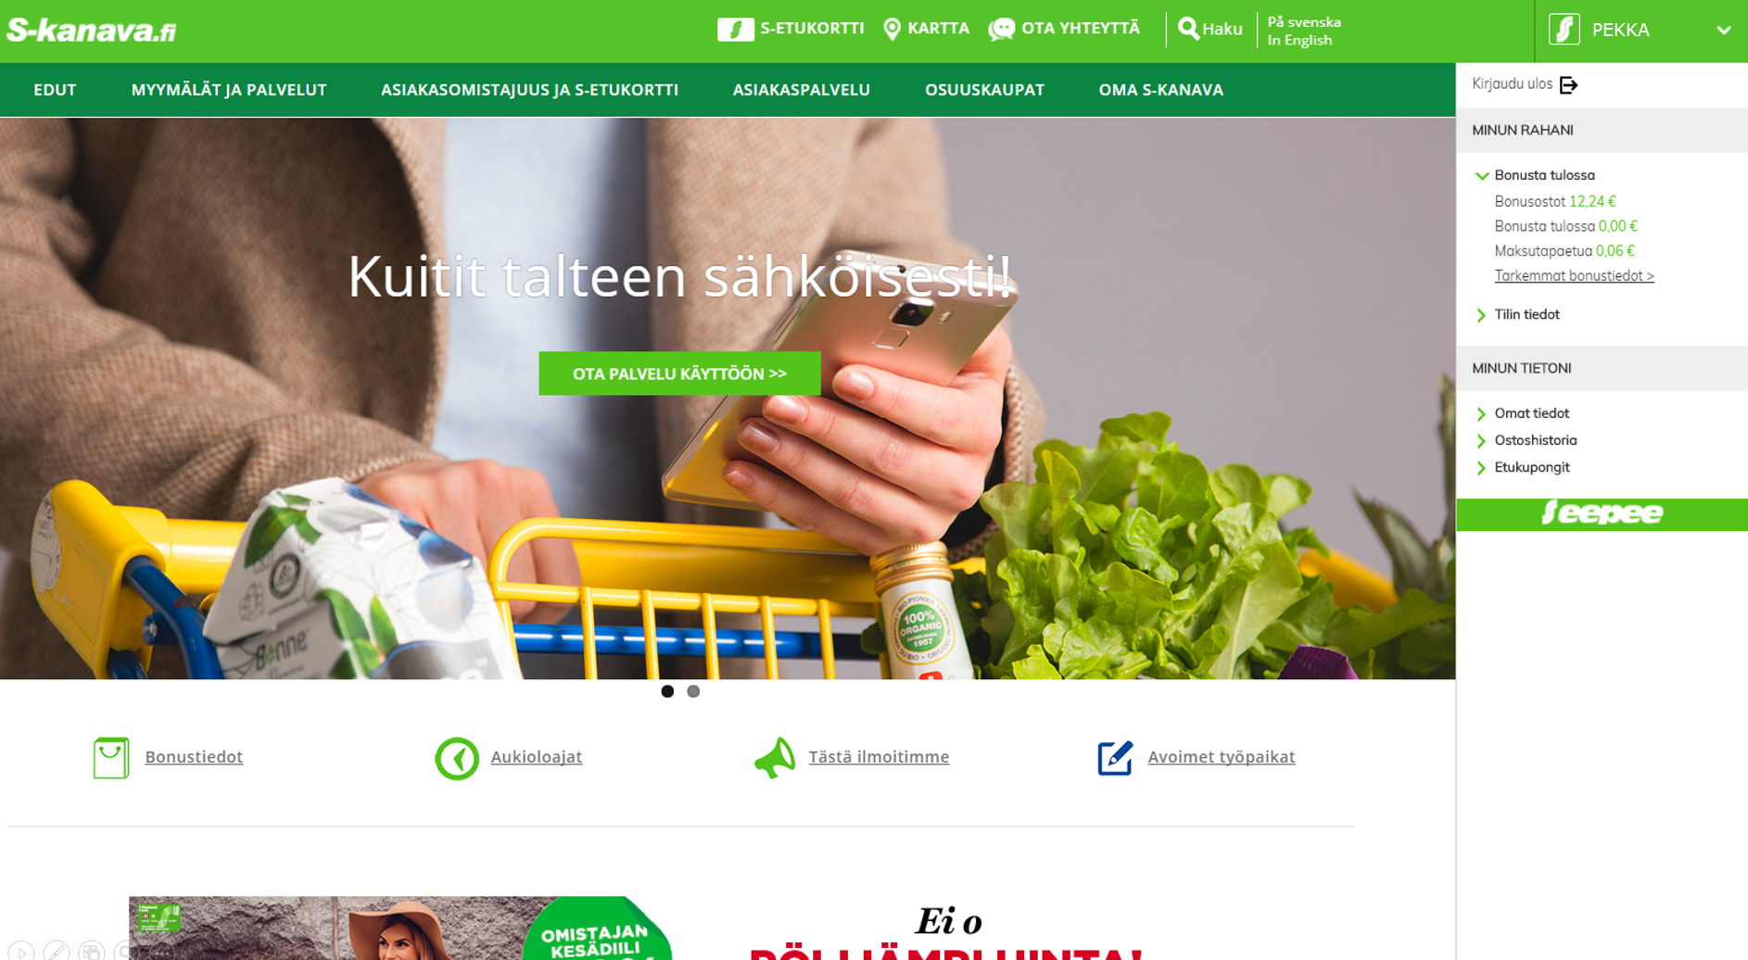

Slide 18
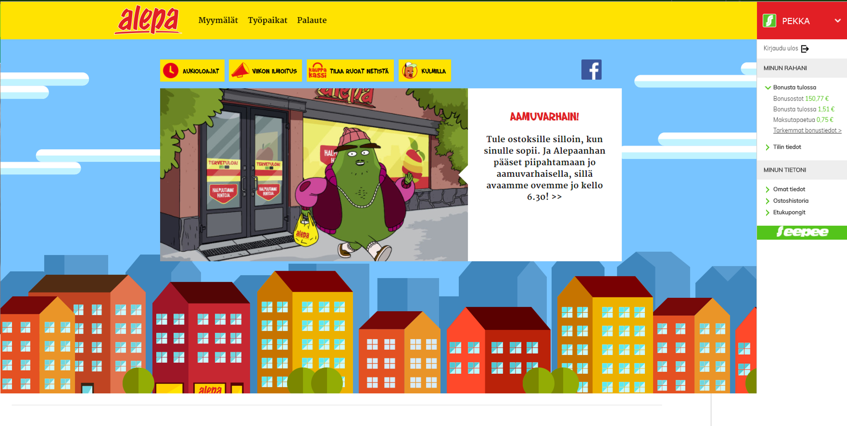

Slide 19
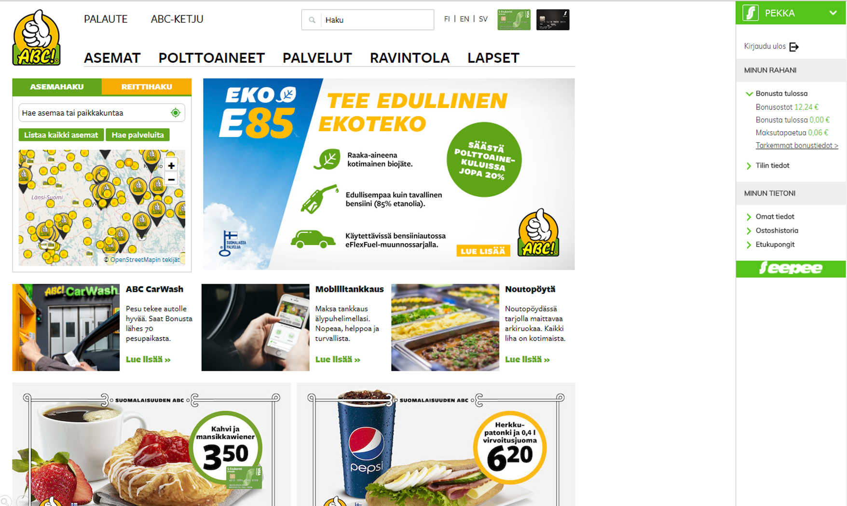

Slide 20
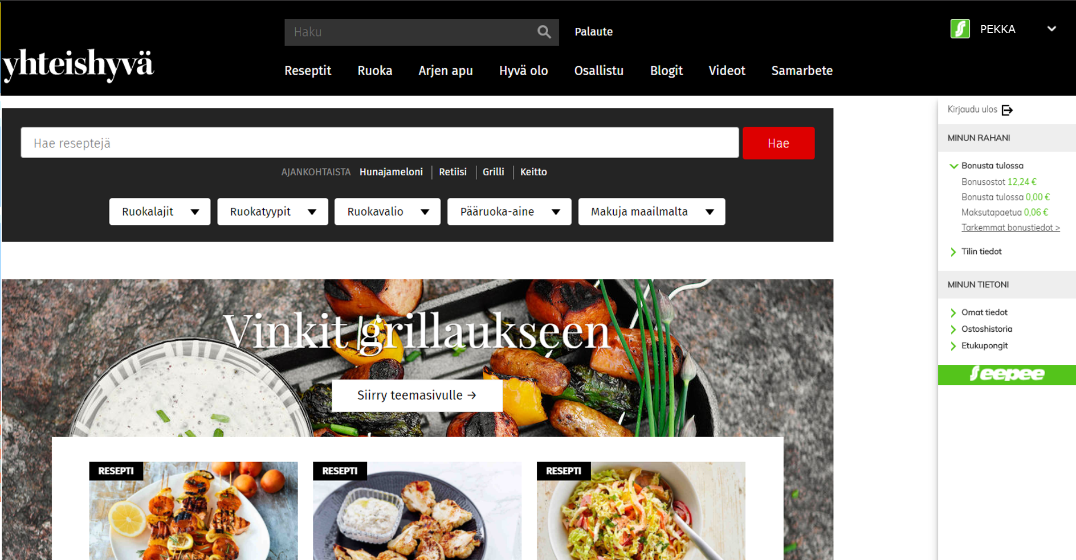

Slide 21
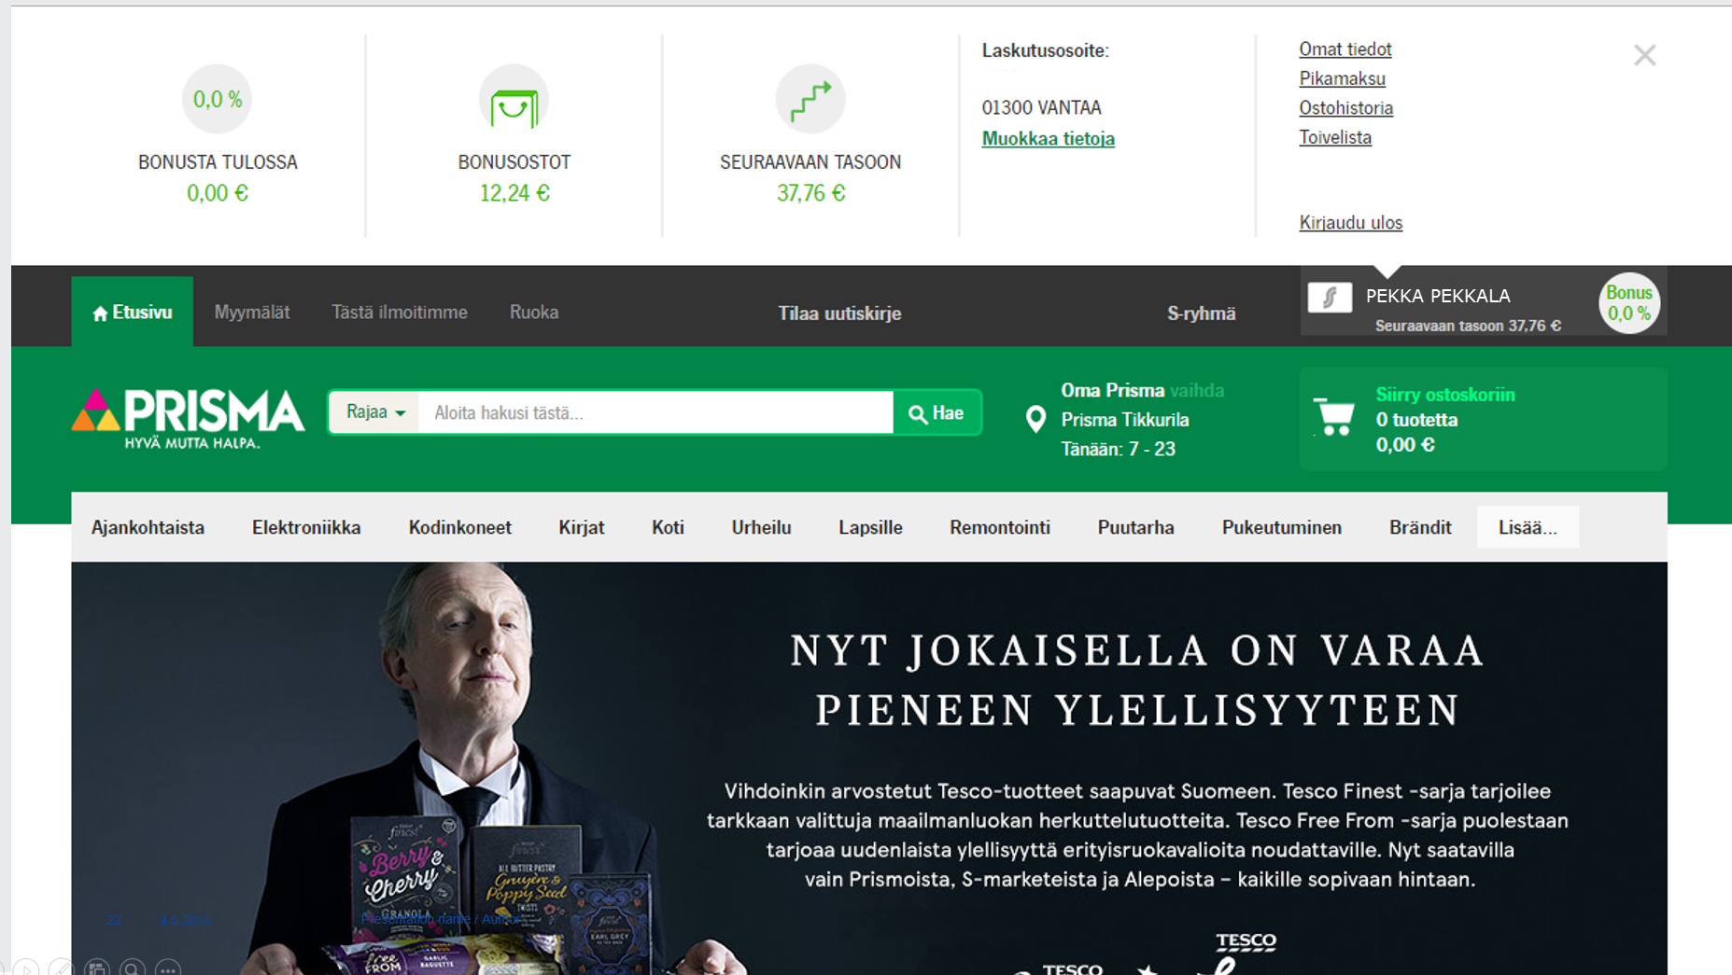

Slide 22
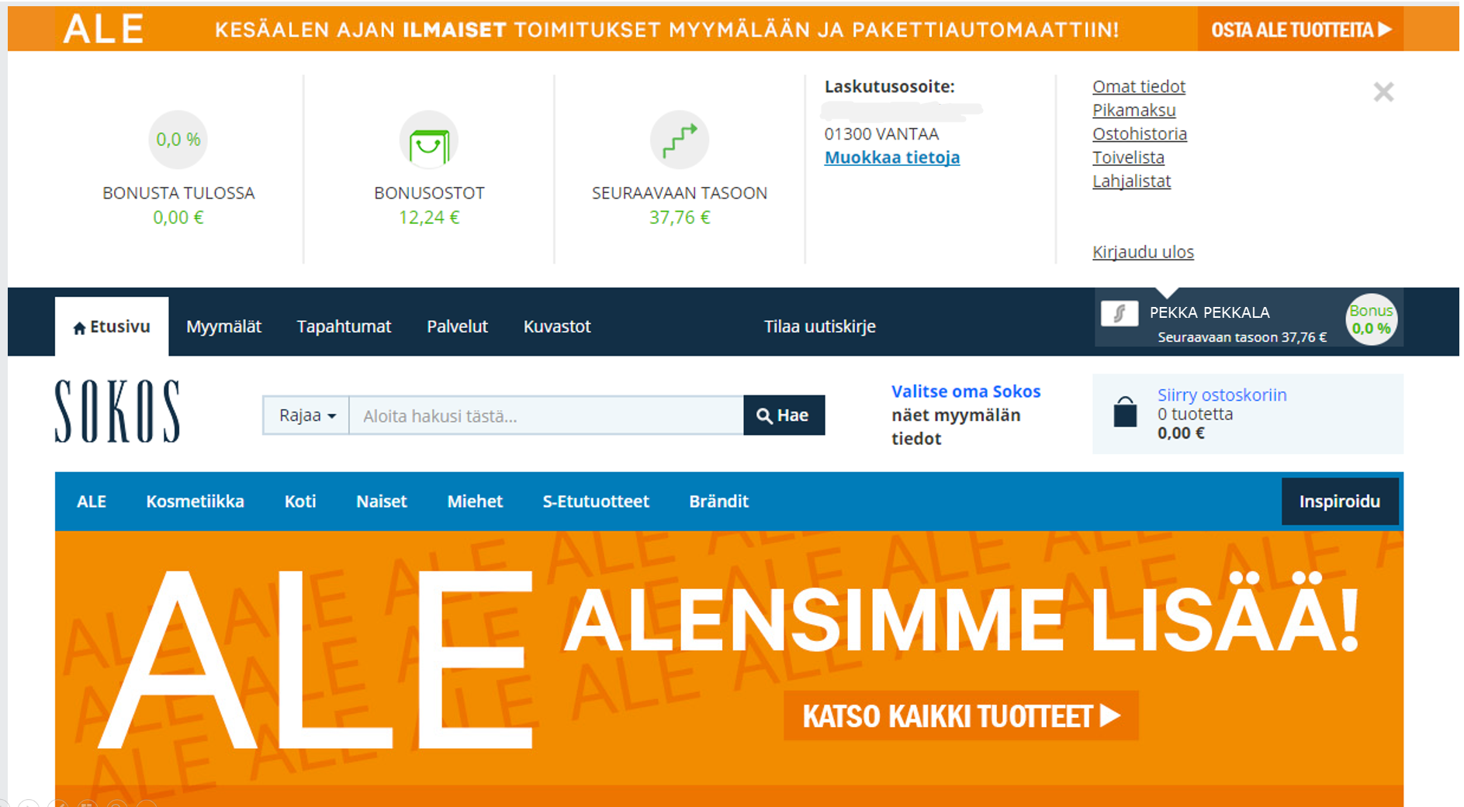

Slide 23
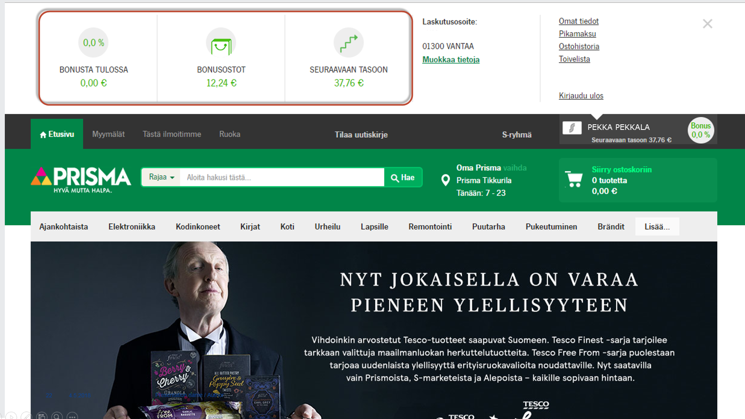

Slide 24
Our core challenges

Slide 25
Managing and implementing levels of assurance
 | Erittäin heikko (0.5) | Heikko (1.0) | Vahva (2.0) | Vahvennettu (3.0)
Identity | Unregistered identity | Registered identity | Identified identity | Very strong authentication
Authentication | Light implicit authentication | Strong implicit authentication and light sing-up | Multi-factor authentication | Very strong authentication
Federation | Link without contract | Light contractual trust | Strong contractual trust and audit access or national trust framework | Regulated federation / national level
How to manage LOA in multi-channel, multi-business, multi-capability framework (with varioud legal frameoworks)

Slide 26
Integration of bank and retail authentication and identities
We aim at seemless integration of retail identity and bank identity
We require still clear organizational separation because of different organization and legal basis
Retail cash-back is paid to S-banks account as straight cash ⬄ Concepts are fundamentally connected. Many people do not distinguish these two organizations
Many collaboration opportunities such as PSD2, EIDAS, cardless payment, customer 360
Bank critical features | Retail critical features
Part of national trust framework Always strong authentication Bank app as a 2FA authentication method | Different kinds soft authentication Large amount of different kinds of channels Optimize purchasing usability In-store authentication

Slide 27
Household identity (HIAM)
Our loyalty is a progressive cash-back model based on household’s cumulative purchase total
There is always a co-op member that own’s the household (main member)
Main member has certain priviledges over common data
Common data, sharing and digital service use with the group identity cannot be centralized to only one household member, but more group member options are needed
Related to group privacy concept and ourdata
➔ The household identity concept and all different roles and elements of it should be easy and comprehensive for the customer
Sharing, common data management and service use with the group identity
Digi
ID
Digi
ID
Digi
ID
Household level common data
Household based progressive loyalty framework
Co-op
Member
Loyalty master

Slide 28
One ID – multiple business units
We aim at one master B2C customer identity, which is connected to our loyalty framework (customer 360), but how do we support the complex ecosystem considering different business and partners
Some core challenges:
Legacy IT / Legacy CRM in different business units
Bank customers as part of S-group’s customer 360
Some of the business units have independent legal registry
Sometimes users want to be just customers of single BU, not customers of S-group as a whole. How to manage this with customer 360 and centralized identification and personal data management without complex merging / duplicate elimination processes.
We have soft registration (and upgrades) and strong registration depending on customer life-cycle

