Slide 1
Evaluation Laura Isoniemi 14.2 2019
Tiling games

Slide 2
Task
Each group get own box of different selected tiles
The content of the boxes are different and also benefit both mathematical issues and aesthetic elements in design
Each group creates at least 3 as different surface versions with the given tiles as possible
Prepare to present 3 versions by pictures

Slide 3
Group Estimators
Elements:
Matt hexagon
Mirror hexagon
Opposite elements
One shape in two color variations

Slide 5
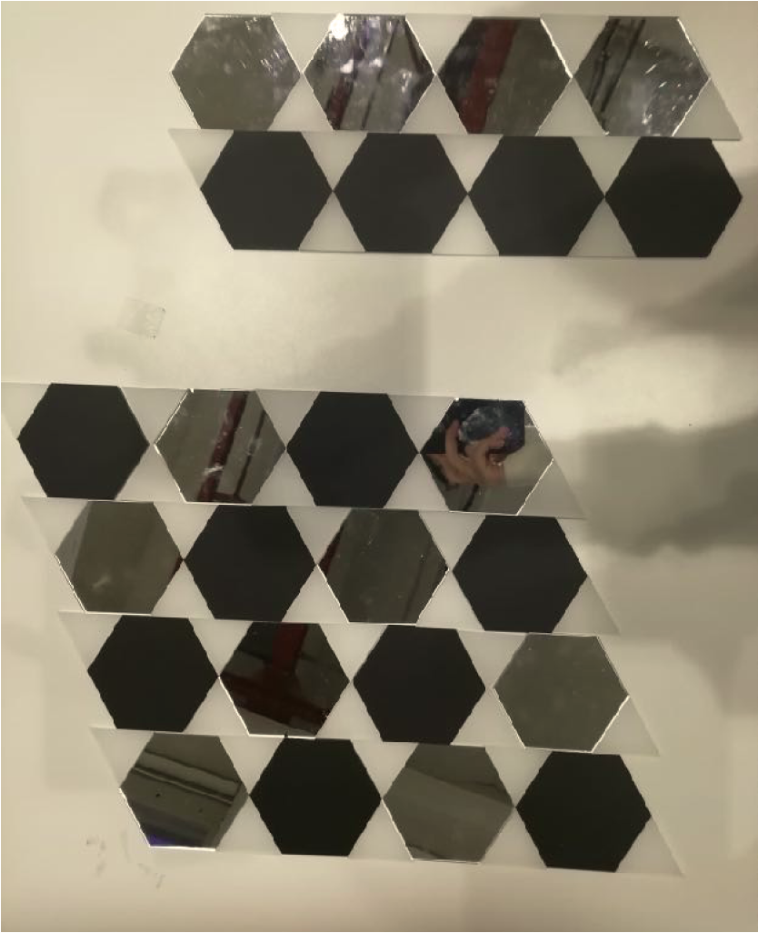

Slide 6
Group Trouble makers
Elements:
Hexagon
Matt black
Matt Wooden
Opposite materials
( wood –plastic)
Contrasts in use :dark/light

Slide 7
Both hexacons in use
One hexacon in use

Slide 8
Piled tilings

Slide 9
Group Ais- T
Elements
Square
hexagon
shiny blue
matt wood
two shapes and their variety of repetitions

Slide 10
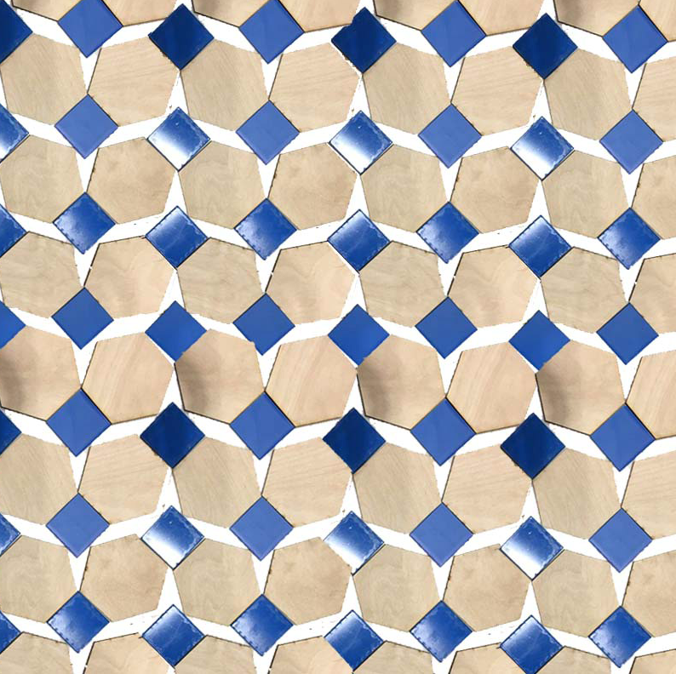

Slide 12
One element in use

Slide 13
Group Not a robot
Elemements
3 shapes
Triangle,hexacon,square
Matt black
Wood
Shiny black
Big variety of possibilities in colorwise and repetition wise

Slide 15
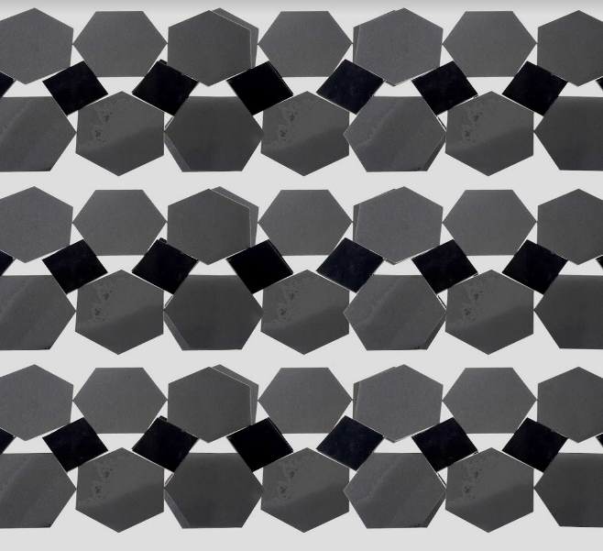

Slide 16
Group Susy
Elements:
Triangle shape
Shiny red
Matt wood
Opposite materials
Only one variant in shapes
2 variants in colors

Slide 19
Group Peace of the Pi
Elements:
Square shape
Matt transparent white
Shining black
(opposites in colors
and existence)

