Slide 1
opportunity prototyping
Peter Kelly (peter.kelly@aalto.fi)
Connector @ Aalto
Visiting Professor of Business, Trinity College Dublin
Academico Visitante Internacional, MADA Design School Santiago del Chile

Slide 2
how do you know an
opportunity
when you see it?

Slide 3
why is
prototyping
a good approach?

Slide 4
Notes:
WE THINK THE CHALLENGE IS CATCHING THE ROADRUNNER

Slide 5
Notes:
EVERY PROBLEM REQUIRES A STEP BY STEP APPROACH – ENGINEERS LOVE THIS ---
BUT THINGS NEVER GO ACCORDING TO PLAN AND USUALLY HAVE BIG UNKNOWNS

Slide 6
Notes:
GOOD CUSTOMER WITH CASH. TOLERANT OF SOLUTIONS THAT DON’T WORK!
IF YOU HAVE A NEW SOLUTION – WHAT MAKES IT DIFFERENT THAN WHAT HAS BEEN TRIED BEFORE

Slide 7
I
D
E
A
P
L
A
N
€
$
£
¥
E
X I T
Notes:
LINEAR LOGIC TO SOMETHING THAT IS ANYTHING BUT LINEAR
AND THIS EVEN PLAYS AT A BIGGER LEVEL – I ”PLAN” TO BE AN ENTREPRENEUR – WHAT DOES THAT PROCESS ENTAIL?

Slide 8
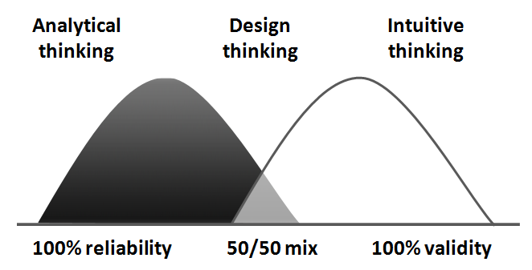
Notes:
ANALYTICAL TYPES LIKE DATA – THEY LOOK FOR RELIABLE SOLUTIONS –
DEMONSTRABLY WORKED BEFORE ---

Slide 9
see opportunity
sense customer pain
believe they can make a go of it
feel time is right to act
Notes:
THERE IS A LOT OF EMOTIONAL ENERGY AND CREATIVE EXPLORATION GOING ON WHEN LOOKING AT …

Slide 10
novelty
is the quality of being new, or following from that,
of being striking, original or unusual. Novelty may
be the shared experience of a new cultural phenomenon or the subjective perception of an individual

Slide 11
Notes:
ANALYTICAL TYPES LIKE DATA – THEY LOOK FOR RELIABLE SOLUTIONS –
DEMONSTRABLY WORKED BEFORE ---

Slide 12
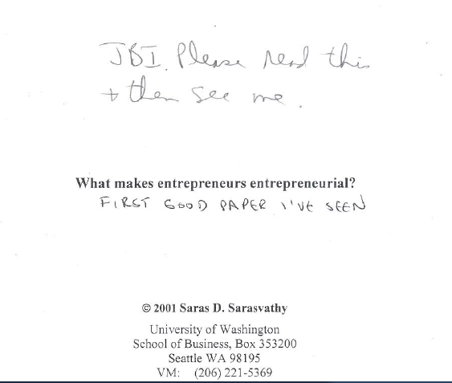
Notes:
Note the dates

Slide 13
means

Slide 14
passions
skills
networks

Slide 15
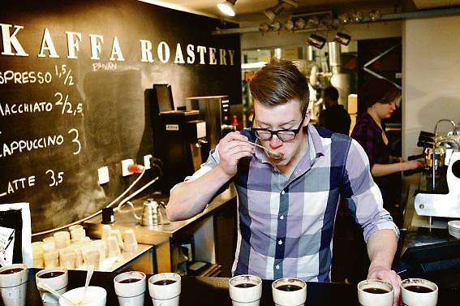

Slide 16
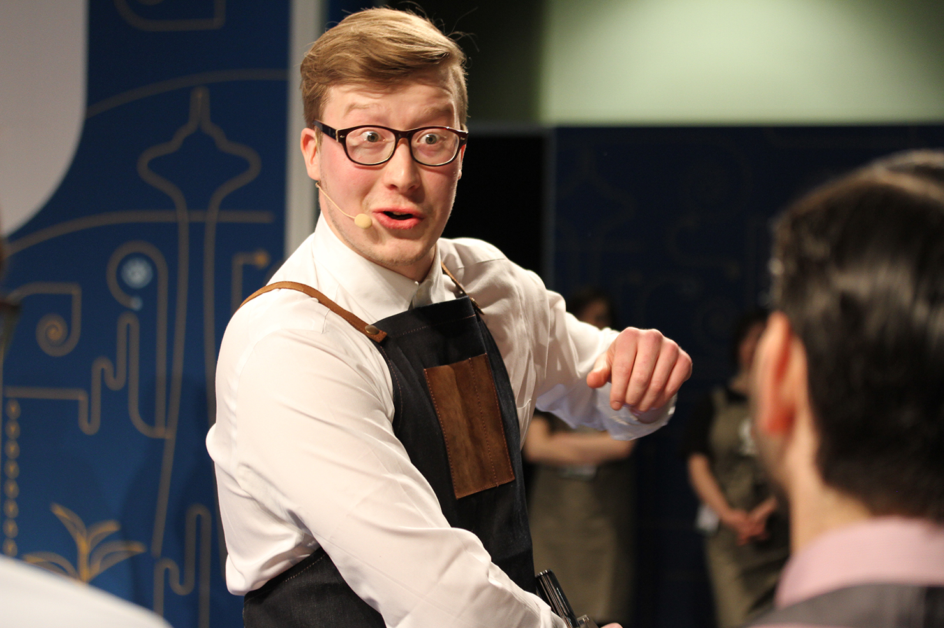
Notes:
2013 & 2015 Nordic Barista of Year #9 in world
Look at those eyes – you know he is into coffee –

Slide 17
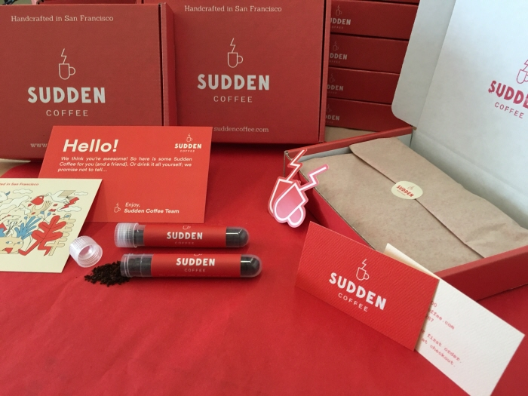
Notes:
RAISED $5 MILLION – INITIALLY A SUBSCRIPTION SERVICE B2C BUT PIVOTED TOWARDS A B2B MODEL but at $6 per cup how to scale
MAKING INSTANT COFFEE FOR ESTABLISHED BRANDS could not raise money to build a factory

Slide 18
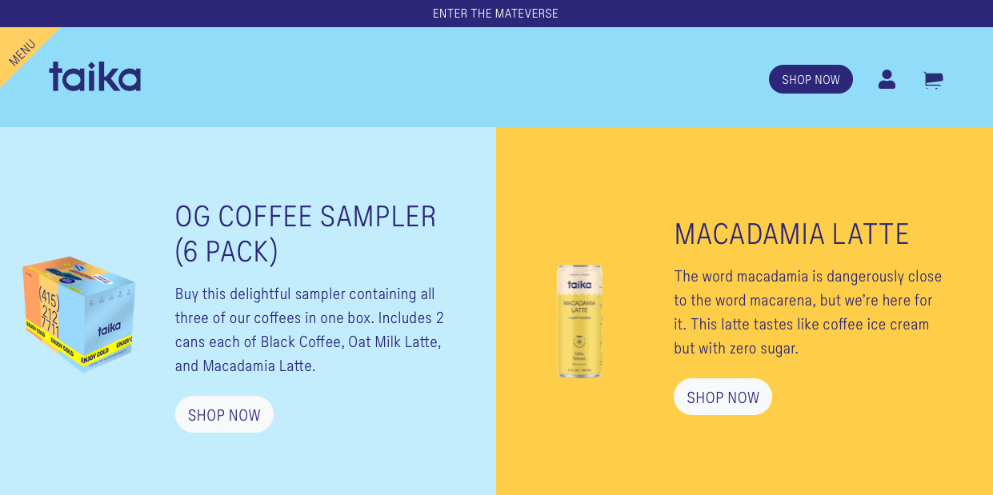
Notes:
TAIKA – raised $3 million to produce ADAPTOGENIC coffee

Slide 19
top 0,0001% (1 in 1000)
45
&
Notes:
MIT Professor Pierre Azoulay (and others) looked at new firms established in US 2007-2014
AVERAGE AGE AT START 41,9 YEARS
HIGH TECH 43,2 (41,5 SILICON VALLEY)
VENTURE CAPITAL BACKED 41,9 (40,2 SILICON VALLEY)
TOP 0,1% PERFORMERS (45)

Slide 20
passions
skills
networks

Slide 21
affordable
loss
Notes:
TO MAKE IT BIG YOU NEED TO THINK SMALL
INVESTMENT IN TIME (AND MONEY)

Slide 22
experiment
prototype

Slide 23
5127

Slide 24
Notes:
15 years of working in the basement, 5127 prototypes before hitting on the one launched in 1993
Filed 1100 patents on 175 inventions --- existing players wanted to sell BAGS

Slide 25
co-creation
Notes:
ENGAGE OTHER PARTIES WHO ARE ALSO PREPARED TO EXPERIMENT AND AFFORDABLE LOSS

Slide 26
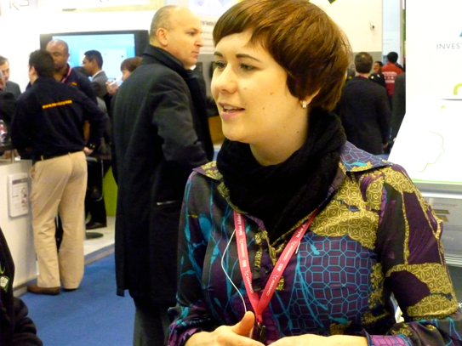
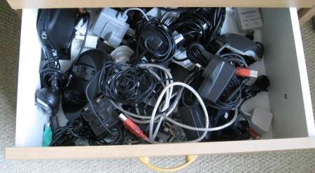
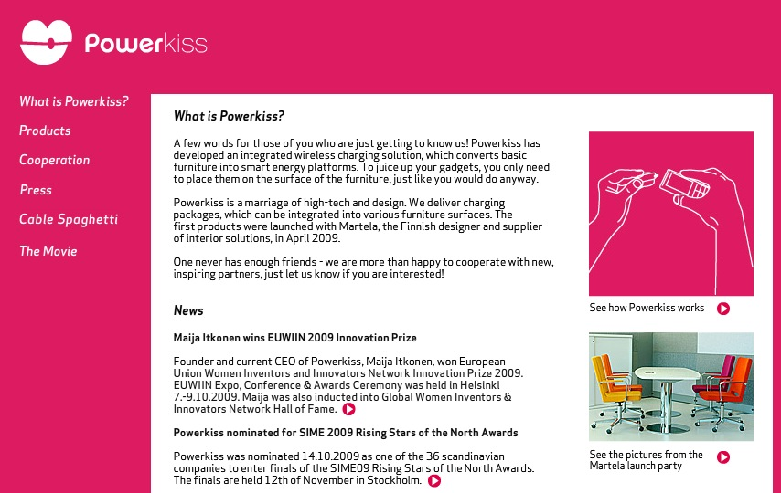
Notes:
INVESTORS ARE CO-CREATORS, FOUNDERS, PARTNERS, CUSTOMERS

Slide 27
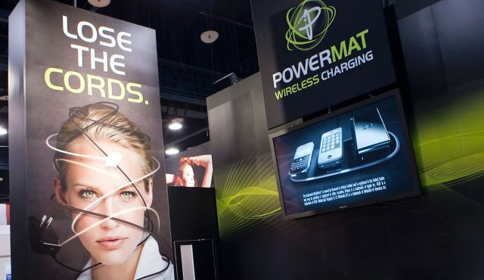
Notes:
As seen at JFK airport terminal 8 –
May 2013 they buy the business ---
Entrepreneur reported a 600k capital gain (36)

Slide 29
Notes:
POWERMAT IS WORKING CLOSELY WITH PROCTER GAMBLE WHO PRODUCE DURACELL BATTERIES

Slide 30
surprise
Notes:
WHAT DID YOU FIND OUT ALONG THE WAY THAT YOU DID NOT KNOW BEFORE YOU STARTED ???

Slide 31
youth
hostel
Notes:
What pops to mind?

Slide 32
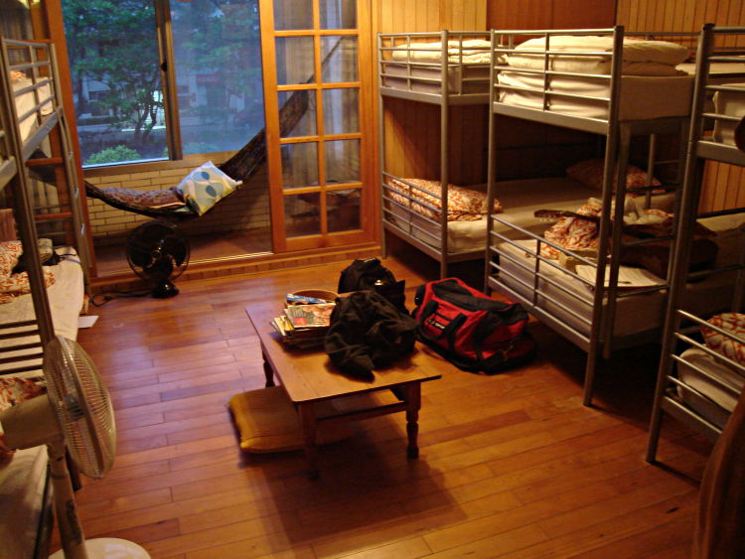
Notes:
OSKAR DIOS OPERATES A YOUTH HOSTEL IN UPPSALA –

Slide 33
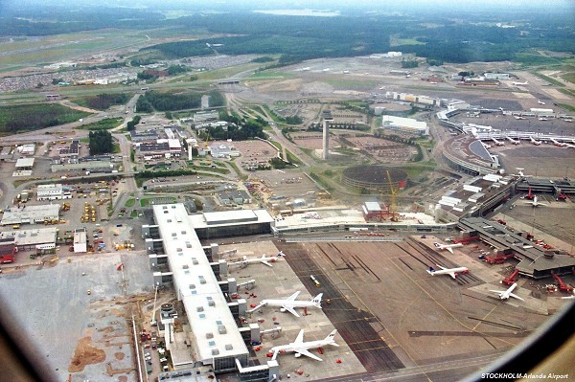
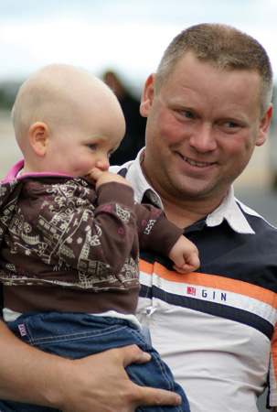
Notes:
OSKAR DIOS OPERATES A YOUTH HOSTEL IN UPPSALA –

Slide 34
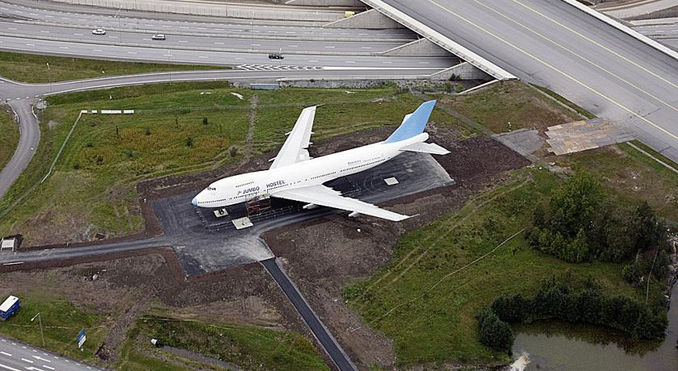
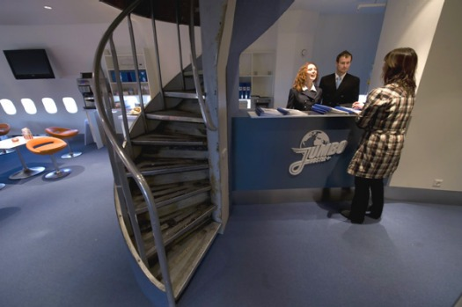
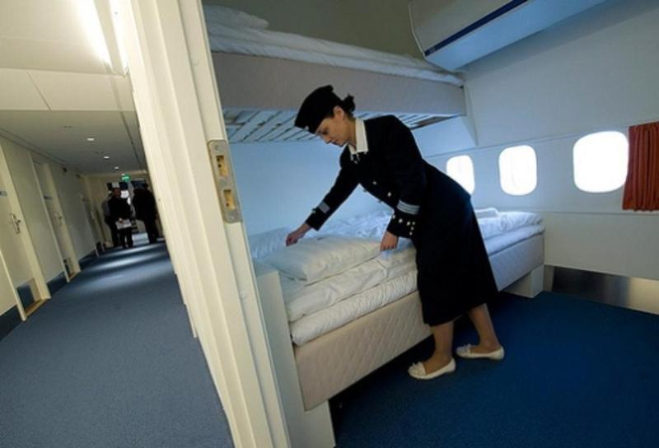
€2 million
Notes:
So negotiate the parking fines, cut down some fence, move it and retrofit (including staff)

Slide 35
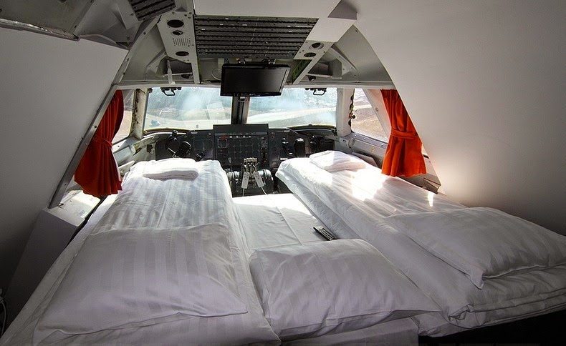
Notes:
Cockpit – aka the honeymoon suite

Slide 36
Notes:
Note the dates

Slide 37
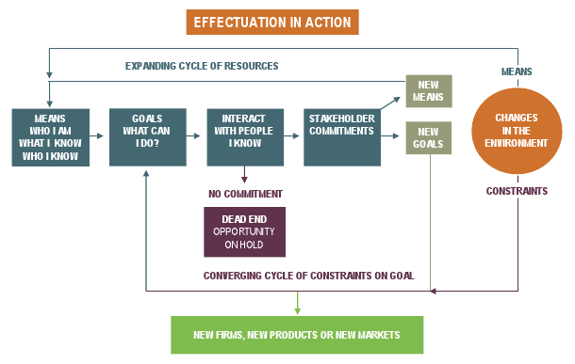
Notes:
THERE HAS BEEN REFLECTION – STUDY, EXPERIENCE AND OTHER FACTORS
+ VIEW OF THE FUTURE

Slide 38
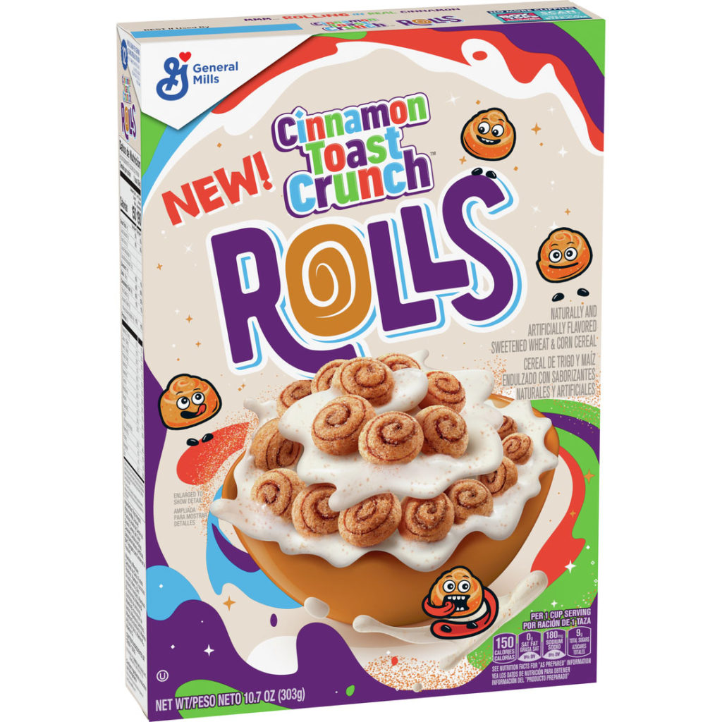
Notes:
THIS NEW PRODUCT IS 1 YEAR OLD BY THE TIME IT HITS THE SHELF FOR THE FIRST TIME

Slide 39
driven by a
vision of the
future

Slide 41
Notes:
THERE HAS BEEN REFLECTION – STUDY, EXPERIENCE AND OTHER FACTORS
IMMEDIACY (ACTION NOW)
+ VIEW OF THE FUTURE

Slide 42
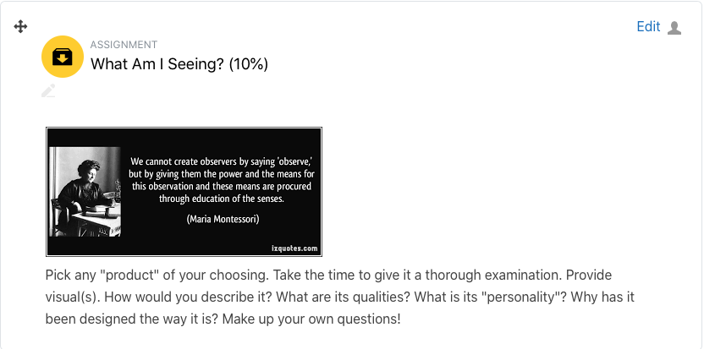
Notes:
13 SEPTEMBER

Slide 43
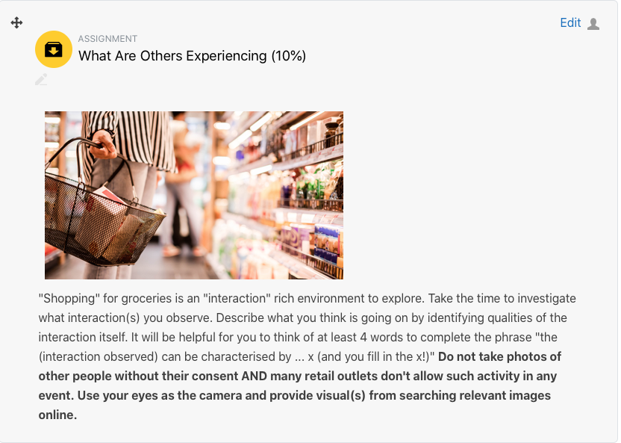
Notes:
20 SEPTEMBER

Slide 44
Notes:
11 OCTOBER

Slide 45
Notes:
THIS IS A VISION AND REMEMBER FROM 1995 –
WHAT TECHNOLOGIES / PRODUCTS / SERVICES / COMPANIES POP INTO YOUR MIND?
WHAT DEVELOPMENTS (CHANGING OR UNSTABLE PATTERNS IN ENVIRONMENT)
OR TRENDS (CHANGING OR UNSTABLE PATTERNS IN BEHAVIOR)

Slide 46
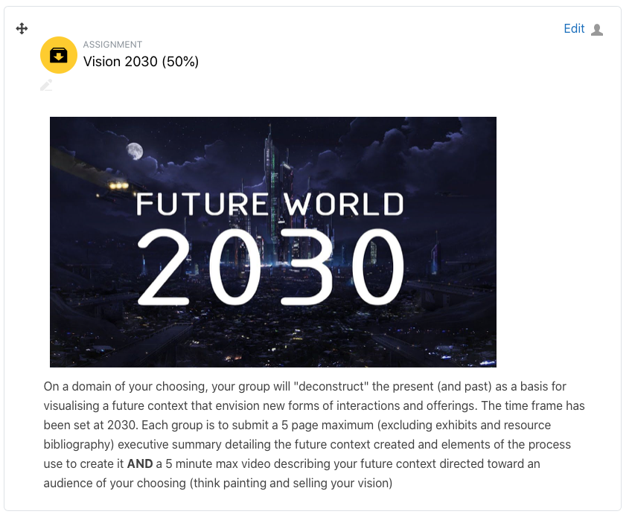
Notes:
11 OCTOBER

Slide 47
Notes:
11 OCTOBER

Slide 48
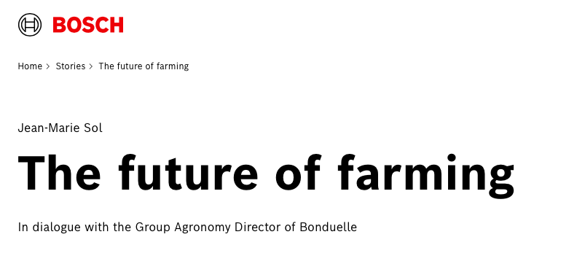
Notes:
11 OCTOBER

Slide 49
affinity
mapping
Notes:
ANYBODY HEARD OF THIS?

Slide 50
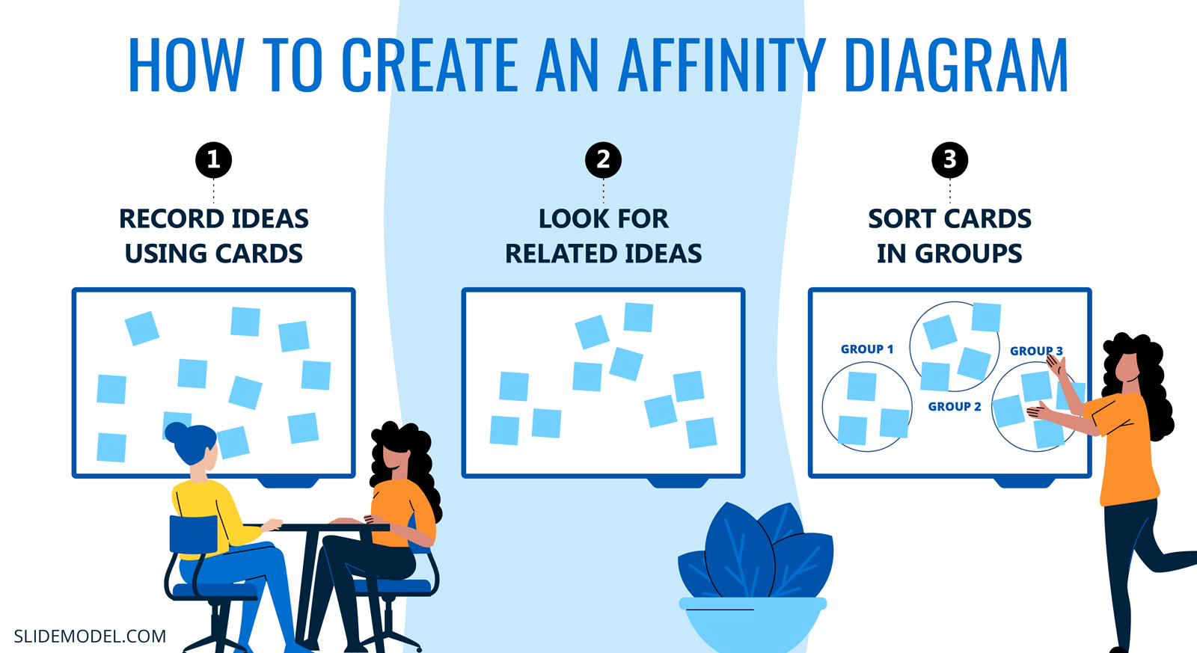
Notes:
THE PROCESS

Slide 51
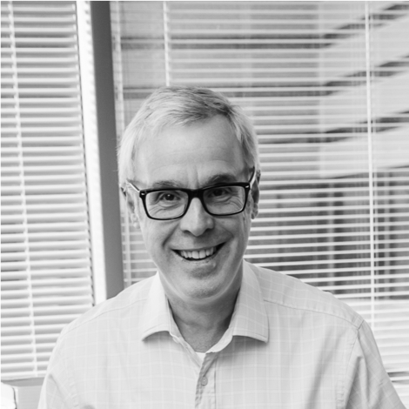
Mentor
Notes:
GUESS WHAT I AM JOINING ALL YOUR TEAMS

Slide 52
Notes:
14 OCTOBER

Slide 53
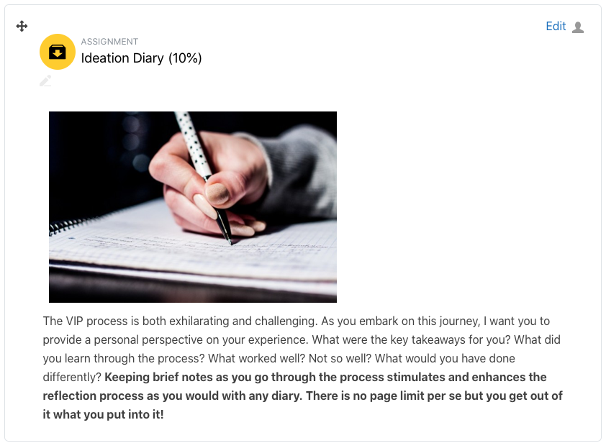
Notes:
16 OCTOBER

