Slide 1
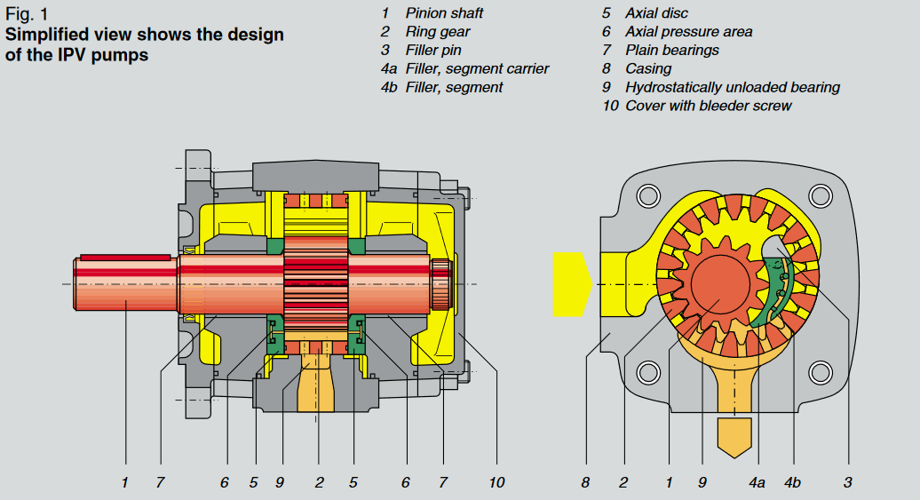
Internal gear pump (VOITH Turbo) – Type IPV

Slide 2
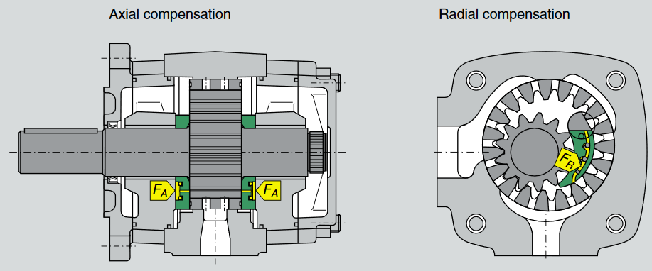
Axial and radial compensation
The axial compensation forces (by Voith)
F_{A} are generated by pressurized areas 6 in the axial discs and are proportional to operating pressure. The
axial discs are pressing with a small excess force in the area of the pressure chamber against the sides of the ring gear, pinion and filler. As a result,
the axial leak gaps between the rotating and stationary parts are extremely small. Due to the exactly determined compensation the pressure chamber has the best possible axial sealing under all operating conditions, even after an extended period of service.
The radial compensation force (by Voith) F_{R} is exerted both on the segment carrier and the filler segment. Proportional to the operating pressure, these two filler parts are pressed against the outside diameters of pinion shaft and ring gear teeth. The areas and the position of the two sealing rolls between the filler segments are designed to press the two parts of the filler always against the tips of the teeth under a light excess force. This force is so that under all operating conditions sealing is effected without wear. In this way the sealing gaps are kept to a minimum.
In order that the filler segments are pressed against the tips of teeth even under very low pressure, appropriate spring elements are arranged beneath the sealing rollers.

Slide 3
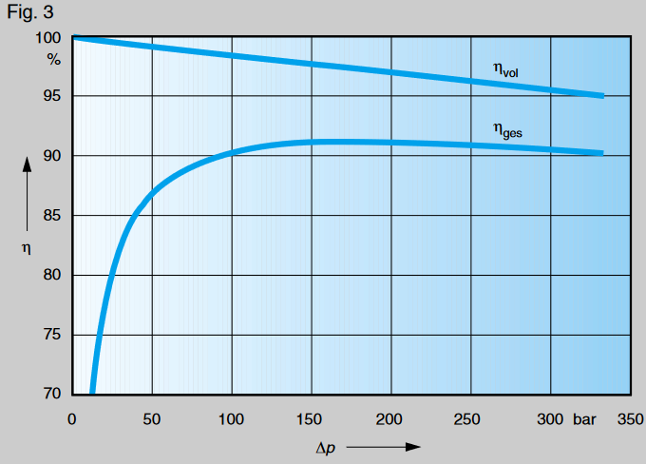
Volumetric and overall efficiency
Small models
Max. Continuous pressure 330 bar
Max. Peak pressure 345 bar
Rotational speed with maximum pressure
400 – 3600 rpm

Slide 4
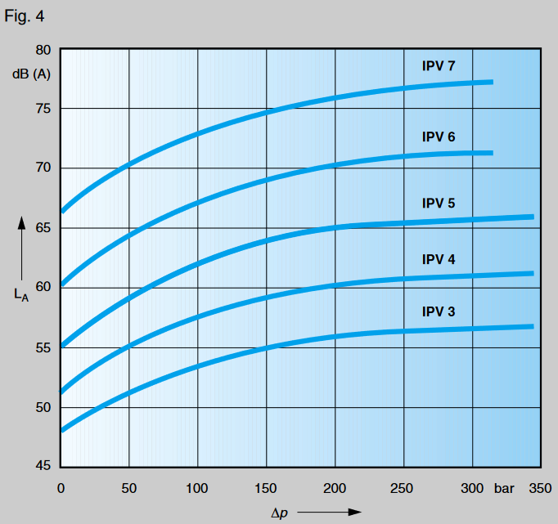
Noise levels
Speed
1500 rpm
Measuring point 1 m distance from the
pump in axial direction.
Measuring room Voith sound measuring
room (not totally anechoic. If measured in an
anechoic room, values will be 5 dB (A) lower.)
http://www.sophtech.net/uploads/files/pdf-root/ipv%20gear%20pumps.pdf

