Slide 1
Layers in Vuosaari
Some layperson observations on social change and environment
Eero Hyvönen Jan 20, 2021

Slide 2
Vuosaari is the future of Helsinki

Slide 3
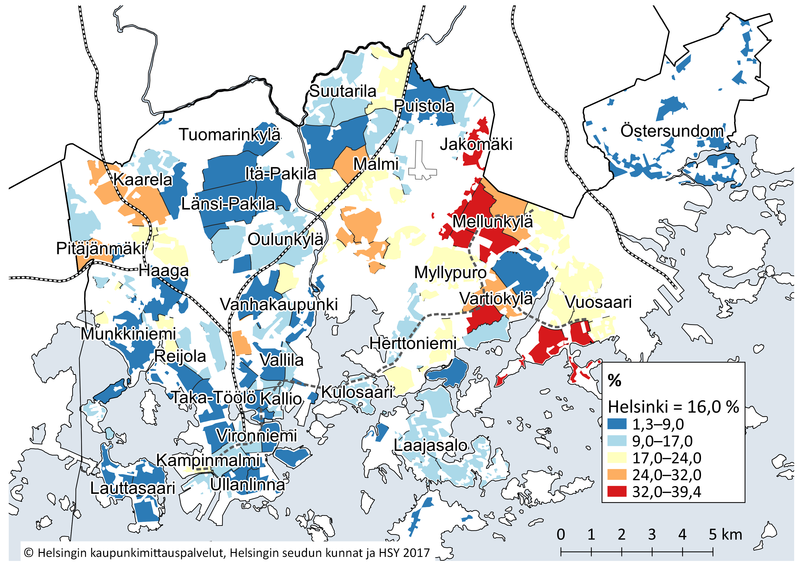
Figure 13. Proportion of residents with foreign background in the population of Helsinki sub-districts on 1 Jan 2019
Source: Statistics Finland

Slide 4
In 2035, the largest foreign-language groups will be made up of speakers of Middle Eastern and North African languages, on the one hand, and Far Eastern languages, on the other hand.
Source: City of Helsinki, Newsletter on the report Helsingin seudun vieraskielisen väestön ennuste 2018–2035.

Slide 5
We don´t know much about the first migrants to the area now known as Finland
The oldest mammoth bone so far found in Finland was detected in 2005 during the construction of port of Vuosaari
The area of nowaday Finland was gradually populated after the thick ice cover of the last Ice Age had slowly melted about 10 000 years ago.
The first migrants probably didn´t speak proto-Sami nor proto-Finnish languages, but unknown ones
We also know for sure that they didn´t set foot on Vuosaari island, because it was under the water.

Slide 6
Approximately 7 000 years ago some scattered islands rose from the sea in the area of Vuosaari of nowadays
As the upthrust got momentum the nearby islands merged together and formed one large island. There isn´t proof of that island being settled, but theory has it that it may have been visited by fishers and hunters
One thing we know for sure….

Slide 7
If they came, they came with dogs
Seal hunting on Gulf of Finland. Photo: Sakari Pälsi, 1924, Museovirasto.

Slide 8
This is where the oldest coastline was located

Slide 9
Land and nature were cultivated in many ways in Vuosaari
Farming brought steady settlement to Norsö (Vuosaari) from Sweden in the late middle ages
Rastila and Vuosaari mansions
A royal shipyard functioned in Vuosaari in 1590`s
Bricks for Suomenlinna fortress were produced also in Vuosaari in the 18th century
Villas and commuter boats were typical of 19th century Vuosaari

Slide 10
Sand, cement and lime = Saseka (Santa, sementti ja kalkki)
The peaceful leisure time in Vuosaari villas was heavily interrupted in 1937 by Petter Forsström´s company Saseka which took advantage of the vast quantities of sand and lime that was available in Vuosaari. Noise and dust emerged in Central Vuosaari (photo: Simo Rista, 1970, Helsingin kaupunginmuseo, CC BY 4.0)

Slide 11
Petter Forsström was suspicous of democracy and of the red dictator Joseph Stalin. The brown shirted one, Adolf Hitler, he could live with. PF was convicted of treason after the continuation war

Slide 12
PF had opened the gates: Finnish speakers from the countryside started pouring in
The Big Picture: Small farms that were established to resettle some 400 000 evacuees from the ceded part of Carelia, couldn´t support families any longer. Industrialization and urbanisation had been delayed, but happened rapidly once started

Slide 13
Nowadays
Photo: Eeva Rista, Helsingin kaupunginmuseo

Slide 14
With so many pouring in, the housing conditions were difficult
Not enough apartments to rent, but only the best-off could afford buying an apartment. The banks set harsh terms for loans.
Martti Ilveskorpi visioned and organised a non-profit association, Asuntosäästäjät ry (People saving for an apartment) that negotiated the terms with banks and the depositors and had the apartments built plus sold them for the price of the expenses. In many instances, people could pay a part by working at the construction site – even building apartment blocks.
(->17´10” siltaan saakka)
This is what became of those houses, which were drawn by architects Viljo Revell and Heikki Castren.
Some 30 000 people joined the association in Helsinki and surrounding areas
At its peak Asuntosäästäjät´s share of housing development in Finland was 7 %, Vuosaari being the biggest single project.

Slide 15
But Vuosaari was also the last major project for Ilveskorpi
The bank wanted to get rid of headstrong Ilveskorpi
The same time political parties and other banks wanted their share of the profits available
Mauno Koivisto, then head of Workers´Savings Bank, regarded Asuntosäästäjät as a type of chain letter: as long as new people came in, the earlier members would get their due.
Asuntosäästäjät wasn´t any more able to get financing for their new projects
Corruptive interface between companies, banks and political parties strenghtened, which led to scandals and bankcruptcies later in the 1990´s during the economic depression
Depression in turn meant that social housing became the mainstream in Vuosaari developments. To make the social mixture work again, expensive apartments were later built elsewhere in Vuosaari and plans of supplementary construction are being made nowadays. Some of the plans are strongly opposed by locals

