Slide 1
Chance, Strategy and Change: The Structure of Contingency in the Evolution of the Nokia Corporation, 1986–2015
Jaakko Aspara, NEOMA Business School, France Antti Sihvonen, Jyväskylä School of Business and Economics, Finland
Henrikki Tikkanen, Aalto School of Business, Finland Juha-Antti Lamberg, Jyväskylä School of Business and Economics, Finland

Slide 2
Introduction
Chance has become an increasingly important issue in explaining organizational outcomes
Very few studies have focused on the role of chance in organizational processes (see Cattani 2006; De Rond and Thietart 2007; Rao and Greve 2018)
Chance in its purest form refers to an “event happening in the absence of any obvious design” (de Rond and Thietart 2007: 535)
We focus on contingency as a weak form of chance which implies that something is “likely but not certain to happen” and it is “dependent on or conditioned by something else” (Merriam-Webster dictionary)
Suggests uncertainty and dependency that cannot be planned or predicted
Enables us to understand what could have happened and what generated the actualized outcome
We examine how and why chance affects and is embedded in strategy processes by studying the key strategic choices that Nokia made during 1986-2015

Slide 3
How chance has been treated in strategy literature
Chance and strategy outcomes
Majority of earlier studies track the impact of chance on performance (Denrell, Fang, and Liu 2015)
Chance refers to events in the business environmental that individuals or organizations respond to or events that influence innovation and technologies
Chance understood as natural variation (e.g., MacKay and Chia 2013) or statistical random variance (e.g., Denrell 2005)
Chance events and strategic choices
How chance events influence strategic choices and decisions is a much less studied area
Also covers the individual (Rao and Greve 2018), organizational (de Rond and Thietart 2007; Baum et al. 2003; Korn and Baum 1999), and innovation/technology levels (Cattani 2006)
Yet, studies on the organizational level don’t really focus on actual strategic choices or decisions

Slide 4
Sensitizing framework
We draw from historical sociology analyzing the structure of contingency (Ermakoff, 2015, 2019; also Lara-Millán et al., 2020; Sauder, 2020) and strategic management literature addressing chance and luck (e.g., de Rond & Thietart, 2007; MacKay & Chia, 2013)
Key concepts:
Moment of collective indeterminacy
Moments of indecision when existing procedures seize to guide actions, when conflicts emerge, or when managers don’t know what to do next
Generally these are situations that don’t solve themselves and are open to influence
Emergent choice scenarios
Alternative courses of action that emerge during collective indeterminacy
Parallel event sequences
Partly exogenous event sequences that influence collective indeterminacy and provide resolution to it
Strategic choice
Decision to actualize a scenario and collective alignment following the decision
5. Structure of contingency
-- Processes that generate likely events which actualization is dependent on parallel events

Slide 5
Sensitizing framework

Slide 6
Methodology – Context and data
Research Context: Key Strategic Changes in the Nokia Corporation 1986-2015
Nokia’s transformation into a mobile telecom corporation by divesting former core businesses during 1989-1992
Nokia’s decision to initiate collaboration with Microsoft and discontinue own software development in 2010-2011
Nokia’s decision to sell mobile phones to Microsoft in 2012-2013
Data collection
Secondary sources (81 academic publications, biographies ex-CEOs, studies by former Nokia managers among others)
Archival data (unrestricted access to Nokia archives until the year 2000)
Interviews (25 interviews with former Nokia board members, executives and relevant industry experts)
Three events that came somewhat as a surprise to the top managers themselves

Slide 7
Methodology – Analysis (1/2)
Stage 1: Identifying periods of collective indeterminacy and alternative scenarios
Writing narratives to make sense of the events (Pentland, 1999) and bracketing (Langley 1999) periods where Nokia’s top management lacked collective direction
Identifying alternative decision-making scenarios from documents and interviews pertaining to the period
Stage 2: Analyzing event sequences leading to alternative scenarios
Event structure analysis (Corsano & Heise, 1990; Heise, 1989) to trace events leading to different scenarios
Coding initial narratives into event chronologies
Analysis of event relations using the ETHNO program
The process generates a network of necessary antecedents
Includes iterative addition/removal of events to identify necessary prerequisite events for the scenarios
Event structure analysis using ETHNO focuses on analyzing the event chronology forward, while answering a series of yes/no questions to
determine which events are required for
the current event to occur (Griffin 1993)

Slide 8
Methodology – Analysis (2/2)
Stage 3: Closure of scenarios
Identifying events and event sequences that influenced the viability of scenarios
Focus on the closure of alternative scenarios and the eventual decision
Event structure analysis to trace how parallel events influenced the viability of scenarios
Integration of the two event sequences to understand how scenarios emerged and how parallel events closed scenarios and influenced the final choice
Stage 4: Theory development
Comparison across event sequences
Elaboration of how contingency manifests as a property of strategic change processes

Slide 9
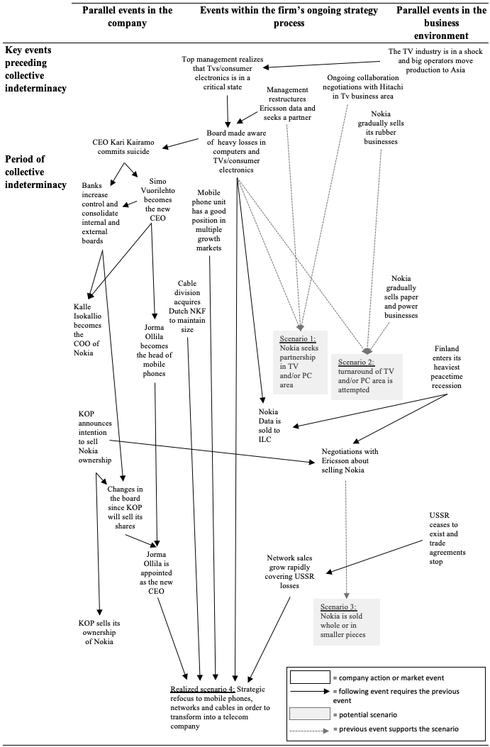
Nokia’s transformation into a telecom company 1989-1992
During the latter part of 1980s Nokia made major investments in computer and TV businesses that eventually led to heavy losses and suicide of the CEO Kari Kairamo that left a power vacuum in Nokia
The top management experienced collective indeterminacy on the direction of Nokia and several alternative scenarios surfaced over time:
Seeking partnership in the computer and/or TV business area
This was negotiated with Hitachi in the TV area (and Honeywell, Olivetti and ILC in the PC area)
Attempting a turnaround of the computer and TV business areas
Divestment of the paper and power businesses already provided capital for this
Selling Nokia as a whole or in pieces
This was actively negotiated with Ericsson
Strategic refocus to mobile phones, networks and cables
Initially this seemed very unlikely to happen

Slide 10
Nokia’s transformation into a telecom company 1989-1992
The suicide of CEO Kari Kairamo set in motion a parallel event sequence
Simo Vuorilehto became the new CEO who chose CFO Jorma Ollila to lead the mobile phone business
Rivalrous commercial banks (KOP and SYP) increased their control of Nokia, while there was also power struggles among top management
In 1991, KOP announced their decision to sell their shares of Nokia, while CEO Vuorilehto announced his retirement
This cleared the table for a new strategic direction
Jorma Ollila was asked to become the CEO and draft a new strategy for Nokia
This led to a decision to realize the scenario of focusing on mobile telecom

Slide 11
Nokia’s decision to collaborate with Microsoft in 2010-2011
During 2007-2010 Nokia focused on Symbian that was becoming rapidly outdated and they missed the emergence of ecosystems
In 2010 it was realized that cost-cutting initiatives by CEO Kallasvuo had not addressed the main problems and new direction was needed
The top management experienced collective indeterminacy on how to rectify the situation and four scenarios emerged over time:
Accelerate the development of MeeGo and make it the primary OS
Anssi Vanjoki was tasked by the board of directors to develop a plan for this
Use a MeeGo and Android hybrid
A way to retain in-house software development and mitigate the Android threat
Focus purely on Android
Proposed by McKinsey consultants as a low risk alternative
Focus purely on Windows Phone
Microsoft had been seeking collaboration with Nokia for some time

Slide 12
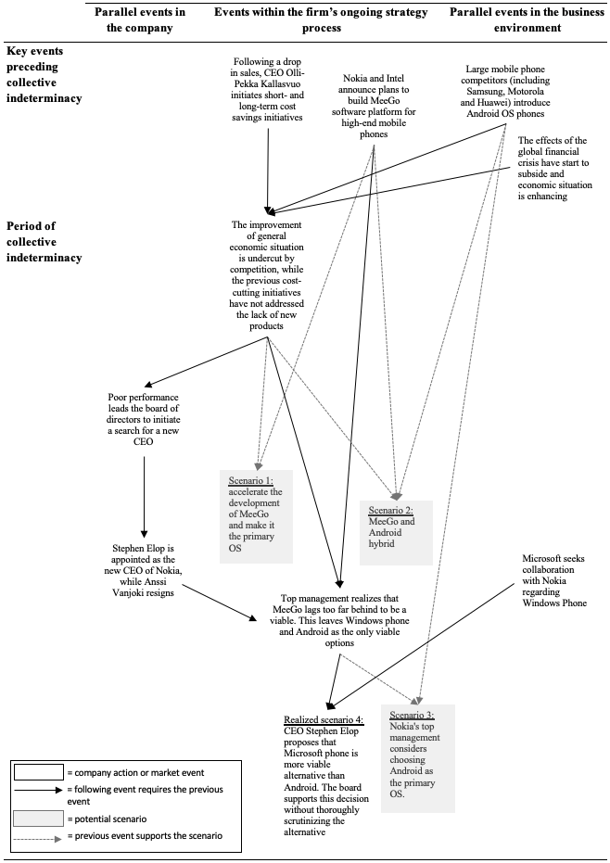
Nokia’s decision to collaborate with Microsoft in 2010-2011
The problematic situation initially led to a search for new CEO where Stephen Elop and Anssi Vanjoki were the primary candidates
The decision to hire Elop led Vanjoki to resign
The plans to save MeeGo were lost when Vanjoki left
Soon afterwards the top management realized that MeeGo was a failure leaving Android and Windows phone as the only viable options
CEO Elop proposed that Microsoft collaboration is the more viable option
The board unanimously supported this decision without considering the alternative
This led to a decision to realize the scenario of focusing purely on Windows phone

Slide 13
Nokia’s decision to sell mobile phones to Microsoft in 2012-2013
Microsoft introduces the Surface tablet in 2012 casting a shadow over their collaboration with Nokia
Nokia’s top management initiated scenario work to respond to this unexpected event:
Develop both Windows and Android phones
Nokia had the option to renegotiate the Microsoft collaboration
Divest mobile phones by selling them to Microsoft (or other actor)
Would mean selling the core business and retaining only NSN which is a joint venture with Siemens
Microsoft initiated discussions about acquiring Nokia’s mobile phones
This led to the divestment of mobile phones and full acquisition of NSN

Slide 14
Discussion
Chance had a key role in all three major strategic changes that Nokia made during 1986-2015
Chance unlocked problematic situations and realized initially unlikely development paths
The findings show how contingency manifests as as a weak form of chance
Chance-based conjunctures generates unexpected outcomes, even to the participating actors
Contingency has a structure that enables studying chance
Structure of contingency explains how chance becomes embedded into strategy processes
Top managers are able to channel chance
Top managers form and shape the potential scenarios
Choices emerge through chance-based conjunctures
We focused on major changes but it is fair to ask how prevalent chance is in explaining more minute events and changes
The seminal study on the structure of contingency by Ermakoff (2015) focused on a single meeting

