Slide 1
Smart Workplace Solutions

Slide 2
Hello!
Laura Remes
Smart Building Technologies and Services
laura.remes@aalto.fi

Slide 3
Content
Background
What are the smart workplace solutions?
Summary
The task

Slide 4
1.
Background
Why smart workplace solutions are an interesting topic?

Slide 5
The evolution of smart building technologies and services 1/2
User-
centered buildings
Building automation
Intelligent buildings

Slide 6
The evolution of smart building technologies and services 2/2
Intelligent buildings
Also known as smart buildings
Sustainable
Energy efficient
Cost effective
Utilize various technologies
Interactive and dynamic
Integrated features
Intelligently maintained
User-centered & smart workplaces
Also known as human-centered/-centric
Respond to users’ needs holistically
Enhance users’ productivity
Increase comfort & wellbeing
Convenient & helpful
Time saving

Slide 7
The next step of the evolution 1/2
Software
Hardware
Physical
Mental

Slide 8
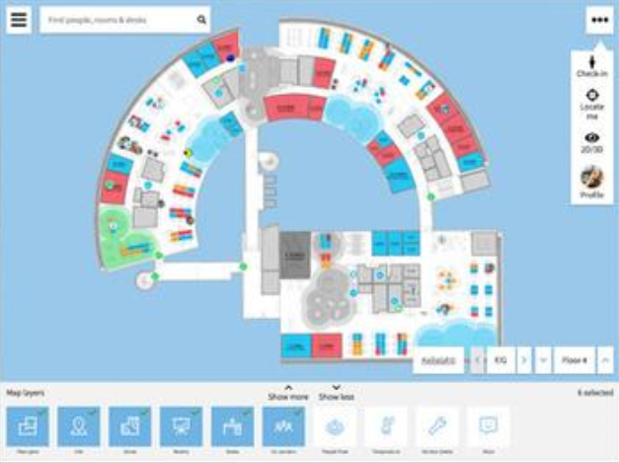
The next step of the evolution 2/2
Several smart workplace solutions have emerged to the market to fill the niche
While these solutions are relatively new, they have lacked a proper definition
There have not been any general guidelines, which features they should have
Place your screenshot here

Slide 9
2.
What are the smart workplace solutions?
What to call them and what features they should have?

Slide 10
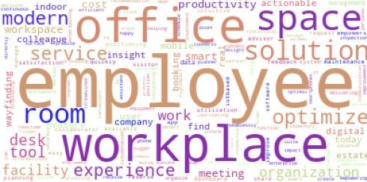
Why should they be called smart workplace solutions?

Slide 11
Your Work Experience

Slide 12
Features - The core
Booking
Search box
The core
Free spaces
1st layer
Wayfinding
2nd layer
Occupancy
3rd layer

Slide 13
Features - Layer 1
Unattendance
Indoor environment quality (IEQ)
Incident reporting
The core
1st layer
Calendar sync
2nd layer
People flow
3rd layer

Slide 14
Features - Layer 2
Equipment
Asset
tracking
Hospitality
The core
1st layer
Room displays
Building performance
2nd layer
3rd layer

Slide 15
Features - Layer 3
IEQ remote control
Space freeing
Digital keys
Lunch queue
IEQ feedback
Payment possibility
Lunch menu
Service quality
Financial performance
Maintenance planning
The core
Parking spaces
Cleaning management
Scheduling assistant
1st layer
Property management
Event information
Concierge service
2nd layer
Room service
Work time
3rd layer
Wellness analytics
Personal layout
Parking analytics

Slide 16
Summary
A niche has emerged for smart workplace solutions as intelligent buildings are evolving increasingly user-centered
Smart workplace solutions are software-based and they provide personal workplace experiences
The core features are booking, free spaces, occupancy, wayfinding, and search box

Slide 17
Thanks!
Questions?

Slide 18
Credits
My co-writer DSc. Kenneth Dooley
Free presentation template by SlidesCarnival
Picture of the Empathic Building application: https://haltian.com/resource/the-future-of-smart-buildings-is-empathic/

Slide 19
The Task
Do you think that the most important features are taken into consideration?
Are some relevant features still missing?
How do you see the future of smart workplace solutions?

