Slide 1
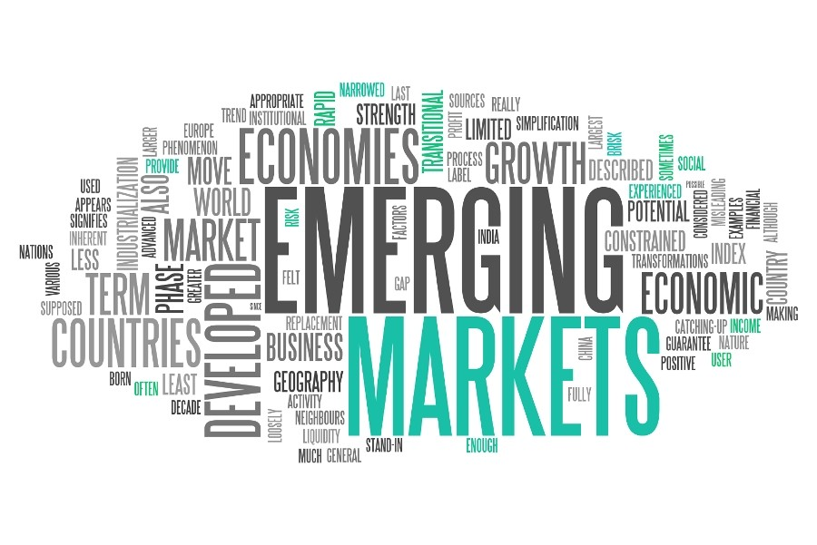
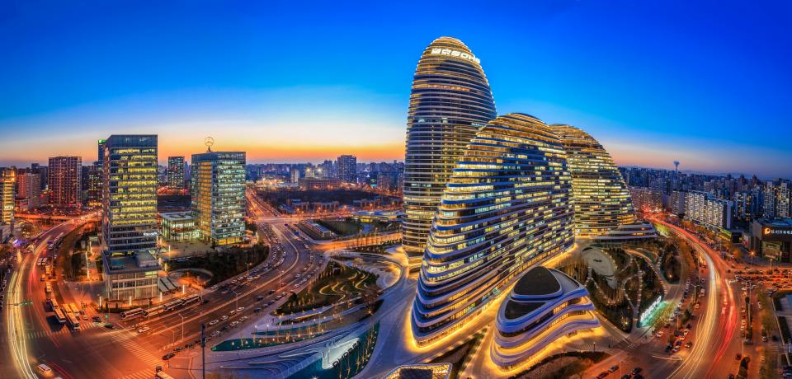
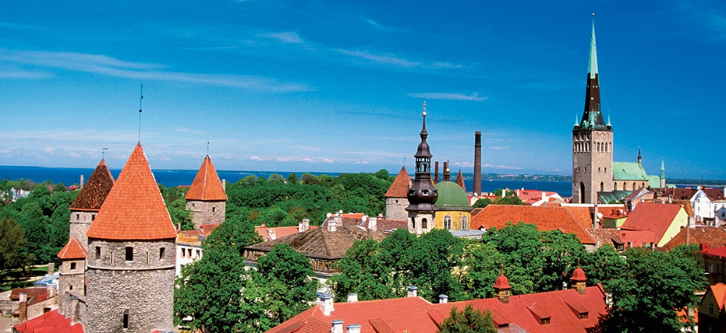
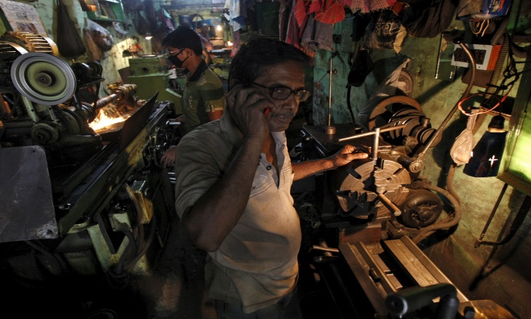
Lecture 1: Introduction to Emerging Markets
Svetlana Ledyaeva
Aalto University School of Business

Slide 2
Some history of the term ”emerging markets”
The term “emerging markets” dates back to 1981, recalls the man who invented it, Antoine van Agtmael.
He was trying to start a Third-World Equity Fund to invest in developing-country shares, but his efforts to attract money were being constantly rebuffed.
“Racking my brain, at last I came up with a term that sounded more positive and invigorating: Emerging markets. Third World suggested stagnation; Emerging Markets suggested progress, uplift and dynamism.”

Slide 3
What is meant by an emerging country today? 1
Countries with underfunded growth opportunities with problems.➔
➔Developing country where investment brings higher return but be accompanied with greater risk.
Recent integration with global capital market.➔
➔Greater openess to cross-border capital flows and domestic financial liberalization.
Poorer than those in the developed world but that has capital markets (stock and bond markets) accessible to international investors.

Slide 4
What is meant by an emerging country today? 2
Less developed country but one that has adopted the institutional, legal, and financial structures ➔
➔ a potential path to becoming a more developed country over time.
Sufficiently open to the global economy ➔
➔ can freely accommodate international trade and allow international investors to have access to its bond and stock markets as well as the ability to make foreign direct investment.
Platform for sustainable economic growth. ➔
➔ has undertaken economic development and reform programs and [has] begun to ‘emerge’ as significant player . . . in the global economy.

Slide 5
Classification of countries with respect of their accessibility to foreign investors
Developed markets: most accessible to and supportive of foreign investors.
Emerging markets: generally, have less accessibility relative to developed markets but demonstrate some level of openness.
Frontier markets: much less accessible to foreign investors; have notable limitations in their regulatory and operational environments; support a smaller investment landscape.

Slide 6
Emerging markets from investment point of view:
Are those included in one or more emerging-markets equity or bond benchmarks/indices.
Benchmark is a measure/index to what you compare your fund’s returns with to judge its performance.
Index can be the average performance of funds similar to yours or a broad index of the investments your fund usually picks from.
Index is computed from the prices of selected stocks (typically a weighted average).

Slide 7
The primary benchmarks/indices representing the global stock market
MSCI (Morgan Stanley Capital International)
FTSE (Financial Times Stock Exchange)
Standard & Poor’s
Dow Jones

Slide 8
What is Emerging Markets Equity Index?
Example: The MSCI Emerging Markets Index is an index created by Morgan Stanley Capital International (MSCI) designed to measure equity market performance in global emerging markets.
It is a float-adjusted market capitalization index that consists of indices in 24 emerging markets.

Slide 9
How the index is calculated? FTSE (Financial Times Stock Exchange) index example

Slide 10
MSCI emerging markets index allocation (2020)

Slide 11
The MSCI Emerging Markets Index – main characteristics (2020)
The MSCI Emerging Markets Index captures large and mid cap representation across 26 Emerging Markets (EM) countries*.
With 1,390 constituents, the index covers approximately 85% of the free float-adjusted market capitalization in each country.

Slide 12
The MSCI Emerging Markets Index – dynamics (2020)
Across 23 developed countries and 27 emerging markets

Slide 13
The MSCI Emerging Markets Index – sector and country weights (2020)

Slide 14
Details of indices calculations
Usually are computed from Monday to Friday
Can be computed for separate countries, sectors, groups of countries, group of regions
Can be computed in USD and other currencies, local currencies.
Can be computed based on equity price, gross or net returns.

Slide 15
MSCI index can be customized

Slide 16
Why we need EMs equity indices?
It is a tool used by investors and financial managers to describe the market, and to compare the return on specific investments.
An index is a mathematical construct, so it may not be invested in directly.

Slide 17
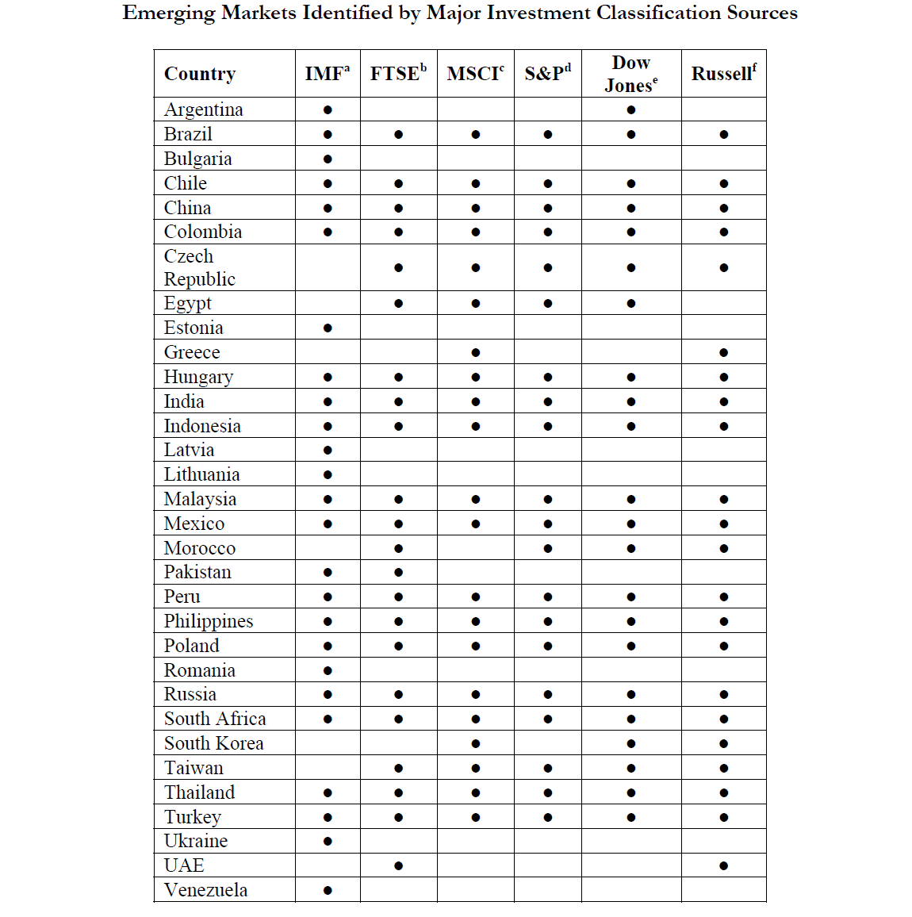
Marquis&Rainard (Harvard Business School Working paper 2014)

Slide 18
FTSE classification, September 2020

Slide 19
Process of development
Brazil, Russia, India, China, South Korea
Portugal, Ireland, Italy, Greece, Spain
Frontier
Emerging
Developed
South Korea
Argentina

Slide 20
Characteristics of emerging markets 1
David F. DeRosa
Are less rich than the developed world.
Many emerging markets are greatly dependent on commodity exports.
Few emerging-markets countries are well-diversified industrial economies;
many have two-tier economies, one a fully documented market segment that forms part of the world economy and the other a local segment that functions outside the documented and taxed economy (i.e., a large gray or black market),
and in some countries, the latter constitutes a sizable portion of the population and income.

Slide 21
Characteristics of emerging markets 2
Many emerging-markets countries have—or have had—large, and possibly out of control, fiscal deficits ➔ fiscal debt.
Many emerging-markets nations have experienced extreme macroeconomic dislocations in the past—such as hyperinflation, currency crises, and economic collapse.
Many emerging-markets countries have immature financial sectors and fragile banking systems.

Slide 22
Characteristics of emerging markets 3
Some emerging markets countries do not have truly independent central banks.
Emerging markets countries have a pronounced vulnerability to the ebb/leak/loss and flow of international capital.

Slide 23
Five agreed upon characteristics 1 (By Kimberly Amadeo Updated December 14, 2016)
Lower-than-average per capita income. The World Bank: countries with low or lower middle per capita income of less than $4,035.
Rapid growth. 4-10% versus 1-2% in developed countries
High volatility. That can come from three factors: Natural disasters, external price shocks, and domestic policy instability.

Slide 24
Five agreed upon characteristics 2 (By Kimberly Amadeo Updated December 14, 2016)
Capital markets are less mature.
Don't have a solid track record of foreign direct investment.
It's often difficult to get information on companies listed on their stock markets.
It may not be easy to sell debt, such as corporate bonds, on the secondary market.
Higher-than-average return for investors.
Many of theses countries focus on an export-driven strategy.
They don't have the demand at home, so they produce lower-cost consumer goods and commodities for developed markets.

Slide 25
Paul Marsh, Emeretus Professor of London Business School
EMs are only marginally more volatile than developed ones and are becoming increasingly less volatile:
Typical EM is probably 10-15% more volatile than average developed market. EMs have developed and risk has reduced.
Since 2000, EMs have been less crisis-prone than developed markets.
Since 1980, developed markets have caused more contagion (harmful effects) than EMs:
Developed countries crises are more likely to spread to the World than EMs crises.

Slide 26
Unlike developed countries which are rather homogenous in their socio-economic development, Emerging countries are very heterogenous!!! Heterogeneity –bw and within energing markets

Slide 27
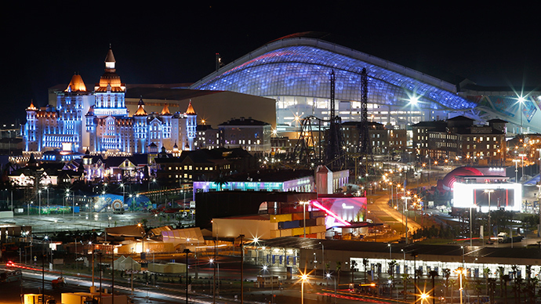
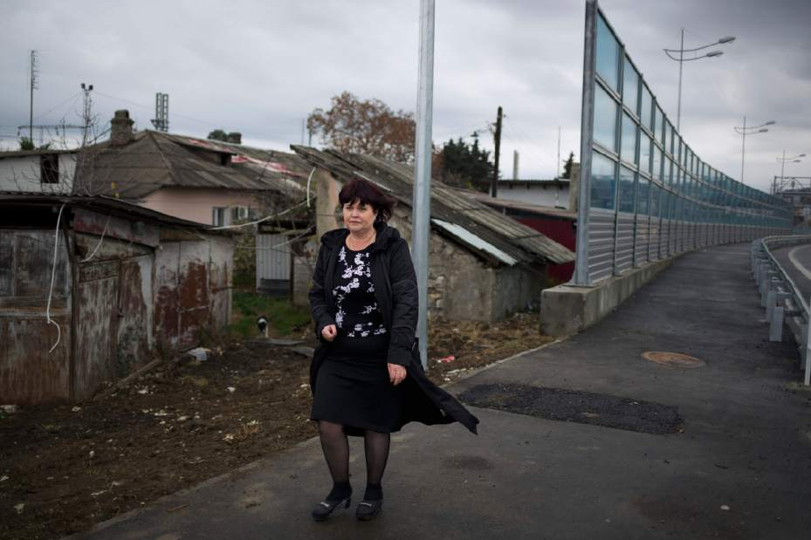
Russia: Sochi versus village near Sochi

Slide 28
Russia, hospital, province versus Moscow

Slide 29
China: Beijing versus poor village

Slide 30
Political regimes in emerging markets

Slide 31
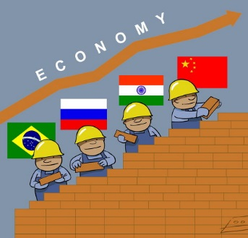
EMs simplest classification: BRIC(S) or non-BRIC(S)
The four largest (Brazil, Russia, India, and China, known collectively as BRIC) and everywhere else.
BRICS includes South Africa (from 2009).
The “everywhere else” includes a wide array of countries on several continents including North and South America, Africa, and Asia. The non-BRIC markets are characterized by their diversity, even within the same geographical region.

Slide 32
Why BRIC(S)?
All have huge populations, are rich in natural resources, and have enormous growth potential. Combined, they have 42 percent of the world’s population and 23 percent of the world’s total output of goods and services. If these countries do nothing more than get their economies up to the world’s average, their output will double.
Non-BRIC countries have reasonable political stability, a good business climate; they’re just not as large, market-wise, as the big BRIC countries.

Slide 33
Key features of the BRICS countries
Global competitiveness index 2019
Singapore – 1; 84.8
China – 28; 73.9
Russia – 43; 66.7
India – 68; 61.4
Brazil – 71; 60.9

Slide 34
Modern investors on BRIC acronym
David Riedel - founder and President of Riedel Research Group, which provides independent equity research focusing on emerging markets Asia, Latin America,
and Europe.
”BRIC(S) – useless acronym, two major exporters and importers of commodities.”
What would be alternative to BRIC(S)? Panel discussion of some business owners/CEOs:
Nigeria – 175 million population and rising population.
POC (Pasific Ocean Countries) – Mexico, Peru, Colombia, Chile
EMNO – emerging markets new opportunities
CHIIM – China, India, Indonesia, Mexico
CHINDIA – China, India

Slide 35
Transition economies
Transition economies:
-former social economies/central planned/command economies.
-started transition from command to market economy in late 80s, early 90s.

Slide 36
Classification of transition economies
New EU member states:
Bulgaria, Croatia, Czech Republic, Estonia, Hungary, Latvia, Lithuania, Poland, Romania, Slovakia, Slovenia
South-Eastern Europe:
Albania, Bosnia and Herzegovina, Montenegro, Serbia, The former Yugoslav Republic of Macedonia
Commonwealth of Independent States:
Armenia, Azerbaijan, Belarus, Kazakhstan, Kyrgystan, Moldova, Russia, Tajikistan, Turkmenistan, Uzbekistan
Ukraine, Georgia

Slide 37
Transition economies by region
Central Europe
Czech Republic, Hungary, Poland, Slovak Republic, Slovenia
Southeast Europe
Bulgaria, Croatia, Romania, Albania, Bosnia and Herzegovina, Montenegro, Serbia, Macedonia
Former Soviet Union (FSU) Europe
Belarus, Estonia, Latvia, Lithuania, Moldova, Ukraine, Russia
FSU Asia and Mongolia
Armenia, Azerbaijan, Georgia, Kazakhstan, Kyrgyz Republic, Mongolia, Tajikistan, Turkmenistan, Uzbekistan
Southeast Asia
LAO PDR
Vietnam
China

Slide 38
Developing economies by region

Slide 39
Principal differences between transition and developing economies
TEs suffer from a comparative disadvantage in distribution and networking, as well as financial and other business services.
TEs, more than DEs, also have a greater demand for business/financial services, given their highly developed production sector.
Future economic growth, concentrated in various ”knowledge sectors” is going to be even more dependent on human capital than in the past, and TEs are well situated to take advantage of this.

Slide 40
Principal differences between transition and developing economies
Long experience of Communism in TEs and, hence, the necessety of a major quick change in institutions.
While in DEs production developed more or less in tandem with the required market institutions, in TEs a modern production sector might already exist but with no/underdeveloped market or government infrastructure. ➔
➔TEs are in greater need of market institutions but they face higher barriers in developing them.

Slide 41
Differences between TEs and DEs: summary
TEs are endowed with many more objects, both material and human, but many of them embody wrong ideas (Paul Romer 1993).
But since they have come from different heritages, the mix of policy instruments, their exact shape and emphasis and the pace and sequence may differ.
DEs demand mostly ordinary technological transfers, TEs require mostly and more urgently massive importation of modern market, financial and corporate governance services.

Slide 42
Fuel-exporting countries

Slide 43
EMs (according to FTSE 2016) in World GDP, 2015

Slide 44
EMs (according to FTSE 2016) in World Export, 2015

Slide 45
EMs (according to FTSE 2016) in World FDI, net inflows, 2015

Slide 46
EMs (according to FTSE 2016) in World population, 2015

Slide 47
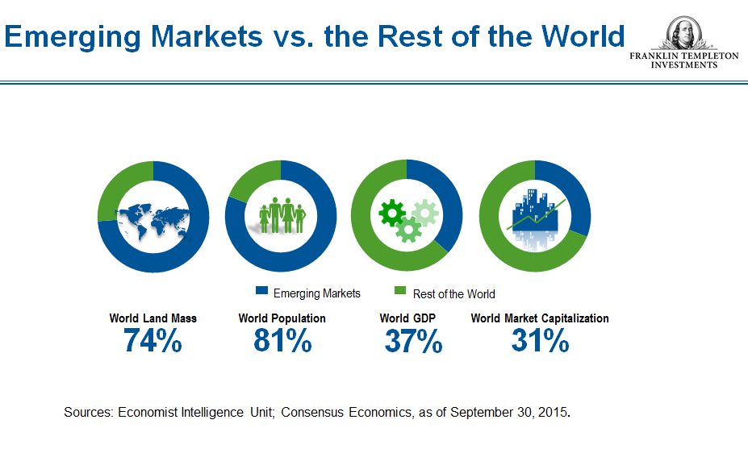
Alternative data

Slide 48
Market capitalization refers the total dollar market value of a company's outstanding shares. Commonly referred to as "market cap," it is calculated by multiplying a company's shares outstanding by the current market price of one share. The investment community uses this figure to determine a company's size, as opposed to using sales or total asset figures.

Slide 49
What we study about emerging economies/markets in this course?
Factors that are relevant for direct and portfolio investment decisions into these economies:
Macroeconomic factors – economic growth, business cycles, income distribution, living standards, inflation, exchange rates, macroeconomic crises
Institutional factors
Multinationals` and local companies` activities in emerging markets
Industrial development in emerging markets
Industrial sectors, policies and role of global value chains
Four last lectures – round-tables on investment decisions in various emerging markets

Slide 50
Types of investment
Foreign Portfolio Investment: short-term interest
Equity ➔
Stock market ➔
volatile and risky
Fixed income securities ➔ bonds ➔
steady but moderate returns
Involves establishing a direct business interest in a foreign country, such as buying or establishing a manufacturing business.
Direct investor owns directly or indirectly at least 10% of the voting power of the direct investment enterprise.
Foreign Direct Investment: long-term interest

