Slide 1
Topic 4: Efficient Probabilistic Circuits Inference in Hardware
Probabilistic machine learning
Inference of Probabilistic machine learning
Efficiency(tractability) of inference
Tractable probabilistic models
Efficient inference methods

Slide 2
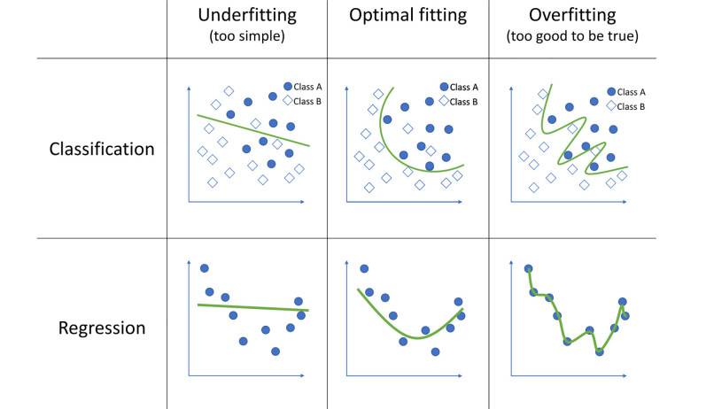
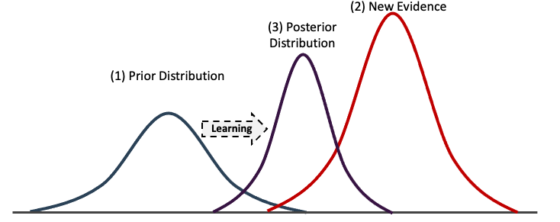
Why probabilistic machine learning?
Uncertainty representation
Probability is used to avoid over fitting by answer as probability rather than a certain category/value:
P(class=A |evidence from dataset)=0.9
Belief update
P(class A |new evidence)=0.92
P(class A |new evidence)=0.95
P(class A |new evidence)=0.99
…

Slide 3
Probabilistic ML training
Training involves both structure and parameter learning [1]
Variables
Structure learning:
Active research topic
Example with LearnSPN_{[2]}
Iterative clustering (+) and independence tests (x)
V₁ V₂ V₃ V₄
Instances
Parameter learning:
Main algorithm is expectation-maximization
Idea: Find the best likelihood under missing data

Slide 4
Probabilistic ML inference
Inference:
Computing the posterior distribution of the hidden variables over the observed variables [1]
Nodes: variables
B
Will A happen if B has already happened?
P(A|B) =0.9
There is 0.9 possibility to happen
Observed variables: B
Hidden variables: A
Posterior distribution P(A|B)
P(B)=0.2
Arrows: dependency
A
P(A|B)=0.9
posterior probability

Slide 5
Example: step 1: Training from dataset
There is a big city which has 1000 streets, we have a data set which records there is traffic jam or not for every roads in every day and at each time.
Day has 7 categories, Time has many categories, StrJam_N are binary variables.
Day | Time | StrJam_1 | StrJam_2 | StrJam_3 | StrJam_4 | StrJam_5 | StrJam_...
Monday | 9.00 | yes | no | no | no | no | no
Monday | 9.01 | no | no | yes | no | no | no
…… | …… | …… | …… | …… | …… | …… | ……
Friday | 9.01 | no | no | yes | no | no | no
Friday | 9.02 | no | no | no | no | no | no

Slide 6
Example: step 2: Inference from model
We get a model M contains variables {Day, Time, StrJam_1, StrJam_2,. . . , StrJam_1000} and their probabilistic relation description.
StrJam_2
Time
Day
StrJam_3
StrJam_1
StrJam_...
How to use this model to answer following questions?
q1: What is the probability that there is a traffic jam on street1 on Monday?
q2: Which combination of streets is most likely to be jammed on Monday at 9am?

Slide 7
Tractability of inference
Inference: Posterior distribution of the hidden variables over the observed variables
P(X)
A simple distribution
Hidden variables X
Categories of X:(x1,x2,x3)
the inference is intractable when it requires complex computation to get the distribution
0.5
0.3
0.2
x1
x2
x3
Tractability of inference: [1]
A class of inference is tractable when a probabilistic models M owns X number of variables, query runs in time O(poly(|X|))

Slide 8
Marginal(MAR) inference
What is the probability that there is a traffic jam on street1 on Monday?
P(Day = Mon, StrJam_1 = 1)
Marginal means only these two variables are considered.
So, we need sum all situations that include these two variables.
Inference calculation
P(e) = $\sum{\text{p}\text{(}\text{e}\text{, }\text{H})}$
e: Evidence variables: {Day, StrJam_1}
$\text{H}$: Hidden variables: {Time, StrJam_2, StrJam_3,. . . , StrJam_1000}
Computation steps:
Calculate all P(e)
Summation of P
Number of P(e): number of time categories · $2^{999}$→ impossible to calculate

Slide 9
Maximum a posteriori(MAP) inference
Which combination of roads is most likely to be jammed on Monday at 9am?
Combination of roads which contribute
the maximum posterior P(Day = Mon, Time = 09.00| combination of roads )
Inference calculation
Max( $\text{p}\text{(} H|\text{e}$) )
e: Evidence variables: {Day, Time}
$\text{H}$: Hidden variables: {StrJam_1, StrJam_2, StrJam_3,. . . , StrJam_1000}
Computation steps:
Calculate all $\text{p}\text{(} H|\text{e}$)
Choose the largest $\text{p}\text{(} H|\text{e}$) and corresponding combination of roads
Number of all combination of roads: $2^{1000}$ → impossible to calculate

Slide 10
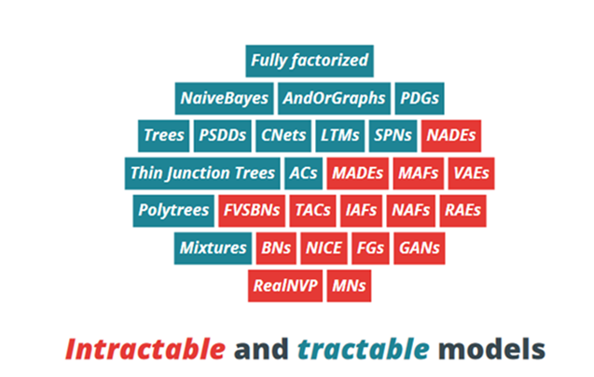
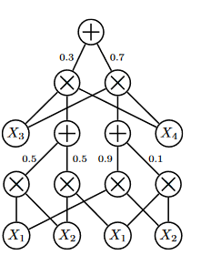
Tractable probabilistic models
Probabilistic circuits PCs(SPNs) : Tractable

Slide 11
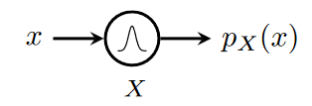
Tractable probabilistic models
Base of building a tractable model: a single node encoding a distribution
Get the distribution directly
category
probability value
Sum nodes p= w1·p1+w2·p2
0.2
+
0.8
variable
P(X)
x
x
Product nodes
p = p(X) · p(Y)
x
0.5
0.3
0.2
X
Y
X
Y
X: x1, p=0.5 Y: y1, p=0.5
Probability = 0.5*0.5*0.2+0.5*0.5*0.8=0.25
x1
x2
x3

Slide 12
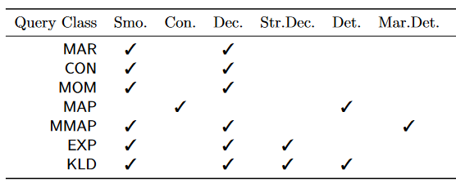
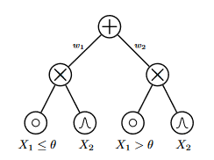
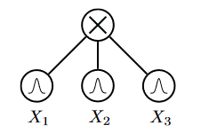
Tractable inference
MAP Inference of PCs is tractable when model is Consistency and Determinism
Con. (Consistency)
No repeat variables for product nodes
Det. (Determinism)
Only one node is non-zero to sum nodes

Slide 13
MAP inference with Probabilistic circuits
0.2
M
0.8
x
P(X)
P(Y)
x
x
0.6
0.7
0.4
M
M
M
M
0.3
x1
x2
y1
y2
x1
x2
y1
y2
x1
x2
y1
y2
Sum nodes select only one node, So, Sum nodes turn into max nodes
MAP(e): X = x1, Y=y1
Computational times equal to go through this structure only once

Slide 14
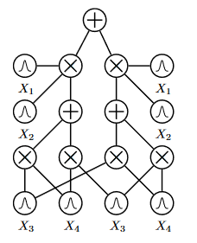
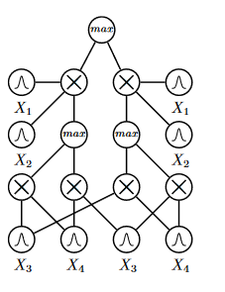
Efficient inference methods for Probabilistic circuits
Structure Approximation
Example: Transfer normal PCs into Det. and Con. PCs gets the approximation of MAP
Normal PCs
Det. and Con. PCs

Slide 15
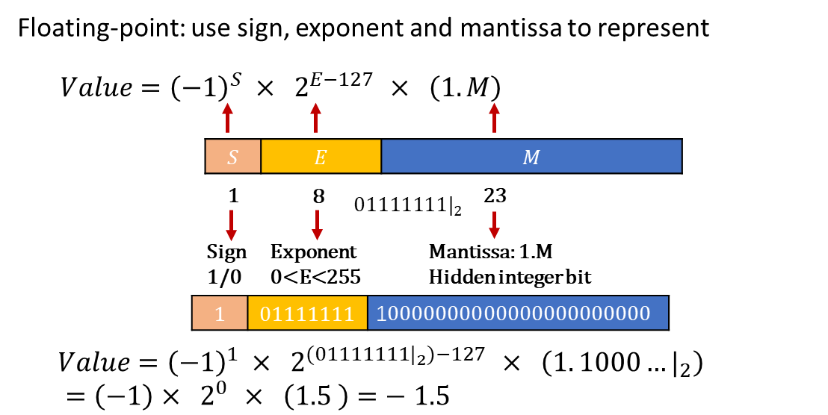
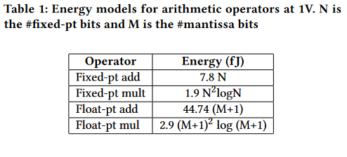
Efficient inference methods for Probabilistic circuits
Alternative number system[4]
Fixed-point, floating-point, posit, logrithm
Fixed-point:
Less accurate
Less energy per bits
Floating-point:
more accurate
more energy per bits

Slide 16
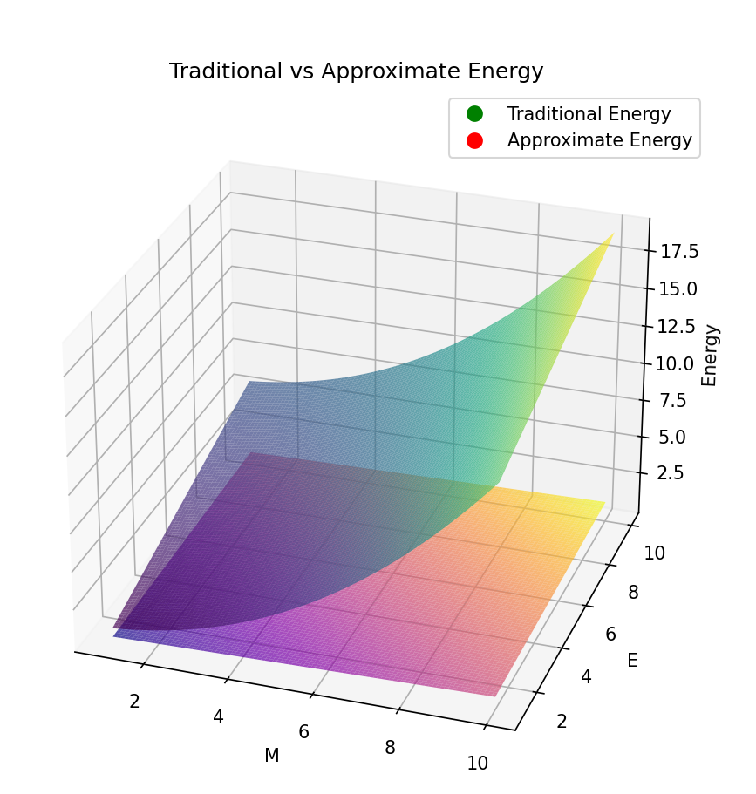
Efficient inference methods for Probabilistic circuits
Operator Approximation [3]
Normal floating-point multiplier -> Approximate multiplier
After simulating the energy consumption of the floating multiplier energy and approximate floating multiplier in 65nm, and then we get the equation after fitting the data:

Slide 17
Assignment questions
Briefly explain MAP and MAR inference
Why we need our probabilistic model tractable?

Slide 18
References
[1] Y. Choi, A. Vergari, and G. Van den Broeck, “Probabilistic circuits: A unifying framework for tractable probabilistic models,” oct 2020.
[2] Gens, Robert, and Domingos Pedro. "Learning the structure of sum-product networks." International conference on machine learning. PMLR, 2013.
[3] Saadat, H., Bokhari, H., & Parameswaran, S. (2018). Minimally biased multipliers for approximate integer and floating-point multiplication. IEEE Transactions on Computer-Aided Design of Integrated Circuits and Systems, 37(11), 2623–2635.
[4] Sommer, L., Weber, L., Kumm, M., & Koch, A. (2020). Comparison of arithmetic number formats for inference in sum-product networks on fpgas. 2020 IEEE 28th Annual International Symposium on Field-Programmable Custom Computing Machines (FCCM).
[5] París, I., & Díez, F. J. (2020). Sum-product networks: A survey. arXiv. https://doi.org/https://arxiv.org/abs/2004.01167v1

Slide 19
Thanks for your attention!

