Slide 1
Thermodynamics and Heat Transfer Lecture 11: Heat Transfer
Ali Khosravi Aalto University

Slide 2
Learning Outcomes
Understand the basic mechanisms of heat transfer, which are conduction, convection, and radiation, and Fourier’s law of heat conduction, Newton’s law of cooling, and the Stefan–Boltzmann law of radiation.
Examples with EES and Matlab
Example with SAM

Slide 3
Video Credit: https://youtu.be/zvQZtpZnRRE

Slide 4
Conduction
Conduction is the transfer of energy from the more energetic particles of a substance to the adjacent less energetic ones as a result of interactions between the particles. Conduction can take place in solids, liquids, or gases. In gases and liquids, conduction is due to the collisions and diffusion of the molecules during their random motion. In solids, it is due to the combination of vibrations of the molecules in a lattice and the energy transport by free electrons.
The rate of heat conduction through a plane layer is proportional to the temperature difference across the layer and the heat transfer area, but is inversely proportional to the thickness of the layer. That is,

Slide 5
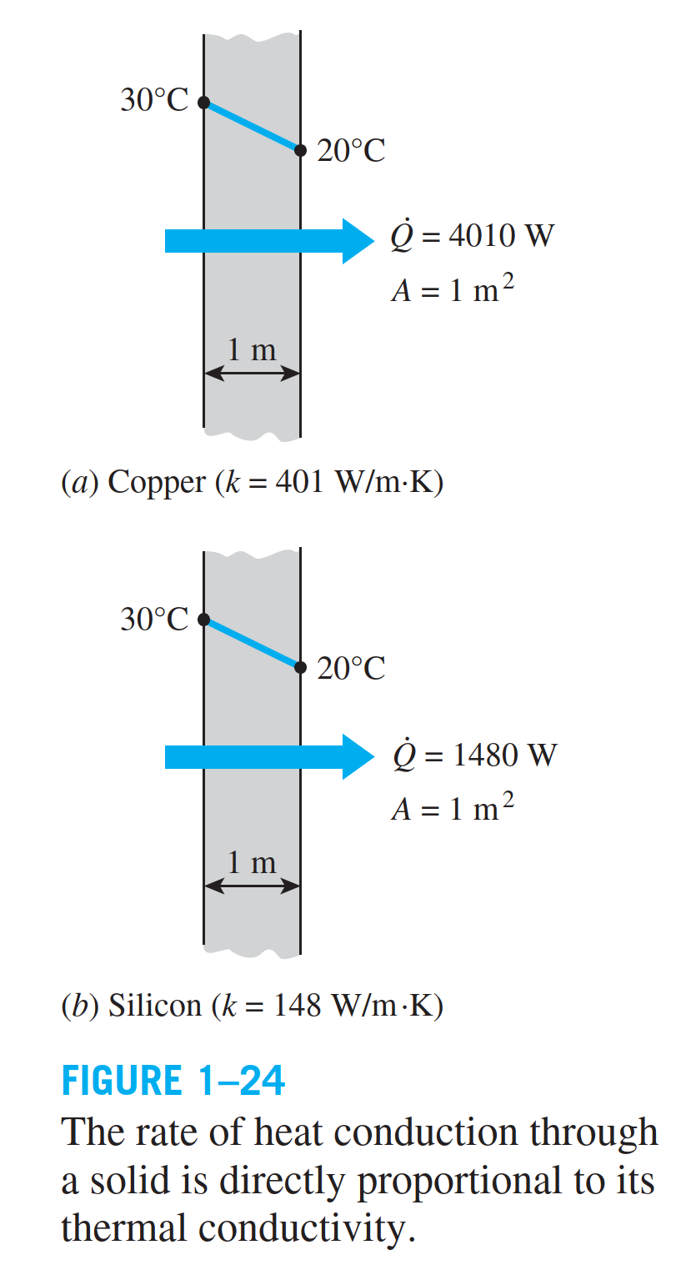
which is called Fourier’s law of heat conduction.

Slide 6
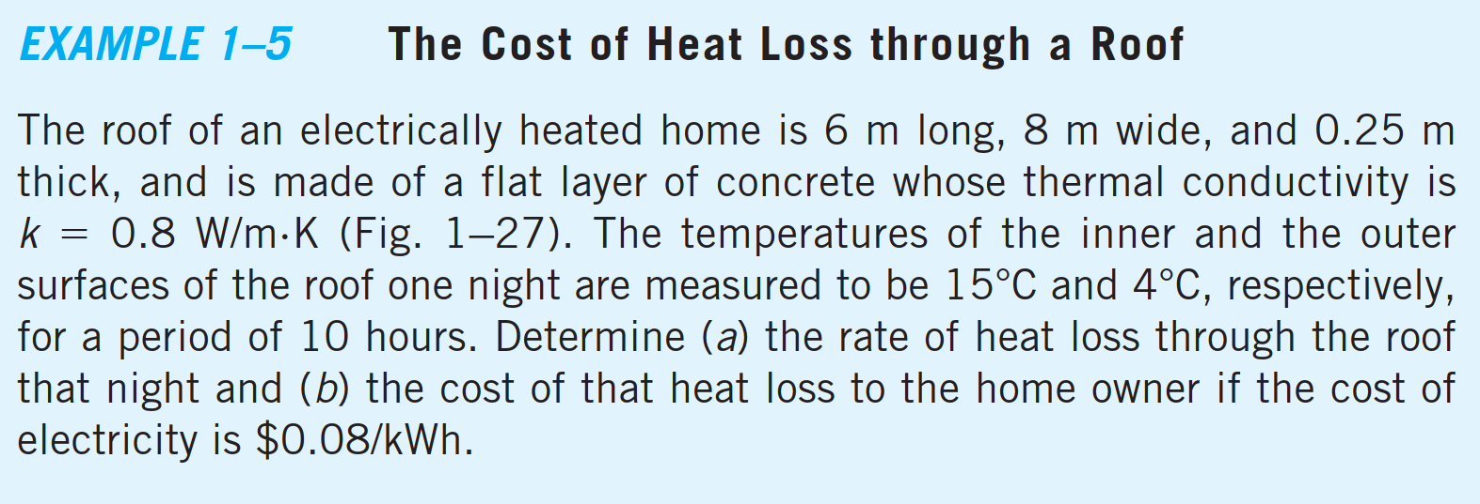
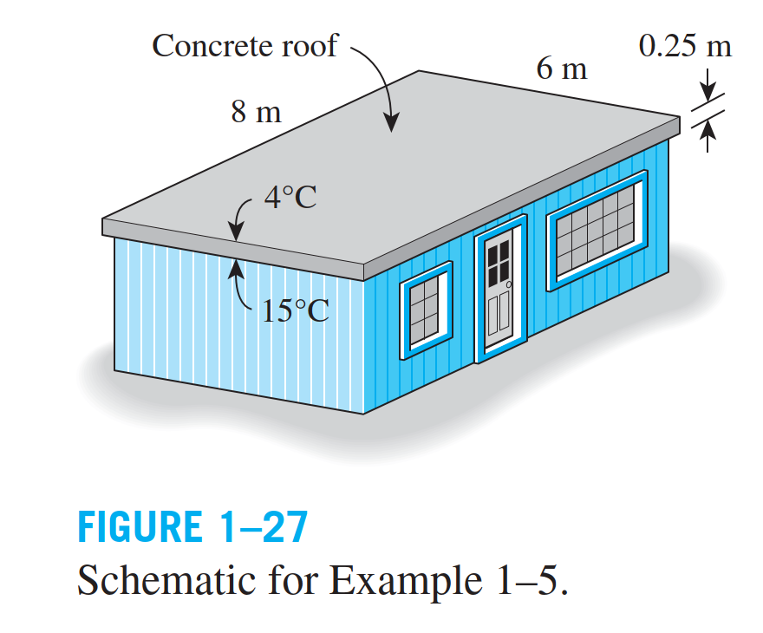
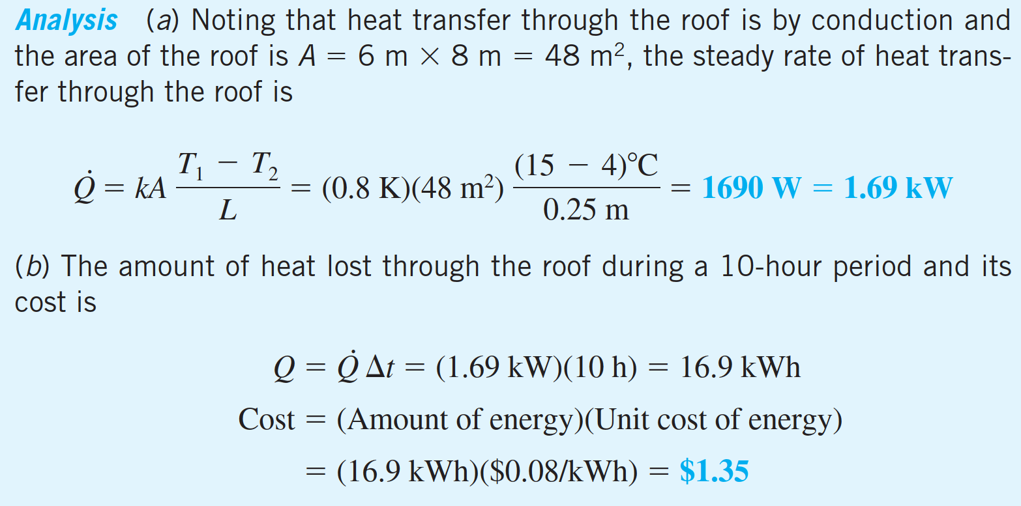
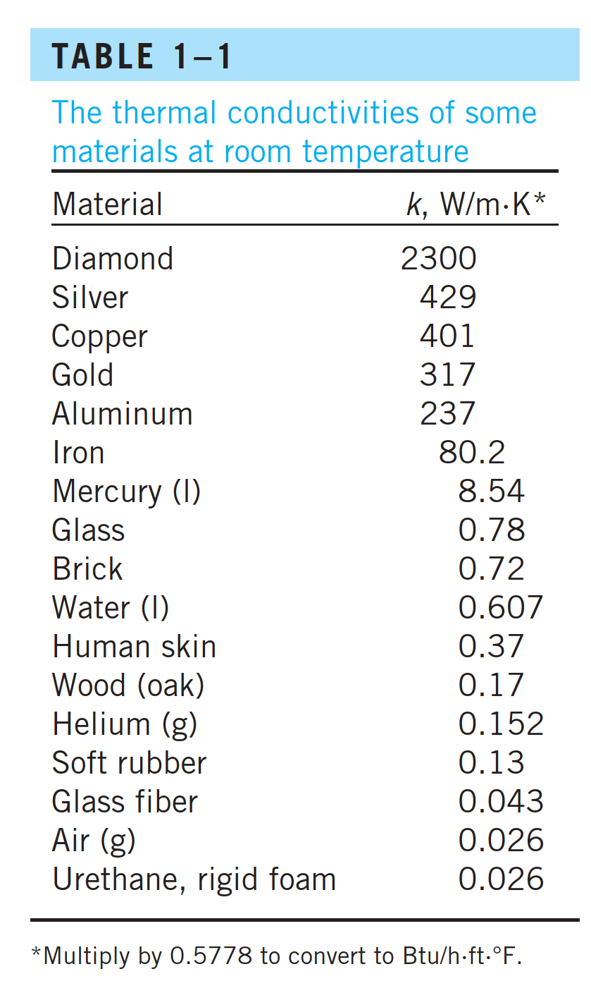

Slide 7
EES
How much is the cost of the heat loss to the home owner if the cost of electricity varies between $0.02/kWh to $2/kWh?
Calculate the cost of heat loss for electricity cost of $0.08/kWh and k from 0.5 W/m.K to 5 W/m.K.

Slide 8
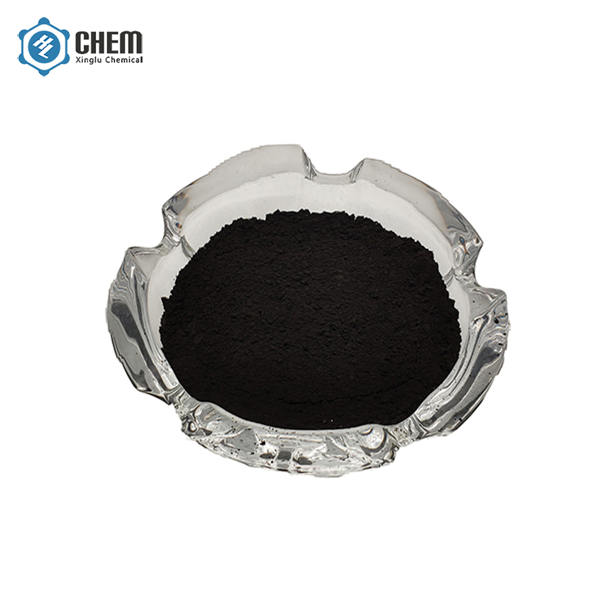
nano Copper Oxide CuO Nanoparticles (CuO, high purity, 99.9%min, 25-55nm

Slide 9
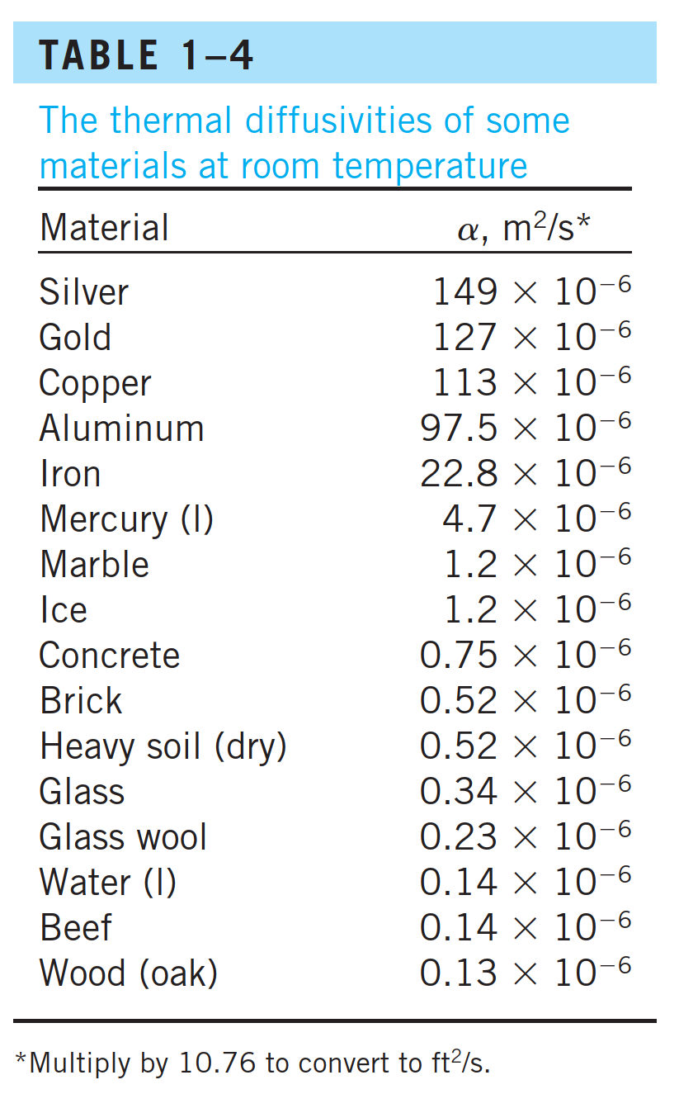
Another material property that appears in the transient heat conduction analysis is the thermal diffusivity, which represents how fast heat diffuses through a material and is defined as:
Note that the thermal conductivity k represents how well a material conducts heat, and the heat capacity ρ$c_{p}$ represents how much energy a material stores per unit volume.

Slide 10
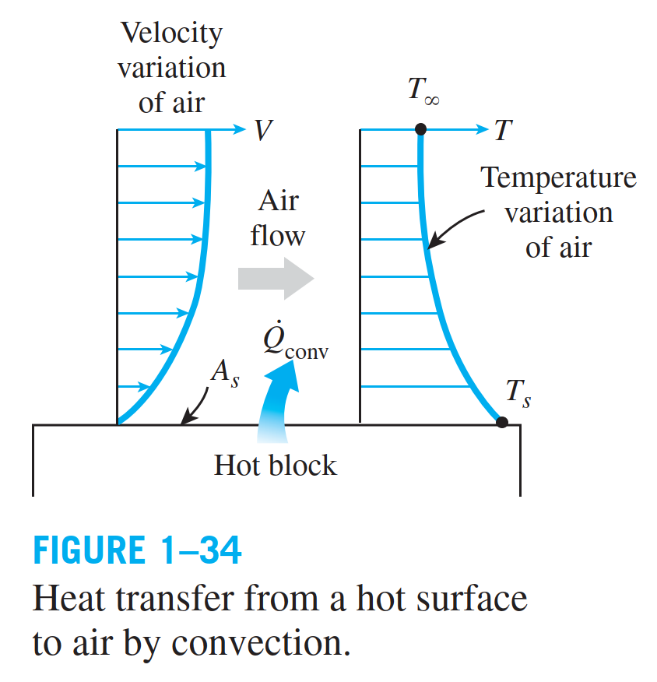
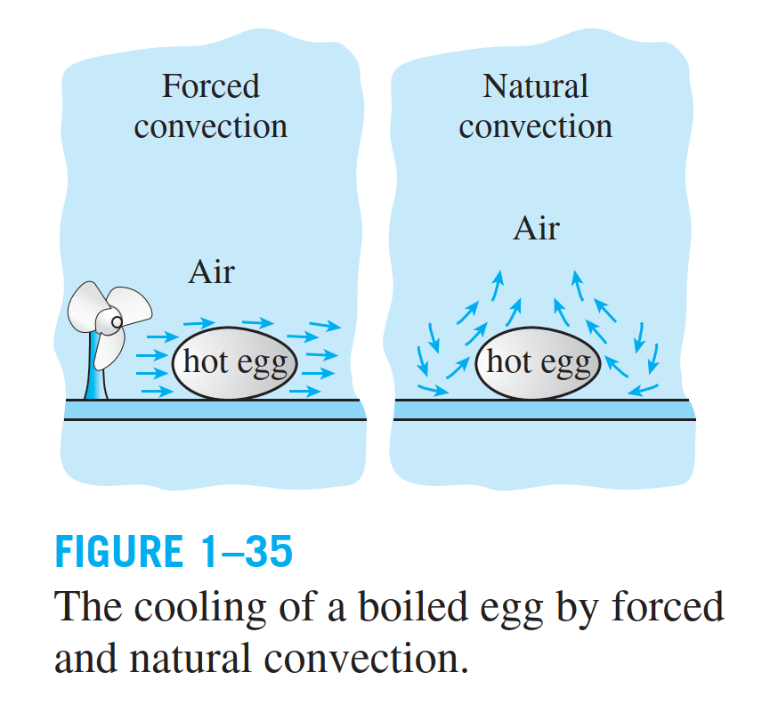
CONVECTION
Convection is the mode of energy transfer between a solid surface and the adjacent liquid or gas that is in motion, and it involves the combined effects of conduction and fluid motion. The faster the fluid motion, the greater the convection heat transfer. In the absence of any bulk fluid motion, heat transfer between a solid surface and the adjacent fluid is by pure conduction. The presence of bulk motion of the fluid enhances the heat transfer between the solid surface and the fluid, but it also complicates the determination of heat transfer rates.

Slide 11
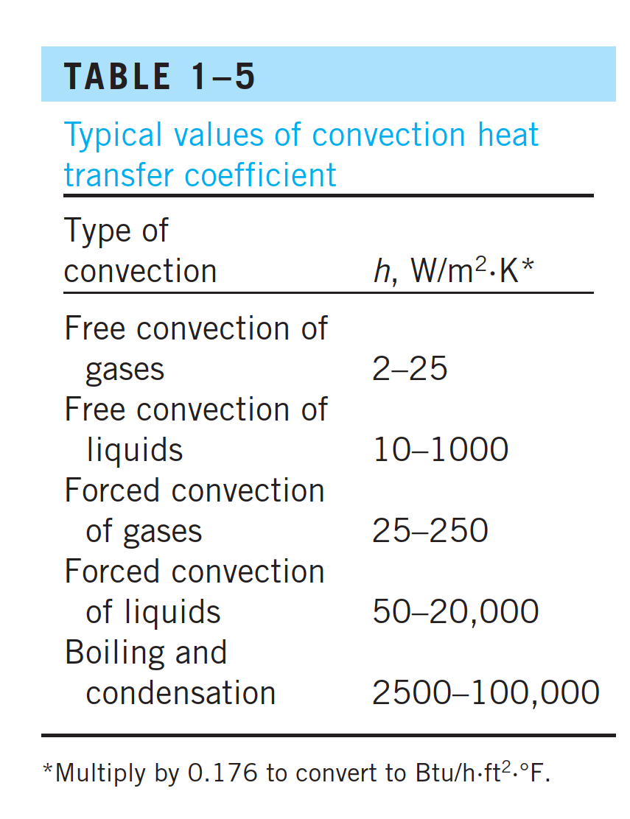

Slide 12
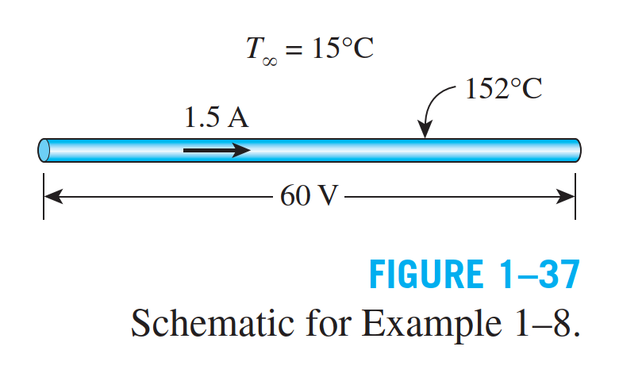

Slide 13
EES
How much is the convective heat transfer coefficient if V varies from 60 V to 120 V?

Slide 14
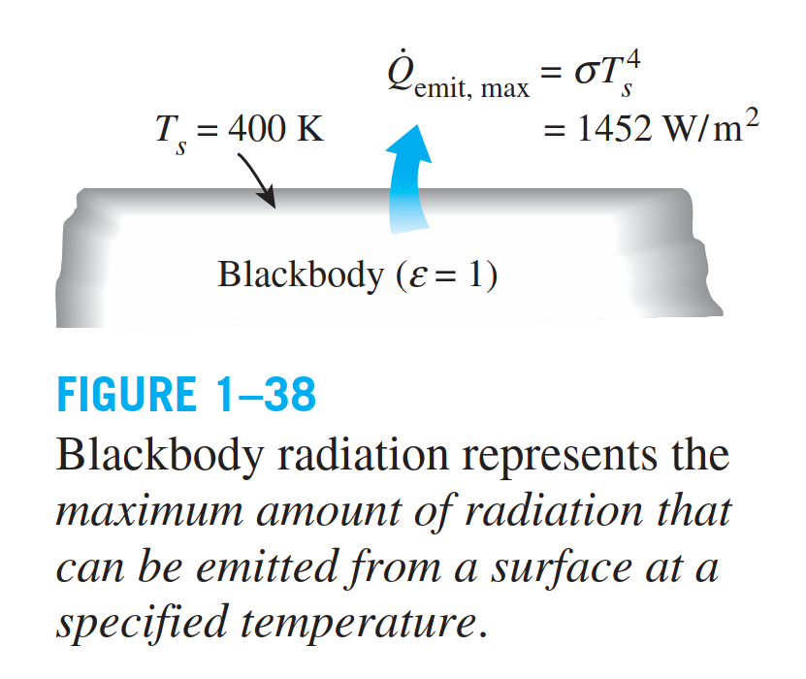
RADIATION
Radiation is the energy emitted by matter in the form of electromagnetic waves (or photons) as a result of the changes in the electronic configurations of the atoms or molecules. Unlike conduction and convection, the transfer of heat by radiation does not require the presence of an intervening medium. In fact, heat transfer by radiation is fastest (at the speed of light) and it suffers no attenuation in a vacuum. This is how the energy of the sun reaches the earth.

Slide 15
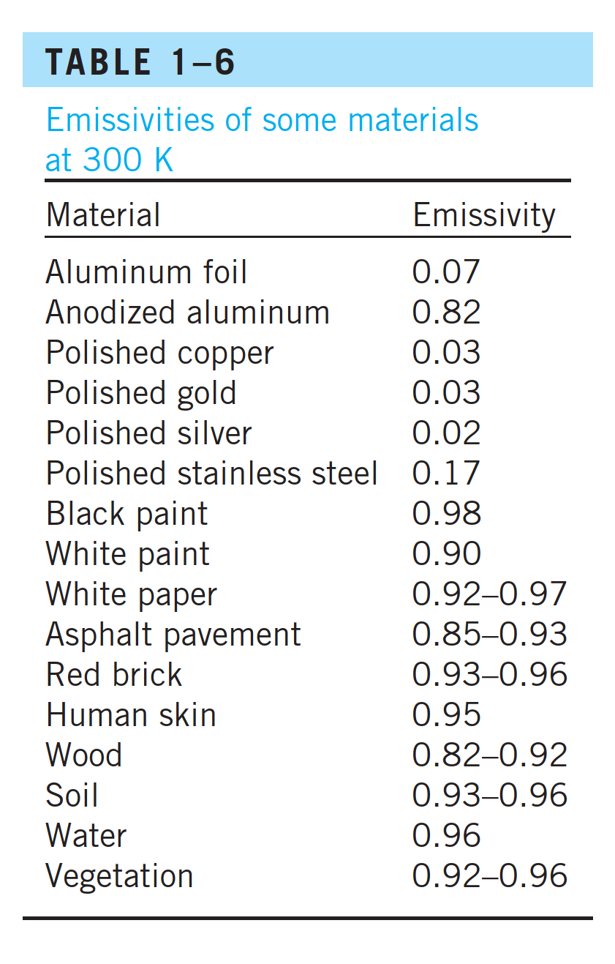
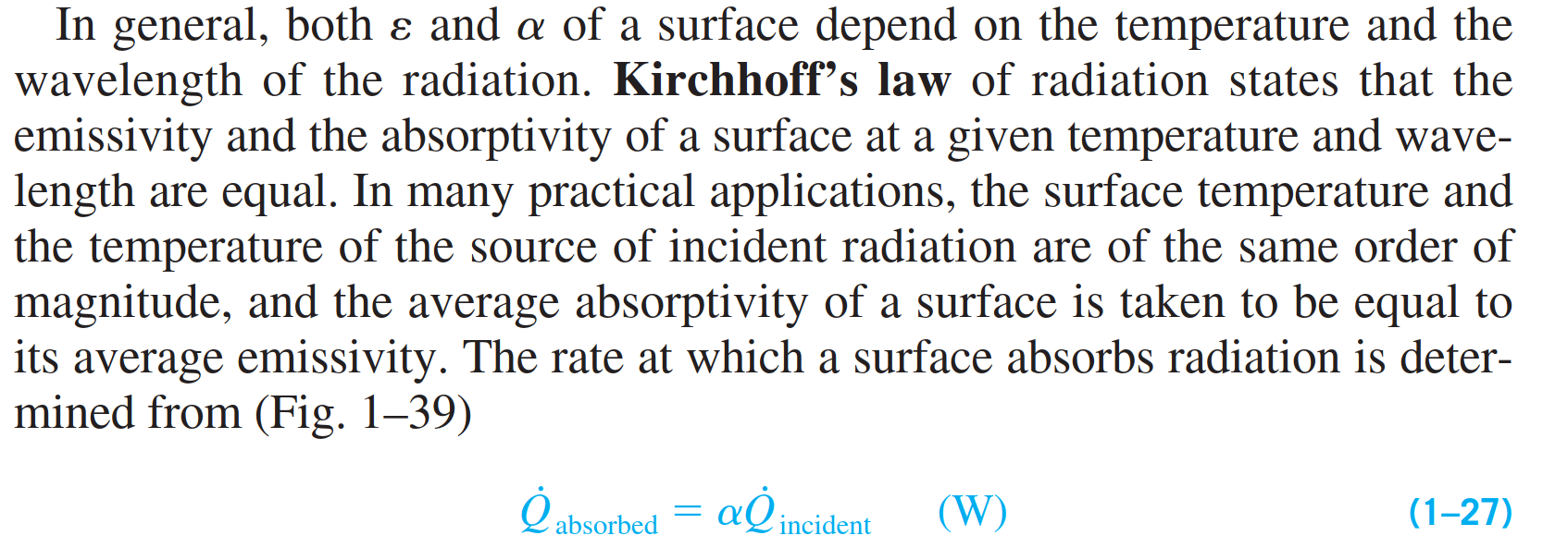

Slide 16
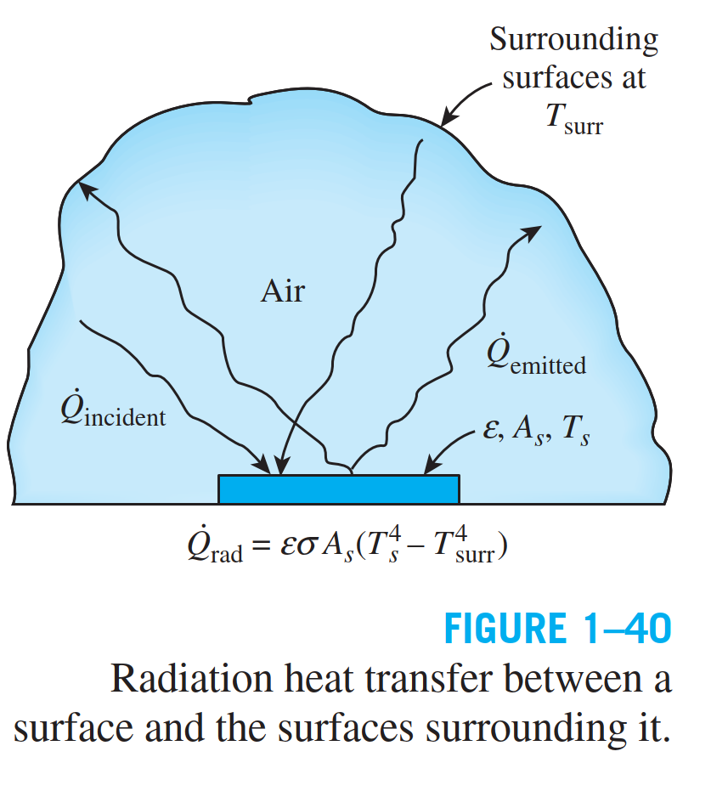

Slide 17
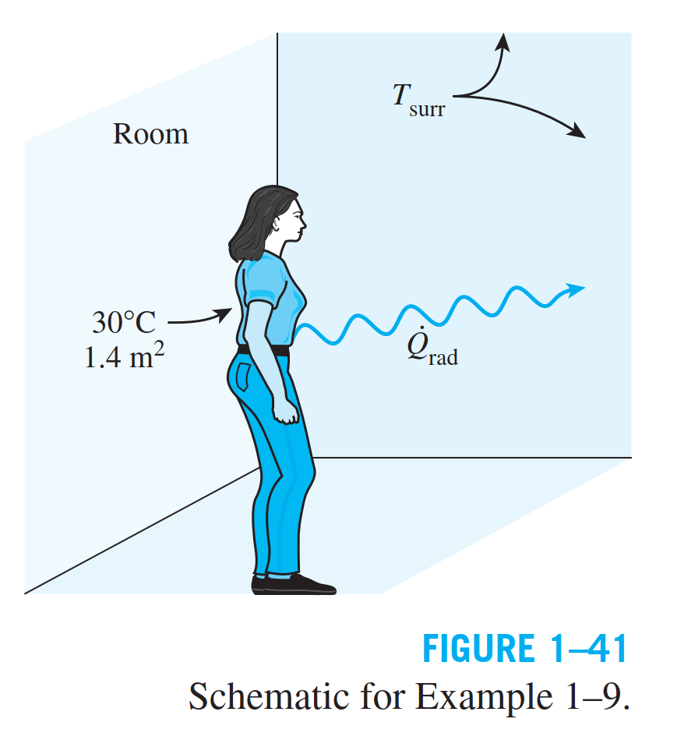

Slide 18
Example 1-10

Slide 19
SAM Example: Solar Power Tower System
Calculate the receiver power loss for a solar power tower system.

Slide 20
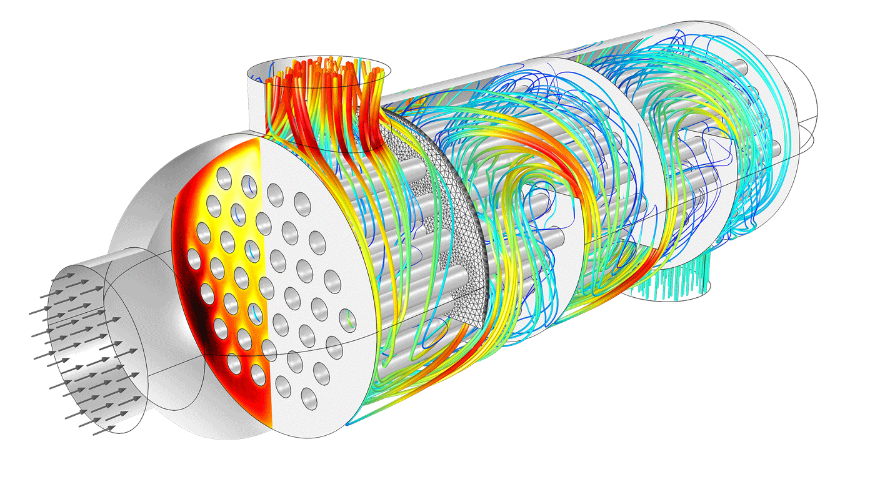
Heat Transfer Modeling
Credit: https://www.comsol.pt/heat-transfer-module

Slide 21
Ali Khosravi
Thank you

