Slide 1
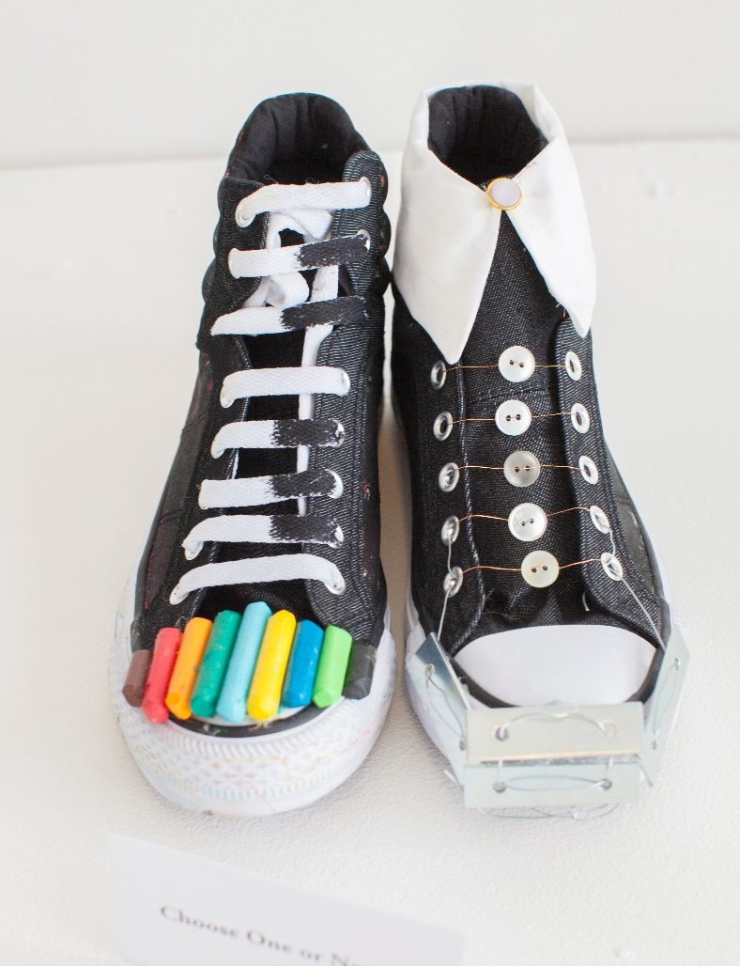
In new shoes
Visualized me
Open University Laura Isoniemi
Aalto University 2020

Slide 2
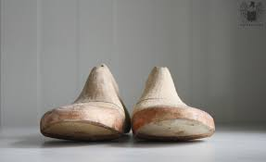
In new shoes
Introduction:
Changes in working life and the challenges in multicultural world are worked out by customing a new pair of shoes.
A self made pair of shoes is a new concrete start .Shoes can help - mentally- in stepping to new challenging situations as they work as a mental power station of a new start.
Giving meanings to different materials as well as group working and discussions are important parts of the process.

Slide 3
Goals: To increase well being , making an inspiring pair of shoes, increasing self understanding and self support by means of artistic expression, getting new resources for life .Understanding and getting tools to personal and cultural differencies.
Working methods: Experiental learning methods, art therapy methods, understanding by doing, picture lectures, discussions, recycling and shoe making

Slide 4
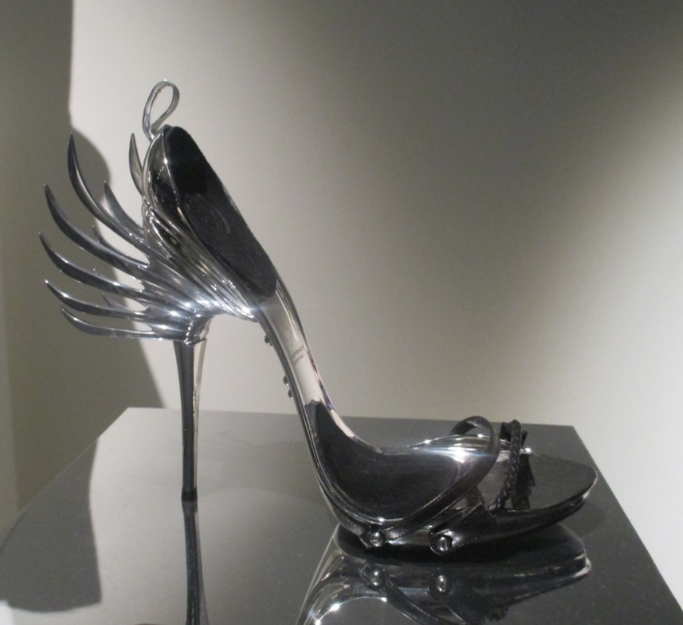
Anatomy of the shoes; Main elements
Shoe heel
Shoe heels are the supportative and main structural element of the shoe.
It can work as a metaphora for your self ; what is your most supportative thing that on what you can always stand on?
How to express it in shoe?

Slide 6
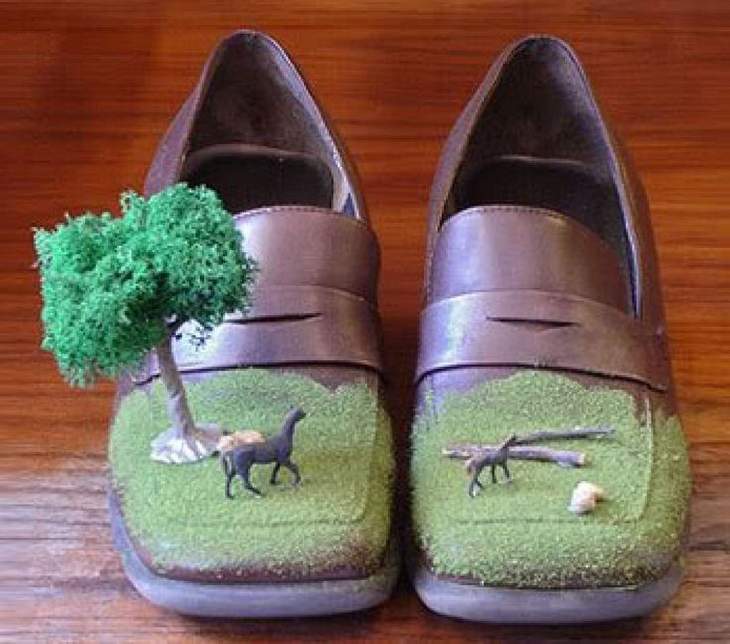
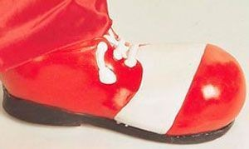
Tip of the shoe/ facade
Tip of the shoe is the part that is visible to all. The most precious thing can be presented here.
It can also be thought as a stage of most important happenings.

Slide 7
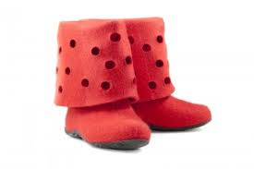
Shoe itself , ”body”
Bootleg
Is it bound with ribbons?

Slide 8
The ebottom of the shoe

Slide 9
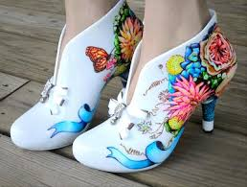
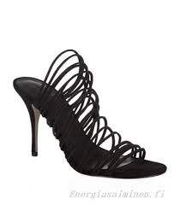
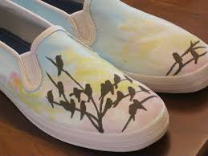
Details
Decorations

Slide 10
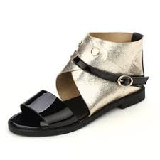
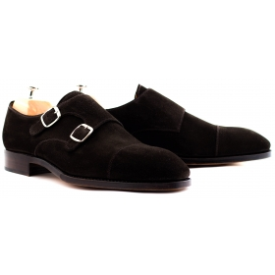
Bucles

Slide 11
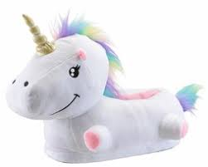
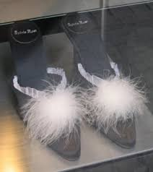
Shoe categories slippers sneakers High heels Flip-flops boots Organic shoes Traditional shoes Fantasy shoes

Slide 12
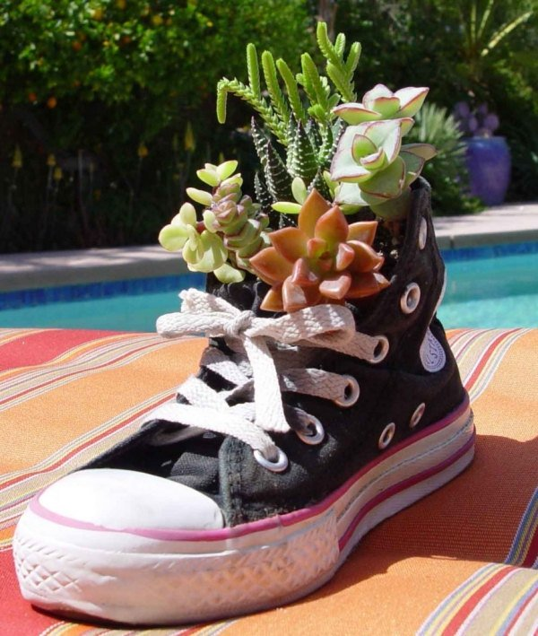
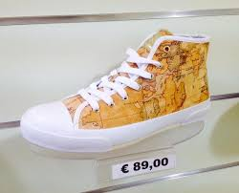
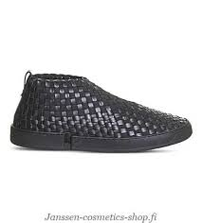
Sneakers

Slide 13
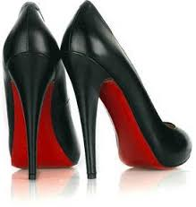
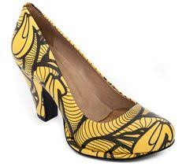
High heels

Slide 15
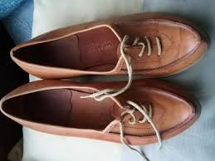
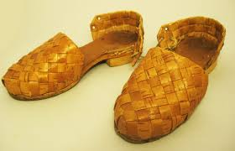
Traditional shoes based on culture heritage

Slide 16
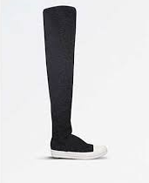
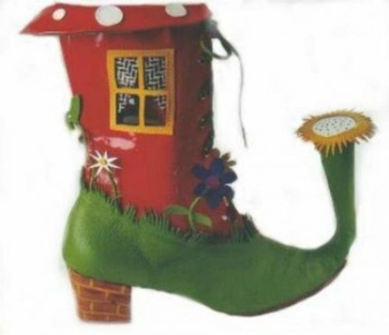
Boots

Slide 17
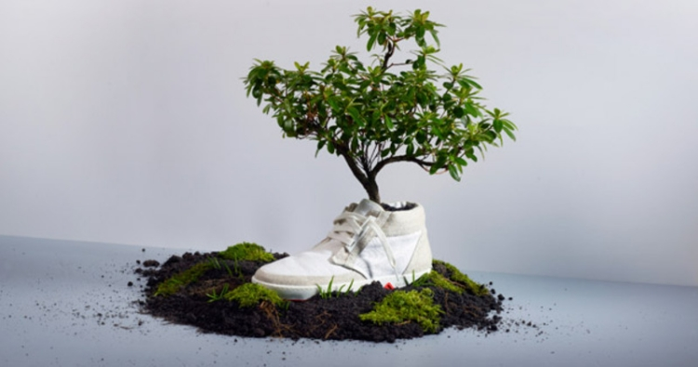
Organic shoes

Slide 18
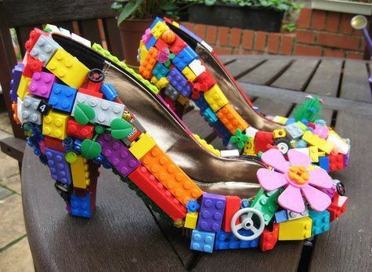
Fantasy shoes

Slide 19
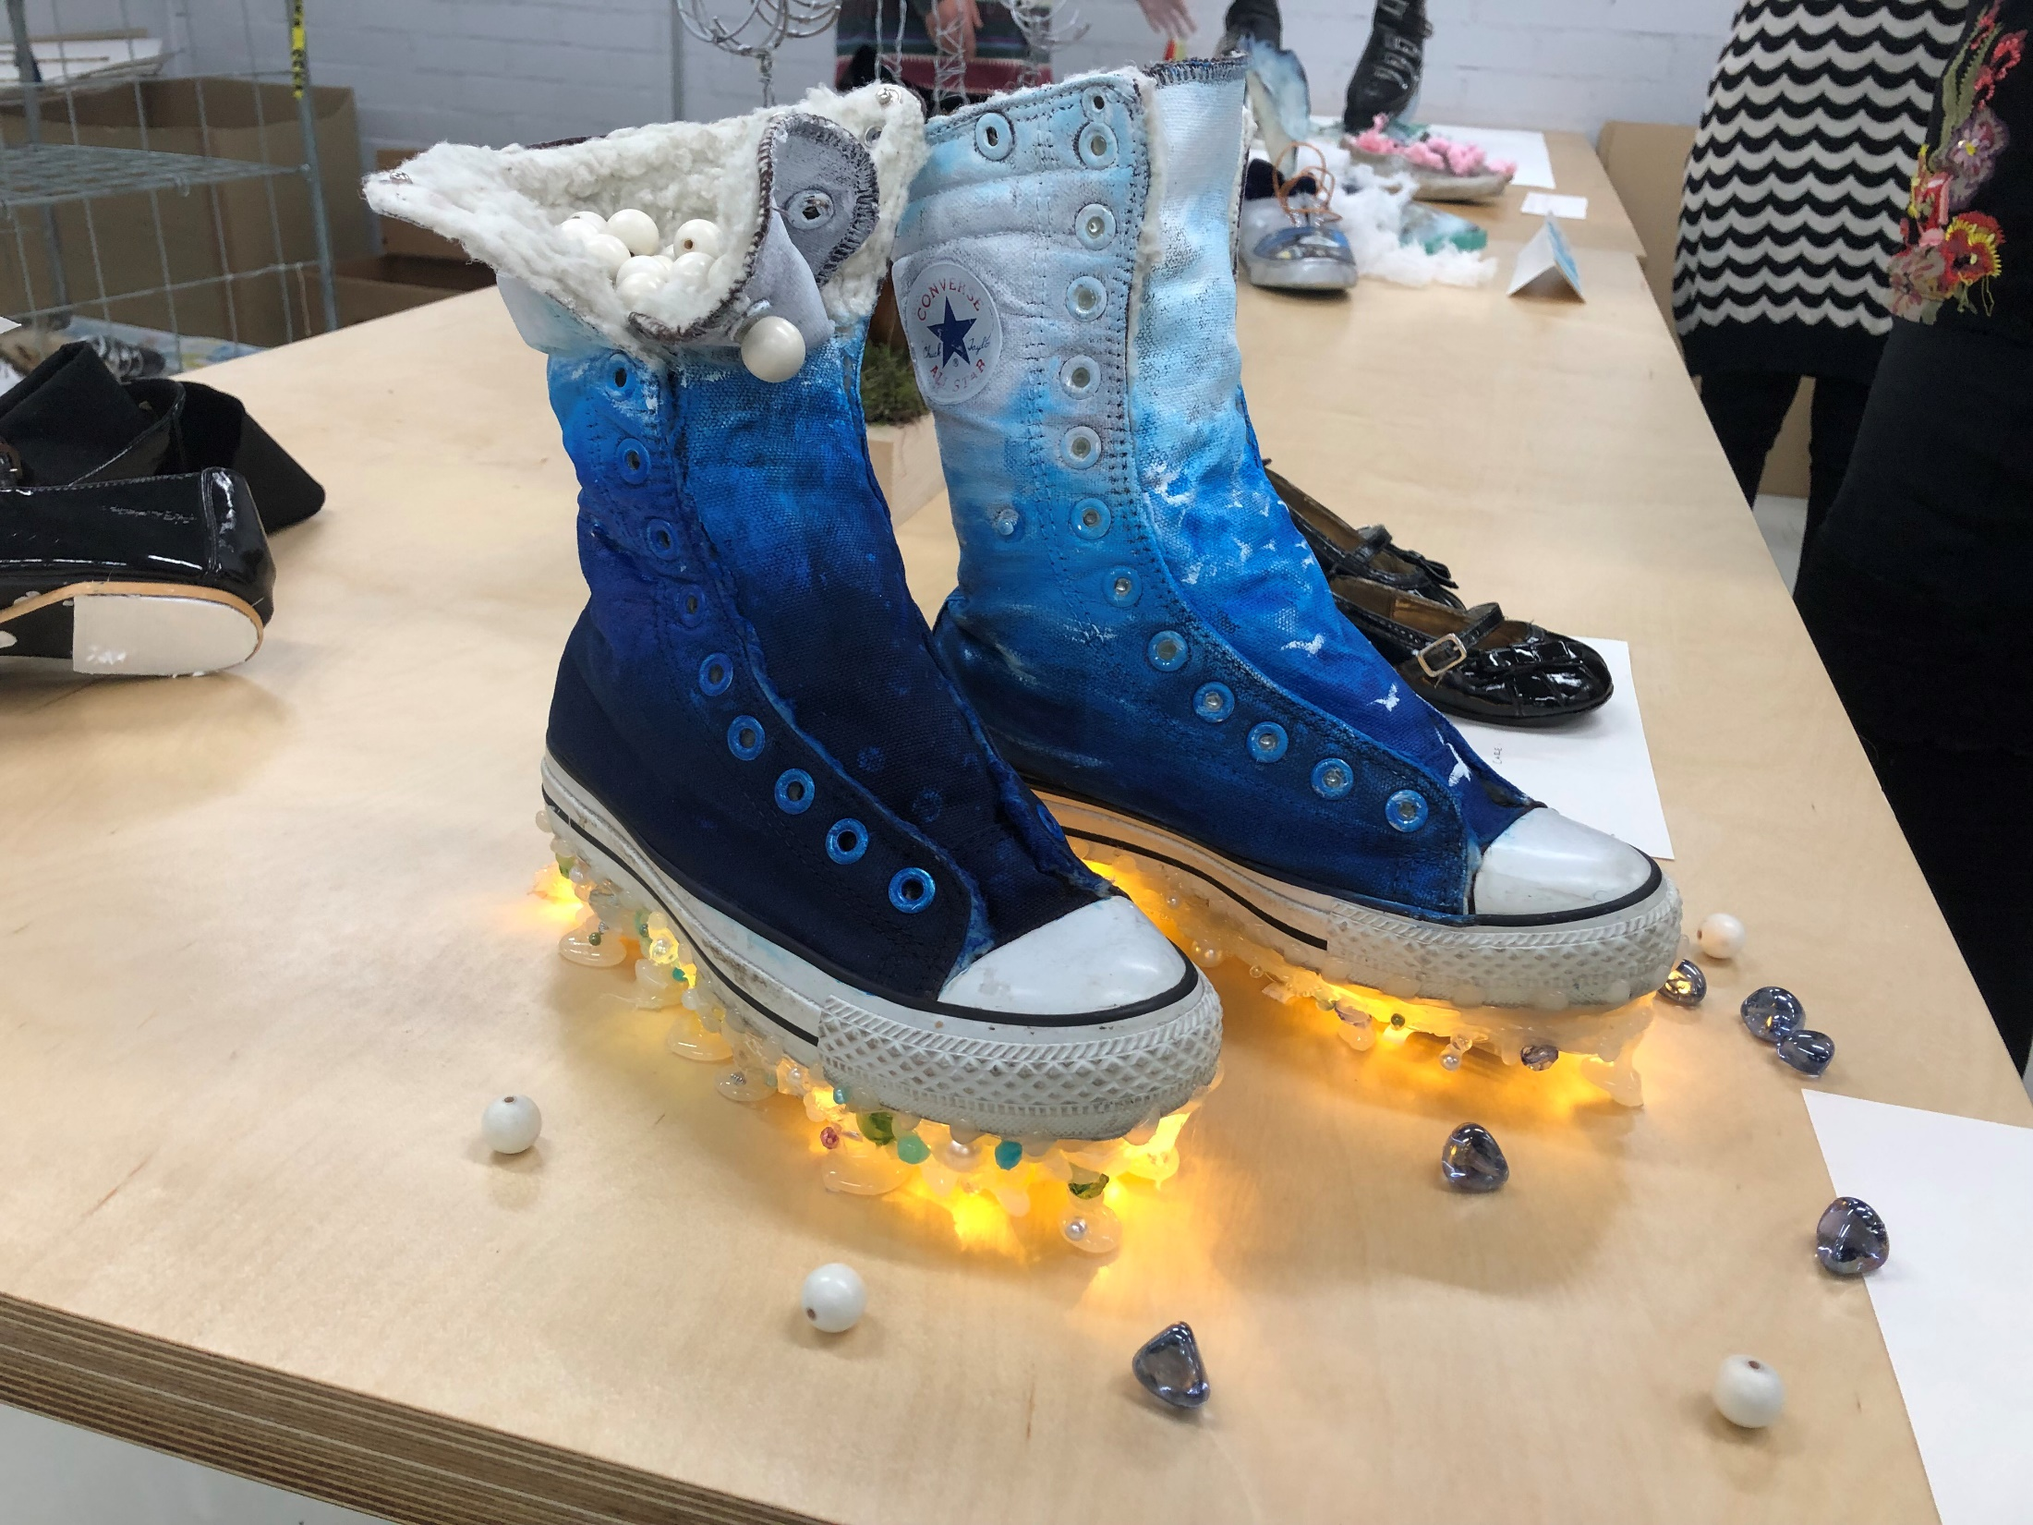

Slide 20
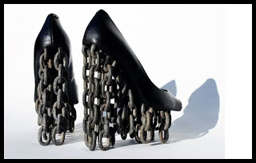
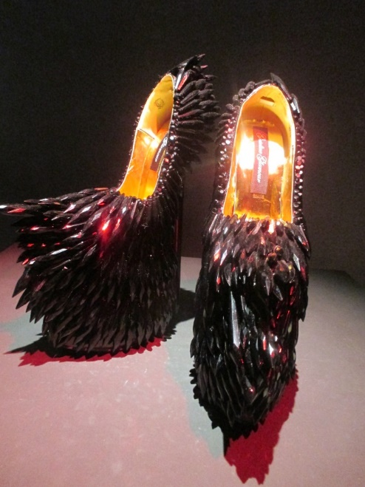
Fantasy shoes
Fantasy shoes

Slide 21
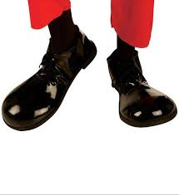
Funny shoes

Slide 22
Me ,myself and I exhibiton 2/2018 Aalto Arts Shoes

Slide 23
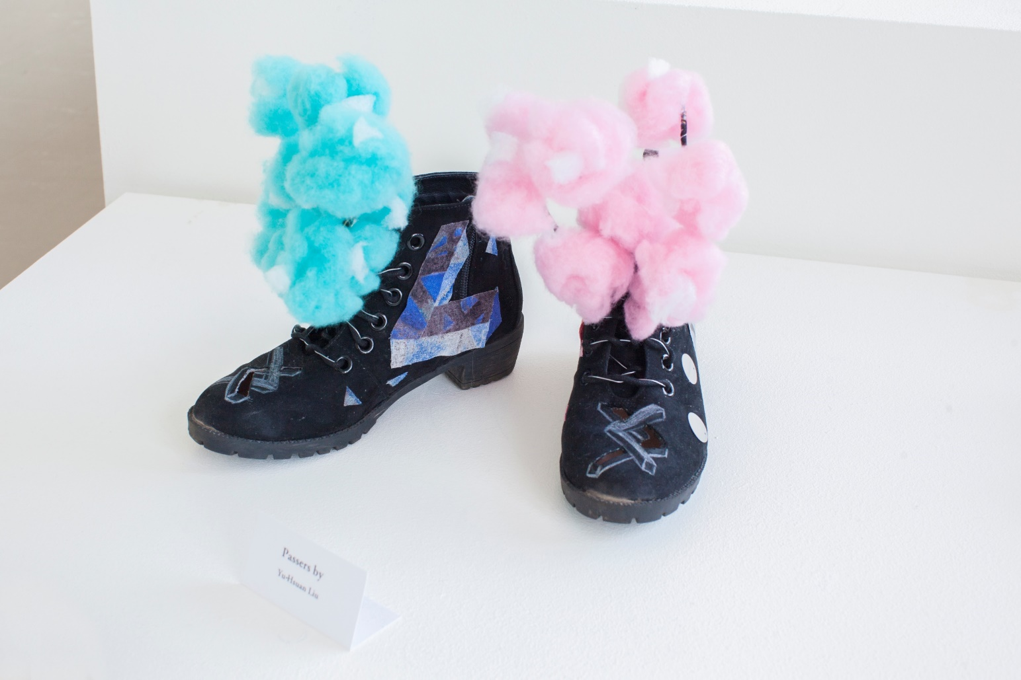
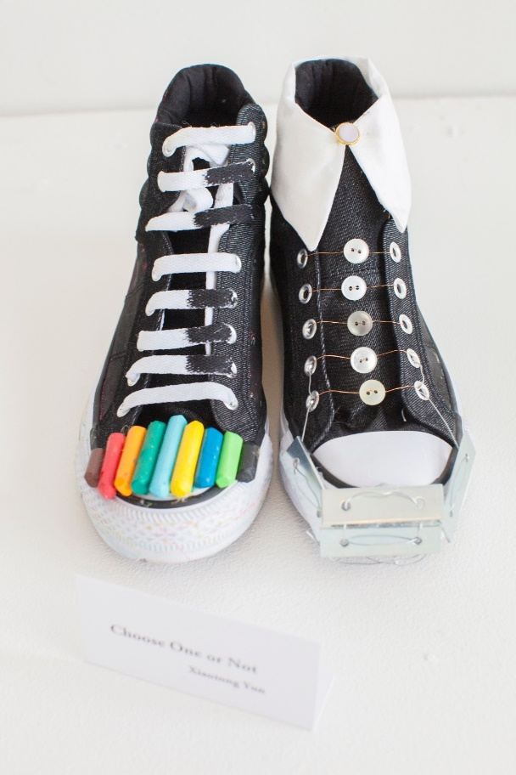
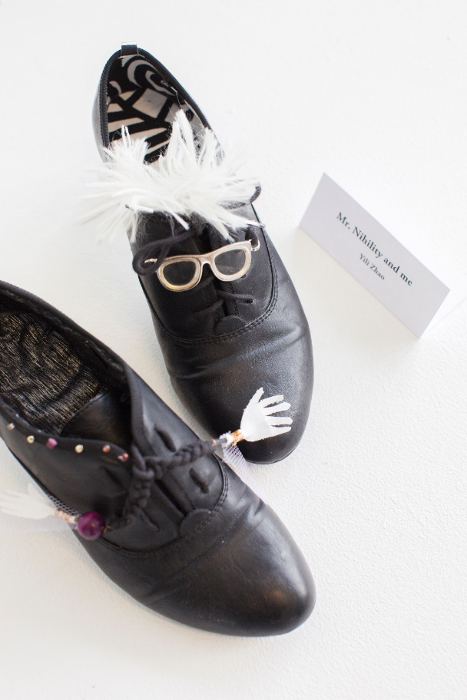

Slide 24
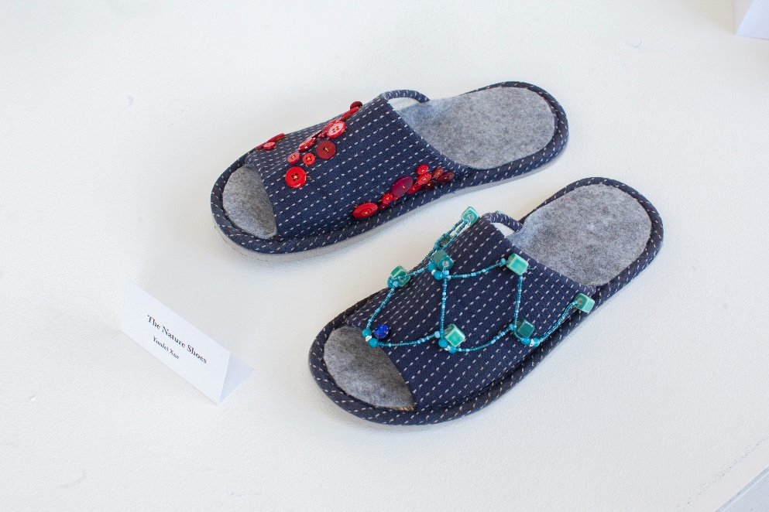
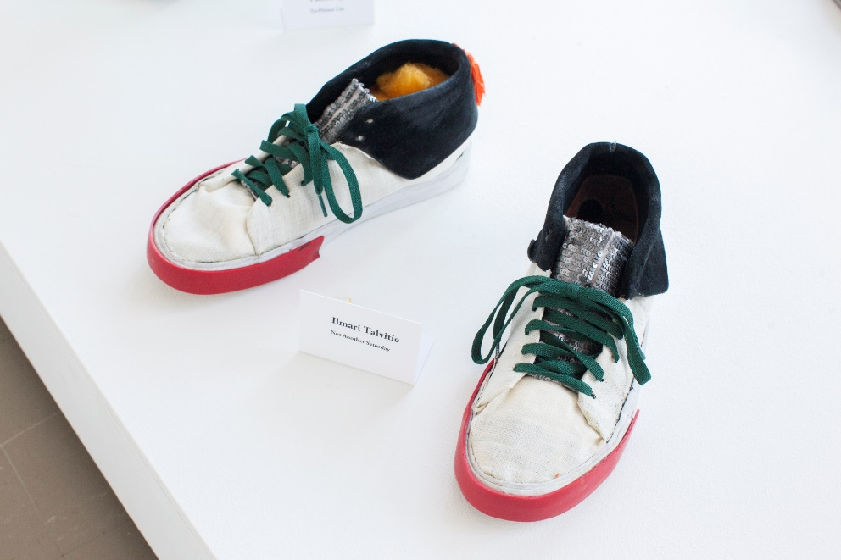

Slide 25
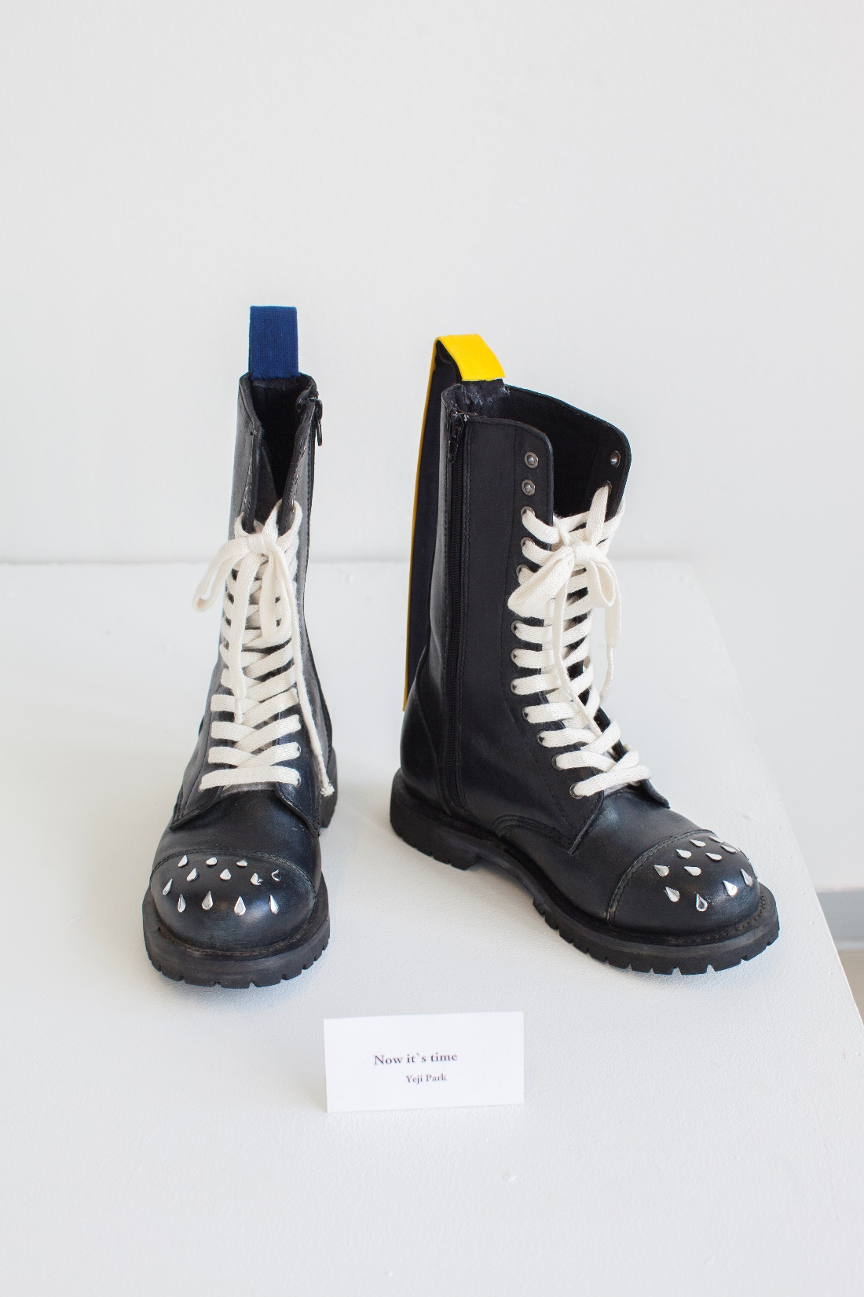
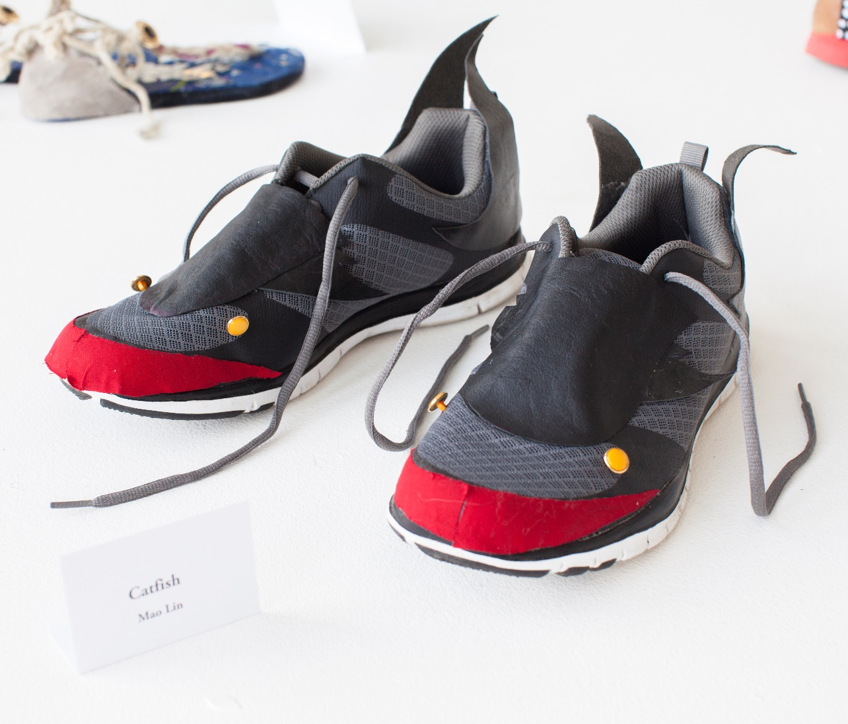

Slide 29
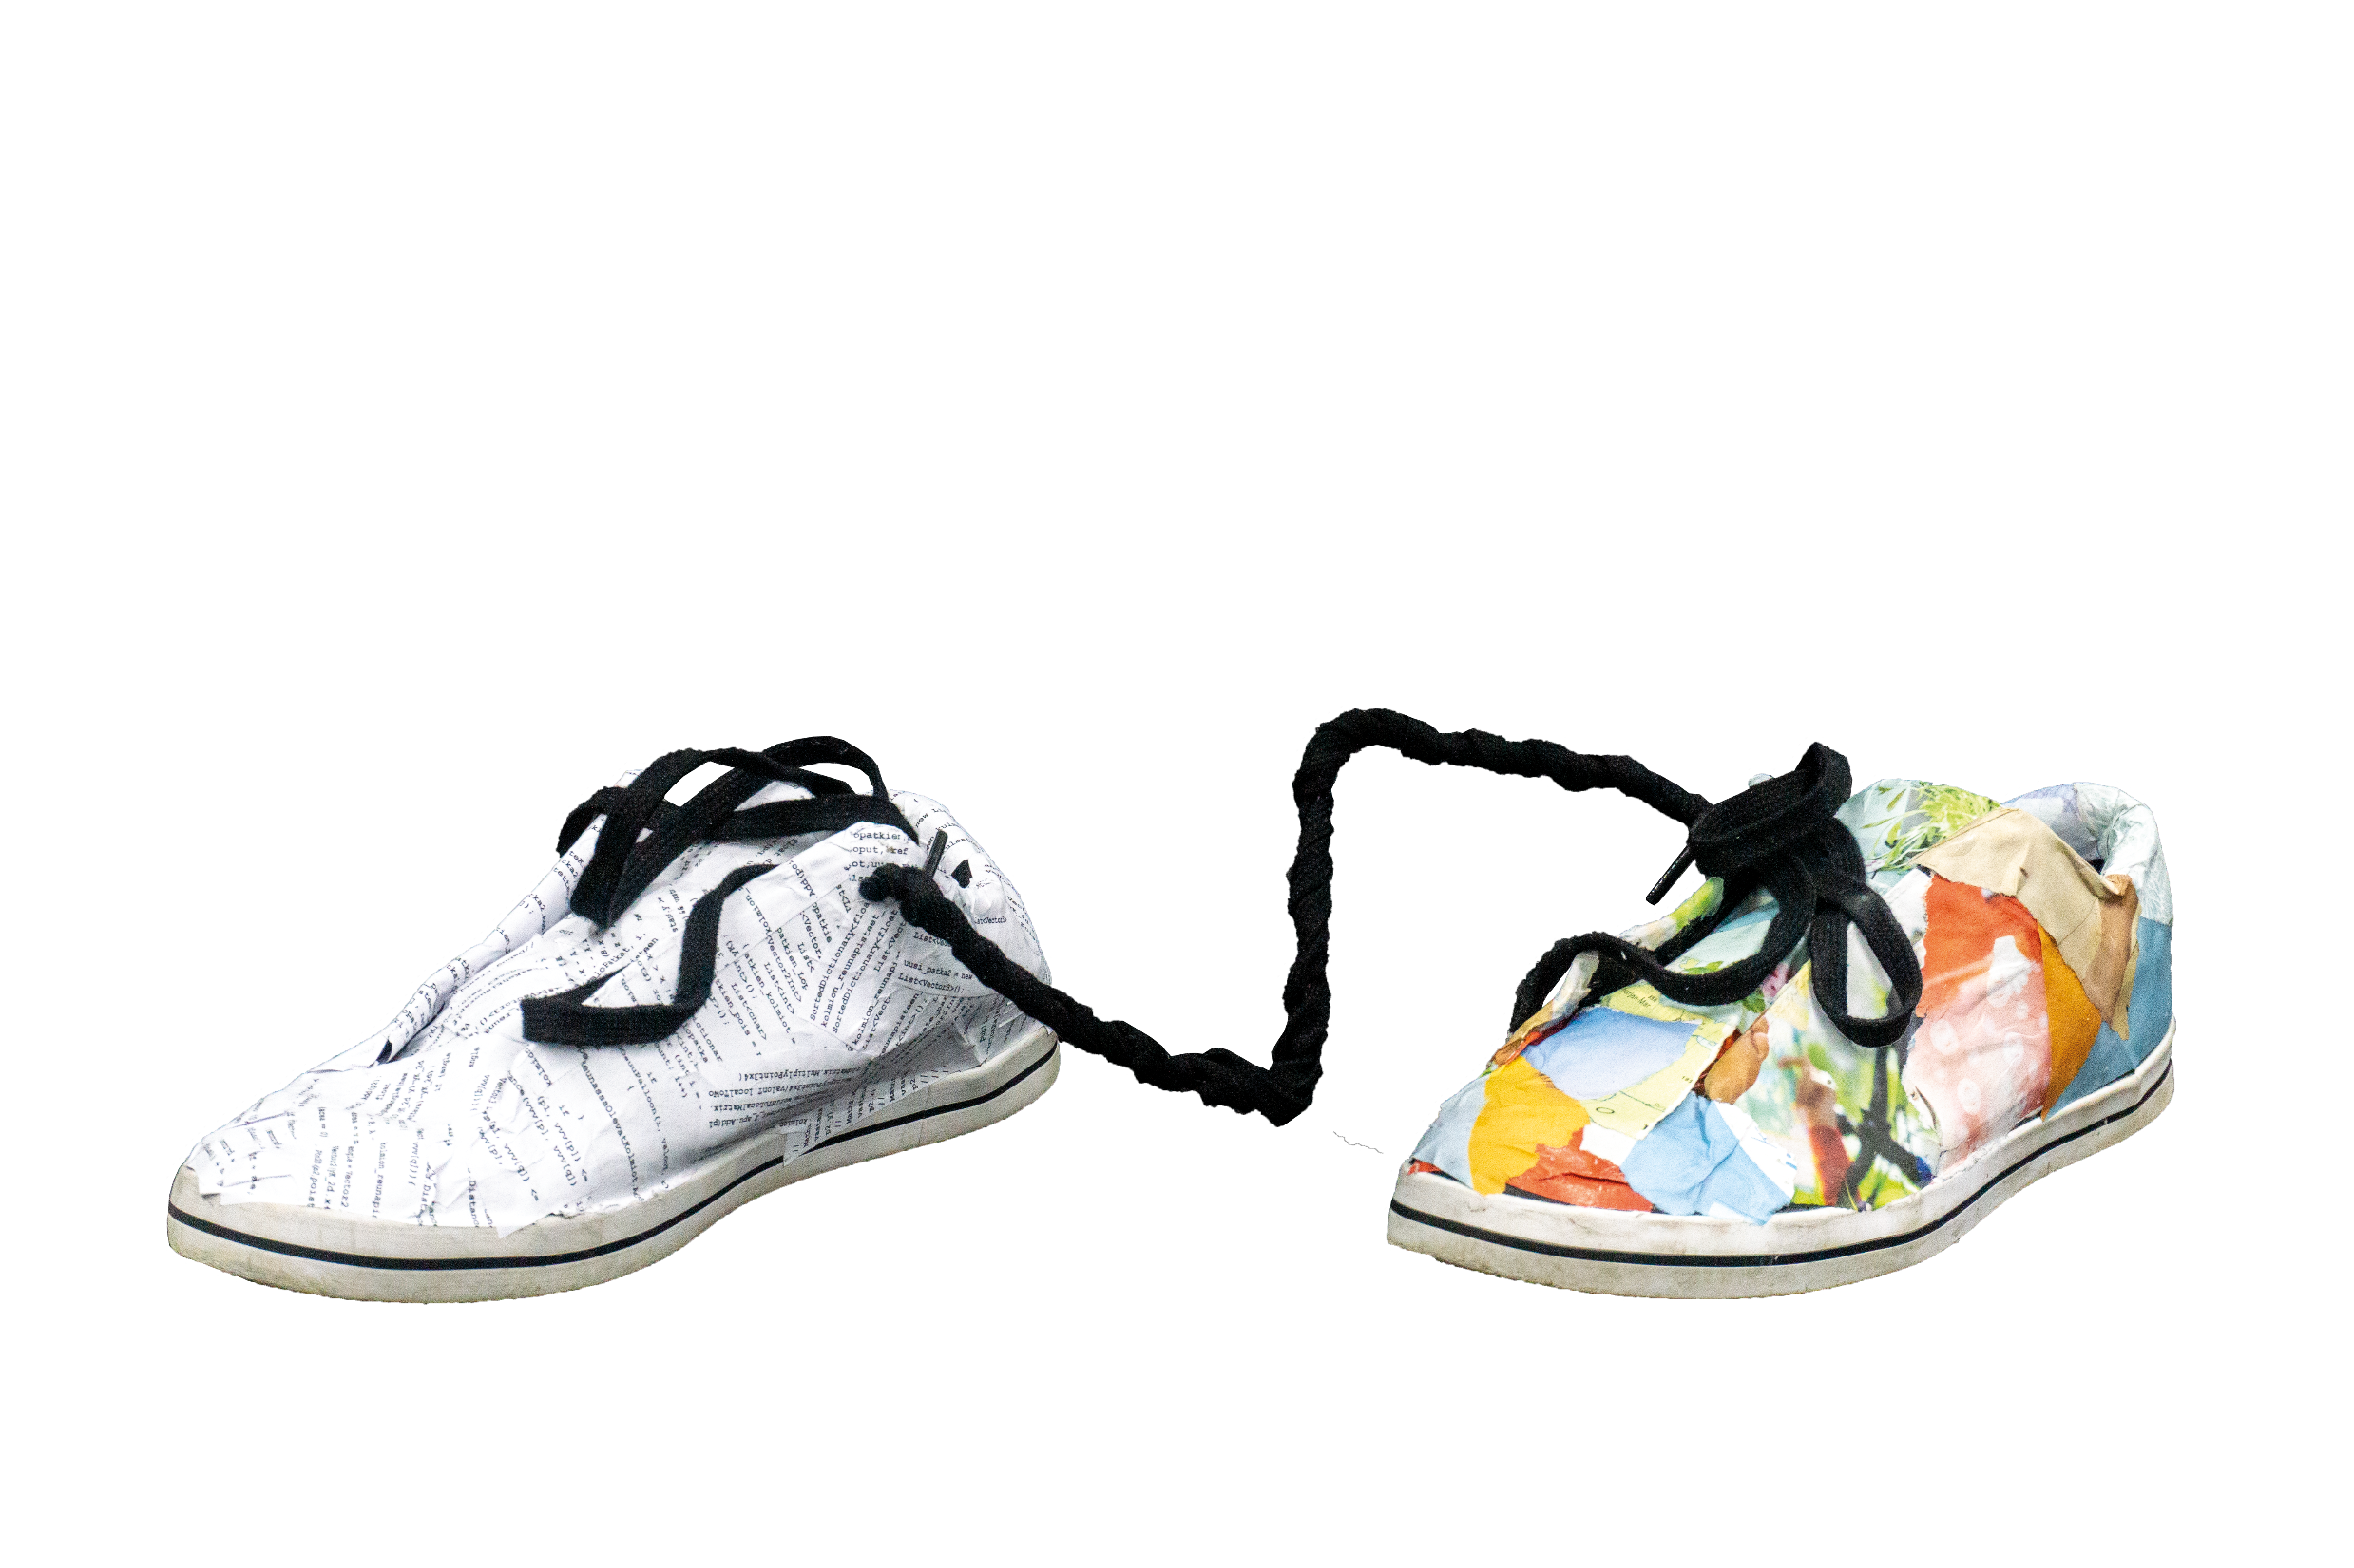

Slide 32
