Slide 1
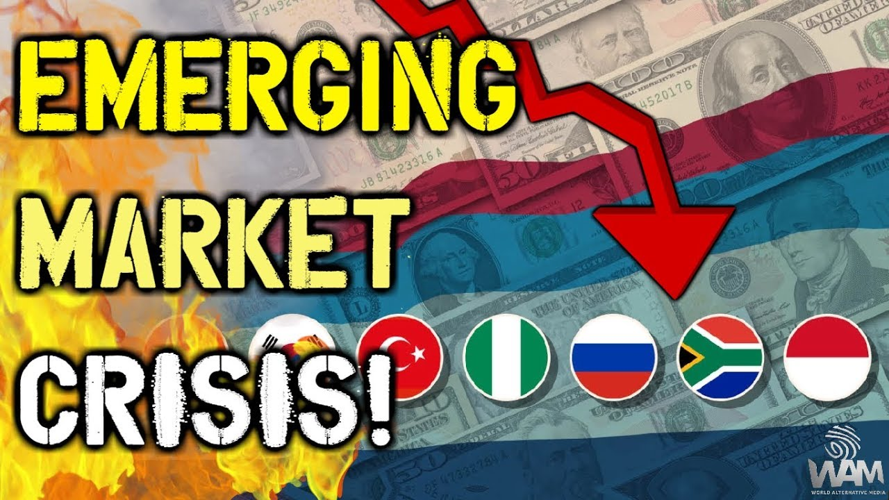
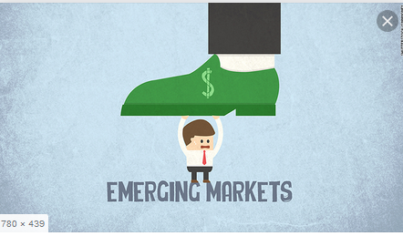
Crises in Emerging Markets
Svetlana Ledyaeva
Aalto University School of Business

Slide 2
Crisis – how it happends in general?
High capital inflow into the country ➔
Economic growth, local currency appreciation, current account deficit (import is financed not by export but by capital inflow)
Something happends and capital stops flowing into the country! ➔
Economic downturn, sharp currency devaluation, country`s default on its debt, …

Slide 3
Car crash analogy of the crisis
From lecture of J Frankel (Harvard)

Slide 4
Car crash analogy of the crisis 1
From lecture of J Frankel (Harvard)

Slide 5
Car crash analogy of the crisis 2
From lecture of J Frankel (Harvard)

Slide 6
Car crash analogy of the crisis 3
From lecture of J Frankel (Harvard)

Slide 7
Car crash analogy of the crisis 4
From lecture of J Frankel (Harvard)

Slide 8
Three waves of crises in emerging markets
From lecture of J Frankel (Harvard)

Slide 9
First cycle: 1975-1981-1989
1970s – two large oil price shocks
Created current account surpluses among oil-exporting countries ➔
Invested via large US money-center banks and US government (US treasury bills) ➔
Invested to emerging markets ➔
Created current account deficits among oil-consuming countries, in particular, emerging. ➔
High international debt of emerging markets
World recession ➔ higher interest rates on loans ➔ emerging markets default

Slide 10
Second cycle: 1990-1996-2002
Plaza accord of 1985 ➔ major superpowers agreed to weaken US dollar ➔
Low interest rate in developed countries ➔
Investors look for opportunities of high return somewhere else ➔
1990s – influx of capital into emerging countries: hot money, portfolio investment dominated ➔
Economic bubble, external shocks (devaluation of Chinese and Japanese currencies; appreciation of US currency; US economy recovered from recession; rising US interest rates to head off inflation)➔
Capital outflow from emerging markets to US.

Slide 11
Third cycle: 2003-2008-present
High oil prices ➔ petrodollar money
Oil exporters opted to make most of their investments directly into diverse global markets, and the recycling process was less dependent on intermediary channels such as international banks and the IMF.
Global financial crisis quickly shifted to emerging markets in 2008-2009.
US monetary policy: Taper talk in 2013 ➔ increase of interest rates in US.
Oil prices started to collapse in 2014.

Slide 12
From lecture of J Frankel (Harvard)

Slide 13
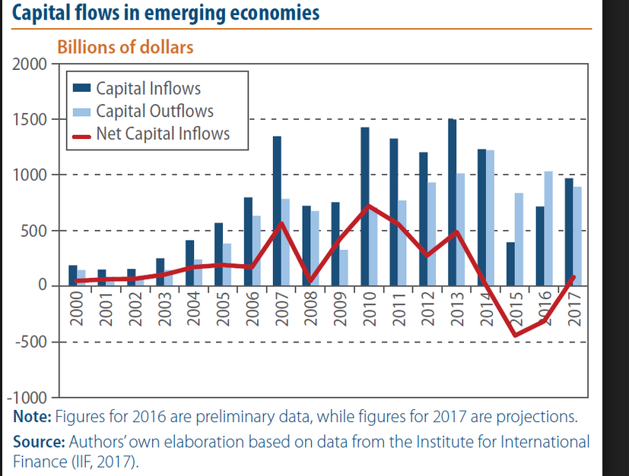
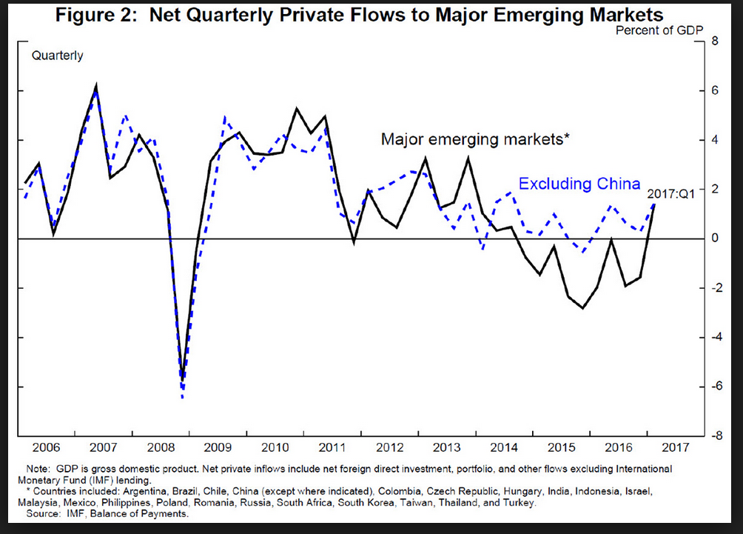

Slide 14
Main factors of crises in emerging markets
Oil price volatility
US monetary policy
High risks in the world economy in general, global crisis
Contagion effects

Slide 15
The role of US monetary policy in crises in emerging markets
US FED tightening policy; Taper talk
The word ”tapering” in financial terms is increasingly being used to refer to the reduction of the Federal Reserve's quantitative easing, or bond buying program.
Less money available in US economy ➔ Higher interest rates in US ➔ Investments come back from emerging markets to US.

Slide 16
From lecture of J Frankel (Harvard)

Slide 17
Professor Andrew Karolyi (Cornell University) on taper tantrum of May-June 2013
May-June 2013: Federal reserve chief Ben Bernanke laid out his most specific plan yet for when the Central bank will start easing up on its controversial stimulus program which is pumping 85 billion USD a month into the economy.
In many EMs equity inflows has dropped but not in all.

Slide 18
Tapering talk: The impact of expectations of reduced Federal Reserve security purchases on emerging markets Barry Eichengreen, Poonam Gupta 19 December 2013, VoxEU
The largest negative impact of tapering was felt by countries that allowed exchange rates to run up most dramatically in the earlier period of expectations of continued Federal Reserve easing, when large amounts of capital were flowing into emerging markets.
The largest negative impact was in countries that allowed the current account deficit to widen most dramatically in the earlier period when it was easily financed.

Slide 19
From lecture of J Frankel (Harvard)

Slide 20
From lecture of J Frankel (Harvard)

Slide 21
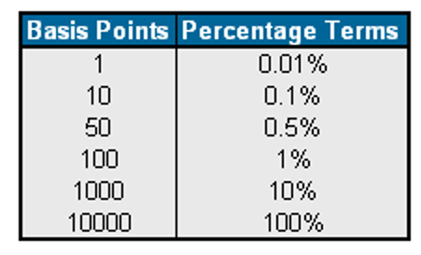
From lecture of J Frankel (Harvard)

Slide 22
From lecture of J Frankel (Harvard)

Slide 23
From lecture of J Frankel (Harvard)

Slide 24
Crises` consequencies
Local currency devaluation
Inflation
Economic downturn

Slide 25
From lecture of J Frankel (Harvard)

Slide 26
Trade balance –
Net Export
From lecture of J Frankel (Harvard)

Slide 27
From lecture of J Frankel (Harvard)

Slide 28
Balance sheet effect ➔ currency mismatch
The extent to which economy`s liabilities determined in foreign currency and assets – in domestic currency.
Asset-liability missmatch
For example, a bank that chose to borrow entirely in US dollars and lend in Russian rubles would have a significant currency mismatch: if the value of the ruble were to fall dramatically, the bank would lose money.

Slide 29
From lecture of J Frankel (Harvard)

Slide 30
From lecture of J Frankel (Harvard)

Slide 31
From lecture of J Frankel (Harvard)

Slide 32
From lecture of J Frankel (Harvard)

Slide 33
From lecture of J Frankel (Harvard)

Slide 34
From lecture of J Frankel (Harvard)

Slide 35
From lecture of J Frankel (Harvard)

Slide 36
From lecture of J Frankel (Harvard)

Slide 37
From lecture of J Frankel (Harvard)

Slide 38
From lecture of J Frankel (Harvard)

Slide 40
From lecture of J Frankel (Harvard)

Slide 41
From lecture of J Frankel (Harvard)

Slide 42
From lecture of J Frankel (Harvard)

Slide 43
From lecture of J Frankel (Harvard)

Slide 44
From lecture of J Frankel (Harvard)

Slide 45
From lecture of J Frankel (Harvard)

Slide 46
From lecture of J Frankel (Harvard)

Slide 47
Expert opinion: Nenad Pacek, President, Global Success Advisors GmbH; Co-Founder, CEEMEA Business Group
Crisis in Asia in 1997 - all Asian markets crashed except China.
It can happened again! But now things are different.
In that times Asia had only 500 billion USD foreign currency reserves; now they have 5 trillion USD (10 fold increase). ➔
They do not want to ask money from IMF, they want to be masters of their dignity ➔
They want to have a buffer.
They also cut foreign debt – 17% of GDP (Asia, aggregate) – good for businesses.

Slide 48
Conclusions of macroeconomic module The macroeconomic risks of emerging market investment
No question – emerging-market investments are exposed to additional macro risks:
Accelerated inflation;
Exchange rate fluctuations;
Macroeconomic and political distress;
Proneness to crises.

Slide 49
Modern crisis in emerging markets

