Slide 1
Lecture 6. Intra-industry trade and gravity modelling
Svetlana Ledyavea
Aalto BIZ
Winter 2019

Slide 10
Intra-industry trade.

Slide 18
Measures the degree of substitutability among products within industry. The lower it is, the more differentiated are products.

Slide 19
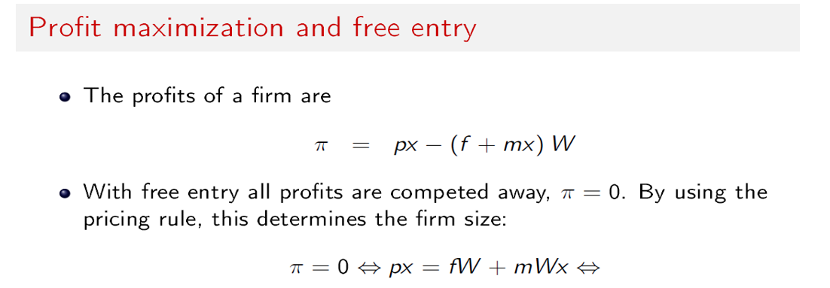
The elasticity of demand for each product =
1/(1-ϴ)

Slide 24
= 1/(1-ϴ)

Slide 26
Grubel-Lloyd index

Slide 29
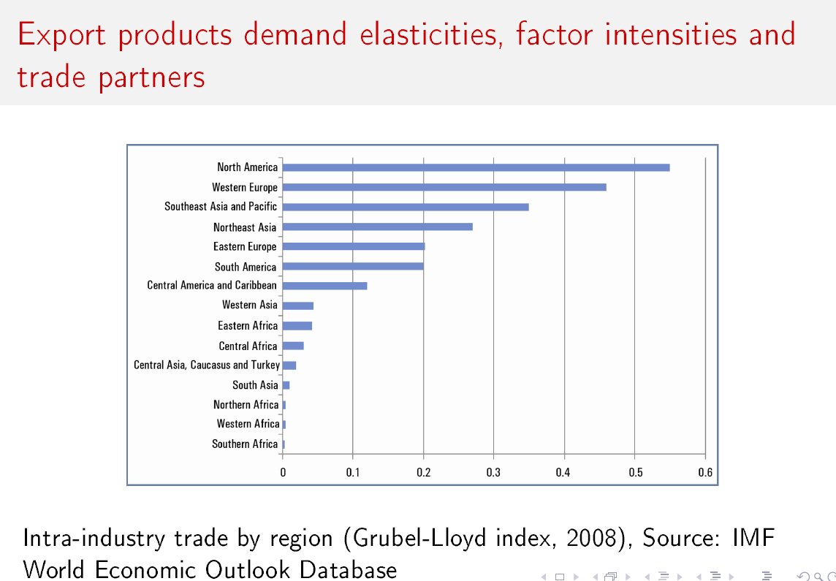

Slide 37
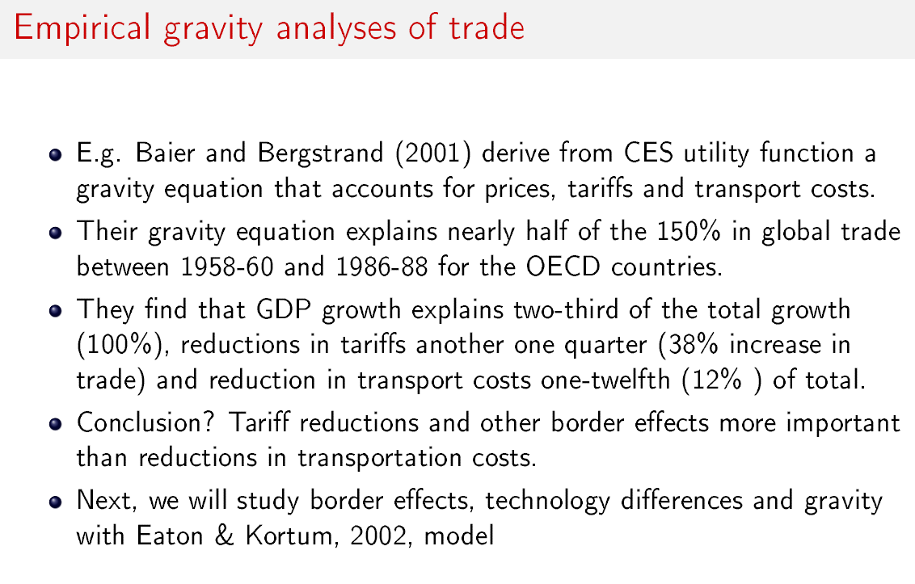
growth

Slide 45
pi is overall price index in the country; appropriate index of intermediate goods pricese here.

Slide 46
The average labor share in gross manufacturing production in the data.

Slide 49
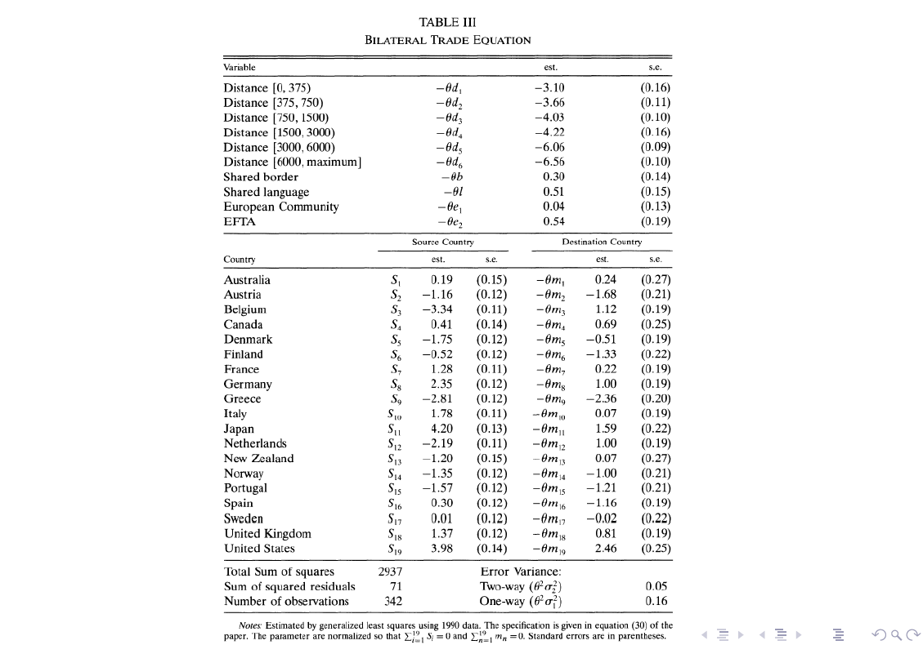

Slide 51
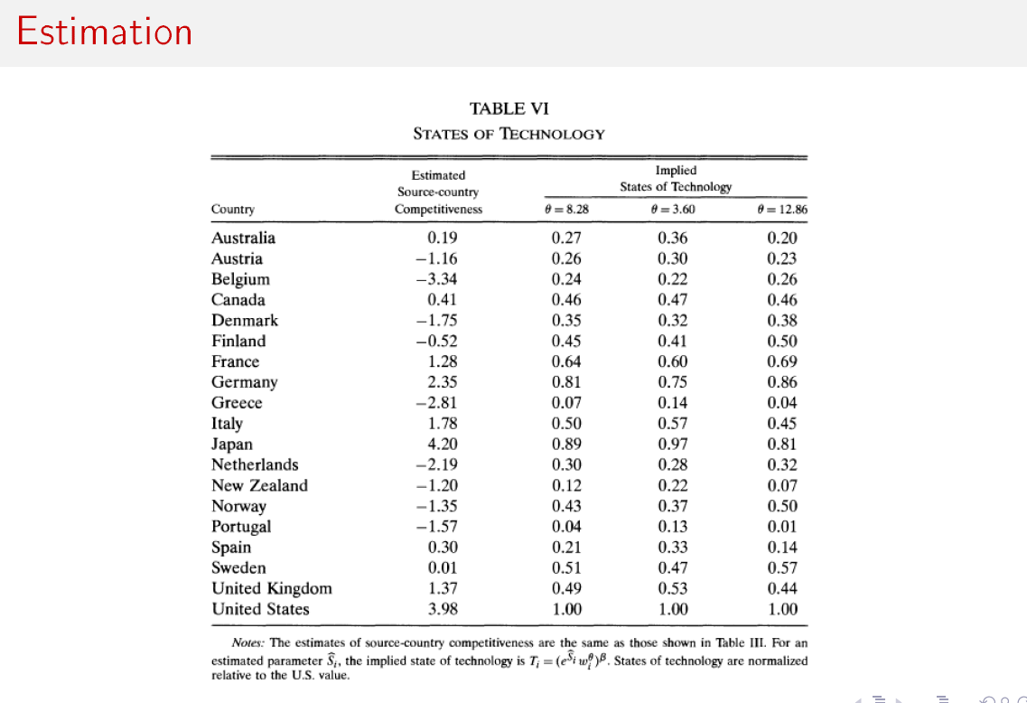

Slide 52
