Slide 1
Thermodynamics
An Engineering Approach
Lecture 4: Mass and Energy Analysis of Control Volumes
Qiang Cheng (Jonny)

Slide 2
Learning Outcomes
When you complete your study of this chapter, you will be able to…
describe key concepts related to control volume analysis, including distinguishing between steady-state and transient analysis, distinguishing between mass flow rate and volumetric flow rate, and explaining the meanings of one-dimensional flow and flow work.
apply mass and energy balances to control volumes.
develop appropriate engineering models for control volumes, with particular attention to analyzing components commonly encountered in engineering practice such as nozzles, diffusers, turbines, compressors, heat exchangers, throttling devices, and integrated systems that incorporate two or more components.
obtain and apply appropriate property data for control volume analyses.
Notes:
Heat is energy can be converted from one form to another, or transferred from one object to another. For example, a stove burner converts electrical energy to heat and conducts that energy through the pot to the water. This increases the kinetic energy of the water molecules, causing them to move faster and faster. At a certain temperature (the boiling point), the atoms have gained enough energy to break free of the molecular bonds of the liquid and escape as vapor.

Slide 3
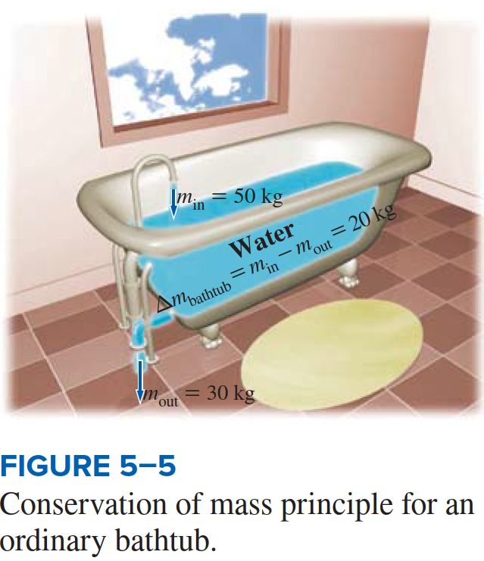
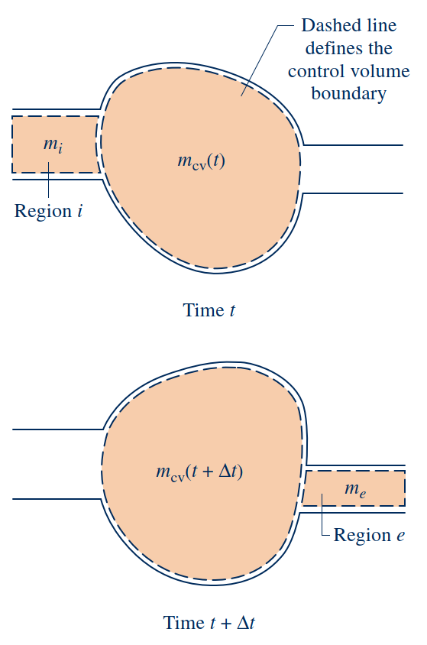
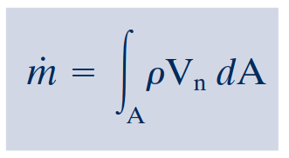
Conservation of Mass for a Control Volume
Conservation of Mass for a Control Volume
When applied to such a control volume, the conservation of mass principle states
mass flow rates
In general, there may be several locations on the boundary through which mass
enters or exits. This can be accounted for by summing, as follows
Evaluating the Mass Flow Rate

Slide 4
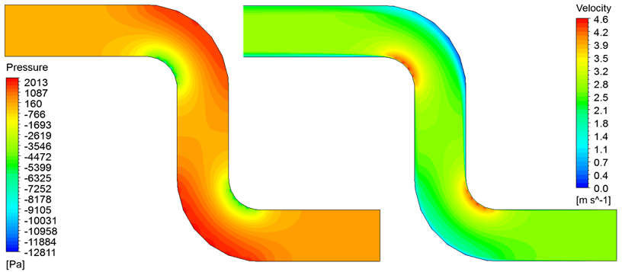
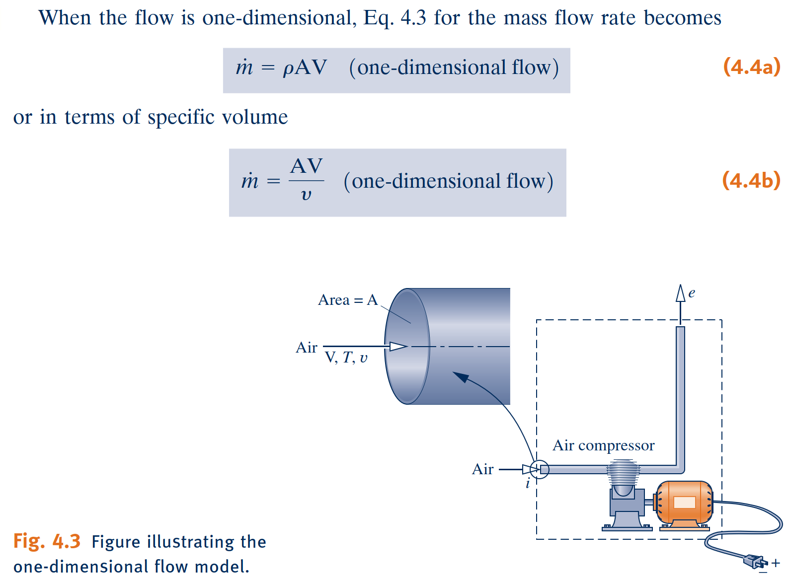
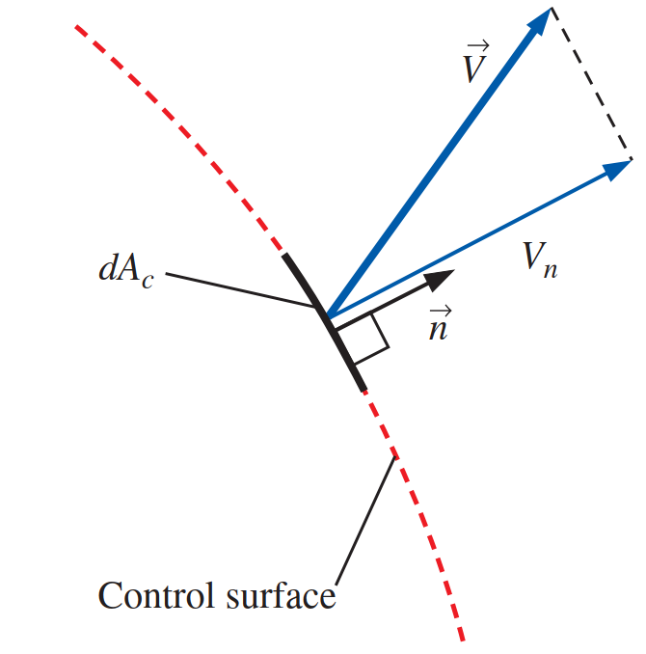
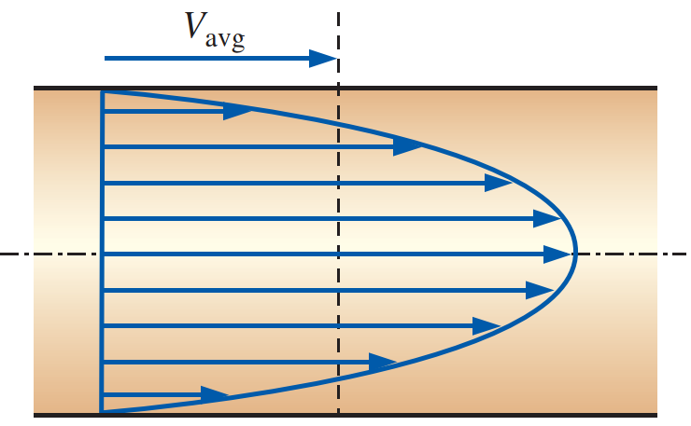
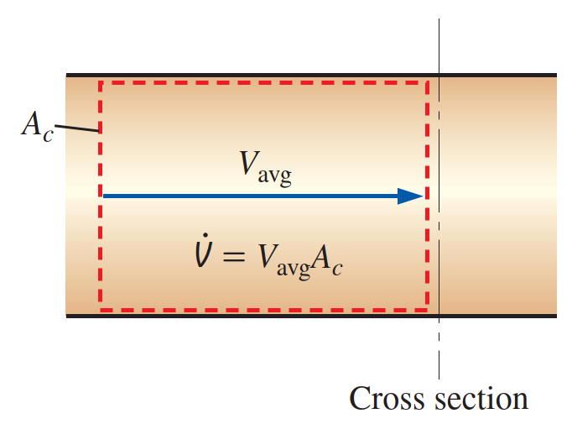
Forms of the Mass Rate Balance
When a flowing stream of matter entering or exiting a control volume adheres to the following idealizations, the flow is said to be one-dimensional:
The flow is normal to the boundary at locations where mass enters or exits the control volume.
All intensive properties, including velocity and density, are uniform with position (bulk average values) over each inlet or exit area through which matter flows.
One-Dimensional Flow Form of the Mass Rate Balance

Slide 5
Forms of the Mass Rate Balance
Steady-State Form of the Mass Rate Balance
all properties are unchanging in time.
Integral Form of the Mass Rate Balance
The product $ρV_{n}$appearing in this equation, known as the mass flux, gives the time rate of mass flow per unit of area.
Notes:
https://www.thoughtco.com/list-of-phase-changes-of-matter-608361

Slide 6
Applications of the Mass Rate Balance
Steady-State Application

Slide 7
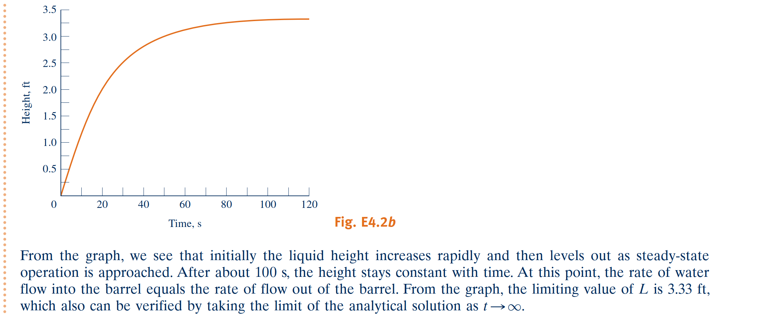
Applications of the Mass Rate Balance
Time-Dependent (Transient) Application

Slide 8
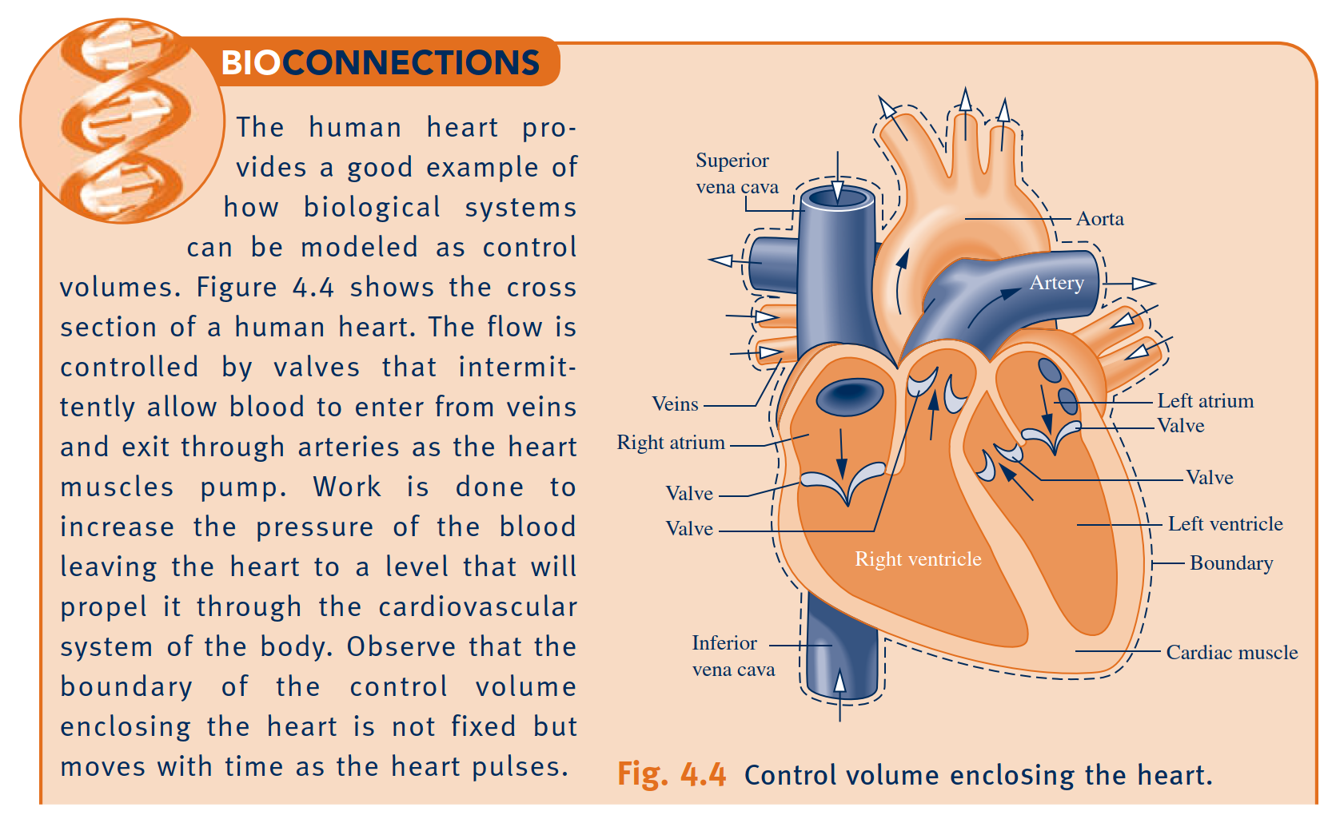
Applications of the Mass Rate Balance

Slide 9
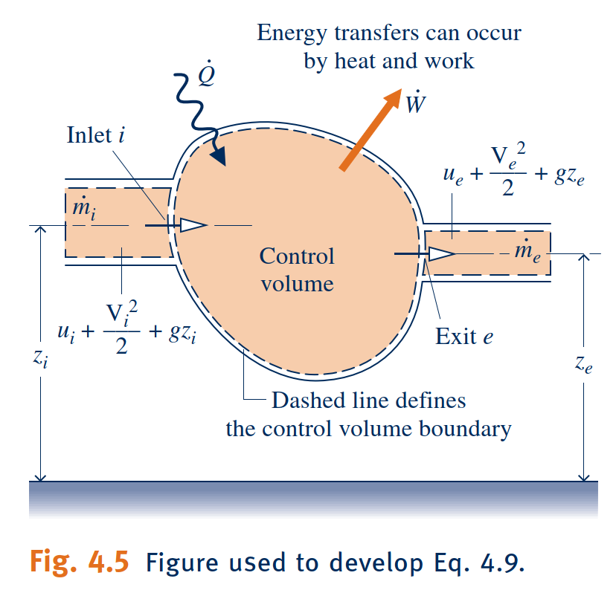
Conservation of Energy for a Control Volume
conservation of energy
Because work is always done on or by a control volume where matter flows across the boundary, it is convenient to separate the work term $\dot{W}$ of Eq. 4.9 into two contributions:
One contribution is the work associated with the fluid pressure as mass is introduced at inlets and removed at exits.
The other contribution, denoted by ${\dot{W}}_{\text{cv}}$, includes all other work effects, such as those associated with rotating shafts, displacement of the boundary, and electrical effects.
flow work

Slide 10
One-Dimensional Flow Form of the Control Volume Energy Rate Balance
energy rate balance
Integral Form of the Control Volume Energy Rate Balance

Slide 11
Steady-State Forms of the Mass and Energy Rate Balances
Steady-State Forms of the Mass and Energy Rate Balances
saturation temperature and pressure
one-inlet, one-exit control volumes at steady
state.

Slide 12
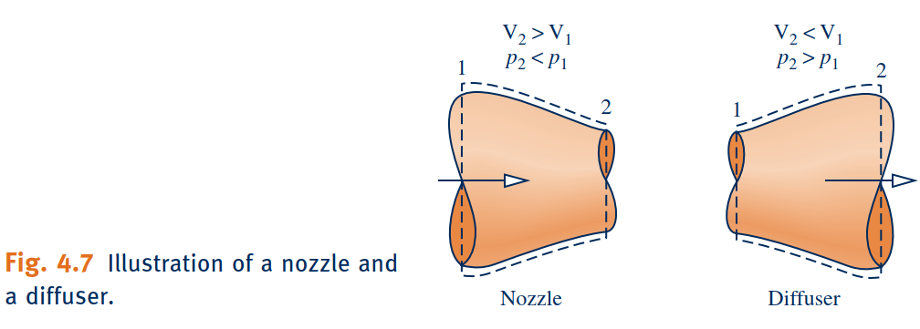
Nozzles and Diffusers
Nozzle
A nozzle is a flow passage of varying cross-sectional area in which the velocity of a gas or liquid increases in the direction of flow.
Diffuser
In a diffuser, the gas or liquid decelerates in the direction of flow.
For a control volume enclosing a nozzle or diffuser, the only work is flow work at locations where mass enters and exits the control volume, so the term ${\dot{W}}_{cv}$ drops out of the energy rate balance. The change in potential energy from inlet to exit is negligible under most conditions.
Application to a Steam Nozzle

Slide 14
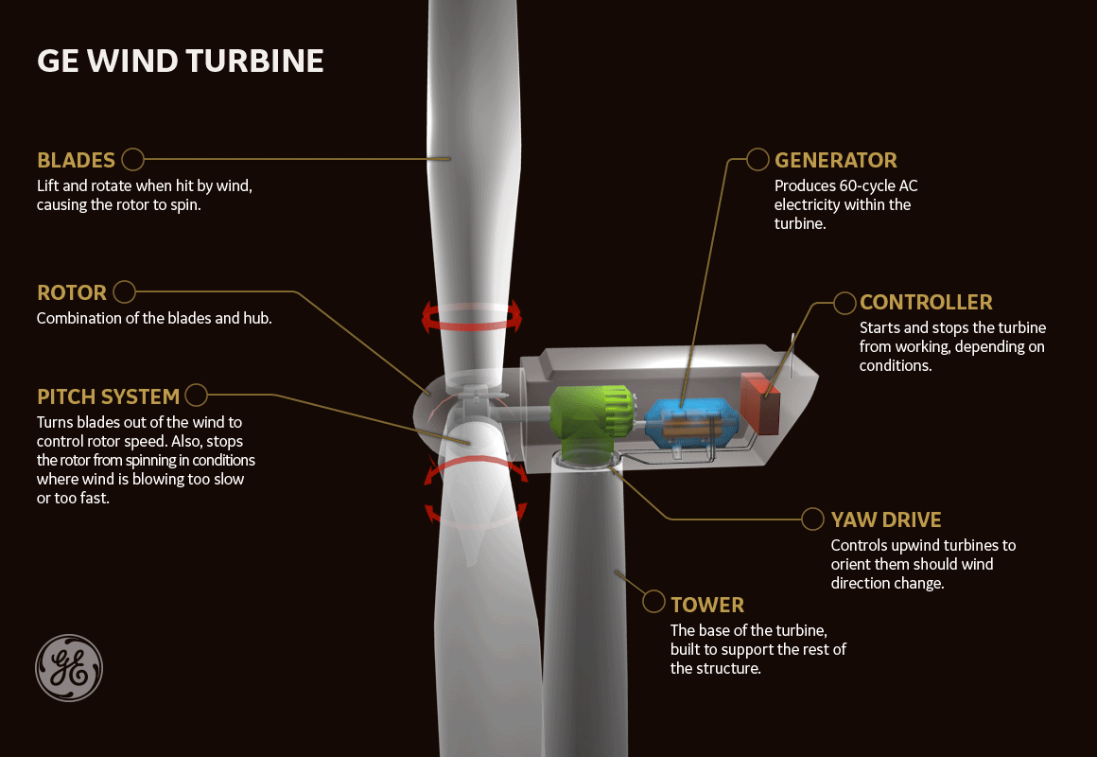
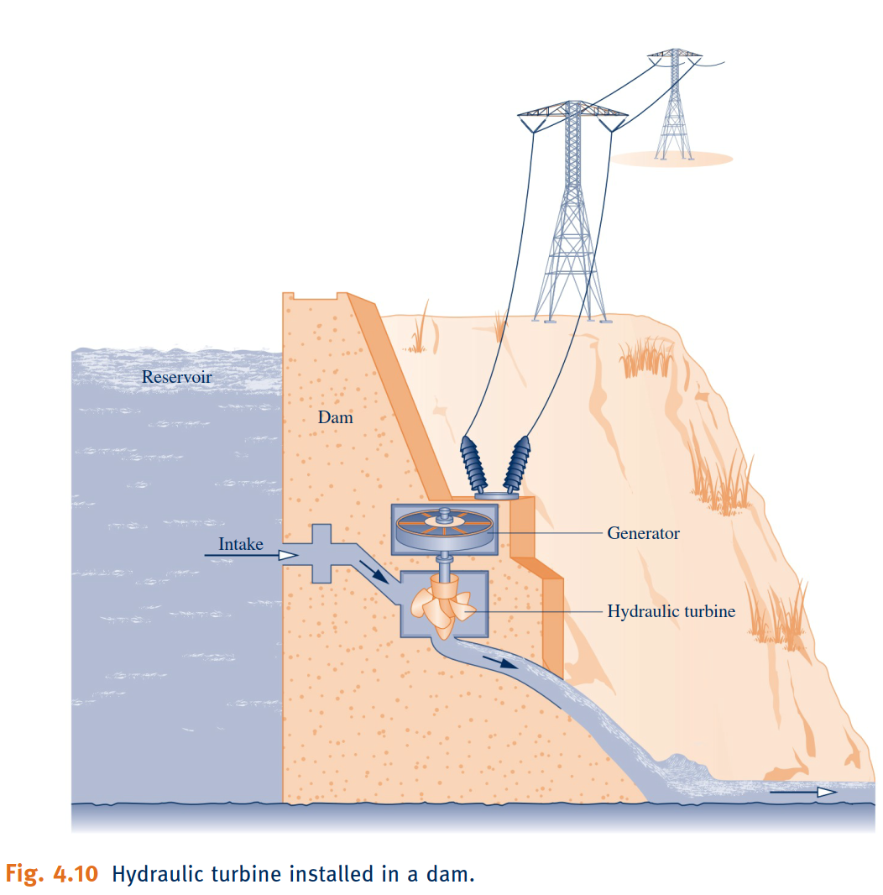
Turbines
Turbine
A turbine is a device in which power is developed as a result of a gas or liquid passing through a set of blades attached to a shaft free to rotate.

Slide 16
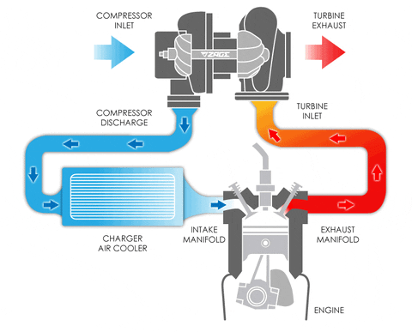
Compressors and Pumps
Compressors and pumps are devices in which work is done on the substance flowing through them in order to change the state of the substance, typically to increase the pressure and/or elevation. The term compressor is used when the substance is a gas (vapor) and the term pump is used when the substance is a liquid.
Compressors and pumps

Slide 18
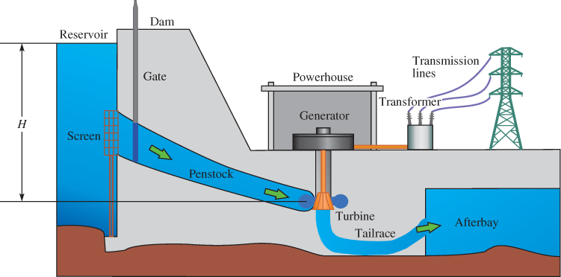
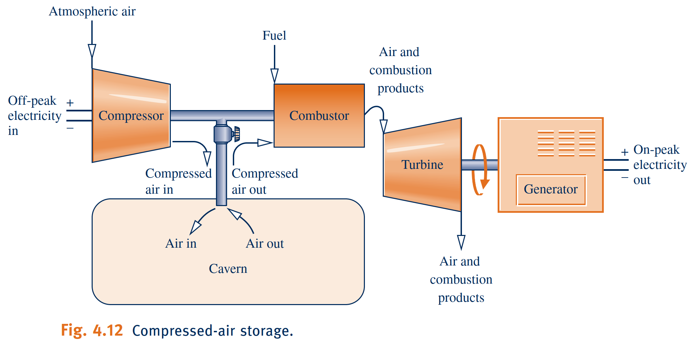
Pumped-Hydro and Compressed-Air Energy Storage
Owing to the dictates of supply and demand and other economic factors, the value of electricity varies with time. Both the cost to generate electricity and increasingly the price paid by consumers for electricity depend on whether the demand for it is on-peak or off-peak. The on-peak period is typically weekdays—for example, from
8 a.m. to 8 p.m., while off-peak includes nighttime hours, weekends, and major holidays. Consumers can expect to pay more for on-peak electricity. Energy storage methods benefiting from variable electricity rates include thermal storage and pumped-hydro and compressed-air storage introduced in the following box.

Slide 19
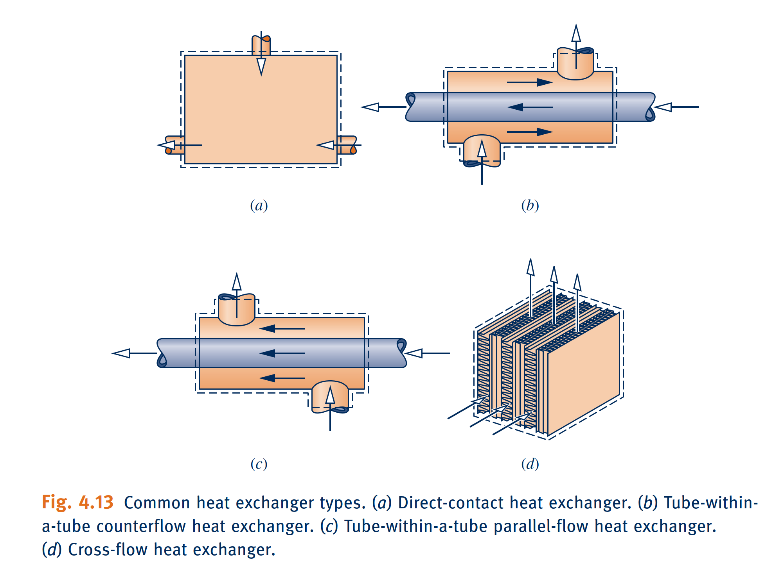
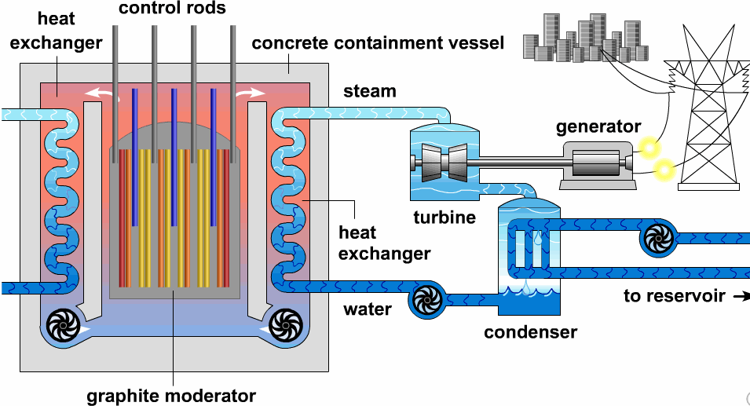
Heat Exchangers
Heat exchangers have innumerable domestic and industrial applications, including use in home heating and cooling systems, automotive systems, electrical power generation, and chemical processing.
Heat Exchangers

Slide 21
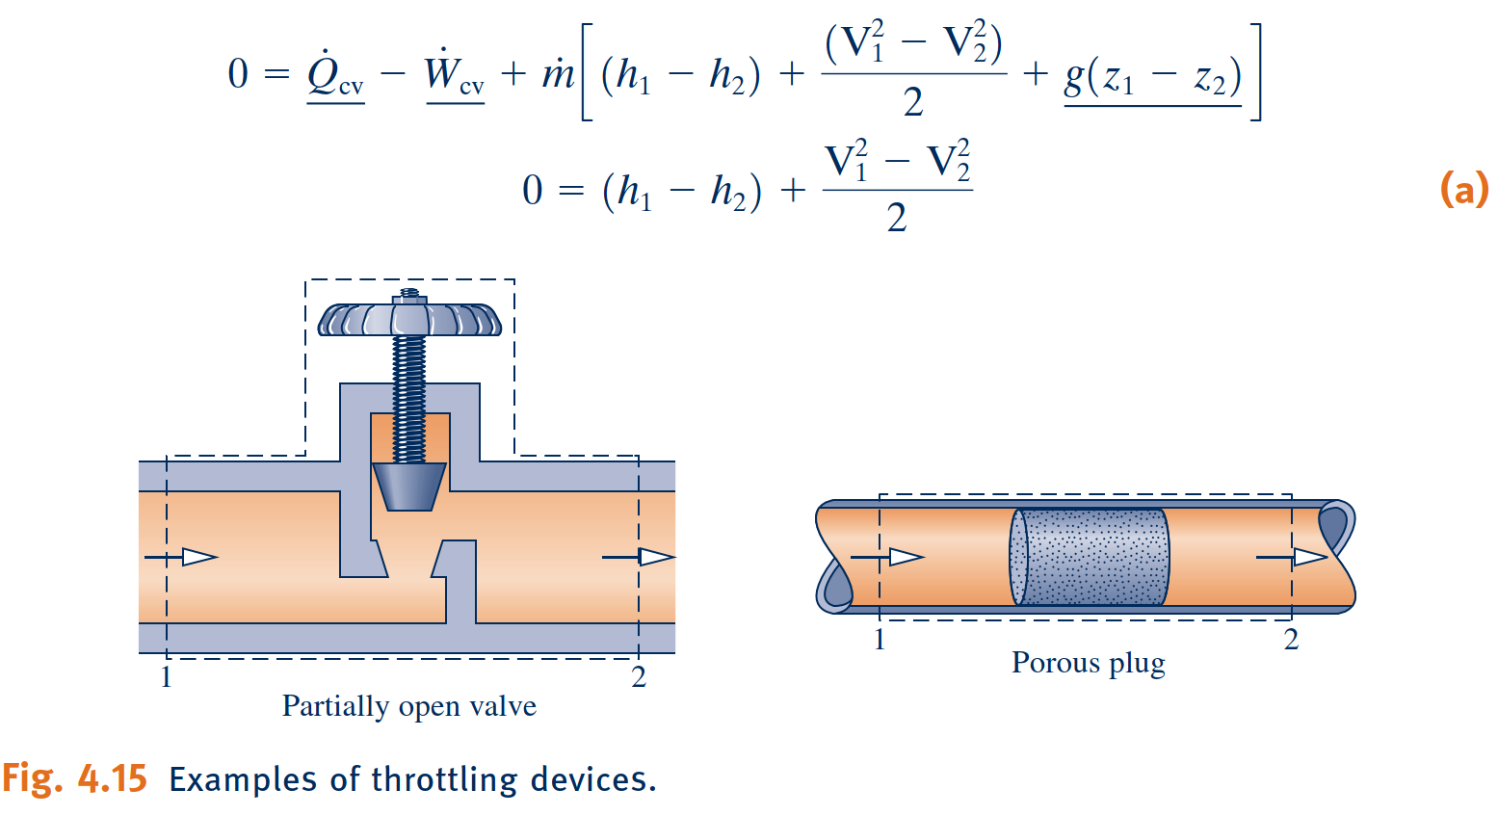
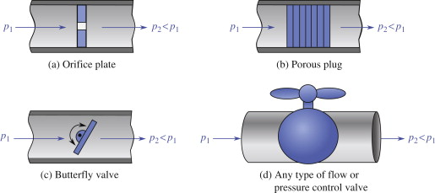
Throttling Devices
A significant reduction in pressure can be achieved simply by introducing a restriction into a line through which a gas or liquid flows. This is commonly done by means of a partially opened valve or a porous plug.
Throttling Devices
throttling process
When the flow through the valve or other restriction is idealized in this way, the
process is called a throttling process.

Slide 22
System Integration
system integration
Engineers often must creatively combine components to achieve some overall objective, subject to constraints such as minimum total cost. This important engineering activity is called system integration.

Slide 23
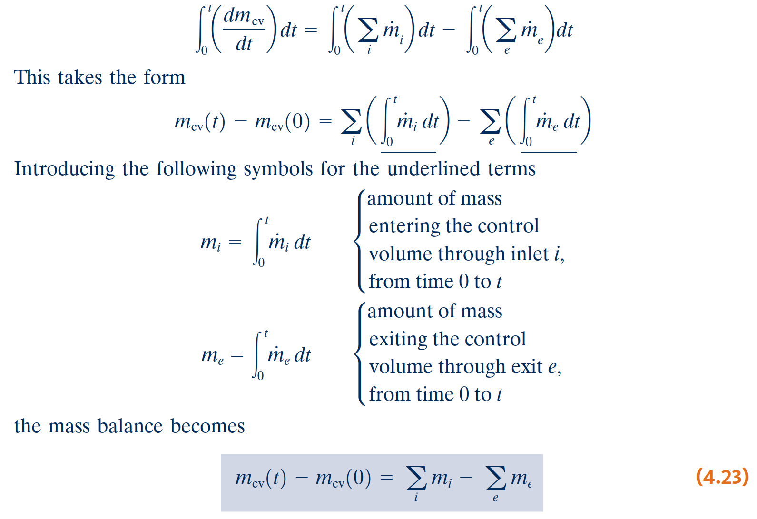
Transient Analysis
transient operation
Many devices undergo periods of transient operation during which the state changes
with time.
First, we place the control volume mass balance in a form that is suitable for transient analysis. We begin by integrating the mass rate balance, from time 0 to a final time t.
This states that the change in the amount of mass contained in the control volume equals the difference between the total incoming and outgoing amounts of mass.

Slide 24
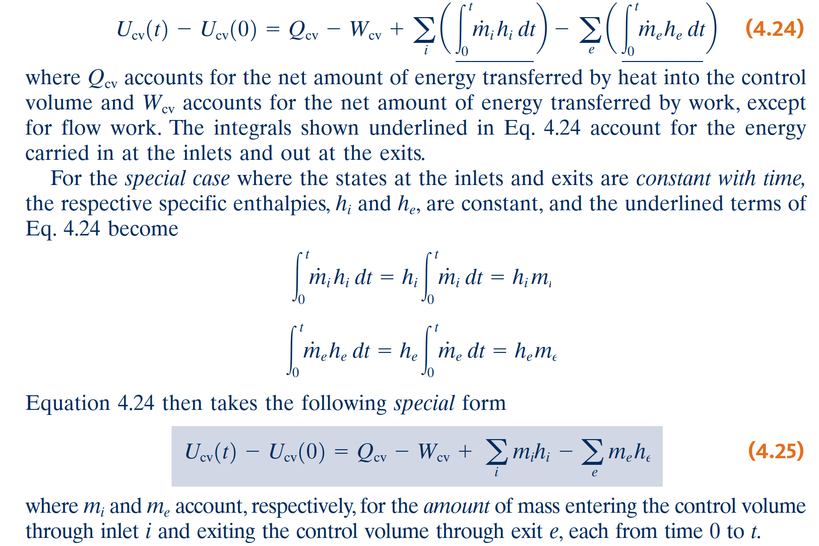
The Energy Balance in Transient Analysis
Next, we integrate the energy rate balance, ignoring the effects of kinetic and potential energy.
Another special case is when the intensive properties within the control volume are uniform with position at a particular time t. Accordingly, the specific volume and the specific internal energy are uniform throughout and can depend only on time, that is, $ν\left(t\right)$ and $u\left(t\right)$, respectively.

Slide 25
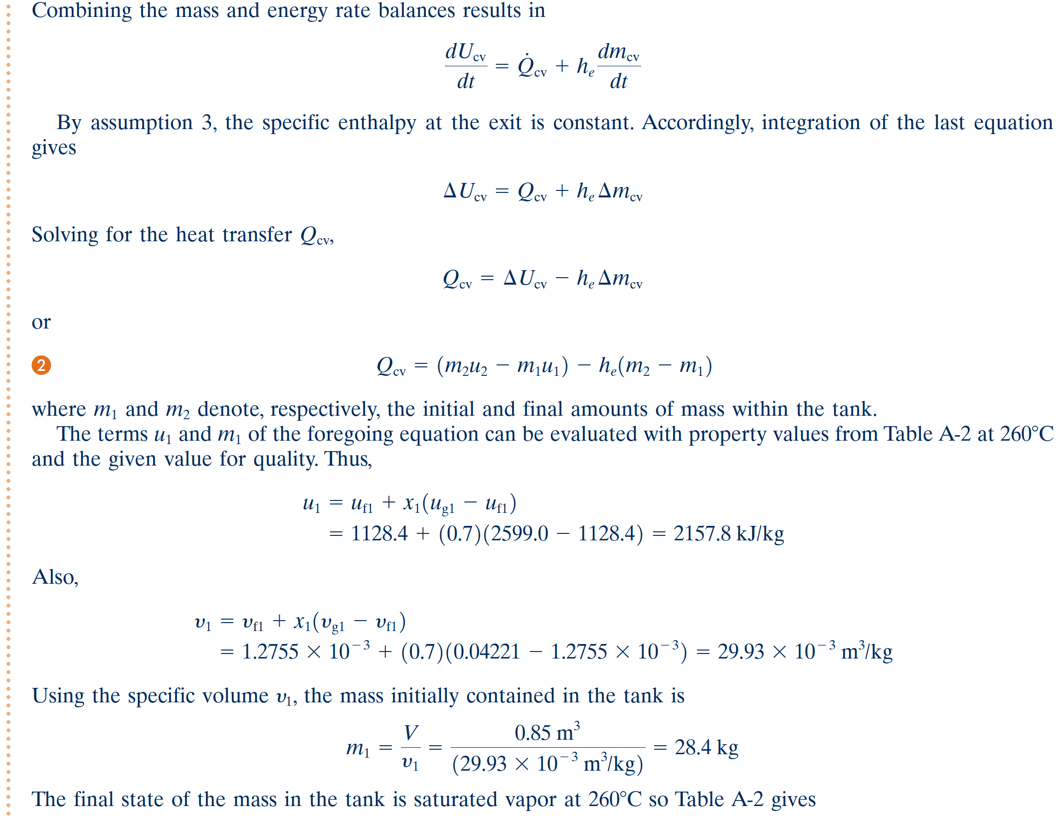

Slide 26
