Slide 1
Notes:
I'd like to structure today's proposal of mine into three parts. One - for international audience (tourists), another one - for locals in Finland, and the third one - for everyone and that's the idea that could be scaled to all Starbucks restaurants in the world.

Slide 2
Notes:
Let's start with tourists.

Slide 3
Notes:
Why do people, who are likely coming from places that have Starbucks, choose to go to Starbucks again, abroad? At least partly that's due to predictability.

Slide 4
Notes:
It's human nature to choose known & familiar – a coffeeshop where one is guaranteed to get a decent pumpkin spice latte and staff that speaks English.

Slide 5
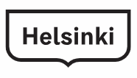
Notes:
Though, people don't usually PLAN to go to Starbucks in Helsinki. At least I haven't yet seen "visit Starbucks" in to-see and to-do in Finland lists. That means Helsinki locations aren't special. People are drawn to Starbucks as a safe space, but going to Starbucks, McDonald's, or Pizza Hut is not the reason why people travel - people travel to get new experiences.

Slide 6
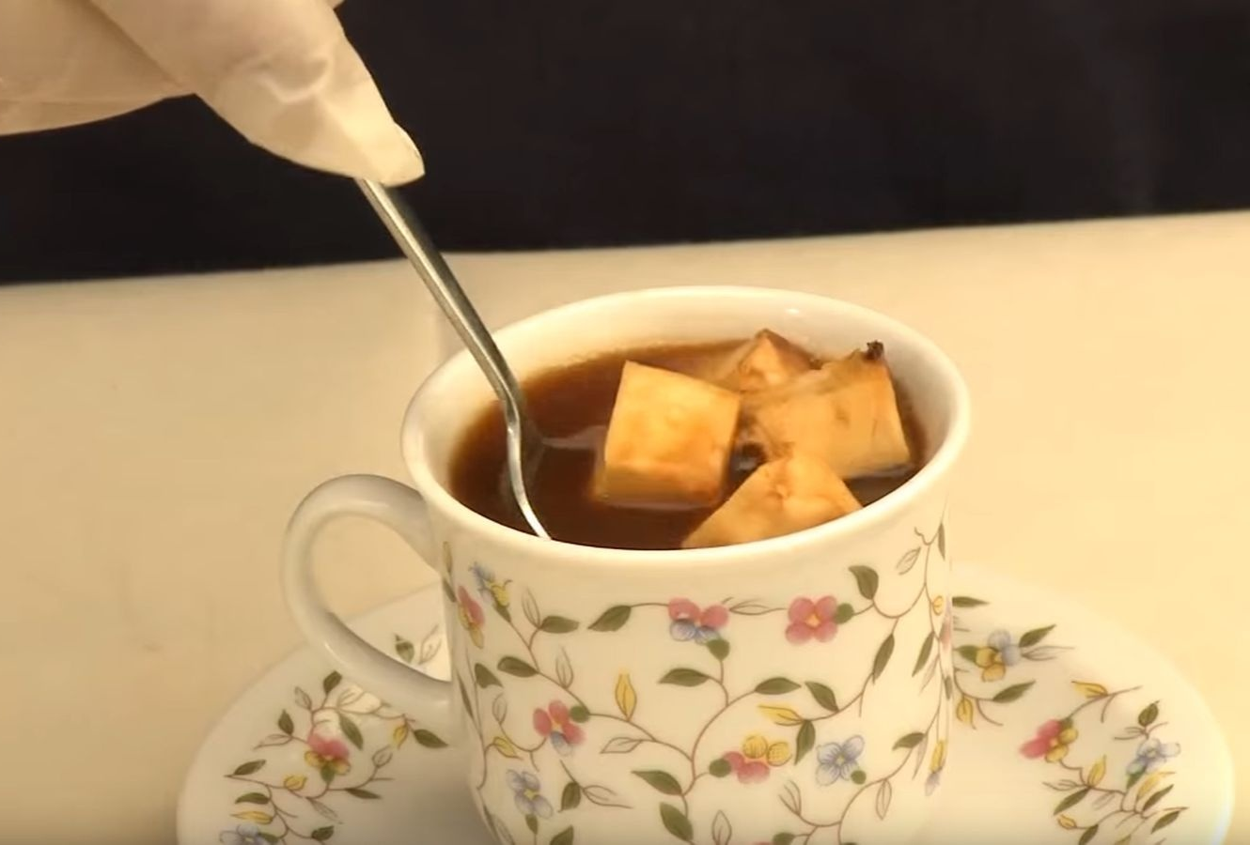
Recommendation 1: Finnish specialities
Notes:
Let's give customers new experiences! Let's treat them with something that will make them remember Starbucks in Helsinki and Finland. My suggestion is to introduce special "Finnish" drinks. I'm not a food R&D person, but I'd consider coffee with leipäjuusto. Simple and exotic!

Slide 7
Notes:
Now, to the locals.

Slide 8
Notes:
Overall, localization is a trend amplified by COVID-19 and the Russian-Ukranian war. Being local also works in the coffeeshop business. Let's look at Starbuck's competition in Helsinki.

Slide 9
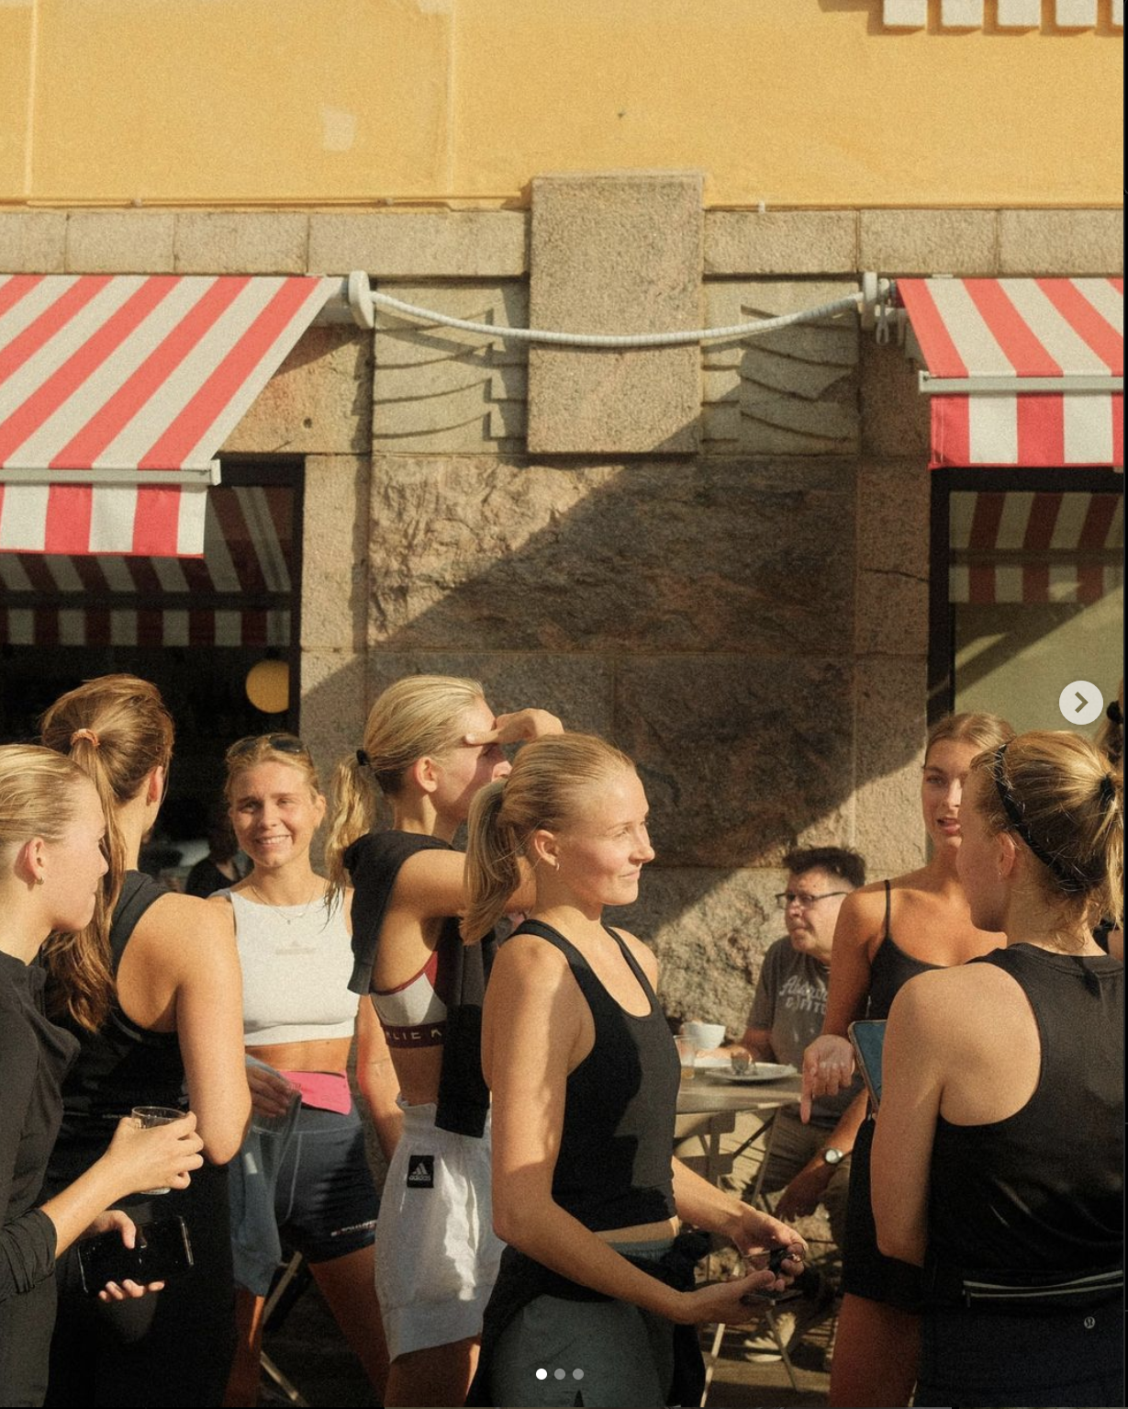
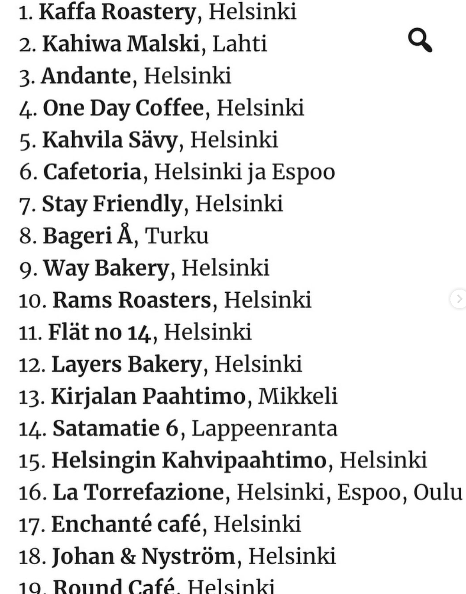
Helsinki Coffee Week’s rating:
Notes:
Way bakery -> serves runners from the local running club.

Slide 10
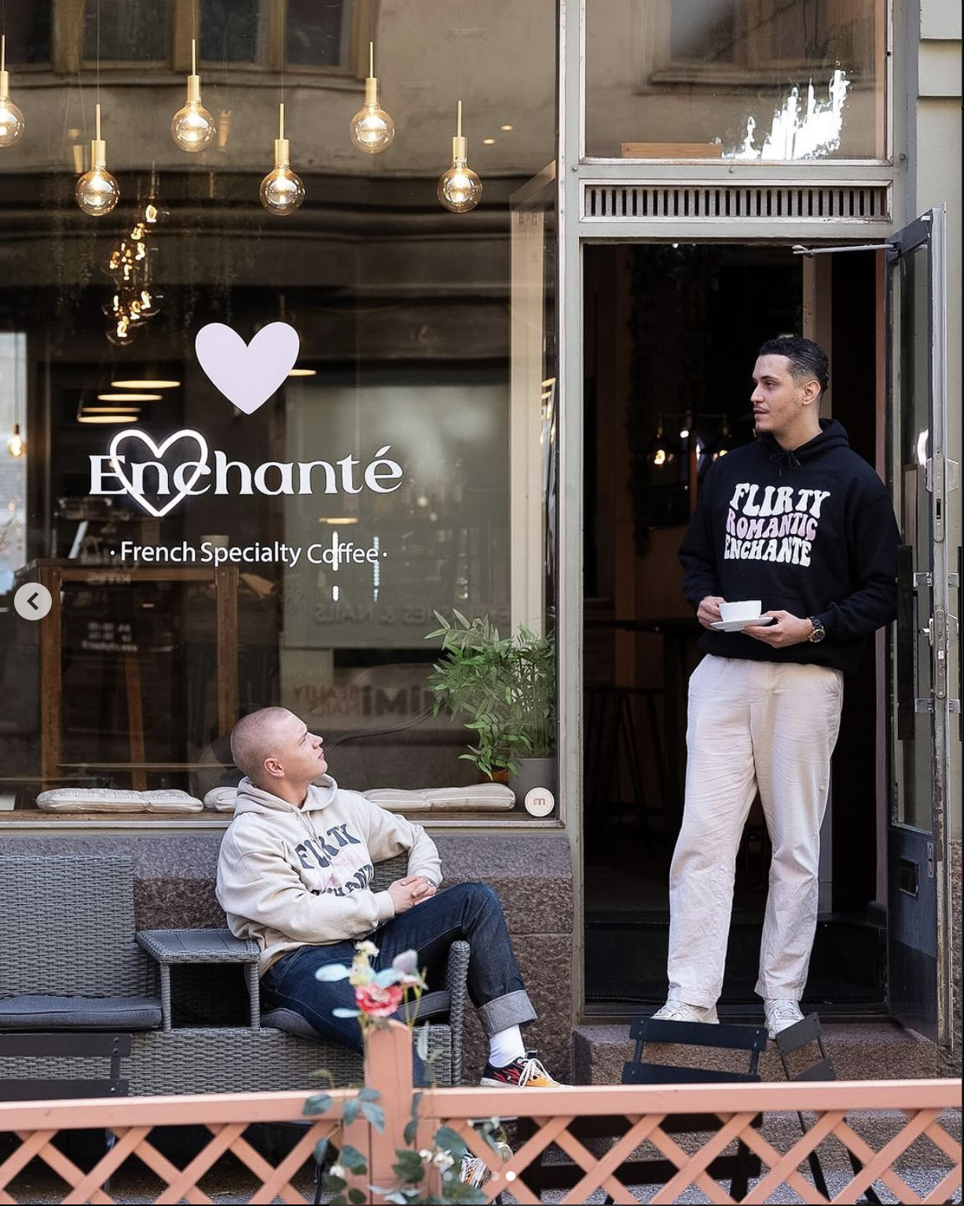
Helsinki Coffee Week’s rating:
Notes:
Enchante cafe -> French-speaking owners help guests practice French.

Slide 11
Helsinki Coffee Week’s rating:
(sounds of a fight of drunk people)
Notes:
Round Helsinki -> make hilarious and relatable content.

Slide 12
?
Notes:
But how could Starbucks connect to its audience? The staff is busy, so meaningful conversations are a luxury; Starbucks doesn’t really need SMM.

Slide 13
Recommendation 2: Local events
Notes:
Let's start small - by supporting local events! E.g., Helsinki Half-marathon. The people there are mature and probably engaged in very intellectual jobs since they recognize the importance of physical activity. Hence they have solid purchasing power.

Slide 14
Notes:
Now, onto an idea that could benefit everyone.

Slide 15
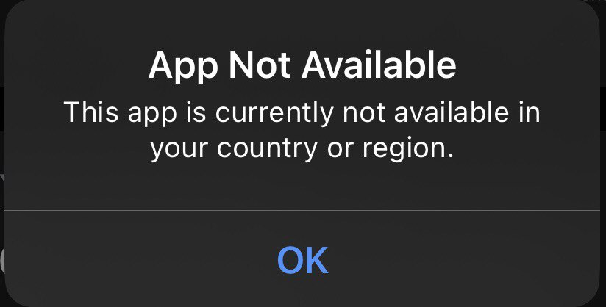
Notes:
First of all, Starbucks has to enable the app in Finland.

Slide 16
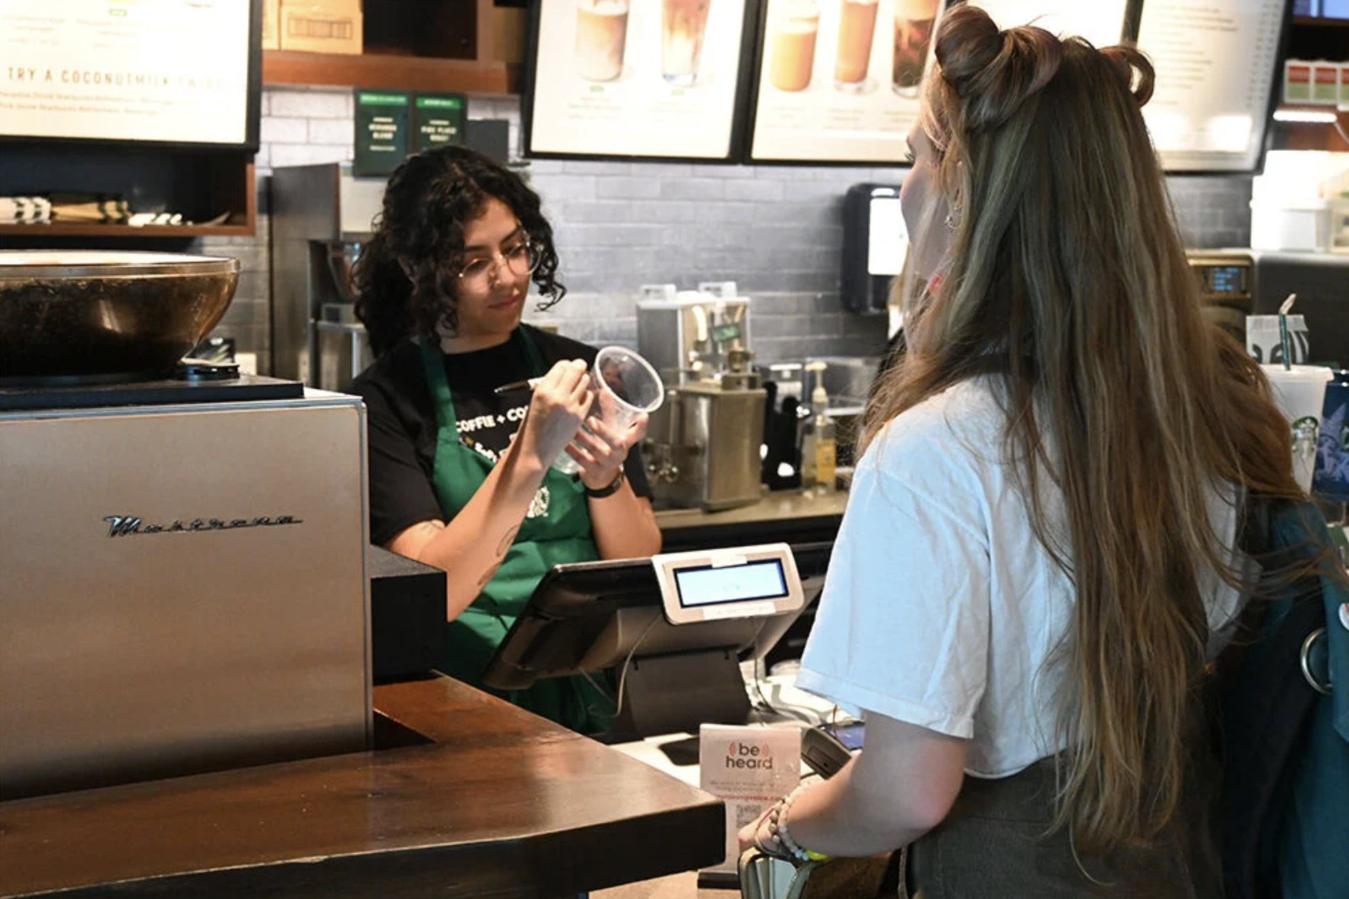
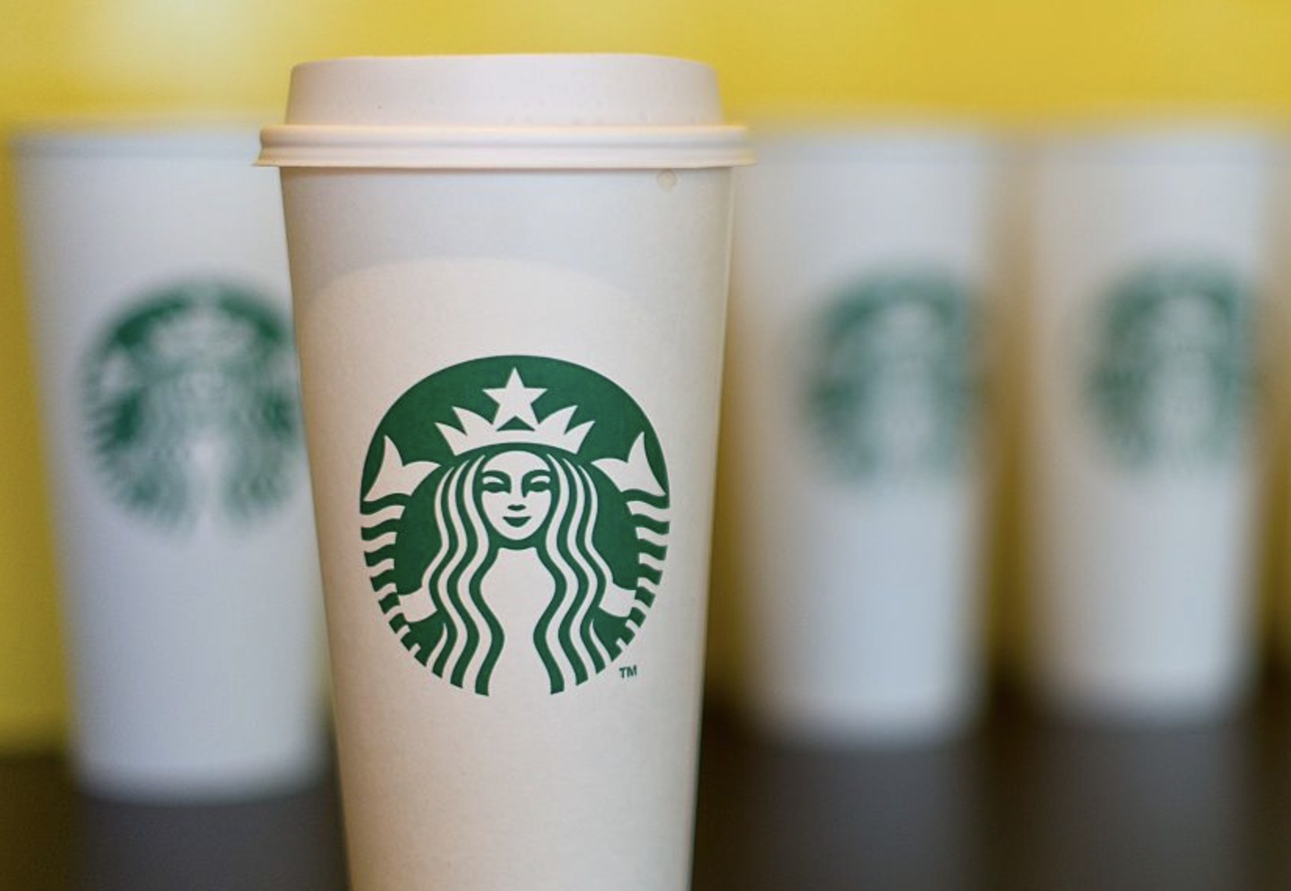
Notes:
It will bring multiple benefits but importantly - eliminate the barista's burden of spelling. Spelling takes a lot of time, which is a problem during rush hours (tho undoubtedly an iconic feature). When a name is misspelled, it not only is funny or offensive but can complicate the search for a ready drink from several others.

Slide 17
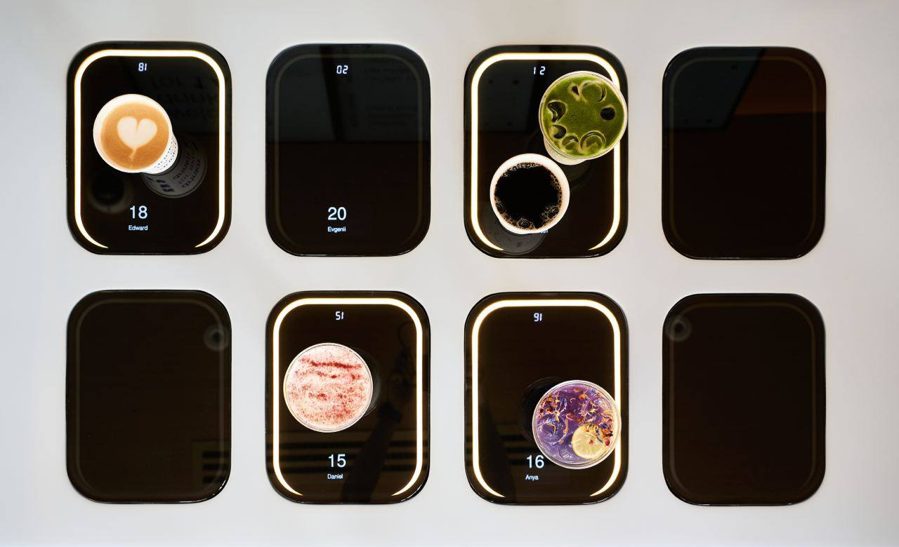
Recommendation 3: Smart pick-up zone
Notes:
Let's build a smart drink pick-up zone. It could highlight the name of the drink and person. This way, baristas can focus on what matters most - creating exceptional coffee and not trying to pronounce names they've never seen before or getting distracted with questions about whether a drink is a cappuccino with coconut milk.

Slide 18
Recommendations:
Finnish specialities in the menu
Local events
Smart pick-up zone
Notes:
And with this slide, I'd like to conclude my presentation. Thank you all! Happy to hear your questions and comments!

