Slide 1
Micro-Management – Does It Have a Bad Name for a Reason? Supervisor: Marjo-Riitta Diehl, Associate Professor, Organization and Management marjo-riitta.diehl@aalto.fi
Micromanagement is commonly regarded a pathology of leadership, equated with obsession with detail, pedantic control and abuse of authority. The phenomenon of micromanagementis widely regarded a major problem in popular leadership and management discourse. Yet, micromanagement has not been a topic for systematic academic research. This is inriguing, especially as the negative categorization of micromanagement stands sharply against reports that many successful leaders are at times even obsessive with their attention to detail. At the same, there is a strong empahsis on contextual understanding, compassion, care and trust in th management literature, suggesting that leadership is not only about strategic visioning and the big picture. Research is thus needed to fully capture and critically assess the phenomenon of micro-management.
Possible research questions:
-How do managers perceive micro-management?
-What are the possible benefits and downsides of micro-management?
-Can micro-management be equaled with caring for employees and their work versus control? If so, when?
-How do employees experience micro-management?
What is on offer for you:
-A supervisor who is truly into the topic and excited about it!
-Preliminary interview-guide is available
-Financial support can be considered depending on the exact research plan.
-If more students join, a possibility to join forces in gathering data and learning together!

Slide 2
Women and Networking – What Motivates Women to Network and What Are the Outcomes of Networking? Supervisor: Marjo-Riitta Diehl, Associate Professor, Organization and Management marjo-riitta.diehl@aalto.fi
In order to offer a “solution” to gender inequality, a burgeoning number of women-only networking events around the world encourage women to connect with one another for the purposes of career progress. However, the phenomena of Queen Bee and Imposter Syndrome often discussed in popular press cast doubts over women’s willingness and even their perceived ability to network with other women. This MSc project contributes to an existing project and data collection effort on the theme women and networking. Quantitative skills and willingness to reach out to female leaders are needed. Hints for literature and the online survey for data collection are provided.
Possible research questions:
-What motivates women to engage in women-only networking?
-What benefits do women perceive to receive from women-only networking?
-How does imposter symptom influence women’s willingness to support other women?
-Do Queen Bees exist and how do they approach women-only networking?
-How does women’s family demands influence their networking and consequently their careers?
What is on offer for you?
-a supervisor who is truly into the topic and excited about it!
-readily implementable online questionnaire exists.
-financial support can be considered depending on the exact research plan.
-if more students join, a possibility to join forces in gathering data and learning together!

Slide 3
Women-Only Networking in Business: How Does Homophily-By-Choice Work? Supervisor: Marjo-Riitta Diehl, Associate Professor, Organization and Management marjo-riitta.diehl@aalto.fi
In order to offer a “solution” to gender inequality, a burgeoning number of women-only networking events around the world encourage women to connect with one another for the purposes of career progress. However, women-only networking has also been criticized as mere “pink washing” and corporate promotion, which throws female solidarity and support into question. A key challenge is to create benefits from a networking setting purposefully created to tap into individuals’ tendency to associate with similar others, a phenomenon named homophily. Such a tendency of humans to associate with similar others is a well documented social phenomena yet how it functions in the context of women-only networking remains a puzzle and forms the underlying question of this research.
More than one thesis can be conducted on the topic. Methodology can be qualitative or quantitative.
Please note that I am open to supervising also other topics related to gender and careers / leadership.
Possible research questions:
-how does women-only networking compare to men-only networking?
-how does women-only networking and the homophily it implies affect the way how women make sense of their work and career?
-how does women-only networking function on-line? What are the benefits and downsides of women-only on-line networking? For example, the case of Mothers in Business Community.
What is on offer for you:
-a supervisor who is truly into the topic and excited about it!
-a basic questionnaire for interviews is available, adjustment done on the basis of fine-tuning and specific interest. Also leads for interviewees are available.
-financial support can be considered depending on the exact research plan.
-if more students join, a possibility to join forces in gathering data and learning together!

Slide 4
Middle managers in knowledge-intensive workplaces: roles and identities
Phenomenon
Modern universities, as knowledge-intensive workplaces, are increasingly subject to managerialism – they are continuously ranked and evaluated
Most of this burden falls on the shoulders of middle managers – academics who become unit or department heads
These middle managers are “sandwiched” between the university’s top leadership and the faculty
The ability to effectively function in this ‘sandwiched’ position depends on how middle managers perceive their role and are willing to translate various agendas (e.g. ‘sustainability’ agenda) from top to down
Project
Qualitative research
Data collection is to be carried out as soon as possible (12-15 interviews)
Funding available (2,000€ per thesis)
Research project lead by Alexei Koveshnikov and Perttu Kähäri
Your task
Together with the project lead develop qualitative instruments to be used for data collection
Conduct and analyze qualitative interviews with middle managers in Finnish universities (approx. 12-15 interviews)
Contact us: Alexei alexei.koveshnikov@aalto.fi
Perttu perttu.kahari@aalto.fi

Slide 5
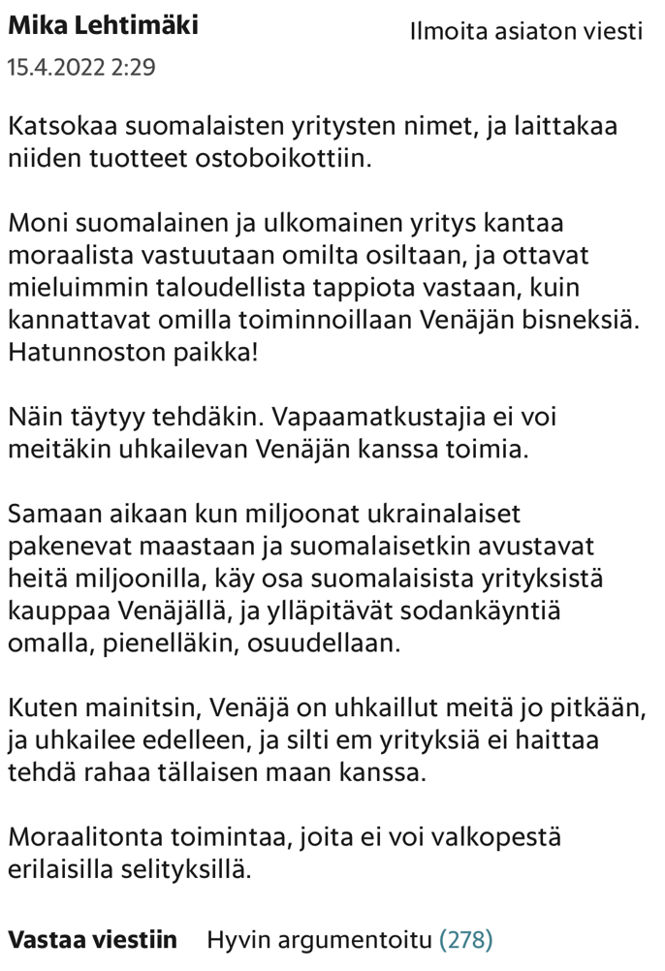
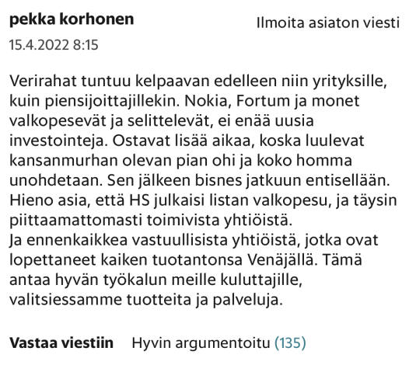
Finnish firms disengaging from Russia
Finnish firms have a long history in doing business in Russia. Even though the signs were there, the Russian invasion of Ukraine took Finnish companies by a surprise. Western stakeholders immediately started to put pressure on companies to leave from Russia. For example, Jukka Moisio, the CEO of Nokian Tyres got a text message saying “your coffee cup has Ukrainian blood” (HS, 2 April 2023). Media and other third parties, including Yale¹, also updated lists of companies leaving and staying in Russia, putting companies’ actions to further scrutiny.
However, leaving Russia is easier said than done. The full disengagement options mean that the firm has to either find a buyer that meets ethical concerns, sell operations to a highest bidder, or liquidate its Russian operations (Meyer & Estrin, 2023). Whereas selling operations may hand the Russian operations over to the hostile government, liquidation means that the local employees in Russia loose their jobs and are possibly even imprisoned up to 15 years. In all of the options, significant financial losses are likely to occur. In addition, there is a constant threat of asset expropriation by the Russian government. Western firms operating in Russia thus have had to balance the challenges and financial losses related to leaving Russia with the stakeholder pressures coming from their Western customers, employees, and other stakeholders.
In this thesis, you get to dive deeper into these topics both theoretically and empirically. Research is conducted via 10-12 interviews with practitioners involved in the disengagement activities of Finnish firms from Russia. We have also collected readers’ comments from Helsingin Sanomat (in Finnish) that could be analyzed in the thesis work in addition to the interviews. There is a 2000€ grant compensation paid after thesis completion. Knowledge of Finnish or Russian is a merit but the work will be done in English.
Interested in hearing more? Contact alexei.koveshnikov@aalto.fi & iiris.saittakari@aalto.fi.
¹ https://som.yale.edu/story/2022/over-1000-companies-have-curtailed-operations-russia-some-remain

