Slide 1
EEN-E3007: Process Integration and Energy Optimization L
Exercise 4
Heat Integration with Pinch Technology
1 point for attendance
7 points for Home assignment
0 points for Exercise problems

Slide 2
After the Exercise You should be able to …
Identify the hierarchy and stages within process design methodology and Extract data relevant for thermal analysis.
De-construct a process or plant or system thermodynamically and Classify potential thermal surplus and/or deficit sources.
Apply the pinch analysis method to Quantify process performance targets (e.g. Energy consumption) and Present feasibly efficient alternatives.
Understand the driving force for maximum heat recovery and Examine the tradeoff between Energy and Cost.
Mohamed Magdeldin
Notes:
The number of staff members has been indicated as man-years.
The annual budget of the University is approximately EUR 400 million (2011)
The founding universities are the best in Finland in their own fields.
Helsinki School of Economics in 2009
3,560 students
58 professors
Helsinki University of Technology in 2009
14,975 students
219 professors
University of Art and Design Helsinki in 2009
1,944 students
40 professors
(Images: Aalto University archives; Juha Juvonen)

Slide 3
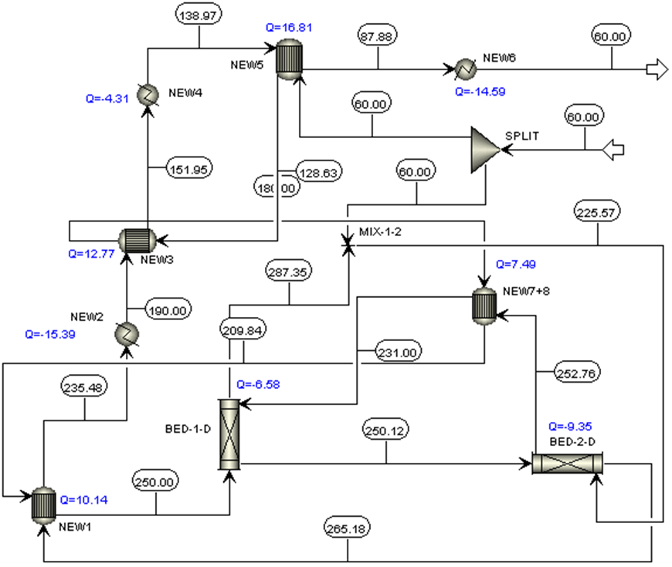
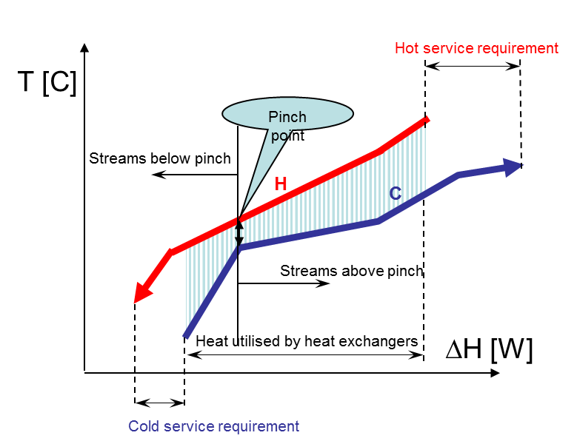
What is Pinch technology?
The 2nd law of thermodynamics is the basis for the development of adequate instruments to ensure better thermal integration aiming at both the minimization of entropy production or exergy destruction.
Techniques like Pinch Analysis introduced in the 1970s implement the 2nd law analytically in an algorithmic manner; using heat or mass flows as carriers and temperature or concentration of some species to express the driving force for the heat or mass transfer.
Mohamed Magdeldin
Notes:
The number of staff members has been indicated as man-years.
The annual budget of the University is approximately EUR 400 million (2011)
The founding universities are the best in Finland in their own fields.
Helsinki School of Economics in 2009
3,560 students
58 professors
Helsinki University of Technology in 2009
14,975 students
219 professors
University of Art and Design Helsinki in 2009
1,944 students
40 professors
(Images: Aalto University archives; Juha Juvonen)

Slide 4
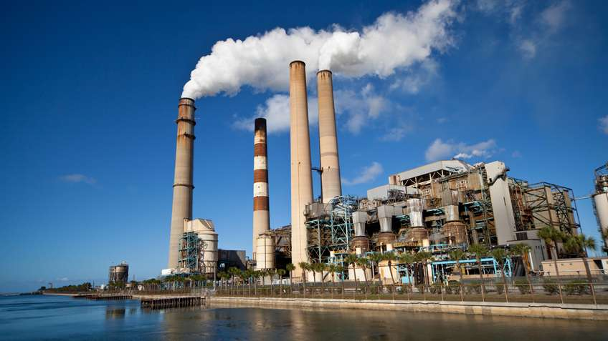
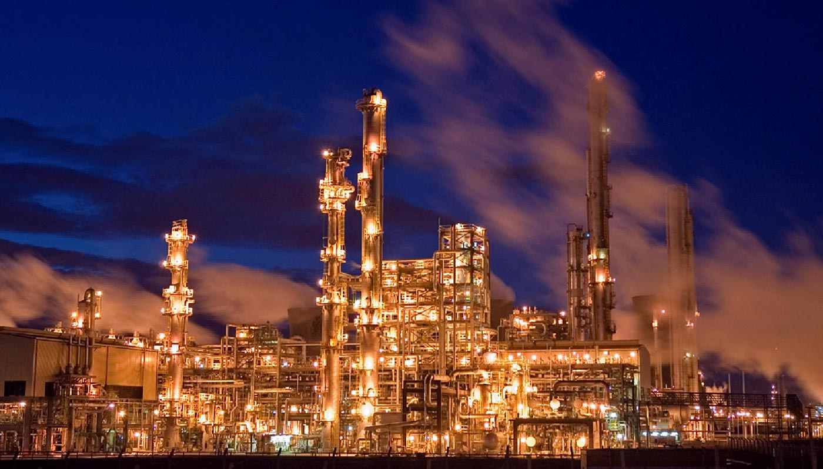
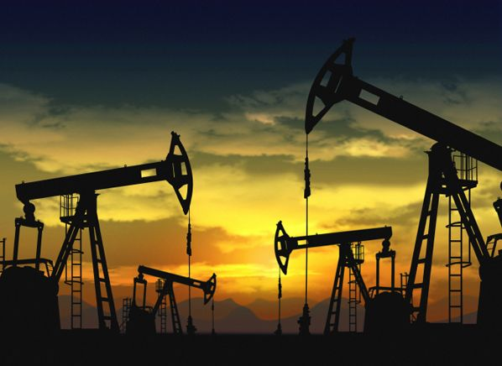
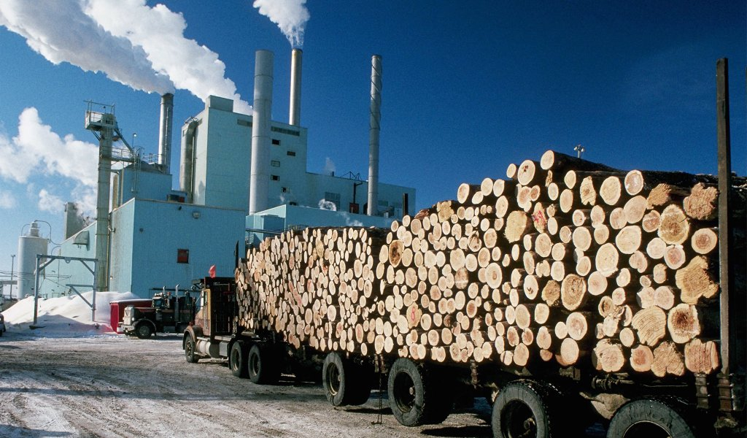
Did you know that..
Typical savings identified through the application of energy pinch, and expressed as a percentage of the TOTAL purchased fuel (except for P&P, where they are expressed as a percentage of total steam production), are as follows:
Oil refining 10-25%
Petrochemicals 15-25%
Iron & steel 10-30%
Chemicals 15-35%
Food & drink 20-35%
Pulp & paper 15-30%
Source: Pinch Analysis: for the efficient use of energy, water and hydrogen. 2003, Natural Resources Canada, CanmetENERGY. Link: http://www.nrcan.gc.ca/energy/offices-labs/canmet/5715
Mohamed Magdeldin
Notes:
The number of staff members has been indicated as man-years.
The annual budget of the University is approximately EUR 400 million (2011)
The founding universities are the best in Finland in their own fields.
Helsinki School of Economics in 2009
3,560 students
58 professors
Helsinki University of Technology in 2009
14,975 students
219 professors
University of Art and Design Helsinki in 2009
1,944 students
40 professors
(Images: Aalto University archives; Juha Juvonen)

Slide 5
In one way you can … but we will …
Open an on line web application (written by undergraduate student J.S. Umbach from the University of Illinois, Chicago 2010)
Or use one of the readily available softwares for ”slightly” more complex problems such as PRO_PI1 or Hint from this link.
Mohamed Magdeldin
Notes:
The number of staff members has been indicated as man-years.
The annual budget of the University is approximately EUR 400 million (2011)
The founding universities are the best in Finland in their own fields.
Helsinki School of Economics in 2009
3,560 students
58 professors
Helsinki University of Technology in 2009
14,975 students
219 professors
University of Art and Design Helsinki in 2009
1,944 students
40 professors
(Images: Aalto University archives; Juha Juvonen)

Slide 6
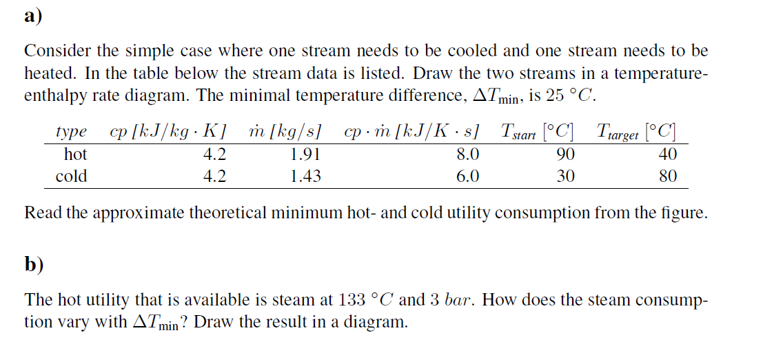
Problem 1. Temperature-enthalpy rate diagram

Slide 7
Keep in mind …
How do we calculate the total amount of heat (Q) released or recieved by the stream?
$$Q=\dot{m} c_{p} \left(T_{in} −T_{out}\right)$$
$$Q=\dot{m} \left(h_{in} −h_{out}\right)$$
$$Q=U A ∆T_{lm}$$
Where
Sensible heat transfer
Latent heat transfer
Heat exchanger design

Slide 8
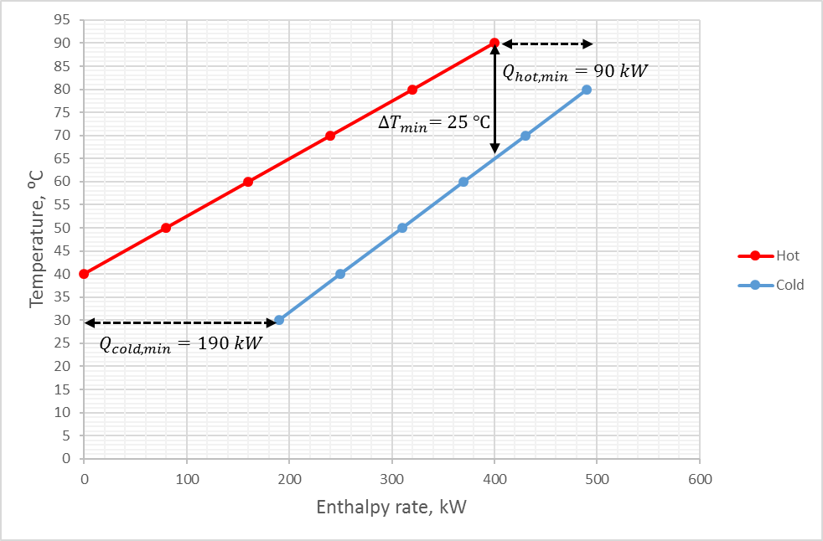
Solution (a)…

Slide 9
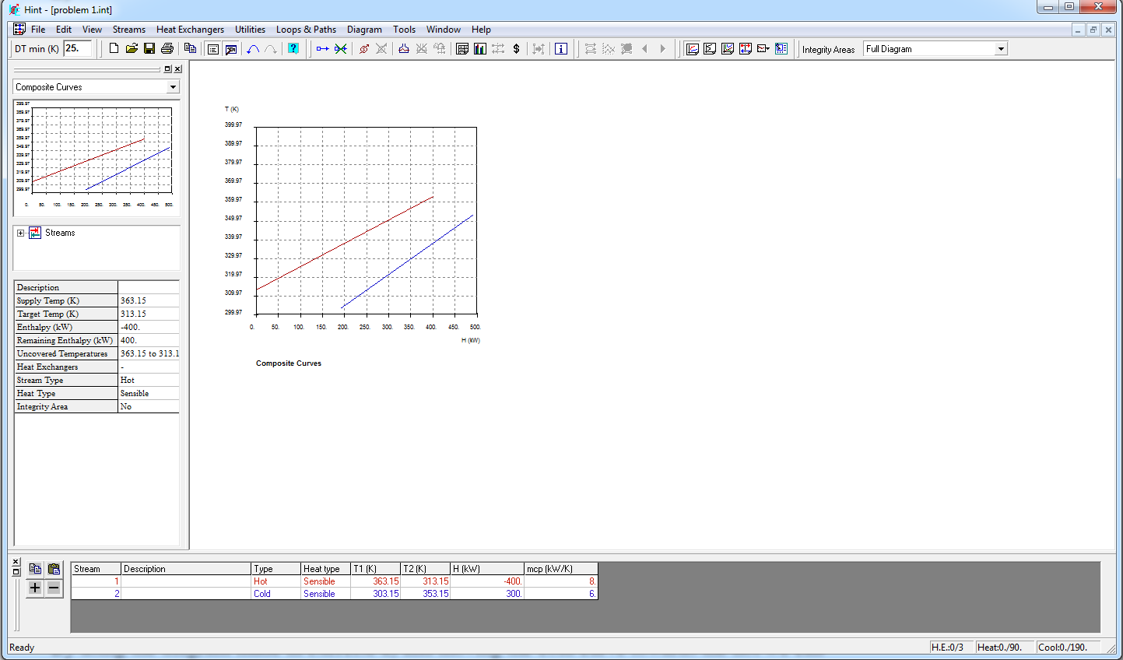
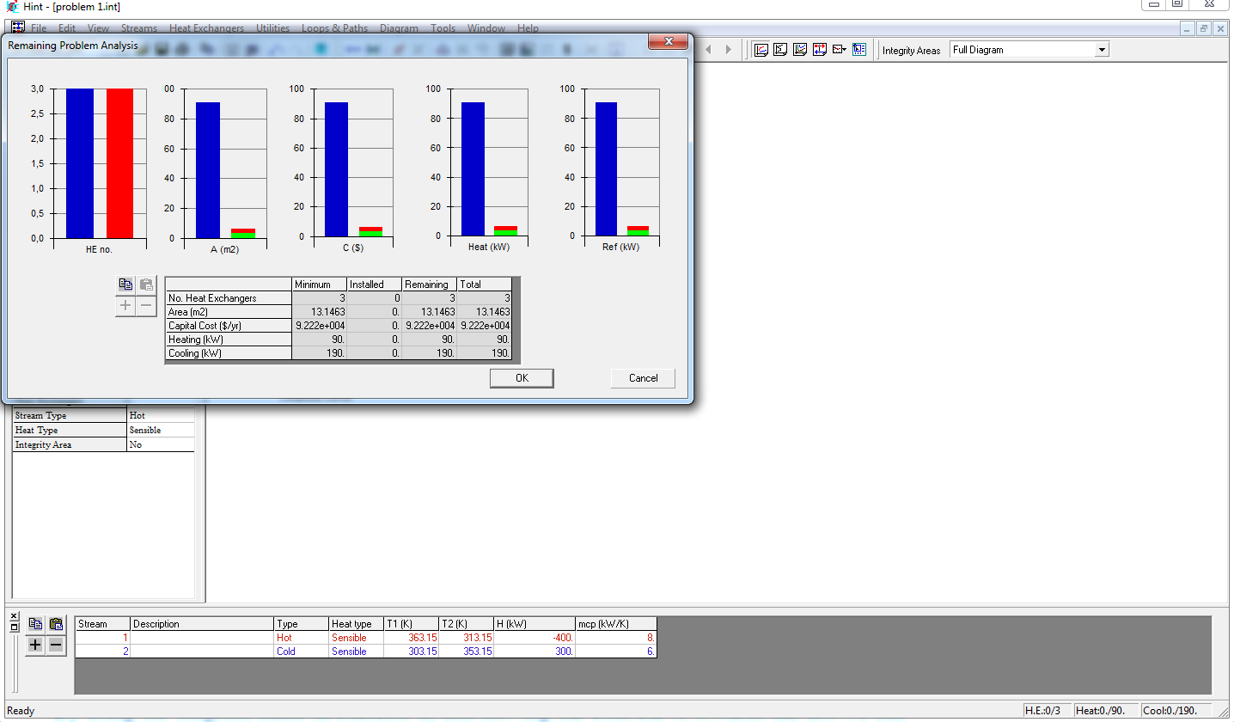
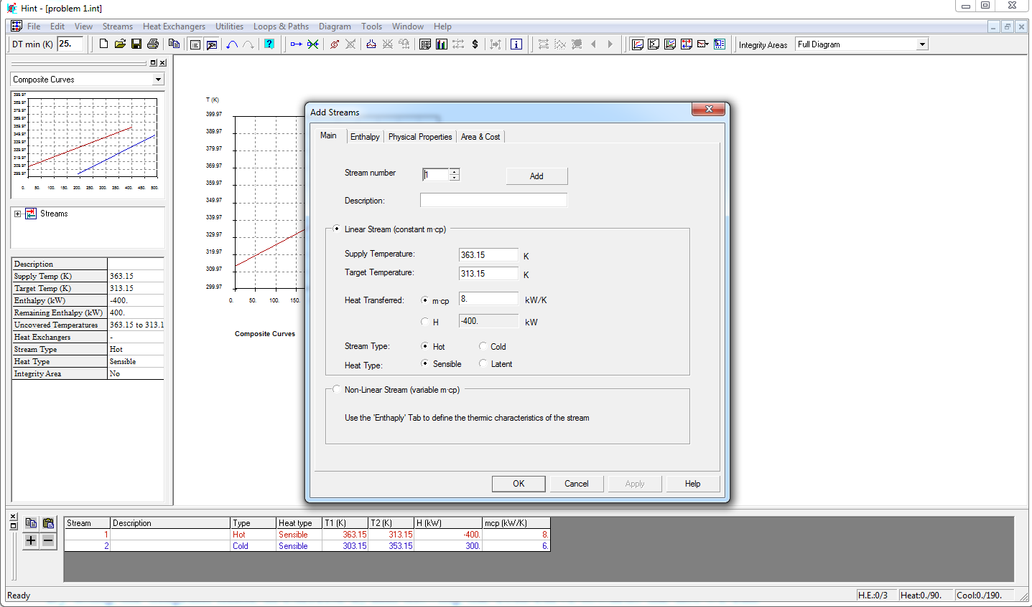
Doublecheck Solution (a)…
Step 1: Open Hint software from your workstation
Step 2: change your $∆T_{min}$.
Step 3: add streams.
Step 4: Generate results.

Slide 10
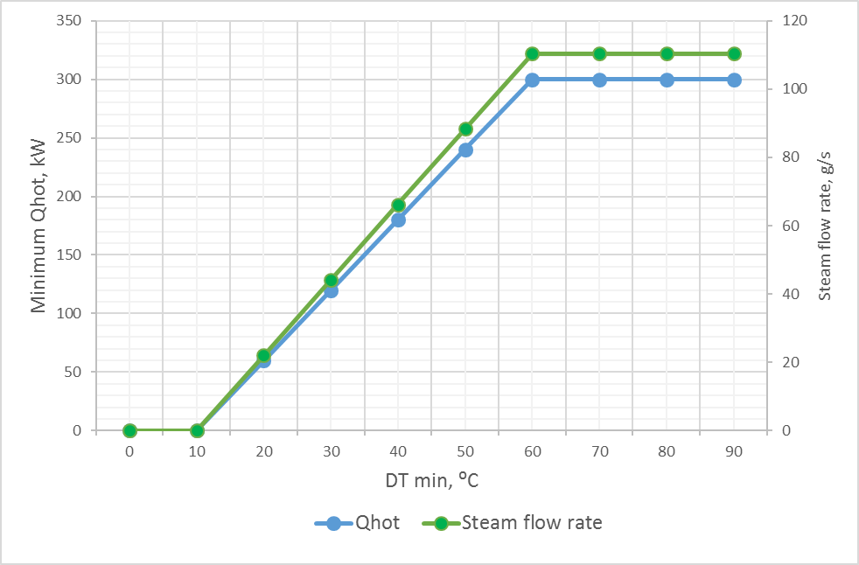
Solution (b)…

Slide 11
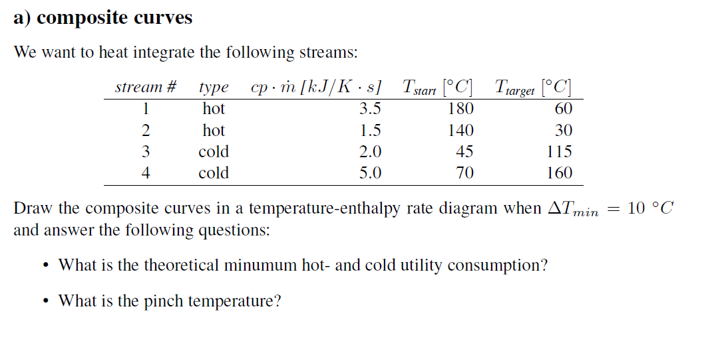
Problem 2. Composite curves

Slide 12
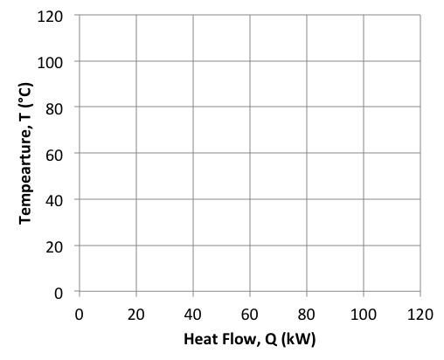
Keep in mind …
How do you combine multiple heat sources or sinks into a single total amount of heat (Q)?
 | H1 | H2
T_{supply} (°C) | 80 | 120
T_{target} (°C) | 20 | 40
m.cp (kW/K) | 1.0 | 0.5
Q_{total} (kW) | 60 | 40

Slide 13
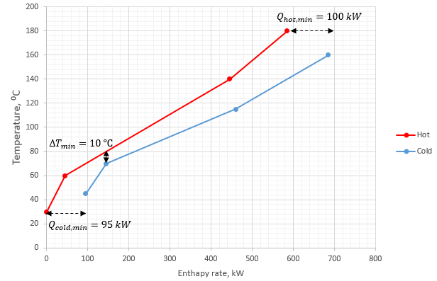
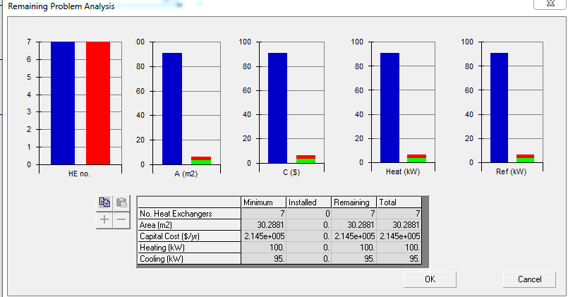
Solution …
What about the pinch point?
75 $℃$

Slide 14
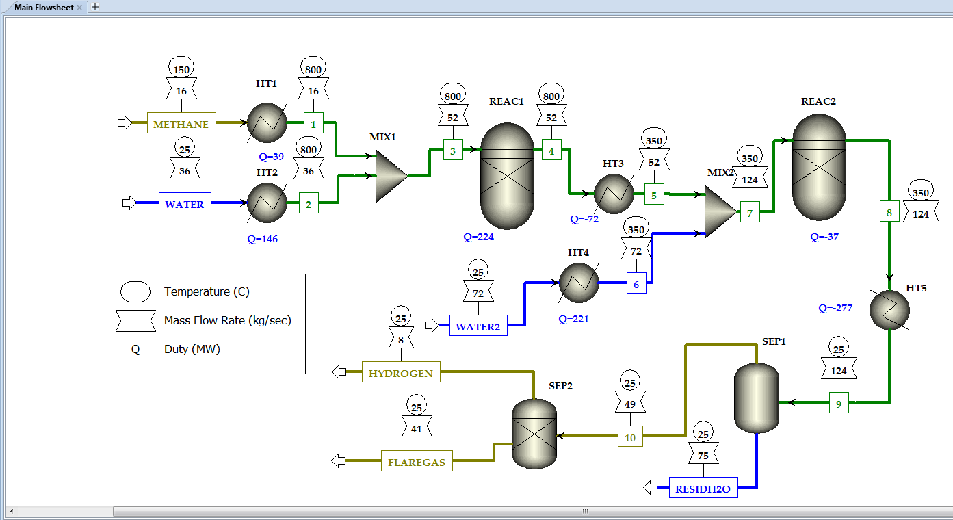
Homework Pinch analysis for the steam reforming process.

Slide 15
Questions?
Thank you and See you next time!

