Slide 1
Notes:
WANT TO TAKE YOU BACK TO STANFORD – WHERE I MET CHIP HEATH

Slide 2
Notes:
CORE (ITS ALL ABOUT..), SURPRISE, REALISM, BELIEVABILITY, STIRRING, MESSAGE THAT CAN BE RETOLD
SO LET ME TELL YOU A STORY --- AND WE WILL COME BACK TO IT …

Slide 4
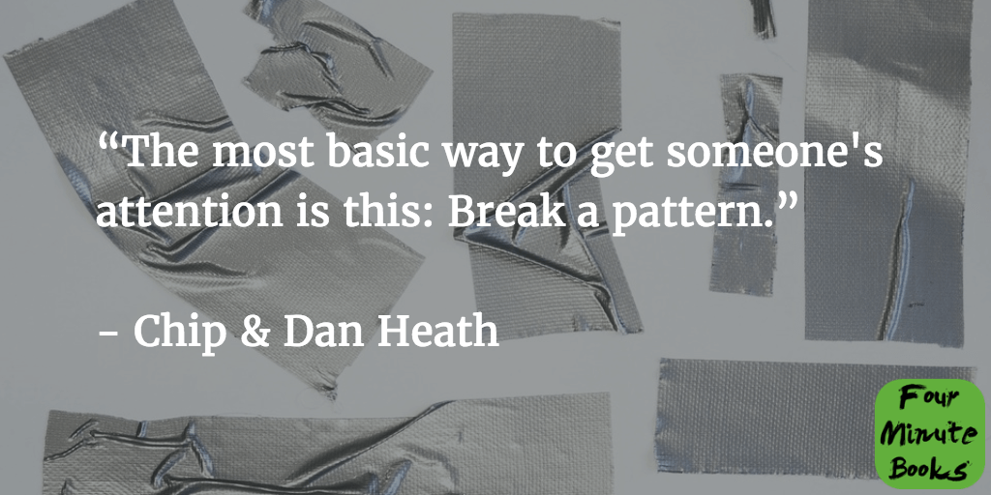
Notes:
IN OTHER WORDS, THE UNEXPECTED TWIST

Slide 5
Notes:
AN LBS MBA STUDENT OF MINE & TEAM WROTE A PLAN – THAT SOUGHT TO EASE THE PAIN OF ARRANGING SKI TRIPS FOR GROUPS OF EUROPEAN TRAVELLERS

Slide 6
Project
Participants
Plan
Pages
Notes:
WENT TO US BUSINESS PLAN COMPETITION, I WAS BROUGHT IN AS MENTOR –
THIS IS OUR CLASS PROJECT, LET ME INTRODUCE THE TEAM, HERE IS OUR AGENDA, AND FOLLOW THE SLIDE
NUMBERS – OH GOD THEY ARE ONLY ON SLIDE 6 OF A 20 SLIDE DECK!

Slide 7
bullet
points
stimulate
reading
Notes:
IS THIS THE BEST WAY TO ENCOURAGE ACTIVE LISTENING

Slide 8
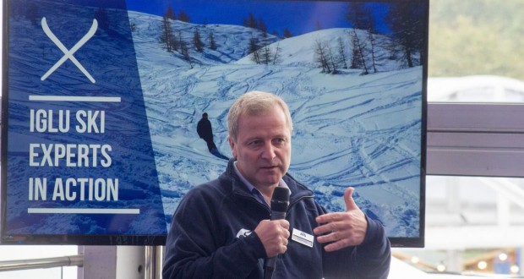
Notes:
RICHARD DOWNS & TEAM CRAFTED A PITCH ON THE LONG PLANE RIGHT TO TEXAS – WE NEED TO SHOCK AN AMERICAN AUDIENCE AND GET A BIT MORE VISUAL – THERE IS A NATURAL APPEAL FOR AUDIENCE MEMBERS THAT ARE INTO SKIING

Slide 9
<2%
Notes:
HE BROUGHT A HUGE PILE OF BROCHURES DROPPED THEM IN FRONT OF THE JUDGES/INVESTORS
HOW MANY OF YOU ARE SKIEERS? HOW MANY HAVE SKIIED IN EUROPE?
HOW MUCH TIME BROWSING BROCHURES? WHAT % OF CHALETS COVERED? ANY IDEA?

Slide 10
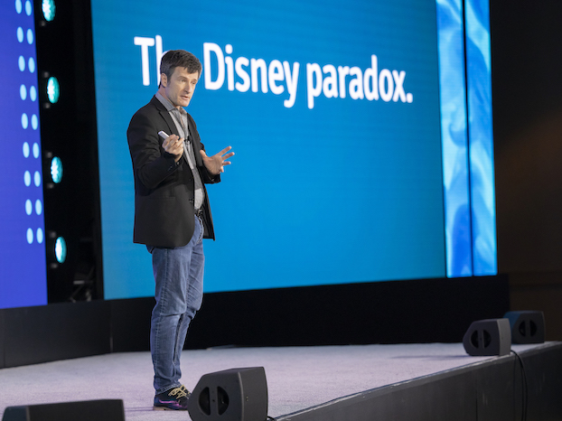
Notes:
NOW A FEW TIPS FROM THIS GUY CHIP HEATH FROM STANFORD – REMIND YOU SOMEBODY

Slide 11
size
Notes:
CONTRAST AND READABILITY
LIKE MY PROXIMITY NETWORKING DEVICE – CUE CARD

Slide 12
zoom
Notes:
IF YOU ARE WORKING IN ZOOM

Slide 13
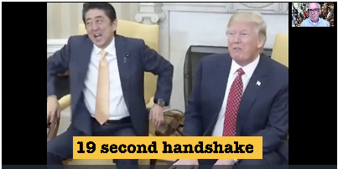
Notes:
MIGHT REMEMBER THIS VISUAL AND I LIKE TO SEE THE SPEAKER

Slide 14
Notes:
DEPENDING ON THE AUDIENCE, YOU ARE VERY MUCH THE EXPERT ON STAGE

Slide 15
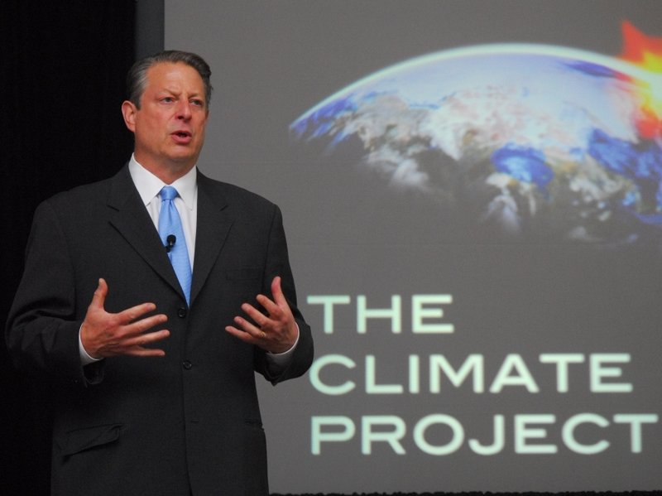
Notes:
HOW SHOULD AL GORE TALK ABOUT HIS CLIMATE PROJECT?

Slide 16
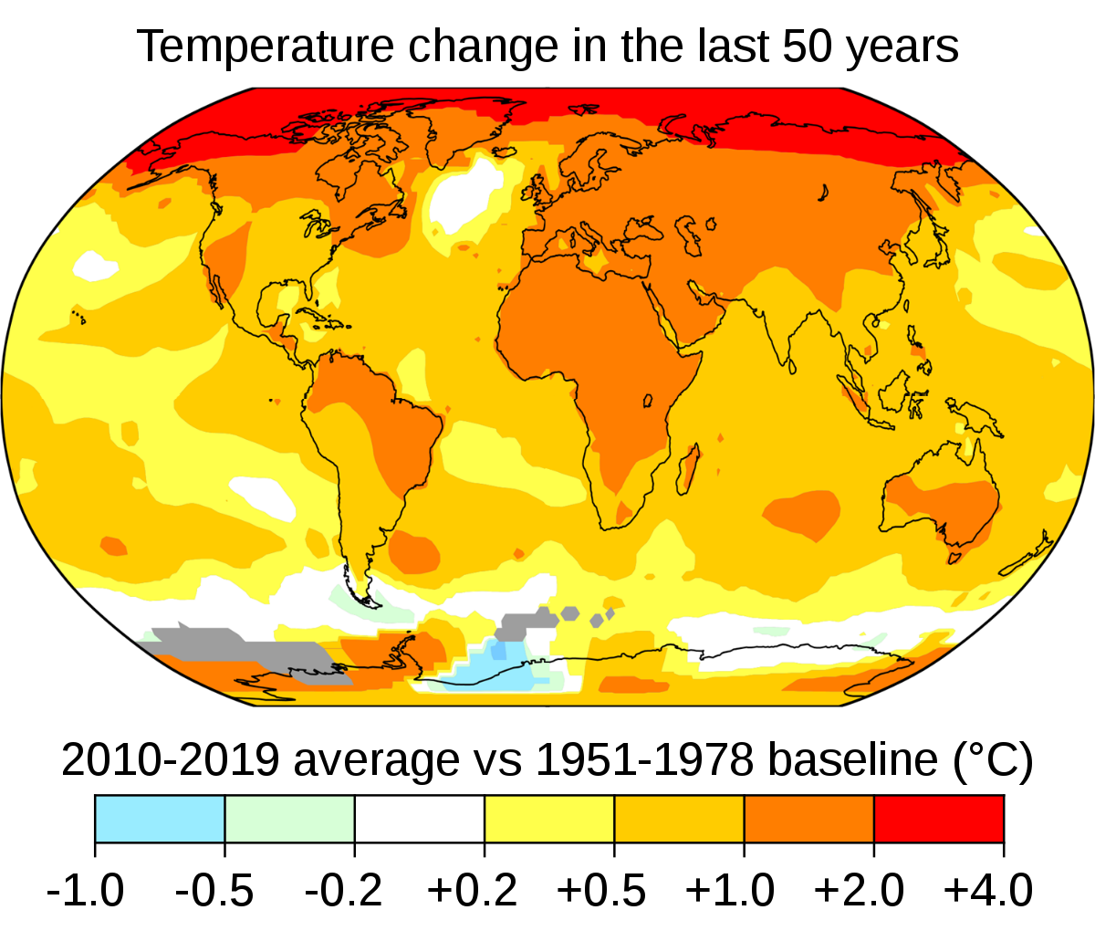
Notes:
FIND YOUR COUNTRY AND SEE HOW WE ARE DOING – BUT NOTICE WHERE THE RED IS …

Slide 17
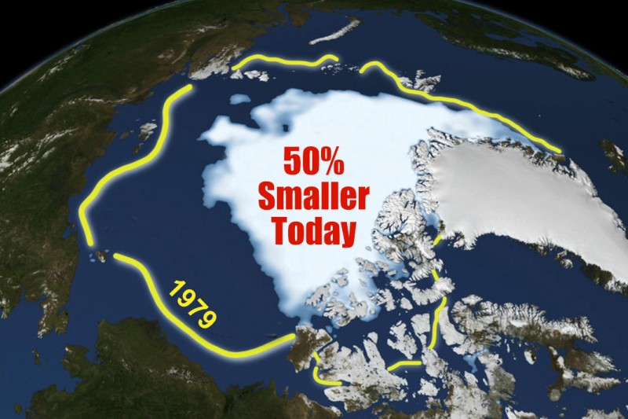
Notes:
ZOOMING IN A LITTLE MORE …

Slide 18
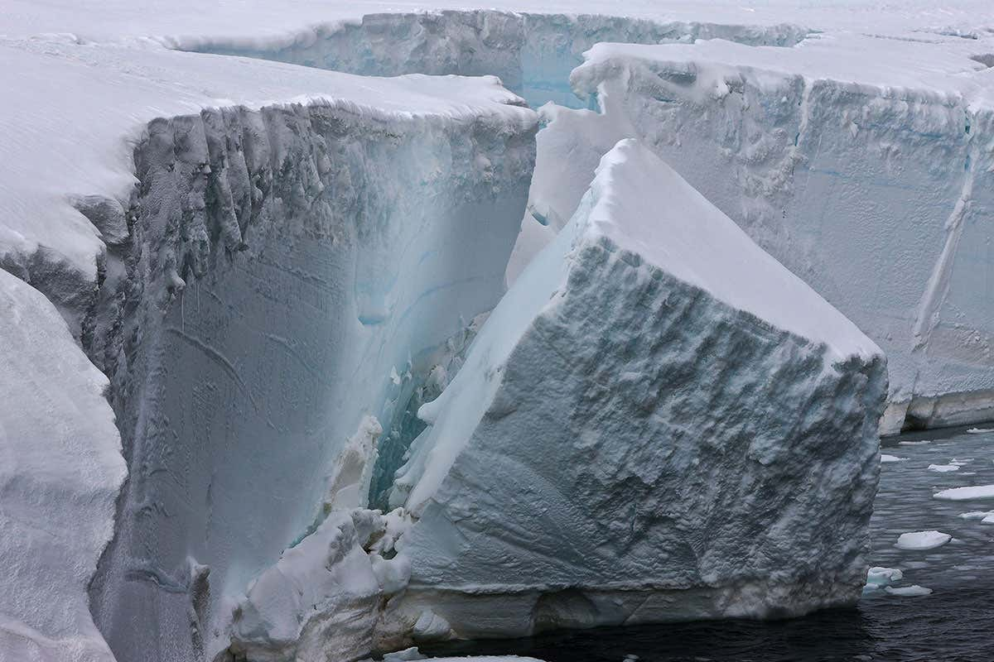
Notes:
AND IN FULL RESOLUTION – IDEALLY YOU WOULD WANT TO ESTIMATE THE VOLUME OF WATER RELEASED

Slide 19
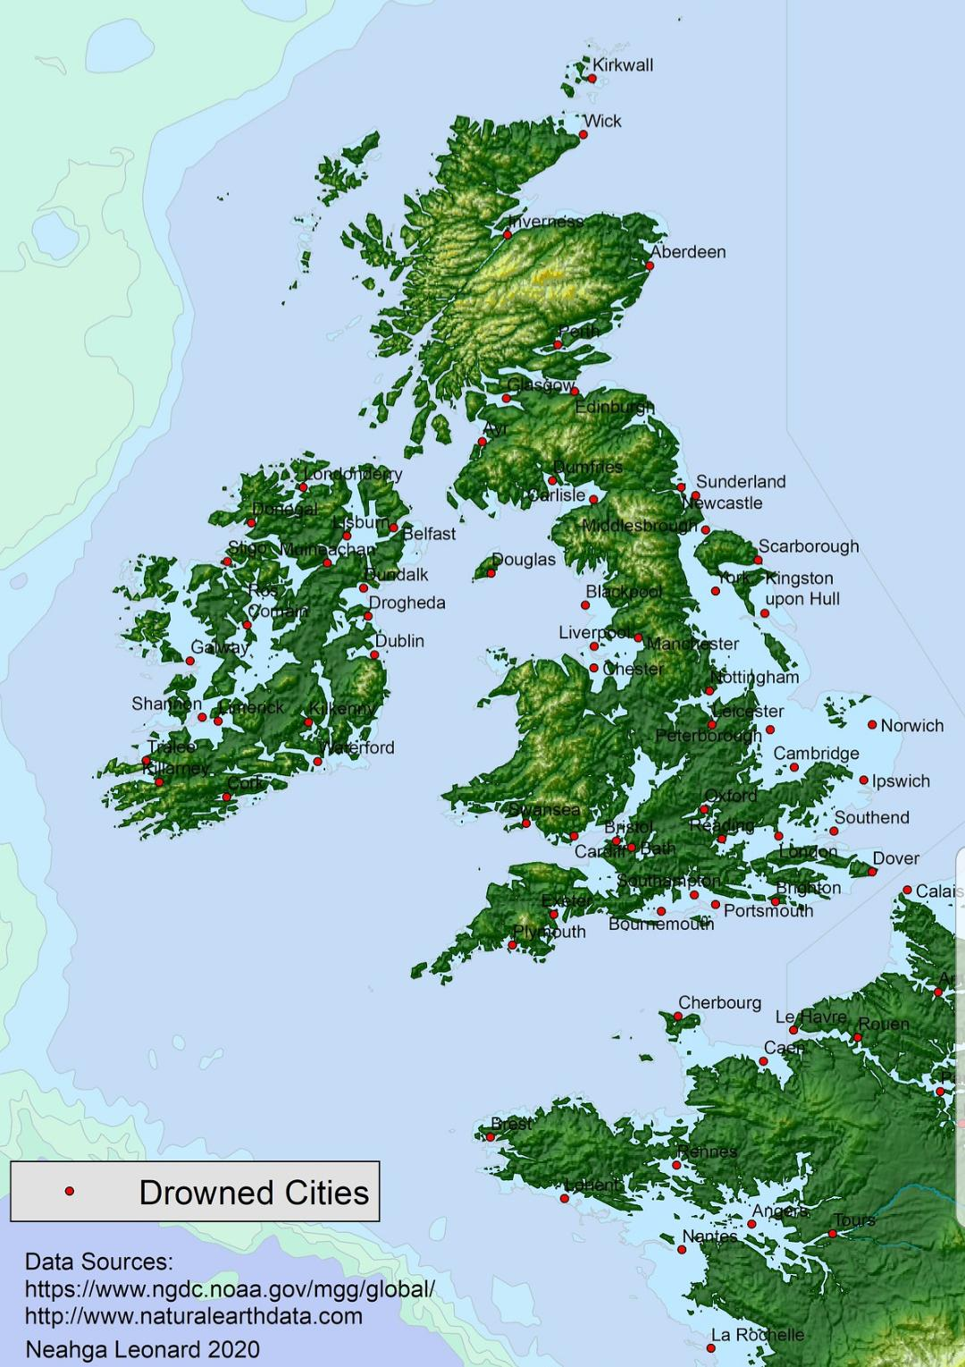
Notes:
NOTICE THE DIFFERENCE

Slide 20
Notes:
WHO IS SEEING AND HEARING YOU …

Slide 21
Notes:
FOR AN AALTO AUDIENCE – USE AALTO VISUALS

Slide 22
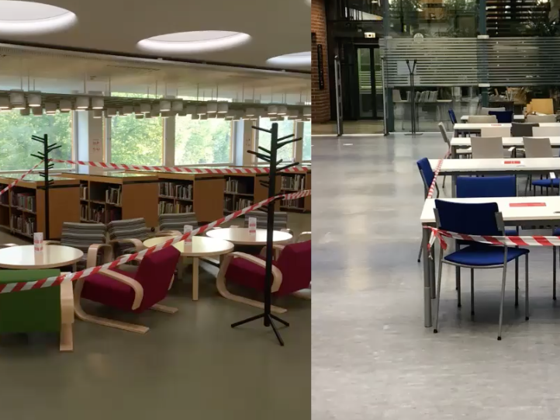
Notes:
SOCIAL DISTANCING AT AALTO
POLICE TAPE – AND OF COURSE I ASK WHO DIED?

Slide 23
Notes:
OR FOR FINNAIR AND YOU ARE LOOKING AT INTERCONTINENTAL BUSINESS

Slide 24
Notes:
THIS IS WHAT IS ADVERTISED … PREPARED ON THE GROUND (AND CONSUMED ON THE GROUND

Slide 25
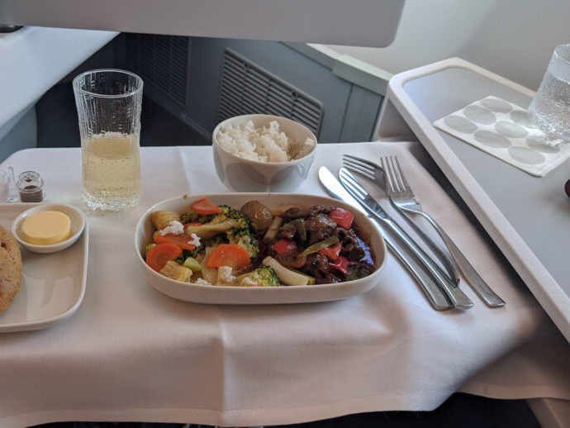
Notes:
THIS IS WHAT IT LOOKS LIKE IN THE AIR - YUM

Slide 26
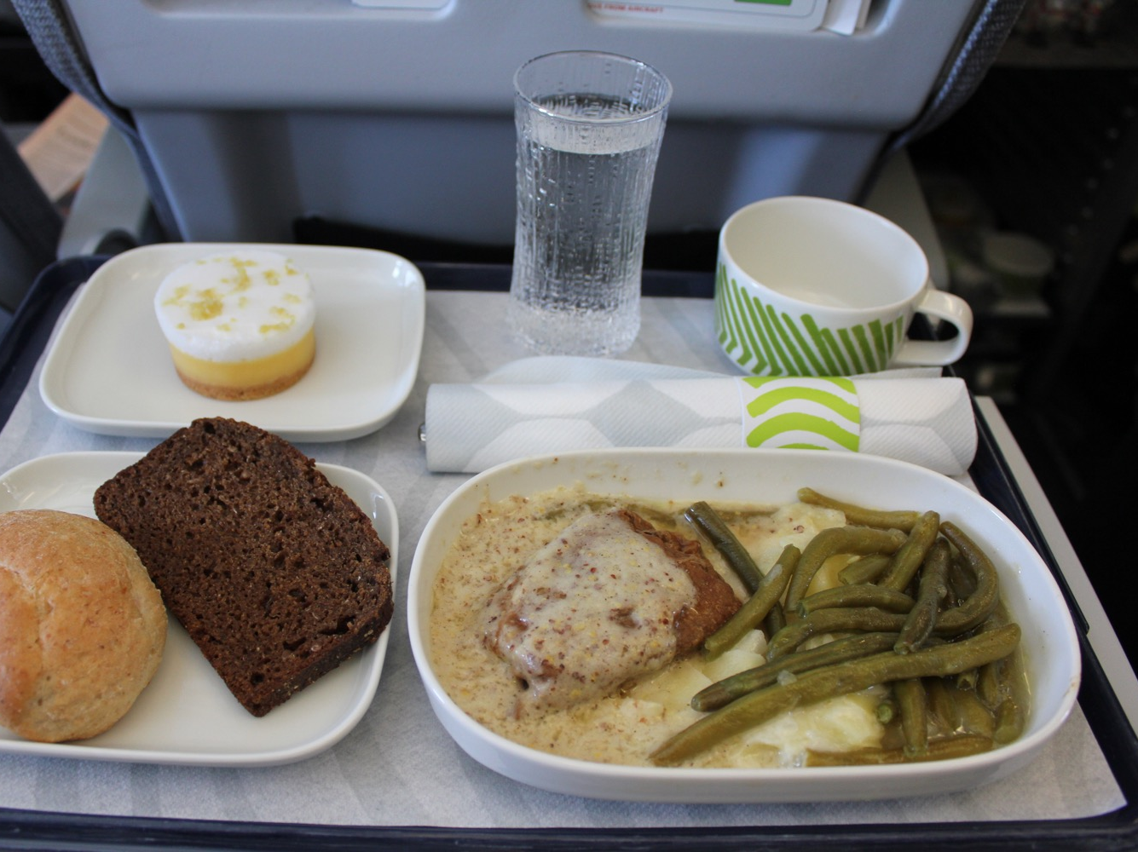
Notes:
OR IN SHORT HAUL BUSINESS

Slide 27
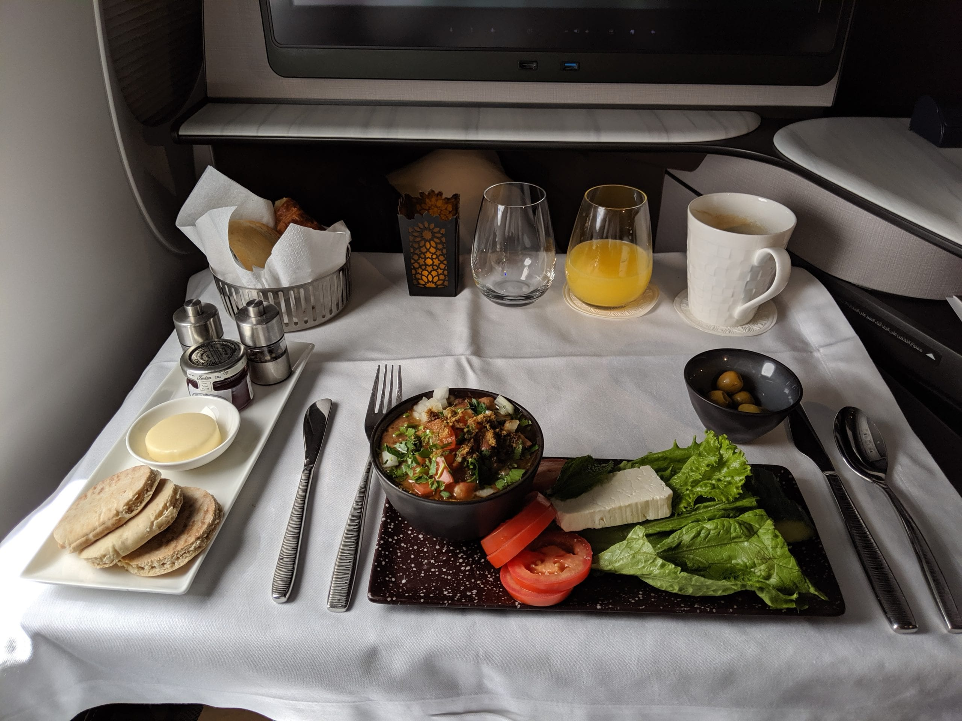
Notes:
HERE IS MY STARTER ON QATAR AIRWAYS

Slide 28
Notes:
AND MY MAIN

Slide 29
Notes:
DATA MAKES THE CASE IN THE END, BUT THE STORIES MAKE IT RELATEABLE

Slide 30
tease
don’t
tell
Notes:
MYSTERY NOVELS ENCOURAGE YOU TO TURN THE PAGE – YOU WANT YOUR AUDIENCE TO CONTINUALLY ENGAGE
AND IN THE END MOTIVATING THEM TO SEEK OUT MORE INFORMATION

Slide 31
Notes:
TO AN AALTO AUDIENCE – GREAT YOU HIGHLIGHT PLATFORM AND THAT THEY CURATED THE SEARCH PROBLEM (PERSONAL)
BUT NEVER SHOW CLIP ART – WOULD BE BETTER TO SHOW A PICTURE OF THE PERSON … DRAW AN EMOTIONAL CONNECTION TO STORY
FIRST STEP EXPLORE A MINOR

Slide 32
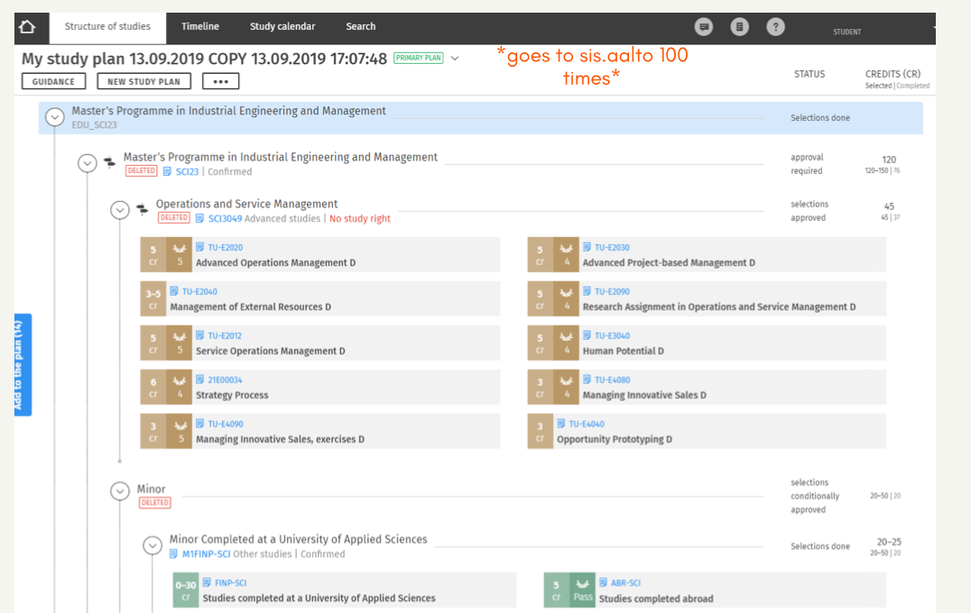
Notes:
SECOND STEP – WHAT FULFILLS THE MINOR – BUT THE SHOCKER HERE IS GOING BACK 100 TIMES – NOT BIG ENOUGH – WHAT WHERE THE TOP 3 BIG CONSUMERS OF TIME …

Slide 33
Notes:
THIS IS A BRILLIANTLY SIMPLE DISPLAY OF COMPLEXITY – I KNOW THERE IS LOTS OF BACKGROUND RESEARCH THERE – IF THE AALTO
AUDIENCE PICKS UP THE MESSAGE – THEN FILL IN THE DETAILS – DOCUMENTING JOURNEYS HELPS BUILD CREDIBILITY

Slide 34
make it personal

Slide 35
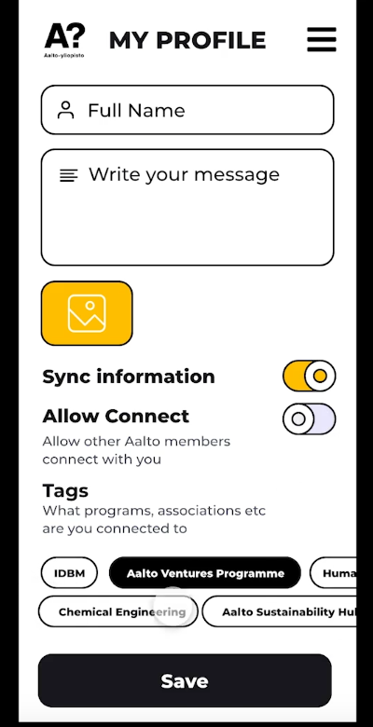
Notes:
STARTED WITH THIS ---

Slide 36
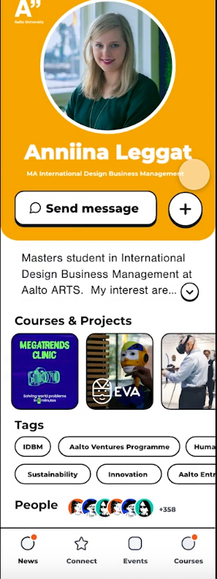
Notes:
A MOCK UP OF A PERSONAL PROFILING APP – AND SHE WAS SPEAKING – AND THE REACTION OF THE AUDIENCE WAS AMAZINGLY POSITIVE
BUT INSTITUTIONAL REFLEX COMES IN – LOOK WHAT YOU CAN WIREFRAME QUICKLY – THE SCHOOL MAY MOVE IN 2 YEARS! (STUDENTS ROCK)

Slide 37
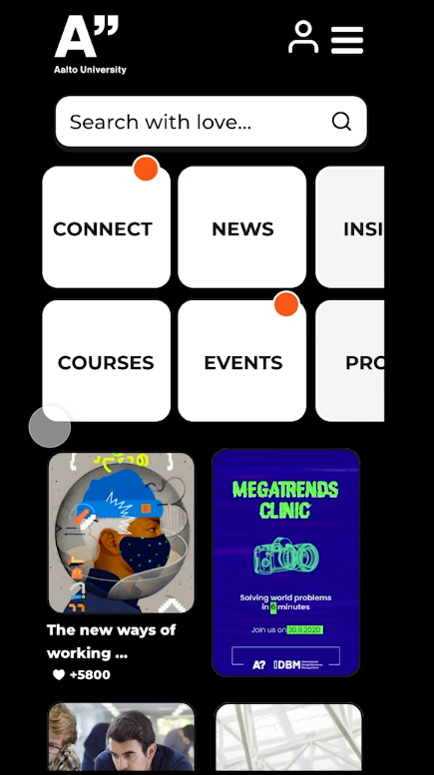
Notes:
WALKED THROUGH SOME OF THE FUNCTIONALITY (CURATED EXPERIENCE)
REMEMBER THE CURSE OF KNOWLEDGE – YOU KNOW MORE ABOUT THE SUBJECT MATTER THAN THE AUDIENCE

Slide 38
pecha
kucha

Slide 39
20 frames
20 seconds
Notes:
FRAMES DOES NOT MEAN POWERPOINT SLIDE

Slide 40
1 minute
3 frames

Slide 41
what the visual is saying

Slide 42
what you
are
telling
Notes:
30 – 35 words – practice, practice and don’t rush
I can always ask for more information

Slide 43
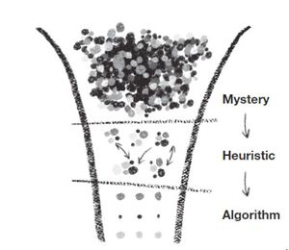
Notes:
ROGER MARTIN ”THE DESIGN OF BUSINESS” HBS PRESS (2011)

Slide 44
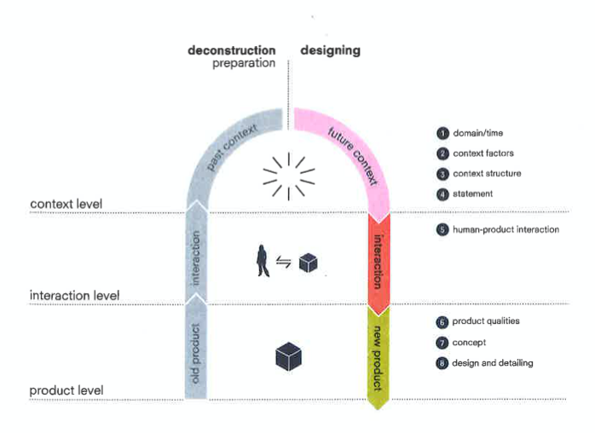
Notes:
NOTICE THE USE OF DIFFERENT LABELS BUT THE STRONG RESONANCE OF TWO APPROACHES

Slide 45
domain as you
“see it”
Notes:
ALGORITHMS AND HEURISTICS (PATTERNS)

Slide 46
driving
forces at play
Notes:
WHY ARE THEY CRUCIAL? EVIDENCE

Slide 47
the
forces of
change
Notes:
WHAT ARE THEY? WHAT MAKES THEM RELEVANT IN YOUR MIND?
EVIDENCE …

Slide 48
the domain as you
“envision it”
Notes:
MYSTERY – HOW IT MIGHT UNFOLD

Slide 49
Notes:
YOU ARE THE DOMAIN EXPERTS IN THE MAKING

Slide 50
skip the
team
introduction
Notes:
IF I WANTED TO KNOW I WOULD ASK

Slide 51
2
Notes:
NO MORE THAN 2 SPEAKERS

Slide 52
skip the
thank you
slide
Notes:
YOUR TEAM HAS SET THE AGENDA ABOUT THE FUTURE CONTEXT

Slide 53
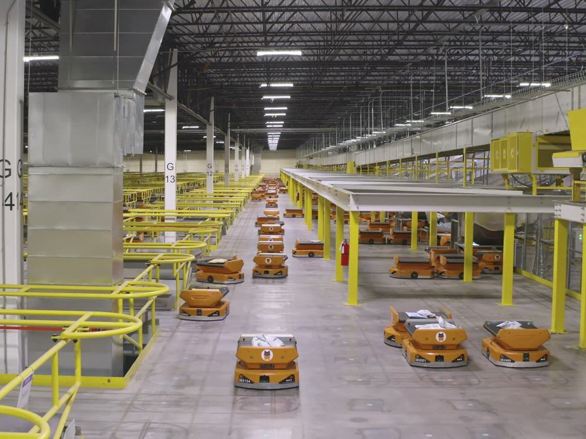
Notes:
ROBOTS NAVIGATING PATHS IN A CONFINED SPACE

Slide 54
Notes:
OMNICHANNEL RETAIL – WHAT ABOUT OMNICHANNEL HEALTH

Slide 55
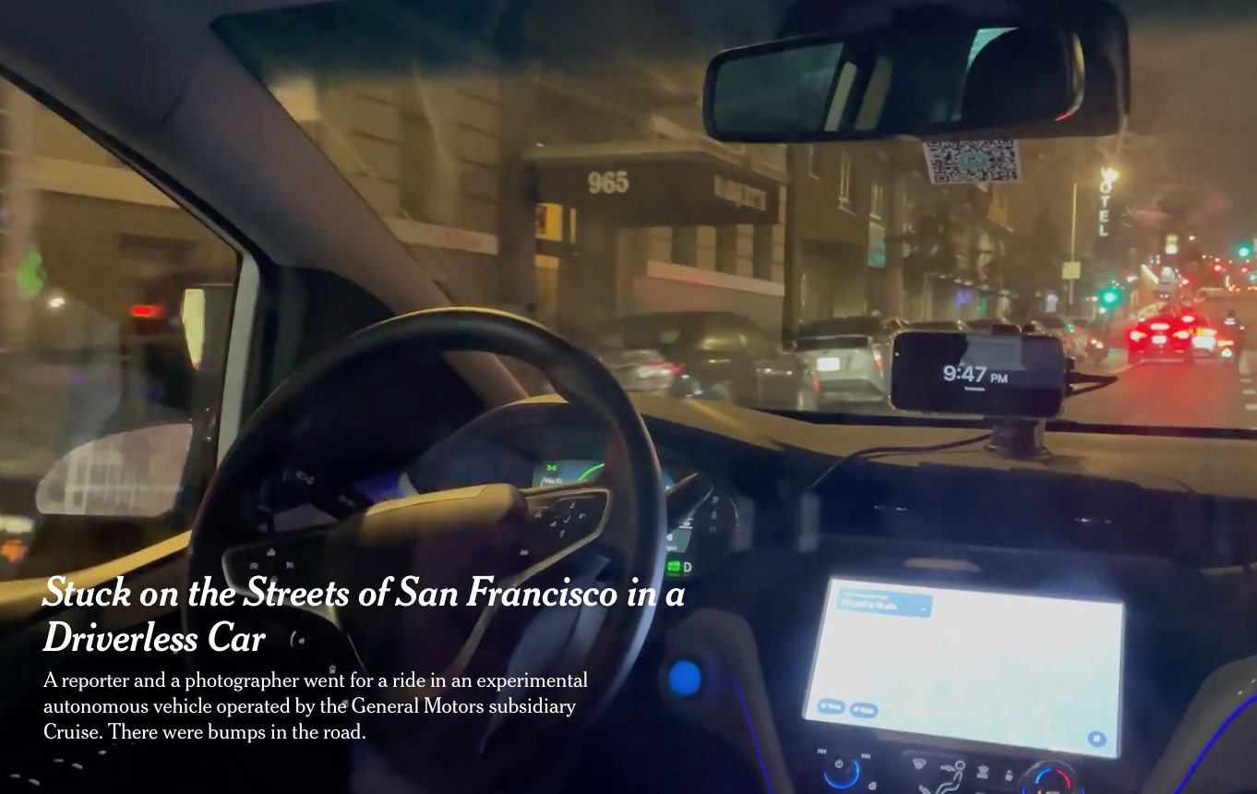
Notes:
HOW WOULD YOU FEEL?

Slide 56
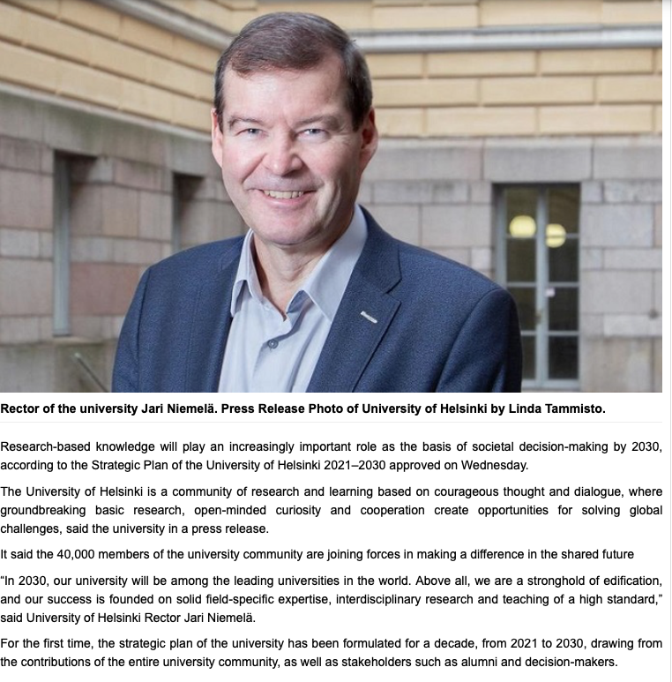

Slide 57
Notes:
THINK BEYOND OFFICE

Slide 58
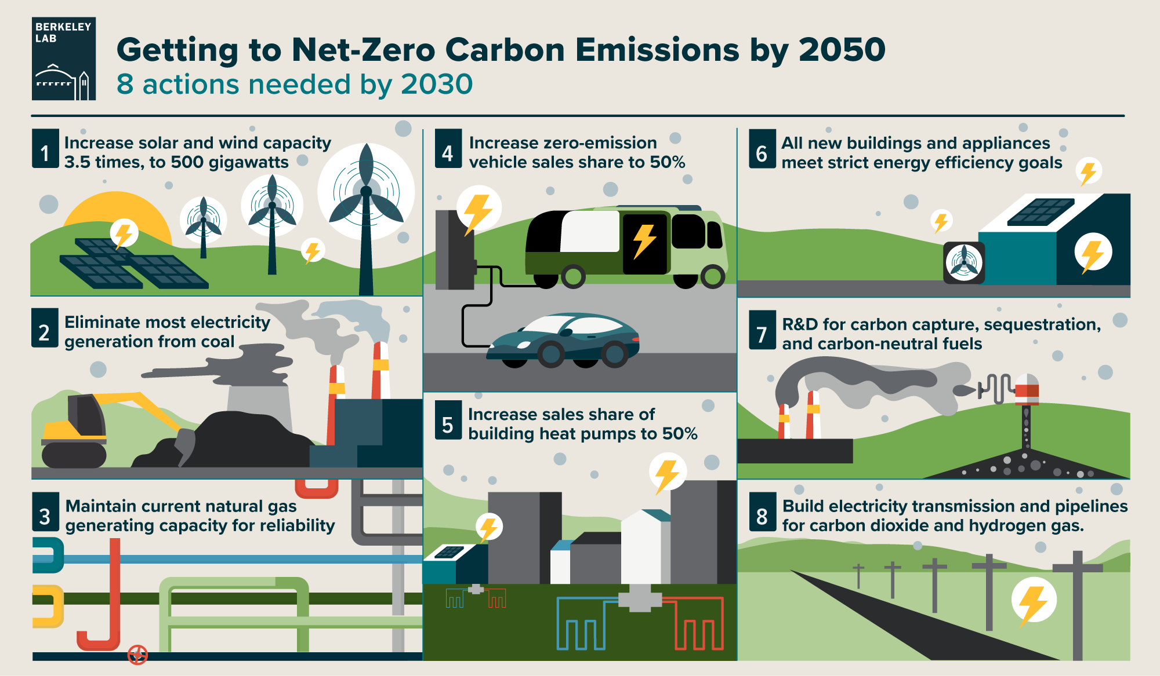
Notes:
AS A SPRINGBOARD FOR REIMAGING FUTURE CONTEXTS

