Slide 1
Microfabrication 2023 CHEM-E5115 sami.franssila@aalto.fi victor.ovchinnikov@aalto.fi

Slide 2
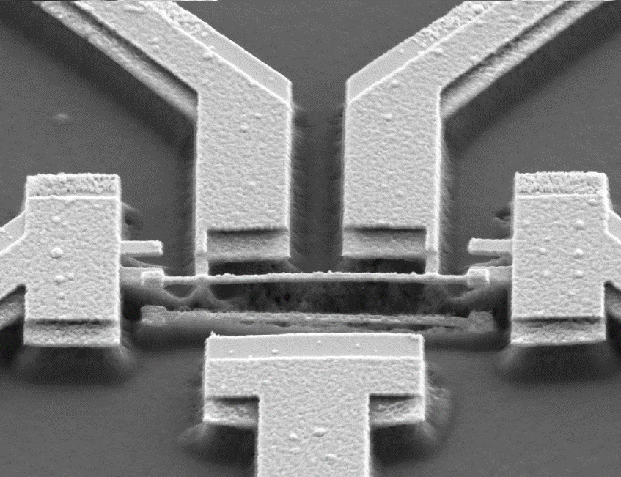
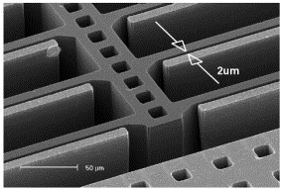
Goals
After the course you should be able to design simple microfabrication processes and analyze complex processes.
The devices look like these:
CMOS transistors
Nanobridge
MEMS accelerometer

Slide 3
You must understand:
Microscale dimensions
-is 100 nm linewidth feasible ?
-is 4 nm film thickness possible ?
-is 100 nm/min high or low rate?
-is 300 MPa high or low stress ?
-is 20 μΩ-cm low enough resistivity ?
Materials
-silicon wafers
-thin films of SiO₂, SiN_{x}, Al, W, Cu, Au, Pt, ……
Processing of materials at microscale:
-patterning
-doping
-thin film deposition
-bonding

Slide 4
Learning
Book
-Introduction to Microfabrication
-provides the facts
Lectures
-show how to think about the facts
-are no substitute for reading the book !
Spot exercises
-simple group work
-check understanding of basic concepts
Home exercises
-develop feeling for orders of magnitude
-practice fabrication processes on paper
Lab demo: 3 hours in Micronova cleanroom
-hands-on microfabrication (lithography & etch)
-electrical measurements outside cleanroom, too

Slide 5
Timetable, period IV
Date | Topic of lecture | Exercise (H=home; S=spot) | Teacher | Readings for this lecture
 | Lectures: Zoom | Exercises: Zoom |  | Introduction to Microfabrication
28 Feb | Introduction |  | SF | Chapter 1
 | Litho & etching |  | SF | Chapters 9,11
 | Silicon |  | VO | Chapter 4
7 March | Cleaning & cleanroom & safety |  | VO | Chapters 12,35
 | Thin films |  | VO | Chapter 5
 |  | S1: Thin film, litho & etch | VO, SF | Chapters 12, 35
 |  | LAB REGISTRATION STARTS
14 March |  | H1: thin film, litho, etch | MM
 | Oxidation |  | SF | Chapter 13
 | Lab device (sputtering) |  | SF
 |  | First group in lab March 15th
21 March |  | H2: resistors, caps | LM
 | Doping (incl. Epi) |  | VO | Chapters 6,14,15
 |  | S2: oxidation & doping | VO, SF
28 March |  | H3: oxide, doping | LM
 | Bonding & CMP |  | VO | Chapters 16,17
 | Integration | LAST GROUP IN LAB March 30th | SF | Chapter 25
4 April |  | H4: lab reports dicussed | MM
 | MEMS 1 (etch) |  | SF | Chapters 21,22
 |  | S4: MEMS 1 | SF
11 April |  | H5: MEMS basics
 | CMOS |  | VO | Chapter 26
 |  | S3: CMOS starters | VO, SF
18 April | exam week, no teaching

Slide 6
Timetable, period V
25 April |  | H6: CMOS | VO
 | MEMS 2 (bulk) |  | SF | Chapter 30
 |  | S5: MEMS 2 | SF, VO
2 May |  | H7: MEMS advanced | SF
 | MEMS 3 (surface) |  | SF | Chapter 29
 |  | S6: MEMS 3 | SF, VO
9 May | Yield & reliability |  | VO | Chapter 36
 | Economics of microfabrication |  | SF | Chapter 37
 |  | S7: metallization | SF, VO
16 May |  | H8: yield; economics, MEMS surface | VO, SF
 | Scaling |  | SF | Chapters 26, 28
 | Nano-CMOS & Moore |  | VO | Chapters 26, 38
June 2 | Exam | time: 9-12 o'clock | all

Slide 7
Pre-reading
The slides are available beforehand (we aim for Friday, but Monday morning latest).
We expect that you have familiarized yourself with them, because the pace of lectures is based on assumption that students know the stuff.
Use lectures to ask questions of topics that you did not understand during self-study.

Slide 8
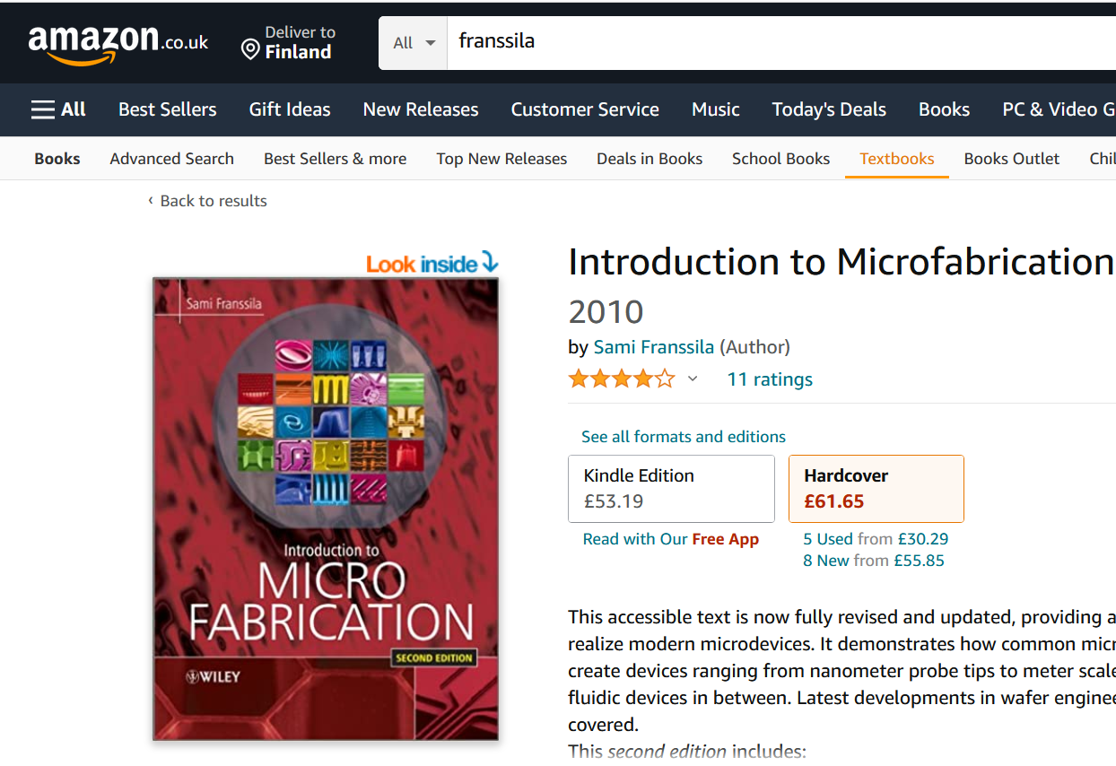
27.2.2023

Slide 9
The book
Introduction to Microfabrication, 2nd edition (John Wiley, 2010). First edition 2004 can also be used.
The course covers chapters 1-6, 9, 11-17, 20,21, 25-31, 35-38 (ca. 60% of the book).
Available as e-book via Aalto library:
http://site.ebrary.com/lib/aalto/docDetail.action?docID=10419414
Other good readings:
Short notes on semiconductor technology:
http://www.semi1source.com/notes/

Slide 10
Homework exercises
Individual. If you submit pieces of text written by somebody else as your work, disciplinary action will be taken.
Published on Tuesdays at 12 noon in MyCourses.
Return to MyCourses by following Sunday 10 pm (22.00).
Late return box will be provided, but points halved !
PowerPoint best, pdf also acceptable
Assistants will check and grade answers. 8 * 4 points
In Tuesday exercise session solutions are presented by the students (selected by the assistant from the best solutions)

Slide 11
On-the-spot exercises
Groupwork. Small groups, 2-4 persons.
Includes three phases:
group work
two groups cross-check each others solution
wrap-up by teachers
Maximum 2 points, same for all group members. 4 spots ➔ 8 points available.
Absence cannot be compensated.

Slide 12
Cleanroom lab demo
Enrollment opens on March 7th
Groups run March 14th to March 30th 2022
Lab report deadline April 2nd (same for everybody)
Lab report feedback session April 4th
Lab report is one of the homeworks, same timetable, but worth 8 points and a compulsory part of the course
Lab report is personal but of course the whole group is using the same data.

Slide 13
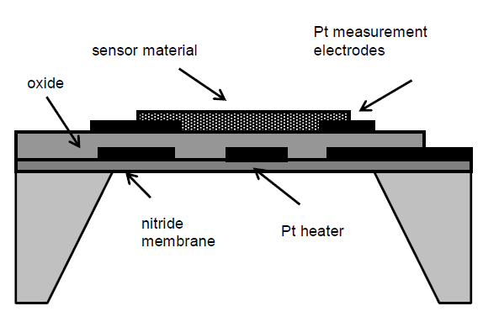
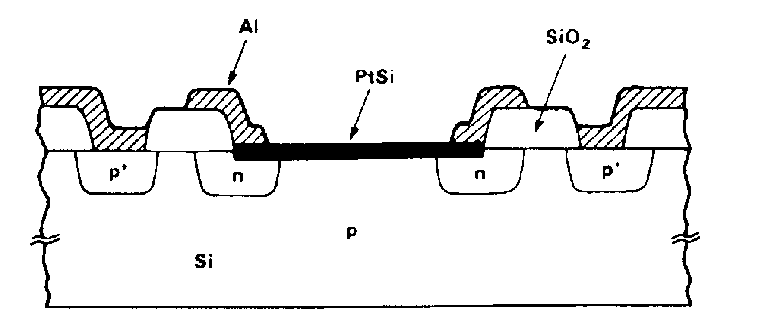
Examples of exam questions
Compare optical lithography and electron beam lithography.
Explain step-by-step how the micro hot plate shown
on top right was fabricated.
Explain step-by-step how the photodiode shown
on the bottom right was fabricated.
The sensor is a wet etched silicon membrane device
(20 µm membrane thickness). Membrane size is
1 mm*1 mm. How many good chips do you get
from a 100 mm wafer? The cost of wafer processing
is taken as 2 €/cm². How much does a single sensor
cost if silicon chip cost is 30% of total sensor cost ?
Chemical-mechanical polishing.

Slide 14
Grading
Grading: | exam (minimum 40% must) | 60
 | homeworks, 8*4 points (minimum 40% must) | 32
 | lab report, 8 points (must pass) | 8
 | spot exercises 4*2 points | 8
 | webropol feedback | 2
 | Total: | 110
Graded according to 100 points.

Slide 15
Related courses
FALL TERM 2023
CHEM-E5150 Surfaces and films
ELEC-E3140 Semiconductor Physics
ELEC-E8713 Materials and microsystems integration
ELEC-E8715 Design and analysis of MEMS
ELEC-E3280 Micronova lab course
SPRING TERM 2024
CHEM-E4105 Nanochemistry and Nanoengineering
CHEM-E8135 Microfluidics and BioMEMS
ELEC-E3220 Semiconductor Devices
ELEC-E3210 Optoelectronics

