Slide 1
PERIOD COSTUME AND STYLE
16.02.2022
ANCIENT AEGEAN, MINOAN AND GREEK CIVILIZATIONS
ETRUSCAN AND ROMAN CIVILIZATIONS

Slide 2
Ancient Aegean, Minoan and Greek civilisations: - Minoan civilization - Heroic, Archaic, Classical and Hellenistic Greece. Development of Doric peplos to Ionic chiton, Doric chiton and Hellenistic chiton. Greek civilization and social organisation. Fabrics and cloth production. - Etruscans and Roman civilisations. Social life of the Etruscans and Roman Empire. Chiton develops to Toga.

Slide 3
The Aegean World
Crete formed a direct bridge to Egyptian civilization
and also to Asia Minor.
Early Bronze Age Culture in Crete was Cycladic civilization
Notes:
The History of Crete goes back as far as the ancient Minoan civilization. After this civilisation was destroyed by natural catastrophes, Crete developed an Ancient Greece-influenced organization of city states, then successively became part of the Roman Empire, the Byzantine Empire, the Venetian Republic, the Ottoman Empire, and the modern state of Greece.

Slide 4
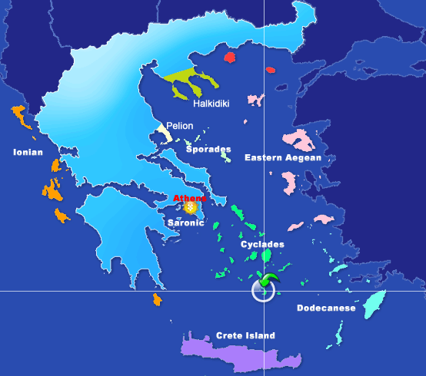
Main locations for Aegean civilizations
Island of Santorini (”the beautiful one” in Greek)
Island of Crete

Slide 5
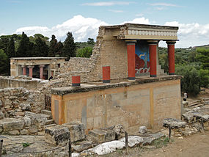
Sources of evidence for costume found from :
Palace of Minos
Hagia Triada
Akrotiri on Thera (now Santorini)
North entrance of the palace Minos
- Notice bull fresco at the back

Slide 6
Fresco depicts the importance of shipping and trade in the region

Slide 7
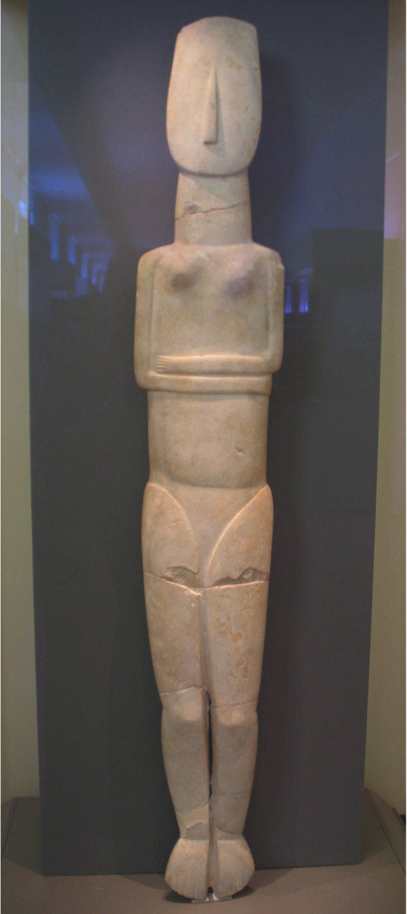
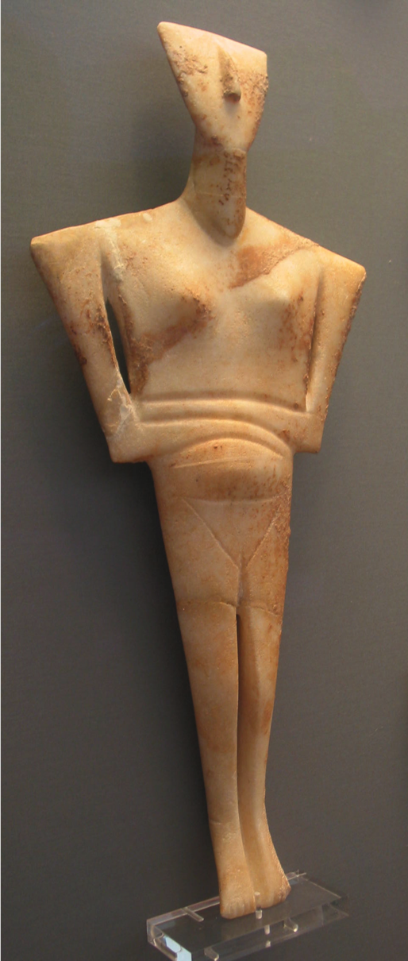
Cycladic Art Mother Goddesses
Beautiful in their classic simplicity made of white marble, Cycladic art is very unique art form by the Minoans

Slide 8
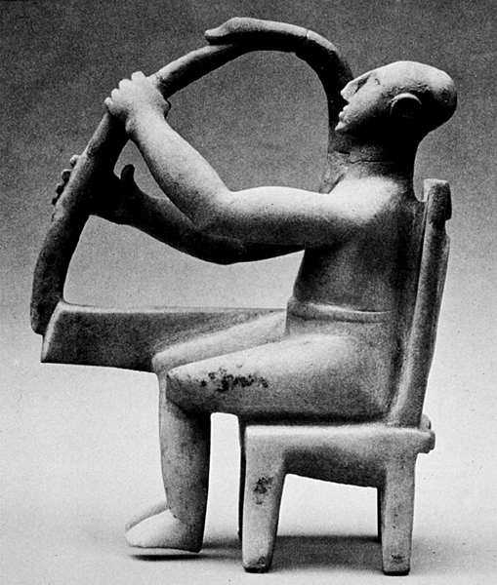
Cycladic Harp Player, wearing a loincloth, 3200 - 2700 BCE
Notes:
The lyre or vertical harp is believed to have originated from Ancient Sumaria. This type of harp was very popular in Greece and Rome. it is also mentioned in the Bible (Genesis 4:21} and was the type of harp King David played as a young man. The lyre is played using only one hand and had fewer strings. Another type of harp that originated from Greece is called the Aeolian harp and is played by the wind.

Slide 9
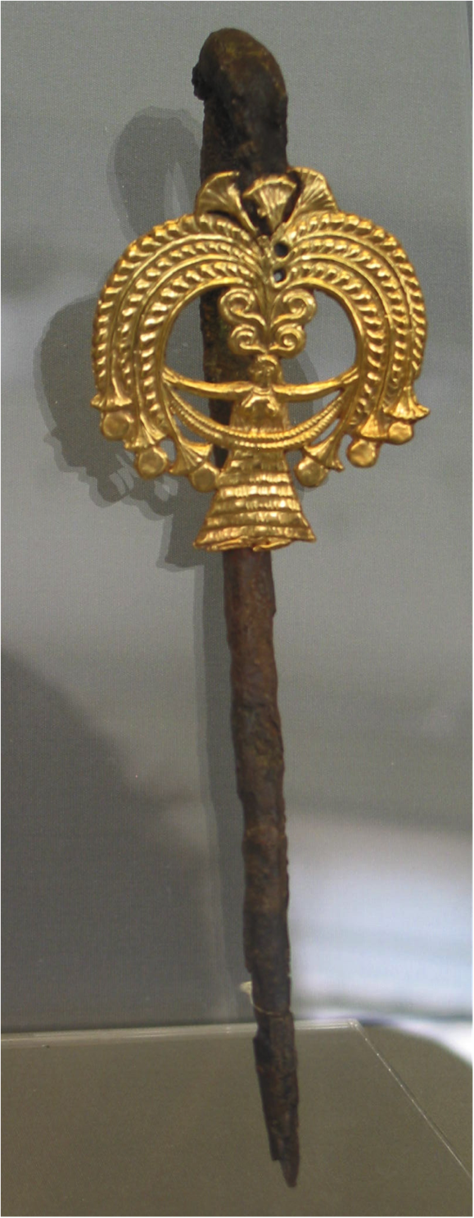
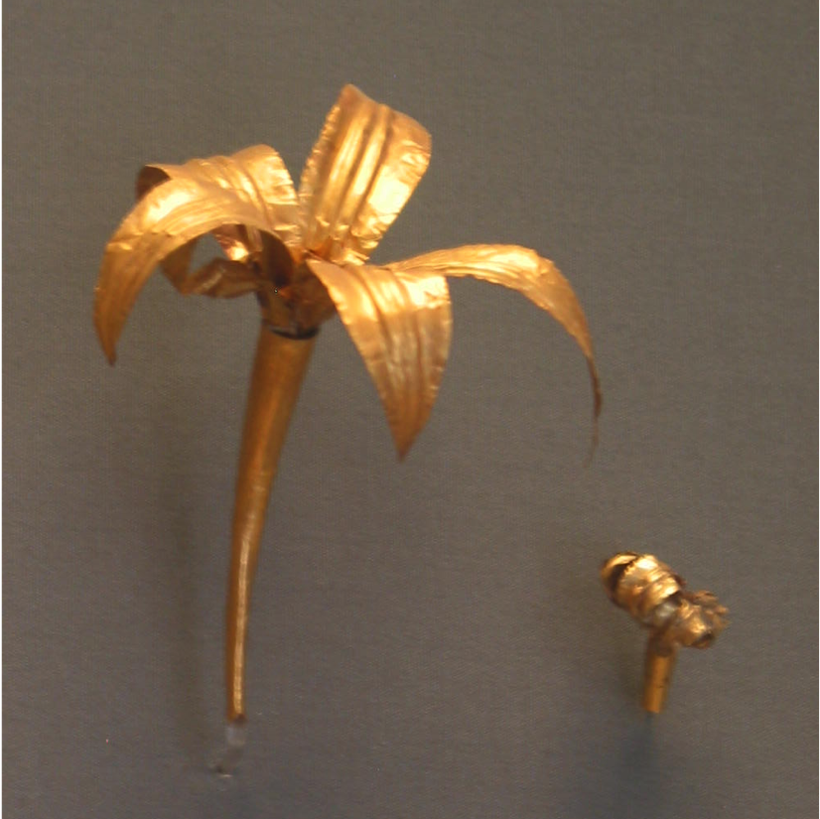
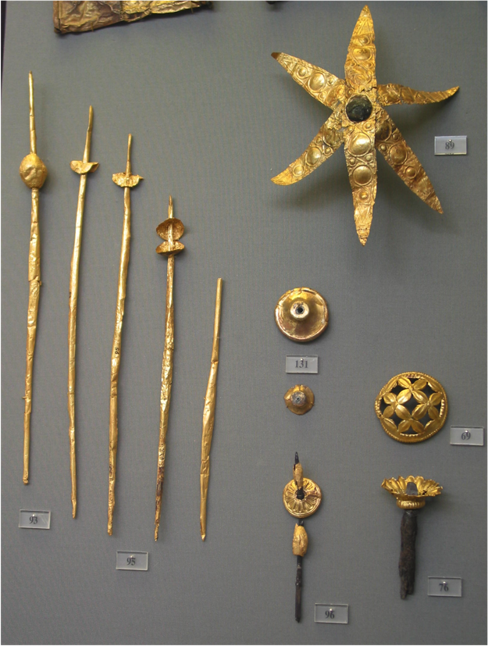
Minoan Jewelry
Generally gold pounded jewelry in the form of pins for fastening garments.

Slide 10
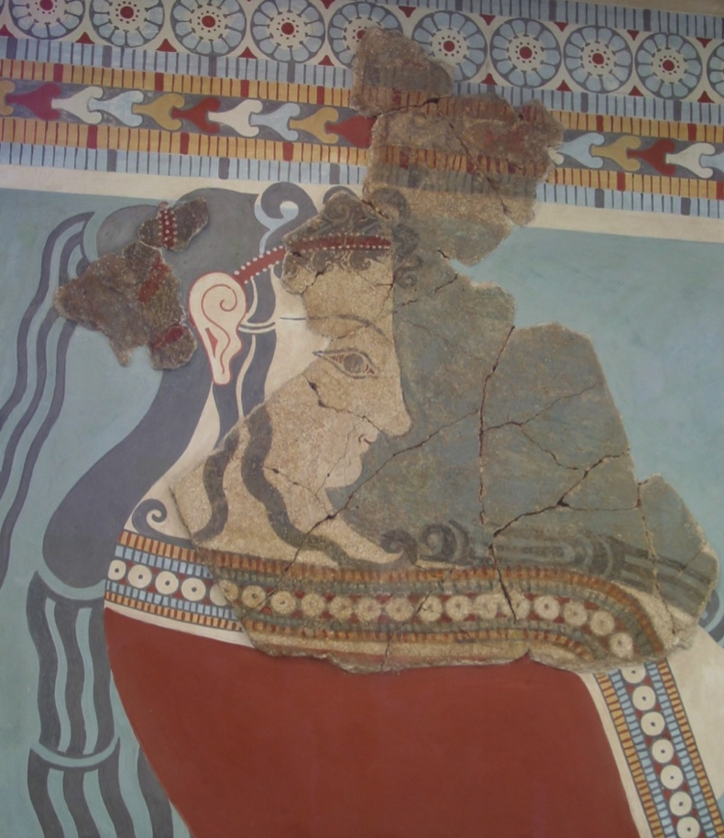
Garments
in Minoan frescoes

Slide 11
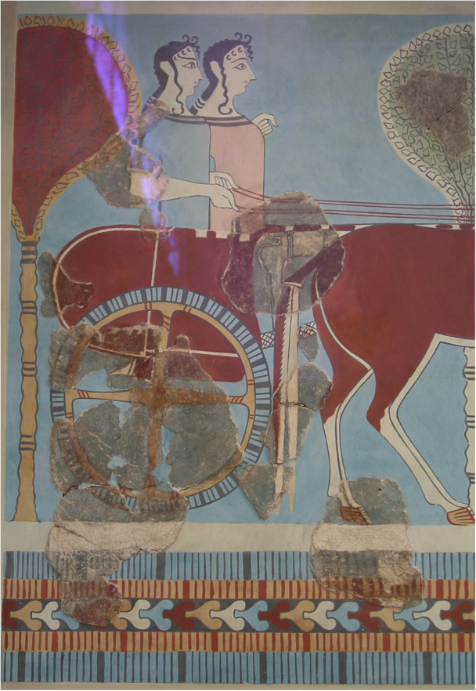
Brightly dyed woolens with contrasting borders
exemplify Minoan
First evidences of wasp waist and hourglass figure
Pearls and long curled hair

Slide 12
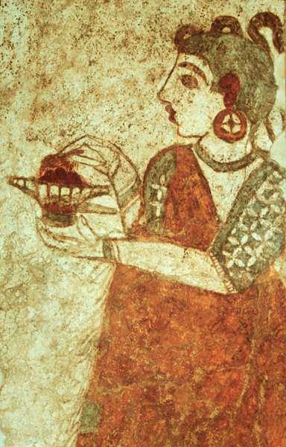
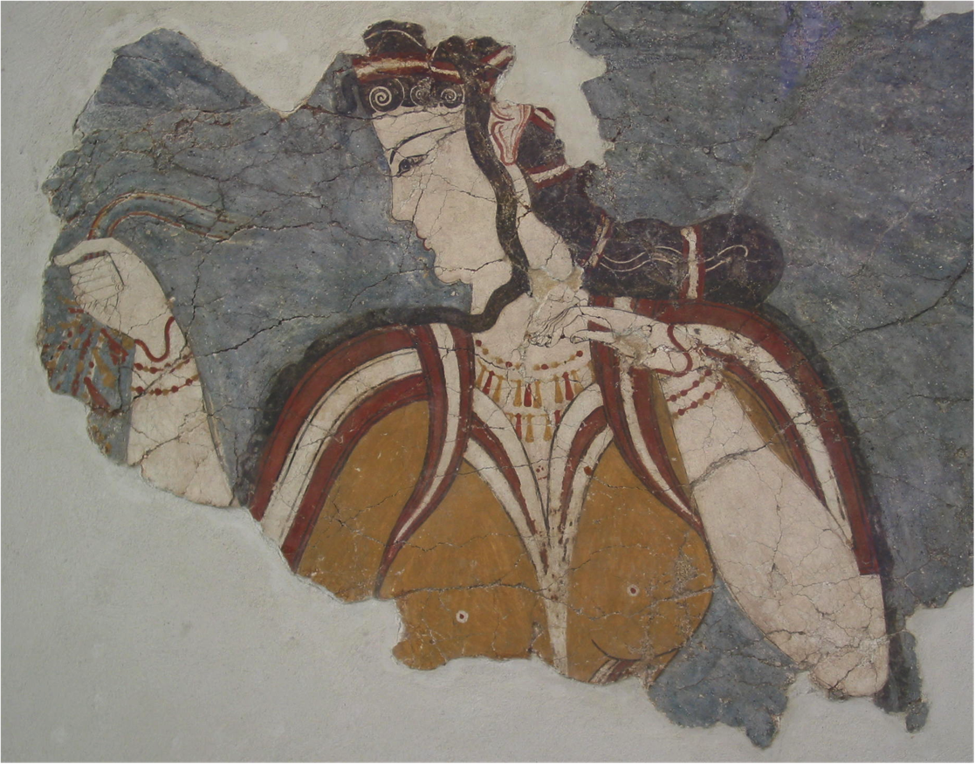
Tunics with plain color and contrasted with ornamental multicolor borders Jewellery: necklaces, bracelets, earrings

Slide 13
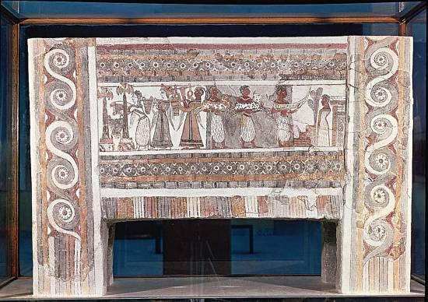
The Hagia Triada Sarcophagus 1450 BCE
- Painted panel of a wooden Sarcophagus shows a bloodless sacrifice in 1450 BC
- Note: there are still kaunakes being worn and colored woolen garments.
- The fresco looks like an Egyptian fresco from the body positioning

Slide 14
Women’s costume
Very fitted
to the body
Upper body covered with simple
T-shape
garment

Slide 15
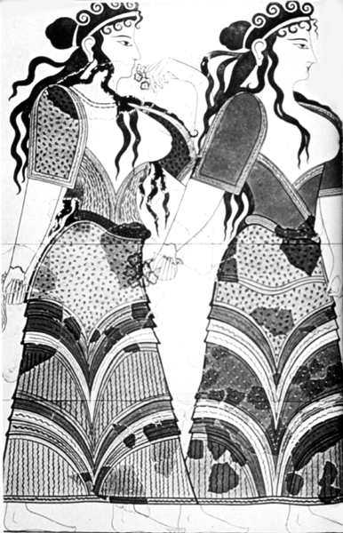
Skirts / culottes were layered and/or decorated with fringing and ornamental borders
Contrasting colors

Slide 16
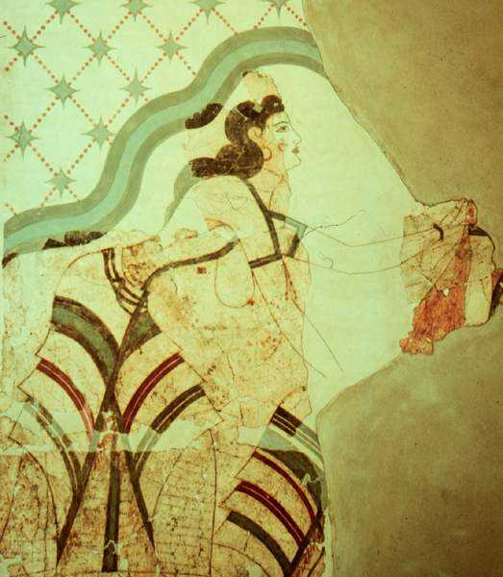
Tiered skirt or pants
Remnants of the sacred sister or mother/daughter statue and
survived frescoes of the same area

Slide 17
Costume components:
Loincloth: was worn as briefs= perizoma
Skirts for women: the length was down to ankle and
for men: to thigh or ankle
Women’s and men’s bodices were tight fitting including sleeves

Slide 18
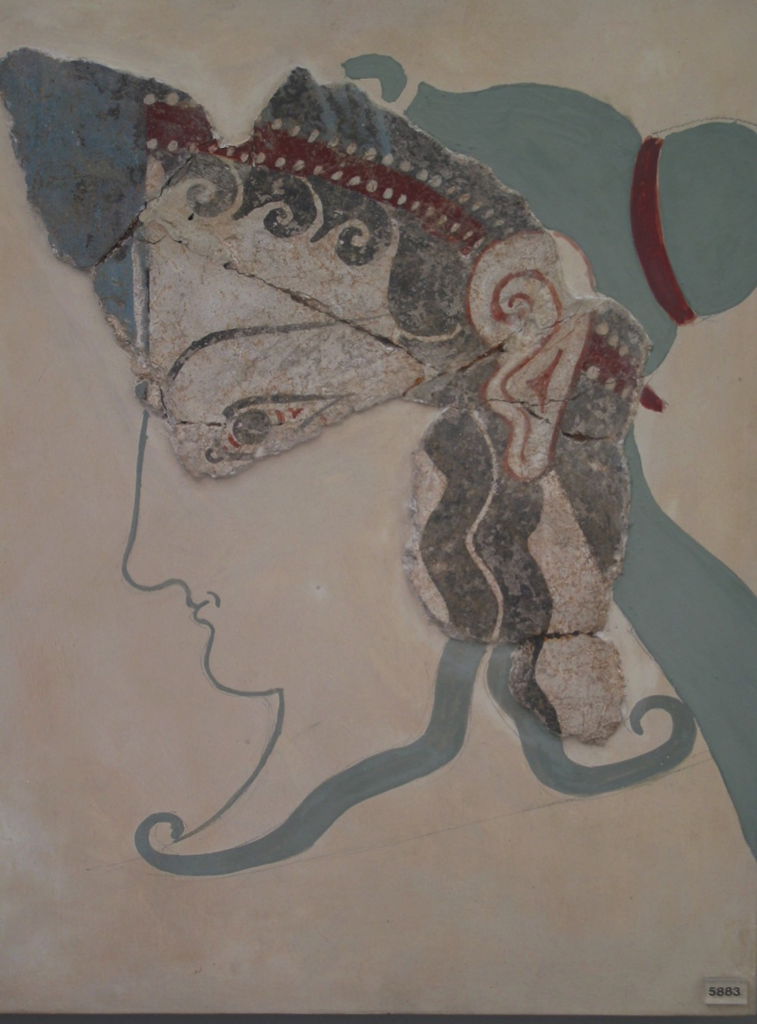
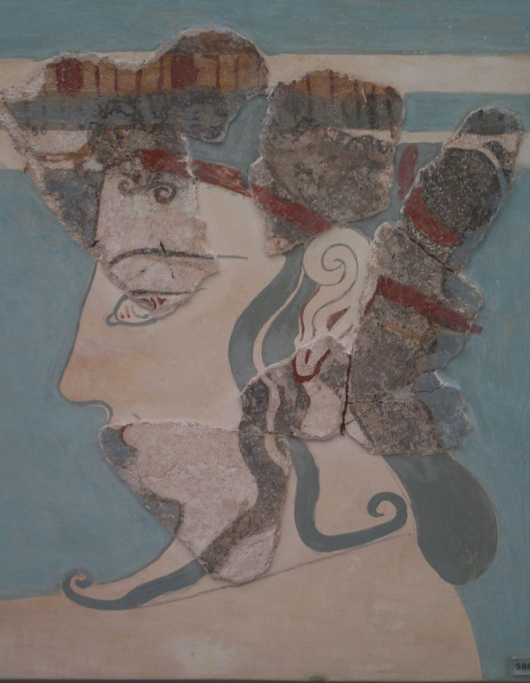
Stylized hair and head ornamets

Slide 19
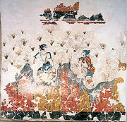
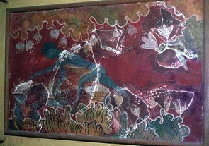
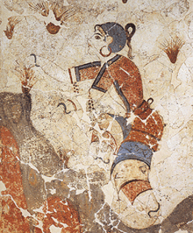
Saffron
Was a major mercantile product for both textiles and medicine
Saffron gathering is depicted in many frescos found from Crete and Santorini

Slide 20
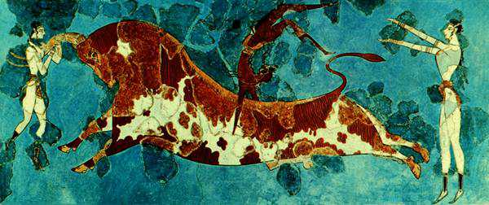
Bull dancing
Bull Leaping fresco, ca. 1500BCE, The museum of Herakleion, Crete
Notes:
A major festive celebration was exemplified in the famous athletic Minoan bull dance, represented at large in the frescoes of Knossos. In this feat that appears extremely dangerous, both male and female dancers would confront the bull and, grasping it by its sacred horns,[30] permit themselves to be tossed, somersaulting over its back to alight behind it. Each of these sequential movements appears in Minoan representations, but the actual significance of the bull dance in Minoan cult and cultural life is lost beyond retrieval. What is clear, however, is that there is no inkling of an antagonistic confrontation and triumph of the human through the ritual death of the bull, which is the essence of the surviving bullfight of Hispanic culture; rather, there is a sense of harmonious cooperation.

Slide 21
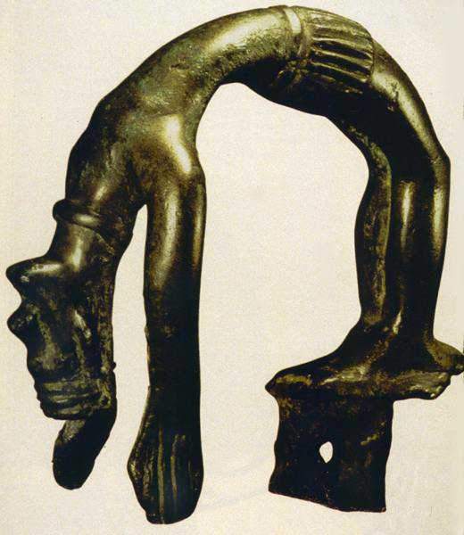
Bull Dancing

Slide 22
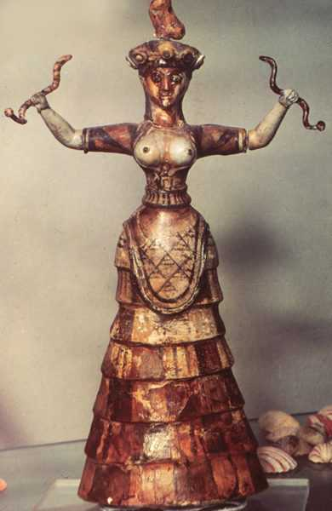
Mother Goddess and a Snake Goddess 1600 BC
Tiered bell- shaped skirt
wasp waist
Bodice
very constructed,
short sleeved,
exposed breasts
Conical Hats
made of felt – come
from Assyria
Notes:
The Minoans worshiped almost exclusively goddesses. Although there is some evidence of male gods, depictions of Minoan goddesses vastly outnumber depictions of anything that could be considered a Minoan god. While some of these depictions of women are speculated to be images of worshipers and priestesses officiating at religious ceremonies, as opposed to the deity herself, there still seem to be several goddesses including a Mother Goddess of fertility, a Mistress of the Animals, a protectress of cities, the household, the harvest, and the underworld, and more. Some have argued that these are all aspects of a single Great Goddess. They are often represented by serpents, birds, poppies, and a somewhat vague shape of an animal upon the head. Some[who?] suggest the goddess was linked to the "Earthshaker", a male represented by the bull and the sun, who would die each autumn and be reborn each spring. Though the notorious bull-headed Minotaur is a purely Greek depiction, seals and seal-impressions reveal bird-headed or masked deities.

Slide 23
Development of Greek Civilizations

Slide 24
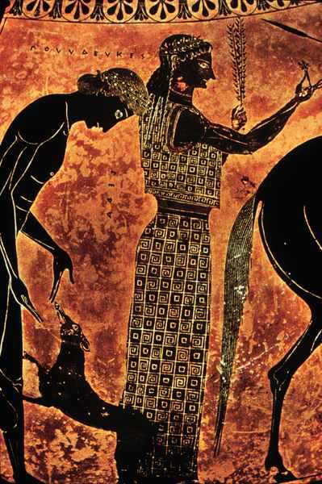
Archaic Greek 800 – 480 BC
Minoans influence the patterns and silhouette

Slide 25
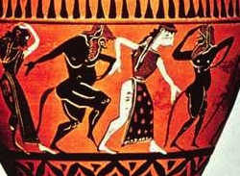
Archaic Greek - Doric Peplos
Women wear tight wrapped sheath gown
- develops into belted Doric chiton and has very elaborate patterns

Slide 26
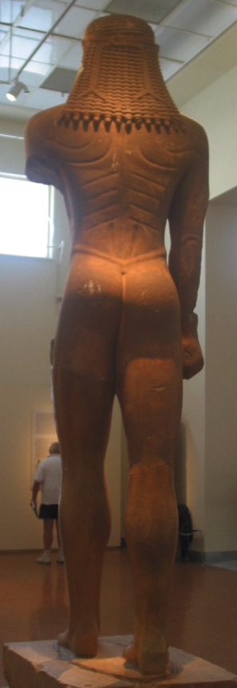
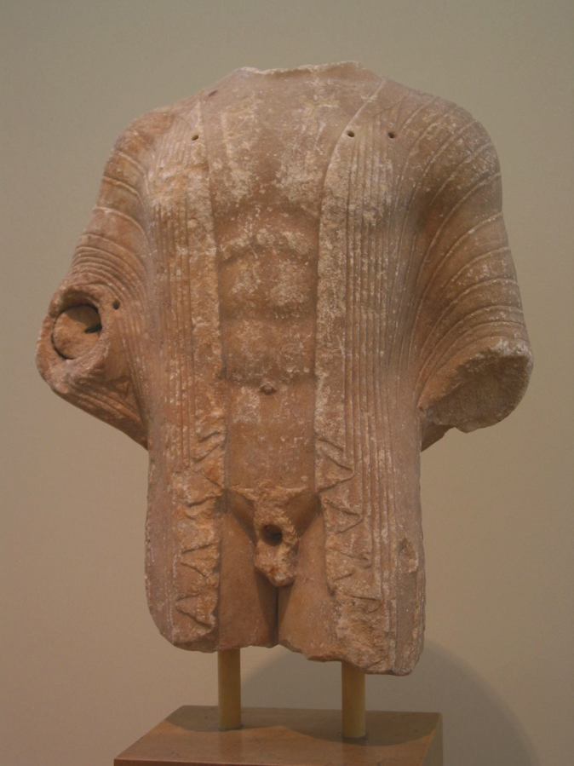
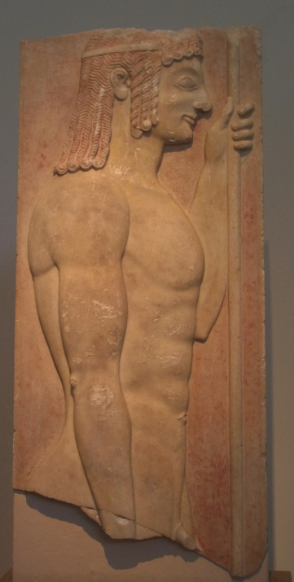
Archaic Greek Men Often depicted naked or wearing a simple loincloth

Slide 27
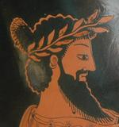
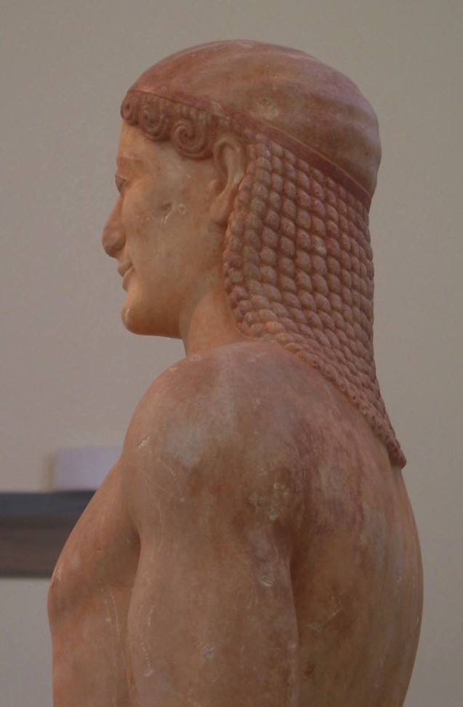
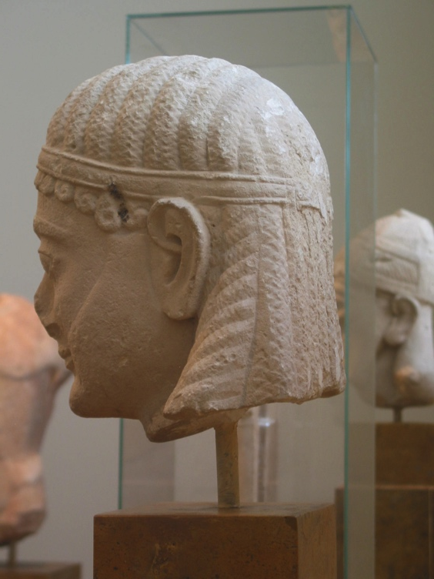
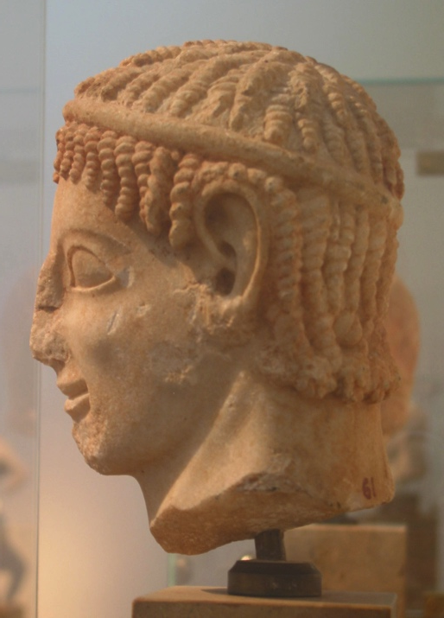
Men are shaved or have have spade beards
and long hair
Hair is plaited like in Egypt

Slide 28
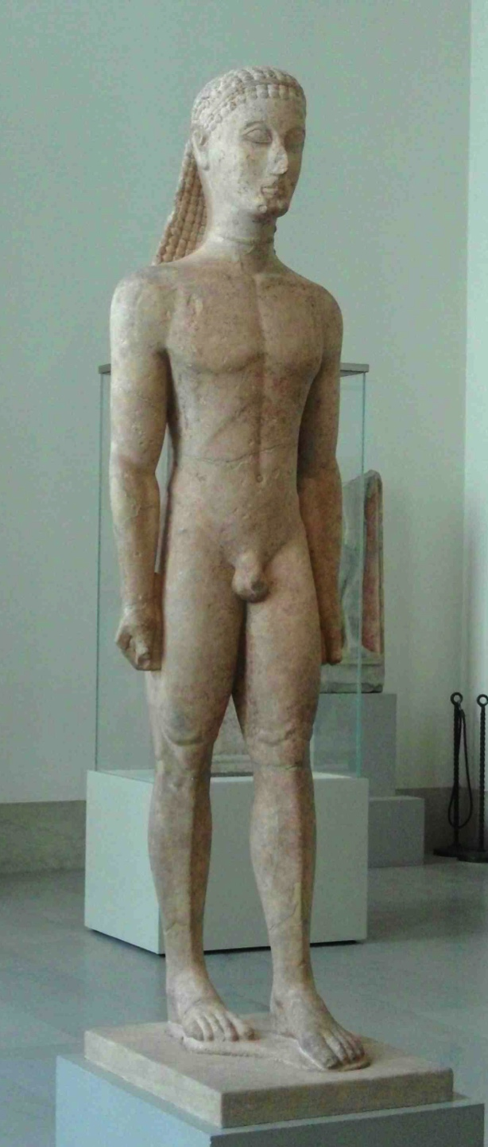
Marble statue of a kouros (youth) Greek, Attic
c. 590-580 BCE
Metropolitan Museum of Art, NYC
Notes:
This is one of the earliest marble statues of the human figure carved in Attica. The rigid stance, with the left leg forward and the arms at the side, was derived from Egyptian art. The pose provided a clear, simple formula that was used by Greek sculptors throughout the sixth century BCE. In this early figure, almost abstract, geometric forms predominate’ and anatomical details are rendered in beautiful, analogous patterns. The statue marked the grave of a young Athenian aristocrat. MET Fletcher Fund, 1932 (32.11.1)

Slide 29
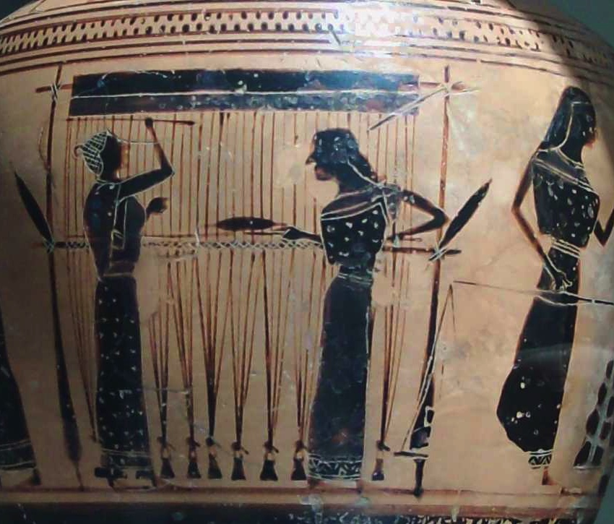
Milwaukee Art Museum, WI
Notes:
Women as head of household
Owned by husband or oldest male
No rights – no vote – Aspasia hetaira of Pericles

Slide 30
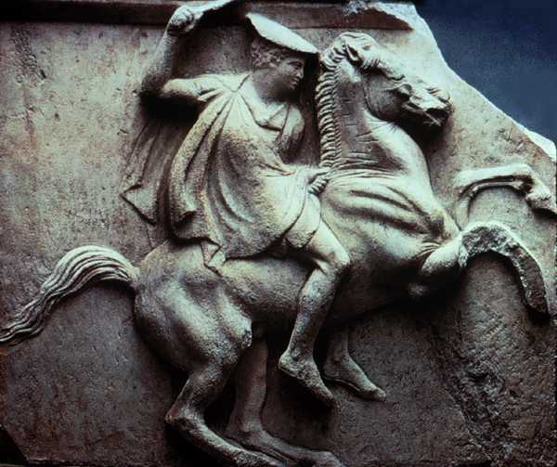
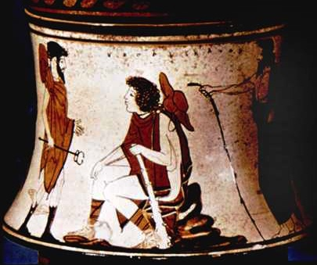
Chlamys is a shorter circular cape
worn by lower classes, warriors and travelers
Petasos is a traveling hat

Slide 32
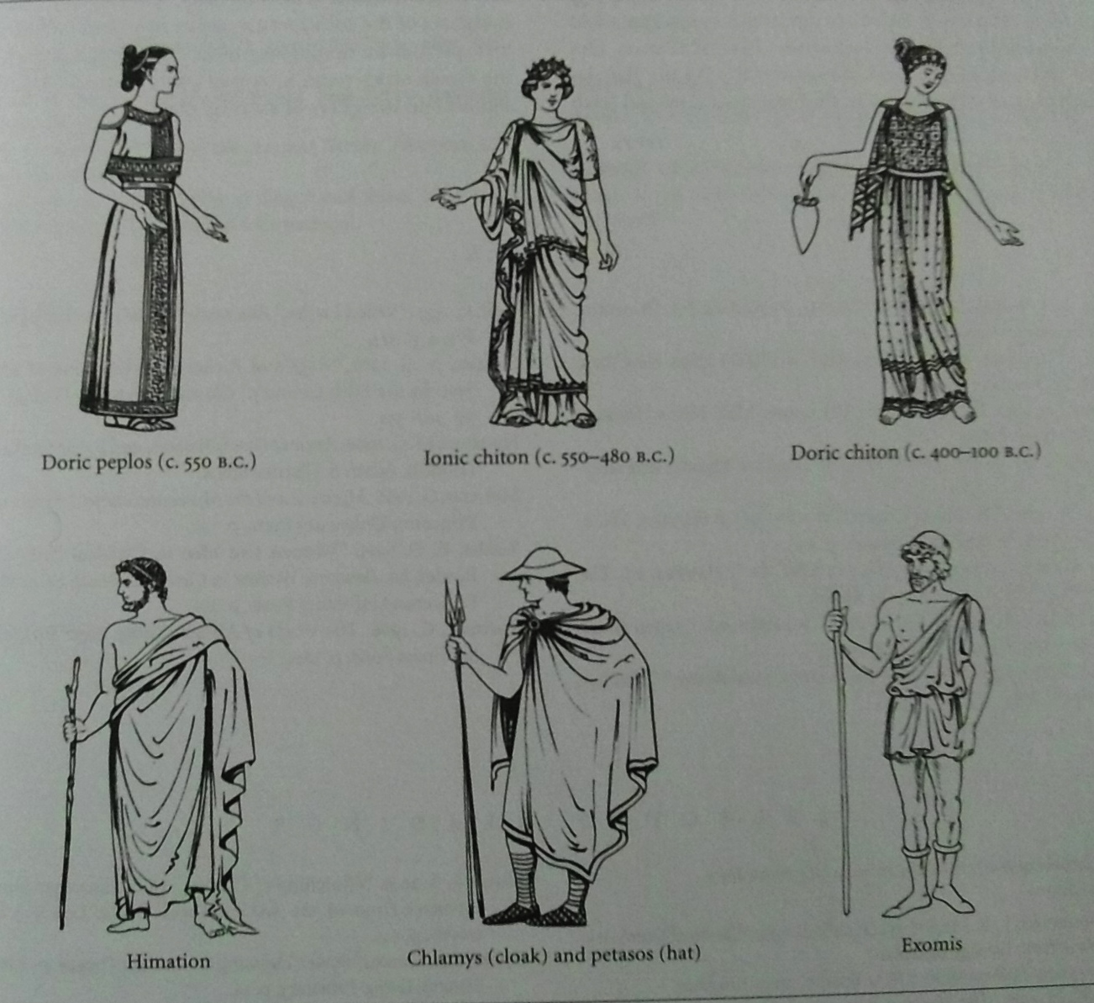
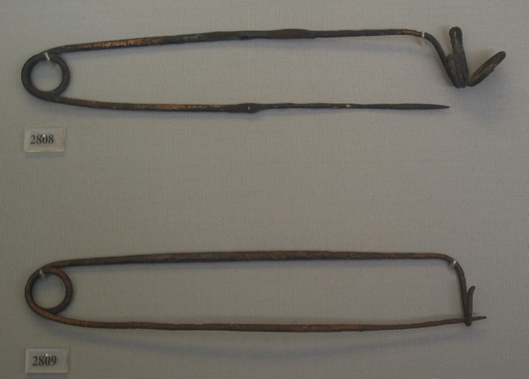

Slide 33
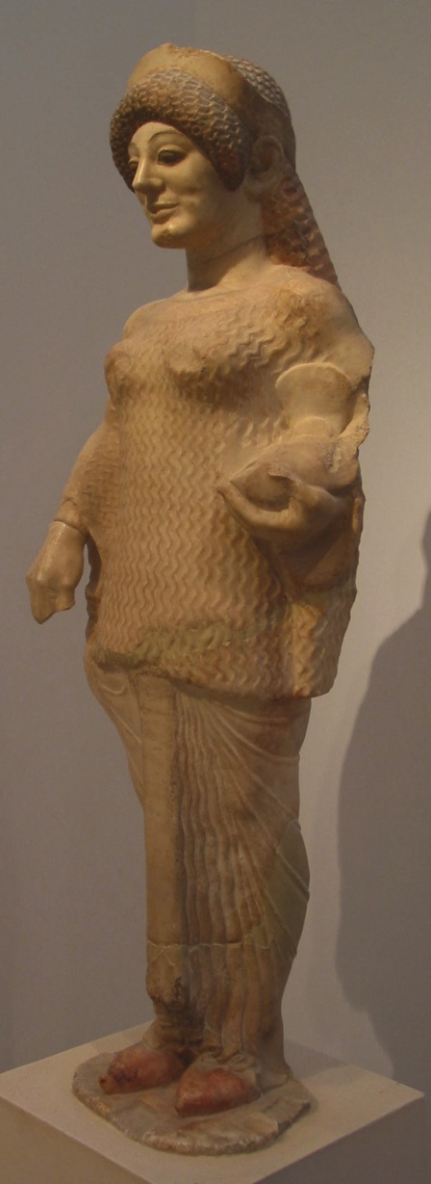
Ionic Chiton Persian influence during Persian Wars
Seen also as finer, sheerer garment
Some parts pleated, similar to kalasiris
held at multiple points with small clasps
often richly patterned + bright colors – some embroidered onto linen

Slide 35
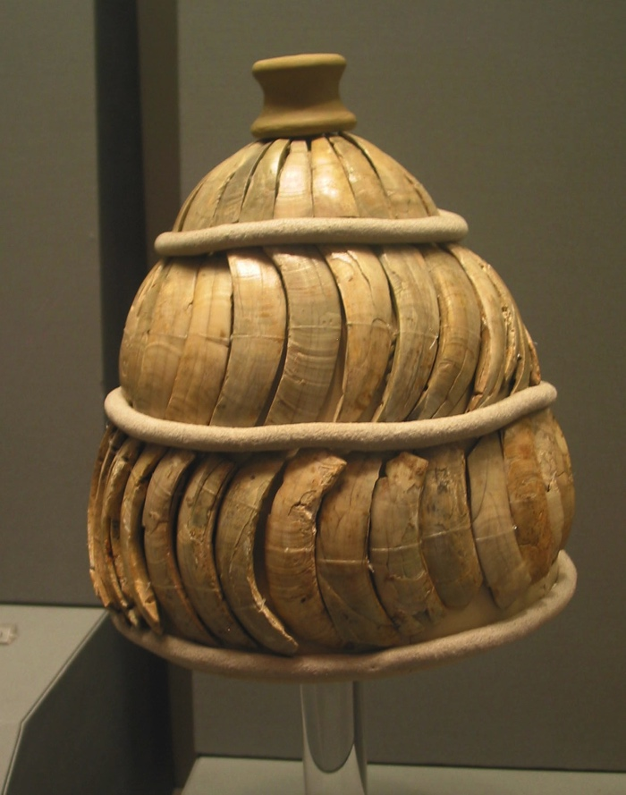
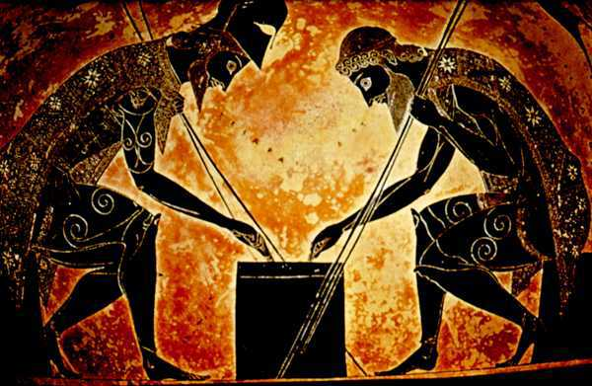
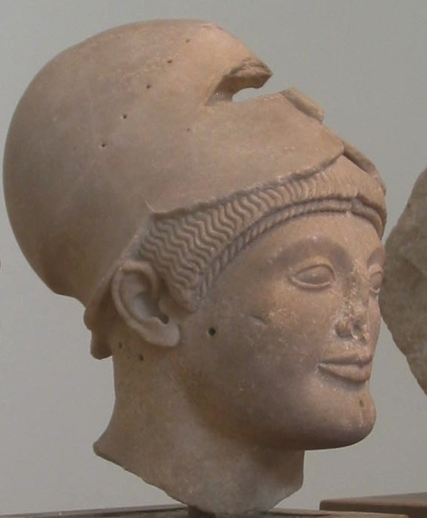
Helmets and greaves

Slide 36
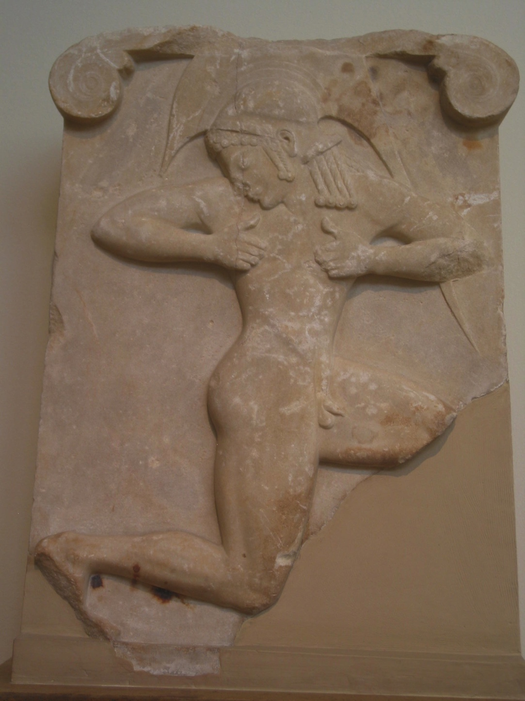
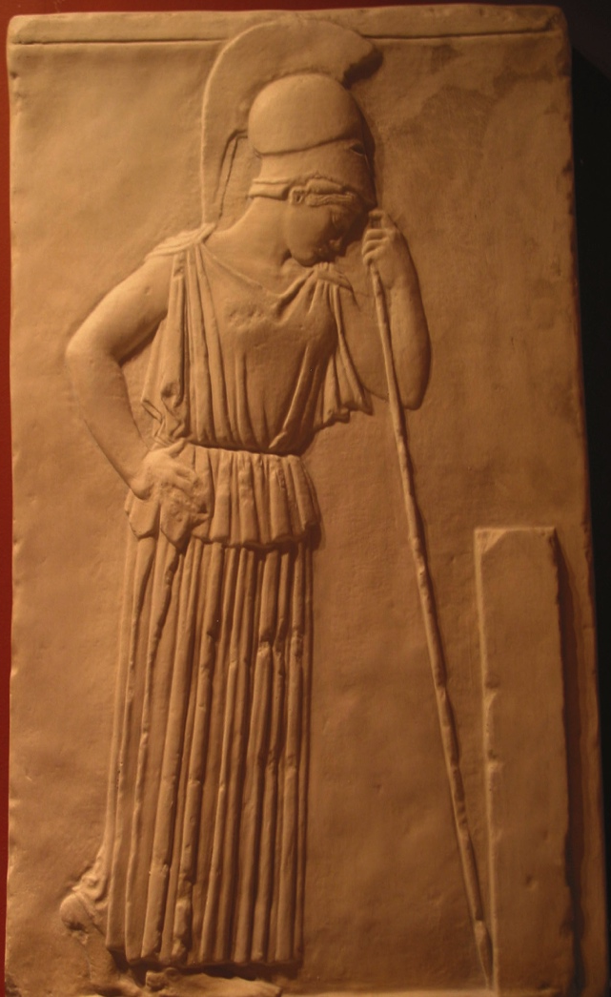
Helmets with blades
breastplate, greaves and helmet with chiton

Slide 37
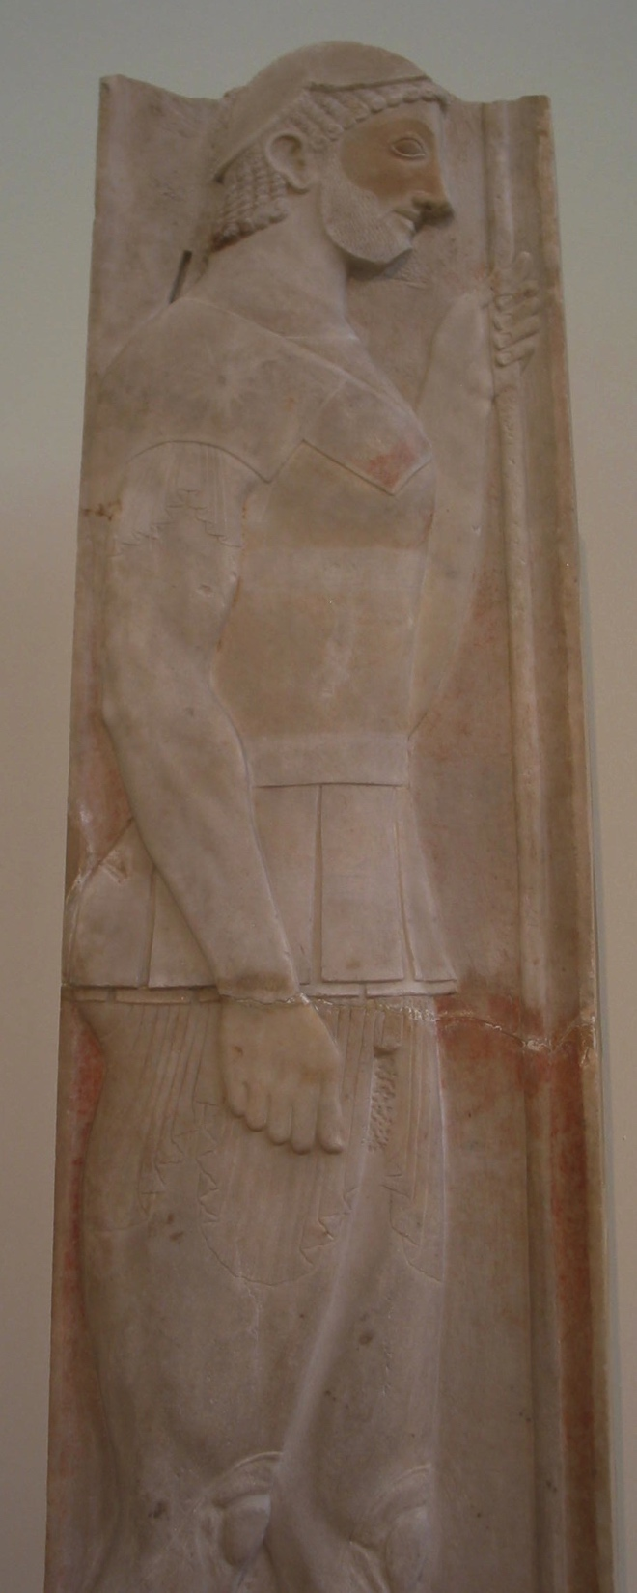
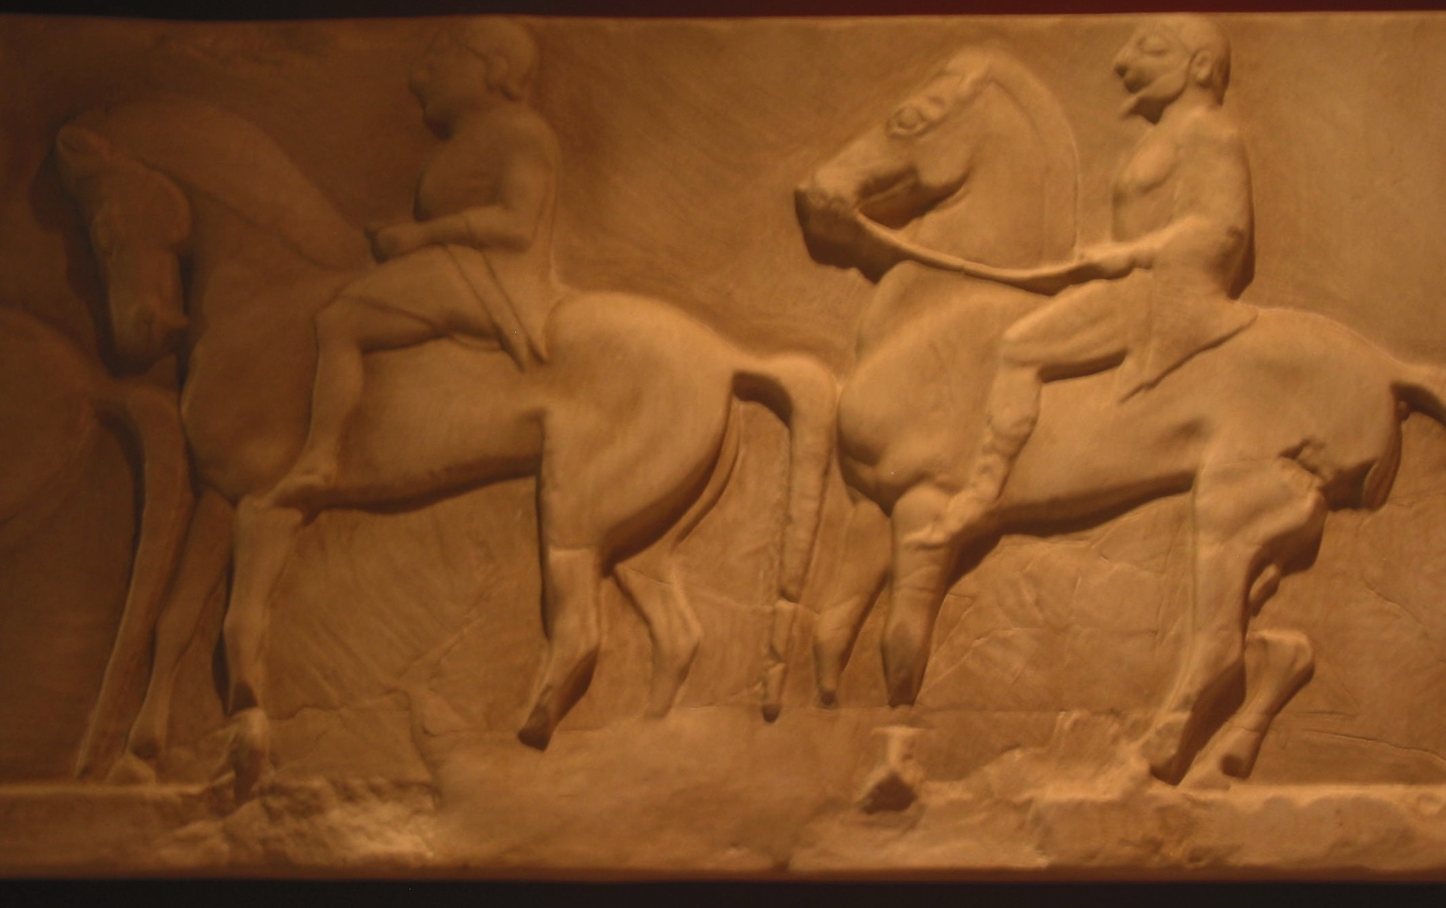
Soldiers on horseback armor

Slide 38
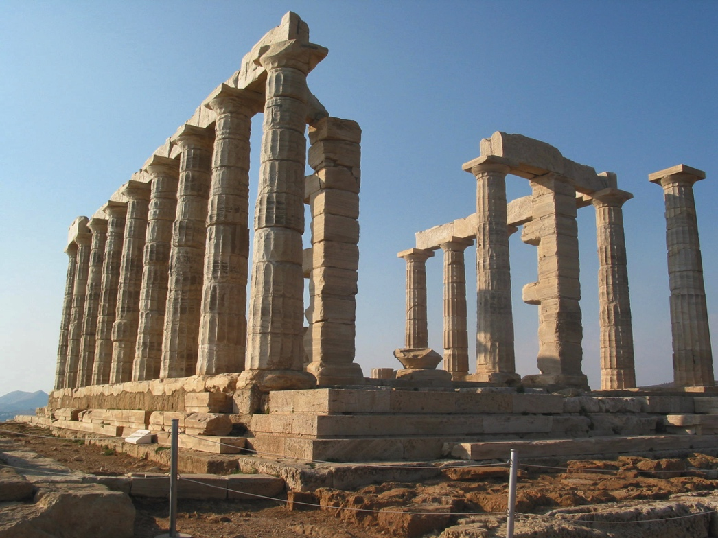
Classical Greece
Age of Pericles/Golden age (460 - 332 BC)
City States ban together under protection of Athens
against Persians
Sculptor Phidias most famous for Parthenon friezes
Parthenon 15 took years to built
Notes:
New Athens takes 50 years to build with finest architects & artists

Slide 39
Democracy is formed – however, only male citizens vote
Philosophers extend modern thinking –
Aristotle, Socrates, Plato

Slide 40
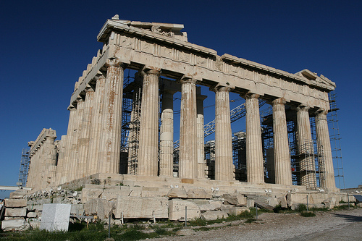
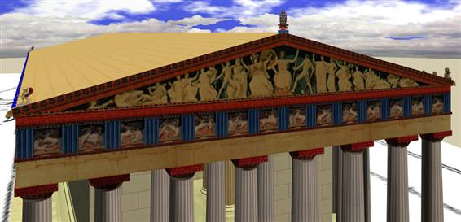
Computer generated version of possible color scheme for the Parthenon

Slide 41
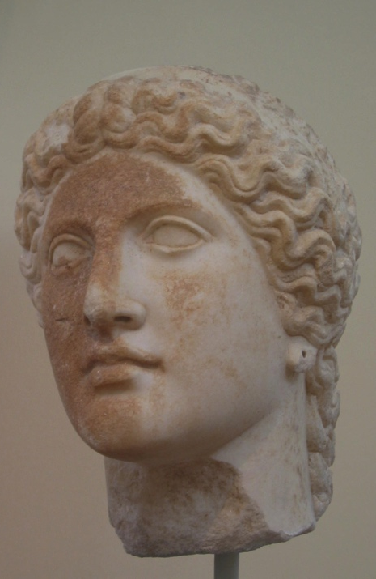
Hairstyles become more natural
Beards persist until
5th BCE on older men
Young men begin to wear shorter natural hair
women catch hair up in triangular scarves

Slide 42
Limestone sarcophagus
2nd quarter of the 5th century BCE
Parasols are adopted from the east and they stay as an accessory

Slide 43
Outer Garments- Himation
long draped garment, like toga
weights added to give drape

Slide 44
SCIENCES Develop
Mathematics develops – Pythagoras & geometry
Calculate the exact positions of the earth, sun & moon
Geology & Biology
Medicine develops – Hippocrates
History as a study – Herodotus

Slide 45
Birth of Drama
Begins with Worship of Dionysus (god of wine)
Drama begins
Aeschylus – 1 speaker
Sophocles – adds second speaker
Aristophanes – comedies
Euripides
- adds emotional conflict

Slide 46
Plague 404 BC
People contaminate the water due to burning throat and fever
- 1/3 of population dies, including Pericles
Athens is defeated by Sparta who takes over control
City states continue to battle with each other

Slide 47
Armour of Classical Greece
Beautifully crafted bronze breastplates
Greaves
- Corinthian Helmets

Slide 49
Bronze helmets Greek, Southern Italy, 350-250 bc
Metropolitan Museum of Art
Bequest of Bill Bass
Notes:
These helmets represent South Italian adaptations of the Greek type know as Corinthian. The general shape is more opena the bottom and the articulation of the face includes marked ridges above the eyes and at the “hairline.” The ecample with the plume holder also has lightly traced ornament and the figure of a horse.
MMA 2003.4070.4,5 Bequest of Bill Blass, 2002

Slide 50
Set of Bronze Armor Greek, South Italy 330 bc
South Italian, Apulian
Chalcidian helmet, horse on each cheekpiece
Cuirass (body armor)
Greaves (shin guards)
Chamfrom (armor for front of horse’s head)
Notes:
Since so little ancient life-sized bronze sculpture is preserved, armor often indicates how artists represented the human body. The curiass, aptly called ‘a muscle cuirass” shows a beautifully articulated, indeed somewhat idealized, torso. MMA Lent by Shelby White and Leon Levy (L.1999.36.3.1-6

Slide 51
Hellenistic Greece (338 - 146 BC)
Time of Alexander the Great
Theatre develops
audience for 10,000

Slide 52
Clothing of Hellenistic Greece
Clothing simplifies
women go back to Doric chiton with Himation
More draped garment than before
patterning disappears
blousing at hipline called kolpos

Slide 53
Garments at their most drapery
Double Girdling is common
Himation is larger
custom woven to specifications of wearer
proper draping is an important social grace
- made of linen and wool

Slide 55
Philip II of Macedonia, 372-336 BCE

Slide 56
Alexander the Great 356-323 BCE

Slide 57
Military Era with Alexander
Helmets had elaborate
plumes
Notes:
boot-like lace-up sandals with heel cup for military
Horseback armies wear leggings
Moulded leather breast plates
less heavy
Helmets with elaborate plumes
Phrygian caps worn on Persians

Slide 58
Sandals with heel cup
Moulded leather armor

Slide 59
Nordic dress, bronze age

Slide 63
Egtved Girl, barrow coffin, Denmark

Slide 65
Etruria
Group of city-states: Rome - Venice
Large in Tuscany area
About 80 remains of cities known
Begins about 800BC until Roman in 509 BC

Slide 66
Greek city-states: South
Sicily to Rome
Woman have more freedom
Appear socially with men
Have higher status, equal to men

Slide 67
Perizoma same as Greek = Loincloth
Doric Peplos as in Greece
Ionic Chiton same as in Greece
Tebenna is Etruscan term = Toga
Notes:
Costume terms

Slide 68
Older men wear long hair
Tutulus is a common hat
made of leather or felted, conical shape
Pilos is a shade hat
Veils or Tebenna as veil
Notes:
headdresses

Slide 69
Unique red pointed toe boots
Buskins = rougher boots, wrapped
Sandals are common with heel cup

Slide 70
City of Rome
The first multi-national metropolitan city
Urban population to 1,000,000
90% are foreign born
Slums and apartment buildings to 7 floors
Rich build single and two story homes around courtyard
Patriarchal society (paterfamilias)
Matron runs household

Slide 71
Roman Republic
Overthrow Etruscans 509 BCE
extend their territory to Sicily and Carthage
Ultimately extended reign to Danube in Europe
Empire includes Greece and Asia Minor
Republic with 2 consuls
Also a Senate like in Greece

Slide 72
Roman Empire
Julius Caesar becomes dictator for life
make an end to civil war
assassinated by Brutus in 44 BC
Augustus Caesar 1st emperor in 27BC
Grand nephew of Julius Caesar
Declares Pax Romana
200 years of Peace
Empire grows
African, Arabia (Persia), Britain, Germanic east of Danube

Slide 74
Tunic and Stola for women
Notes:
Students independent work for tunics etc.

Slide 75
Stola on women

Slide 76
False hair is common in Imperial Rome

Slide 77
Roman textiles
Wool
Flax for linen
Cotton
Silk
Wool the most common –> importance of sheep and goat
Sheep were valuable
Breeding programmes for different qualities
Flax production more time consuming than wool
Cotton imported from Egypt and India, very expensive to prouduce
(cotton expensive fabric until the
invention of cotton gin in 1794)
Silk expensive and denotated status

Slide 78
Roman Armor
Cuirasse with straps for foot soldiers
Moulded leather or metal for officers
Gladiator helmet
Trousers appear

Slide 79
Find out different toga types
Find 6 types of togas (or more)
Who wore them?
In what occasions?
How they are worn on a body?

Slide 80
Toga types for men:
Toga Pura/Viriles - Senators
Toga Candida - Candidates
Toga praetexta - under 16 male and female
Toga Pulla - mourning
Toga Picta - golden embroidery
Toga Trabea - Augers - Striped

Slide 81
Decline
325 AD Constantine moves empire to Constantinople (Istanbul)
395 AD Empire splits into East and West
East becomes Byzantine Empire
476 AD Germans concur Rome

Slide 82
Bog body from Huldremose, Djusland, circa 100AD

