Slide 1
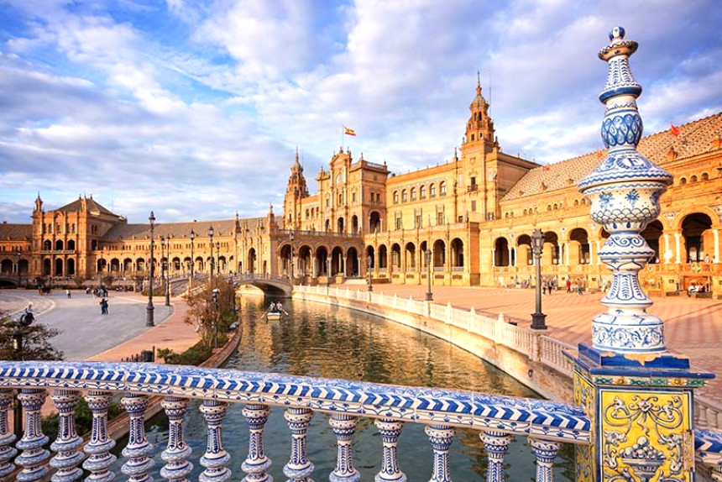
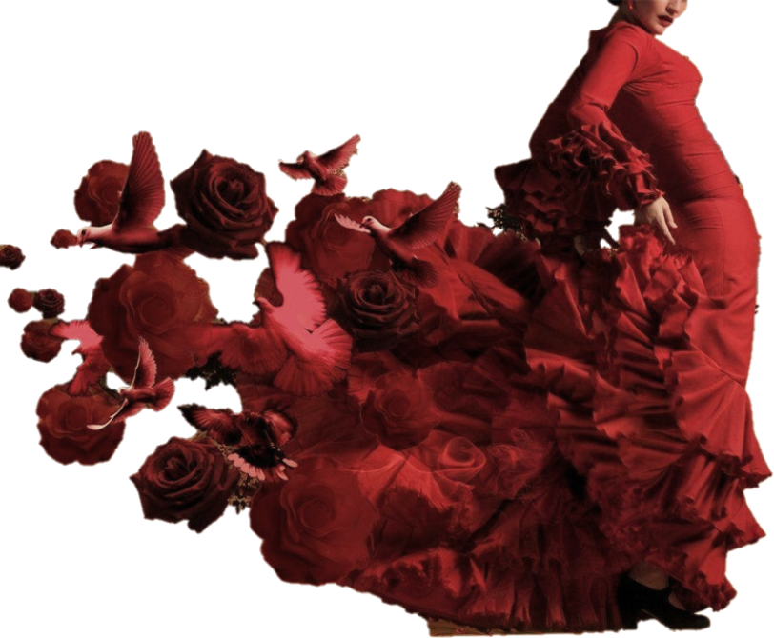
Introduction

Slide 2
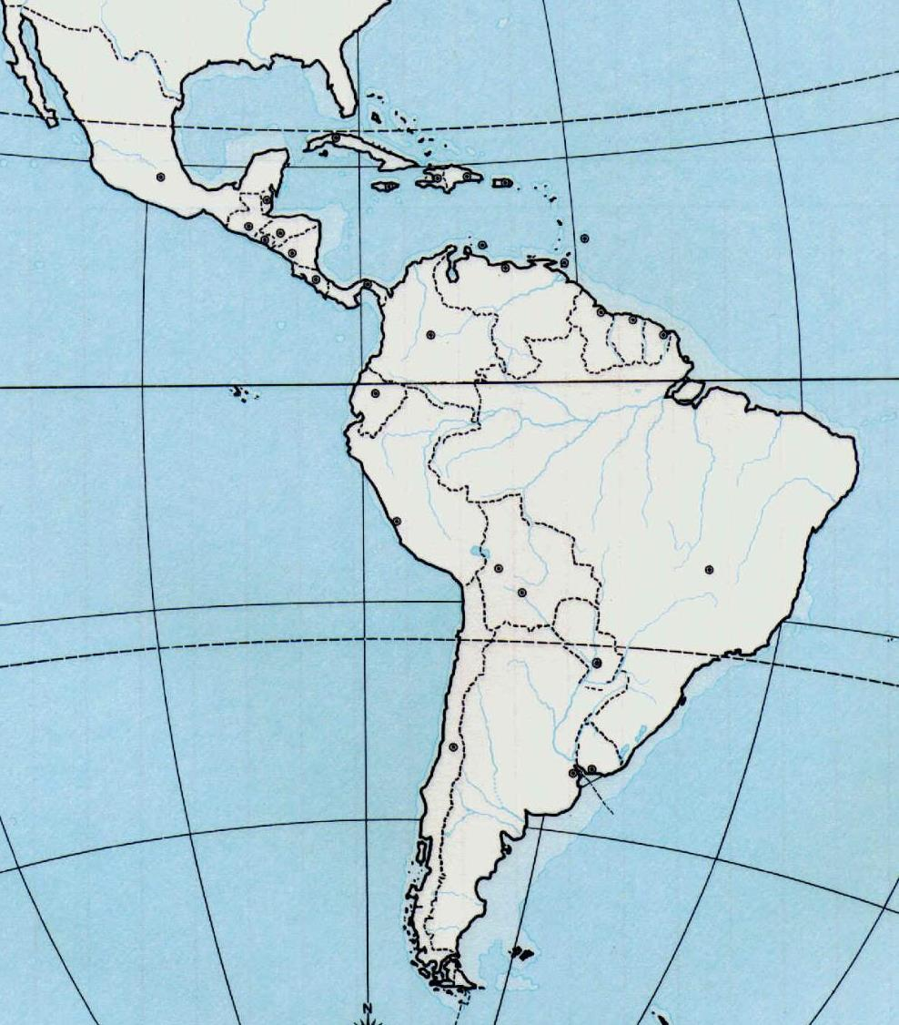
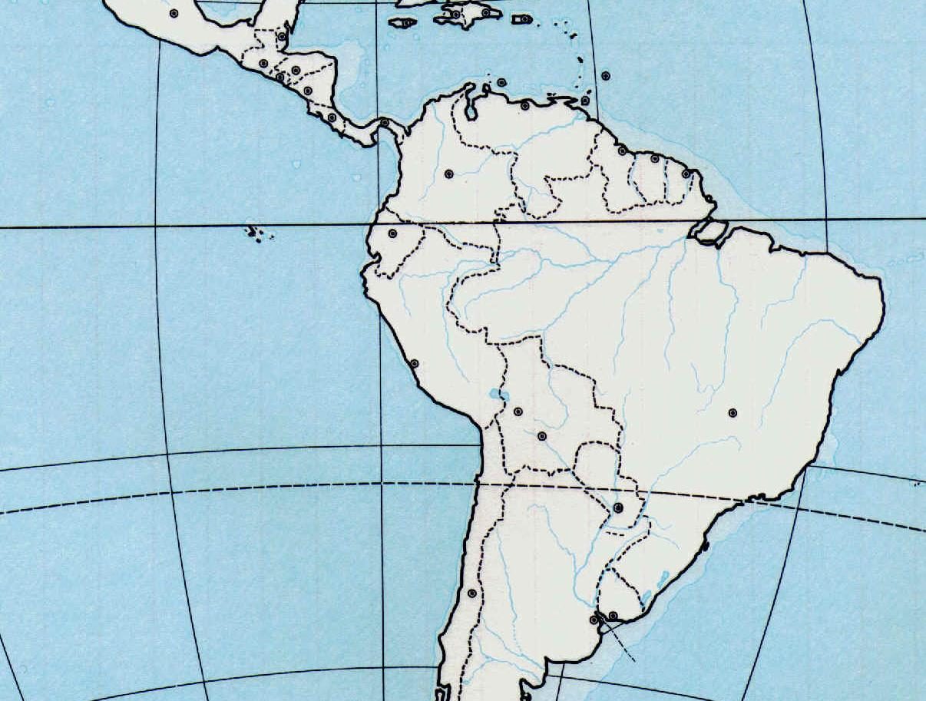
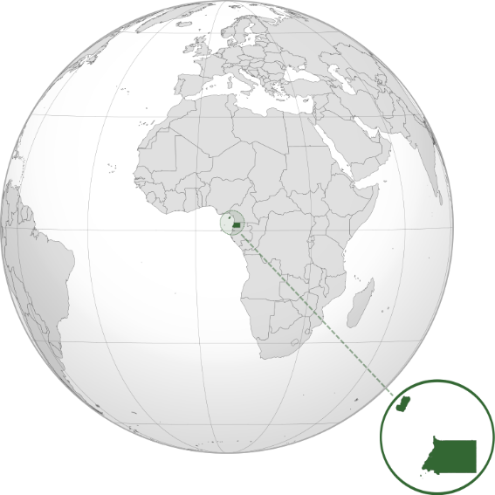
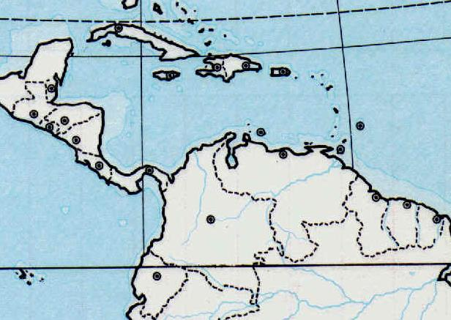
Countries & Cities

Slide 3
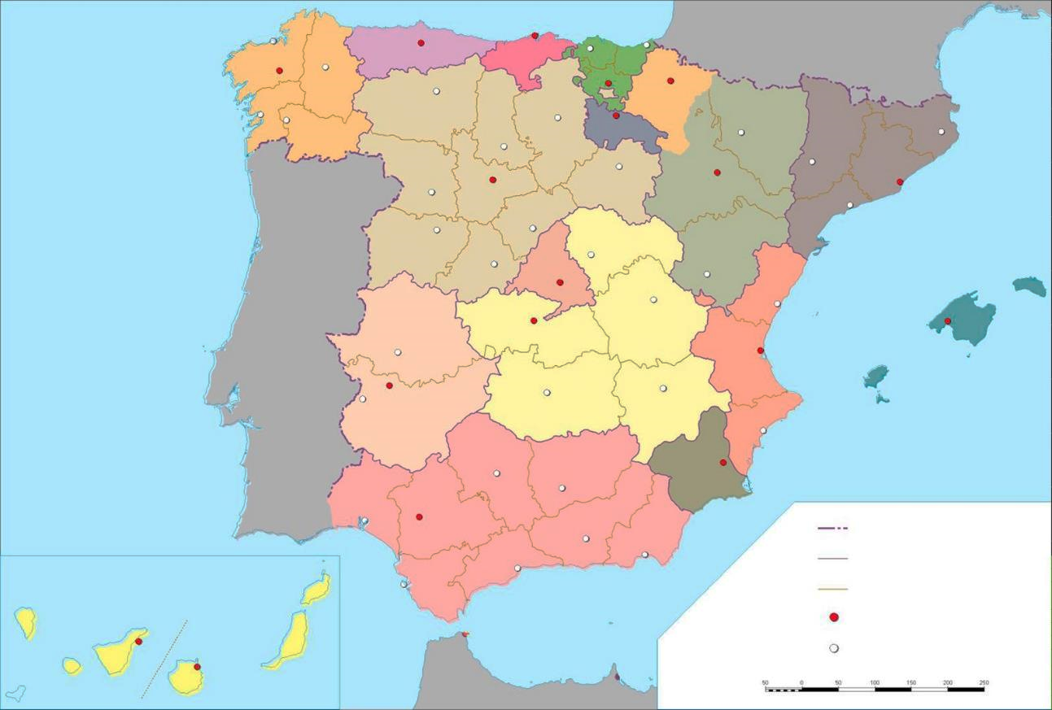
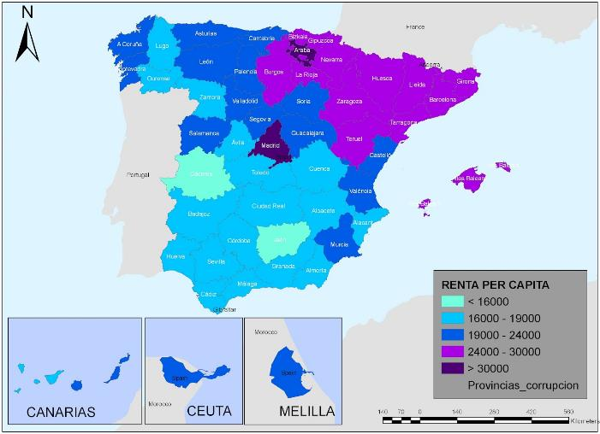
Spain, 1983: Autonomous Communities

Slide 4
Dialects & Stereotypes
robust & foul-mouthed
ambiguous
emphasis on every syllable
singing
correct
tight
stubborn
L
-D → -T
arrogant
ejje
backward
reserved & hard-working ↑
vs.
sociable & lazy ↓
open vowels
+S ↑
-S ↓
slow
S / C
Dialect
Stereotype

Slide 5
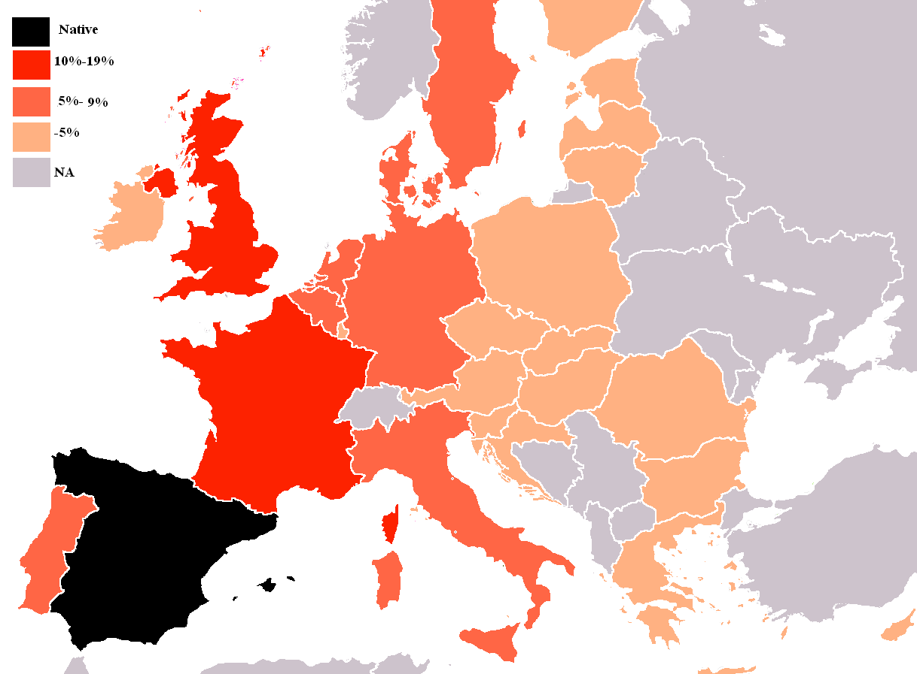
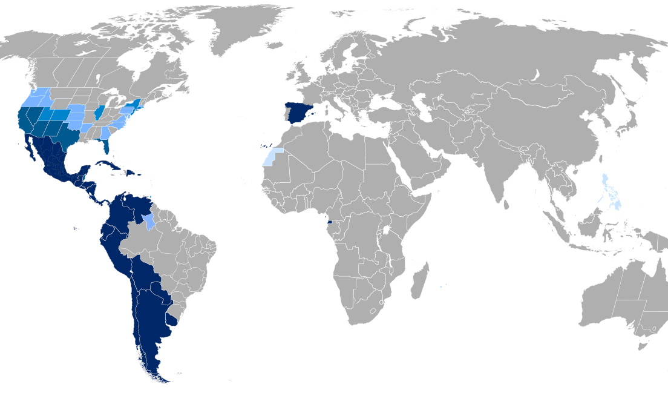
Global language
Official:
21 countries
UN (Arab, Chinese, Spanish, French, English and Russian)
Speakers 2020 (Ethnologue) | 1st language (Millions) | 2nd language (millions)
English | 370 | 898,4
M. Chinese | 921 | 198,7
Hindi | 342 | 295,3
Spanish | 463 | 74,9
French | 77,3 | 199,3

Slide 6
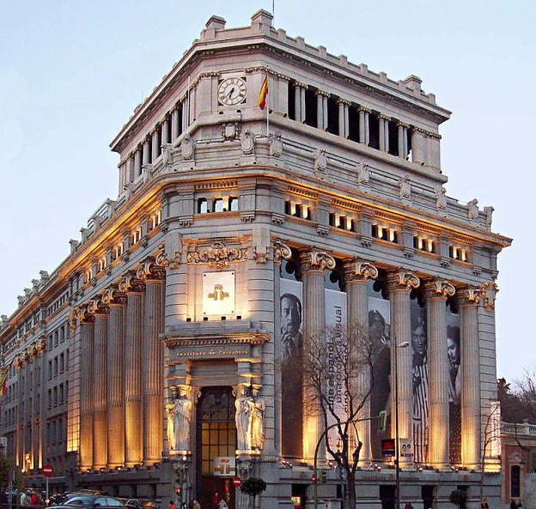
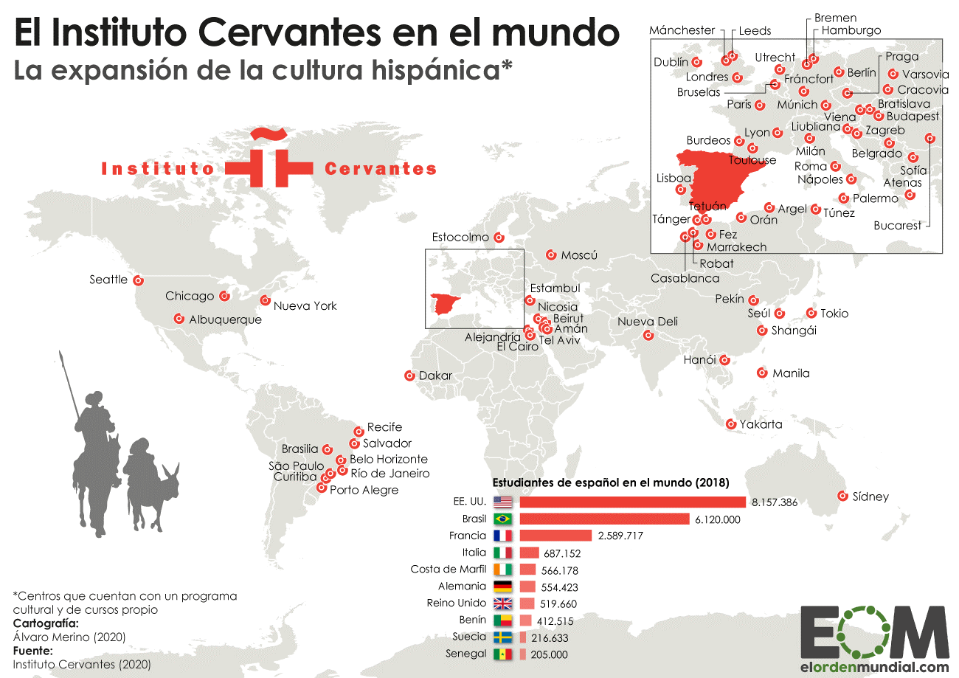
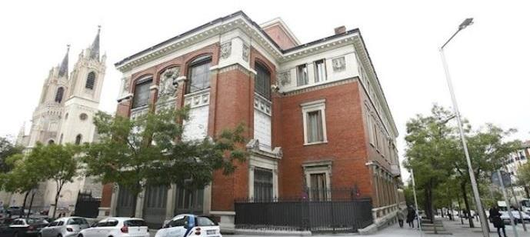
R.a.E & Instituto Cervantes
1991
Instituto Cervantes
87 sites
DELE diploma
1713
Real Academia Española (R.A.E)

Slide 7
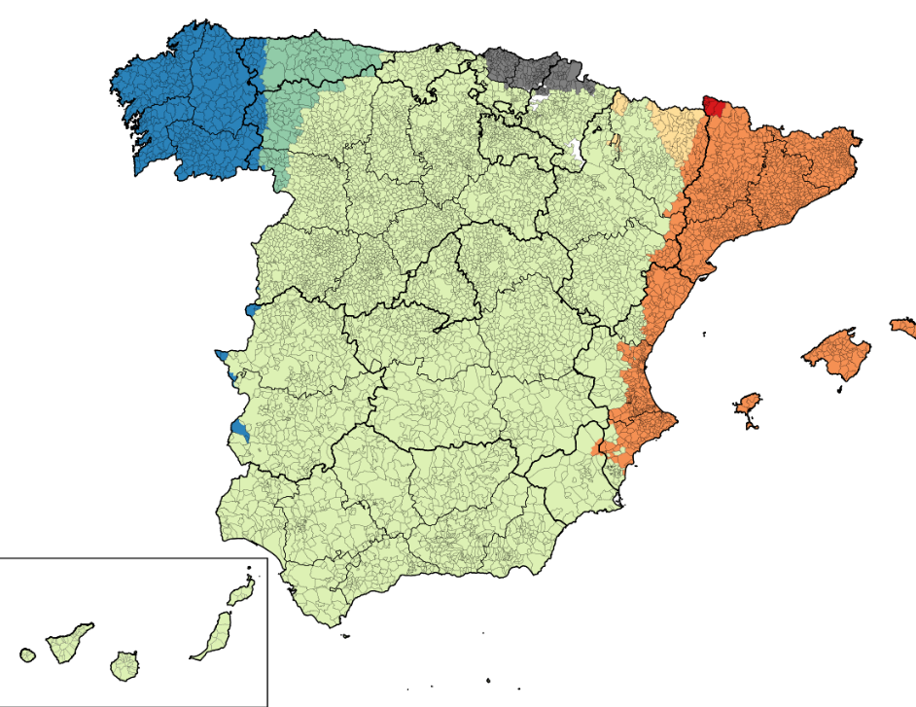
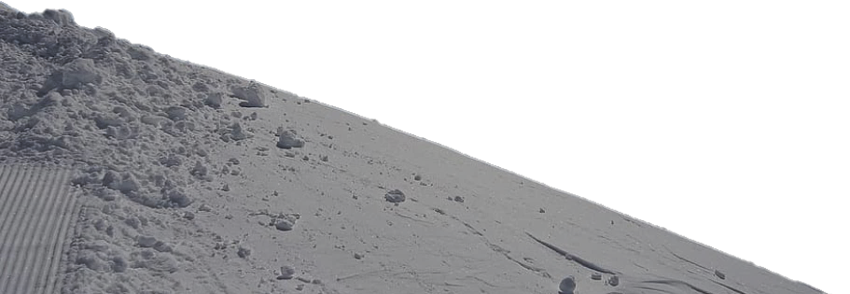
Iberian languages
Español / castellano
“El vino es una bebida alcohólica obtenida de la uva”.
Catalán
“El vi és una beguda alcohòlica obtinguda del raïm”.
Euskera
“Ardoa mahatsetatik lortutako edari alkoholduna da”.
Gallego
“O viño é unha bebida alcohólica obtida a partir de uvas”.
English
“Wine is an alcoholic beverage made out of grapes.”

Slide 8
The Spanish Language
Traits
Vowels
a, e, i, o, u
Consonants
b/d/g vs. p/t/k
Inverted marks
¡! / ¿?
Different to be verbs
Many verbal tenses
Challenges
The object pronouns
The past tenses
The subjunctive
Structure
We address people
Could I have?
Same here.
We jump to conclusions
To run away.
I want in / out.
I laughed my head off.
We do not like
The possessive is not that important
I hit my head against a wall.
Eat your food!

Slide 9
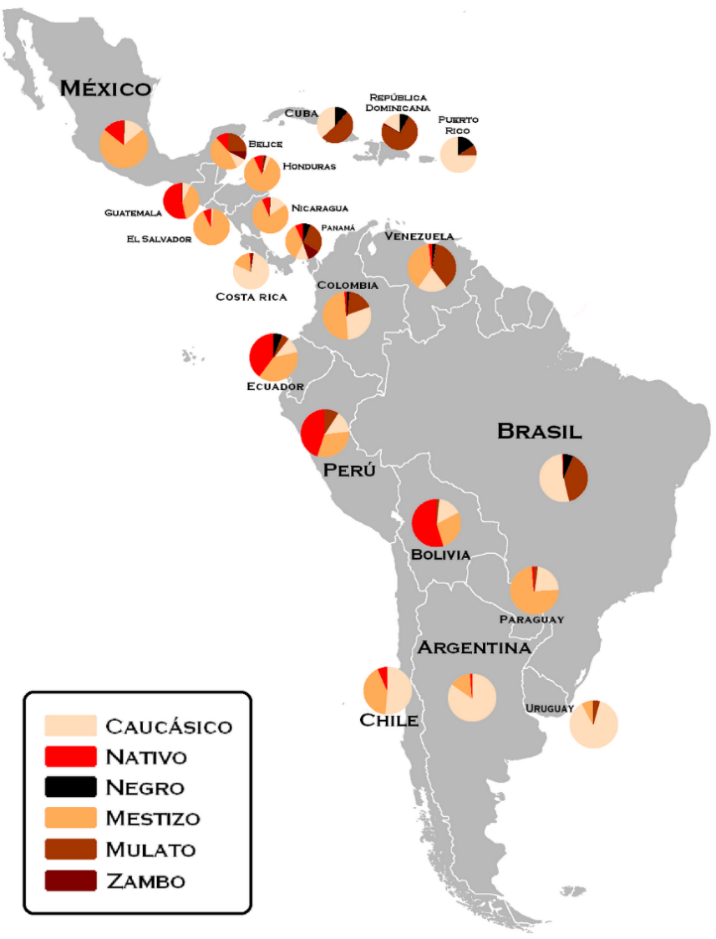
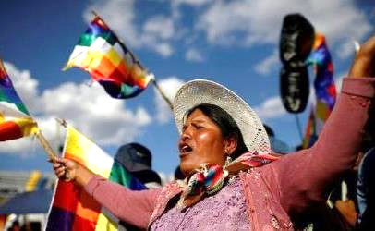
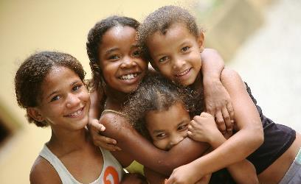
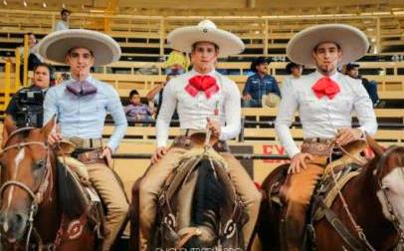
The surface
Names: first name + surname + surname
Tú – usted / vos / vosotros – ustedes
Cheek kissing

Slide 10
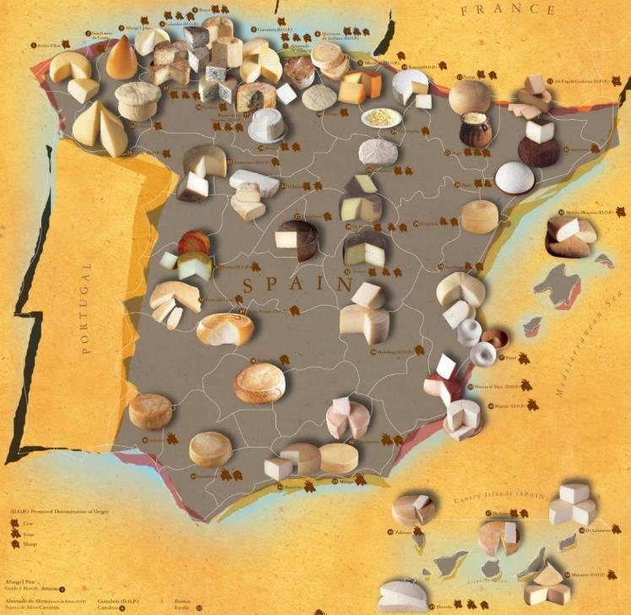
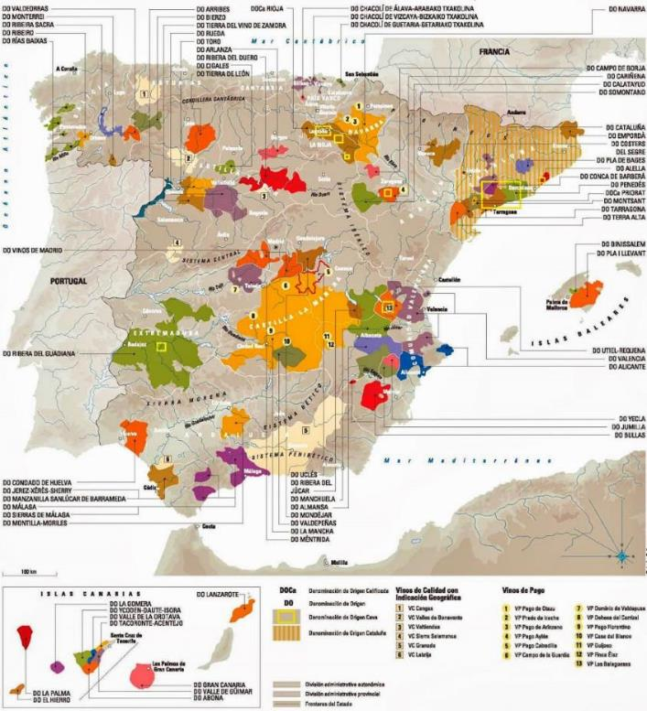
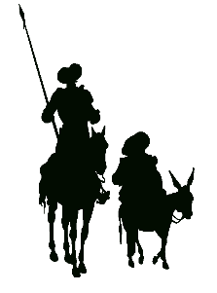
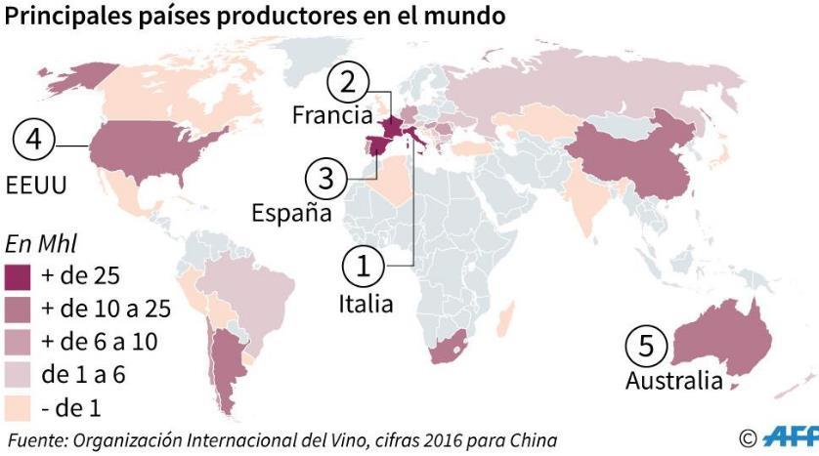
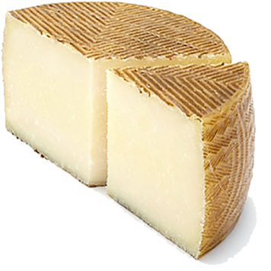
Wine & Cheese
La Mancha
Queso manchego

Slide 11
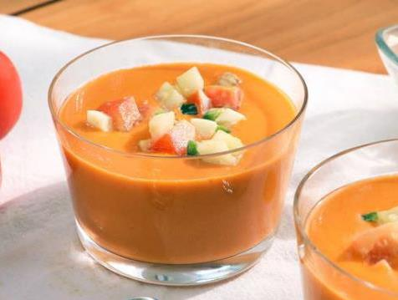
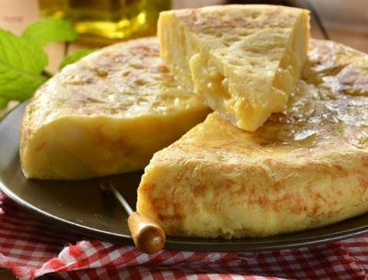
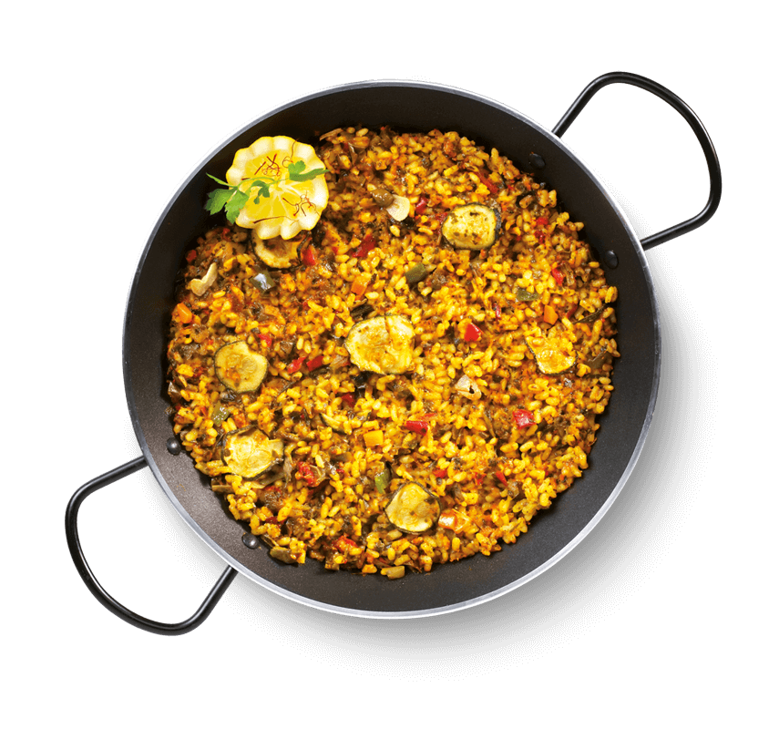
Gastronomy
Gazpacho
Tortilla de patata(s)
Rome
wheat
olives
grapes
lentils
peas
Arabs
rice
Citrus plants
eggplant
nuts
honey
The Americas
potato
tomato
cocoa
beans
pepper
Paella
La tapa: small dish
La ración: large dish (portion)

Slide 12
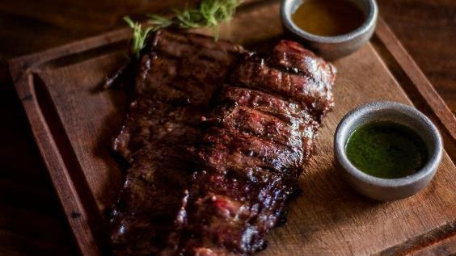
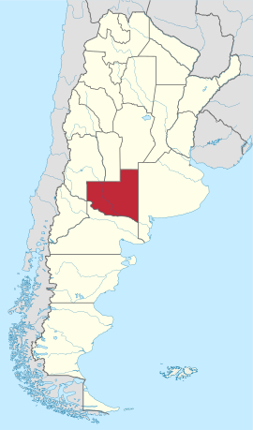
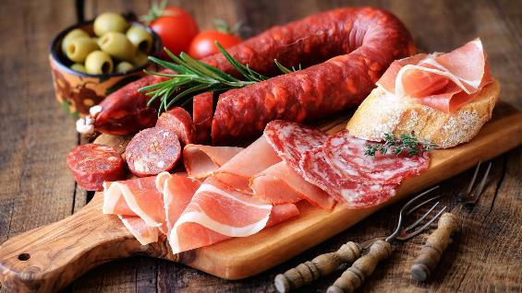
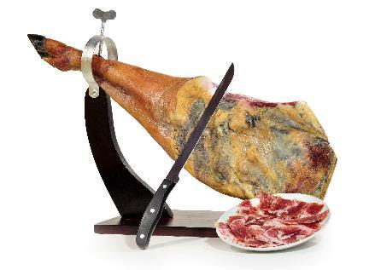
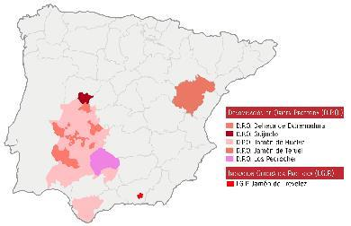
Meat
Asado
Jamón, chorizo, salchichón…
Jamón serrano (highland ham)
Jamón ibérico / jamón de pata negra: Iberian ham
Jamón de bellota: acorn ham

Slide 13
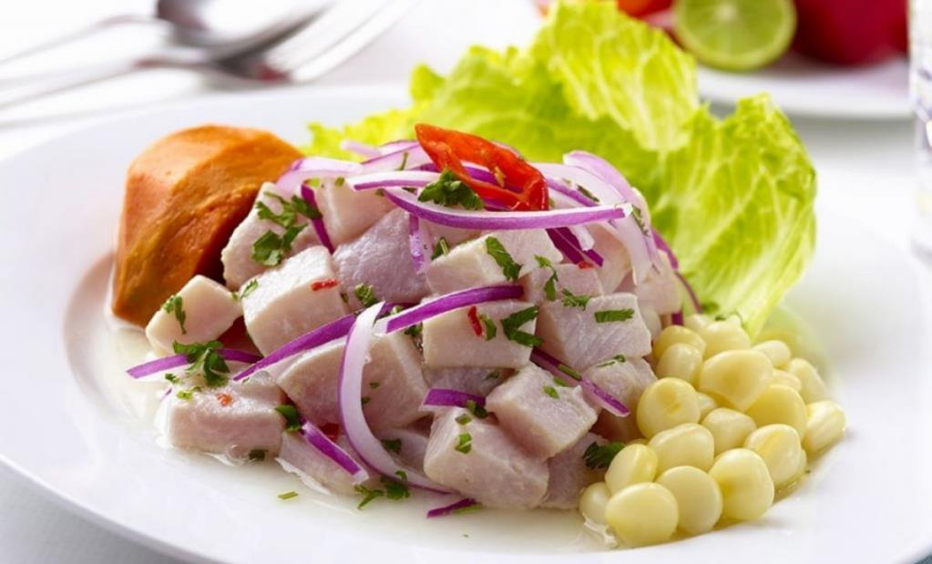
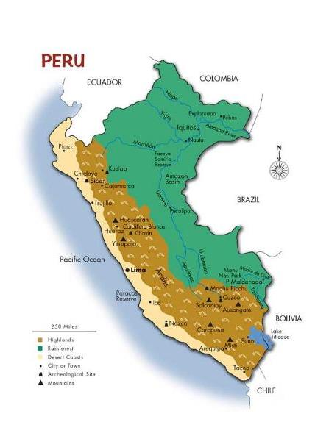
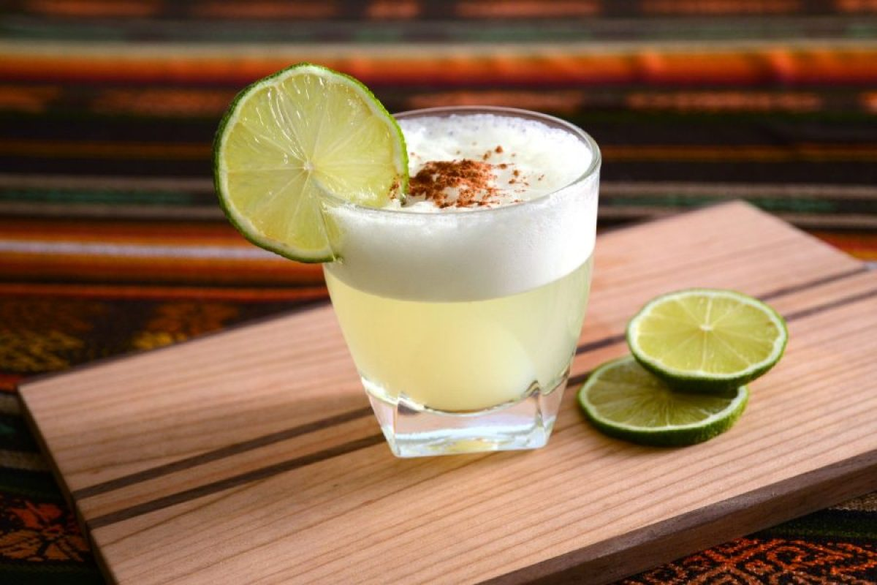
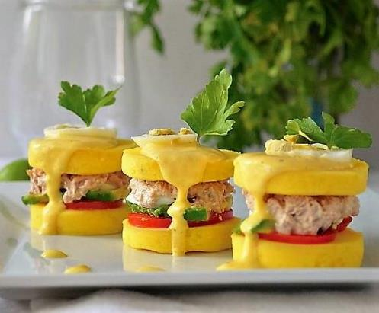
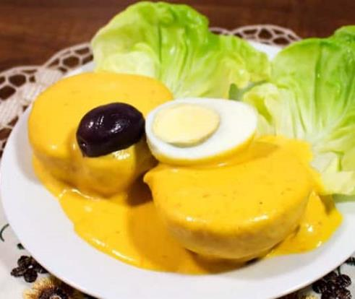
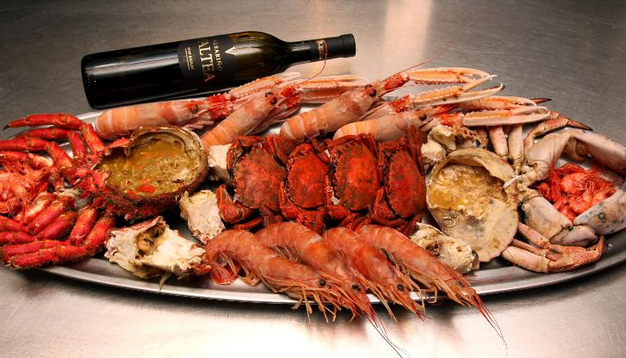
Peru & the fish
2014 Peruvian cuisine
Ceviche
Pisco sour
Causa
Papa a la huancaína
Mariscada (España)

Slide 14
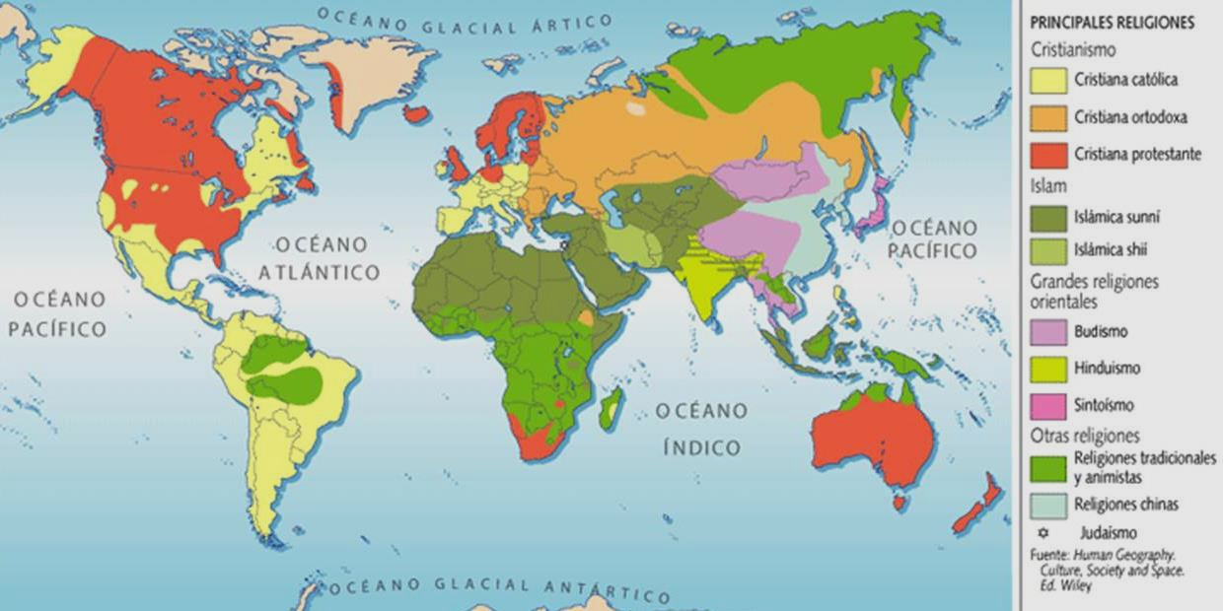
Cultures
Plow vs. Hoe
(1970, Ester Boserup)
Farmers vs. Ranchers
(1996, Nisbett & Cohen)
The Resource Course
(1993, Richard Auty)
Colonialism
Extractivism
The Cold War

