Slide 1
Effectual Strategy
Peter Kelly
Connector @ Aalto University
Visiting Professor of Business, Trinity College Dublin
Academico Visitante Internacional, MADA Design School Chile
Notes:
TITLE

Slide 2
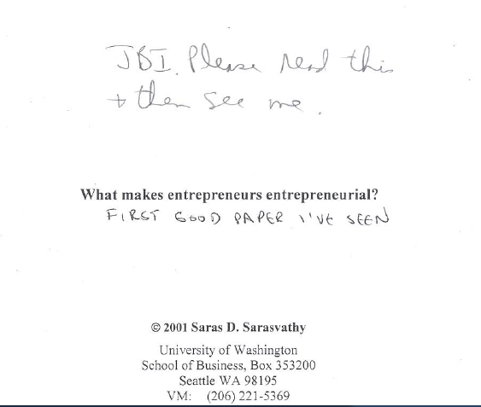
Notes:
BACKGROUND STORY & METHODOLOGY (30 SERIAL ENTREPRENEURS)
VINOD KHOSLA – FOUNDER OF SUN MICROSYSTEMS & VENTURE CAPITALIST

Slide 3
opportunity
perception
is personal
Notes:
THE LENS IS INNATELY PERSONAL – EVERYONE HAS A DIFFERENT VIEW

Slide 4
passions
skills
networks
Notes:
THE LENS THROUGH WHICH YOU SEE THE WORLD IS SHAPED BY 3 THINGS

Slide 5
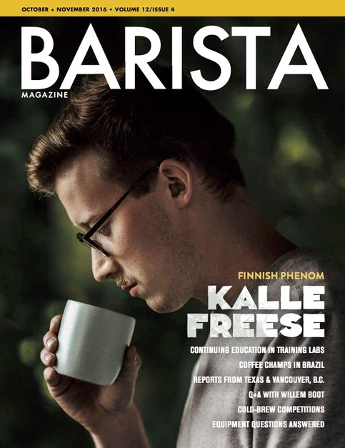
Notes:
MEET KALLE FREESE – DISCOVERED COFFEE AS AN EARLY TEEN (LIKE MANY FINNS)

Slide 6
45
Notes:
MIT Professor Pierre Azoulay (and others) looked at new firms established in US 2007-2014
AVERAGE AGE AT START 41,9 YEARS
HIGH TECH 43,2 (41,5 SILICON VALLEY)
VENTURE CAPITAL BACKED 41,9 (40,2 SILICON VALLEY)
TOP 0,1% PERFORMERS (45)

Slide 7
Notes:
Opportunities are pursued in resource constrained environments by PEOPLE
LATE 40s – Harvard MBA Grad of 1959

Slide 8
passions
skills
networks
Notes:
SALES, NEW VENTURE, ADULT GAME, AND THE ASSOCIATED NETWORK
+ NETWORK AT HARVARD BUSINESS SCHOOL

Slide 9
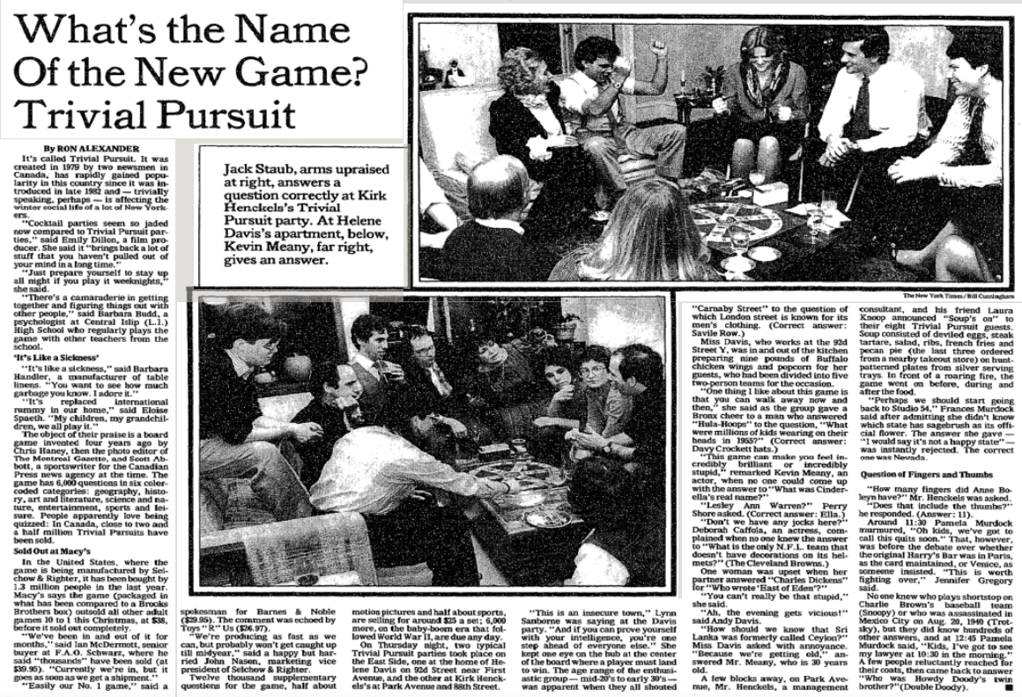
Notes:
AVID READER AND SEES ARTICLES LIKE THIS --- WHAT THE HELL IS THIS ABOUT?

Slide 10
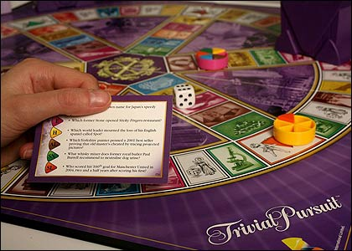
100.000
Notes:
STARTS BY PICKING UP A PHONE – FOR LEADS --- 100.000 GAMES SOLD IN CANADA
RULE OF 10 – AT LEAST 1.000.000 SOLD IN US AND THEY ARE PREMIUM PRICED (25-40 A POP)
FILLS IN BACK STORY – HIS CONNECTIONS IN GAMES FILL IN SOME OF THE DETAILS

Slide 11
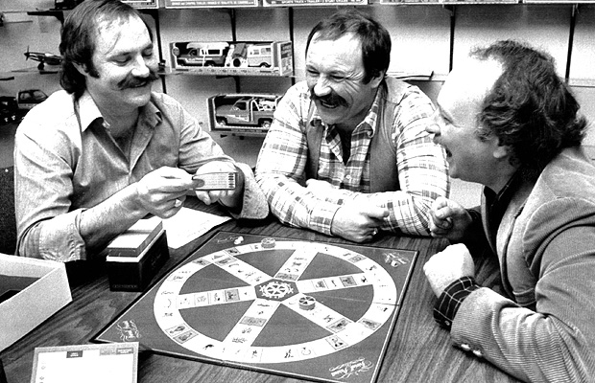
Notes:
THE INSPIRATION FOR THE OPPORTUNITY CAME FROM ELSEWHERE
Over beers in the house playing Scrabble (Dec 79) – a photo editor and a sports editor (press) spent a couple of hours ideating new game
Sold 5 shares in the company – one to an artist in exchange for creating the artwork

Slide 12
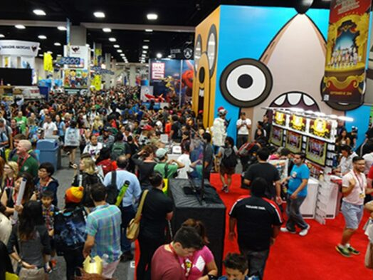
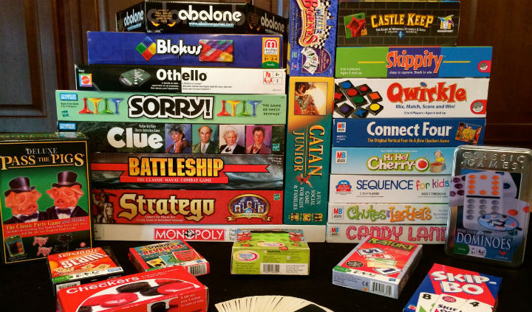
Notes:
Went to Montreal ToyCon posing as a reporter and photographer doing a story about board games
How do board games get developed … 10k worth of information (and they live in Montreal)

Slide 13
$40.000
Notes:
And not from Haney’s mother “didn’t want her to lose the investment!” (1981) 32 INVESTORS

Slide 14
Notes:
COLLECTING DATA FOR A BIG DEAL – AND WORKING EXCEL (EVALUATE AN OPTION)
VERSUS THE RIGHT SIDE – BREAK IT DOWN INTO BITS (CREATING OPTIONS TO EVALUATE)

Slide 15
experiment
prototype
Notes:
OR IN OTHER WORDS …

Slide 16
Notes:
REST IS CHEAP – DATA IS THE DIFFICULT BIT

Slide 17
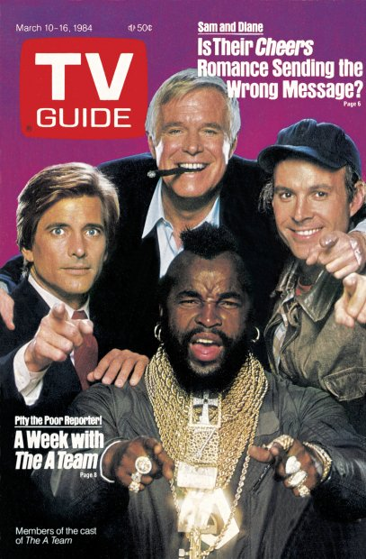
17 million
Notes:
800 POUND GORILLA IN PUBLISHING – SUBSCRIBERS AND POINT OF SALE PRESENCE

Slide 18
“I am a graduate of Columbia and Harvard
who started his own national rep firm in 1959,
specializing in adult games, when it became
a distinct category in 1968. I sold the
company in 1973 to an American Stock
Exchange Company. I remained there for
5 years and built Reiss Games to a
dominant position in the adult-game field.
For the last 3 years, I have been consulting
in the game/toy industry and recently acted
as a broker in the sale of one of my clients,
Pente Games, to Parker Bros.”
Notes:
Carefully crafted and worded sales pitch --- how does this help ---
I AM SOMEBODY YOU WANT TO MEET – PROBABLY TOOK A GAME WITH HIM TO MEETING AS A GIFT
MBA WANTS NUMBERS --

Slide 19
Notes:
COLD CALLS SOMETIMES WORK OUT

Slide 20
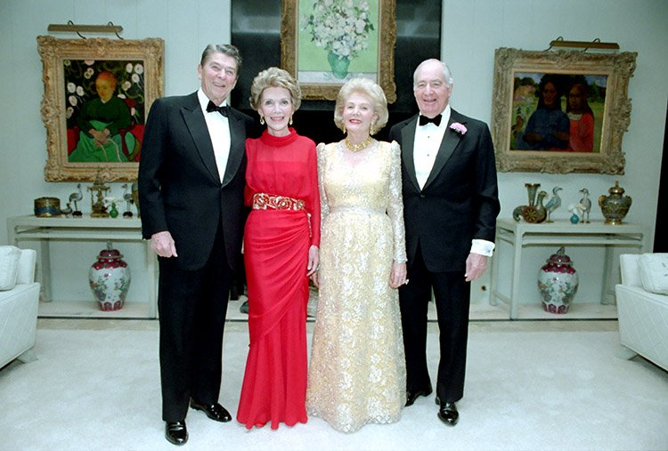
Notes:
Pitching to a multibillionaire with A list friends – Walter Annenberg owned TV Guide
HAS A WHARTON MBA ---

Slide 21
co-creation
Notes:
WE CREATE SOMETHING TOGETHER

Slide 22
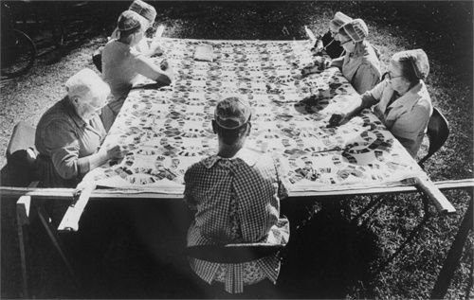
1500 hours
Notes:
INVITE OTHERS TO THE PARTY – WHO MAY INVEST THEIR TIME, THEIR PLACE, THEIR MATERIAL, EXPERTISE TO PRODUCE
Crazy quilts are extremely labor-intensive. A Harper's Bazaar article from 1884 estimate

Slide 23
Notes:
NOTICE THE WORD CANVAS WHICH RELATES TO THE ART WORLD –

Slide 24
sharing risk =
co-creation
Notes:
Find willing parties who bring resources and perspective to the table
Engage them in shaping the offering
Sharing upside (what is in it for me to play?) Do I even want to play with somebody like you?

Slide 25
Notes:
TV GUIDE IS A VAST RESERVOIR OF DATA
Chose not to produce question cards but opted for question books instead
SAVED MONEY ON COLLATING

Slide 26
An inventor friend develops game for 5% royalty
Notes:
BASED ON SALES

Slide 27
An investor friend finances for 50% equity
Notes:
Provides offices, relationships with printers

Slide 28
cheese company does fulfillment for fixed fee per box
Notes:
Known to investor – they have skills and slack capacity –
SURPRISE --- LOOK FOR SOLUTIONS IN MOST UNEXPECTED PLACES

Slide 29
working capital is managed by a factor 1% sales
Notes:
FOCUS ON SELLING AND LET SOMEONE ELSE HANDLE BILLS

Slide 30
engage others
to shape
opportunity
Notes:
THE VALUE OF ”ASSETS” IS NOT IN THE OWNERSHIP BUT IN THEIR USE

Slide 31
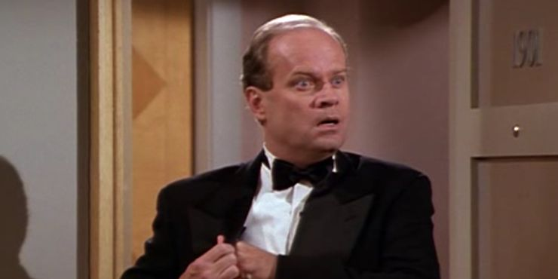
surprise
Notes:
HOW WOULD YOU REACT IF YOU ENCOUNTERED THE UNEXPECTED

Slide 32
youth
hostel
Notes:
WHAT IMAGE POPS INTO YOUR HEAD WHEN I MENTION THE WORDS YOUTH HOSTEL

Slide 33
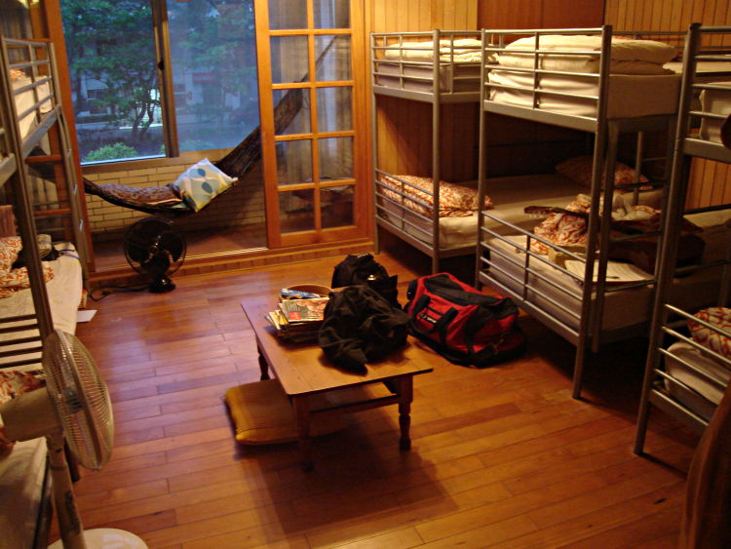
Notes:
SHARED BEDS, BED BUGS, SLIGHTLY BOHEME (READ RUN DOWN FEELING), STRIPPED DOWN OF AMENITIES
SO WHY DO YOU STAY THERE --- IT IS CHEAP

Slide 34
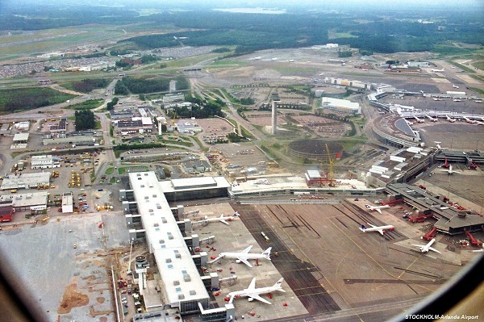
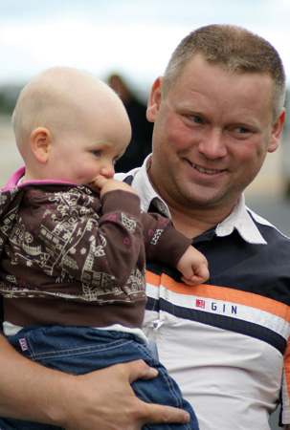
Notes:
OSKAR DIOS OPERATES A YOUTH HOSTEL IN UPPSALA –

Slide 35
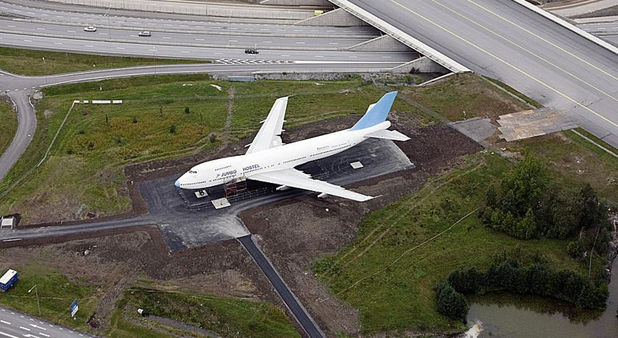
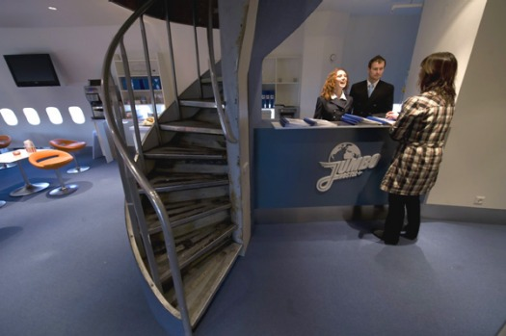
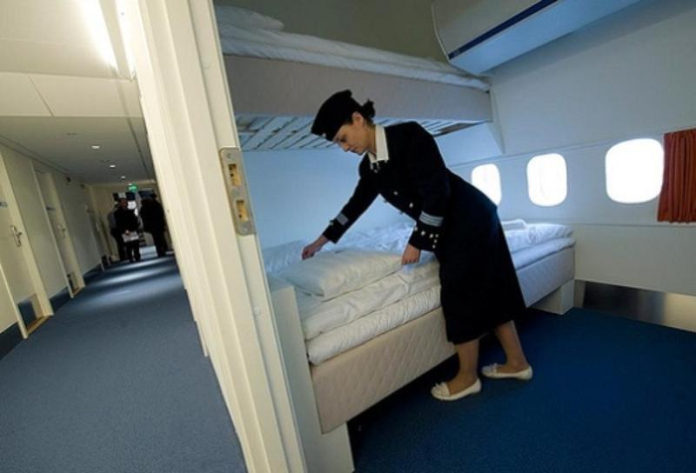
Notes:
So negotiate the parking fines, cut down some fence, move it and retrofit (including staff)
€2 million

Slide 36
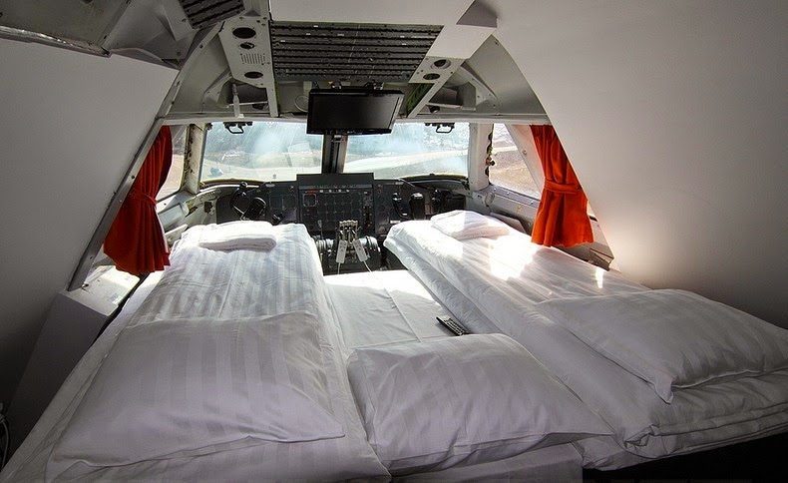
Notes:
Cockpit – aka the honeymoon suite

Slide 37
the unexpected
often unlocks
key insights

Slide 38
Notes:
WHERE WERE THE GAMES MANUFACTURERS IN ALL OF THIS – PROBABLY MEETING AS OPPOSED TO DOING

Slide 39
Why is this a sensible risk management strategy?
Notes:
NO CENTRAL OVERHEADS, ALIGNING EVERYBODY ON SALES

Slide 40
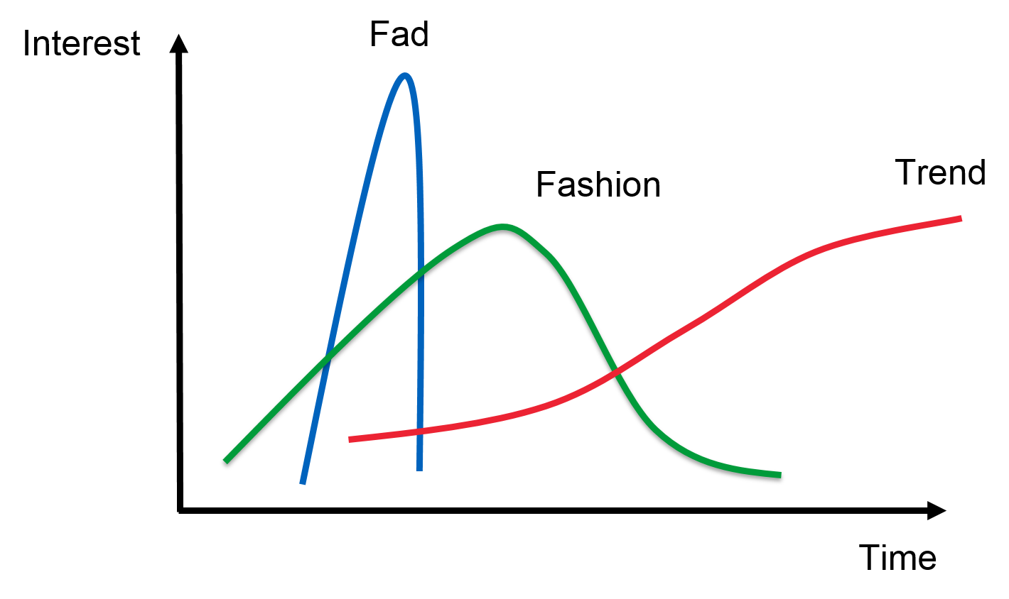
Notes:
Minimizes capital outlay get your money out as quickly as possible ---
No exit --- run it for cash

Slide 41
Notes:
SO HOW DID HE MAKE OUT?

Slide 42
Sales $ 7.000.000
TV Guide $ 700.000
Developer $ 350.000
Cheese Co $ 150.000
Salesforce $ 500.000
Notes:
MINIMAL CAPITAL OUTLAY

Slide 43
Reiss Sales
Commission $ 900.000
Kaplan & Reiss
Capital Gain $ 1.250.000 *
* each pre-tax
Notes:
EVERYBODY IS HAPPY

Slide 44
45

Slide 45
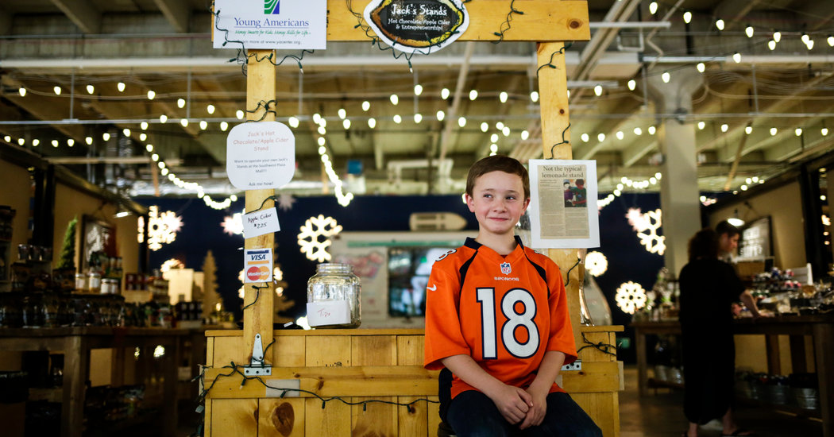
8
Notes:
Jake Bonneau (10) – set up a stand at farmer’s market in Colorado with the help of his father (8) - $2000 sales $900 profit FINANCIAL LITERACY
Next year (9) named operation Jack’s Stands, built a website and set up 3 more stands at other markets
Raised loan of $5000 from Young Americans Bank – and they recruited a sales team in exchange for tips and cut of the profits ($30-$50)
2015 sales were $25.000 with plans to expand in Denver and Detroit financed by crowdfunding

Slide 46
Notes:
Jake Bonneau (10) – set up a stand at farmer’s market in Colorado with the help of his father (8) - $2000 sales $900 profit FINANCIAL LITERACY
Next year (9) named operation Jack’s Stands, built a website and set up 3 more stands at other markets
Raised loan of $5000 from Young Americans Bank – and they recruited a sales team in exchange for tips and cut of the profits ($30-$50)
2015 sales were $25.000 with plans to expand in Denver and Detroit financed by crowdfunding

Slide 47
Effectual Strategy
Leverage your ”means”
Passions
Skills
Network
Fast & cheap experiments (prototyping)
Engage others (co-creation)
Open to aha insights (surprise)

Slide 48
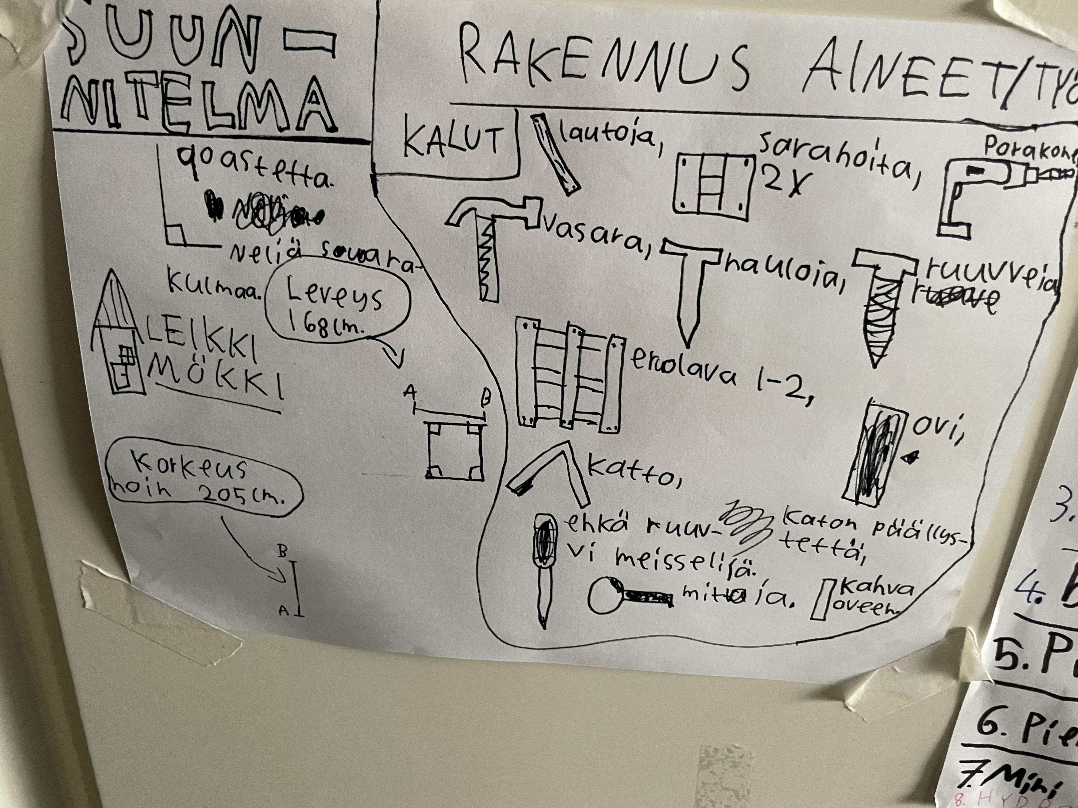
Notes:
MINIMAL CAPITAL OUTLAY

Slide 49
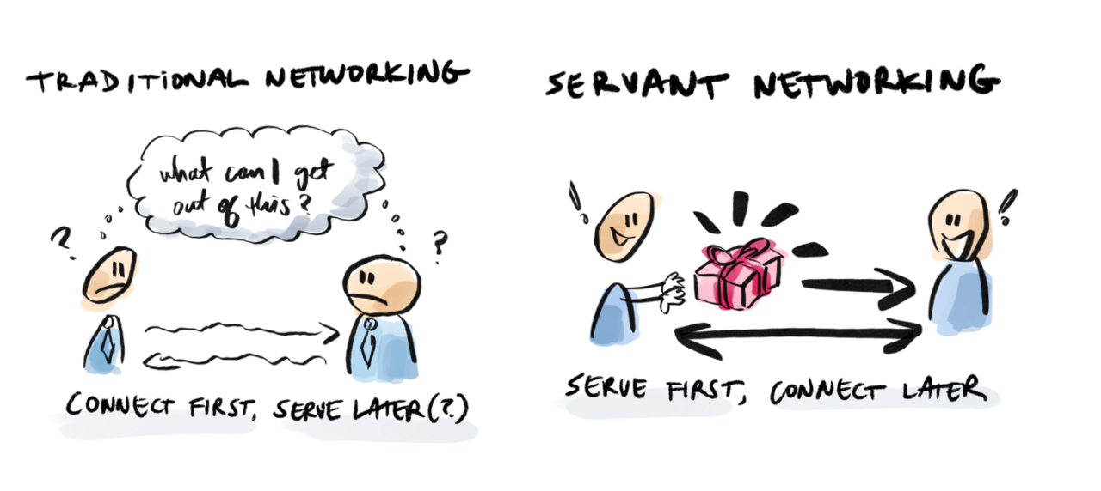
Network with Purpose
Dr Peter Kelly © 2024
Connector, Aalto University
peter.kelly@aalto.fi
Notes:
IT IS NOT WHAT YOU GET OUT OF IT –
IT IS WHAT YOU BRING TO THE PARTY …

Slide 50
So What Do
You Do?
Notes:
PERFECT STRANGERS KNOW NOTHING ABOUT YOU AND ARE GENERALLY LEARY
SO WHAT DO YOU DO? OUR ANSWERS USUALLY – WELL SORRY TO SAY THIS, THEY SUCK ..
I AM FIRST YEAR STUDENT AT AALTO. I AM AN EXCHANGE STUDENT IN COMPUTER SCIENCE …
I WANT YOU TO THINK ABOUT CRAFTING A PERSONAL MANTRA – A SHORT, CAPTIVATING PERSONAL SALES PITCH

Slide 51
personal
mantra
Notes:
A PITHY, MEMORABLE, GENUINE IDEALLY ONE SENTENCE PERSONAL SALES PITCH
WHAT YOU DO NOT WHAT YOU ARE …

Slide 52
So What Do
You Bring?
Notes:
WHAT IS THE GIFT … AND I AM NOT TALKING BRIBES, BROCHURES, BUSINESS CARDS OR CVS

Slide 53
your
“gift”
Notes:
SO OVER TO YOU – WILLY WONKA WORKED WONDERS WITH YOU I HAVE BEEN TOLD

Slide 54
homiphily
Notes:
WE TEND TO INTERACT MOST INTENSELY WITH THOSE “LIKE” US
BIRDS OF A FEATHER FLOCK TOGETHER OR

Slide 55
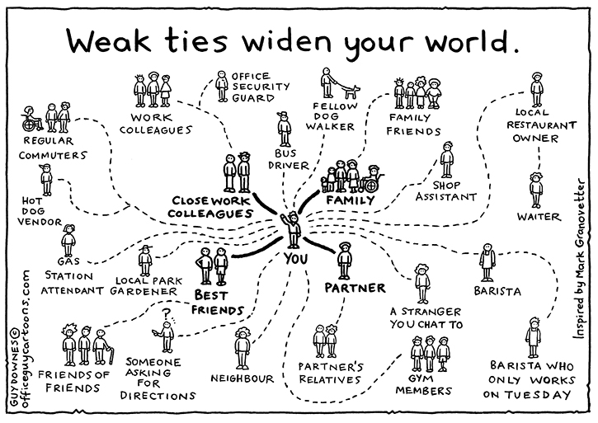
Notes:
NEED COURAGE AND CONVICTION TO EXPLORE BEYOND YOUR COMFORT ZONE
AND PLEASE DON’T ASK ME ”DO YOU SOMEBODY AT” IF I DON’T KNOW YOU AND YOU
DON’T BRING A “GIFT”

Slide 56
Networking
Strategy

Slide 57
high
Prospects
Sponsors
Perceived
Value
Acquaintances
Connections
low
low
high
Perceived Ingroup

Slide 58
high
Prospects
Sponsors
Perceived
Value
Acquaintance
Connection
low
low
high
Perceived Ingroup

Slide 59
high
Sponsor
Prospects
Perceived
Value
ideation
Acquaintance
Connection
low
low
high
Perceived Ingroup
Notes:
LETS DO SOMETHING TOGETHER (AN EXPERIMENT)
AND IF THE EXPERIENCE WORKS OUT WELL …
THE CONNECTION HAS A BETTER BASE OF INFORMATION ABOUT YOU AND YOUR CAPABILITIES
THINK REFERENCE CLIENT

Slide 60
high
Prospect
Sponsor
Perceived
Value
ideation
Acquaintance
Connection
low
low
high
Perceived Ingroup
Notes:
WHICH IN TURN CAN SPONSOR AND OPEN UP NEW POSSIBILITIES
GROWING YOUR NETWORK

Slide 61
high
Prospect
Sponsor
Perceived
Value
Network Playing Field
Acquaintance
Connection
low
low
high
Perceived Ingroup
Notes:
NETWORKING PLAYING FIELD

Slide 62
Strategy Takeaways
making yourself known
know what you seek
selective experiments
trust based referrals
active network limits
Notes:
VOLUME, TARGETING, PLEASE SOMEBODY REALLY WELL, GIVE THEM REASON TO ACTIVATE THEIR SOCIAL NETWORK
FLUIDITY OF 150 --

