Slide 1
Managing references and citing - special tools
The tools have some same features
Manage references in one system but collect from diverce channels: automatically or manually
Choose the citing style from diverse options (e.g. Harvard, Chicago …) OR make your own style.
”Plugins” to add in-text citations and the bibliography.
For example
Mendeley – https://www.mendeley.com/; see more -> the next slides.
RefWorks – Licence and help in Aalto - https://www.refworks.com/
Zotero – Free; special features: web page snapshots and content from diverse sources - https://www.zotero.org/
Many databases export citations automatically to RefWorks and Mendeley. If not there is almost always other ways to export citations one by one or simultaneously.
Comparisons of the citatios management tools.

Slide 2
Content
How to start using Mendeley
Import references from the Scopus database
Add references using the DOI-number
Add more citation styles
Work with Word and Mendeley
Import references from the Abi-Inform/Proquest database
Import references from the Web of Science (WoS) database
Import PDF-text
Import references from the Mendeley library
Import references from the webpages in the RIS-format

Slide 3
Mendeley
Help from guides and video tutorials: http://community.mendeley.com/guides (User account needed.))
Some find these guides more easy to use than my slideshow ;)
Mendeley-guide from York University http://researchguides.library.yorku.ca/content.php?pid=308804&sid=2528677
Mendeley-opas Suomeksi Tampereen yliopistosta: http://libguides.uta.fi/mendeleyopas
TO START the MENDELEY / A PRE TASK
Download for free to create a Mendely account at https://www.mendeley.com/
Download Mendeley Desktop at: https://www.mendeley.com/download-mendeley-desktop/
Adopt The Web importer tool to add references quickly from the web pages: https://www.mendeley.com/import/
Install the Mendeley MS Word Add Inn from the tools menu of the Mendeley desktop
IF YOU WISH: Create a Mendeley group and invite your paper co-authors to it. Go to your account in the web -> Create a new group.
IF YOU WISH: Import (all the existing) references in your paper to this Mendeley group folder
Notes:
To start Mendely / a pre task
2) Create a Mendeley referencing software account at https://www.mendeley.com
3) Download Mendeley Desktop at: https://www.mendeley.com/download-mendeley-desktop/
4) Install the Mendeley MS Word Add Inn and Web Importer from the tools menu of Mendeley desktop
5) Create a Mendeley group (free public group) and invite your paper co-authors to it
6) Import all the existing references in your paper to this Mendeley group folder

Slide 4
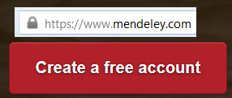
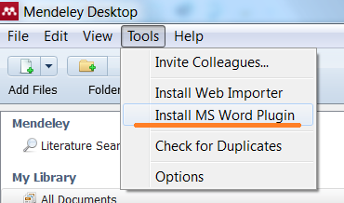
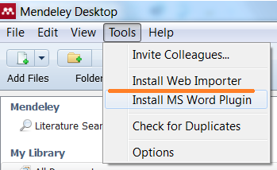
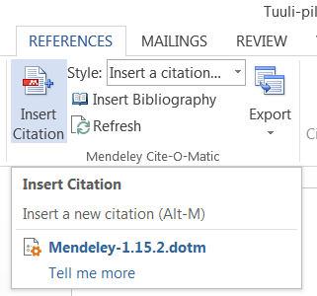
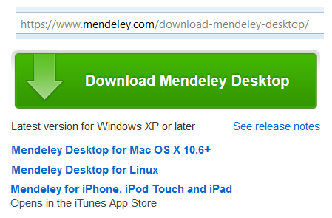
More concrete instructions – four steps to get the advantages
Install the MS Word Plugin via the Mendeley desktop
Make an account for web services
Install the Web Importer via the Mendeley desktop
Downlaod the desktop

Slide 5
The Mendeley Desktop – An overview

Slide 6
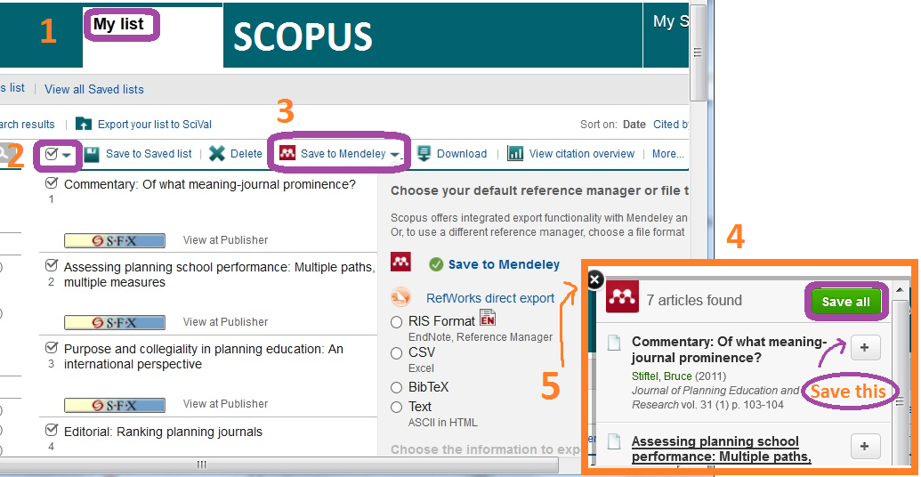
Importing references from the Scopus to Mendeley
Make a search in the Scopus.
Choose references by ticking the boxes in the front of the references OR save relevant references to the ”List”. Go to the ”List” and choose the references. You can continue adding references to ”List”.
1
3
3. Choose the option to add references to the Mendeley
4. The Importer opens. Save the references to Mendeley.
5. Close the Importer and you can continue to search.
2
4
5

Slide 7
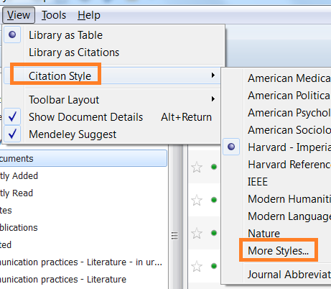
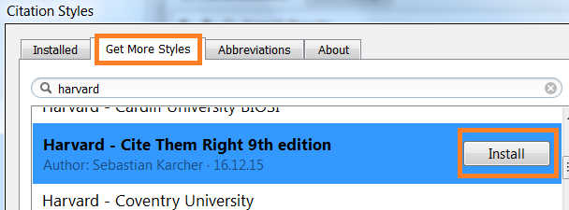
Add citing styles
Go to ”Citation style” -> Open ”More styles”.
Open ”Get more styles” -> search by thename of the style.
Choose one by clicking it and install.
Click again to use the style.
See from Zotero style repository how the styles look like. Search by the name of the style: https://www.zotero.org/styles
1
2
3
4

Slide 8
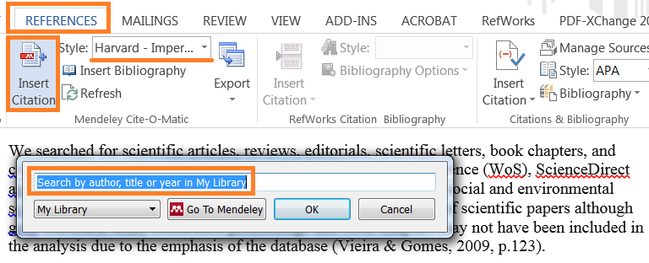
Word and Mendeley – add in-text citation 1
1
Open the REFERENCES to see the options for Mendeley ”plugin”.
Choose the citing style.
2
3
4
3. Put the cursor to the place of citation in the text and click ”Insert citation”.
4. Start typing author (go to the next slide ….)

Slide 9
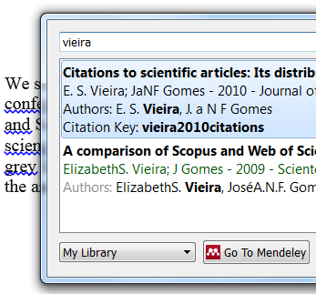
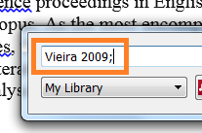
Word and Mendeley – add in-text citation 2
1
Choose the right reference from the list.
Click the reference in the box to open the option to modify in-text citation.
2

Slide 10
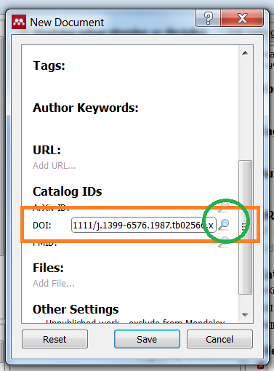
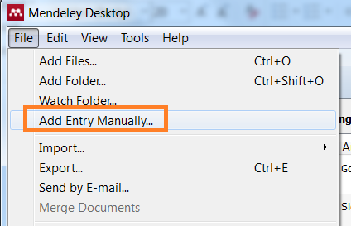
Mendeley– Add the reference using the DOI-number
If you have the articles’ DOI-numbers but not yet the references in the Mendely:
Open ”File” -> ”Add Entry Manually”.
Mendeley opens a new window for the new document -> browse to the DOI -> copy the DOI-number to the box and search.
Check always thet you have retrieved the right reference!
2
3
1

Slide 11
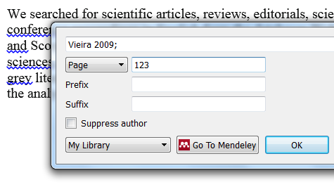
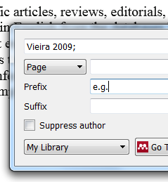
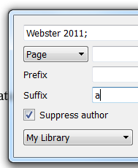
Word and Mendeley – edit in-text citations 1
Citation contains author, year and page.
You can add definitions to the citations, here ”for example” as a prefix.
This suffix informs that there is more than one citation by Webster from the same year.
1
2
3

Slide 12
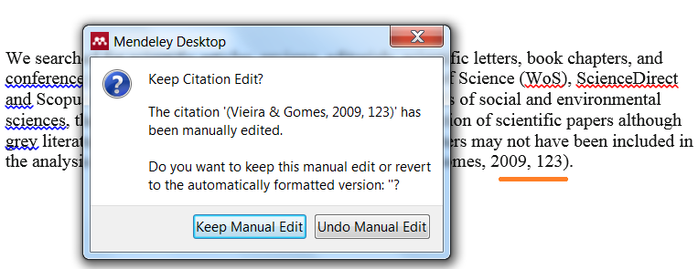
Word and Mendeley – edit in-text citations 2
If you are not satisfied with the format of the citation, you can modify it.
Here the ”p.” is removed just by deleting it. Confirm it by ”Keep the manual Edit”.

Slide 13
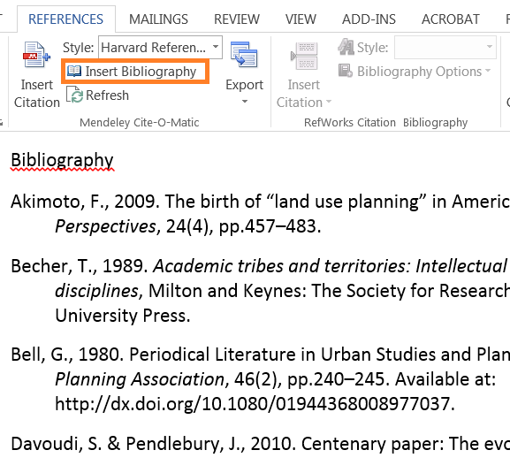
Word and Mendeley – add and edit bibliography
Add (1) the bibliography by inserting it.
Remember to check and clean manually the references to keep the list consistent. Just delete sections you don’t want to include or correct the content, e.g. translate the automatic texts like ”Available at” -> ”Luettavissa” (2).
Permanent changes (e.g. to remove ”Available at”) can be made in the Mendely by deleting the content from the particular meta-field or by changin citation style.
1
2

Slide 14
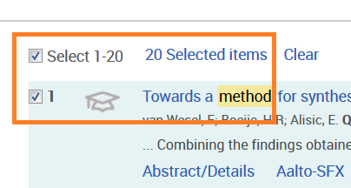
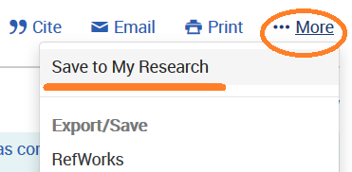
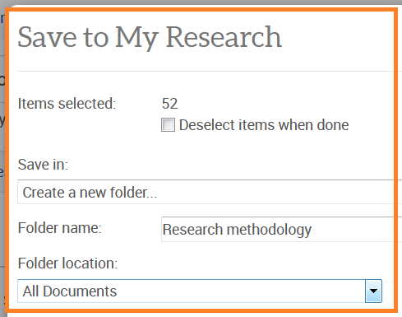
Import references from the ProQuest to the Mendeley -1
Make a search (you can make an account).
Choose the relevant references. If you have an account, save them to the folder. You can use the folder in the future. If you don’t have an account go to the next slide.
Open the ”More” and choose ”Save to my research” to make a folder for your references.
1
2
3

Slide 15
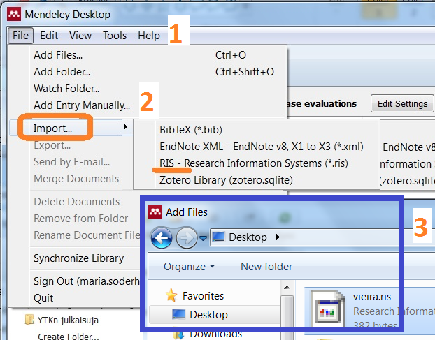
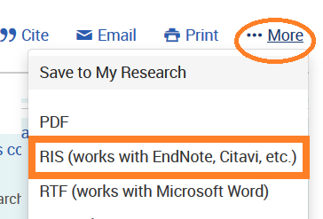
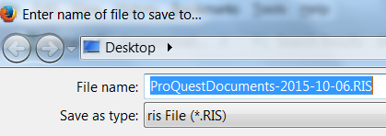
Import references from the ProQuest to the Mendeley - 2
4. Choose references from the result list to import them to the Mendeley (or from your folder).
5. Open the ”More” to import the references using RIS-format. Save the RIS-document to your computer.
4
6
6. Open the Mendeley
1. Open the File.
2. Use import.
3. Open the RIS-document using option RIS.
5

Slide 16
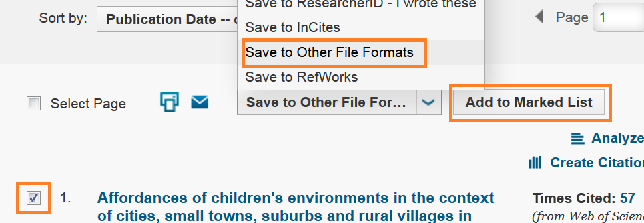
Import references from the WoS Mendeley 1
1. Choose the Core
2. Save the reference(s) using ”Other fle format”
OR you can add the references to ”Marked list” , e.g. to collect more.

Slide 17
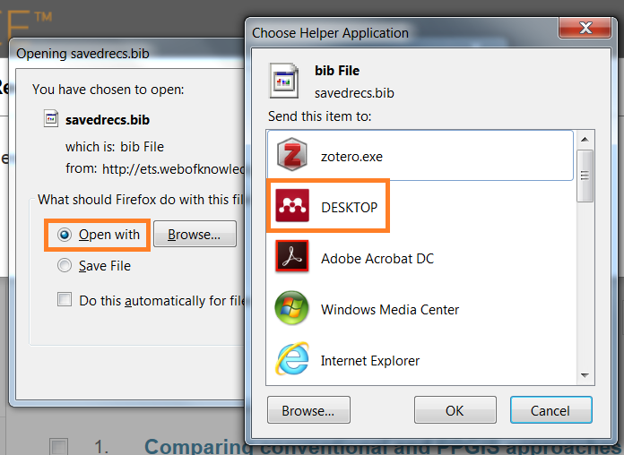
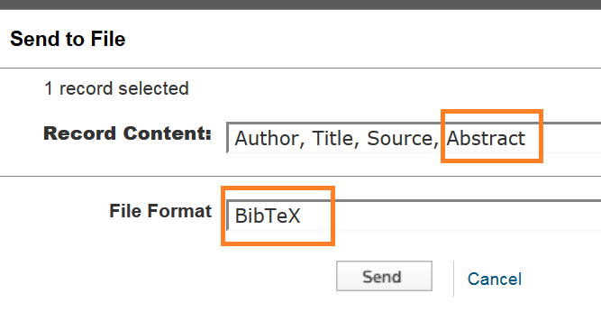
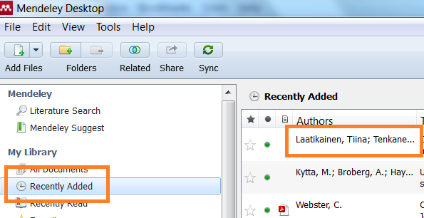
Import references from the WoS Mendeley 2
3. Continue selecting the saving format: choose first what information you want to save and then format BibTeX.
4. Open the BibTeX file using DESKTOP -> Mendeley. The reference(s) in in the ”Recently added” folder.

Slide 18
Add the file (ful text) and correct the record in Mendeley

Slide 19
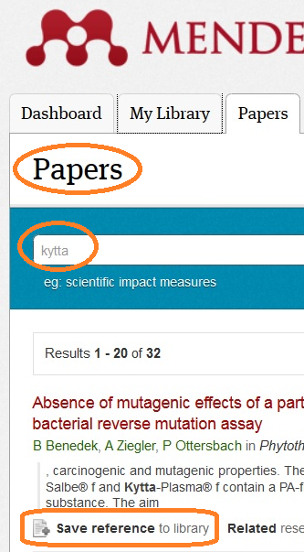
Mendeley – add references using community’s catalogue
If you have a reference list but not yet imported them to the Mendeley, search the catalogue to pick them up to your Mendeley library
Open File and choose the option ”Literature search” OR
Use directly Mendeley service
Validate the content you retriev!
2
1

Slide 20
Import the reference from the web page – Using RIS-form -1
Locate the reference.
The reference is in the publishers page.
Use the publisher’s Export-tool.
Save the reference in the RIS-form.
The reference is saved to your computer.
Go to the Mendeley and open the ”File” and then the ”Import”.
Import the reference in the RIS-form.
Search the RIS-file and ”Open” it -> The reference has been importet to Mendeley.
You can save the full text as well! Open the reference in the Mendeley and look for the ”files – Add file”
Easier to locate the reference in some database and import there?

Slide 21
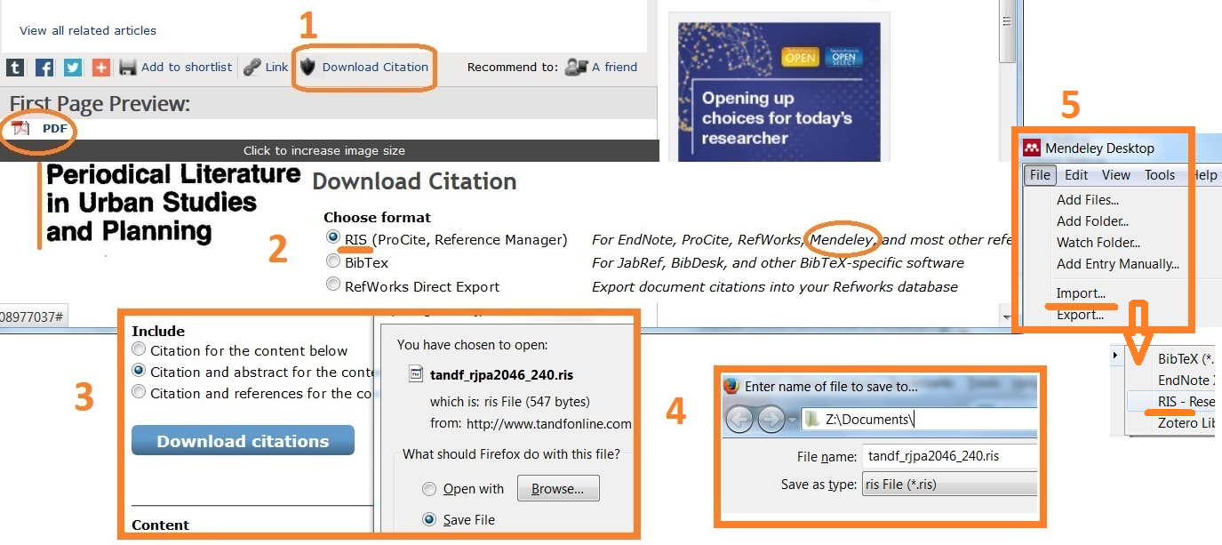
Import the reference from the web page – Using RIS-form -2
The reference has been located.
1. Use the publisher’s Export-tool.
2.-4. Save the reference in the RIS-form.
5. The reference is saved to your computer -> Open File and the option Import.
Import in the RIS-form
Easier to locate the reference in some database or use Mendeley options? See slides 4 and 5
Olisiko helpompi paikantaa jostain kannasta?

Slide 22
References from the Google Scholar (GS) to Mendeley -1
Check from GS Settings that you have in the Bibliography manager BibTex.
If you have the GS ”My library-tool” in use, you can collect references to your ”My library” and then one by one import them to Mendeley.

Slide 23
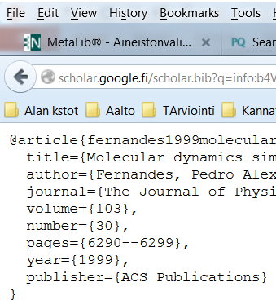
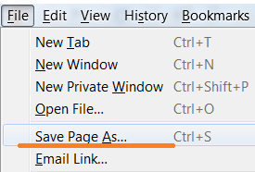
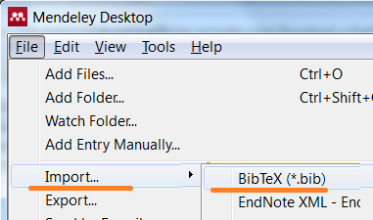
References from from the Google Scholar (GS) to Mendeley -2
1
1.Make a search and use option ”Import in to … BibTeX”.
2. The reference opens in the BibTeX-form.
3. Save the reference -> ”Save page…” to your computer.
4. Open the Mendeley and import the reference.
2
3
4

Slide 24
KIITOS!
Do not hesitate to contact:
Maria Söderholm: maria.soderholm@aalto.fi

