Slide 1
Storytelling I: Dramatic Situation
Otso Huopaniemi
otso.huopaniemi@uniarts.fi

Slide 2
what is a situation?

Slide 3
situation, an attempt at defining it
a dramaturgical concept for understanding the key elements of a text, performance, or presentation and the relationships between them
situation of a work (its entirety)
situation of a moment within the work

Slide 4
situation
situation is often understood in relation to tension or suspense, as a field of forces between the elements of the work
this tension at least implies change, activity, or other movement towards some sort of release

Slide 5
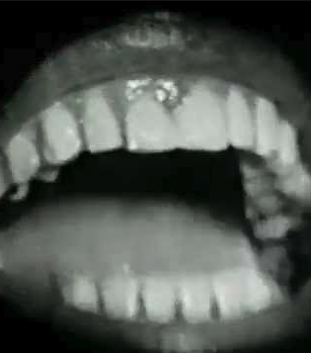
situation
static situations are of course possible, too
Samuel Beckett: Not I

Slide 6
situation
as a dramaturgical concept, situation is often associated with drama
in drama, situation refers to interpersonal relationships: who, when, where, what?

Slide 7
dramatic situation
a tensional constellation of relationships between the characters of the drama

Slide 8
example of dramatic situation(s)
A, B and C are the children of D and E
A becomes seriously ill
D and E decide to move back to home country with A, B and C
B and C struggle and become ill, too
D dies
B concentrates on work and friends and succeeds
C struggles more, but eventually gets better
E loses memory, A recovers very, very slowly

Slide 9
situation
The concept of situation also makes it possible to divide a text or presentation into smaller parts by distinguishing between individual situations and their changes.

Slide 10
dramatic situation
according to the classic rules of drama, the situation changes mechanically when
a person arrives or leaves the setting of the scene, or
the time or place changes

Slide 11
dramatic situation
in contemporary drama, the situation is often defined either
through the basic tension between the characters (A wants something from B, B wants something else from A), or
through a major change (initial situation⇢turn⇢end situation)

Slide 12
situation
A theatrical situation can be created, for example, between a performer and the text they are reading. Cf. Gatz by Elevator Repair Service
Photo: McCarter Theater Center

Slide 13
situations
in drama, the situation is fictional
in performance art or live art, the situation includes the viewer’s relationship to the performance and what it’s about

Slide 14
beyond drama
As a tool, situation can be used and applied beyond the dramatic context: relationships and tensions can also be seen between elements other than the characters in a drama.

Slide 15
perspectives from other fields/media
how do you understand situation? do you think about it? how does it work in your work?

Slide 16
Closer look at dramatic situation

Slide 17
the very basics of dramatic situation
who?
where?
when?
what?

Slide 18
dramatic situation
tension
conflict
conflict of motives

Slide 19
dramatic situation
change / changes in power relations

Slide 20
dramatic situation
beginning
middle
end

Slide 21
dramatic situation
what do the characters want from each other?
how do they go about trying to get what they want?

Slide 22
dramatic situation
weapon
attitude
position (or posture)

Slide 23
dramatic situation
difference between thought and action
what is the character concealing?

Slide 24
Source
Numminen, Katariina & Kilpi, Maria & Hyrkkänen, Mari. 2018. Dramaturgiakirja – kaikki järjestyy aina. The publishing series of Uniarts Helsinki, Theater Academy, 68. Helsinki: Uniarts Helsinki, Theater Academy.

