Slide 1
Economy under sanctions, Ukraine-Russia crisis: Economic consequences
Svetlana Ledyaeva
Aalto University School of Business

Slide 2
Reasons for sanctions
Part 1

Slide 3
How it started: Chronicle of events
21 November 2013 - then-president Viktor Yanukovych suspended preparations for the implementation of an association agreement with the European Union, ➔ Months of protests called “Euromaidan”,
22 February 2014 - Yanukovych was forcedly removed by the protesters,
18 March - Annexation of Crimea by Russia,
Subsequently, unrest in Donetsk and Lugansk oblasts of Ukraine evolved into a war between the post-revolutionary Ukrainian government and pro-Russian rebels.

Slide 4
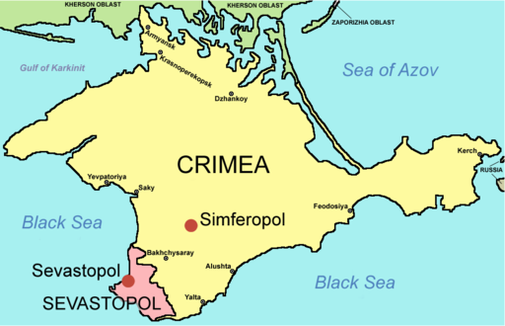
Why annexation of Crimea by Russia?
From Mikhail Khodorkovskij speech in Kyev, 10 March 2014:
“This is no mere territorial dispute about a few extra square kilometres,
Crimea has no reserves of oil, and for the Russian economy it is more likely a burden than an acquisition.”
EUOBSEVER (March 2014):
Why is a world leader prepared to risk international dishonor and, possibly, crippling economic sanctions for an obscure piece of land?
-Ordinary Russians are not Putin priority.

Slide 5
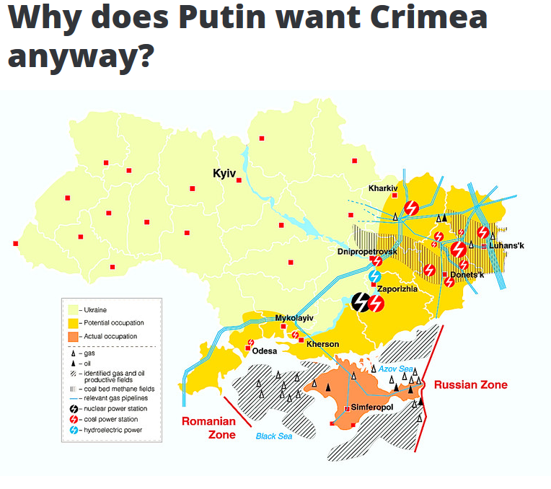

Slide 6
Crimea's Strategic Value to Russia: Military benefits By Paul N. Schwartz, March 2014
-Access to the naval base at Sevastopol, home to Russia’s Black Sea Fleet,
-Russia’s current lease of Sevastopol runs through 2042, but due to recent events Russia had become increasingly concerned that its future access might be compromised,
-Ability to project power in and around the Black Sea,
-Important strategic defense capabilities,
-Mediterranean Task Force.
Source: http://csis,org/blog/crimeas-strategic-value-russia

Slide 8
Crimea's Strategic Value to Russia: Thorn in Ukraine`s side By Paul N, Schwartz, March 2014
The need to regain influence over Ukraine’s future direction, which was diminishing rapidly following the removal of Yanukovich,
Crimea will serve as a symbol to encourage pro-Russian factions in Ukraine to support Russia and resist efforts by Kiev to achieve closer integration with the West,
The West will hesitate to incorporate Ukraine (for example, NATO) while it is deeply embroiled in a territorial dispute with Russia over Crimea,
These are all elements of the playbook that Putin used in Georgia and elsewhere in the CIS to counter past efforts at NATO and EU expansion.
Source: http://csis,org/blog/crimeas-strategic-value-russia

Slide 9
Western sanctions against Russia
Part 2

Slide 10
Reasons of Western sanctions
Official reasons:
-The Crimean referendum was illegitimate,
-Russia’s illegal annexation of Crimea,
-Russia’s continued violation of Ukrainian sovereignty and support for the pro-Russian separatists.

Slide 11
A deep disagreement over the post-Cold War security order in Europe
Russia wants to preserve the former Soviet “sphere of influence”.
Meanwhile the West regards these countries as sovereign states that are free to engage in any international cooperation they choose.
Source: Oxenstierna and Olsson (2015): http://foi,se/rapport?rNo=FOI-R--4097--SE

Slide 12
Sanctions` target:
-The EU and US sanctions have been carefully designed and are “targeted” to have as much impact as possible on the regime and minimize the impact on the population.
➔ SMART SANCTIONS

Slide 13
Western sanctions in brief
In 2014 the USA, EU, and several other countries imposed diplomatic and economic sanctions on Russia.
Diplomatic sanctions:
suspensions of EU-Russia partnership talks and Russia-NATO cooperation.
asset freezes and visa bans targeted at individuals and entities have been imposed.

Slide 14
Western economic sanctions
In July 2014, economic sanctions of three types were adopted:
The first restricts access to Western financial markets and services for designated Russian state-owned enterprises (mainly) in the banking, energy, and defense sectors,
The second places an embargo on exports to Russia of designated high-technology oil exploration and production equipment,
The third is an embargo on exports to Russia of designated military and dual-use goods (NATO 2015).

Slide 15
Question for points
Would you guess which type of economic sanctions has been most harmful for Russian economy?
You get one point for answering this question correctly.

Slide 16
Sanctions: Current state
Up to present moment, all these sanctions have been continuously renewed and enlarged several times.
On 12 June 2017, U.S. senators` agreement on legislation imposing new sanctions on Russia: A provision that would prevent the easing, suspending or ending of sanctions by the White House/US President without the approval of the United States Congress.

Slide 17
US sanctions against Russia in 2017
The sanctions will target people and entities that:
-- undermine US cybersecurity on behalf of the Russian government
-- invest certain amounts in Russia's energy export pipelines
-- conduct "significant" transactions with Russian defense and intelligence agencies (though this will come into effect six months from now)
-- commit, or assist in, serious human rights abuses
-- commit acts of "significant" corruption
-- provide support to the Syrian government to acquire arms
-- invest, or facilitate the investment of, $10 million or more in the Russian government's privatization of any state-owned asset in a one-year period that could unfairly benefit government officials or their associates.
Sanctions can include freezing assets, such as property, revoking US visas and banning exports from the United States to those sanctioned.

Slide 18
US sanctions against Russia in 2018
Washington (CNN) ”The Trump administration is unleashing additional sanctions against seven Russian oligarchs with ties to President Vladimir Putin along with 12 companies they own or control.”
“The measures were also aimed at 17 senior Russian government officials and the state-owned Russian weapons trading company, Rosoboronexport, which has long-standing ties to Syria and its subsidiary, Russian Financial Corporation Bank.”

Slide 19
August 2018: U.S. Issues New Sanctions on Russia Over Skripals’ Poisoning
Any attempt by an American company to obtain an export license to sell anything with a potential national security purpose — gas turbine engines, electronics, integrated circuits and testing and calibration equipment — will be automatically denied.
Exporters can attempt to prove that the goods will be used for legitimate purposes, but that is a tough hurdle to clear.

Slide 20
Sanctions impact on Russian economy
Part 3

Slide 21
Russian GDP drop – Western sanctions effect or something else?
EUOBSERVER.com:
The sanctions, imposed by the EU and US in mid-2014, prompted the Russian economy to contract by 1 to 1,5 percent.
The Russian economy shrank 4 percent in total in 2015.
In normal circumstances, it might have grown by up to 5 percent.
The slump in world oil prices, which coincided with Russia’s invasion of Ukraine, was the main factor, costing at least 4 percent of GDP.
Lack of structural reforms, such as loosening state control on major firms, also had a bigger impact than the Western sanctions.
Source: https://euobserver,com/foreign/131812

Slide 22
Oil price dynamics

Slide 23
Sanctions impact on Russian economy: Expert opinion
The most damaging sanction was the ban on accessing new Western debt and credits for a handful of state banks and energy companies ➔ an almost total ban by all Western banks and trade organizations on any Russia`s risk.
These sanctions accelerated the decline due to oil price drop: The lower oil price strained the availability of local liquidity which would normally be compensated by accessing foreign debt markets.
The selective ban on supplying some services and equipment to the oil industry has not yet had any noticeable impact. ➔ will affect in long-term period though Russia actively searches for substitutes in Asia, particularly China.
Source: Expert opinion of Chris Weafer, a senior partner with Macro Advisory, a consultancy advising macro hedge funds and foreign companies looking at investment opportunities in Russia, http://www,themoscowtimes,com/opinion/article/how-much-have-sanctions-really-hurt-russia/525228,html

Slide 24
The impact of financial sanctions on Russian economy (Gurvich and Prilepskiy 2015, Russian Journal of Economics)
The financial sanctions have considerable indirect effects on the Russian economy in the form of decreasing FDI, fewer borrowing opportunities for companies and banks not directly targeted by sanctions and lower capital inflow in government debt market.
Financial consequences of sanctions are to a large extent (40%) offset by decreased capital outflow (Anti-offshore legislation).
The effects of oil prices` decrease were significantly stronger than that of sanctions.

Slide 25
A major medium-term risk for the economy lies in the continued dearth/lack of investment (World Bank)
Low investment demand hints at the deeper structural problems
➔ a new era of potentially small growth.
Higher interest rates ➔ Russian banks` costs of funding rise, credit levels decline, and more loans default.
a vicious cycle of a shortage of project credit, rising lending rates, and a tightening of access to credit.
More fundamental factors that could limit investment demand:
Geopolitical tensions and sanctions.
Source: http://www,worldbank,org/en/country/russia/publication/russia-economic-report-33

Slide 26
In 2020 – about 10 billion USD [COVID negative impact]

Slide 27
Investment into fixed capital, percent to corresponding period in previous year

Slide 28
Long-term prospects for Russia (World Bank)
Russia will continue to depend on natural resource exports ➔ adopting technology that can support exploration of less accessible oil and gas fields.
Natural resource revenues should be invested to improve long-run growth prospects, particularly given restricted access to external financing (FDI).
As long as access to external finance continues to be a constraint, a policy of careful management of financial sector risks and buffers will be vital.
Source: http://www,worldbank,org/en/country/russia/publication/russia-economic-report-33

Slide 29
Any positive effects for Russia? (World Bank)
The only bright spot is that the weak ruble could create incentives for expansion in some tradable industries.
However, high level of capacity utilization, structural rigidities, and the surging cost of imported investment goods and credit may dampen these benefits.
Source: http://www,worldbank,org/en/country/russia/publication/russia-economic-report-33

Slide 30
Main macroeconomic indicators of Russia in 2012-2020
 | 2012 | 2013 | 2014 | 2015 | 2016 | 2017 | 2018 | 2019 | 2020 | 2021 forecast
GDP growth, % | 3,4 | 1,3 | 0,6 | 2,8 | -0,23 | 1,55 | 2,3 | 1,3 | -3 | 4.3 (World Bank)
Final consumption expenditure (annual % growth) | 6,16 | 3,78 | 0,89 | -7,97 | -1,53 | 3,40 | 3,46 | 2,94 | -5,21 | 3.1 (Fitch solutions)
Gross fixed capital formation growth,% | 6,20 | 1,92 | -2,14 | -10,62 | 1,26 | 4,66 | 0,62 | 1,53 | -4,34 | 2.9 (World bank)

Slide 33
Exchange rate of ruble

Slide 34
Western sanctions impact at company level
Ahn, D. P., & Ludema, R. D. (2020). The sword and the shield: The economics of targeted sanctions. European Economic Review.
Significant losses in operating revenue, asset values, and employees for sanctioned firms relative to their non-sanctioned peers, which are greater in sectors dependent upon Western service inputs.
Strategic firms systemically outperform non-strategic firms under sanctions, implying a cost of shielding to the regime that adds substantially to the total cost of sanctions.

Slide 35
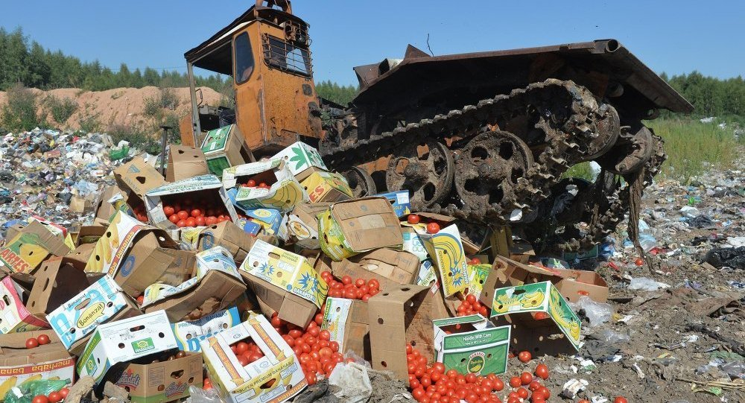
Part 4 Russia`s counter sanctions and their Impact on Russian economy

Slide 36
Russia`s countersanctions
Russia`s ban on the import of certain foods from the EU, the US, Australia, Canada and Norway imposed on 7 August 2014.
New Zealand, Japan and Switzerland were not included in the “ban” list (Though some media sources claim the opposite).
The list of products that should not be imported includes meat in all forms, fish, dairy products, fruit and vegetables.

Slide 37
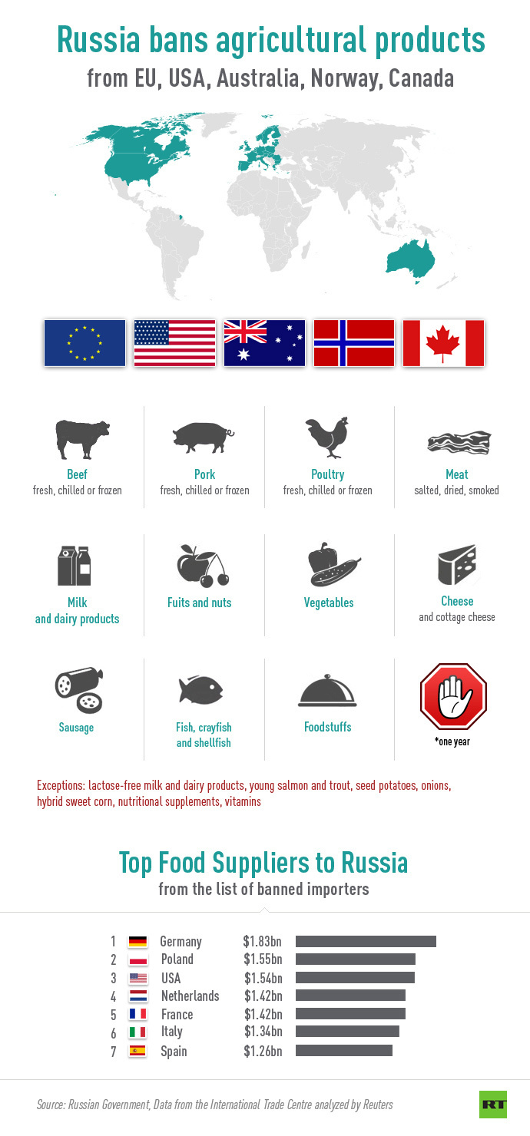

Slide 38
Russia`s countersanctions: Exceptions
Lactose-free dairy products;
Food items for sportsmen;
Biologically active additives and vita-mineral complexes;
Children food.

Slide 39
Question for points
Would you guess what would be immediate consequences of these countersanctions:
For consumers?
For producers?

Slide 40
Countersanctions impact on Russia: Inflation (in short-term period)
 | CPI | CPI for food items | CPI for non-food items | CPI for services
Inflation rate in 2013 (Dec2013 to Dec2012), % | 6,3 | 7,3 | 4,5 | 8
Inflation rate in 2014 (Dec2014 to Dec2013), % | 11,4 | 15,4 | 8,1 | 10,5
Inflation rate in 2015 (Dec2015 to Dec2014), % | 12,9 | 14 | 13,7 | 10,2
Inflation rate in 2016 (Dec2016 to Dec2015), % | 5,4 | 4,6 | 6,5 | 4,9
Inflation rate in 2017 (Dec2017 to Dec2016), % | 2,5 | 0,8 | 2,8 | 4,5
Inflation rate in 2018 (Dec2018 to Dec2017), % | 4,3 | 5,1 | 4,1 | 3,9
Inflation rate in 2019 (Dec2019 to Dec2018), % | 3,4 | 3,77 | 3,04 | 3,78

Slide 41
Countersanctions impact on Russian agrifood producers in short term
Necessity to search for new suppliers to substitute foreign suppliers ➔
Negative effects for production.

Slide 42
Import substitution strategy in agri-food sector in Russia 1
Agriculture minister Alexander Tkachyov: “Russian farmers will push foreign food imports off the Russian market entirely in the course of just 10 years!” (was said in July 2015);
INDEED:
There is a lot of dynamics when it comes to the Russian legislation on import substitution: New laws, by-laws, resolutions and orders are created every month.

Slide 43
Import substitution strategy in agri-food sector in Russia 2
The Russian government has allocated 42.5 billion Euro for the period of 2015–2020 to further boost domestic food production.
Governmental program in Russia at increasing domestic food production boosts demand for food and beverage processing machinery.
➔
Opportunities for foreign companies.

Slide 44
First results of import substitution sector in agri-food sector
In recent years, the sector was one of the few bright spots in the Russian economy, growing at an average 3.2%.
According to Forbes “in few years, state support, counter-sanctions (agro embargo) and ruble devaluation turned Russian agro sector into one of the most profitable businesses in Russia”.
Russia has fully substituted imports with domestic production of pork and chicken.
It has become a top producer of sugar beet.
Greenhouse vegetable production in 2016 was up 30 per cent on the year before.

Slide 45
Growth rates of production of embargoed products (in percent) in Russia between 2013 and 2019
Product | Growth rate between 2013 and 2019
Cattle meat | 122%
Pork | 202%
Poultry | 134%
Fruits, berries, nuts | 220%
Cheese and cheesy products | 124%
Vegetables, frozen | 185%

Slide 46
Russia has become an important player in global agricultural markets
Shipments of Russian food have reportedly grown by 25 percent since 2012.
The country also boosted exports of products such as sweets and sugar.
Russia has managed to capture more than half of the wheat market in recent years, becoming the world’s biggest exporter of the grain.
While agriculture remains far below oil and gas, the sector has overtaken arms sales to become Russia’s second-biggest exporter.

Slide 47
Sanctions` effects for the World economy
Part 5

Slide 48
Impact of sanctions on EU-Russia trade
Russia is the European Union's third-biggest trading partner.
In 2014, EU goods exports to Russia fell, with estimates of the decrease varying from 12.1% to as much as 14.5%.

Slide 49
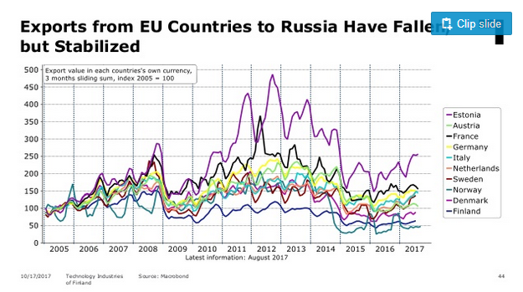

Slide 50
Export to Russia; Index as % to 2011

Slide 51
EU export to Russia: further details
Szczepański 2015:
Exports to Russia have been affected in two ways:
Firstly,
-by the EU ban on the sales of certain goods;
-by the Russian import embargoes.
Secondly,
The ruble’s depreciation, exacerbated by capital flight from Russia, has weakened Russian purchasing power:
Areas of exports not subject to sanctions also face deteriorating prospects, due to spillover effects and the worsening economic situation.

Slide 52
Collateral damage: The impact of the Russia sanctions on sanctioning countries' exports Study of Matthieu Crozet and Julian Hinz
From December ’13 to June ’15, the total export loss was 60,2 billion USD.
The major part of this loss (82%) is accounted for by the products that are not targeted by the Russian countersanctions.
The EU countries bear 77% of all trade loss.
French firm-level data points to a deterioration of trade finance services as the dominant mechanism:
-those trade flows to Russia that rely on bank intermediation services have been disrupted or delayed by the implementation of EU financial sanctions.

Slide 53
Overall damage to Europe`s economy: Some estimates
European commission:
-0,3% of the EU's GDP in 2014 and -0,4% in 2015 (€40 and €50 billion respectively);
Moody’s:
The overall impact on EU GDP growth was limited to less than one percentage point in 2015;
Institute of Economic Forecasting of the Russian Academy of Sciences:
-0,5% of EU GDP.

Slide 54
Article: Which sanctions matter? analysis of the EU/Russian sanctions of 2014, Journal of Comparative Economics, Belin and Hanousek (2020)
Russian sanctions imposed on European and American food imports ➔ decreased imports by about 12.6 billion USD
EU and US sanctions on exports of extraction equipment to Russia ➔ 1.5 billion USD of lost imports of the sanctioned goods.

Slide 55
Geographical distribution of the damage
Baltic countries, Finland and Eastern European Countries have been affected more than the EU average.
EU countries most affected by ban on the sale of “dual use” technology for the exploration of oil and gas deposits: Germany, Italy, France.
EU countries most affected by ban on the import of European food products: Lithuania, Poland, Finland, Greece and Spain.

Slide 56
Sectoral distribution of the damage
WIFO:
In the short-term:
Agriculture and manufacturers of food products, the metal product industry, the manufacturing of machinery, equipment and motor vehicles, as well as manufacturing related services (wholesale, business services).
These effects are then likely to spread to industries that are more dependent on final household demand:
Construction, wholesale trade, business services and retail trade.

Slide 57
Future perspectives of Russian economic development
The question is not about sanctions` removal; can be too long-term process.
Cooperation between Russia and the West will be pragmatic.

Slide 58
Russia in Decline: Three Possible Scenarios for the Future
Scenario 1: Realistic — Slow Decline, Manageable Instability
Scenario 2: Pessimistic — War Mode
Scenario 3: Optimistic — Moderate growth, Limited Reforms

