Slide 1
Introduction
Svetlana ledyaeva

Slide 2
Second lecturer
Katariina Nilsson-Hakkala:
Chief research scientist, The Research Institute of the Finnish Economy (Etla)
Contact details: katariina.nilsson.hakkala@etla.fi. Arkadiankatu 23 B
Notes:
Student introduce themselves. Go over syllabus: location, textbook, logistics.

Slide 3
Grading
(1) Exam 50 % (compulsory to pass the course)

Slide 4
Grading
(2) Exercises 15 %
3 problem sets and 3 exercise lectures (the correct answers are only provided during the exercise lessons)
Exercise lectures by the course's teaching assistant: Tolga Benzer, Aalto, tolga.benzer@aalto.fi
Andrey Zhukov, Aalto, anrey.zhukov@aalto.fi
Some Fridays (see syllabus)

Slide 5
Grading
(3) Term paper 35 % (compulsory to pass the course)
Create a team of 2 persons or write individually
Think of a research question, not research topic
Choose research methodology and present draft results during last lecture
15 mins per presentation + time for comments
Consider the feedback and finalize your term paper

Slide 6
Grading
(3) Term paper 35 % (compulsory to pass the course)
Examples of past research questions:
How trade policies have affected the imports of cars to Finland?
Determinants of Foreign Direct Investments to sub-Saharan Africa?
Impact of EU membership on the new members' trade?
How trade has affected the incomes of the poorer versus the richer in developed countries?
Other ideas and suggestions downloadable from MyCourse

Slide 7
Grading
(3) Term paper 35 % (compulsory to pass the course)
Deadline for sending the main research question and name of people in your research team to Katariina (katariina.nilsson.hakkala@etla.fi): Monday 21.01.2019 at 23.59
Presentation of draft term papers Thursday 14.2.2019, 13:15-15
Deadline for sending the full Term Papers to Katariina: Monday 25.02.2019 at 23.59
Notes:
Any questions regarding the grading?

Slide 8
What do we want to explain?
Real analysis vs. monetary analysis
Real analysis:
Why trade takes place?
Implications of commodity and factor price changes on real variables such as labor and capital?
Benefits from international trade?
Effects of trade restrictions and trade agreements on economies?
Focus on equilibrium determination and change in real trade flows and welfare

Slide 9
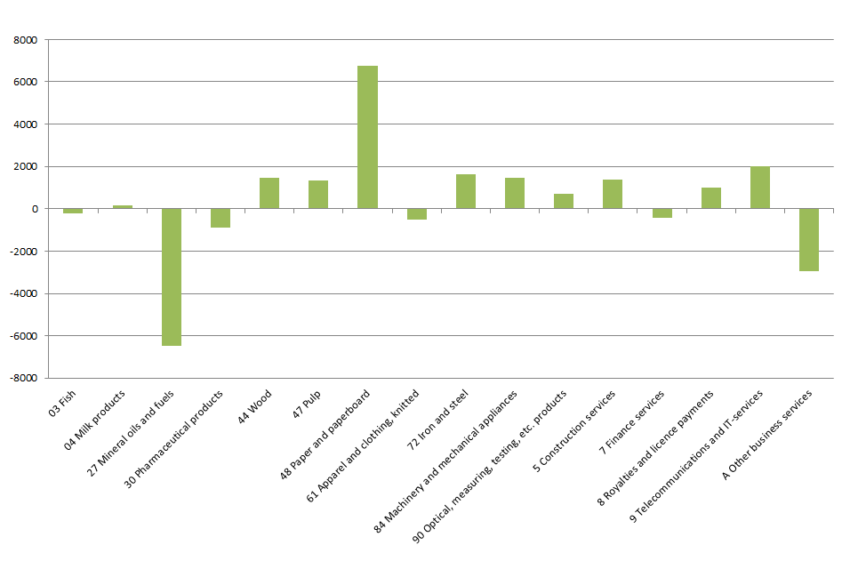
Facts to be explained 1: Inter-industry specialization
Figure: Net exports of Finland 2013 (million euro)

Slide 10
Facts to be explained 1: Inter-industry specialization
Competitive general equilibrium theory, the backbone of the (classical) trade theories
We'll use mostly the simplest two-industry versions of the theory.
Production possibility frontier = possible combinations of output with full capacity
Shape of the production possibility frontier affected by the availability of resources in the economy, technological knowledge (effectively used) and inter-sectoral differences in technologies.
These can differ across countries and lead to the comparative advantage of nations.
Notes:
What is perfect competition?

Slide 11
Facts to be explained 1: Inter-industry specialization
Classical trade theories focus on the supply side determinants of inter-industry trade patterns, e.g. factor endowments.
Classical trade theories also emphasize the structural changes implied by e.g. reductions of trade barriers and international transport costs.
Welfare implications for trade policy, such as tariffs, quantitative restrictions or import quotas, tariff-quota systems and anti-dumping policies

Slide 12
The classical trade theories to explain inter-industry specialization
Lecture 2: Ricardian theory of Comparative advantage (from year 1817)
Lecture 3: Factor intensity and the Heckscher-Ohlin model (from year 1933) + Stolper-Samuelson proposition and Rybczynski proposition
Lecture 4: Trade policy: tariffs, quotas and NTMs (with perfect competition models)

Slide 13
Facts to be explained 2: Intra-industry trade
Despite obvious inter-industry specialization various goods and services are both exported and imported.
Exports of Nokia phones, import of iPhones
A growing share of world trade is intra-firm trade. About 60 percent of US imports from EU were trade within multinationals in 2009. (Lanz & Miroudot, 2011)

Slide 14
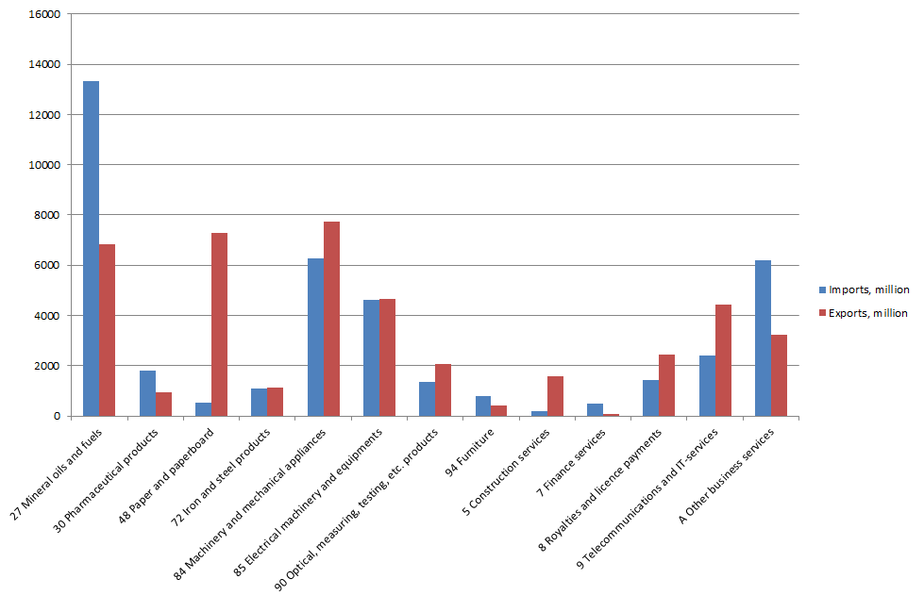
Facts to be explained 2: Intra-industry trade
Figure: Finland, exports and imports of some product categories 2013 (million euro)

Slide 15
Facts to be explained 2: Intra-industry trade

Slide 16
Facts to be explained 2: Intra-industry trade
One way to understand intra-industry trade:
Product differentiation and consumer's love-of-variety
Theory of monopolistic competition and increasing returns to scale.

Slide 17
The 'new trade theories' & applied models to explain intra-industry trade
Lecture 5: Increasing returns to scale and imperfect competition (theories from year 1977 onwards)
Lecture 6: Intra-industry trade (theories from 1970's and 1980's) and Gravity modelling (theories from 2002 & 2003 )
Lecture 7: Strategic (theories from 1980's) & applied trade policy, including applied partial and general equilibrium models' basics (developed especially after 1990's)
Lecture 8: Firm heterogeneity and the Melitz model (empirics from 1995 onwards and Melitz model from 2003)
Notes:
Krugman’s model
Firms are not identical

Slide 18
Facts to be explained 3: Off-shoring
Boeing 787 is produced in USA?

Slide 19
Facts to be explained 3: Off-shoring
Lot of research in the last 15 years on analyzing the fragmentation of production processes (outsourcing of some stages of production to other firms located possibly in foreign countries).
One measure of international outsourcing is the share of imported intermediates in production.
An increase in the share may be an indication of off-shoring
Factories of Nokia and Kone abroad increased imported intermediate input use

Slide 20
Facts to be explained 3: Off-shoring
Especially small countries such as Denmark, Finland, Netherlands and Sweden have a high share of imported intermediates.
The increases have been highest in Denmark, Finland, Germany and Sweden (largest percent increase in Japan).
What explains the increasing fragmentation and off-shoring of production?
Liberalization of world trade, communication technologies, integration of Eastern Europe and China in the world economy, increasing international competition.
The other side: increasing exports of services.

Slide 21
Facts to be explained 3: Off-shoring
Global fragmentation of production processes and 'trade in tasks’
What statistics should be looked when we want to analyze the effects of trade on labor markets? Gross exports vs. domestic value added of exports?
Notes:
IBM China assembling

Slide 22
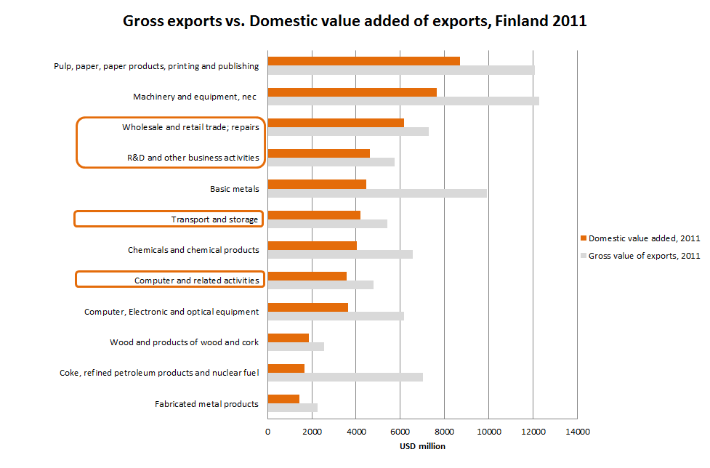
Facts to be explained 3: Off-shoring
Figure: Gross value of exports vs. their domestic value added (VA), Finland (OECD, TiVA indicators)

Slide 23
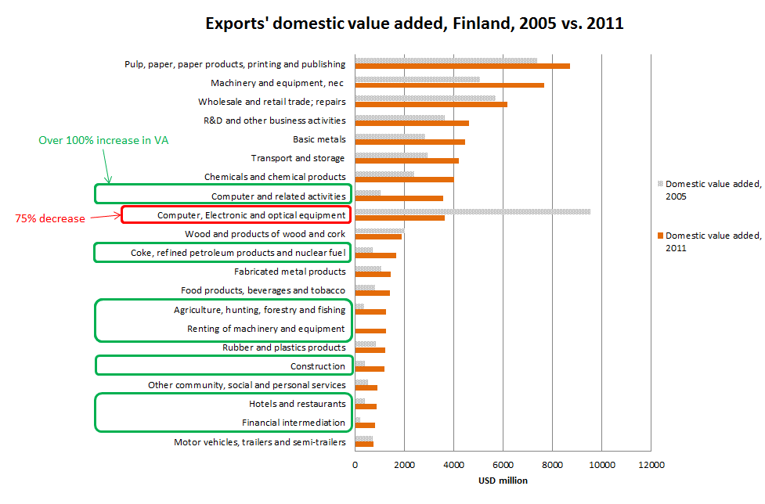
Facts to be explained 3: Off-shoring
Figure: The Great Structural change in Finnish exports (OECD, TiVA indicators)

Slide 24
Facts to be explained 3: Off-shoring
How does trade affect our job markets?
Does off-shoring shift our jobs to China?

Slide 25
Models on multinationals &trade in tasks to explain these phenomena
Lecture 9: Multinational Firms and Fragmentation of Production (theories from 2004 onwards)
Lecture 10: Offshoring and labor markets (theories developed during the last 10 years)
Lecture 11: Trade and income inequality (theoretical explanations developed from 2008 onwards)

