Slide 1
Data driven Real Time Economy Aalto University 9.4.2019 Bo Harald

Slide 2
Agenda
The Big Picture – automation, real time and service design
Leading the way.
2.1. Deep roots – connecting customers with standardization & 4-corner models
2.2. Real Time Economy program
2.3. GDPR+MyData for life event driven service design
2.4. Big Data – Big time
Five Big Leaps
4. Questions

Slide 3
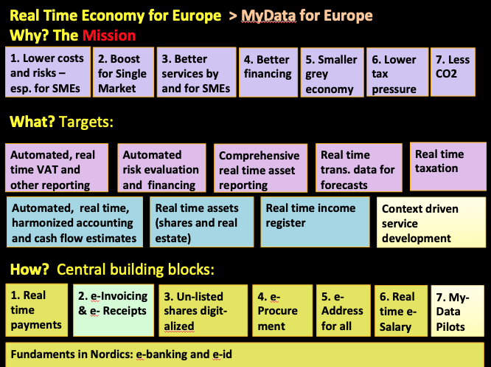
Automation in Real Time
1. Huge cost
savings
2. Better productivity
3. Better services
4. Economy forecasting
1.Real
Time
Economy
Real time BigData
Real Time MyData
Data for Life Event-based
Service Design
(AI driven)
GDPR

Slide 4
2.1. Leading. Why has Finland led the Fintech way?
1. Mission driven – save costs and time for customers
2. Make it convenient > e-invoicing
3. Connecting customers in new ways
4. Automate entire value chain (from orders to accounting and VAT-reporting)
5. Ecosystem thinking

Slide 5
How? Deep ecosystem roots > global leadership
First in e-banking (1982)
First in e-ID (1992) – KYC reused 150 million times (e2019)
First in e-commerce payments (1996)
First in e-signing 3rd party contracts (1998)
First in e-invoicing ecosystem (1998) – 450million (e2019)
First in e-foreign payments (1999)
First in e-salary ecosystem (2000)
First in mobile banking (2000)
First in SEPA adoption – EU-wide ecosystem
First in e-Receipts?
First in Real Time VAT-reporting?

Slide 6
2.2. Real Time Economy – public-private co-innovation-program
Full
SEPA
FVC
FIA1
FIA2
SME50
2006
2008
2009
2010
2012
Ecosystem work:
RTE-> TARU->Taltio -> RTECO programmes
Full SEPA
(Full Single European Payment area)
SEPA payments
E-invoicing
FVC
(Full Value Chain)
Harmonizing from e-order
to e-invoicing
FIA 1
( Fully Integrated Accounting 1)
1.1.2009-30.6.2010
E-accounting reference
Standard for Electronic Financial Reporting
Global e-invoicing standard ISO20022
European e-invoicing work
FIA 2
(Fully Integrated Accounting 2) 1.8.2010-30.12.2011
Electronic Financial Statement and XBRL
Fully Integrated Payroll (FIP): Payroll reporting codes and practices
Real-Time VAT
European e-invoicing work
SME 50 (’Administrative costs in half…’)
2012-2013
AFA – Automated Financial Administration
FAR – Fully Automated Reporting
ERM – Enterprise Risk Mitigation
SIM – Sustainability Intelligence Management

Slide 7
Real Time Economy for Europe > MyData for Europe
Why? The Mission
1. Lower costs and risks – esp. for SMEs
2. Boost for Single
Market
3. Better services by and for SMEs
4. Better
financing
5. Smaller
grey
economy
6. Lower tax
pressure
7. Less CO2
What? Targets:
Automated, real time VAT and other reporting
Automated risk evaluation and financing
Comprehensive real time asset reporting
Real time trans. data for forecasts
Real time
taxation
Automated, real time, harmonized accounting and cash flow estimates
Real time assets
(shares and real estate)
Real time income
register
Context (Life event) driven service design
How? Central building blocks:
1. Real time payments
2. e-Invoicing
& e- Receipts
3. Un-listed shares digit-alized
4. e-Procurement
5. e-Address
for all
6. Real time e-Salary
7. My-Data Pilots
Fundaments in Nordics: e-banking, e-ID services, 4-corner ecosystems

Slide 8
RTE going borderless
Ministry of Finance: Finland to become first Real Time Economy in Europe
Tax: Real Time VAT reporting
EU: REFIT horizontal program: Real Time Economy/Timmermans
Nordic countries: Nordic Smart Government, XBRL > ASD, VATreporting etc
Estonia: cowork on e-receipt etc
Globally: over 50 countries have made e-Invoicing public-sector-mandatory. e-Receipt now rising.

Slide 9
2.3. MyData service design
Do Not serve your customer!
Serve the customers life event with Mydata and BigData and AI
PSD2 model for all data
GDPR protects and empowers the citizen

Slide 10
Strengthen individual rights and trust towards data handling
Strengthen, harmonise and clarify data protection
Enable new personal data based services
EU GDPR gives the legal right
MyData takes the data to the life event
Notes:
object: GDPR vs. MyData

Slide 11
Simple insight:
The only thing scarce in a world of abundance is human attention.

Slide 12
The best innovation is often
Reuse of a familiar tool
For new purposes
"What I hear, I forget.
What I see, I remember.
And what I do, I understand.“

Slide 13
It is all about human behaviour….
"What I hear, I forget.
What I see, I remember.
And what I do, I understand.“
Learn once – use everywhere – (SMS, Bank e-id 150m times, Youtube, WhatsUp..)
Economy of Repetition + Economy of Trust + Economy of Reuse + Economy of Scope + Economy of Scale = fast adoption = ∑ €€€€€€€ !!!

Slide 14
Simple ideas are easier to understand.
Ideas that are easier to understand are repeated.
Ideas that are repeated change the world.

Slide 15
2.4. Data – the new ”Oil” – that can be used infinitively…
Two kinds of data: MyData and BigData
What is the combined value of My- & BigData? For AI. When it is:
Structured +
Standardized +
Verified +
Delivered in Real Time

Slide 16
RTE Big Data in 4 big realtime screens
Income
- Salaries
- Social support
- Pensions
- Dividends
Per:
Sector
Region
Skill
Gender
Age
Spending
e-invoices
e-receipts
Per:
Sector
Region
Type of seller
Type of buyer
Turnover
Based on VAT reports
Per:
Sector
Region
Size of enterprise
Export/Import
Investments
Listed shares
Funds
Unlisted shares
Real Estate
Bank accounts
Per:
Sector
Region
Type of investor
Tenor
https://www.finextra.com/blogposting/16304/four-big-screens

Slide 17
3. Five Big leaps
Productivity leap (RTE)
Service Design leap (GDPR/MyData)
Technology leap (DLT)
AI-leap
Single Market leap (REFIT)
All five support each others!

Slide 18
4. Questions (1/2)
This will all materialize – only a question of time. How can we make it happen faster? Much faster.. Europe cannot afford to wait…
Is there any reason why invoice and receipt data should not be in structured form by xx.xx.21 (with exceptions granted on specific terms) ?
Regulation and mandatoryship the ordinary cause of business in payments, trading, telecom etc. Is anybody against it in next RTE-layers – where the benefits are massive?

Slide 19
4. Questions (2/2)
4. Should the infrastructure needed (standards, rulebooks and governance) be publicly financed – like roads?
5. Can we be sure that business secrets are not in danger? Do we need GDPR for SMEs?
6. How can Tax and Statistics support European enterprises with Big Data?

Slide 20
Simple ideas are easier to understand.
Ideas that are easier to understand are repeated.
Ideas that are repeated change the world.
See to the narrative!
https://greenstep.fi/artikkelit/the-time-is-now

Slide 21
Notes:
21

Slide 22
Start early – let mature – implement gradually
“Any hype will do”
Early start: “Explorer”
Late (re)start: “Panicky follower”
“ICE AGE”
“ICE AGE”
Notes:
22

Slide 23
The Data driven future is not planned
nor prognosed
It is created !
Action is All!
Thank you
Bo.harald1@gmail.com

