Slide 1
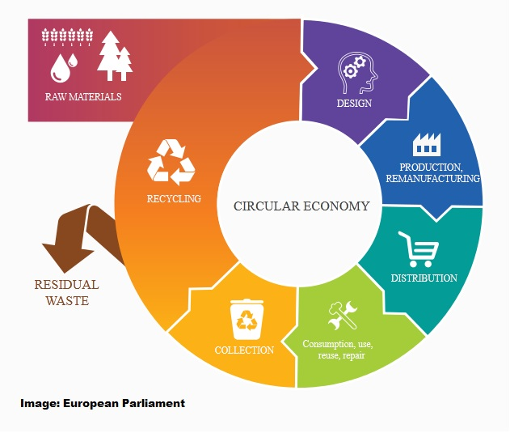
Course Practicalities
AAE-E3120 Circular Economy for Energy Storage
Neha Garg (Responsible Teacher)
Annukka Santasalo-Aarnio (Responsible Professor)
Simon Jech (Responsible teaching assistant)
Arjun Muralidharan (Teaching assistant)

Slide 2
Learning outcomes
Identify circular economy concepts and the role of energy in recycling
Recognize the material choice effect to degradation mechanisms of the system
Develop new design for recycling approach for energy storage application and justify with scientific argumentation

Slide 3
Module Based Learning
The course has 3 Modules
Module A - Circular Economy and Recycling concept
Module B – New Material Solutions
Module C – Eco-design
Timetable for modules and contact sessions at MyCourses

Slide 4
Module Based Learning
Each Module has the same tasks (duration around 2 weeks)
2-3 Video Module Lectures
(available in the beginning of the module)
Find individual reading material related to your application and topic of the module
Contact Session (end of module):
Where group present and discuss posters, teaching staff address the questions posted
Possibility to ask/elaborate any questions
Personal task (Lecture journal) where you reflect the videos and readings
Group task (Poster preparation) you meet with your group (in person/online) reflect your learning from the module and prepare a poster of your application point of view
Online, dates will be provided at the front page of MyCourses
Mandatory attendance at the contact sessions
(or replacing assignment)

Slide 5
Course tasks
Personal Tasks (85 p.)
Lecture Journals (3 x 20 p.) 60 p.
Energy return on energy stored 20 p.
Webropol Feedback 5 p.
Group tasks (65 p.)
Posters (3 x 10 p.) 30 p.
Final project – Eco-design 35 p.
In Total 150 p.
You will require min. 90 points to pass the course

Slide 6
Poster dates
Friday 03.11.2023 (13.00-16.00)
Friday 17.11.2023 (13.15-16.00)
Friday 01.12.2023 (13.15- 16.00)

Slide 7
Personal tasks

Slide 8
Questions at video modules
The blue boxes have questions, when appear at video lecture, please pause the video and write short notes to your journal
Reflect to your
lecture journal
What do you think…
On your opinion…
These are questions that you can think during your learning journey, but you do NOT need to address these on your journal

Slide 9
Lecture Journals
There is a lecture journal template (please use that) – MyCourses
Lecture journals are your personal reflective work:
Each Lecture Journal markings:
Three video lectures (3*5p)
Journal paper review (3p)
Conclusions from the module (2p)
If you have further questions from the module, please put them at “Questions for the Module” – at the end of each journal assignment (that can be about the videos/reading material) -

Slide 10
Energy return on Energy stored
Calculate how much energy we need for the storage raw materials
You will:
Get an idea how much energy we need
How does it compare with the stored energy over storage lifetime
Understand the potential energy intensity of raw materials
More information will be provided during poster session 1

Slide 11
Group tasks

Slide 12
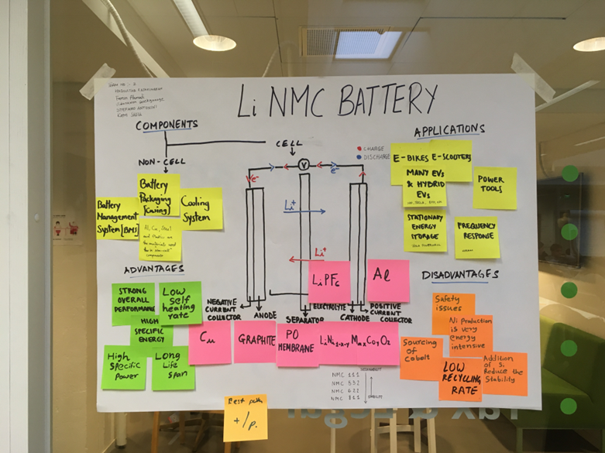
Group tasks: Posters
Group selects
an application –
where they apply the knowledge from the modules

Slide 13
Group tasks: Posters
 | Topic | Poster instructions
Poster1 | Application and state-of-art Materials | 1 )What is the application and how does it work? 2) What are the state-of-materials used in this application?
Poster 2 | New material solutions | What are the current material innovations on your application? What are the most relevant durability issues in your application?
Poster 3 | Current material availability and life cycle assessment | What is the material availability for your applications? The whole value chain of your application (i.e. LCA )

Slide 14
Final Project: Eco-Design
Make an innovation presentation of Eco-Design for your energy storage application
(No written report, only PowerPoint slides)
(More information will be provided during poster session 2)

Slide 15
Group formation

Slide 16
Team division
Material expertise
Chemical engineering
Energy engineering
All other background

Slide 17
Warm up exercise
Prepare a mind map for
Energy Storage Technologies

Slide 18
Example mind map
Pumped Hydroelectric
Storage (PHS)
Compressed Air Energy Storage (CAES)
Flow Batteries
Superconducting Magnetic Energy Storage (SMES)
Batteries
Mechanical
Electrical/Electro-chemical
Supercapacitors
Flywheels
Energy Storage
Applications
Latent Heat Energy Storage
Thermal
Chemical
Electrolyser
Fuel Cells
Termochemical Energy Storage
Sensible Heat Energy Storage

Slide 19
Group application
Choose 4 different storage technologies from the different storage types (you can make a preference order)
1. Mechanical
2. Electrical/Electrochemical
3. Thermal
4. Chemical
Provide for the information in MyCourses
Latest by Fri 27th at 12 pm

Slide 20
At this course, we do not go through Energy Storage Systems, therefore you can start with :
A0 Module:
A.R. Dehghani-Sanij et al. Study of energy storage systems and environmental challenges of batteries, Renewable and Sustainable Energy Reviews 104 (2019) 192–208 (MyCourses)
Look at the video module ”A0 Energy Storage Systems”

Slide 21
Welcome to the course
We will meet at poster session 1
If you decide not to participate, please contact the course staff

