Slide 1
Commodities and emerging markets. The resource curse and Dutch desease.
Svetlana Ledyaeva
Aalto BIZ

Slide 2
Commodities
Substitutability: A commodity is an economic good or service that has full or substantial substitutability: that is, the market treats instances of the good as equivalent or nearly so with no regard to who produced them.
Price factor: A good or service whose wide availability typically leads to smaller profit margins and diminishes the importance of factors (such as brand name) other than price.
The price of a commodity good is typically determined as a function of its market as a whole: well-established physical commodities have actively traded spot and derivative markets.
Most commodities are raw materials, basic resources, or agricultural products, such as iron ore, sugar, or rice.

Slide 4
Main commodities
Grains, food and fiber | Livestock and meat | Energy | Industrial metals | Precious metals | Other
Corn | Lean Hogs | WTI crude oil | Copper | Gold | Amber
Oats | Live cattle | Brent crude | Lead | Platinum | Palm Oil
Rice | Feeder cattle | Ethanol | Zinc | Palladium | Rubber
Soybeans |  | Natural gas | Tin | Silver | Wool
Rapeseed |  | Heating oil | Aluminium
Soybean meal |  | Gulf Coast Gasoline | Alumunium Alloy
Soybean oil |  | RBOB Gasoline | Nickel
Wheat |  | Propane | Cobalt
Milk |  | Purified Terephthalic Acid | Molybdenum
Cocoa |  |  | Recycled steel
Coffee
Cotton
Sugar
Frozen concentrate orange juice
Adzuki bean

Slide 5
Performance of each emerging market in 2016 (when commodities have experienced their most significant rally since the end of 2011) and their correlations to gold, silver, oil and the Bloomberg Commodity Index
YTD-year to date

Slide 6
The correlation of EM equities to commodity prices

Slide 7
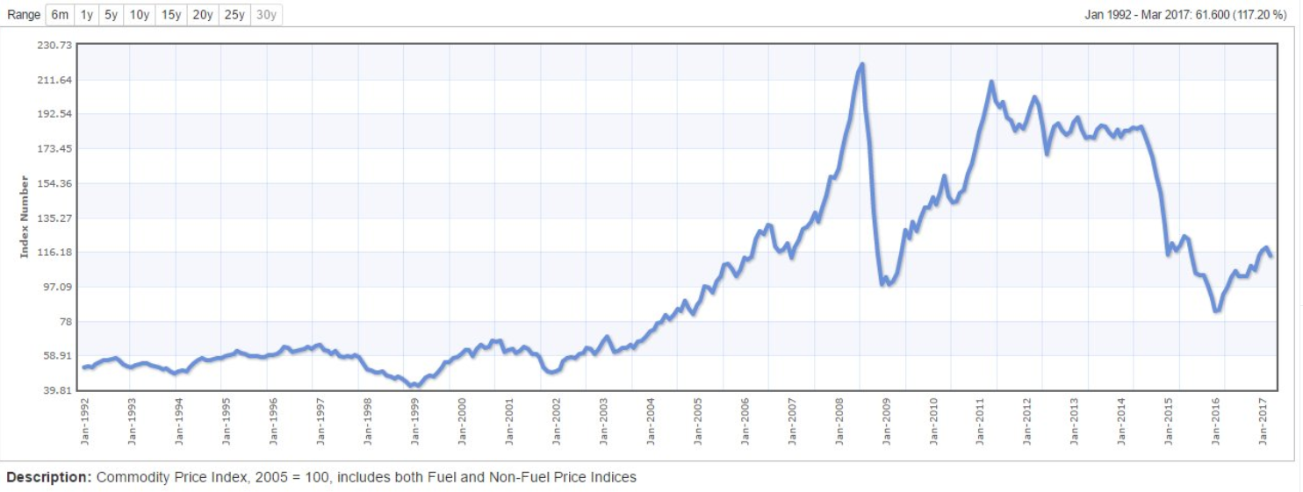

Slide 8
PERCEPTION
The relative performance of emerging markets is linked to the performance of commodities, ➔ “betting” on emerging markets might be similar to “betting” on commodities.
Indeed, some of the big oil exporters are based in emerging markets, like the Arabian Gulf countries, Russia, Venezuela, Nigeria, Libya, Mexico, etc.
Also, some of the big exporters of industrial metals, grain, etc. are Brazil, South Africa, Russia, Argentina, etc.
Simultaneously, developed markets are the consumers of all of those commodities.

Slide 9
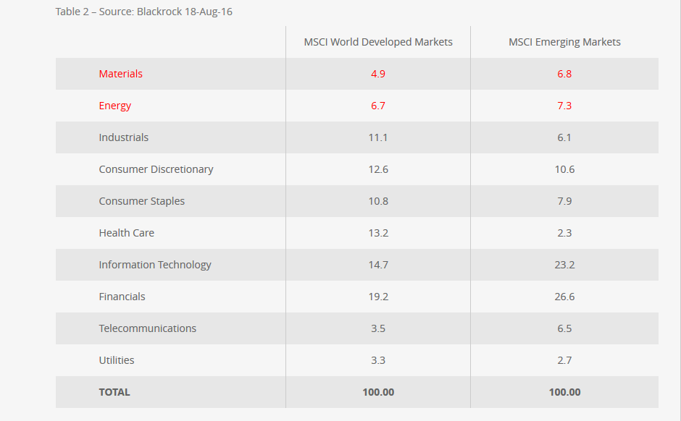
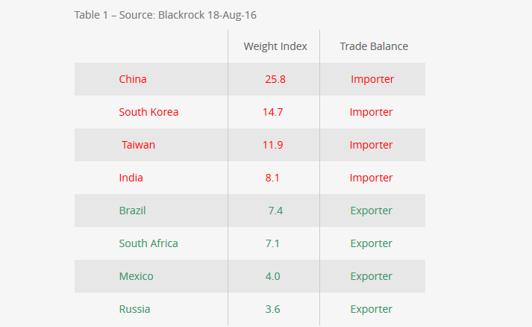
REALITY
Not true for all emerging markets! China is the biggest exception!

Slide 10
Natural resources curse
The term resource curse encompasses the significant social, economic and political challenges that are unique to countries rich in oil, gas and minerals.
Many oil-, gas- and mineral-rich countries have failed to reach their full potential as a result of their natural resource wealth.
In general, they are also more authoritarian, more prone to conflict, and less economically stable than countries without these resources.

Slide 11
Resource curse in Emerging economies
The worst development outcomes - measured in poverty, inequality, and deprivation - are often found in those countries with the greatest natural resource endowments.
"There are twenty-three countries in the world that derive at least 60 percent of their exports from oil and gas and not a single one is a real democracy," observes Larry Diamond of Stanford University.

Slide 12
Mineral resources and economic development
African countries (Angola, Nigeria, Sudan) rich in resources ➔Low per capita income and low quality of life.
East Asian economies Japan, Korea, Taiwan, Singapore and Hong Kong have achieved western-level standards of living despite being rocky islands (or peninsulas) with virtually no exportable natural resources.

Slide 13
Explanations for resource curse? Numerous!

Slide 14
Possible Channels of the Natural Resource Curse
It is not that countries with oil wealth will necessarily achieve worse performance than those without.
Norway versus Nigeria
Oil production per capita, barrel/day/million people
313,661 10,752
GDP per capita in 2019
$75 420 $2 230
Global competitiveness ranking in 2019
17 116

Slide 15
Democracy: Oversight incentives in resource-rich and resource-poor countries

Slide 16
Conflict
Natural resources can, and often do provoke and sustain internal conflicts as different groups fight for control of the resources or use natural resources to finance their fighting.
The tendency of oil-rich states to provoke or be targets of international conflict, has been observed in some cases, such as with Iraq’s invasion of Iran and Kuwait.

Slide 17
Weaker institutional development
Institutions can be weaker in resource-rich countries because it is easy for elites to capture or take large sums of cash.
Rent-seeking and rent-seizing ➔
Corruption and week institutions.

Slide 18
The quality of institutions
A prominent trend in economic thinking: the quality of institutions is the deep fundamental factor that determines which countries experience good performance and which do not.
On one hand:
In high-rent countries the natural resources elicit a political contest to capture ownership.
In low-rent countries the government must motivate people to create wealth:
by pursuing comparative advantage, promoting equality, and fostering civil society.
On other hand:
The important question is whether the country already has good institutions at the time that oil/other resources is discovered, in which case it is more likely to be put to use for the national welfare instead of the welfare of an elite.

Slide 19
Price arguments 1
Prices of commodities/resources could be subject to secular decline on world markets.
The hypothesis suggested Paul Prebisch (1950) and Hans Singer (1950), “structuralist school”: The prices of mineral and agricultural products follow a downward trajectory in the long run, relative to the prices of manufactures and other products, to be called the “structuralist school”.
The theoretical reasoning was that world demand for primary products is inelastic with respect to world income. That is, for every one percent increase in income, the demand for raw materials increases by less than one percent.

Slide 20
Test of Prebisch–Singer hypothesis
Yamada and Yoon, 2014, When Grilli and Yang meet Prebisch and Singer: Piecewise linear trends in primary commodity prices
Published in Journal of International Money and Finance
They find that the Prebisch–Singer hypothesis holds sometimes, but not always.

Slide 21
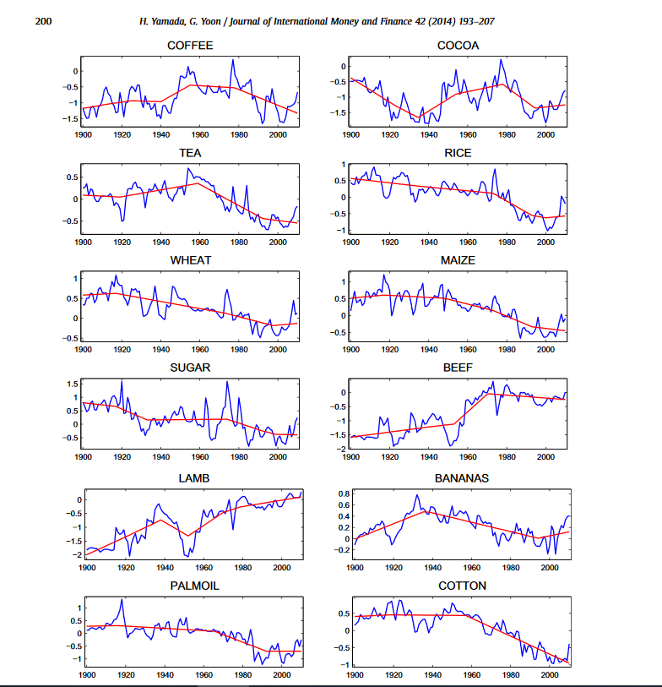

Slide 22
Prebisch–Singer hypothesis ➔ Advice for developing/emerging countries!
To allow their domestic manufacturing sector to develop behind protective walls,
rather than exploiting their traditional comparative advantage in natural resources as the classic theories of free trade would have it.
➔ “Import substitution industrialization” policy!

Slide 23
Price arguments 2
There also exist persuasive theoretical arguments that we should expect prices of oil and other minerals to experience upward trends in the long run.
Demand grows with population, supply is fixed; what could be clearer in economics than the prediction that price will rise?
Hotelling (1931) deduced from these assumptions the important theoretical principle that the price of oil in the long run should rise at a rate equal to the interest rate.
Empirical evidence: Terms of trade for commodity producers had a slight upward trend from 1870 to World War I, a downward trend in the inter-war period, upward in the 1970s, downward in the 1980s and 1990s, and upward in the first decade of the 21st century.

Slide 24
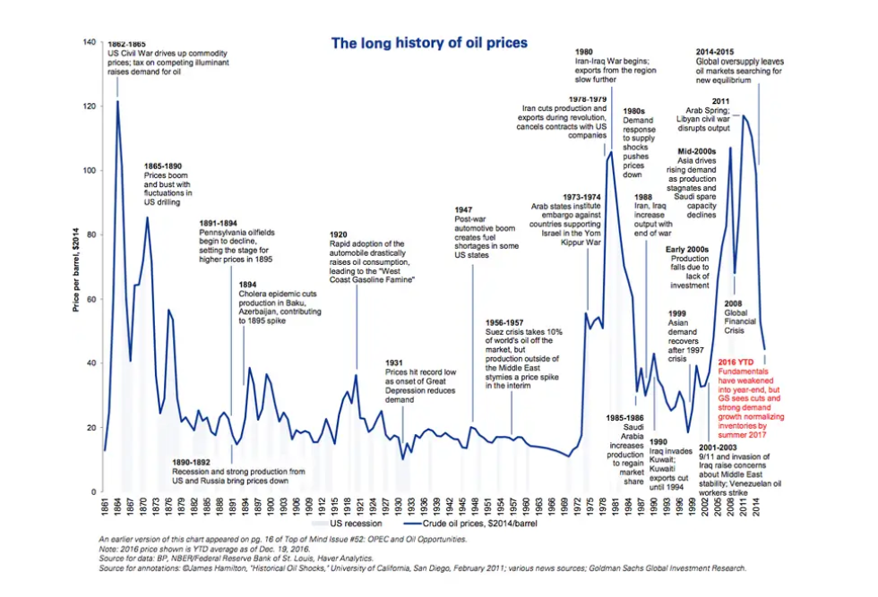

Slide 25
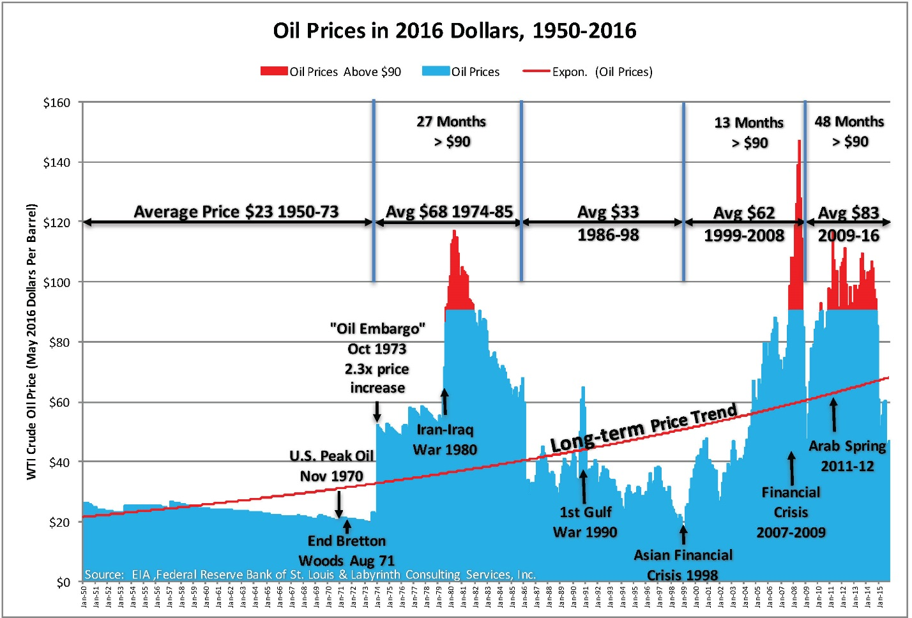

Slide 26
Medium-term Volatility of Commodity Prices
The price of oil does not follow a smooth path, whether upward or downward.
Even prices of other mineral and agricultural commodity prices are far more volatile than prices of most manufactured products or services.
In general commodity price volatility has negative impact on economic growth.

Slide 27
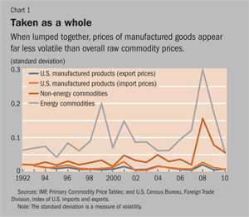
Some graphs on price volatility: commodity versus others
Third channel – commodity price volatility!

Slide 28
Volatile prices ➔Inefficient spending and borrowing
The amount that governments collect in resource revenues can change drastically from year to year because of changes in commodities prices and production.
Several studies have shown that it is very difficult to effectively spend fluctuating and unpredictable revenues.
However! Emerging markets try to solve this issue!
Successful example: Stabilization fund of the Russian Federation

Slide 29
Stabilization fund of Russia
The Stabilization fund of the Russian Federation ("the Fund") was established on January 1, 2004 to balance the federal budget at the time when oil price falls below a cut-off price. In 2008 it was divided into Reserve fund and National Wealth Fund.
When oil price is high – Fund accumulates excessive oil export revenues; when the price is low – the fund is used to finance federal budget deficit, etc.
Due to crisis in Russia, by 01.01.2018, the Reserve fund was spent off (On 01.02.2008 it was equal to 125.19 billion USD).
Now National Wealth Fund is being used for further expenses (75.59 billion USD on 01.11.2018).

Slide 30
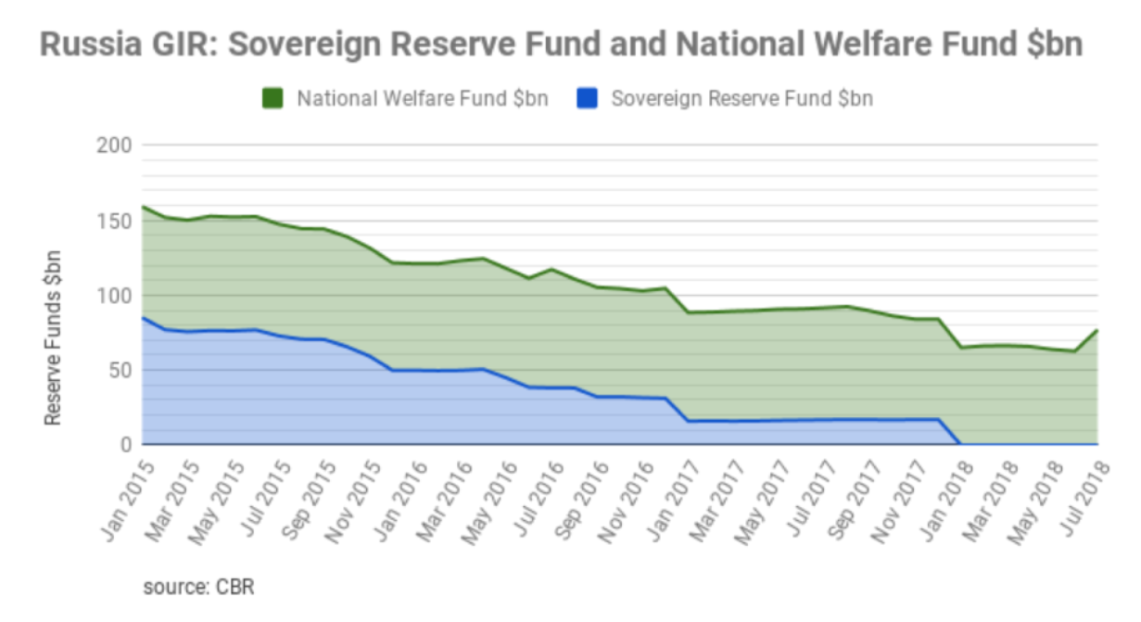

Slide 31
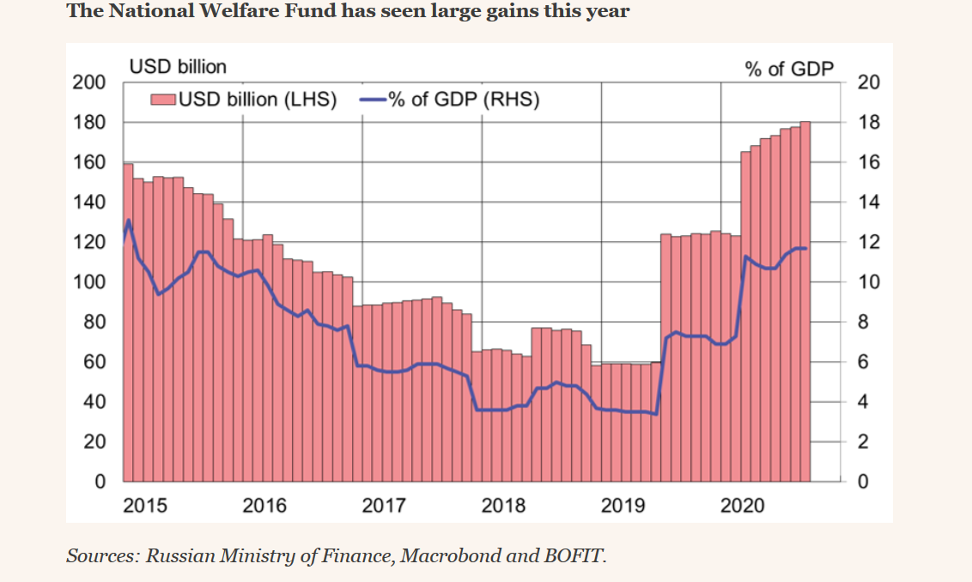
last

Slide 32
Political resource course (Brollo et al. 2013, American Economic Review)
This paper studies the effect of additional government revenues on political corruption and on the quality of politicians, both with theory and data (data is for Brazil).
The empirical evidence shows that larger transfers increase observed corruption and reduce the average education of candidates for mayor.

Slide 34
Dutch disease: History and definition
Is the apparent relationship between the increase in exploitation of natural resources and a decline in the manufacturing sector (or agriculture).
The term was coined in 1977 by The Economist :
The decline of the manufacturing sector in the Netherlands after the discovery of a large natural gas field in 1959.
Bad institutions: prerequisite for Dutch disease.

Slide 35
Dutch disease vs. resource curse
are often used interchangeable,
But:
Resource curse refers to the political and social consequences of country`s high dependence on resources` export.
Dutch disease refers only to the effects of the resulting currency appreciation and changes in the cost of factors of production.

Slide 36
Dutch disease – theoretical model (Bruno and Sachs (1982); Corden and Neary (1982))
Spending effect
Tradable resource (oil) sector
Tradable (manufacturing) sector
Non-traded sector (services)
The resource movement effect
What happens when world oil price goes up?
The spending effect;
The resource movement effect.

Slide 37
Dutch disease: General concept

Slide 38
Dutch disease - outcome
A result:
A fall in the output share of non-natural resource tradables (manufacturing sector) relative to non-tradables (mostly service sector) and resource tradables (e.g. oil industry).

Slide 39
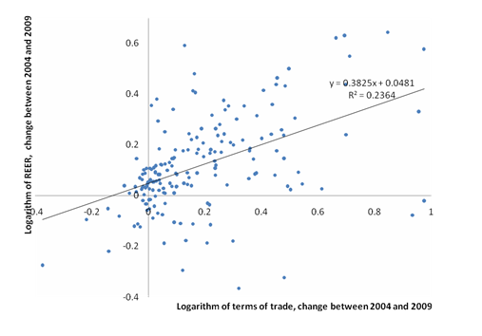
Is there any empirical evidence of Dutch Disease?
Relatively robust evidence that terms of trade increases cause real exchange rate appreciation in natural-resource-rich countries (for example Spatafora and Warner 1995). ➔ local currency appreciation hurts domestic manufacturing sector (particularly export-oriented)!
Vostroknutova, Brahmbhatt, Canuto, VoxEU 2010.

Slide 40
Is there any empirical evidence of Dutch Disease?
The shrinking of the manufacturing sector in response to terms of trade: mixed evidence (Sala-i-Martin and Subramanian 2003).
Ismail (2010) finds strong evidence for Dutch Disease effects, with a 10% increase in an oil windfall/income associated with a 3.4% fall in value added across manufacturing sectors.
On average in resource rich countries the tradables sector (manufacturing plus agriculture) is around 15% of GDP lower than the norm (Vostroknutova, Brahmbhatt, Canuto, VoxEU 2010).

Slide 41
Dutch Disease is good or bad for growth?
Positive:
-higher incomes and allowing more consumption of both non-tradables and tradables;
-increased resources for investment in public goods.
Negative: For Manufacturing
-possess specific long-term, growth-enhancing qualities: positive technological spillovers, learning by doing effects, or increasing returns to scale in production.
-more labour intensive than natural resource industries: implications for employment.

Slide 42
Dutch disease and growth
The effect for economic growth is inconlslusive. Negative: bad institutions.
Shocks that trigger foreign exchange inflows (such as natural resource booms, surges in foreign aid, remittances, or capital inflows) appreciate the real exchange rate, generate factor reallocation, and reduce manufacturing output and net exports.
Real exchange rate misalignment due to overvaluation, and higher volatility of the real exchange rate➔ lower growth.
There is actually no evidence in the literature that Dutch disease reduces overall economic growth.

Slide 43
The Dutch Disease (DD) and growth
Motivated by the experiences of China and other East-Asian countries, a new literature based on the export-led growth strategy states that maintaining an undervalued or “competitive” real exchange rate may foster economic growth—where the operative channel is the size of the (manufacturing) tradable sector. In this view, while real exchange rate overvaluations hurt growth, undervaluations foster it.
However, to show that DD reduces growth needs a strong assumption: that the manufacturing tradable sector is somehow “special.” Mostly, it has been assumed the existence of learning by doing or other types of externalities in this sector to obtain theoretical models linking DD with lower growth.

Slide 44
Natural resources abundance and growth
Economic growth
Exports of primary products as a fraction of GDP

Slide 45
The Dutch Disease: Summary
Upward swing in the world price of the export commodity/discovery of large resources deposits causes:
a large real appreciation in the currency.
an increase in spending (especially by the government).
an increase in the price of non-traded goods (goods and services such as housing that are not internationally traded), relative to traded goods (manufactures and other internationally traded goods other than the export commodity).
resultant shift of labor and land out of non-export-commodity traded goods.
When crowded-out non-commodity tradable goods are in the manufacturing sector, the feared effect is deindustrialization.

Slide 47
Dependence of emerging markets on resources

Slide 48
Total natural resources rent, % of GDP (threshold 2%)

Slide 49
Total natural resources rent, % of GDP

Slide 50
Total natural resources rent, % of GDP (threshold 3%)

Slide 51
Total natural resources rent, % of GDP (threshold 3%)

Slide 52
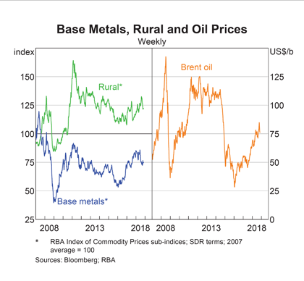
Commodity prices

Slide 53
Global growth versus commodity prices (de Souza VOX 2013)

Slide 54
Global growth and commodity prices (de Souza VOX 2013)
The most traumatic commodity price shocks can be found in the 1970s. The cumulative increases in global energy prices observed in 1973-1974 and 1979-1980 reached, respectively, around 200% and 100%.
➔significant negative changes in global economic growth
The negative correlation present during the 1970s to the mid-1980s seem to have changed after that period. Commodity price spikes have not been associated with similar growth slowdowns. If anything, the relationship would seem to be even slightly positive since the mid-1980s.

Slide 55
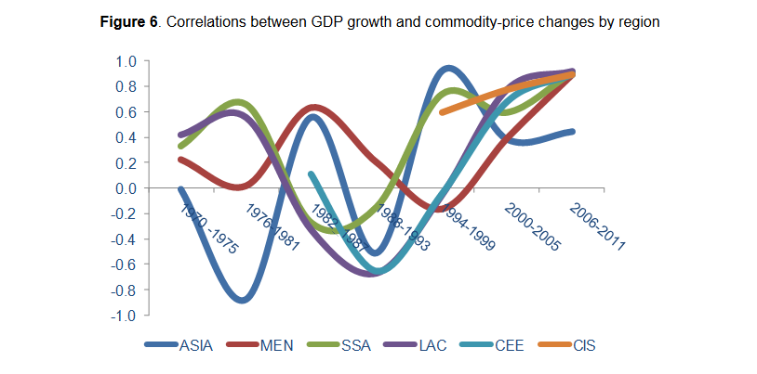
A rolling five-year correlation window between growth and commodity prices for the period 1970-2011 (de Souza VOX 2013)

Slide 56
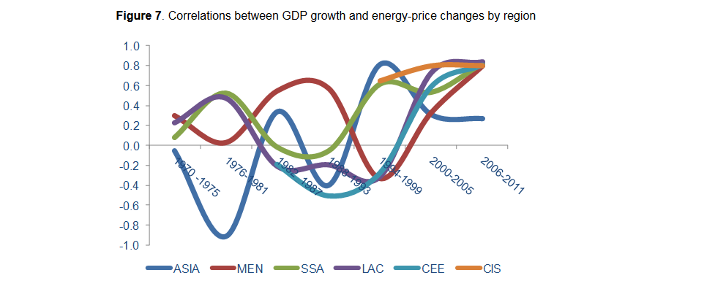
Correlations between GDP growth and energy prices changes (de Souza VOX 2013)

Slide 57
Conclusions (de Souza VOX 2013)
The global economy is more resilient (albeit certainly not immune) to commodity-price shocks than normally thought.
This is a conclusion that holds true for both developed and developing regions, and also broadly among different developing regions.
Reasons could be the greater commodity efficiency since the 1970s, or more robust policy frameworks and responses, such as greater central bank independence and inflation-fighting capacities (Bernanke et al, 1997), floating exchange rates, or sovereign wealth funds and fiscal rules.

