Slide 1
Vehicle Mechatronics: Control
Lecture 2: Longitudinal and Lateral Control
Slides: Jari Vepsäläinen

Slide 2
Topics
Control systems basics
Longitudinal control
PID
Feedforward PID
Lateral control
Follow-the-carrot
Pure pursuit

Slide 3
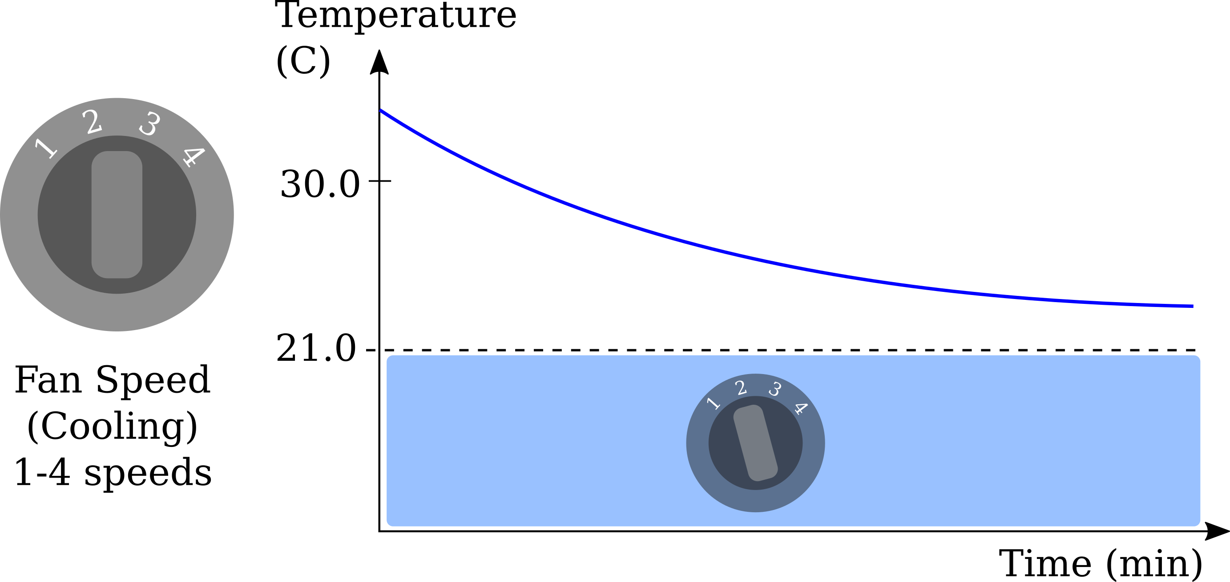
Car cabin thermostat
Error
Actual
Reference

Slide 4
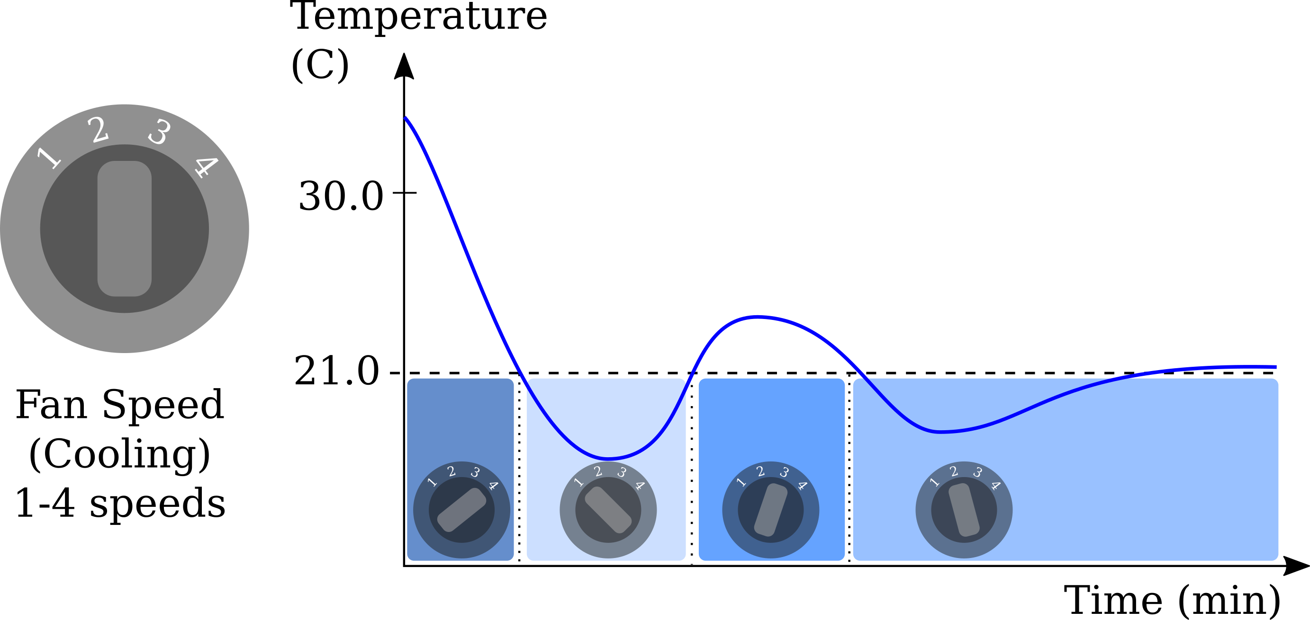
Car cabin thermostat

Slide 5
Control system - thermostat
PLANT
INPUT
OUTPUT
FAN SPEED
TEMPERATURE
CABIN

Slide 6
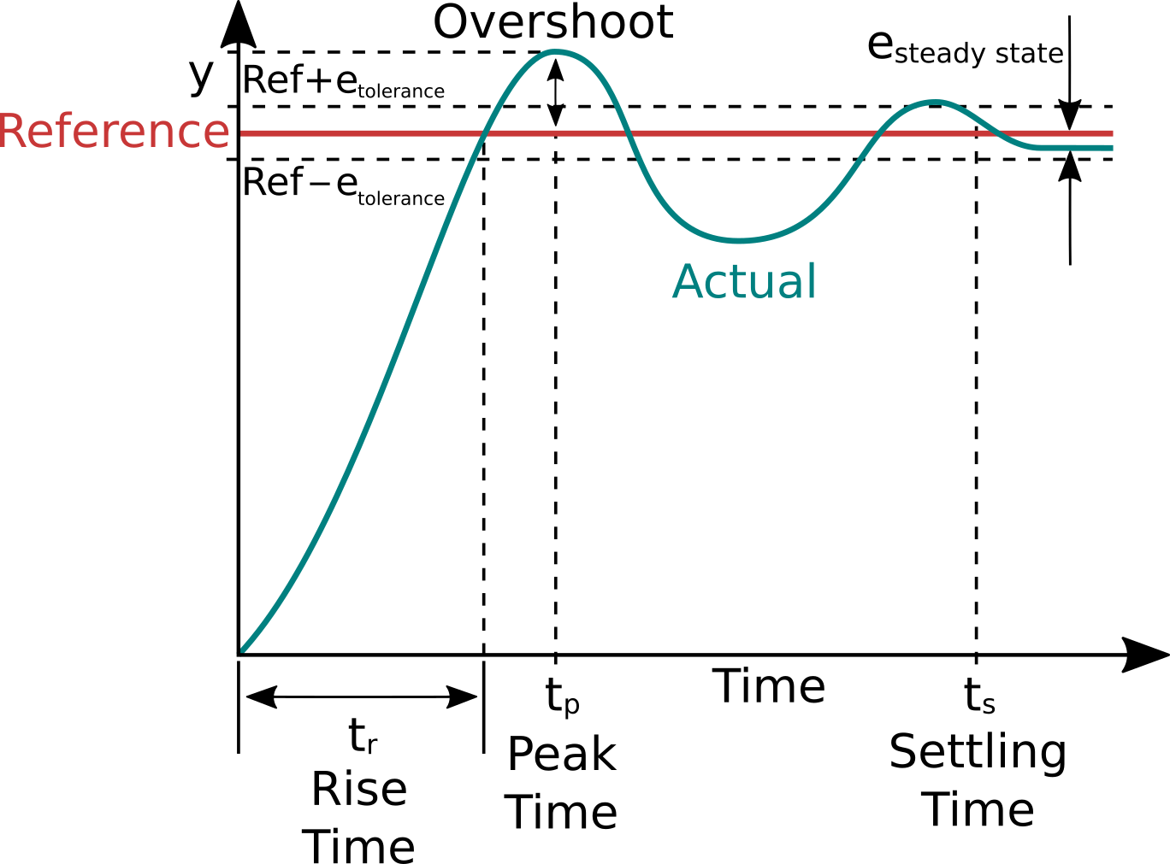
Terminology
Rise time
The time it takes to reach the
Overshoot
How much the reference is surpassed after reaching it
Peak time
Time at the peak of the overshoot

Slide 7
Terminology
Steady state error
The system is “steady” when the control is stable within tolerance limits
Settling time
The time to reach steady state error

Slide 8
Control systems
Open loop system
Based on estimates of how the system behaves
Estimated input -> hope for the best
Closed loop system
Based on feedback of how the system behaves
Measure output, compare to reference -> adjust

Slide 9
Open vs. closed loop system
PLANT
INPUT
OUTPUT
FAN SPEED
TEMPERATURE
CABIN
Error
PID
PLANT
Reference
+
INPUT
OUTPUT
-
TEMPERATURE
FAN SPEED
TEMPERATURE
CABIN
Measurement

Slide 10
Vehicle speed control
PLANT
INPUT
OUTPUT
GAS PEDAL
SPEED
VEHICLE
Error
PID
PLANT
Reference
+
INPUT
OUTPUT
-
SPEED
GAS PEDAL
SPEED
VEHICLE
Measurement

Slide 11
Longitudinal Control

Slide 12
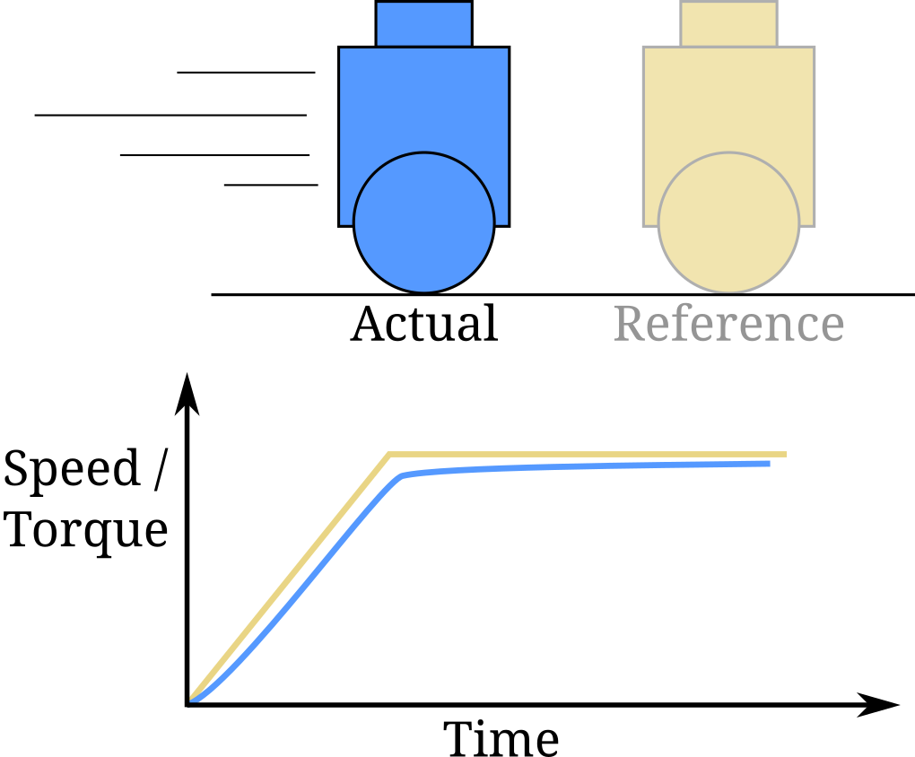
Longitudinal control
Control: minimize the offset to reference speed or torque
Controllers
PID controller
FF-PID controller

Slide 13
PID control
$$K_{p}$$
How the error term is treated?
Proportional – multiplied error
Integral – cumulative error
Derivative – changes in error
The controller is tuned by changing the gains of these error terms:
- $K_{p}, K_{i} and K_{d}$
$$K_{i}\int{ }$$
+
Error (e)
+
INPUT
+
$$K_{d}\frac{d}{dt}$$

Slide 14
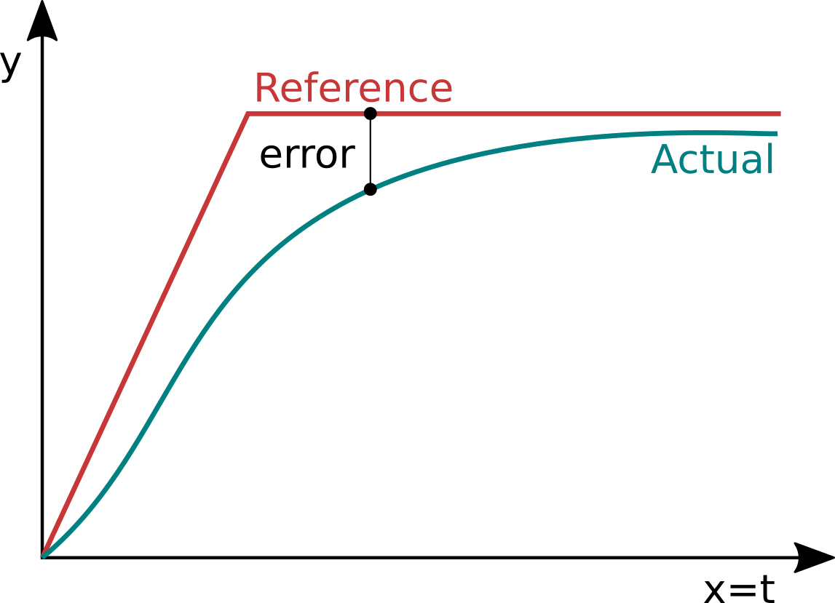
PID – Proportional gain
$$P=K_{p}∙error$$
Directly proportional to the current error
Control tuning typically starts with only tuning the proportional gain

Slide 15
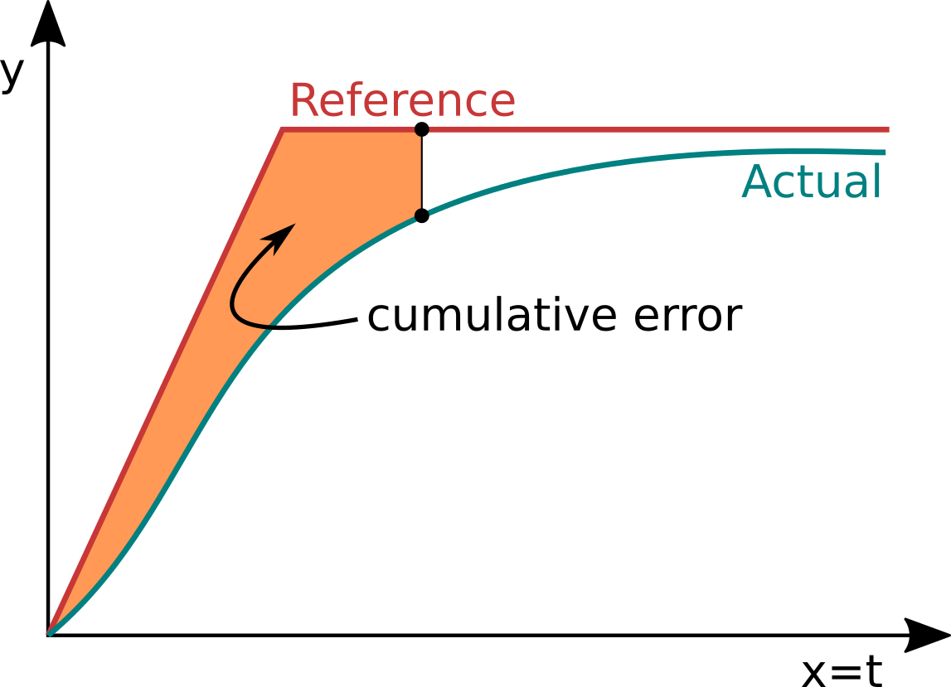
PID – Integral gain
$$I=K_{I}∙cumulative error$$
Helps to get rid of steady state errors

Slide 16
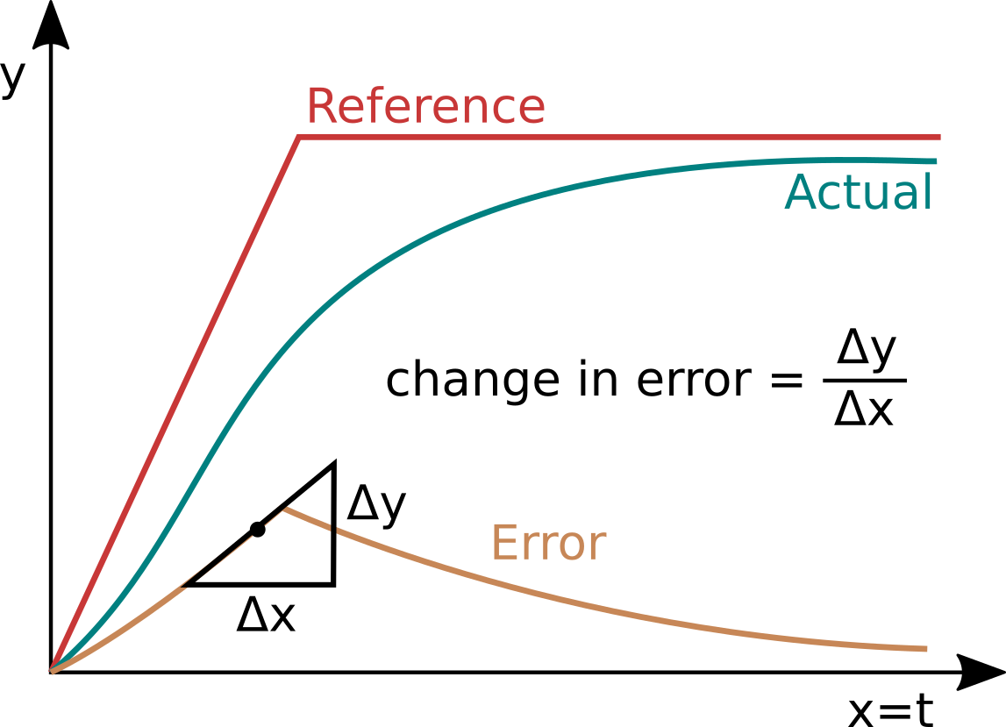
PID – Derivate gain
$$D=K_{D}∙changes in error$$
Tries to minimize sudden changes
Acts as a damper

Slide 17
Feedforward PID (FF-PID)
FF
Error
PID
+
INPUT
PLANT
Reference
+
+
OUTPUT
-
Measurement
FF - A proportional gain to the reference itself
Often referred to as predictive control
Makes the controller more aggressive on higher speeds and steadier in lower speeds

Slide 18
Lateral Control

Slide 19
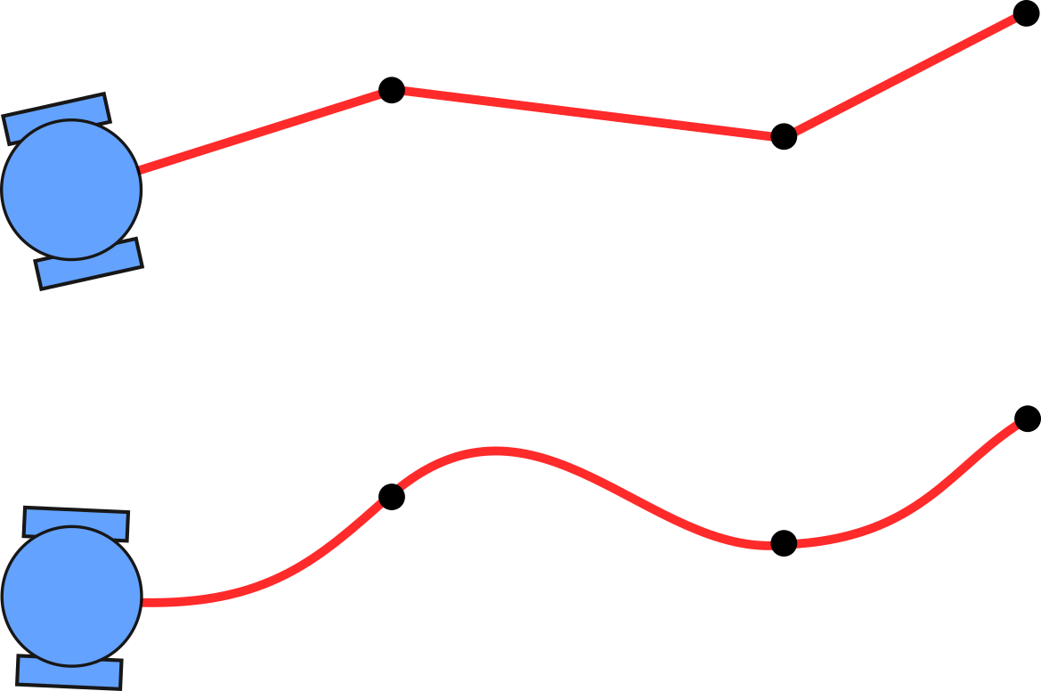
Lateral control
Waypoint-based reference path
Straight line segments
Parametrized curves
Control: minimize the offset to reference path

Slide 20
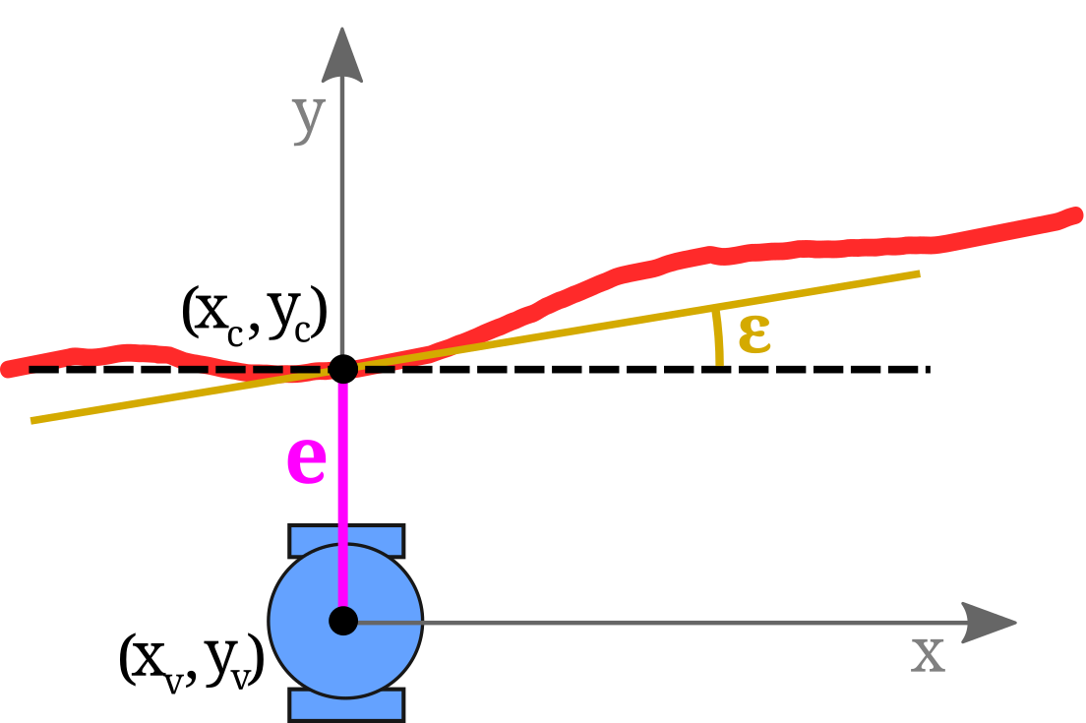
Lateral errors
Heading error, ε
The difference between path heading and vehicle heading at a reference point
Crosstrack error, e
Perpendicular distance from the path and a reference point (closest distance)

Slide 21
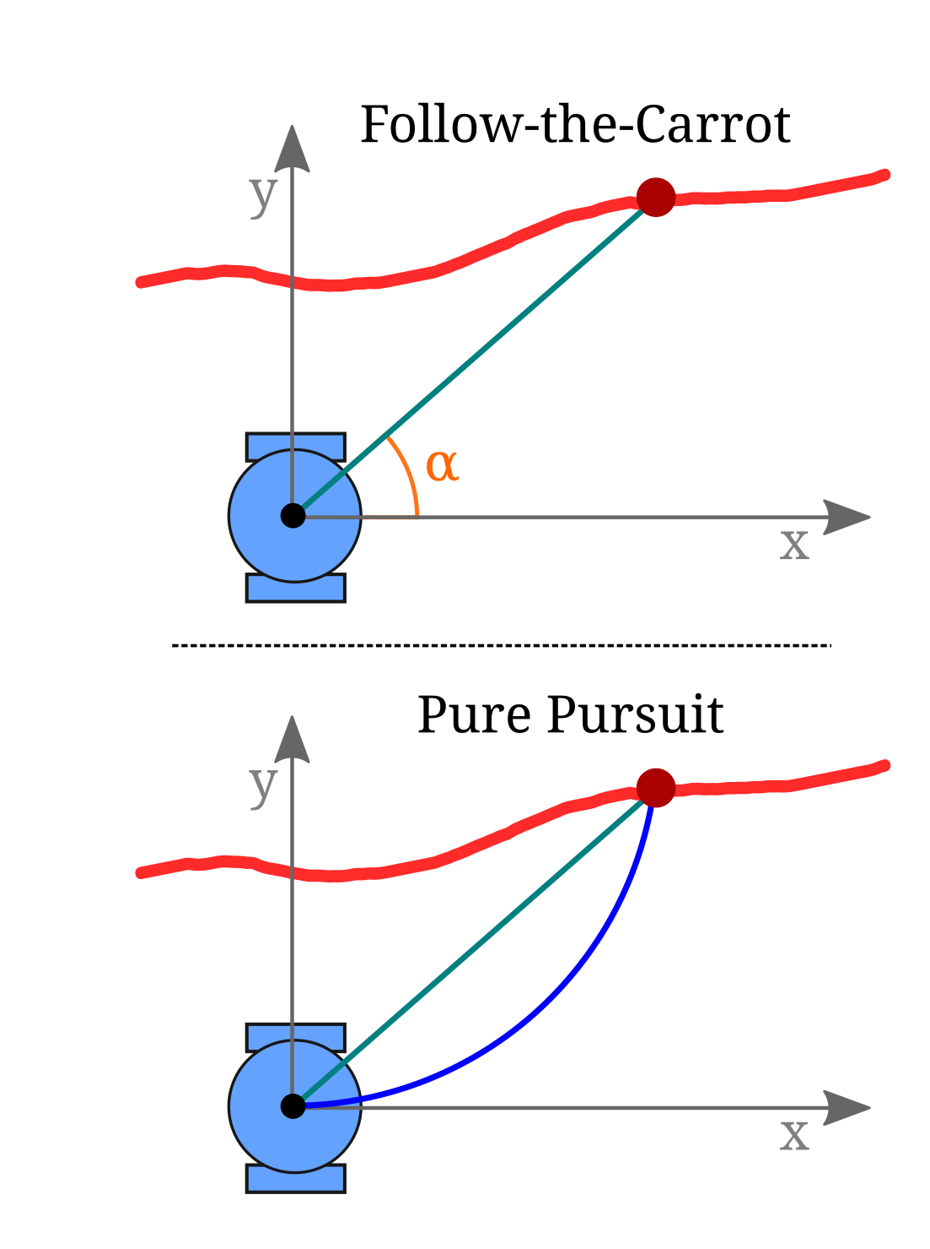
Lateral controllers
Geometric controllers
Bang-Bang control
Crosstrack PID
Follow-the-carrot
Pure pursuit
Stanley
Dynamic controllers
Model predictive control (MPC)
Notes:
Stanley controller differences to Pure pursuit (in the bicycle model case):
- Pure pursuit uses rear wheel as reference, Stanley the front wheel.
- Pure pursuit only based on the heading error, Stanley also takes into account crosstrack error
- Stanley has steadier control in turns than pure pursuit
Model predictive controller (MPC):
- Main purpose is of the system model is to predict the future evolution of the system
- Based on minimizing a defined cost function
--> optimize inputs
- computationally expensive
Good Medium –article fiscussing the pure pursuit, Stanley and MPC controllers: https://medium.com/@dingyan7361/three-methods-of-vehicle-lateral-control-pure-pursuit-stanley-and-mpc-db8cc1d32081
Great video: https://www.youtube.com/watch?v=4Y7zG48uHRo

Slide 22
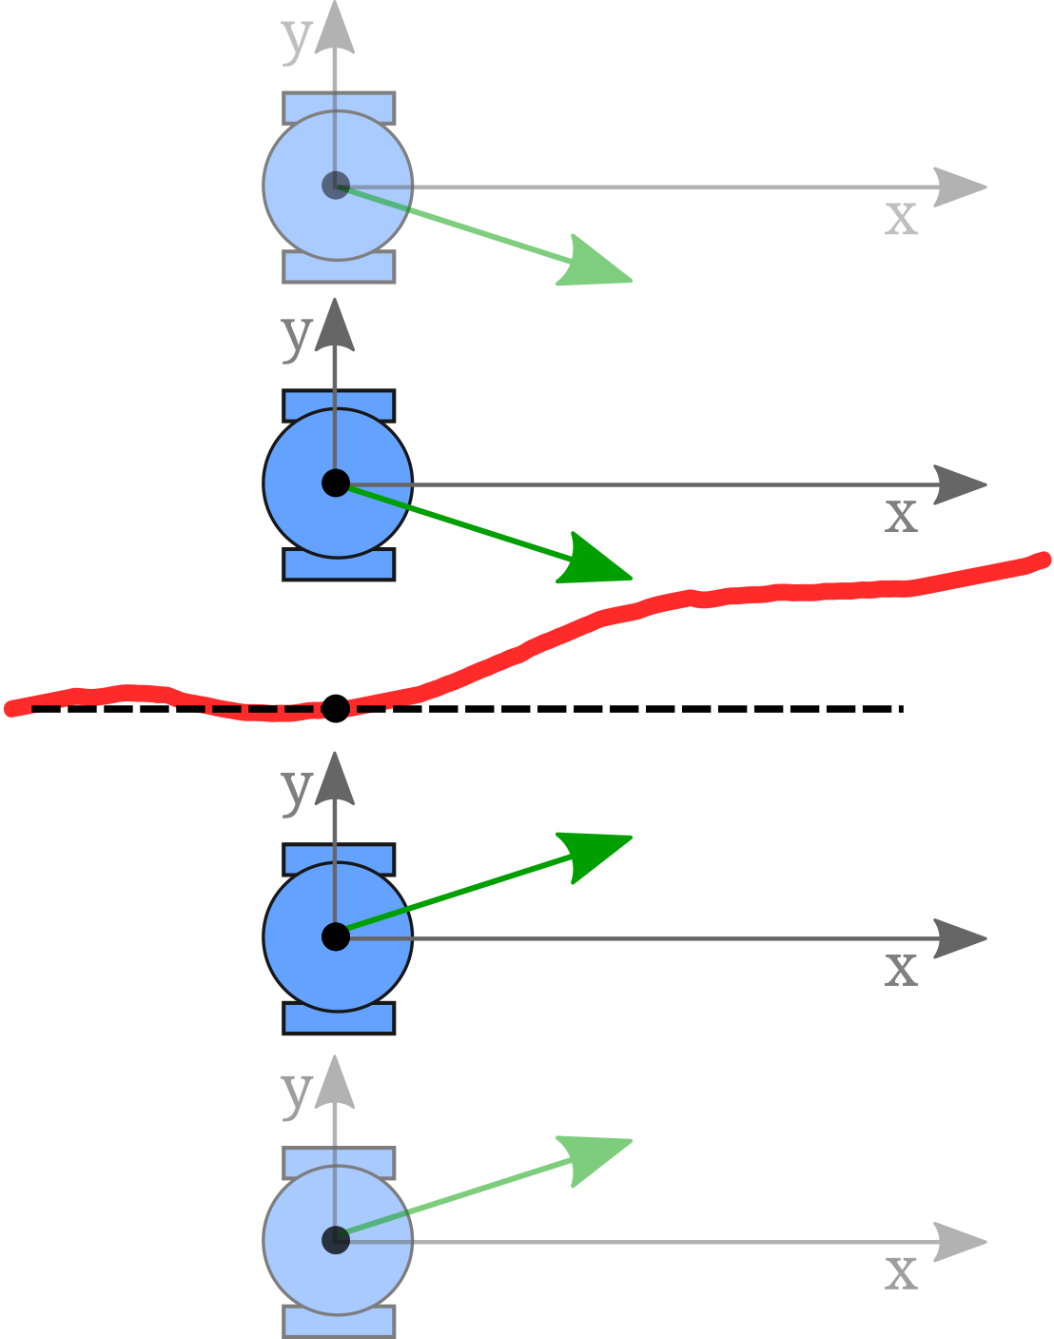
Bang-Bang control
Fixed steering
If the vehicle is to the left of the path, it will turn fixed amount to the right and vice versa
Very simple but uncomfortable and oscillating control
Why not steer proportionally?

Slide 23
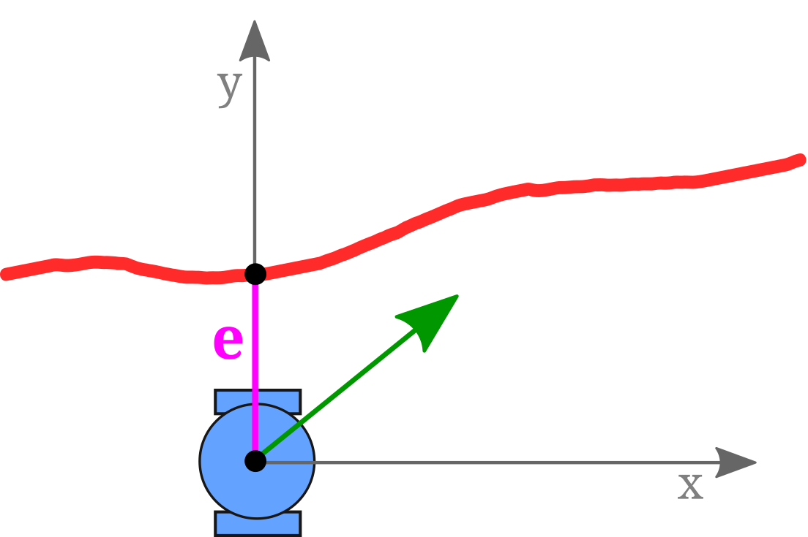
Crosstrack PID
Based on crosstrack error, e
The bigger the error, the higher the steering command
Similar concept as longitudinal PID

Slide 24
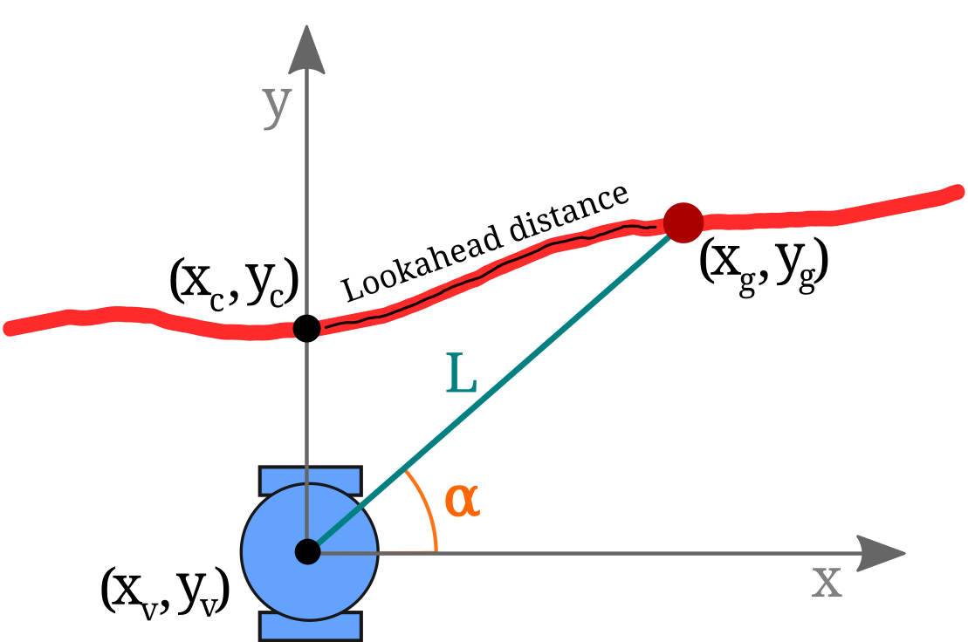
Follow-the-carrot (FTC)
Minimize lookahead heading error, α
Nearest point $(x_{c}, y_{c})$
Travel lookahead to target point $(x_{g}, y_{g})$
Error angle is between goal point direction and current heading
Requires a proportional controller

Slide 25
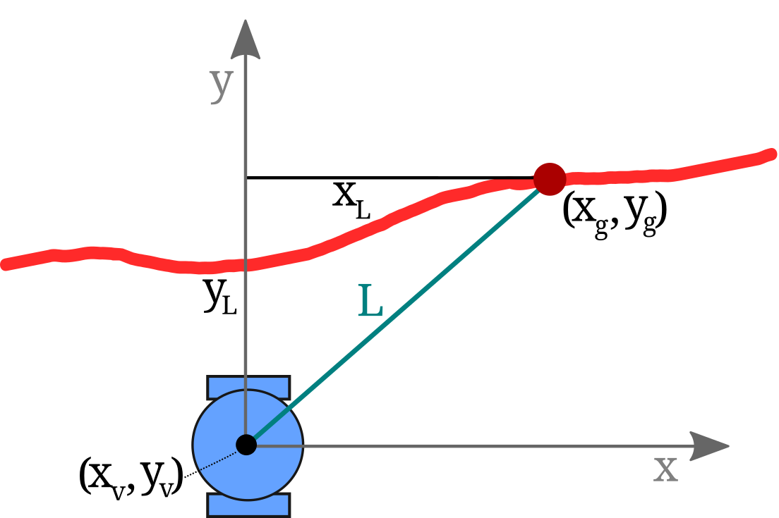
Pure pursuit 1
Calculate goal point the same way as with FTC
Calculate $x_{L}$ and $y_{L}$:
$x_{L}=x_{g}−x_{v}$
$y_{L}=y_{g}−y_{v}$

Slide 26
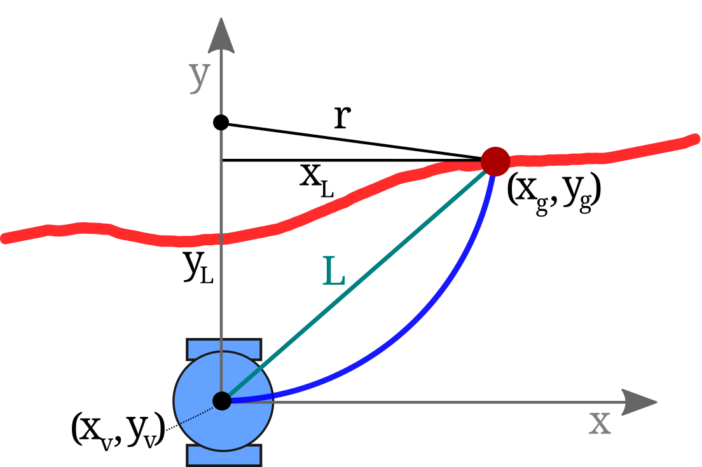
Pure pursuit 2
Connect vehicle and goal points with an arc
Radius $r$ of the arc is defined so that it attaches to the y-axis

Slide 27
Pure pursuit 3
Three geometric equations from the figure:
$$\left\{\begin{aligned}{x_{L}}^{2}+{y_{L}}^{2}= L^{2} (1) \\ a^{2}+{x_{L}}^{2}= r^{2} (2) \\ y_{L}+a=r (3)\end{aligned}\right.$$

Slide 28
Pure pursuit 4
$$a=r −y_{L} \left(3\right)$$
$${\text{(}r −y_{L})}^{2} + {x_{L}}^{2}= r^{2} (2 \& 3)$$
$$r^{2}−2ry_{L}+y_{L}^{2}+ {x_{L}}^{2}= r^{2}$$
$$L^{2}$$
$$−2ry_{L}+L^{2}=0$$
$$r=\frac{L^{2}}{2y_{L}} ⇒ γ=\frac{1}{r}$$
Curvature γ is the steering command

Slide 29
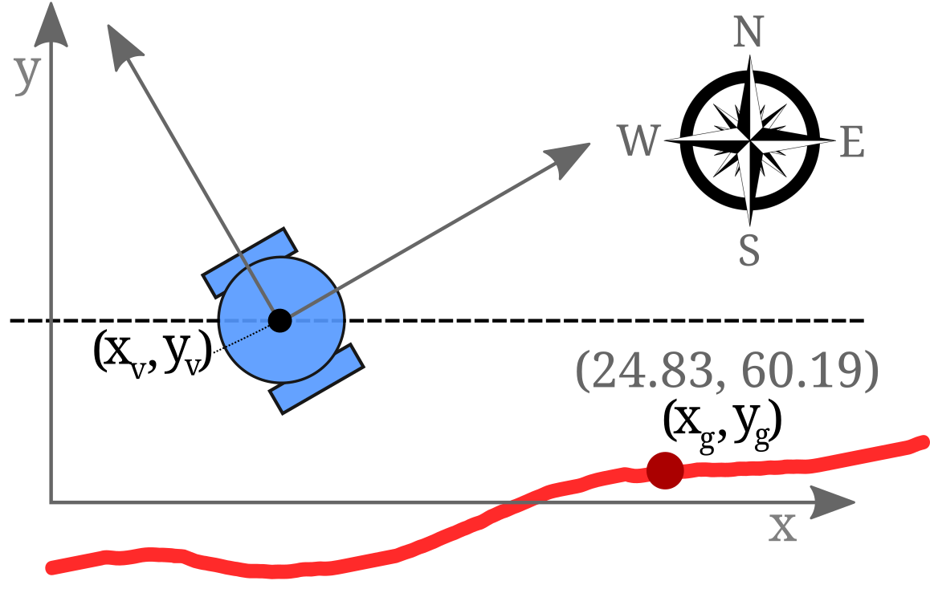
Coordinate systems
Different coordinate systems
Vehicle coordinates
World coordinates

Slide 30
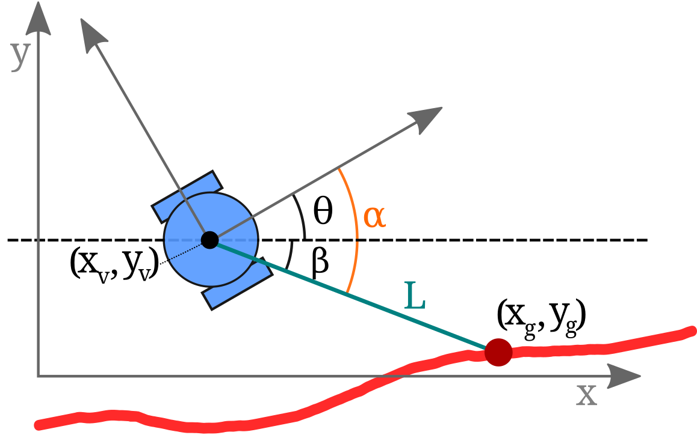
Coordinate transform
goal point $(x_{g}, y_{g})$ in
vehicle coordinates:
$$\left\{\begin{aligned}x_{gv}=\left(x_{g}−x_{v}\right)\cos{θ+\left(y_{g}−y_{v}\right)\sin{θ}} \\ y_{gv}=−(x_{g}−x_{v})\sin{θ+(y_{g}−y_{v})\cos{θ}}\end{aligned}\right.$$
$\left[\begin{matrix}x_{gv} \\ y_{gv}\end{matrix}\right]=\left[\begin{matrix}\cos{θ} & \sin{θ} \\ −\sin{θ} & \cos{θ}\end{matrix}\right]$ $\left[\begin{matrix}Δx \\ Δy\end{matrix}\right]$
Note: negative angles are allowed, thus we can use the clockwise formula

Slide 31
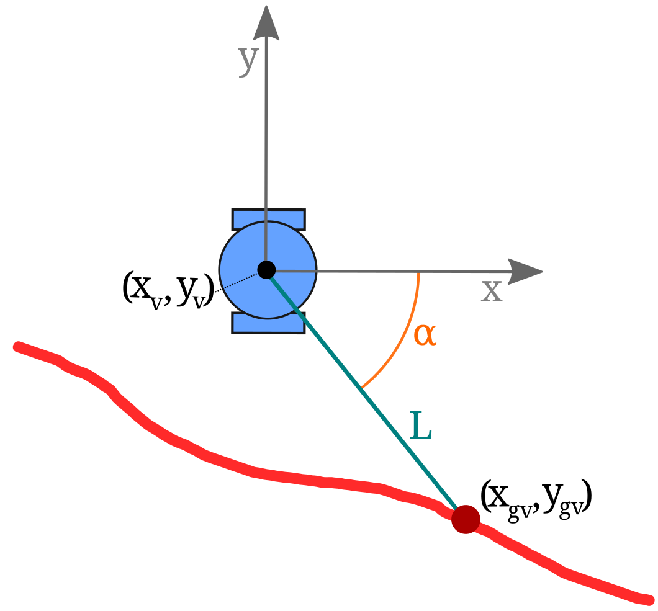
After coordinate transform
Vehicle perceived goal point is $(x_{gv}, y_{gv})$

Slide 32
Summary
Longitudinal control
Lateral control

Slide 33
Thank you

