Slide 1
Thesis Seminar Kick-Off Event
Department of Marketing
Wednesday, 6 Sept 2023

Slide 2
Roles and responsibilities
Master’s thesis is quite large independent scientific/academic work. In one’s master’s thesis, student should be able to (1) form a research problem, (2) acquire required literature and information and data for solving the problem, (3) apply proper research methods, (4) make conclusions and (5) write scientific/academic text.
Researcher’s perspective
Scientific/academic thesis
Builds on the existing knowledge, contributes to it
Solid theoretical background and concepts
Scientifically/academically approved, rigorous and robust methods
Scientific/academic writing and reporting style
Pragmatic perspective
Independent project, must be completed, has a beginning and an ending
Includes the required parts (research questions, literature review, empirical part)
Reported in the required format (structure, citations etc.)
Typically about 60 pages
30 ects, takes around 3-6 months full time work

Slide 3
Roles and responsibilities
STUDENT |  | TEACHER
Student has a right to: propose a supervisor receive guidance for the thesis and research process receive feedback be informed of the learning outcomes in advance be informed of the grading criteria in advance be informed of the schedules and seminar rules of conduct in advance | Student's obligations: to participate actively and be committed to follow the provided instructions and complete the specified tasks to keep to the agreed schedules be responsible for setting their own goal and managing their own work to submit the text on time and prepare for the supervision meetings to make the basic decisions concerning their thesis to utilise feedback received and to revise previously learned knowledge when writing their thesis to acquire required basic methodological knowhow to support the thesis process | Teacher has a right to: a supervision process that is manageable and has a limited timeframe (max 1 year) decide how the course/seminar is organised and scheduled require active participation and work at the seminar receive the text from the student on time in order to provide feedback receive information from the student on which part of the research process they especially need help with | Teacher's obligations: to respond to the student’s queries without undue delay to provide information on the thesis seminar schedule, and grading criteria to provide guidance for the process to instruct the student in responsible conduct of research and research ethics to read and comment on the thesis manuscript to provide feedback to participate in the assessment of the thesis and the thesis process to submit grades to SISU

Slide 4
 | Ilona Mikkonen | Sami Kajalo | Kristina Wittkowski | Alexei Gloukhotsev | Kushagra Bhatnagar
Seminar format | Monthly meetings (compulsory attendance) | Monthly meetings (compulsory attendance) | Monthly meetings | Monthly meetings (more frequent at the start of the seminar) | Monthly meettings
Individual/groups | Seminar meetings in groups, individual meetings as needed | Mandatory group meetings. When needed individual meetings | Seminar meetings in groups + individual meetings | Mandatory group meetings, optional individual meetings | Individual meetings in the most recent cohort
Assignments | Assignments: 1. Presentation of preliminary literature review and gaps 2. Presentation of research questions 3. Presentation of data collection and analysis plans 4. Presentation of preliminary results | Written assignments: 1. Thesis proposal 2. Literature review and research questions 3. Plans for data collection and plans for data analysis 4. Results of the data analysis | Written assignments: Detailed research plan Research profiling Literature review Preliminary results | Written assignments: 1. Thesis proposal 2. Preliminary lit review 3. Methodological proposal 4. Preliminary results | Written assignments: 1. Thesis proposal 2. Preliminary lit review 3. Research questions 4. Data collection and methodology 4. Preliminary results
Presentations | See above | Yes, same as assignments | Students’ progress as part of the seminar meetings | Yes, same as assignments | Yes, same as assignments
Timing of meetings | Agreed in the first meeting | During working hours (agreed in the first meeting) | Group meetings during working hours, individual meetings as agreed with participants | During working hours, as agreed with participants | During working hours (plans agreed with participants in first meeting)
Methodology orientation | Qualitative research methods | Primarily quantitative research methods | Primarily quantitative research methods (SEM, experiments); also | Primarily qualitative research. Open to quant topics that align with my research interests. | Primarily qualitative research. Open to industry-oriented quant research as well.
Research interests | Consumer resistance, deviant consumer behaviors, gender issues Published in: Consumption Markets & Culture, Journal of Marketing Management, Marketing Theory | Corporate social responsibility, sustainability, arts marketing and management. Published in: e.g. International Journal of Retail & Distribution Management, Journal of Retailing and Consumer Services, Journal of Arts Management, Law & Society | Services marketing orientation with focus on access-based consumption (sharing economy) and transformative service research topics | Research topics that have concrete implications for consumer wellbeing and quality of life. Examples: consumer wellbeing and vulnerability; problems related to digital technology; healthcare services; sustainability; (un)ethical consumer behavior. | Digital marketing, marketing’s impact on society, emerging markets, services management and marketing, branding, sociological research on marketing’s connection with gender, race, geography.

Slide 5
 | Henri Weijo | Sanna-Katriina Asikainen, D.Sc.(Tech), Associate Professor | Henrikki Tikkanen, D.Sc. (Intl' Marketing), Ph.D. (Economic History), A. I. Virtanen Prof. of Consumer Research, Prof. of Business Administration in Marketing | Arto Lindblom | Tomas Falk
Seminar format | Agreed-upon meeting schedule (usually tri-weekly to monthly) | Monthly meetings | Monthly meetings | Monthly meetings | Monthly meetings
Individual/groups | Seminar meetings plus regular individual meetings per student needs/inititiative | Seminar meetings in groups + individual meetings | Seminar meetings in groups, when needed individual meetings (digital) | Seminar meetings in groups + individual meetings (digital) | Depending on number of participants and participants’ preferences. Seminar meetings in groups, when needed individual meetings.
Assignments | A few mandatory readings. Status updates through single-slide presentations | Written assignments: 1. Preliminary literature review and research gaps 2. Research questions and thesis matrix 3. Data collection and analysis plan 4. Preliminary results | 1. Presentation of preliminary literature review and research gaps 2. Presentation of research questions and thesis matrix 3. Presentation of data collection and analysis plans 4. Presentation of preliminary results | 1. Presentation of preliminary literature review and research gaps 2. Presentation of research questions and thesis matrix 3. Presentation of data collection and analysis plans 4. Presentation of preliminary results | 1. Presentation of preliminary literature review and research gaps 2. Presentation of research questions and research plan 3. Presentation of data collection and analysis plans 4. Presentation of preliminary results
Presentations | Status updates | Yes, same as assignments | See above | See above | See above
Timing of meetings | Agreed collectively in first meeting | During working hours (agreed in the first meeting) | After work (agreed in the first meeting) | During working hours (agreed in the first meeting) | During working hours, as agreed with participants (no meetings in Aug. 2020)
Methodology orientation | Qualitative methods | Primarily quantitative research methods (SEM, experiments). | Both qualitative and quantitative research methods, business history | Primarily qualitative research. | Both qualitative and quantitative research methods
Research interests | Consumer activism, value creation, consumer movements, creativity, branding, marketing communications, consumer culture | International marketing, internationalization, marketing strategy, decision making (consumer and managerial), intl. entrepreneurship, consumer behavior. Published e.g. in Journal of the Academy of Marketing Science, Journal of Intl’ Marketing, Technological Forecasting & Social Change, Intl’ Journal of Research in Marketing | B2B marketing, industrial networks, marketing strategy, strategic management & leadership, business history, history of consumption & history of marketing practices and thought. Published in: e.g. Journal of Marketing, Strategic Management Journal, Journal of Management Studies, Long Range Planning, Journal of Service Research, European Journal of Marketing, Industrial Marketing Management, Business History | Retail marketing, category management, retail strategic management, retail business models, retail entrepreneurship, supplier-retailer relationships, market orientation, entrepreneurial orientation and marketing capabilities | Behavioral decision making, consumer behavior, service management, service and technology, AI and service, Published in: e.g. , Journal of Marketing, Journal of Service Research, Journal of Retailing, Journal of the Academy of Marketing Science, Journal of Business Research.

Slide 6
Alexei Gloukhovtsev
Assistant Professor in Marketing
Qualitative and quantitative research with social impact. Research primarily driven by substantive (as opposed to theoretical) concerns with concrete implications for consumer wellbeing and quality of life.
I’m looking to take on a handful of students with a clear fit in research interests.

Slide 7
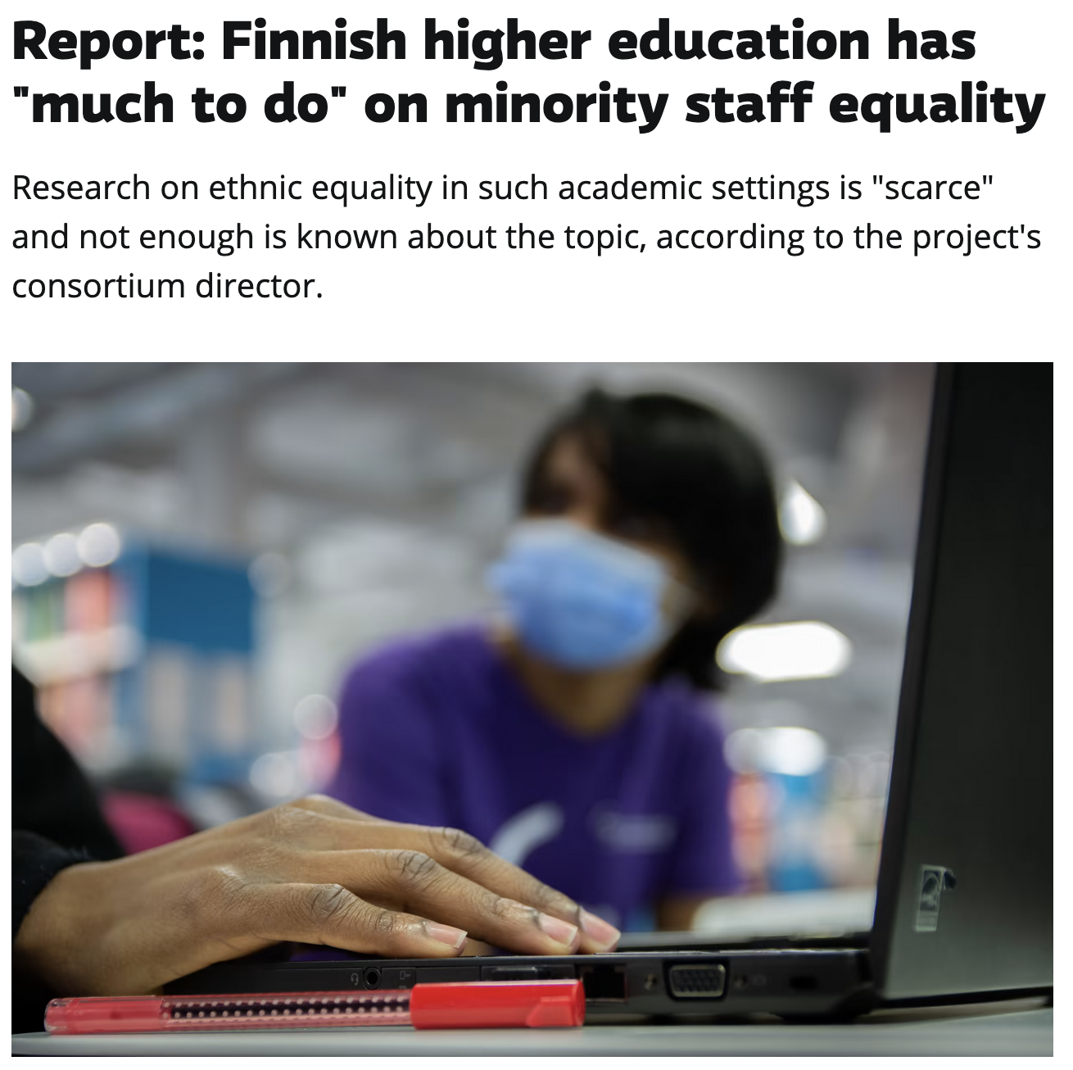
Specific topic of interest: EDI issues in higher education
Equity, diversity and inclusion is increasingly becoming a “hot topic” in business, but there are clear issues in higher education as well.
You chance to write a thesis on a topical issues and provide practical implications?
Sources: Kylteri.fi (2022); Yle.fi (2022)

Slide 8
Specific topic of interest: EDI issues in higher education
Recent thesis topic example:
Anu Rantama (2021): “Stupid girls of Marketing: The gendered discourses building the reputation of the marketing major in Aalto University School of Business”.
Possible follow-up thesis topics:
What is the experience of students who break the stereotype of a particular major?
What is the experience of underrepresented student minorities in Aalto degree programs?
What challenges or barriers do they face?

Slide 9
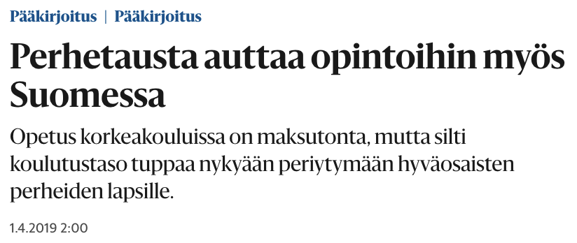
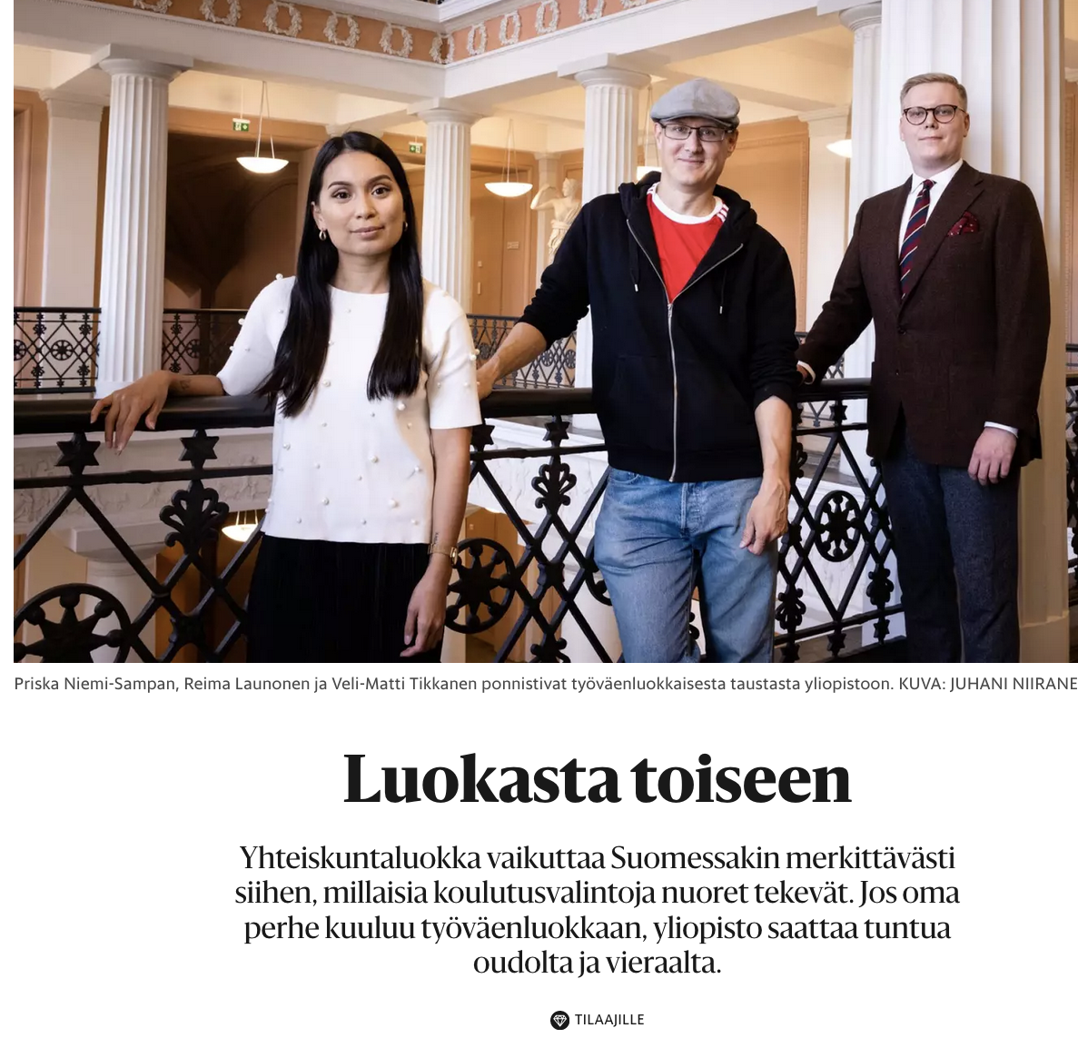
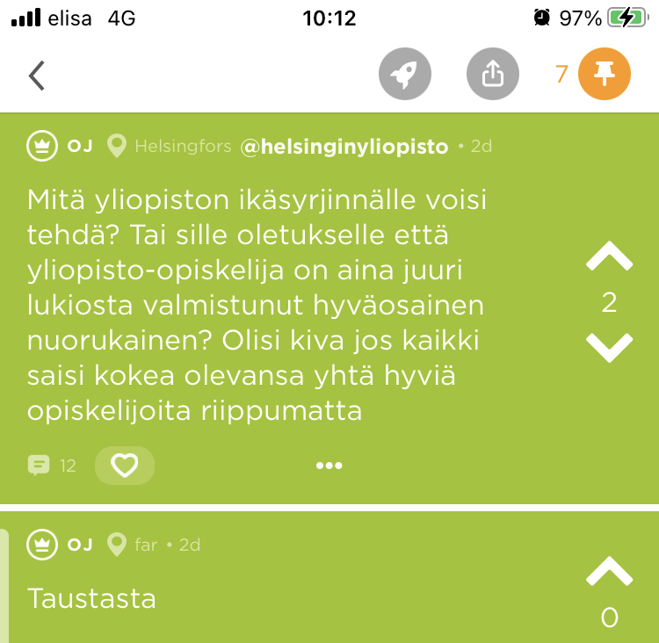
Specific topic of interest: EDI issues in higher education
An important principle in Finland: “free higher education that is accessible to all”
In practice, higher education may be more accessible to some than to others.
Possible thesis topic:
What is the experience of “non-traditional students” at Aalto BIZ or in Marketing specifically?

Slide 10
Get in touch!
Please email me to discuss your ideas! alexei.gloukhovtsev@aalto.fi
No need to wait until you have a fully formed topic: we can discuss you broad interests and ideas and see if there’s a fit.

Slide 11
Anastasia Nanni
Assistant Professor
Marketing Department
MARK-E1047 - Digital Marketing: Technological Innovation in Service
Notes:
As I said, I am a PhD Candidate at Bocconi University. My defense is scheduled for June 2021

Slide 12
Main topics
Creative Industries
ARTIFICIAL INTELLIGENCE
How companies can exploit AI to:
Get to know better their customers?
Improve customer experience ?
Increase the revenues?
Improve the society (e.g., more sustainable)?
DOWNSIDES OF IMPLEMENTING AI
Are there some downside in
technologies?
When do consumers feel threatened
by technology?
Are companies losing the human touch?
MUSIC INDUSTRY
What makes a song successful (e.g., feat vs. non-feat., genre, past popularity)?
What are customers’ perceptions about artistic creative process?
Technology
in service
Methods
Qualitative/Quantitative methods
Mail: anastasia.nanni@aalto.fi
Notes:
Regarding research, I have two principal fields of interest. The first one is the investigation of the effect of new technologies in different service settings. The second area is creative industries, in particular, I am interested in music industry and the factors that contribute to the success of a song. I would start with a close look to my dissertation

Slide 13
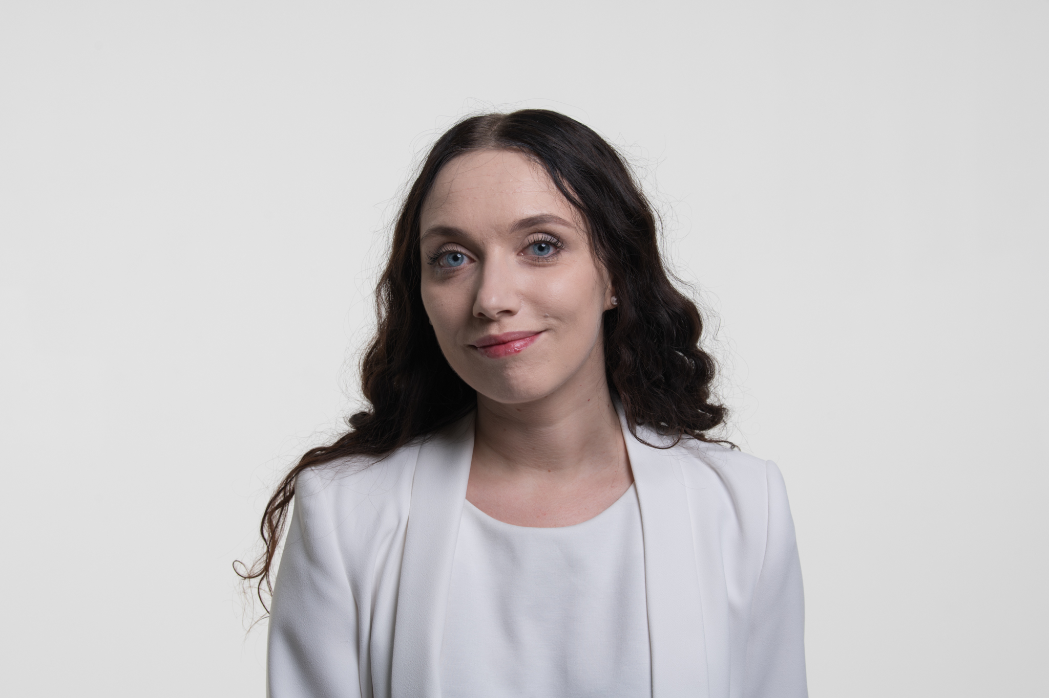
Tatsiana (Tanya) Padhaiskaya, Doctoral Researcher
Areas of interest:
Experiential consumption
Consumer well-being
Methodological expertise:
Qualitative research (long interviews, ethnography, nethnography)
Contact:
tatsiana.padhaiskaya@aalto.fi

Slide 14
Topic ideas
Micro-level
Individual, subjective consumption experiences
Embodiment and temporality aspects
Meso-level
Role of marketers and service providers in orchestrating and co-constructing consumption experiences
Macro-level
Marketplace ideologies and their (re-)interpretation (e.g. especially those related to well-being)

Slide 15
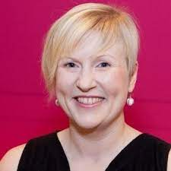
Ilona Mikkonen
DSc (PhD) Marketing
Senior Lecturer
Teaching: Consumer Research (Bachelor level) Bachelor Seminars Qualitative research methods (Master level)
Master’s seminars
Research issues: Gender studies Consumer resistance
”Taboo” subject (deviance) (sex and drugs and rock’n roll ☺ )
CCT topics preferred, but any (qualitative) research topics are welcome

Slide 16
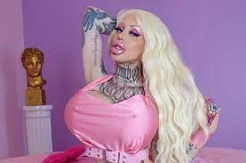
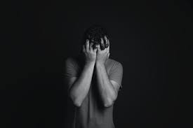
Research topics
Extreme plastic surgery
Shame in consumption

Slide 17
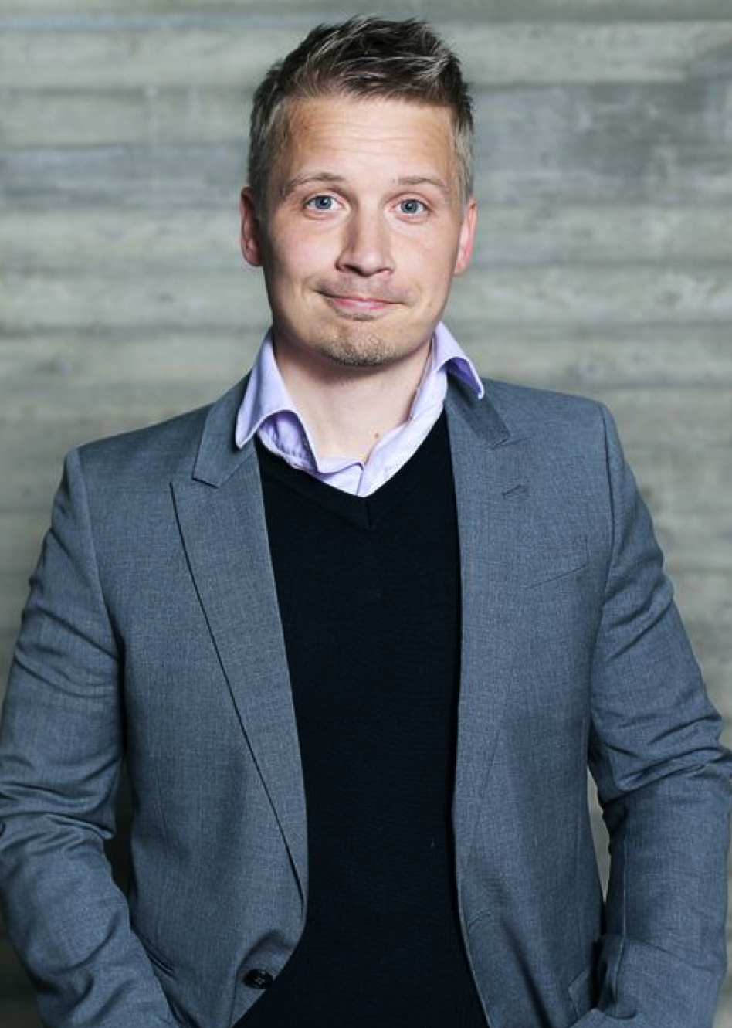
Arto Lindblom
Professor of Marketing
arto.lindblom@aalto.fi
Research expertise:
Retail Marketing and Management
Retail Business Models
Retail Entrepreneurship
Supplier-Retailer Relationships

Slide 18
It would be interesting:
To analyze and compare existing business models in the field of retailing:
Business model describes the way in which the activities (e.g., acquiring, stocking and displaying goods and services) are organized and managed within retailing organization. In the field of retailing, business models vary significantly: there are, for example, vertically integrated models, franchising or co-op models. Lately, platform based models (e.g., Amazon) have gain a lot of interest in the retail industry.
What are the key elements and features of each model? Key advantages? Main limitations? What are the outcomes or performance (e.g., efficiency and effectiveness) of each model?
To analyze multichannel (or omnichannel) retail strategies:
Multichannel retailing is about selling goods or services to consumers through more than one channel. Multichannel retailing can involve very complex organizational arrangements.
What are the critical success factors in multichannel retailing? What are the main challenges when implementing multichannel retailing? How should retailers combine offline and online channels to create cross-channel synergies? What should be the level of cross-channel harmonization of marketing variables (e.g. pricing) in multi-channel retailing? How do customers use different channels during their purchase journey? Showrooming? Webrooming?

Slide 19
To analyze retail-marketing mix decisions, marketing capabilities and/or market-based resources of retailers:
What are the core marketing capabilities, skills and/or resources in the field of retailing? Digital marketing capabilities? Retail branding capabilities? Innovation capabilities? Data analytics capabilities? What are the effects of marketing capabilities and/or resources on performance and competitive advantage?
To explore retail entrepreneurship or entrepreneurial orientation of retail organizations:
Retail entrepreneurs are the owners and managers of their retail businesses, and they invest considerable personal and financial resources in their enterprises. They also carry financial risks related to their retail businesses.
What are the (psychological) features or traits of successful retail entrepreneurs?
To investigate sustainability, corporate social responsibility in the field of retailing:
How do retailers define, promote and implement sustainability and CSR? What is the impact of sustainability and CSR e.g. on store loyalty, store image or store performance?
To explore the nature of supplier-retailer relationships:
How do retailers build strategic relationships with their suppliers? What is the level of channel collaboration in today’s retail environment? What is the level of channel conflict? The role of power?

Slide 20
Some key readings:
Grewal, D., Gauri, D., Roggeveen, A., Sethuraman, R. (2021) Strategizing Retailing in the New Technology Era, Journal of Retailing, 97, 1, 6-12.
Shankar, V., Kalyanam, K., Setia, P., Golmohammadi, A., Tirunillai, S., Douglass, T., Hennessey, J., Bull, J.S., Waddoups, R. (2021) How Technology is Changing Retail, Journal of Retailing, 97, 1, 13-27,
Broekhuizen, T., Emrich, O., Gijsenberg, M., Broekhuis, M., Donkers, B., & Sloot, L. (2021). Digital platform openness: Drivers, dimensions and outcomes. Journal of Business Research, 122, 902-914.
Gauri, D., Jindal, R., Ratchford, B., Fox, E., Bhatnagar, A., Pandey, A.,. Navallo, J., Fogarty, J., Carr,S., Howerton, E. (2021) Evolution of retail formats: Past, present, and future, Journal of Retailing, 97, 1, 42-61.
Blut, M., Teller, C. & Floh, A. (2018) Testing Retail Marketing-Mix Effects on Patronage: A Meta-Analysis, Journal of Retailing, 94, Issue 2, 113-135.
Sorescu, A., Frambach, R., Singh, J., Rangaswamy, A. & Bridges, C. (2011) Innovations in Retail Business Models, Journal of Retailing, 87(1), 3-16.
Ailawadi, K. & Keller, K. (2004) Understanding retail branding: conceptual insights and research priorities, Journal of Retailing 80, 331–342.
Van Alstyne, M., Parker, G. & Choudary, S. (2016) Pipelines, Platforms, and the New Rules of Strategy, Harvard Business Review.
Zhang, J., Farris, P.W., Irvin, J.W., Kushwaha, T., Steenburgh, T.J. & Weitz, B.A. (2010) Crafting Integrated Multichannel Retailing Strategies. Journal of Interactive Marketing, 24(2), 168180.
Matzler, K., Veider, V. & Kathan, W. (2015) Adapting to the Sharing Economy, MIT Sloan Management Review, Vol. 56, No. 2.

Slide 21
KUSHAGRA BHATNAGAR

Slide 22
It’s easier to imagine the end of the world than to imagine the end of marketing.

Slide 23
Why is Marketing Research interesting?
Brands and marketing implicated in everyday stories of status, identity, nationality, class
Can’t live with them – can’t live without them
Closest thing to real magic
A suspension of disbelief (like in the movies)

Slide 24
Qualitative Methodologies
Working with pictures and words, instead of numbers
Deep engagement with Empirical material / data
Approach Marketing/Consumption from a socio-cultural lens
Not about individual choice and preference
But what shapes it

Slide 25
Preferred Research Contexts and Examples
Ethnographies: Understanding less-discovered “small worlds”
E.g. South-Asian immigrants in Finland
The world of Investment bankers
Interactions
Creating followership on social media
Crafting expertise through new styles of interaction
Media Discourses
Future of Advertising in the review economy
The construction of a national myth

Slide 26
Past Projects Supervised
How can financial startups help sustainability
How organizations “do” secrecy
How do consumers make sense of complex financial products
How do consumers become fans of certain brands
How do merged companies create organizational identification
How do individuals craft personal brands on professional social networks
Why do Finnish women struggle to participate in the financial investment market

