Slide 1
CEMS
Global Strategy
Session 5
Expansion and entry strategies
Aleksi Niittymies
November 6, 2023

Slide 2
Tarun Sharma, COO @ Nokia
Expansion and entry strategies

Slide 3
Tarun Sharma, COO @ Nokia
Expansion and entry strategies
Why to expand?
Where to expand?
How to expand?

Slide 4
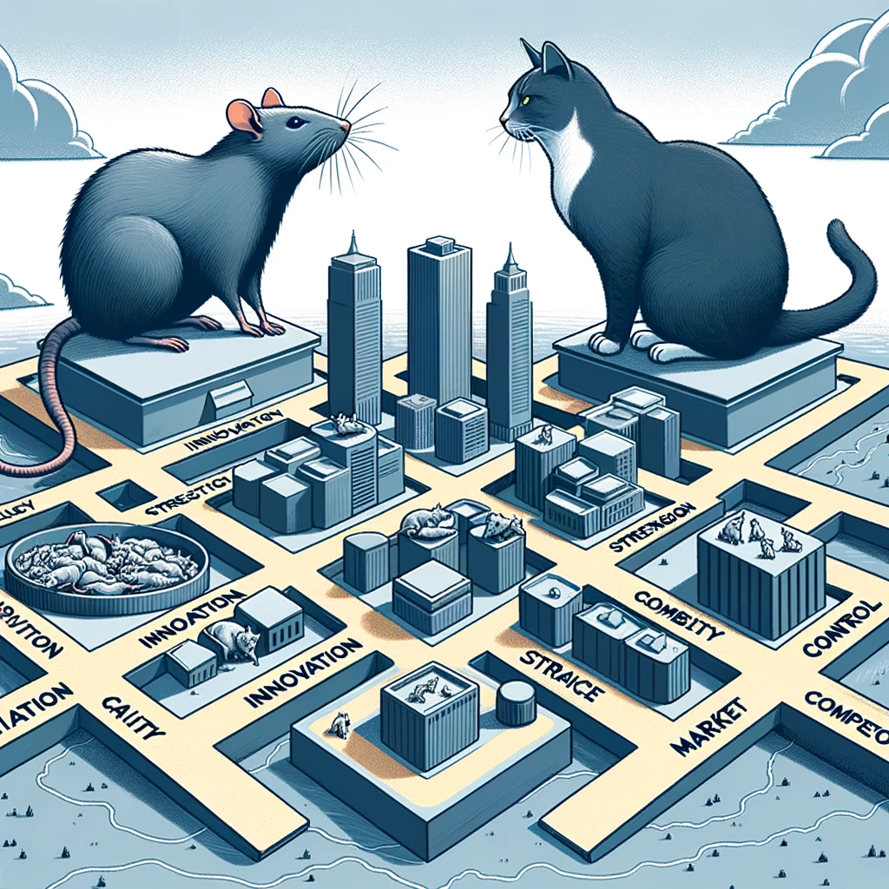
But what you really need to remember from this is Rats, Cats, and locations’ roles in building competitive advantage

Slide 5
Antecedents of capabilities
Macro-level processes
Internal
External
Home-based capabilities
Exploit
Target country/ Customer value
Learning
RAT
Megatrends
Dynamic capabilities
Different roles of target countries
(De)globalization
Augmented capabilities at home
Target country-derived capabilities
Institutional framework changes
Strategic innovation
CAT
Experience
Enhance
Shocks & crises

Slide 6
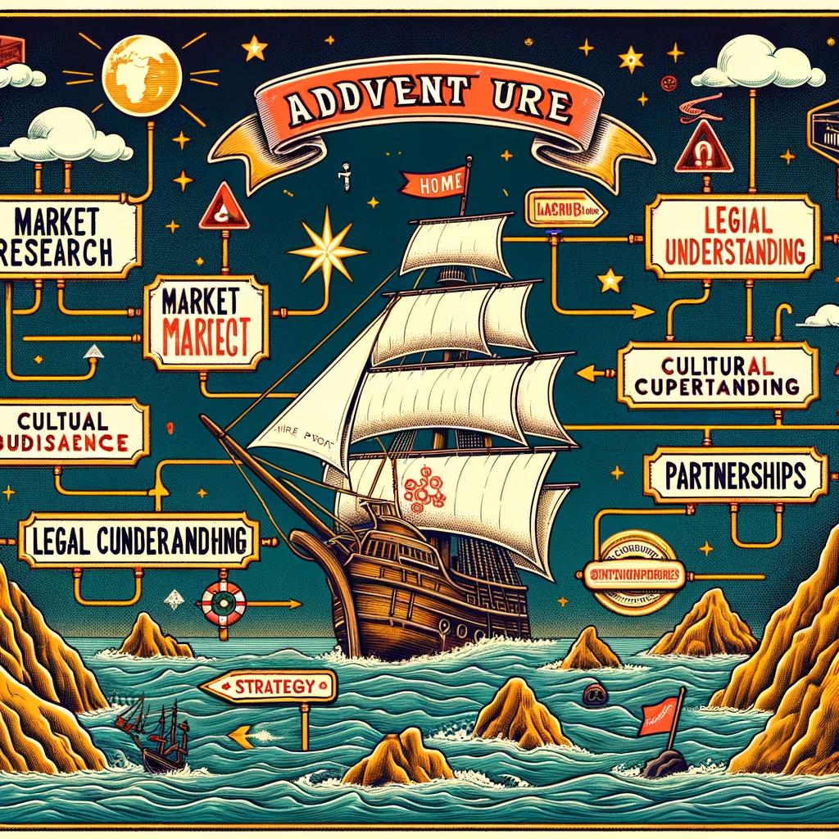
What is internationalization?

Slide 7
Internationalization
Definitions:
“The growing tendency of corporations to operate across national boundaries” (www.businessdictionary.com)
“Internationalization can refer to a company that takes steps to increase its footprint or capture greater market share outside of its country of domicile by branching out into international markets” (www.Investopedia.com)
As a field of research:
Exploring how and why firms expand to different markets/countries
This is studied by utilizing focal themes/constructs
Uncertainty
Psychic distance
Resources and networks
Opportunities (in IE, not so much in IB)

Slide 8
But in practice, it is strategic planning
What we need to decide?
Purpose
Conquering the world?
Building competitive advantage?
Target
What is the target market’s role in building the competitive advantage or value chain?
Commitment/level of investments
Entry mode
Timing

Slide 9
Why to expand?

Slide 10
Why to internationalize?
New potential markets
Growth
Demand
It is easy(?) – accidents, random opportunities
Harnessing unique characteristics of countries
Technology, know-how, resources, price level, general situation, stage of life-cycle
Building multinational competitive advantage
Can be derived from certain area, or various combinations of different areas

Slide 12
Rat and Cat tests for internationalization
What capabilities we have that could be exploited in foreign markets?
What capabilities could we acquire from a particular target country?
Exploiting capabilities
RAT
Relevant
Appropriable
Transferable
Enhancing capabilities
CAT
Complementary
Appropriable
Transferable
Based on Lessard et al., 2013

Slide 13
Rat and Cat tests for internationalization
Internal
External
Home-based capabilities
Exploit
Target country/ Customer value
RAT
Augmented capabilities at home
Target country-derived capabilities
CAT
Enhance
Based on Lessard et al., 2013

Slide 14
Antecedents of capabilities
Macro-level processes
Internal
External
Home-based capabilities
Exploit
Target country/ Customer value
Learning
RAT
Megatrends
Dynamic capabilities
Different roles of target countries
(De)globalization
Augmented capabilities at home
Target country-derived capabilities
Institutional framework changes
Strategic innovation
CAT
Experience
Enhance
Shocks & crises

Slide 15
Where to expand to?

Slide 16
Market selection
Often driven by external drivers
Country characteristics
Customers, demand
Random opportunities
Or internal ones…
Products, networks, partners
Too rarely by properly considered resonance between internal and external aspects

Slide 17
Questions for market selection
R: Is product relevant for the market?
Is bottled water relevant product for Finnish markets?
Price of product/service vs. price level in a certain country
Luxury products in poor countries?
A: Is it appropriable? (can you capture the value?)
T: Transferability of the product to foreign market?
Standardization vs. adaptation
Food stores in Finland
Sticky knowledge
Acceptability of the product in foreign markets?
Physical and psychological/cultural features
Organizing distrubution and customer service

Slide 18
Simple, right?
Answering these question can be hard
Target market can be very different – psychic distance
Poor understanding of the target market and its distinct characteristics
Much of the knowledge is implicit silent knowledge: taken for granted knowledge and assumptions locals have

Slide 19
Coping with the lack of knowledge
Accumulating knowledge
Case Trainer4You
Minimizing need for knowledge
Case M-room

Slide 20
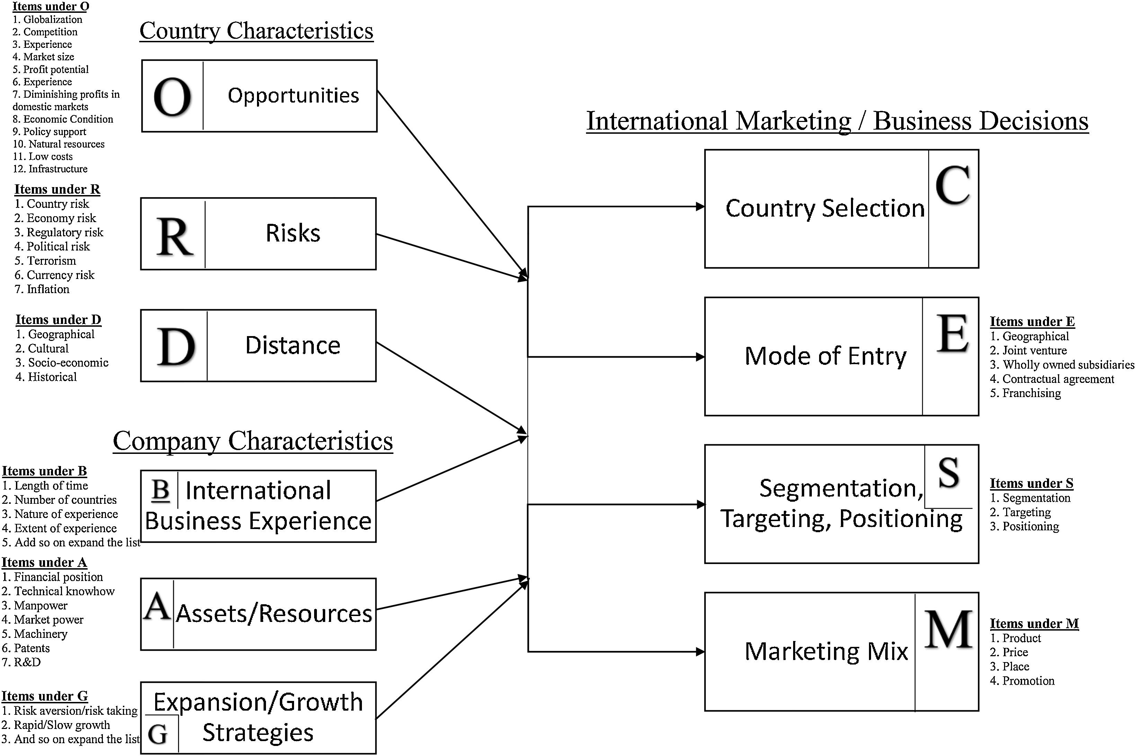
Kotler, P., Manrai, L. A., Lascu, D., & Manrai, A. K. (2019). Influence of country and company characteristics on international business decisions: A review, conceptual model, and propositions. International Business Review, 28(3), 482-498.

Slide 21
How to enter the chocen market?

Slide 22
Deciding the entry mode
Suitable entry mode, but it depends...
Internal capabilities – external environment
The dynamic nature of the interface: Temporal structure of competitive actions in the field
The role of the target market in building the competitive advantage
Level of commitment/investment
Risk-control
Different businesses require different presence
For instance, aeroplanes, accounting services, rubber boots
Speed and timing of entry

Slide 23
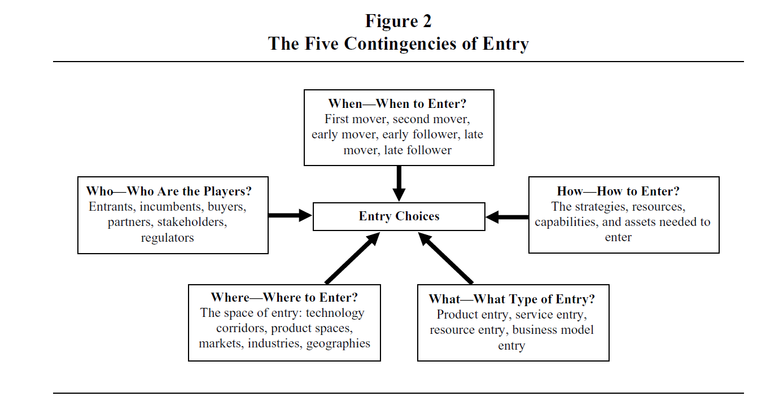
Zachary et al., 2015

Slide 24
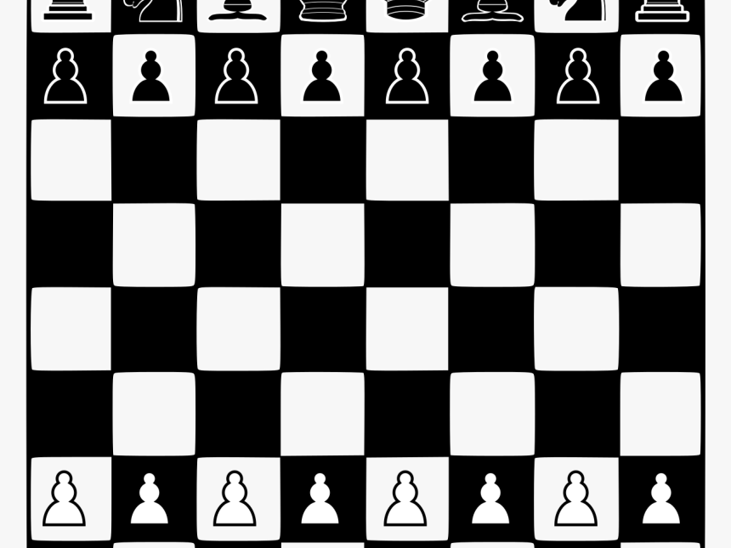
First mover advantage?
In the context of chess, white makes the first move. In general, white has the capabilities for more aggressive opening moves. It is agreed that when all other factors are equal, white wins roughly 52-56% of the time.
In general, black strategizes to play reactively, to counter white’s opening moves.

Slide 25
Commitment
How much can be invested?
Establishing manufacturing?
Establishing sales office?
Sales and production from home-market?
Selling the concept for the business (licensing / franchising
With great commitment comes great… control and risk

Slide 26
Rothaermel, 2012.

Slide 27
Why?
Known firms using franchise model?
Known firms using licensing?
Known firms expansion through partnerships?
Known firms expanding by establishing manufacturing facilities?

Slide 28
Next time: Session 6 on November 8st
CSR, Ethics, and Corruption in Global Strategy
Read
Kolk, A. 2016
Ely & Thomas, 2020

Slide 29
Internal
External
Home-based capabilities
Exploit
Target country/ Customer value
Learning
RAT
Megatrends
Dynamic capabilities
Different roles of target countries
(De)globalization
Augmented capabilities at home
Target country-derived capabilities
Institutional framework changes
Strategic innovation
CAT
Experience
Enhance
Shocks & crises

