Slide 1
Deconstructing
Grocery Retail

Slide 3
where did
you
investigate?

Slide 4
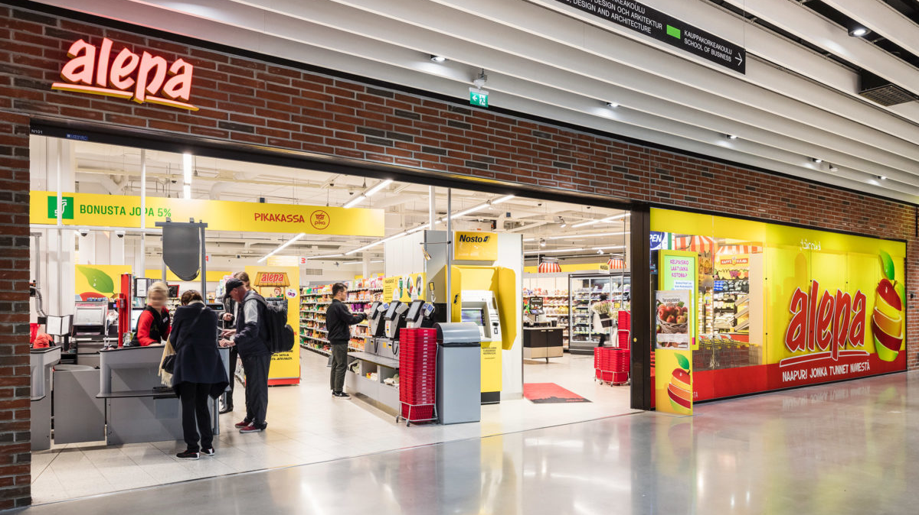
Notes:
GROCERY RETAIL COMES IN ALL SORTS OF SIZE – DESIGN CHOICES IMPACT STRATEGY
WHY IS ALEPA DESIGNED LIKE IT IS … WHAT’S THE BACK STORY?

Slide 5
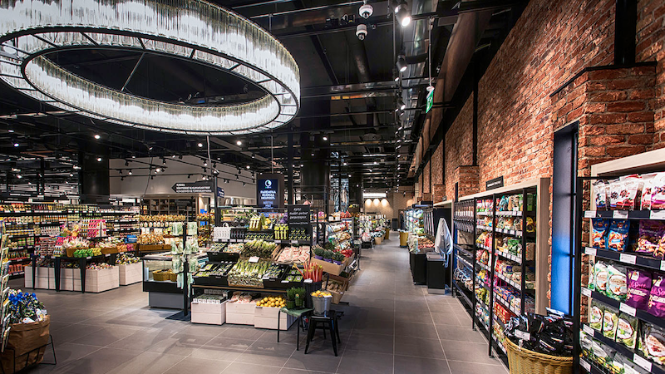
Notes:
NOTICE THE HEIGHT OF EVERYTHING IN THE STORE – WITHIN REACH

Slide 6
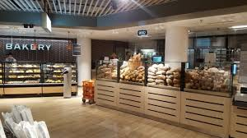
Notes:
THE SMELL OF BAKERY INTERACTS WITH YOUR NOSE, AND ….

Slide 7
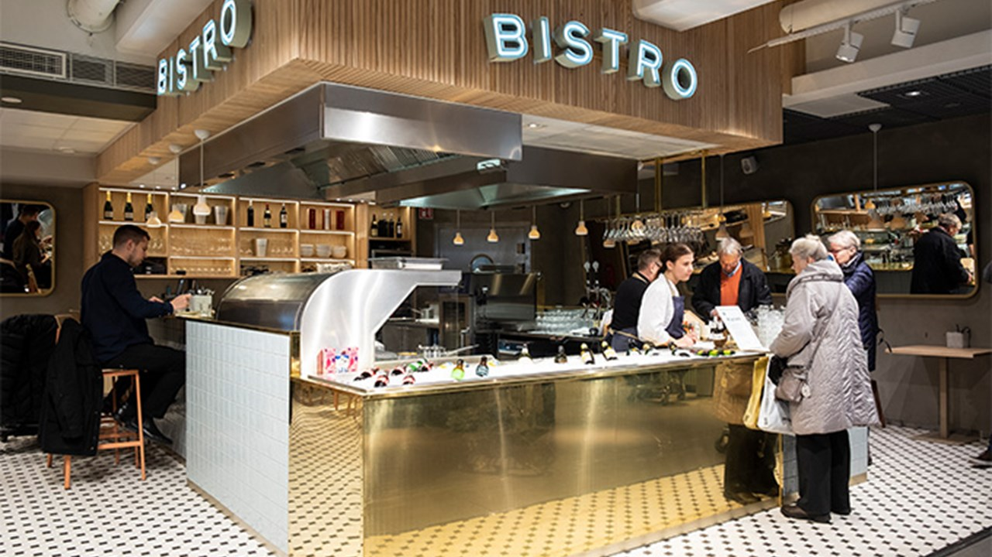
Notes:
YOU CAN EVEN EAT IN THE HERKKU IN HELSINKI – AND TAKE AWAY WHAT IS BEING COOKED

Slide 8
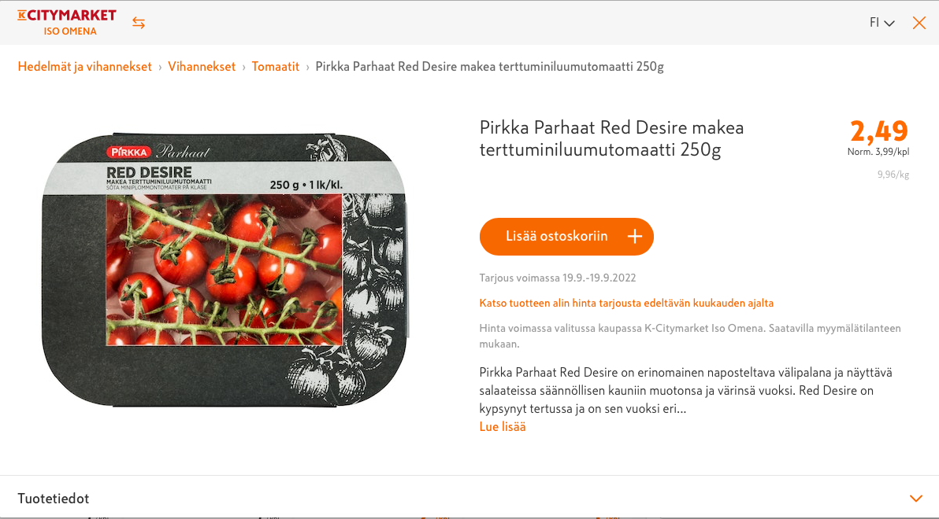
Notes:
THE SHOP COULD BE ONLINE – THIS IS ON MY LIST – MORE ABOUT TOMATOES LATER

Slide 9
phygital
Notes:
THE CONSULTING TRADE HAS INVENTED A TERM “PHYGITAL” –
USE THE WORD MIX – INHERENTLY TALKING ABOUT INTERACTION

Slide 10
your
interaction
insights

Slide 11
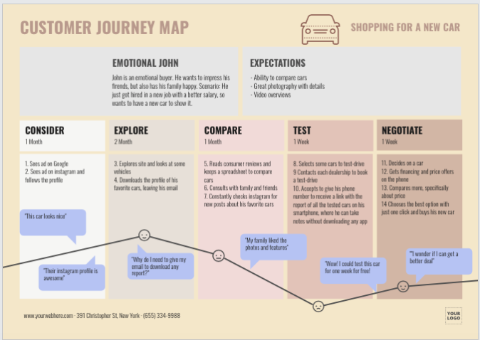

Slide 12
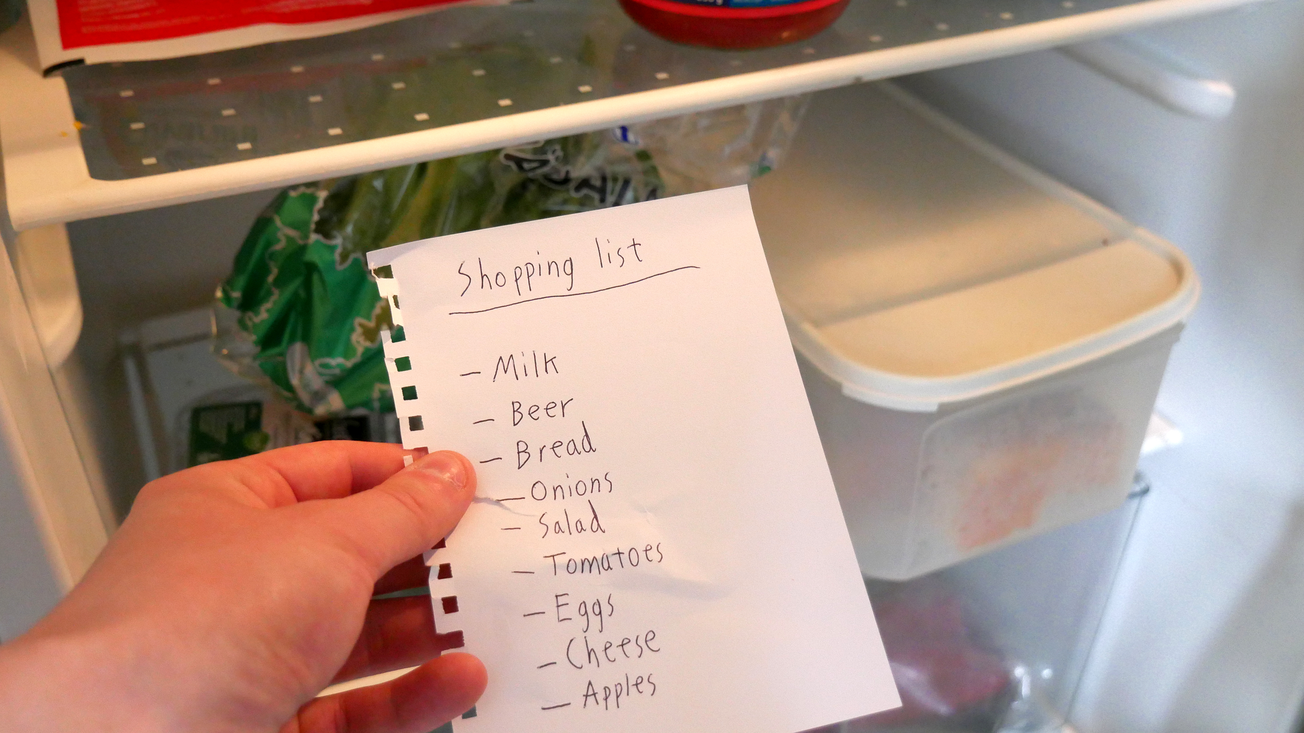
Notes:
THINK OF THE THINGS YOU NEED TO INTERACT WITH TO CREATE A LIST

Slide 13
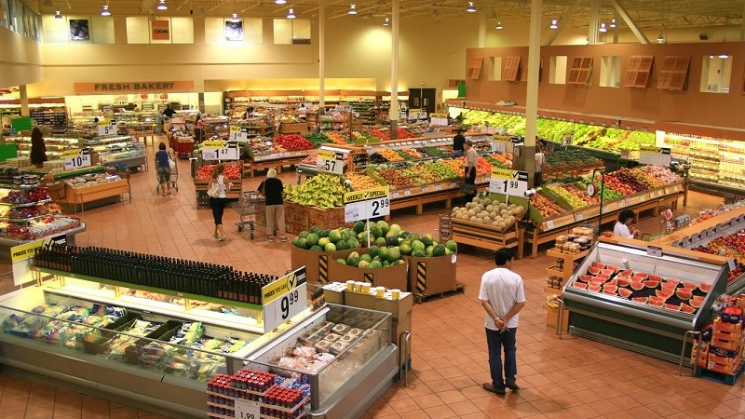
Notes:
THEN YOU ARRIVE AT A STORE – OFTEN WITH A DIZZYING ARRAY OF CHOICES AVAILABLE TO YOU

Slide 14
Notes:
GRAB A BASKET – DESIGNED FOR WHAT KIND OF SHOPPING EXPERIENCE

Slide 15
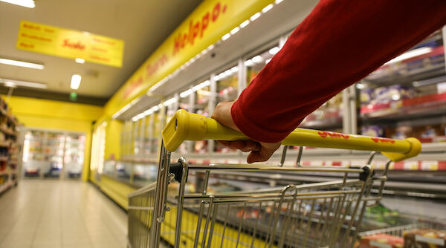
Notes:
OR A CART – OFTEN IN DIFFERENT SIZES DEPENDENT ON THE STORE

Slide 16
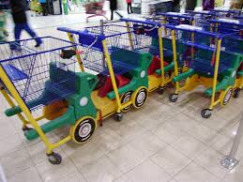
Notes:
OR KID ENTERTAINMENT FRIENDLY

Slide 17
Notes:
INTERACT WITH LOTS OF PRODUCT DIRECTLY --

Slide 18
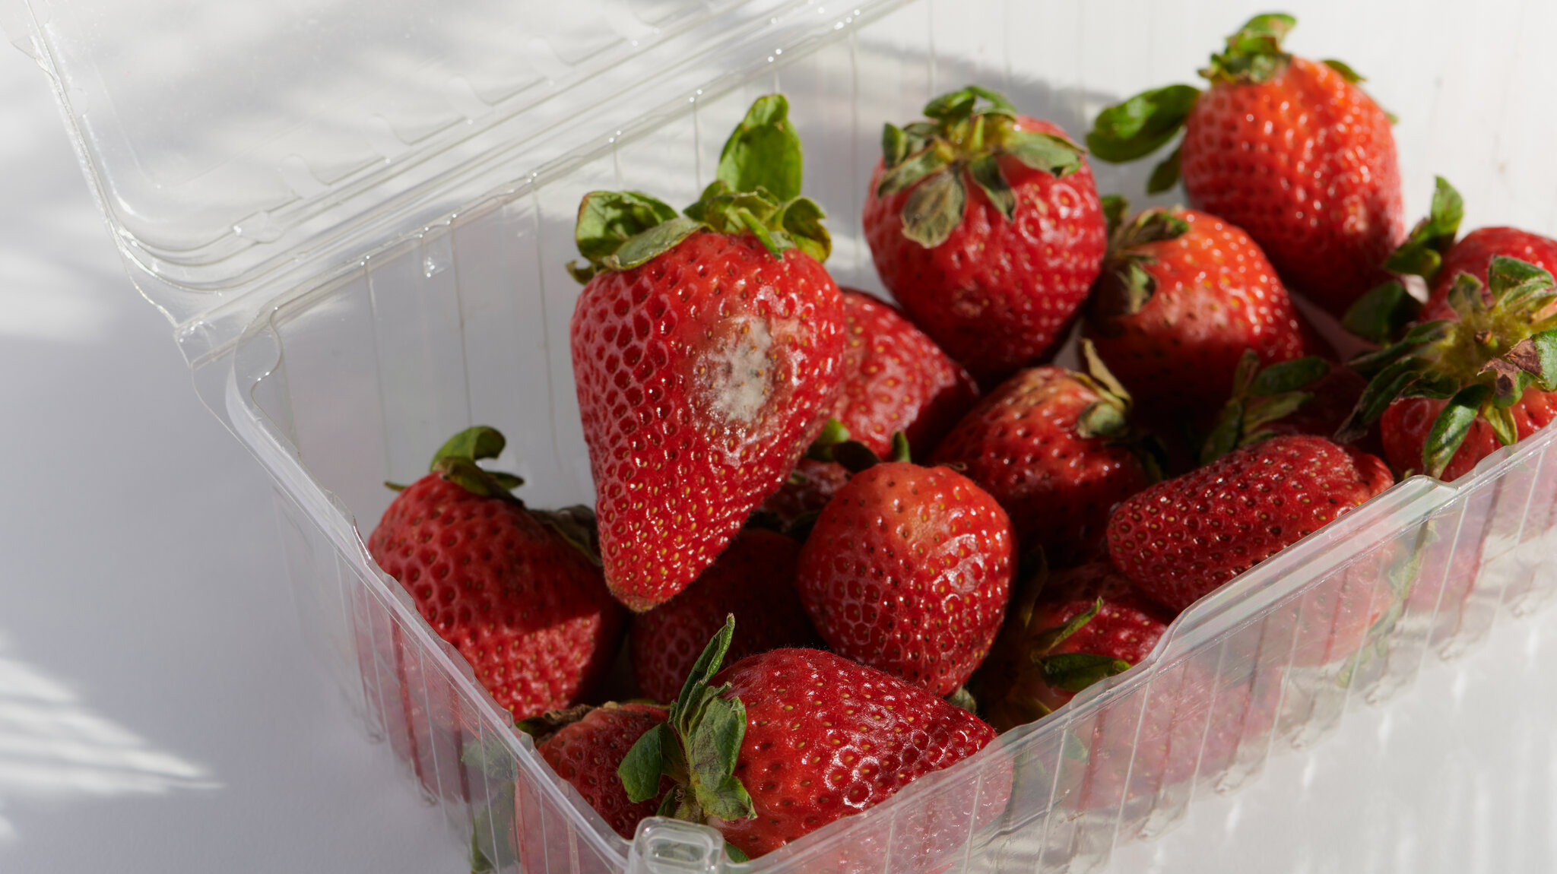
Notes:
AND THAT PRODUCT INTERACTS WITH ITSELF

Slide 19
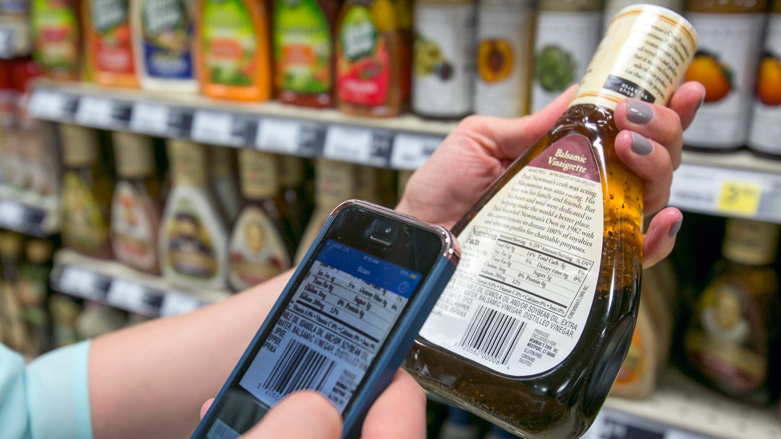
Notes:
BARCODES ALLOW ANOTHER LAYER OF INTERACTIVITY BEYOND STOCK CONTROL AND POS SYSTEMS

Slide 20
Notes:
CHECKOUTS – LINING UP FOR STUFF, HAVING NO CASH, CHECKING IDS, BAGGING

Slide 21
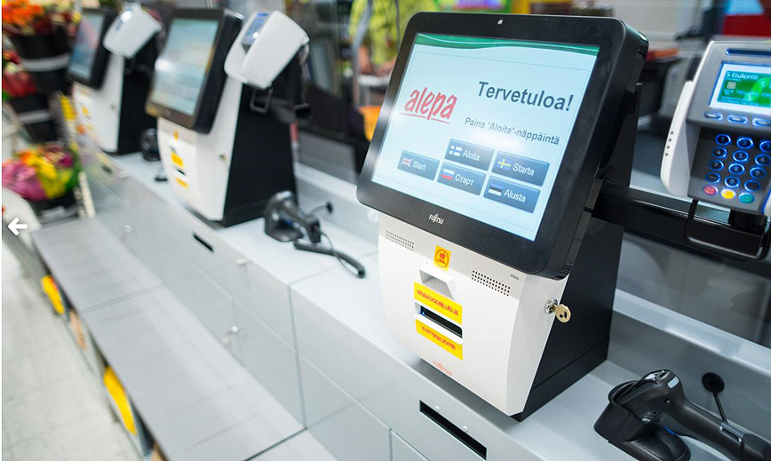
Notes:
SELF CHECKOUT HAVE APPEARED – NO CARTS ALLOWED AND LIMITED SPACE

Slide 22
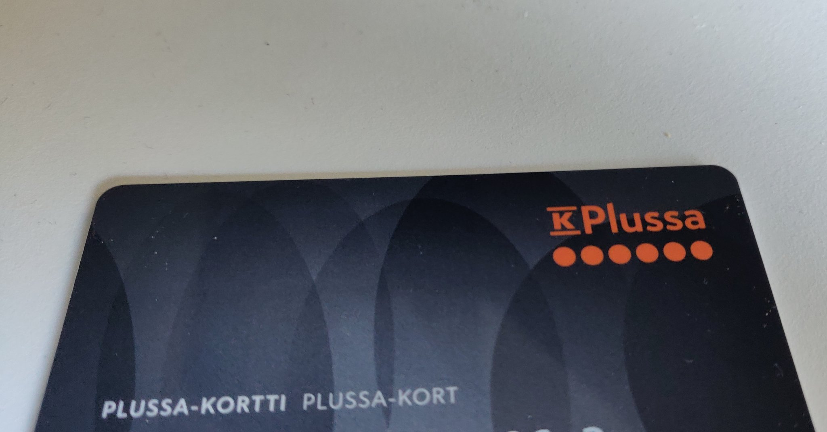
Notes:
AFFINITY CARDS HAVE MORE POTENTIAL THAN JUST COLLECTING POINTS, SAVING MONEY
THEY ARE KEY SOURCES OF DATA (WHICH MEANS …)

Slide 23
Notes:
OBSERVING AT THE MOMENT – WHAT FACTORS ARE AT PLAY TODAY IN GROCERY RETAIL

Slide 24
factors
the building blocks of any context: the observations
of patterns in the world that are selected (by you)
as relevant to the established domain.
Notes:
OFTEN DEAL WITH WHAT PEOPLE NEED OR WANT …
INTERESTING AND COHERENT IN TERMS OF STRUCTURE

Slide 25
principle
the (more or less) stable patterns in life, from
physical and biological to social and psychological;
they can be laws of nature and, most often,
fundamental human concerns or patterns of
behaviour.

Slide 26
principles
Humans are generally neophobic (try before you buy)
Dietary requirements (3 squares a day)

Slide 27
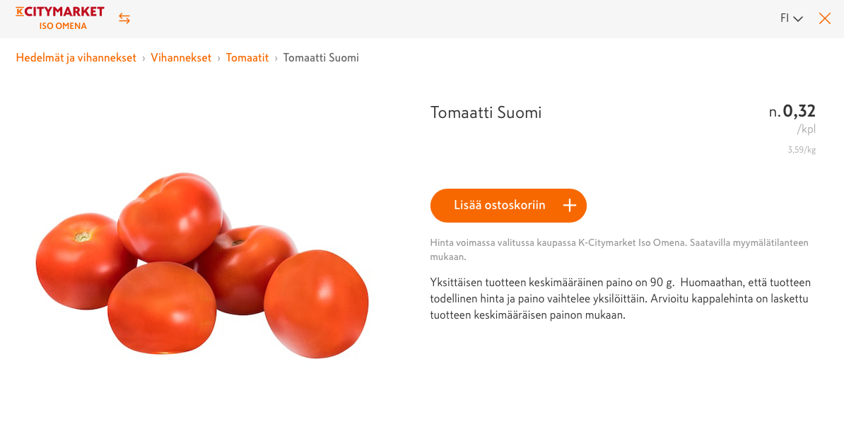
Notes:
I WANT TO PICK MY OWN FRUIT AND VEG – SQUEEZE AND SMELL IT

Slide 28
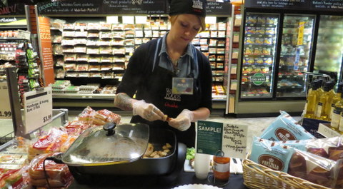
Notes:
WHOLE FOODS TOOK SAMPLING TO A WHOLE NEW LEVEL
LIKE A POT LUCK SAMPLE DINNER CONCEPT

Slide 29
states
phenomena that appear as fixed, but do not need
to be so in the long term. For example, the Western
value of “freedom of speech”

Slide 30
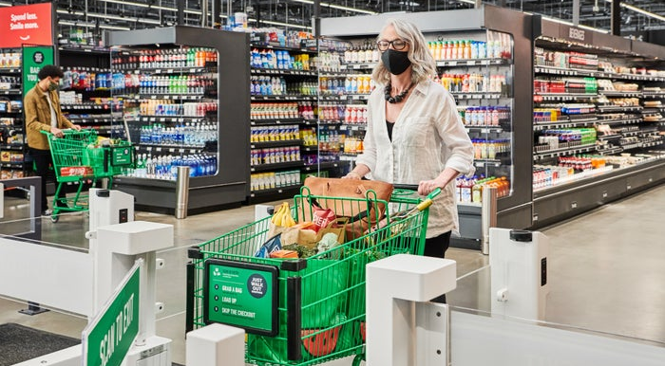
Notes:
PHYSICALITY TO GROCERY – BRICK AND MORTAR IS LIKELY HERE TO STAY
THINK FULFILLMENT CENTRE

Slide 31
development
changing or unstable pattern in the environment or
in the concerns of people in general. Developments can
refer to technological, economic, societal, cultural,
environmental or political changes in the world around
us.

Slide 32
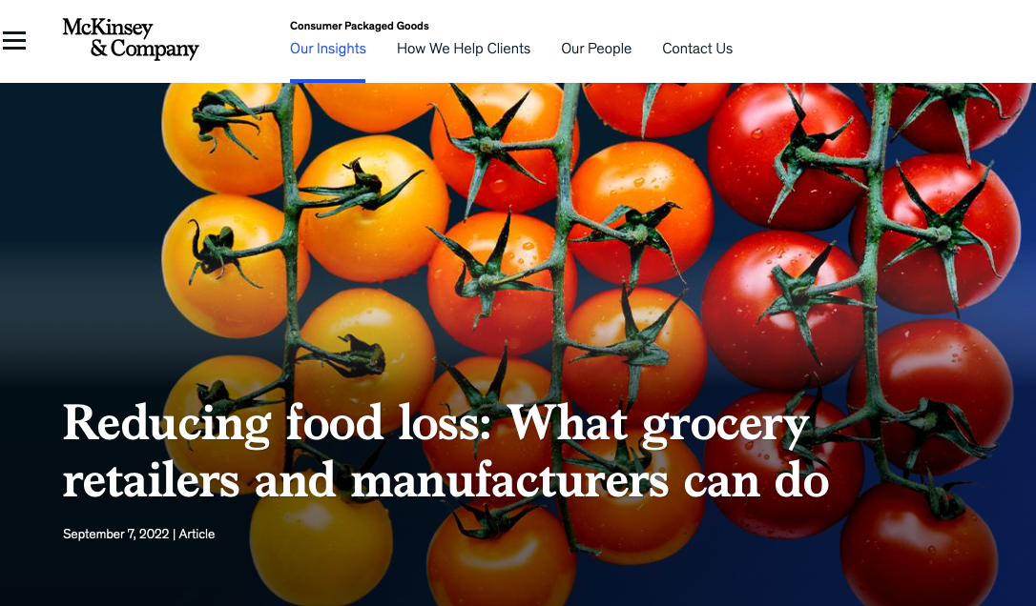

Slide 33
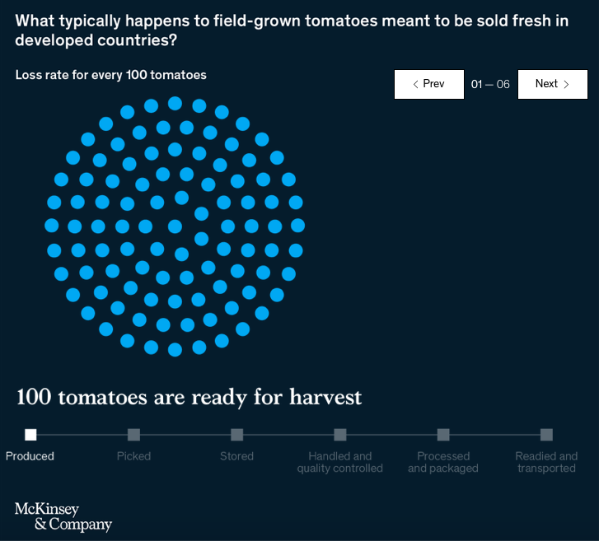

Slide 34
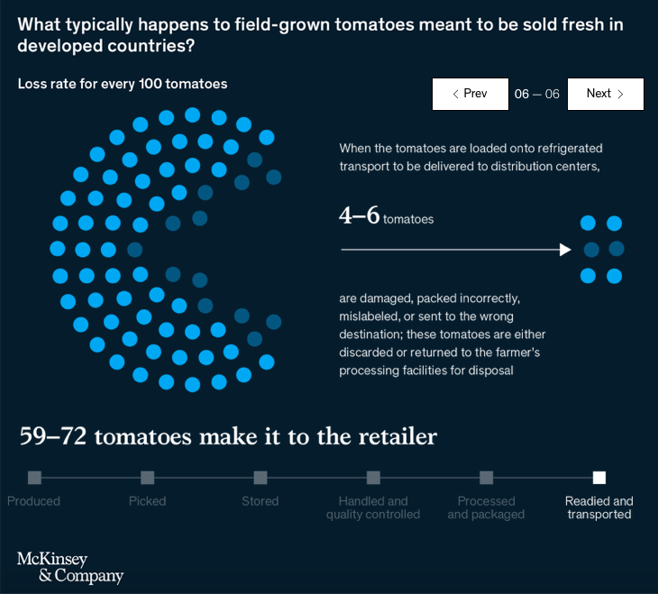

Slide 35
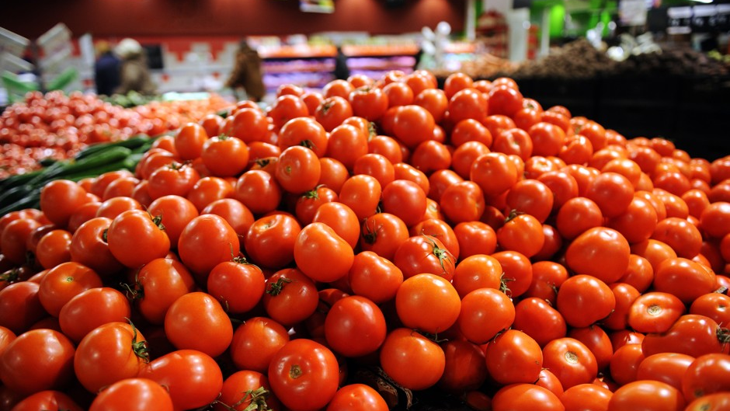

Slide 36
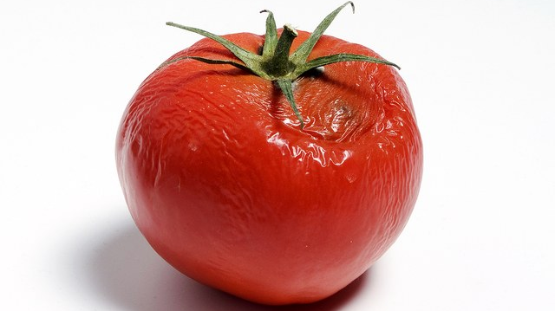

Slide 37
trend
reflections of developments in human behaviour.
when the economy goes down (development), people
spend less money on luxury goods (trend)

Slide 38
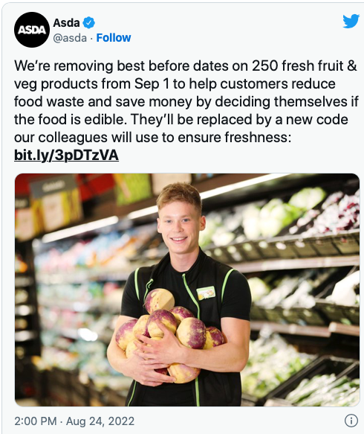

Slide 39
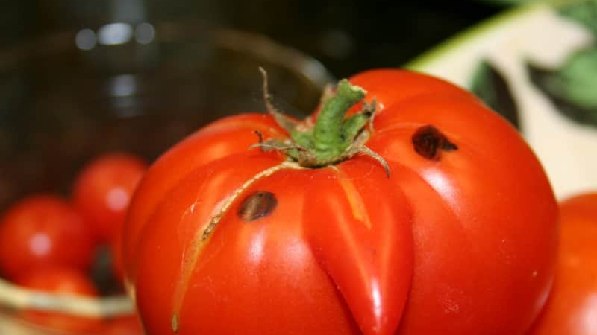

Slide 41
Notes:
HOW THESE FACTORS MIGHT PLAY OUT IN THE FUTURE IN THAT DOMAIN

Slide 43
Notes:
A FUNNY REMINDER OF SOME OF THE STEREOTYPES THAT SOMETIMES CLOUD THINKING
AND WHAT I MIGHT CALL BEHAVIORAL CHALLENGES

Slide 44
Notes:
OBSERVING AT THE MOMENT – WHAT FACTORS ARE AT PLAY TODAY IN YOUR DOMAIN

Slide 45
factors
the building blocks of any context: the observations
of patterns in the world that are selected (by you)
as relevant to the established domain.
Notes:
WHAT PEOPLE NEED OR WANT …
INTERESTING AND COHERENT IN TERMS OF STRUCTURE

Slide 46
domains
Phenomenon – a fact or situation that is observed
to exist or happen but whose cause or explanation
is in question (climate change, aging population)
Problems – situations, questions or things that
cause difficulty, stress or doubt (extreme weather,
retirement)
Areas of life – sustainability (healthy living,
financial security)
Notes:
THE FOCUS OF YOUR GROUP ASSIGNMENT

Slide 47
domain choice
pick one that is of interest to you and ask why
is it so interesting?
many domains are saturated with solutions
conformity and rules underpinning many
products today are well past their “sell by date”
forward vision not problem solving in present
trust your intuition but seek out justifaction
Notes:
THE FOCUS OF YOUR GROUP ASSIGNMENT

