Slide 1
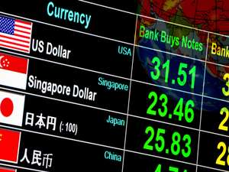
Inflation and exchange rates in Emerging Markets
Svetlana Ledyaeva
Aalto University School of Business

Slide 2
Plan
Inflation and investment decisions, inflation trends in emerging markets
Exchange rates and investment decisions, exchange rates` trends in emerging markets

Slide 3
Inflation and investment decisions
The rate of inflation is important as it represents the rate at which the real value of an investment is eroded.
If a company`s stock returned 4% and inflation was 5%, then the real return on investment would be - 1% (4%-5%).
Inflation uncertainty/volatility ➔ uncertainty about the real net revenues ➔ investment decision

Slide 4
Inflation for investment in stocks versus bonds and FDI
Stocks – more likely (in case of moderate inflation) no real significant impact on the return:
a company's revenue and earnings should increase at approximately the same pace as inflation, so the prices of stocks should rise along with the general prices of consumer and producer goods.
Bonds – significant impact of inflation as Bond yeild is fixed over certain period of time.
Foreign Direct Investment – high and volatile inflation – negative effects. Moderate inflation most likely will not have negative effects.

Slide 5
Economic growth and inflation
Productivity capacity=Long Run Aggregate Supply (LRAS)
. Cost-push inflation could be caused by rising oil prices. It increases costs for firms and reduces disposable income. Therefore, there is lower growth, whilst high inflation.

Slide 6
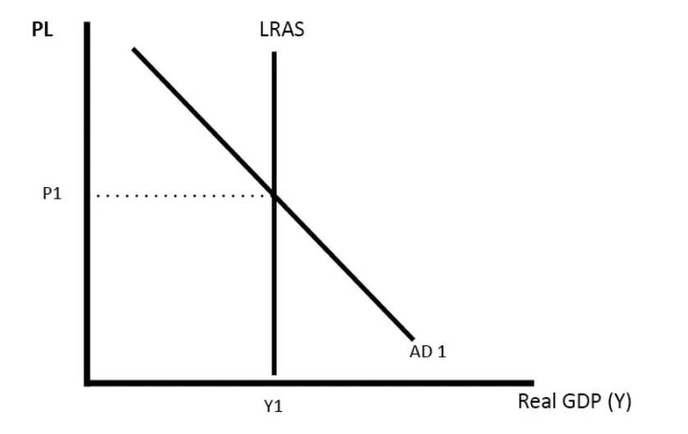
No inflation
Inflation and growth
Cost push inflation

Slide 7
Inflation risk in emerging markets
Economic growth + insufficient monetary restraint
➔ high inflation, a problem that has periodically cropped up in emerging markets.
Runaway inflation ➔ devalue currencies, hurt corporate profit margins, and abruptly slow economic growth.

Slide 8
Inflation in emerging markets: Current trends
Crises in emerging markets in the 1990s (Mexico in 1994, Asia in 1997 and 1998) ➔
central banks started policies that aimed to make inflation targeting part of their standard, ongoing monetary policy.
+
Increased independence for the major emerging market central banks and broadly lower levels of domestic currency volatility
➔ Emerging market inflation has generally trended downwards over the past 10-15 years with fewer spikes of hyper-inflation.

Slide 11
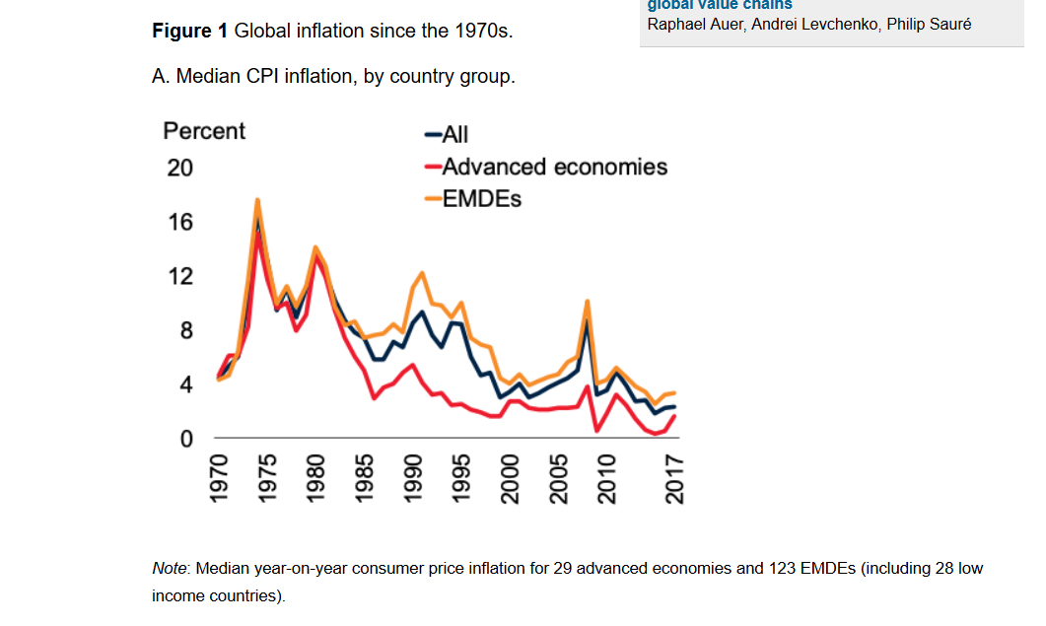

Slide 12
Factors of disinflation in emerging markets
The global crisis played a role in pushing inflation down around the world, but the longer-term trend of disinflation has been driven by many structural forces:
widespread adoption of effective and transparent monetary, exchange rate, and fiscal policy frameworks;
globalization.

Slide 13
The average volatility in headline prices across emerging markets has fallen gradually over the past two decades, and now sits at a record low of 1.5 percent.

Slide 14
Decrease in inflation volatility in emerging markets:
Inflation targeting has become the primary policy objective.
Globalization of trade and increased labor mobility via increased product competition and lower labor costs.
Lower potential growth rates in emerging markets.
Market-friendly governments are less inclined to regulate prices for services and goods -- which tends to trigger abrupt price hikes -- have also contributed to the drop.

Slide 15
Video: Get Your Portfolio Ready for Future Inflation

Slide 16
Inflation-protected investment in emerging markets
A standard bond:
Nominal – the fixed initial investment amount;
Coupon – the regular payments of interest which must be made;
Maturity – the fixed period of time until the debt must be repaid.
Inflation linked bonds:
has the same features as standard but nominal of the bond is no longer fixed; it is
linked to inflation ➔ the coupon is applied to a proportional larger or smaller nominal.
On average, emerging economies issue 23% of their local currency (LC) public debt linked to inflation.

Slide 17
Exchange risk and investment decisions in emerging markets
When investing in any international market,
investors face the risk that exchange rates will move in an unfavorable direction.

Slide 18
What is exchange rate: Reminder
Nominal Exchange Rate (NER): The price of a nation’s currency in terms of another currency.
Real Exchange Rate (RER): Compares the relative price of two countries’ consumption baskets.
RER = (NER x Price of the foreign basket) / (Price of the domestic basket).
Exchange Rate Depreciation/Appreciation (ERD/ERA) is a decrease/increase in the level (value, price) of a currency in a floating exchange rate system due to market forces.

Slide 19
Why exchange rate for investment decision?
“Exchange rate risk management is an integral part in every firm’s decisions about foreign currency exposure” (Allayannis, Ihrig, and Weston, AER P&P 2001)
“Exchange rate exposure is defined as the degree to which the value of a firm is affected by changes in exchange rate”(Adler and Dumas, 1984).
The ability to measure and manage exchange rate risk exposure is critical and does affect asset value and profit margins.

Slide 20
Exchange rate, trade and invetsment decisions (Nucci and Pozzolo 2001, European Economic Review)
ER Depreciation/ER Appreciation:
a firm is dependent on imported inputs ➔
the increase/decrease in variable costs ➔
the reduction/enlargement in the marginal value of capital ➔
the reduction/increase in its level of investment.
Example: An Indian firm imports equipment on 100 Euros.
1 Euro =10 Rupees. ➔ needs 1000 Rupees.
Rupee depreciates: 1 Euro = 12 Rupees. ➔ needs 1200 Rupees.
➔ Less rupees remaining for other investment.

Slide 21
Exchange rate, trade and invetsment decisions
ER Depreciation/ER Appreciation:
a firm with a larger share of revenues from the export markets ➔
the increase/decrease in price competitiveness ➔
the increase/decrease in the expected value of its capital ➔
the increase/decrease in its level of investment
Example: An Indian firm exports goods on 100 Euros.
1 Euro =10 Rupees. ➔ gets export revenues of 1000 Rupees.
Rupee depreciates: 1 Euro = 12 Rupees. ➔ gets export revenues of 1200 Rupees.
➔ More rupees for other investment.

Slide 22
Exchange rate, trade and invetsment decisions
Depreciation of local currency – good for exporting firms with low share of imported inputs. ➔ increase in investments
Appreciation of local currency – good for non-exporting firms with high share of imported inputs. ➔ increase in investments

Slide 23
Exchange rates and Foreign Direct Investment (Goldberg)
”Relative wage” channel:
ER (local currency) Depreciation ➔
Reduces country’s wages and production costs relative to those of its foreign counterparts. ➔
“Locational advantage" or attractiveness as a location for receiving productive capacity investments. ➔
Improves the overall rate of return to foreigners contemplating an overseas investment project in this country.

Slide 24
Exchange rates and Foreign Direct Investment (Goldberg)
“Relative wealth” channel: ER (local currency) Depreciation ➔
Raises the relative wealth of source country agents and can raise multinational acquisitions of certain destination market assets. ➔
To the extent that source country agents hold more of their wealth in own currency-denominated form, a depreciation of the destination currency increases the relative wealth position of source country investors, lowering their relative cost of capital. ➔
This allows the investors to bid more aggressively for assets abroad.

Slide 25
A “firm-specific asset” argument (Blonigen, American Economic Review 1997)
If foreign (Japanese) and domestic (US) firms have equal opportunity to purchase firm-specific assets in the domestic (US) market, but different opportunities to generate returns on these assets in foreign markets.
➔
Currency movements may affect relative valuations of different assets. While domestic (US) and foreign (Japanese) firms pay in the same currency, the firm-specific assets may generate returns in different currencies.
➔
If a representative foreign (Japanese) firm and domestic (US) firm bid for a domestic (US) target firm with firm-specific assets, real exchange rate depreciations of the domestic (US) currency can plausibly increase foreign (Japanese) acquisitions of these target (US) firms.
➔
This channel predicts that domestic (US) currency depreciation will lead to enhanced FDI into this (US) economy.
Example: Data on Japanese acquisitions in the United States support the hypothesis that real dollar depreciations make Japanese acquisitions more likely in U.S. industries with firm-specific assets.

Slide 26
Volatility of exchange rate and FDI activity: ”Production flexibility” argument
Producers need to commit investment capital to domestic and foreign capacity before they know the exact production costs and exact amounts of goods to be ordered from them in the future.
When exchange rates and demand conditions are realized, the producer commits to actual levels of employment and the location of production.
In the production flexibility arguments, the important presumption is that producers can adjust their use of a variable factor following the realization of a stochastic input into profits.
Without this variable factor, i.e. under a productive structure with fixed instead of variable factors, the potentially desirable effects on profits of price variability are diminished.
By the production flexibility arguments, more volatility is associated with more FDI ex ante, and more potential for excess capacity and production shifting ex post, after exchange rates are observed.

Slide 27
Volatility of exchange rate and FDI activity: “Risk aversion” argument
Investors require compensation because exchange rate movements introduce additional risk into the returns on investment.
Higher exchange-rate variability lowers the certainty equivalent expected exchange-rate level.
Certainty equivalent levels are used in the expected profit functions of firms that make investment decisions today in order to realize profits in future periods.
If exchange rates are highly volatile, the expected values of investment projects are reduced, and FDI is reduced accordingly.

Slide 28
”Production flexibility” vs. ”Risk aversion” arguments
Risk aversion arguments are more convincing than the production flexibility arguments posed in relation to the effects of short-term exchange rate variability.
For variability assessed over longer time horizons, the production flexibility motive provides a more compelling rationale for linking foreign direct investment flows to the variability of exchange rates.

Slide 29
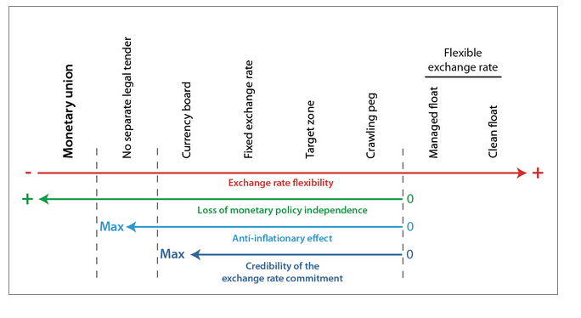
Exchange rate regimes

Slide 30
De facto regimes differ from de jure
Most of those listed as floating in fact intervene in the foreign exchange market frequently.
As Calvo and Reinhart (2000) observe: “Countries that say they allow their exchange rate to float mostly do not.”
Only the United States (US) floats so purely that intervention is relatively rare.

Slide 31
Advantages of fixed exchange rates
The nominal anchor for monetary policy.
Higher exchange rate variability ➔ uncertainty; ➔ discourage international trade and investment.
Fixing the exchange rate ➔would eliminate exchange rate risk ➔ encourage international trade and investment.
Adopting the neighbor's currency as one's own ➔ would eliminate transactions costs as well ➔ promote trade and investment still more.
Prevent competitive depreciation or competitive appreciation.
Preclude speculative bubbles. Some exchange rate fluctuations appear utterly unrelated to economic fundamentals.

Slide 32
Advantages of floating exchange rates
Allows the country to pursue an independent monetary policy.
Government retains two important advantages of an independent central bank: seigniorage and lender-of-last resort ability.
Allows automatic adjustment to trade shocks.

Slide 33
Which factors are likely to dominate, the advantages of fixed exchange rates or the advantages of floating?
No one right answer for all countries.
The answer depends, in large part, on the characteristics of the country in question.
If the country is subject to many external disturbances, ➔ floating currency is better.
If the country is subject to many internal disturbances ➔ fixing currency is better.
The answer also depends: if the source of shocks is monetary or real; the degree of capital and other factor mobility; the relative size of countries.

Slide 34
Standard theory of exchange rate regime choice bases its analysis on the nature of shocks:
Nominal shocks prevail – fixed regime. ➔
A monetary shock will tend to depreciate a floating ER, thus transmitting a nominal shock into a real one. In this context, a fixed ERR would provide a mechanism which accomodates a shift in money supply or demand with less output volatility.
"Suppose the central bank, for no reason at all, unexpectedly doubles the money supply/doubles the price of gold/doubles the exchange rate target/doubles the inflation target etc."

Slide 35
Standard theory of exchange rate regime choice - continue
Real shocks prevail – floated regime. ➔
In this case, when the economy needs to respond to a change in relative equilibrium prices (i.e. tradable prices vs. non-tradable prices), a shift in the nominal ER could help to avoid any unfavourable effects in output and employment (De Grauwe, 1997).
Examples of real shocks include droughts, changes to the oil supply, hurricanes, wars, and technological changes.

Slide 36
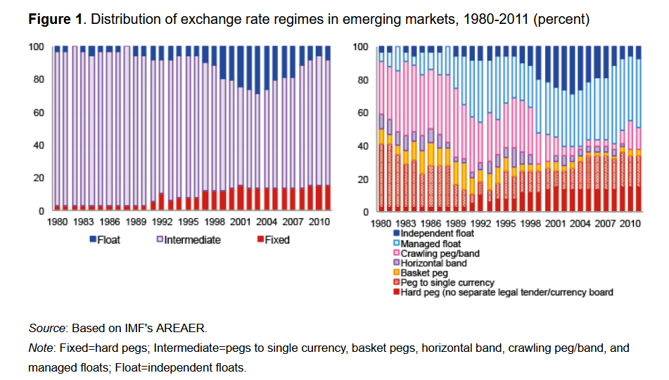

Slide 37
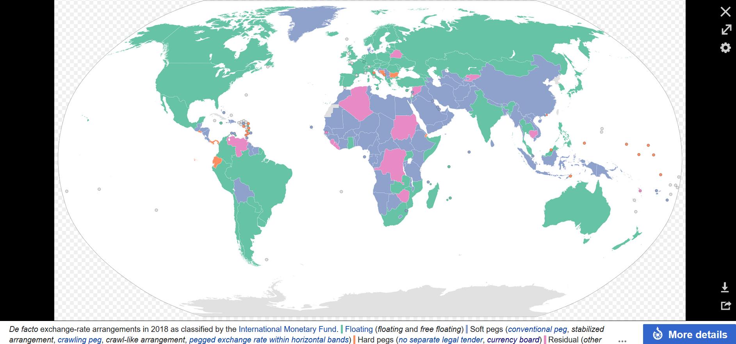
2018

Slide 38
Choice of Exchange Rate Regime in Emerging Markets
Whether countries are free to choose any regime they want, or whether they are instead forced to adopt a particular regime or to choose among a limited number of options?
Determinants in emerging markets:
International financial market integration,
Macroeconomic performance,
Financial sector development,
Political economy considerations.

Slide 39
11 empirical regularities of exchange rates in Emerging Markets (Edwards 2011)
The analysis is undertaken from the perspective of both the Latin American and East Asian nations.
Some of the topics addressed include:
the relationship between exchange rate regimes and growth,
the costs of currency crises,
the merits of “dollarization,”
the relation between exchange rates and macroeconomic stability,
monetary independence under alternative exchange rate arrangements,
the effects of global “currency wars” on exchange rates in commodity exporters.

Slide 40
1st regularity: Exchange rate crises are very costly
A “crisis” occurs when there is either a large depreciation of the nominal exchange rate (a depreciation that exceeds 20%, in a two months period)
and/or
A “sudden stop” or a “current account reversal,” where a country’s current account deficit is reduced significantly in a short period of time (foreign capital outflow).
___________________________________________________________________
Numerous empirical evidence:
Currency crises are extremely costly in terms of growth slowdown, increased unemployment, and higher inflation.

Slide 41
2nd regularity: Countries with More Flexible Exchange Rates Have Tended to Grow Faster in the Long Run than Countries with Rigid Currency Pegs
Levy-Yeyati and Sturzenegger (2003) : emerging countries with more rigid exchange rates have experienced slower growth and higher output volatility than countries with more flexible exchange rate regimes.
They also found that the exchange rate regime has no effect on output growth or output volatility in industrial countries.

Slide 42
3rd regularity: Dollarized Countries do not Outperform Countries with a Currency of their Own
A number of economists argued that there were no compelling reasons for (some) emerging countries having national currencies.
According to this view a number of emerging nations would benefit from adopting an advanced nation’s currency as legal tender. ➔ “dollarization”.
delegate monetary policy to an advanced country’s (conservative) central bank.
lower inflation than countries that pursue an active domestic monetary policy.

Slide 43
Economic effects of dollarization: Supporters
According to its supporters, dollarization will positively affect growth through two channels:
First, dollarization will tend to result in lower interest rates, higher investment and faster growth (Dornbusch, 2001).
Second, by eliminating currency risk, a common currency will encourage international trade ➔ faster growth (Rose (2000), and Rose and Van Wincoop (2001)).

Slide 44
Economic effects of dollarization: Opponents
Edwards and Magendzo (2003, 2006):
Dollarized countries have had a slightly lower rate of growth than countries with a domestic currency.
(b) GDP volatility has been significantly higher in dollarized economies than in with-currency countries.

Slide 45
4th regularity: Countries with flexible exchange rates are able to accommodate external shocks better than countries with rigid rates
This, in turn, will allow countries with floating rates to avoid costly and long-standing adjustment processes (business cycles argument!).

Slide 46
5th regularity: Under Capital Mobility and Fixed Exchange Rates, there is no room for (fully) Independent Monetary Policy (The Impossibility of the Holy Trinity)
“Impossibility of the Holy Trinity,” (Three in one; One in three; Blessed trinity)
➔ it is not possible to simultaneously have:
free capital mobility,
a pegged exchange rate,
and an independent monetary policy.
Some authors, however, have argued that this is a false dilemma, since there is no reason for emerging economies to have free capital mobility:
problem of capital flight ➔ need for capital control.

Slide 47
6th regularity: Exchange Rate Adjustment Based on Inflation Rate Differentials Result in a Loss of Anchor and in Macroeconomic Instability
This type of exchange rate system is known as “crawling peg”:
There is abundant empirical evidence suggesting that this exchange rate rule tends to generate significant inflationary inertia.

Slide 48
7th Regularity: Exchange Rate-Based Stabilization Programs are Dangerous, and have often generated severe Currency Overvaluation
Pegging the nominal exchange rate as a way of introducing price discipline.
The rationale: if exchange rate indexation contributed to inflationary inertia (this is Regularity 6), pegging the nominal exchange rate will help eliminate it.
Chile and Mexico are two examples of this policy. This process generated overvalued real exchange rates and a decline in international competitiveness. In both cases the final outcome was a major and costly currency crisis.

Slide 49
8th Regularity: Real Exchange Rate Misalignment can be Very Costly
The emerging countries’ currency crises of the 1990s and early 2000s underscored the need of avoiding overvalued real exchange rates -- that is, real exchange rates that are incompatible with maintaining sustainable external accounts.
Generally speaking, the RER is said to be “misaligned” if its actual value exhibits a (sustained) departure from its long run equilibrium.
The extent of misalignment tends to be significantly smaller under flexible regimes than under pegged systems.

Slide 50
9th regularity: There is an asymmetry between overvaluation and undervaluation
There is a clear asymmetry between situations of currency undervaluation and currency overvaluation.
Overvaluation simply cannot be sustained: Persistent overvaluation ➔ increasingly tighter protectionist measures ➔ experience a currency collapse (Edwards, 1989).

Slide 51
Currency undervaluation
China example:
Chinese government has been buying US dollar-denominated Treasury bills ➔ Increasing demand for US dollars ➔ Chinese currency was depreciating agains US dollar (artificial depreciation)
This policy helped China to stimulate its export and outcompete US producers in the world market ➔
Trade war between China and USA

Slide 52
10th Regularity: Even under Flexible Exchange Rates the extent for Independent Monetary Policy is Limited
Mundell-Fleming model:
Countries with fixed regimes cannot undertake independent monetary policy.
Countries with flexible exchange rates are able to conduct independent monetary policy.
More recently, however, some authors have argued that countries with flexible exchange rate do not have true monetary autonomy.

Slide 53
11th regularity: There has been an important Structural Break in the relationship between the USD Real Effective Exchange Rate and the Real Effective Exchange Rate of the Emerging Commodity Exporters
In the aftermath of the 2007-2009 global financial crisis policymakers throughout Latin America (and other commodity exporting countries, for that matter) have become concerned about the (real) strengthening of their currencies.
Real exchange rate (RER) appreciations throughout the region have reduced competitiveness, hurt export, and generated political pressure from tradable goods’ producers.
➔ Trade wars: Countries are interested to undervalue their currencies to foster export ➔ appreciation of currencies in competing countries! China-USA-Latin American countries` example!

Slide 54
Exchange rate in advanced emerging markets, local currency to USD

Slide 55
Exchange rate in secondary emerging markets, local currency to USD

Slide 56
Exchange rate in frontier emerging markets, local currency to USD

Slide 57
Exchange rate in frontier emerging markets, local currency to USD

Slide 58
Exchange rate in advanced markets, local currency to USD

