Slide 1
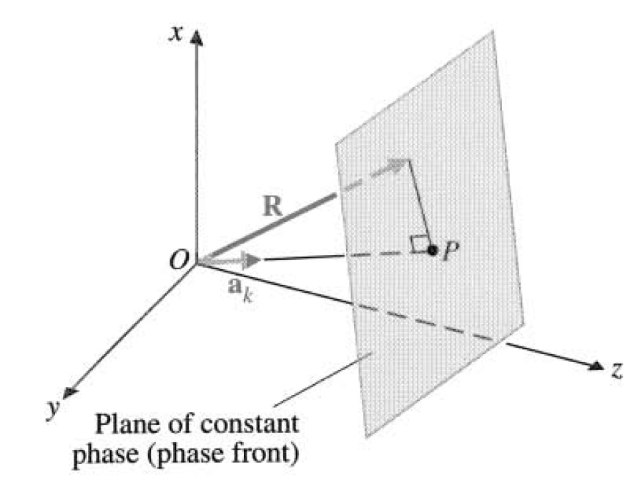
From the coursebook. Chapter 7-2.2
$$x$$
Let us find the wavefront (surface of constant phase)
$$O$$
$$a_{k}$$
$$k a_{k}⋅R=const$$
$$z$$
$$y$$

Slide 2
Brewster’s angle

Slide 3
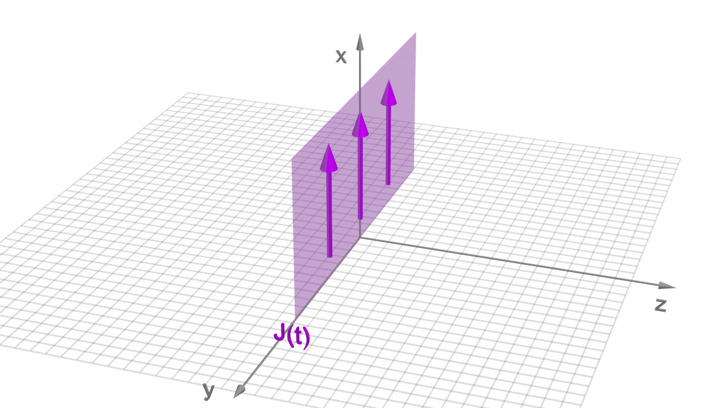
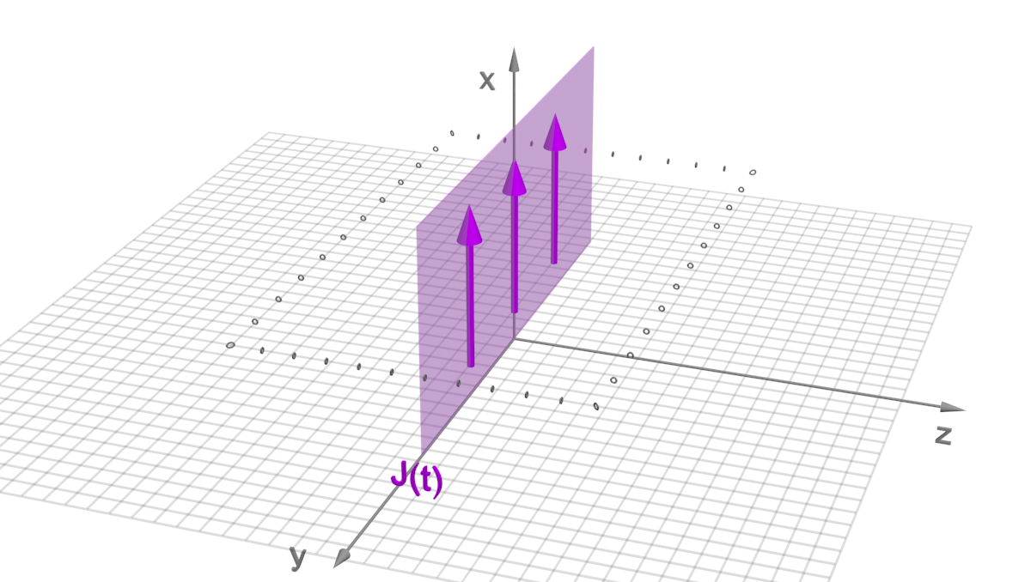
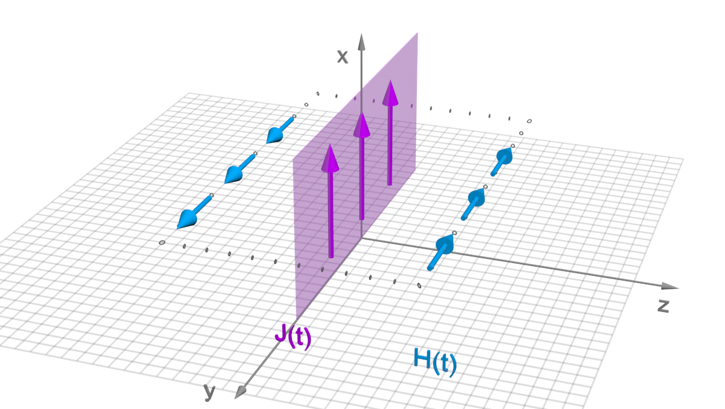
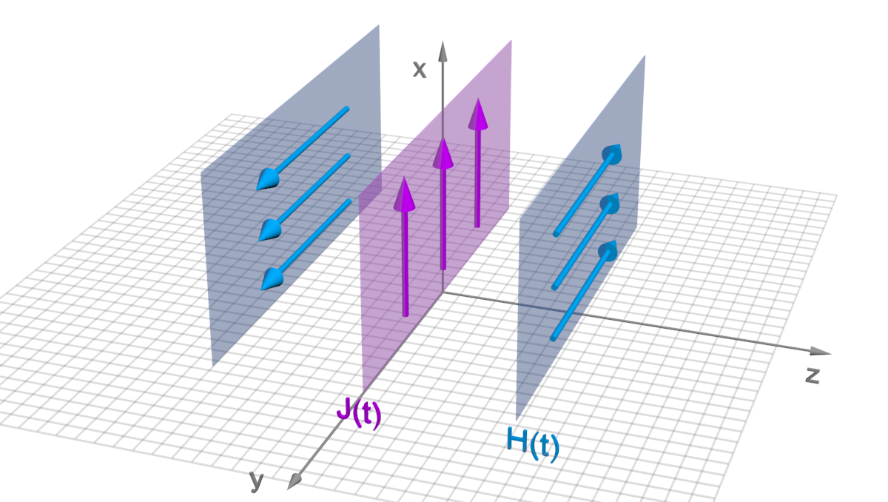
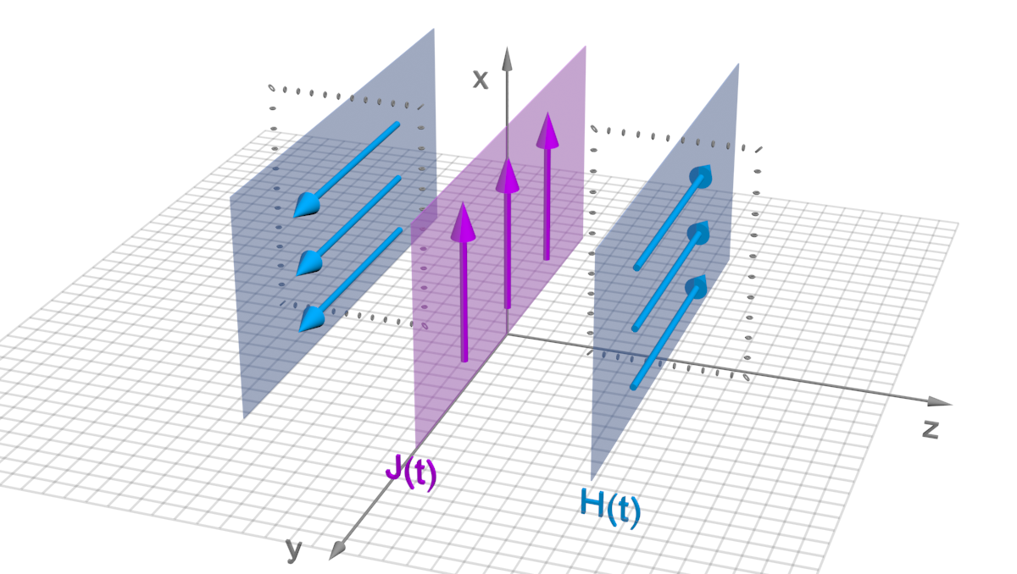
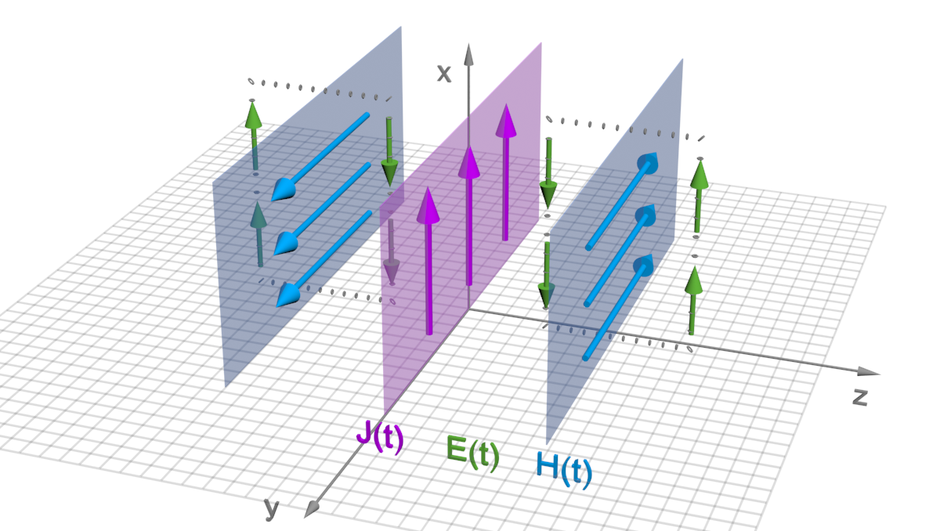
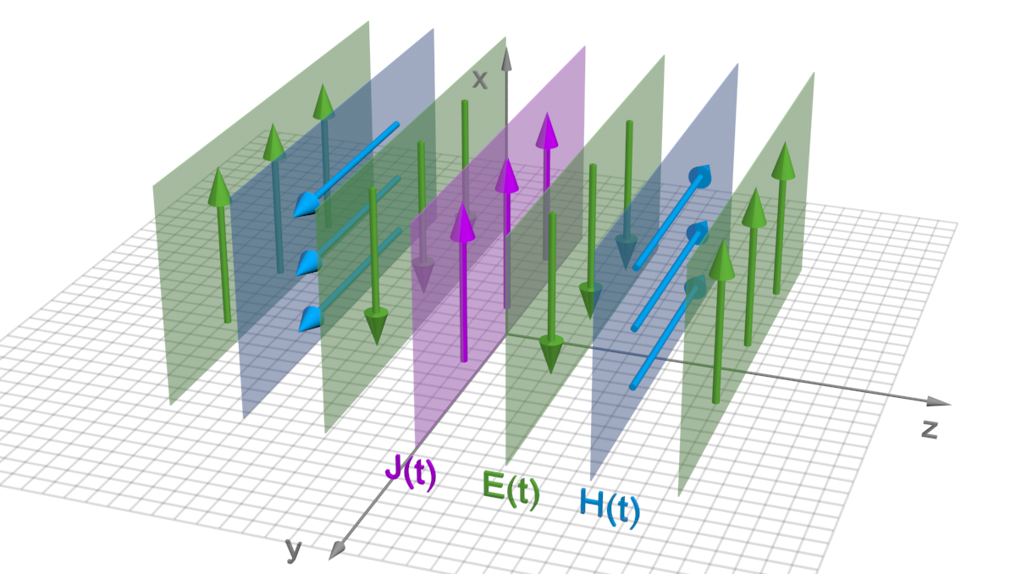
Conceptual 1D picture
$$C_{2}$$
$$J\left(t\right)→H(t)$$
$$C_{2}$$
$$H(t)→E(t)$$
$$C_{1}$$
$$E(t)→H(t)$$
$$H(t)→E(t)$$
$$∇× E=−μ\frac{∂H}{∂t}$$
$$\oint_{C_{2}}{E⋅dl}=−μ\int_{S}{\frac{∂H}{∂t}⋅ds}$$
$$∇×H=ε\frac{∂E}{∂t}$$
$$\oint_{C}{H⋅dl}=ε\int_{S}{\frac{∂E}{∂t}⋅ds}$$
$$∇×H=J$$
$$\oint_{C_{1}}{H⋅dl}=\int_{S}{J⋅ds}$$
…

Slide 4
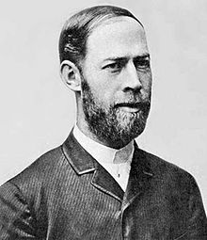
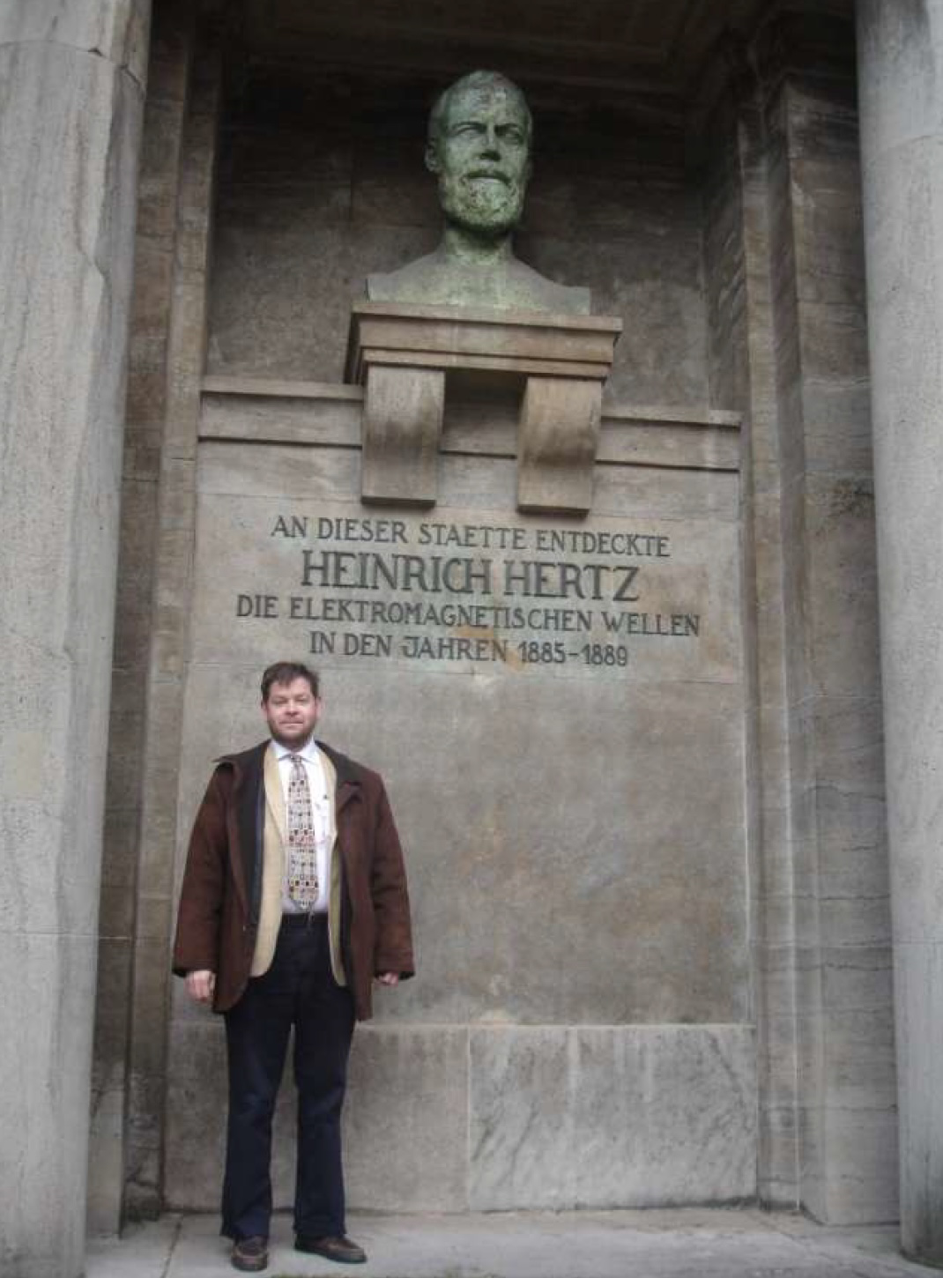
Heinrich Hertz

Slide 5
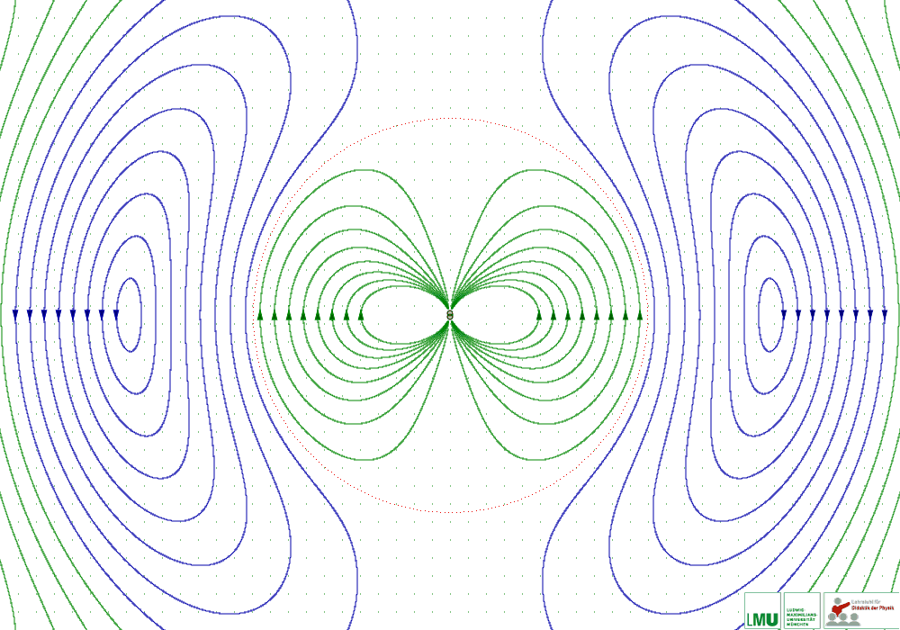
Source: https://www.en.didaktik.physik.uni-muenchen.de/multimedia/dipolstrahlung/index.html
$$E(R,t)$$

Slide 6
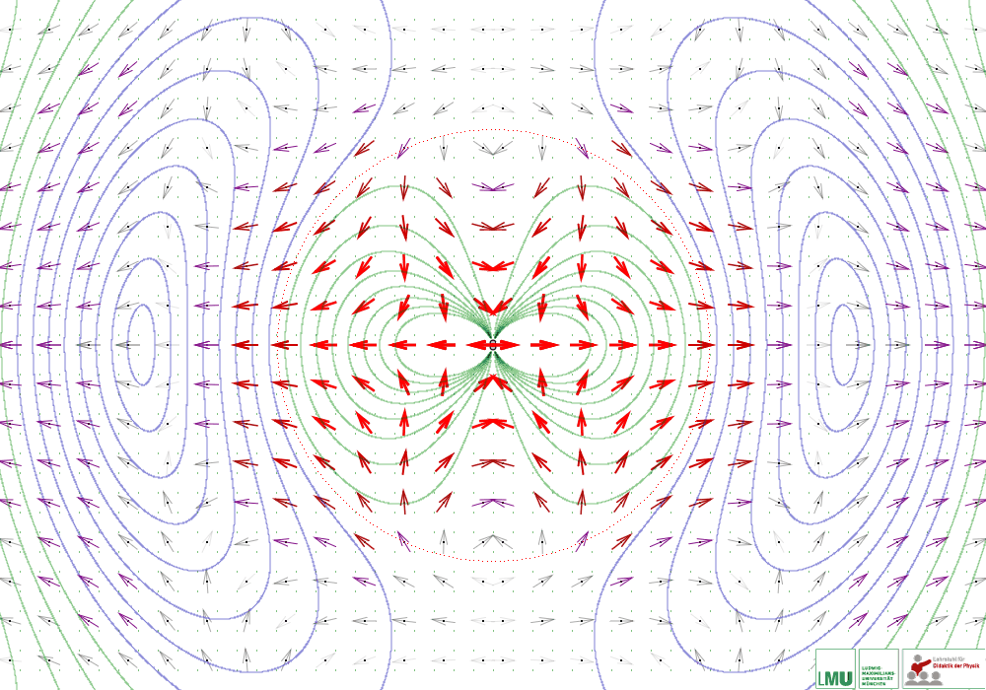
Source: https://www.en.didaktik.physik.uni-muenchen.de/multimedia/dipolstrahlung/index.html
Lines$− E\left(R,t\right)$
A$rrows −S(R,t)$

Slide 7
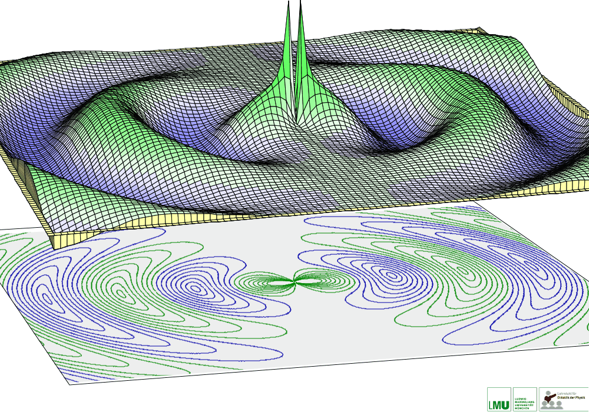
Source: https://www.en.didaktik.physik.uni-muenchen.de/multimedia/dipolstrahlung/index.html

Slide 8
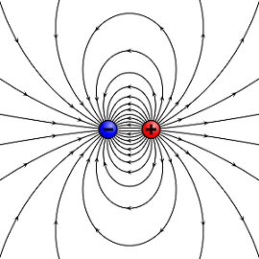
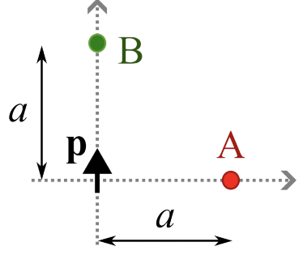
Static dipole vs dynamic dipole

Slide 9
$$S(R)$$
$$S(R)$$

Slide 10
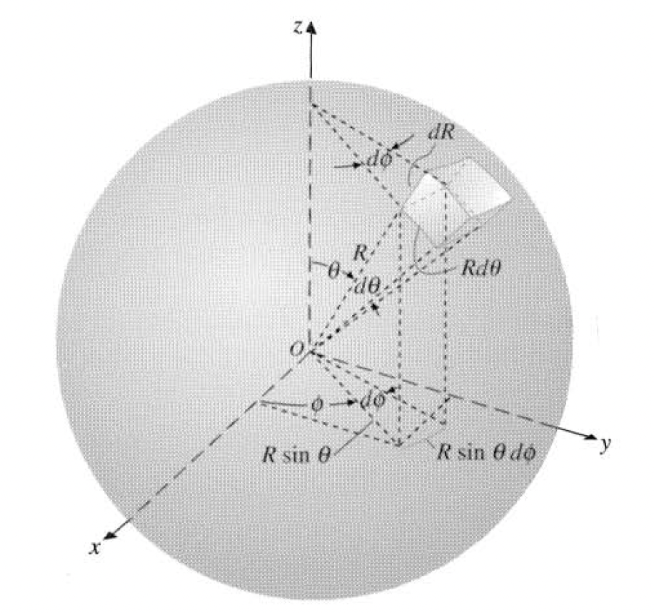
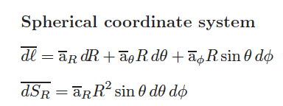
Coursebook. Figure 2-14.

Slide 11
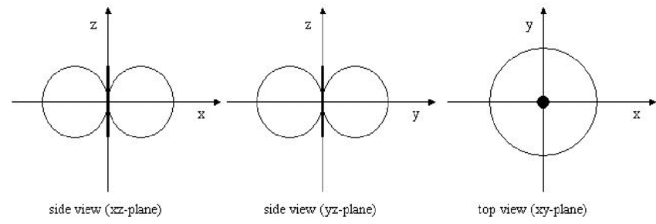
Radiation pattern for Hertzian dipole

Slide 12
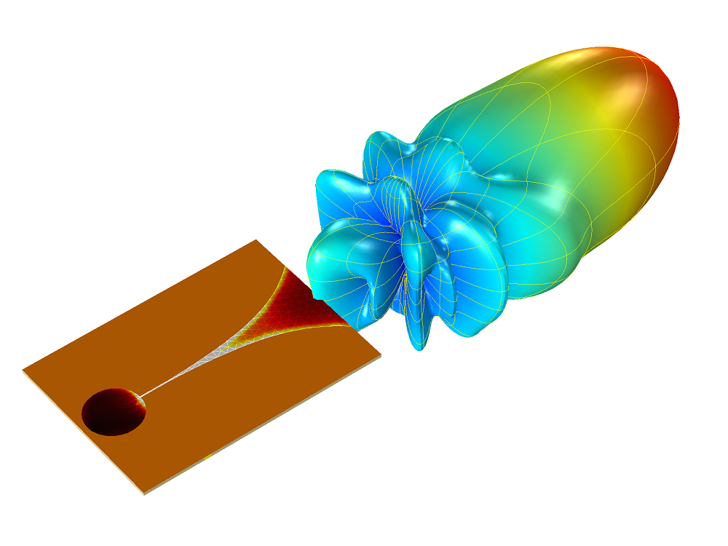
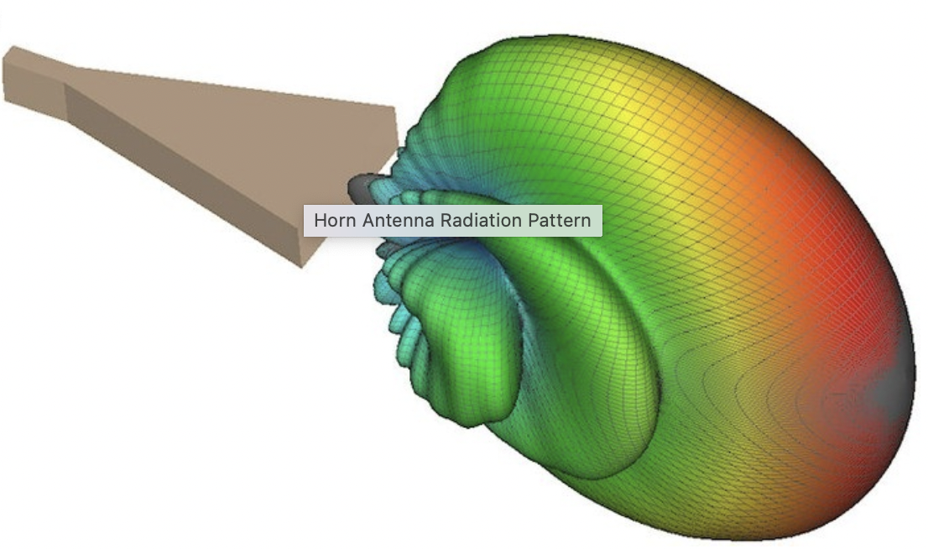
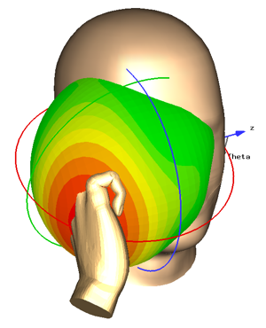
Radiation pattern for some other antennas

Slide 13
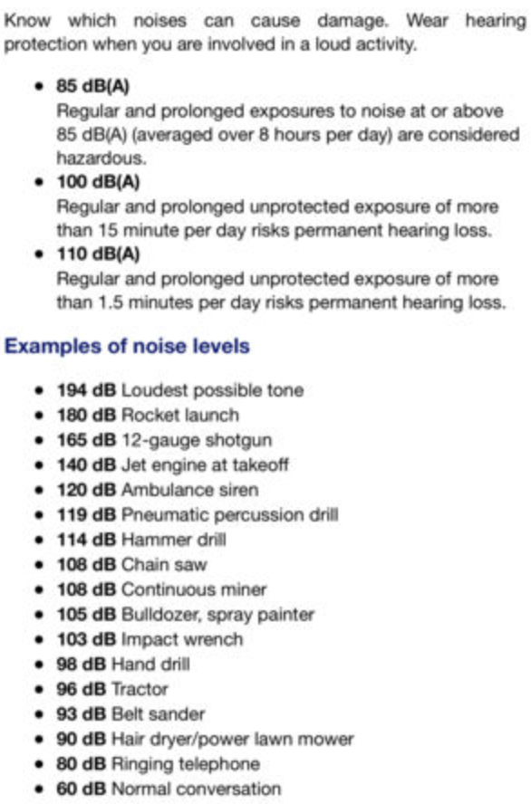
On decibel levels for sound
Human’s ear has dynamic range of ${10}^{12}$!
For eyes, the dynamic range is ${10}^{9}$
More info on dB can be found here: https://www.phys.hawaii.edu/~anita/new/papers/militaryHandbook/decibel.pdf

Slide 14
Happy Easter!

