Slide 1
Session 8: Job applications cont., peer feedback, introduction to A4: Visual analysis, punctuation review

Slide 2
Session 8
Homework:
Processing the job applications
Constructive peer feedback
Punctuation review
Group work
Introduction to Visual Analysis

Slide 3
Processing the job applications
Form selection panels (groups of 3 or 4 students).
Read the applications and give constructive feedback on them (see the following slides)
Choose the candidates for an interview. ☺

Slide 4
Instructions for constructive feedback 1/3
With your selection panel members, read the applications.
Comment on the following items:
The structure of a job application letter: is it clear?
1) Position applied for (title, where you heard about it)
2) Applicant’s situation and skills (his/her current job and most relevant skills or responsibilities)

Slide 5
Instructions for constructive feedback 2/3
3) Applicant’s motivation / reasons for wanting the job
(For example: ready for greater challenges, more responsibility, or a change of direction)
4) Closing paragraph & sign-off
says when available to start work
thanks the reader for considering his/her application
indicates s/he are looking forward to a response, e.g. “I look forward to hearing from you.”
signs off formally, e.g. Yours sincerely,…

Slide 6
Instructions for constructive feedback 3/3
Is the application letter:
1) brief
2) formal but enthusiastic
3) reader-friendly (short, informative paragraphs)
4) accurate (no grammar/punctuation mistakes)?
Homework after class: Update the covering letters and submit to MyCourses for teacher feedback.

Slide 7
A few words of feedback on the activity
How was it to write a job application in English?
How was it to comment on other people’s applications?
Was this useful to you?
Any suggestions as to how to improve this activity?
Thank you for your feedback! ☺

Slide 8
Punctuation review - MyCourses Session 8

Slide 9
Punctuation review – small group activity
Study the rules in groups of three (one part each) and teach them to each other first –> commas 1, commas 2, semicolons and colons (~20 min)
Revise the sentences together (~20 min)
Check your answers (next 3 slides/key in MyCourses)

Slide 10
Punctuation Review Activity - Key
Coach Espinoza, who took her team to the Final Four last year, might take…
…the nation’s best; however, they…
OK!

Slide 11
Punctuation Review Activity - Key
4. …in Atlanta, Georgia; Boston, Massachusetts; and Phoenix, Arizona.
…last semester, but his one downfall…
…to damage, those parts can be built heavier, and other parts can be made lighter, reducing the overall weight…
…a successful college student, two characteristics are needed: a positive….
As a result, ….

Slide 12
Punctuation Review Activity - Key
9. Time management, an important skill for all college students, is taught….
10. …on my partial exam; as a result, I received…
11. …in a dorm in their first year; some even require them …
12. …on three dimensions: asset specificity; uncertainty (including complexity, which is similar to uncertainty in its effects); and frequency.

Slide 13
Time for a short break!

Slide 14
Recap Visual Analysis – What is it?
Based on http://www.monash.edu.au/lls/llonline/writing/artdesign/writing/1.1.xml
“a way of writing about an artwork in order to understand it better”
“involves looking closely at the visual qualities of the work and considering how the various elements come together to create a particular effect or experience”
“like an essay in that it has an introduction and paragraphs that develop the writer's ideas, explore perceptions and lead toward a conclusion”

Slide 15
Recap: Description or analysis - What is the difference?
Description and analysis go hand in hand…
…observe that describing is only a part of analyzing!
“When you analyze anything, you first need a description of the several parts that you have distinguished in some coherent work.”
Analysis: Not only identify but also explain the way the constituent parts or elements relate to one another.

Slide 16
Recap Writing (A4) – Visual Analysis
How long?
max 400 words or 3–5 paragraphs
What style of writing?
Academic
Does it need citations?
Yes, references and in-text citations

Slide 17
Start with reading
…about your chosen artwork in a critical guide, noting which features or qualities of the artwork are particularly discussed.
…consider why these features have been emphasized and think about how they could relate to the overall success or otherwise of the piece.
Or start with your own observation.

Slide 18
How to start? Practice first
For the purposes of practicing, look at Piet Mondrian, Composition with Red, Blue and Yellow, 1930, oil on canvas, 50.8 x 50.8 cm, private collection. Reproduced with permission from Erich Lessing Culture and Fine Arts Archives.
Link in MyCourses, session 7
https://www.monash.edu/rlo/assignment-samples/art-design-architecture/visual-analysis
Working either individually or with a partner/group, view the painting, go through the examples and note down your own ideas (~15 min)

Slide 19
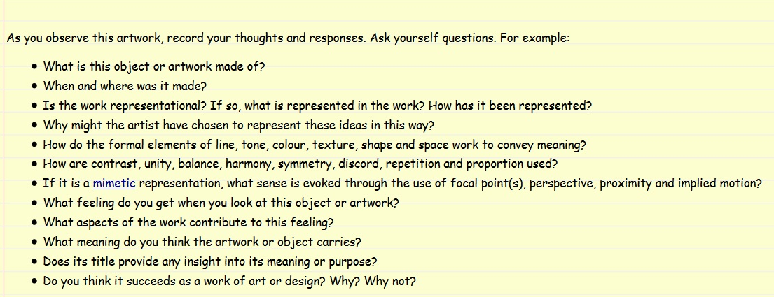
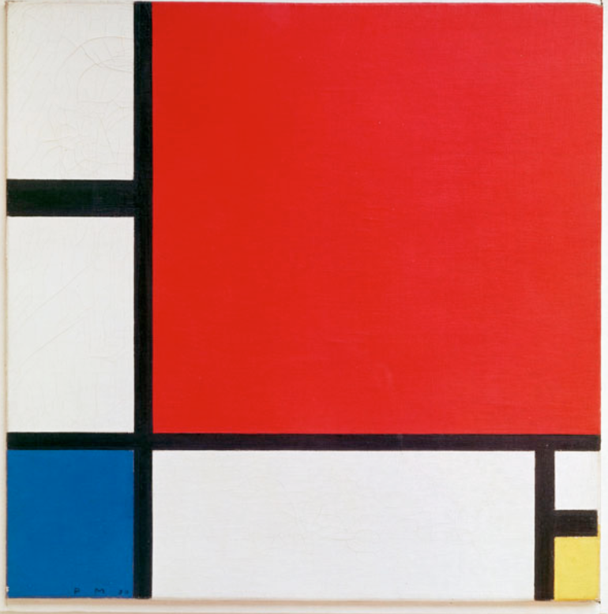

Slide 20
Recap Visual Analysis: How to structure it?
Most visual analyses typically include:
A description of the object
A description of the technique
An interpretation of the meaning or intention of the work
An evaluation of the work

Slide 21
Visual Analysis: How to structure it?
Pay attention to the paragraph construction
Each paragraph one central idea
Transition signals!
Develop an argument (based on your observation and evaluation of the object or artwork)

Slide 22
Visual Analysis: How to structure it?
Do not simply express your opinion about particular qualities of the work
Persuade your reader that your interpretation and evaluation are valid
Each paragraph should advance your argument towards the conclusion

Slide 23
Visual Analysis: How to write it?
Partly a technical activity but also a reflective and subjective one
Both
a) descriptive language of formal observation and
b) more speculative phrases
Use simple and precise language!

Slide 24
Visual Analysis: How to write it?
When describing the artwork/object, use the present tense
The object itself is the subject of the description, rather than the artist or designer
The pot shows
The painting demonstrates

Slide 25
Visual Analysis: How to write it?
When describing the technique…
explain how the artist has achieved a particular effect
Use evidence/examples from the work to demonstrate what you mean
Be evocative (=expressive)
Try describing the object to someone who has NOT seen it
Thick paint has been applied with rough brushstrokes creating an interesting, dynamic texture.

Slide 26
Visual Analysis: How to write it?
When interpreting the meaning or intention of the work…
The evidence from the work is the basis of your interpretation of the meaning or intention of the work
Often only guessing at the artist’s meaning > uncertainty
Notes:
What you see is what you get

Slide 27
Visual Analysis: How to write it?
When interpreting the meaning or intention of the work…
Evokes, creates, appears, suggests
Reflect thinking or guesswork
Other conditional forms: may, could, seems
This choice of subject seems intended to..
The artist appears to be implying...

Slide 28
Visual Analysis: How to write it?
When evaluating the work, you may say something like this:
Overall, this work conveys a strong sense of joy, especially through the use of vibrant, exciting colours which left me feeling elated long after I left the gallery.

Slide 29
Visual Analysis: How to write it?
Look at the image again
https://www.monash.edu/rlo/assignment-samples/art-design-architecture/visual-analysis
Discuss your observations with a partner

Slide 30
Ekphrasis

Slide 31
Poetry (and other forms of art) about art: ekhphrasis
“Ekphrastic poems focus on works of art – usually paintings, photographs, or statues. And modern ekhprastic poems have generally shrugged off antiquity’s obsession with elaborate description, and instead have tried to interpret, inhabit, confront, and speak to their subjects.”
(https://www.poets.org/poetsorg/poems?field_form_tid=408; accessed 24.8.2016)

Slide 32
Pieter Bruegel De val van Icarus (Landscape with the Fall of Icarus) https://upload.wikimedia.org/wikipedia/commons/c/c2/Pieter_Bruegel_de_Oude_-_De_val_van_Icarus.jpg; accessed 16.08.2016
Notes:
Ask questions: Has anybody seen this painting ”live” (in Brussels, in the Royal Museums of Fine Arts of Belgium)? Do you like it? Can you describe something about its theme or the technique, about the colours or the light?
”the painting, perhaps painted in the 1560s, is now usually seen as a good early copy by an unknown artist of Bruegel’s lost original, although recent technical research has re-opened the question” (Wikipedia; accessed 16.08.2016).

Slide 33
Poetry analysis – ekhphrasis
View the painting and in groups, read the assigned poem for your group
William Carlos Williams
W. H. Auden
Michael Hamburger
Begin a discussion about:
Sources of inspiration
An artist’s gaze versus the viewer’s gaze – dictating interpretation?
Interpretation – limits and borders?
Can you think of other examples of writers who were inspired by art to paint with words; or of (inspired) interpretations by artists about other artists’ work?

Slide 34
Sources
https://en.wikipedia.org/wiki/Landscape_with_the_Fall_of_Icarus
https://www.poets.org/poetsorg/poem/landscape-fall-icarus
https://timesflowstemmed.com/2014/06/22/lines-on-brueghels-icarus/
http://english.emory.edu/classes/paintings&poems/auden.html

Slide 35
Homework:
1) Revise your Artist Statement and submit the final version for grading by
Due 10.05 at 22.00 (15% of overall grade).
2) Revise Cover Letter according to the peer feedback you received in class and submit it for teacher comments
Due 13.05 at 22.00 Turnitin
3) Choose the object/finalize your choice of the object of your Visual Analysis.

Slide 36
See you next week!

