Slide 1
Exercise 4
Fuel cells and hydrogen

Slide 2
Problem 1
Solution:
The most prominent difference between ions and electrons are that ions are relatively a lot larger and heavier than electrons
Conduction mechanisms also differ

Slide 3
Problem 2
Solution:
Neglibible electronic conduction
High ionic conductivity ($H^{+}$ in case of PEMFC and $O^{2−}$ in case of SOFC)
Thermodynamic stability over a wide range of temperature and oxygen/hydrogen partial pressure
Thermal expansion coefficient suitable and compatible with that of electrodes and other cell materials
Chemically stable and suitable mechanical properties

Slide 4
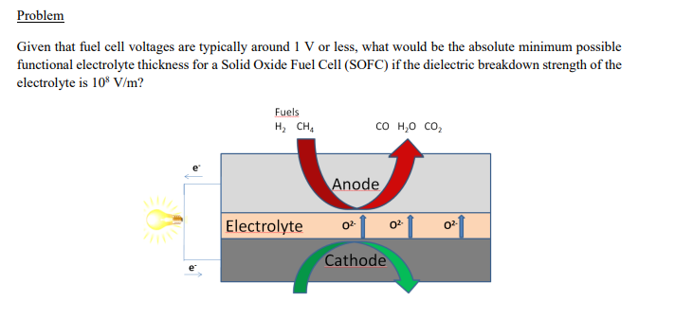
Problem 3

Slide 5
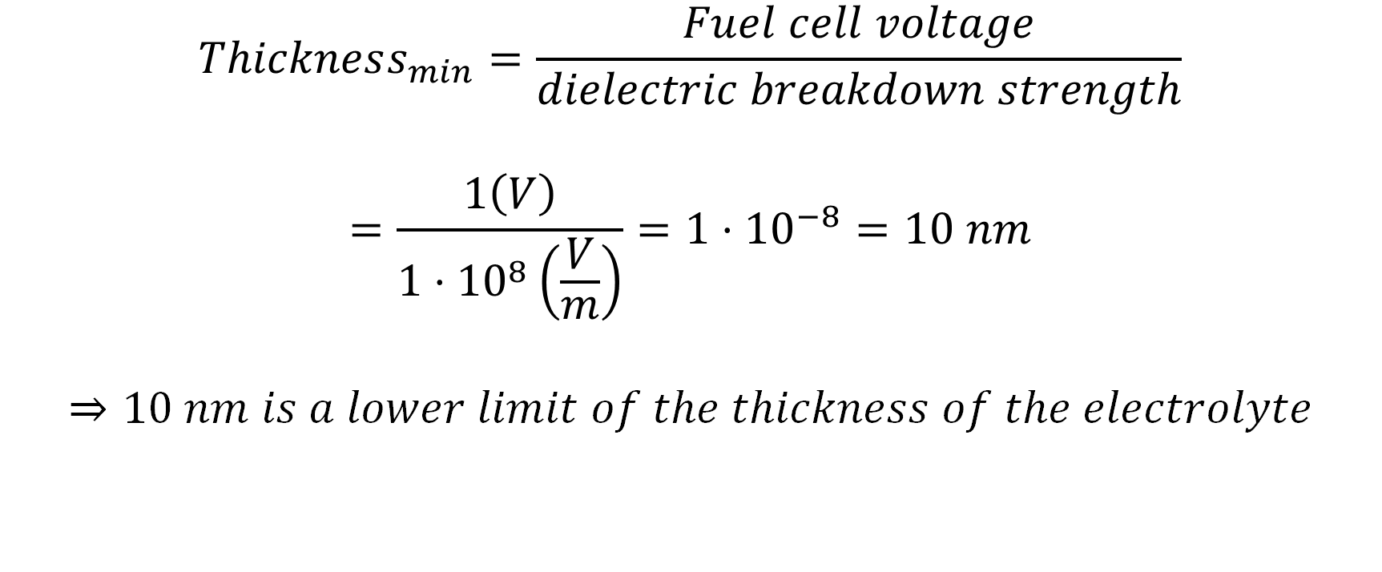
Problem 3
$$Thickness_{min}=\frac{Fuel cell voltage}{dielectric breakdown strength}$$
$$=\frac{1\left(V\right)}{1⋅{10}^{8}\left(\frac{V}{m}\right)}=1⋅{10}^{−8}=10 nm$$
$$⇒10 nm is a lower limit of the thickness of the electrolyte$$

Slide 6
Problem 4

Slide 7
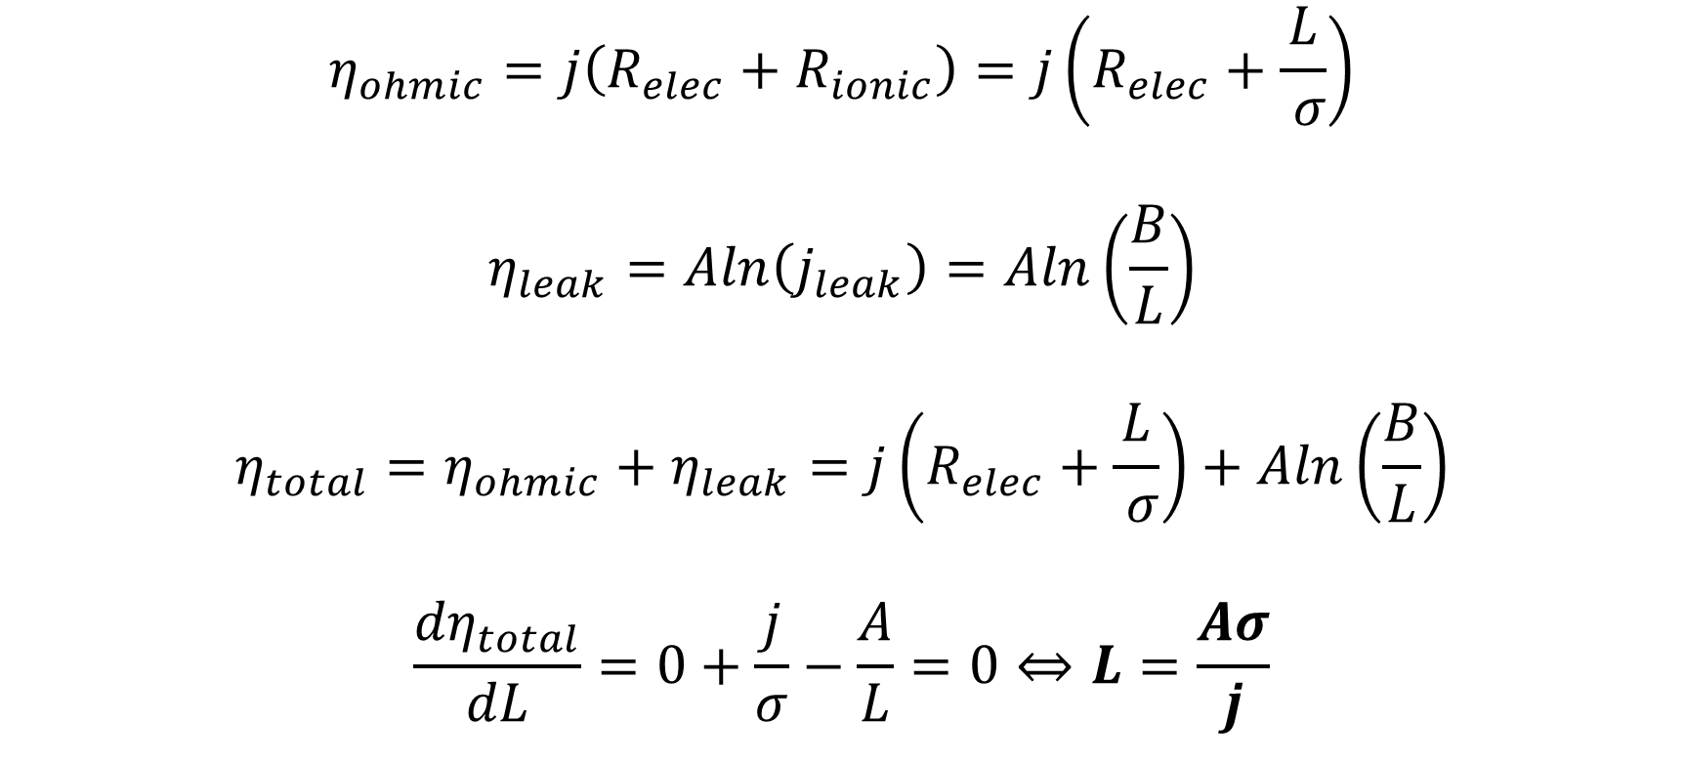
Problem 4
$$η_{ohmic}=j\left(R_{elec}+R_{ionic}\right)=j\left(R_{elec}+\frac{L}{ σ}\right)$$
$$η_{leak}=Aln\left(j_{leak}\right)=Aln\left(\frac{B}{L}\right)$$
$$η_{total}=η_{ohmic}+η_{leak}=j\left(R_{elec}+\frac{L}{ σ}\right)+Aln\left(\frac{B}{L}\right)$$
$$\frac{{dη}_{total}}{dL}=0+\frac{j}{σ}−\frac{A}{L}=0⇔L=\frac{Aσ}{j}$$

Slide 8
Problem 5
Solution
$$η_{ohmic}=i\left(R_{elec}+R_{ionic}\right)=i\left(R_{elec}+\frac{L}{σA}\right)$$
$$=\left(500⋅{10}^{−3}\frac{A}{cm^{2}}\right)⋅\left(5cm^{2}\right)⋅\left(0.01 Ω+\frac{0.01 cm}{0.1\frac{1}{Ωcm}⋅5cm^{2}}\right)=0.075 V$$

Slide 9
Problem 6
Refer to sections 5.2.3 and 5.2.4 in the book for the derivation.
Result: $η_{conc}=η_{conc,Nernst}+η_{conc,BV}=\left(\frac{RT}{nF}\right)\left(1+\frac{1}{α}\right)\ln{\frac{j_{L}}{j_{L}−j}}$

Slide 10
Problem 7

Slide 11
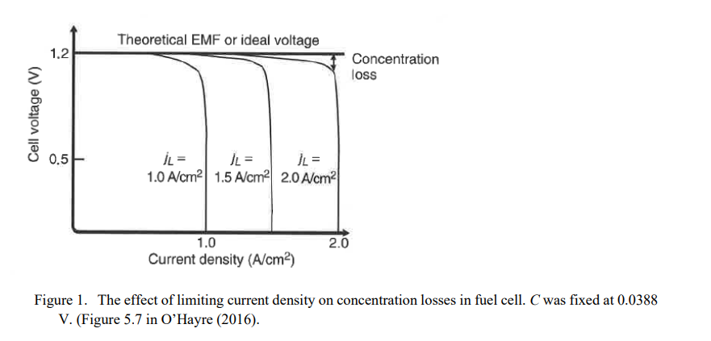
Problem 7

Slide 12
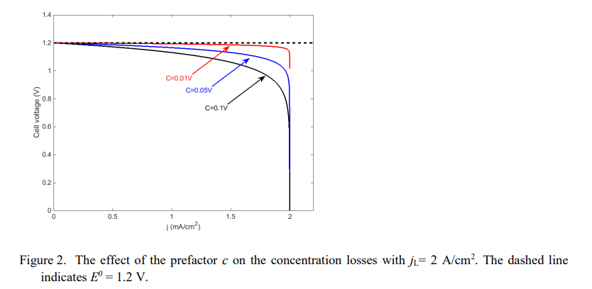
Problem 7

Slide 13
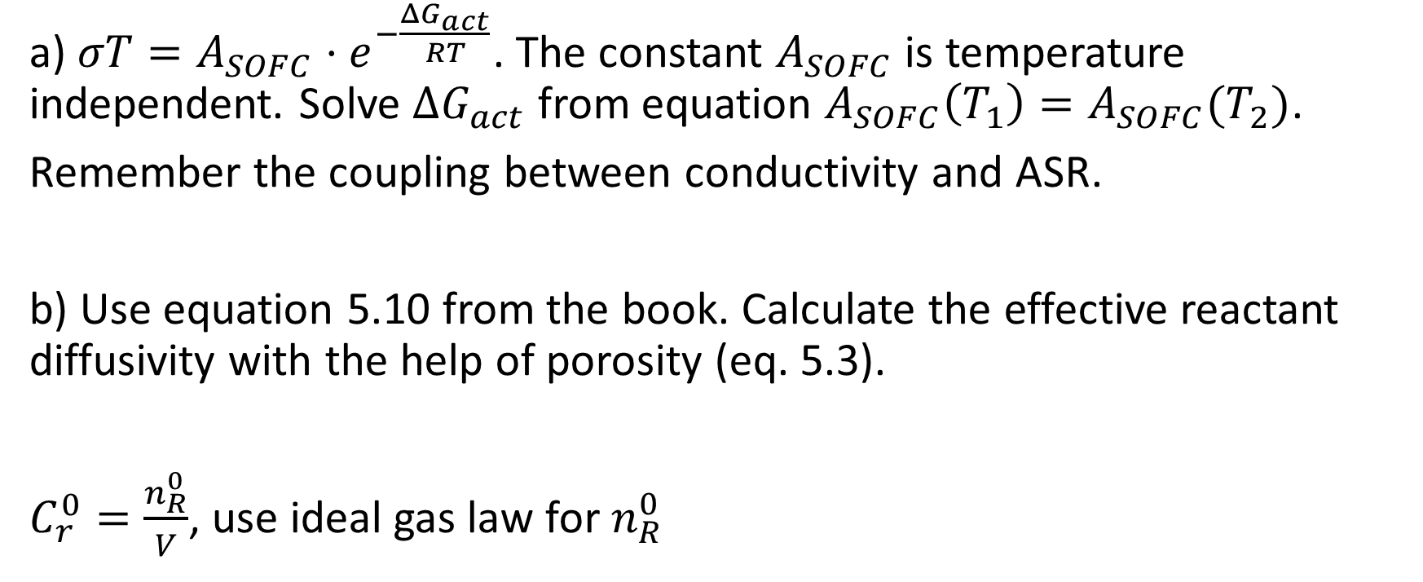
Homework 4
a) $σT=A_{SOFC}⋅e^{−\frac{ΔG_{act}}{RT}}$. The constant $A_{SOFC}$ is temperature independent. Solve $ΔG_{act}$ from equation $A_{SOFC}\left(T_{1}\right)=A_{SOFC}(T_{2})$.
Remember the coupling between conductivity and ASR.
b) Use equation 5.10 from the book. Calculate the effective reactant diffusivity with the help of porosity (eq. 5.3).
$C_{r}^{0}=\frac{n_{R}^{0}}{V}$, use ideal gas law for $n_{R}^{0}$

